Slide 1
CeC RF System Stability
Tom Hayes
Geetha Narayan
Freddy Severino

Slide 2
Outline
Short Term Stability (Jitter)
Long Term Stability (Drift)
Laser Timing Stability

Slide 3
Short Term Stability Performance
 | Requirement |  | Achieved
 | Phase (deg RMS) | Amplitude (RMS) | Phase (deg RMS) | Amplitude (RMS)
112 MHz Gun | 0.1 | 1.0E-4 | 0.06 | 3.2E-5
500 MHz Bunchers (Vector Sum) | 0.1 | 1.0E-4 | 0.04 | 2.0E-4
704 MHz Linac | 0.1 | 1.0E-4 | 0.05 | 4.0E-5
Measured using 100 ksps data for 1 second
Measured performance agrees with continuously logged data – available in LogView
Linac performance >2 times better than last year – switched from direct sampling to using up/down conversion

Slide 4
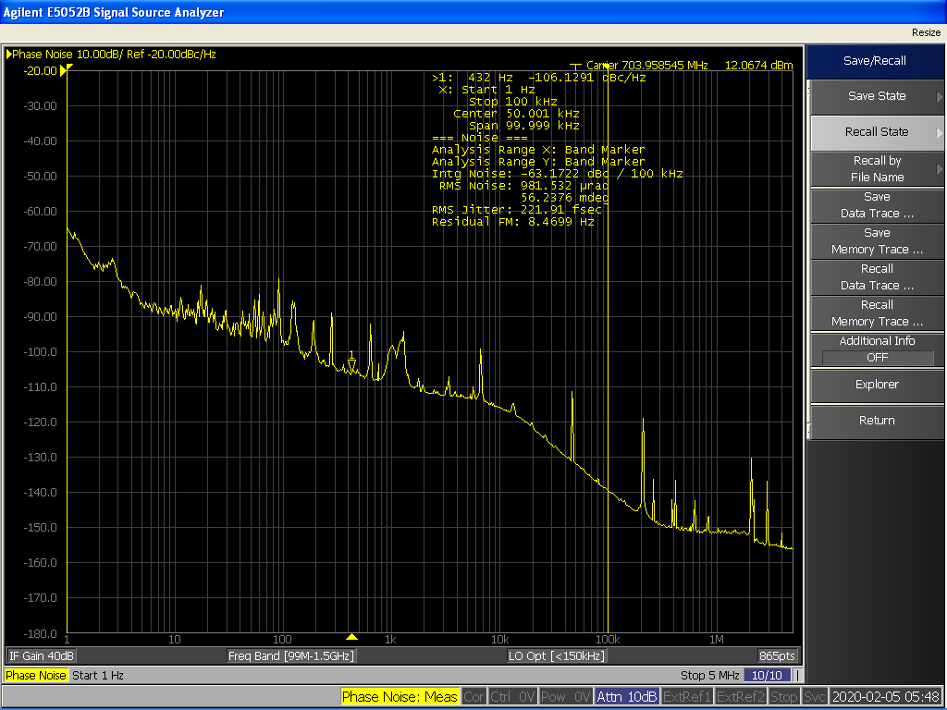
Short Term Performance Confirmation
Independent measurement of jitter
The measured 220 fsec RMS jitter corresponds to 0.045 degrees at 704 MHz
Confirmation of in system measurement of 0.05 degrees

Slide 5
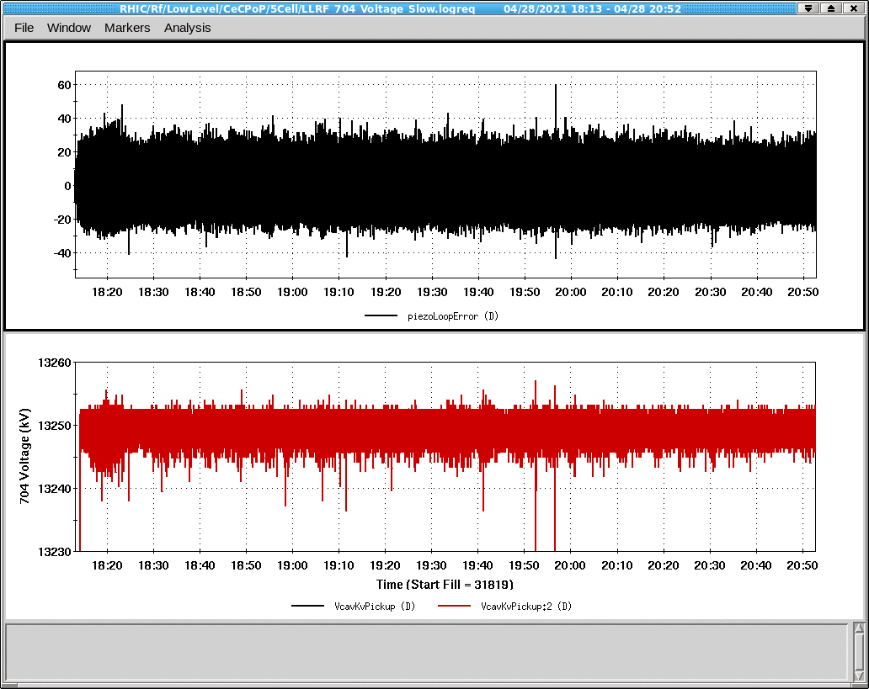
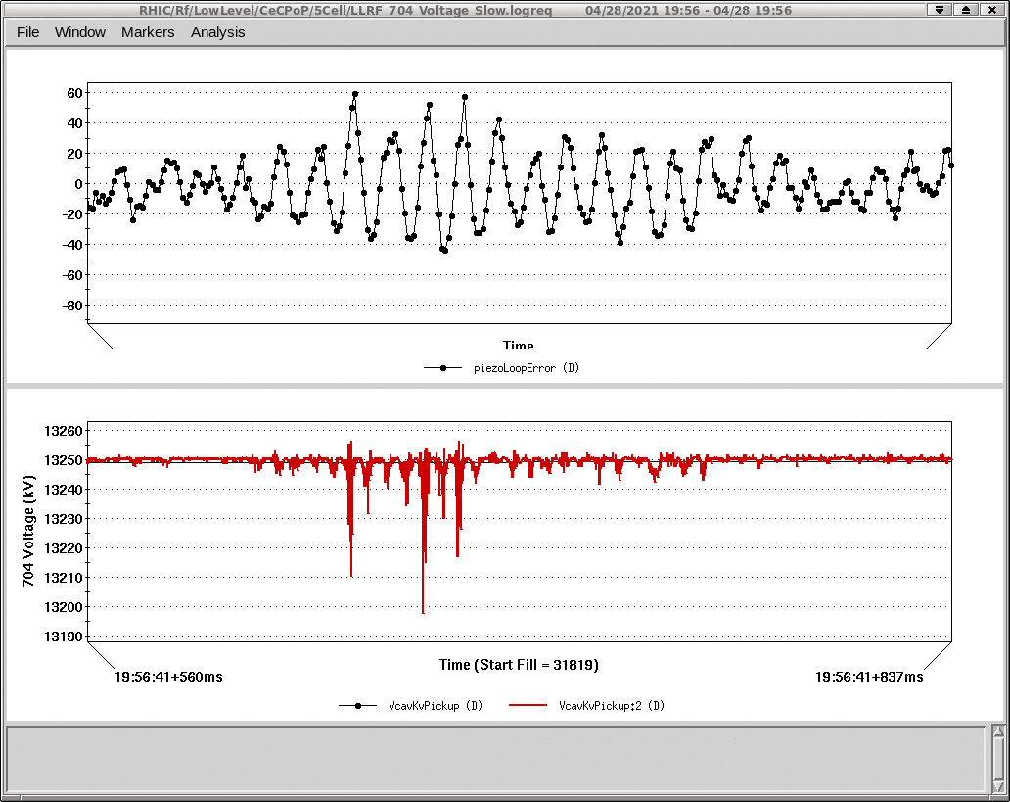
Short Term Performance - Microphonics
Occasional, large microphonic detuning can cause cavity to go out of regulation
Short term events lasting only a few milliseconds
Identified failure mechanism that greatly increases microphonic events
Liquid helium levels too low cause much higher microphonics
Alarms generated by low helium levels

Slide 6
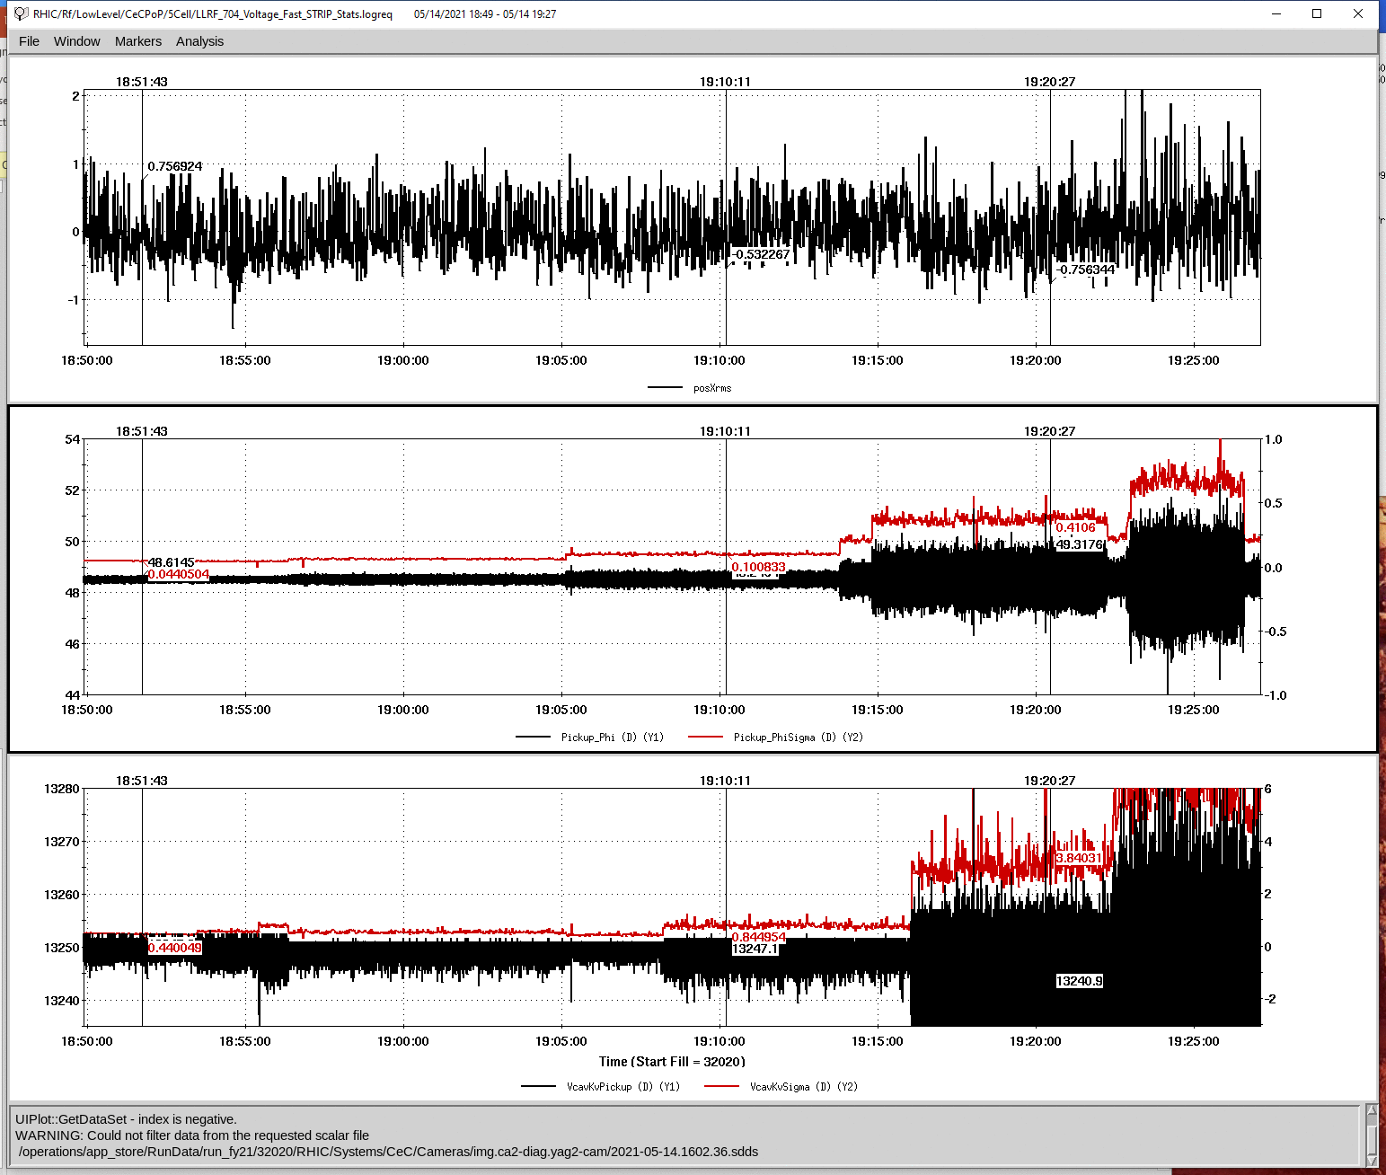
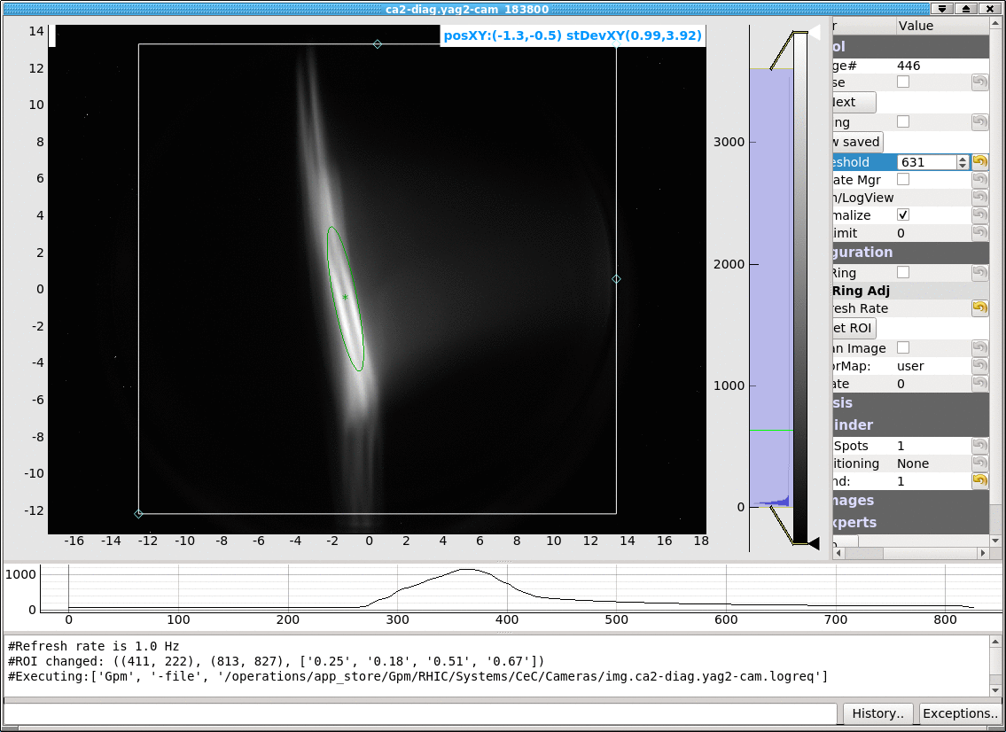
Short Term Performance
Changes in loop gains show degraded regulation as expected but no measurable change in beam energy
For changes up to a factor of 10 in gain, no change in peak to peak energy variation
Linac regulation is not limiting performance

Slide 7
Short Term Performance
Using up/down conversion improved Linac regulation by a factor of 2
Extensive testing was done to ensure optimal system loop gains
Expect some improvement in Buncher regulation by removing second cavity. Regulating vector sum with one cavity fully detuned was difficult.

Slide 8
Long Term Stability
Drift Control Measures
Temperature Controlled Racks
Temperature Controlled Outdoor Conduits for Pickup Cables
Loopback Correction
- Pickup cables tightly bundled with a pair of cables used for loopback measurement
- Measured pickup signal is compensated based on changes in the loopback signal

Slide 9
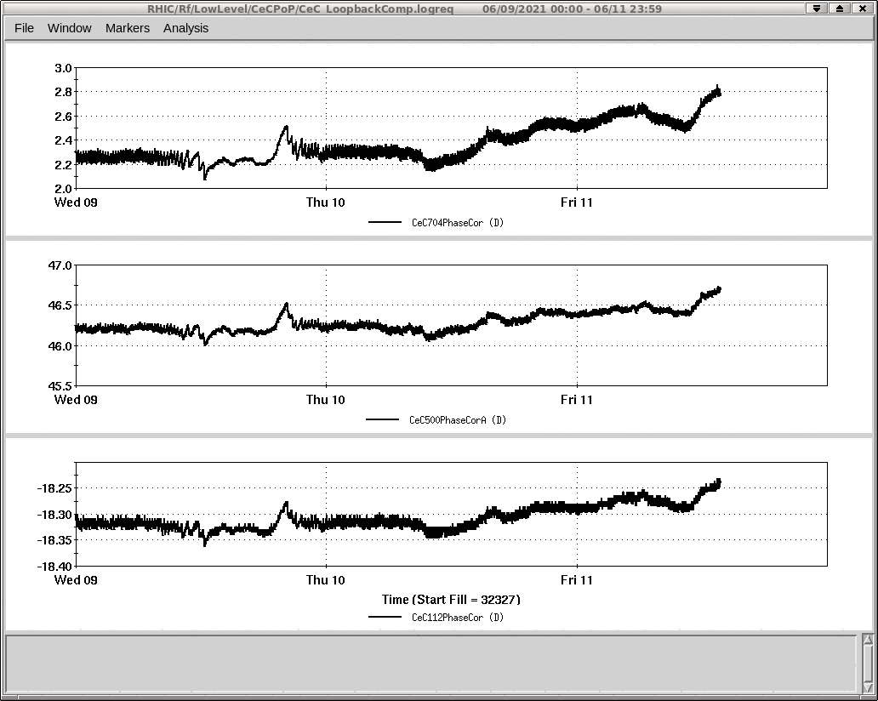
Long Term Stability
Loopback Compensation
Reference signal used to measure drift in cavity pickup cable
Measured amplitude and phase changes used to correct measured pickup signal

Slide 10
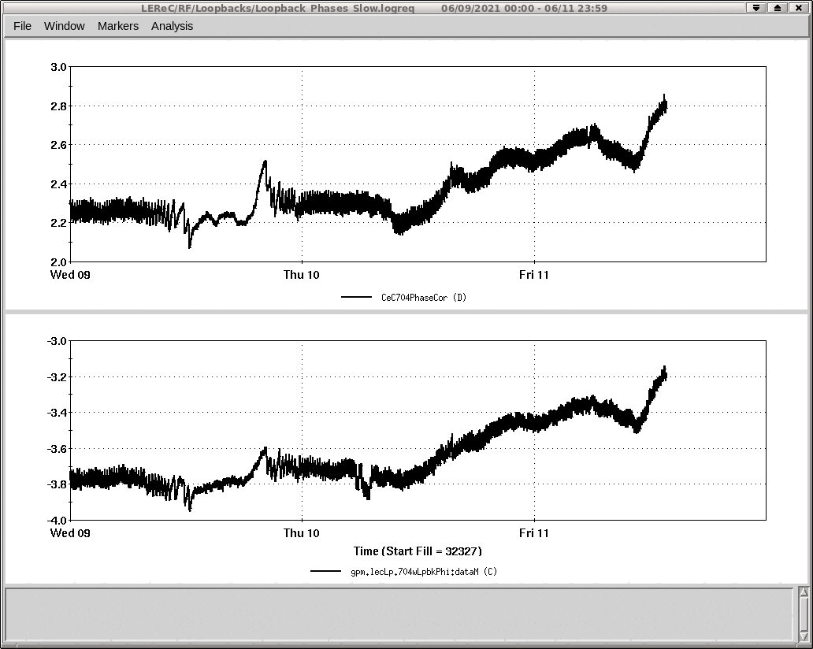
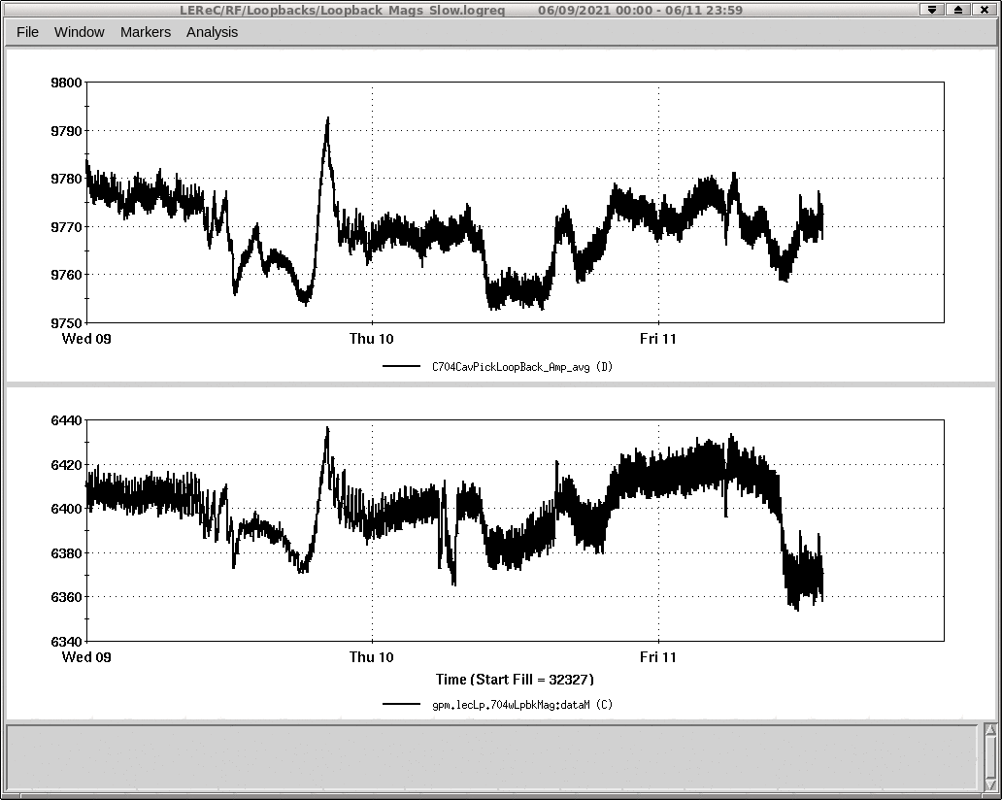
Loopback Compensation – LEReC Comparison
Phase
Amplitude
LEReC lives in same building and has same correction mechanism
Shows very similar corrections

Slide 11
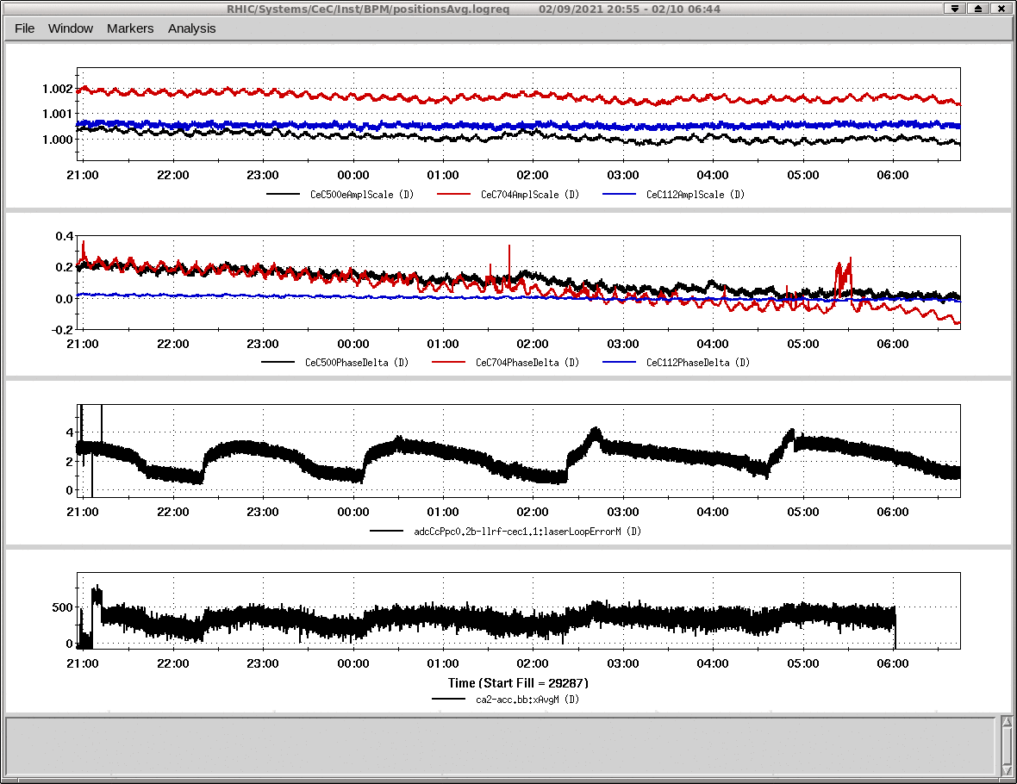
Loopback Compensation
Cable loopback compensation enabled
Laser compensation disabled
Beam energy variation correlated with laser error only

Slide 12
Long Term Stability – Known Issues
Air conditioner for building 1002B failed
Rack temperature control chiller failed
Rack doors were opened for configuration change
Loose connector
All rack connections will be checked during shut down
Change in loopback correction implementation

Slide 13
Long Term Stability
Ultimate stability should be determined by beam based measurements
Hooks exist to control the Linac voltage to adjust for slow beam energy drift based on beam measurements

Slide 14
Laser Timing
Corrections based on photodiode phase measurements
Laser step corrections
Fast drift corrections
Slow temperature/humidity drift corrections
Cable loopback corrections

Slide 15
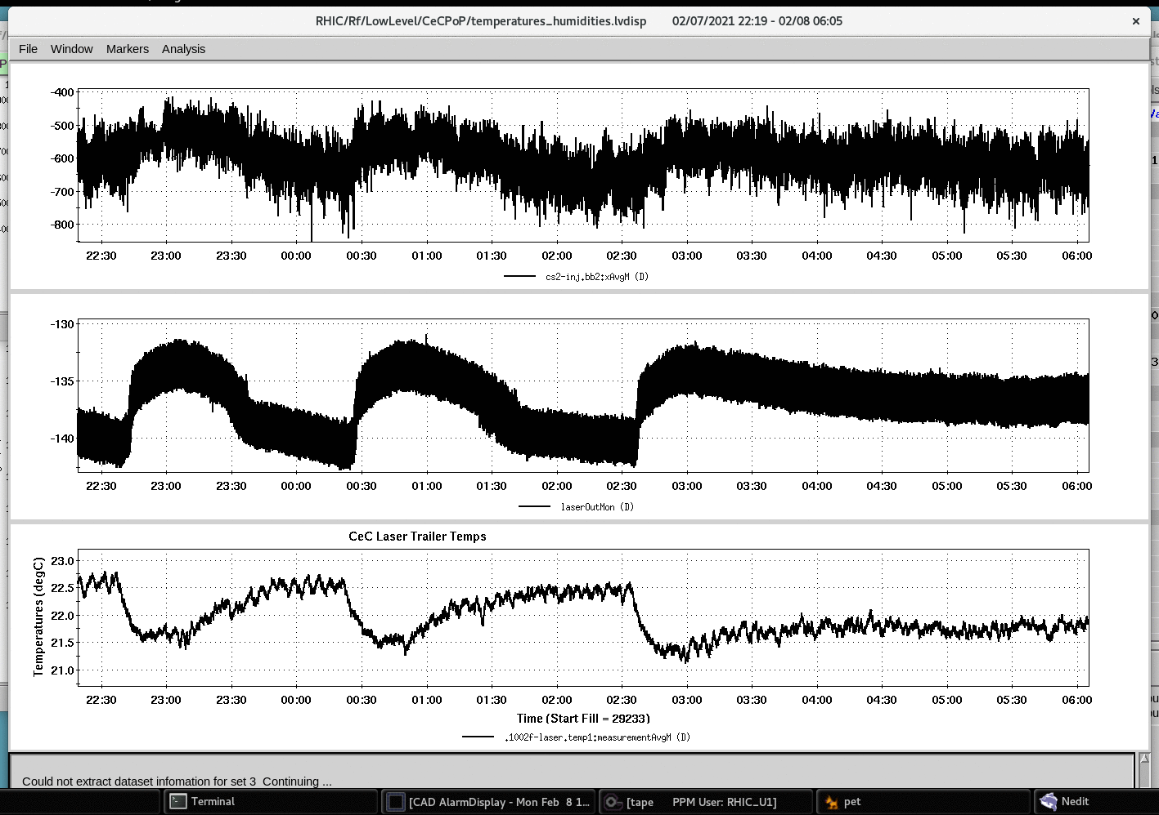
Laser Timing
Measured laser phase (and beam energy) correlated with slow temperature changes in laser trailer

Slide 16
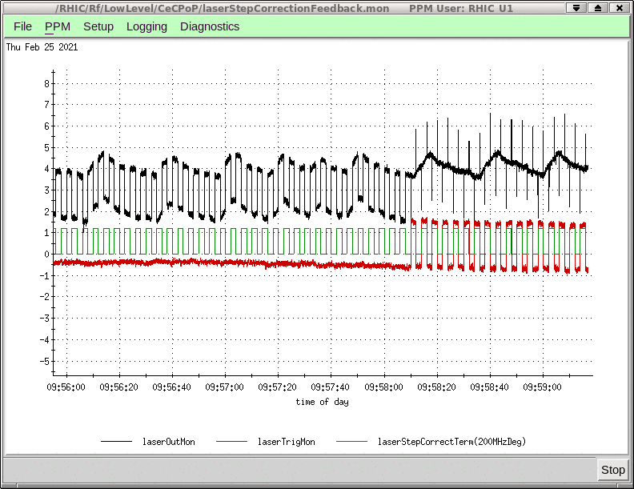
Laser Timing
Laser has ~2 deg, peak to peak steps at a 4 second rep rate
Phase is measured in degrees of 350 MHz
Fast drift with a period of ~25 seconds

Slide 17
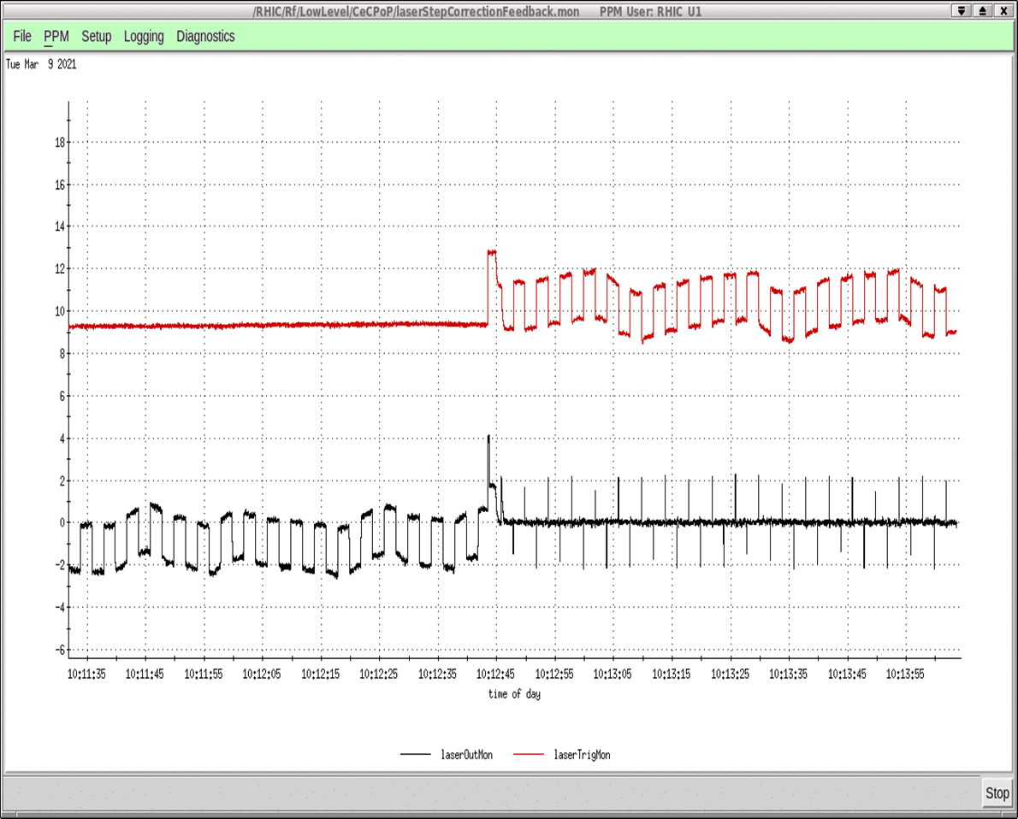
Laser Timing – All Corrections Enabled
Bottom trace shows laser phase measured at the photodiode
Top trace shows phase monitor of the trigger to laser

Slide 18
Summary
Improvements for this year
Linac switched to using up/down conversion
Cable compensation loopbacks enabled
Laser stabilization
Feedforward to correct phase steps
Fast feedback to correct measured drifts

Slide 19
Conclusion
Short-term cavity regulation is excellent
Significant efforts have been expended to stabilize the laser and they have been extremely successful
If long term stability needs to be improved, beam based feedback is the only option left

