Slide 1
First look at IP6 field maps with a simple Geant4 model
Chandradoy Chatterjee
Roberto Preghenella
ATHENA PID Meeting
9 August 2021

Slide 2
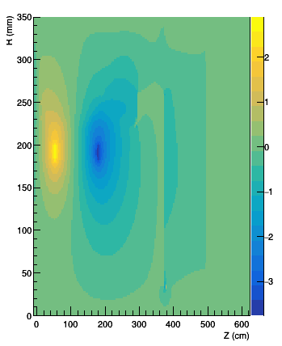
Boxes are not actual dimension Just the Z is approximated to show the B field impact in the analyzed positions!
Red Dashed Line→ Ideal RICH
Blue Solid Line→ 30 cm Shifted
Yellow Dashed Line→ 30 cm Enlarged

Slide 3
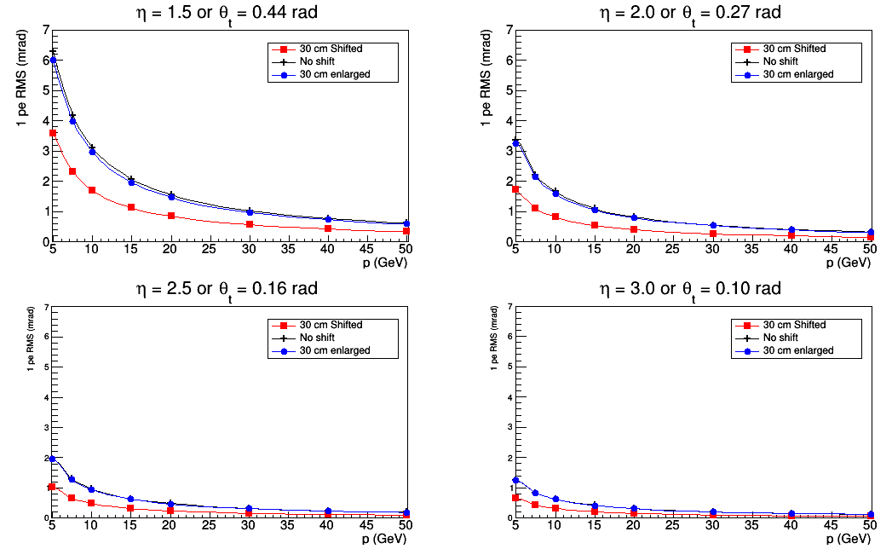
Field ON

Slide 4
Field ON
Zoom at high p values

Slide 5
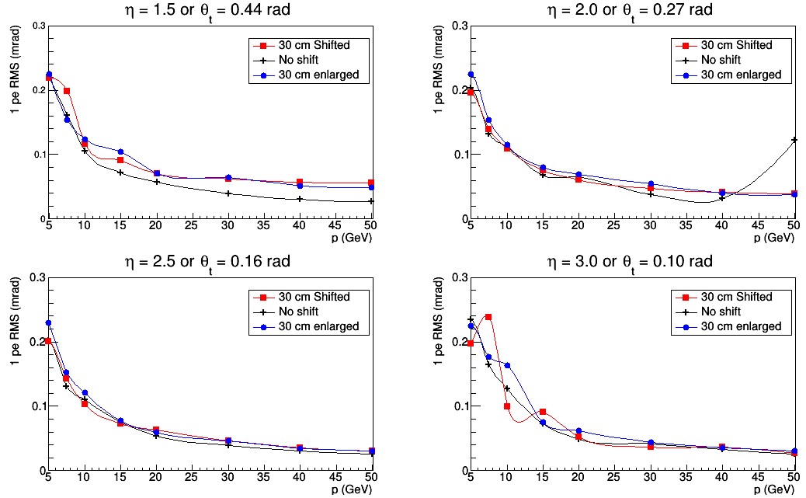
Field OFF

Slide 6
Messages:
Shift helps more to recover single p.e. than enlarging.
For large angle tracks (eta =1.5): if we enlarge the radiator by 30 cm, we gain 4-5 photons (assuming 150 cm original length and 20 photons as starting point.) If each p.e. has 6 mrad of uncertainty, we can get a ring resolution ~1.2mrad. If we keep the length same and just shift 30 cm, we stay same with the Npe. But the single p.e. uncertainty reduces by factor 1.5 leading to an expected ring resolution 0.9 mrad. ~20% gain in shifting over enlarging.
There is also another aspect, this is calculation in low p. But we also have improvement in high p as well. By shifting 30 cm, we see almost ~factor 1.5-2 improvement.

