Slide 1
Update from the Calorimeter WG
erhtjhtyhy
Paul E Reimer
Vladimir Berdnikov
Oleg Tsai
This work is supported in part by the U.S. Department of Energy, Office of Nuclear Physics under contract No. DE-AC02-06CH11357.

Slide 2
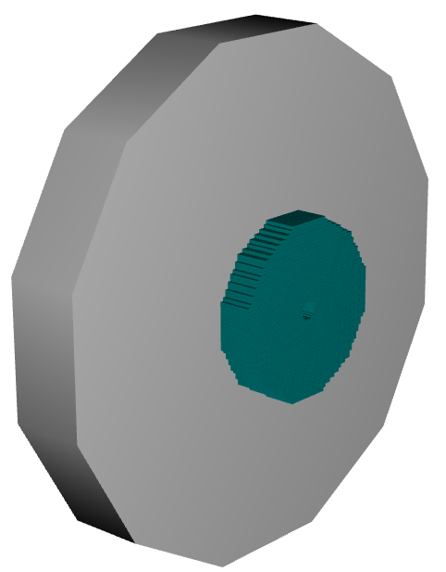
Calorimeter WG: Integration into DD4HEP
HcalEndcapN
Implemented as 38 layers of material 1.195 cm thick for a total of 45.51 cm
Longitudinal segmentation into 10 x 10 cm² blocks.
EcalEndcapN
implemented as an array of tower/crystals.

Slide 3
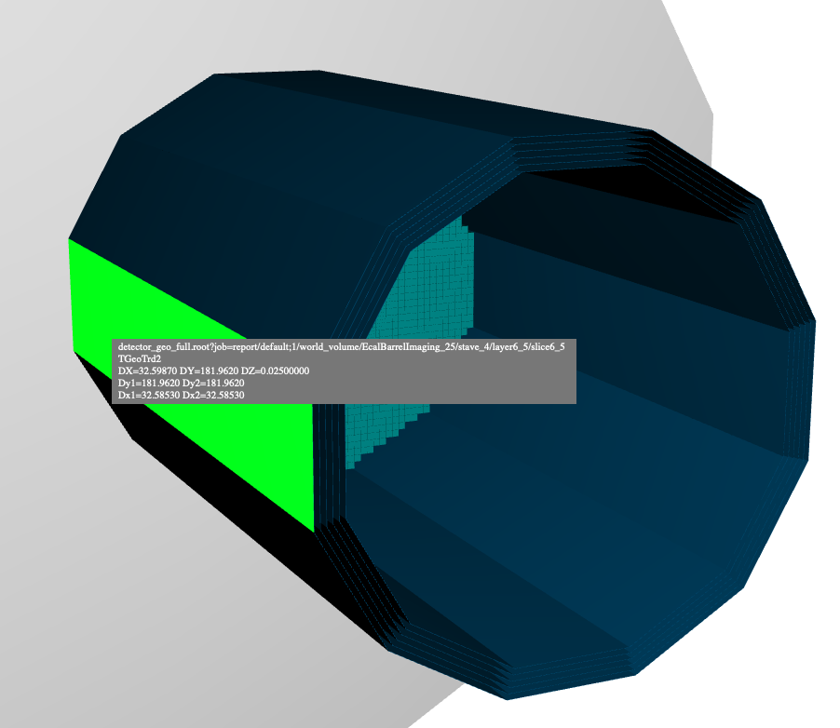
Calorimeter WG: Integration into DD4HEP
HcalBarrel
51-layer steel + scintillator design
10cm square pad size (as above)
Will someone picks up this orphan?
EcalBarrelImaging
implemented with 6 tracking layers
optimization of the number tracking layers and the spacing between them is ongoing
EcalBarrelScFi
implemented as a set of layers, with individual fibers
Run speed optimization is being studied

Slide 4
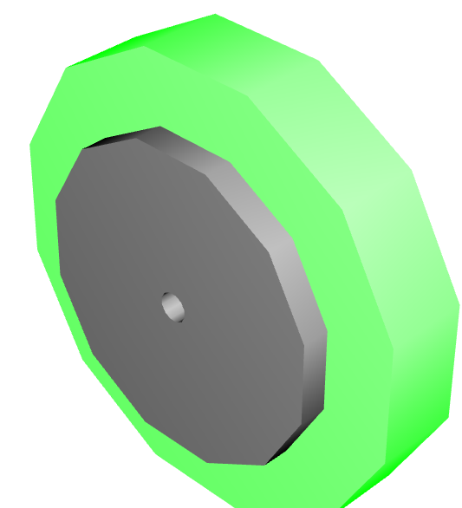
Calorimeter WG: Integration into DD4HEP
EcalEndcapP
28 layers, each layer divided into 4 or more slices
Total thickness is 19.636 cm
Shashlik design with 3.5cm block size
Need to change to SciFi
HcalEndcapP
Implemented as 50 layers of material 1.15 cm thick for a total of 57.5 cm thick
10 x 10 cm² readout

Slide 5
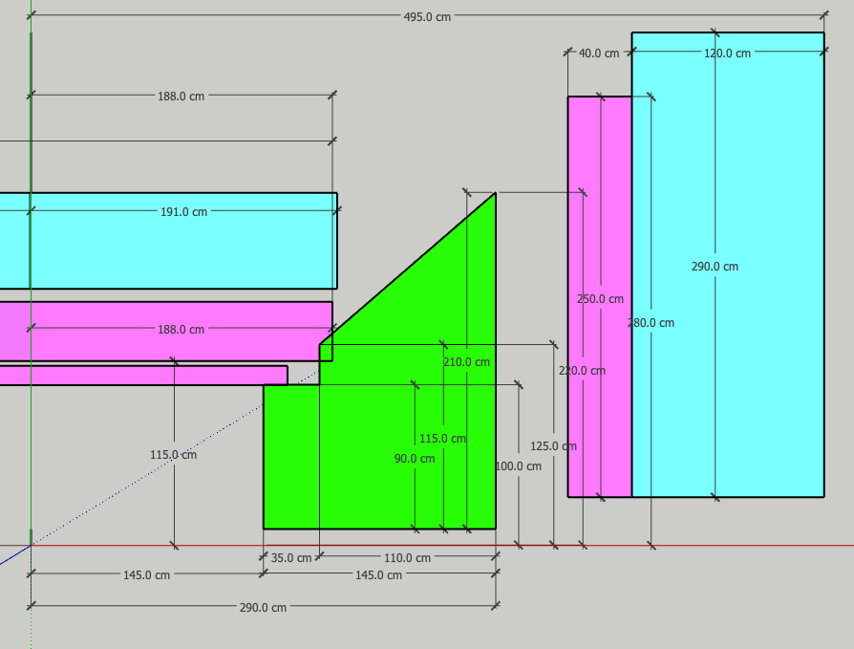
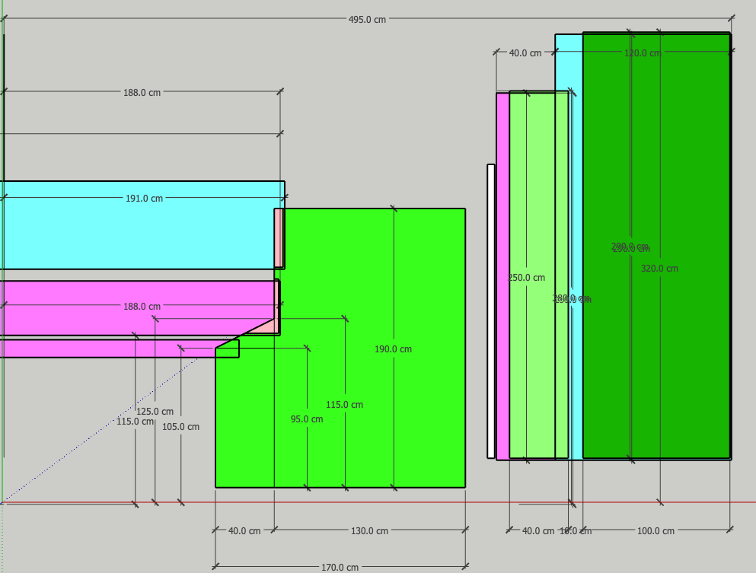
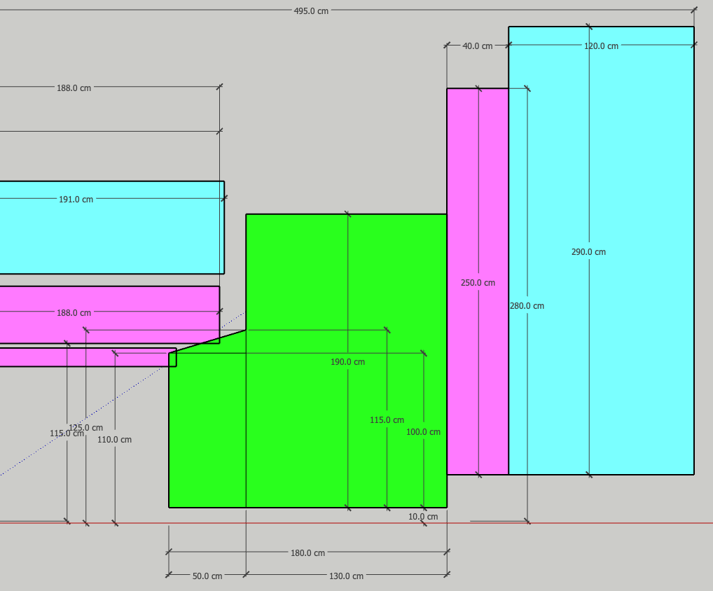
Open Questions:
Room for cabling and support structures
There are several proposals for the RICH area
These are deliberately small so that you can’t read the dimensions, as that is not the point
The point is that these envelopes need to be discussed and updated.

