Slide 1
High Level Integration considerations
E.C. Aschenauer, Ch. Hetzel, Roland Wimmer and friends from EIC-collider team

Slide 2
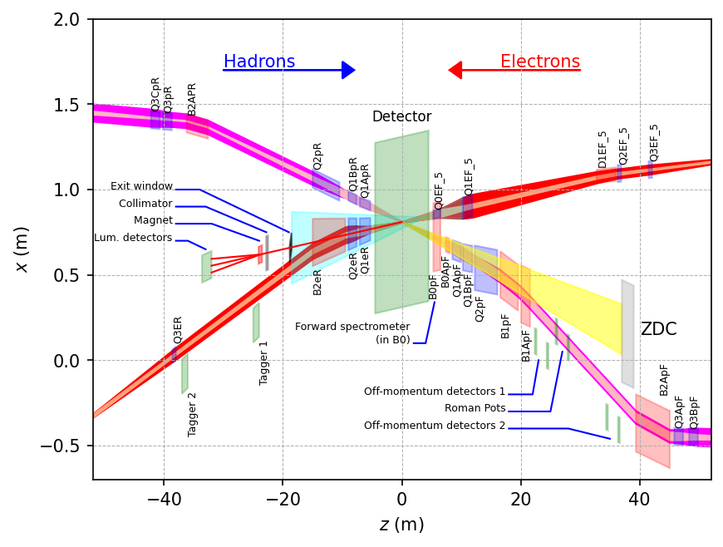
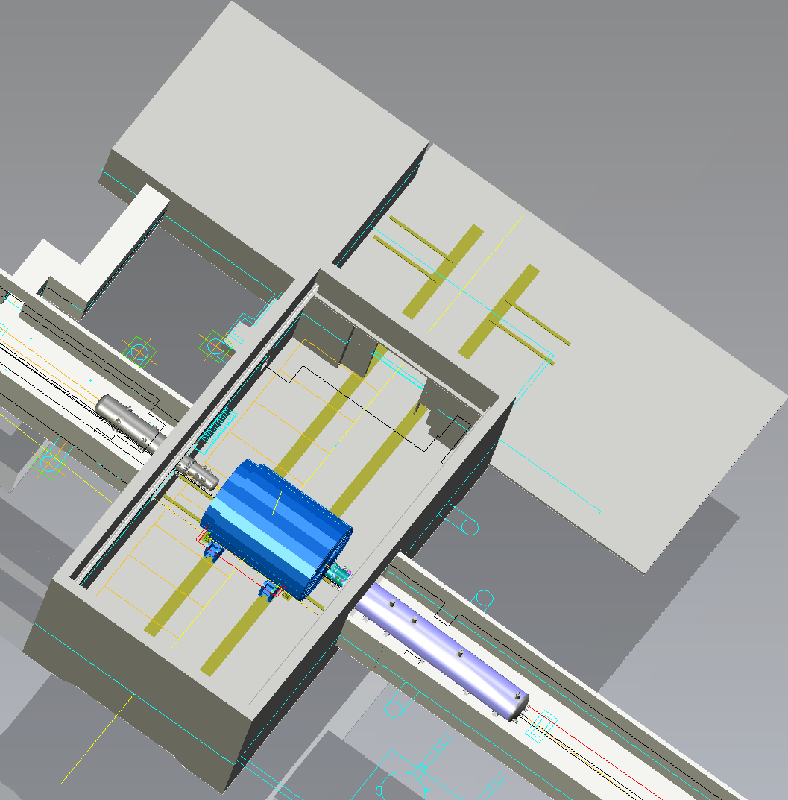
Constrains from IR-6 Design
Ring Inside
Control
&
DAQ-ROOM
Ring Inside
Assembly
Hall
Ring Outside
Hadron
Detector space:
-4.5 m – IP – +5m not negotiable
50 cm space to 1st IR-magnet occupied by vacuum pumps, valves, …..
IP moved 80 cm towards ring inside compared to RHIC; y: 432 cm above floor
no installation possible in collider hall
Ring Outside
Electrons

Slide 3
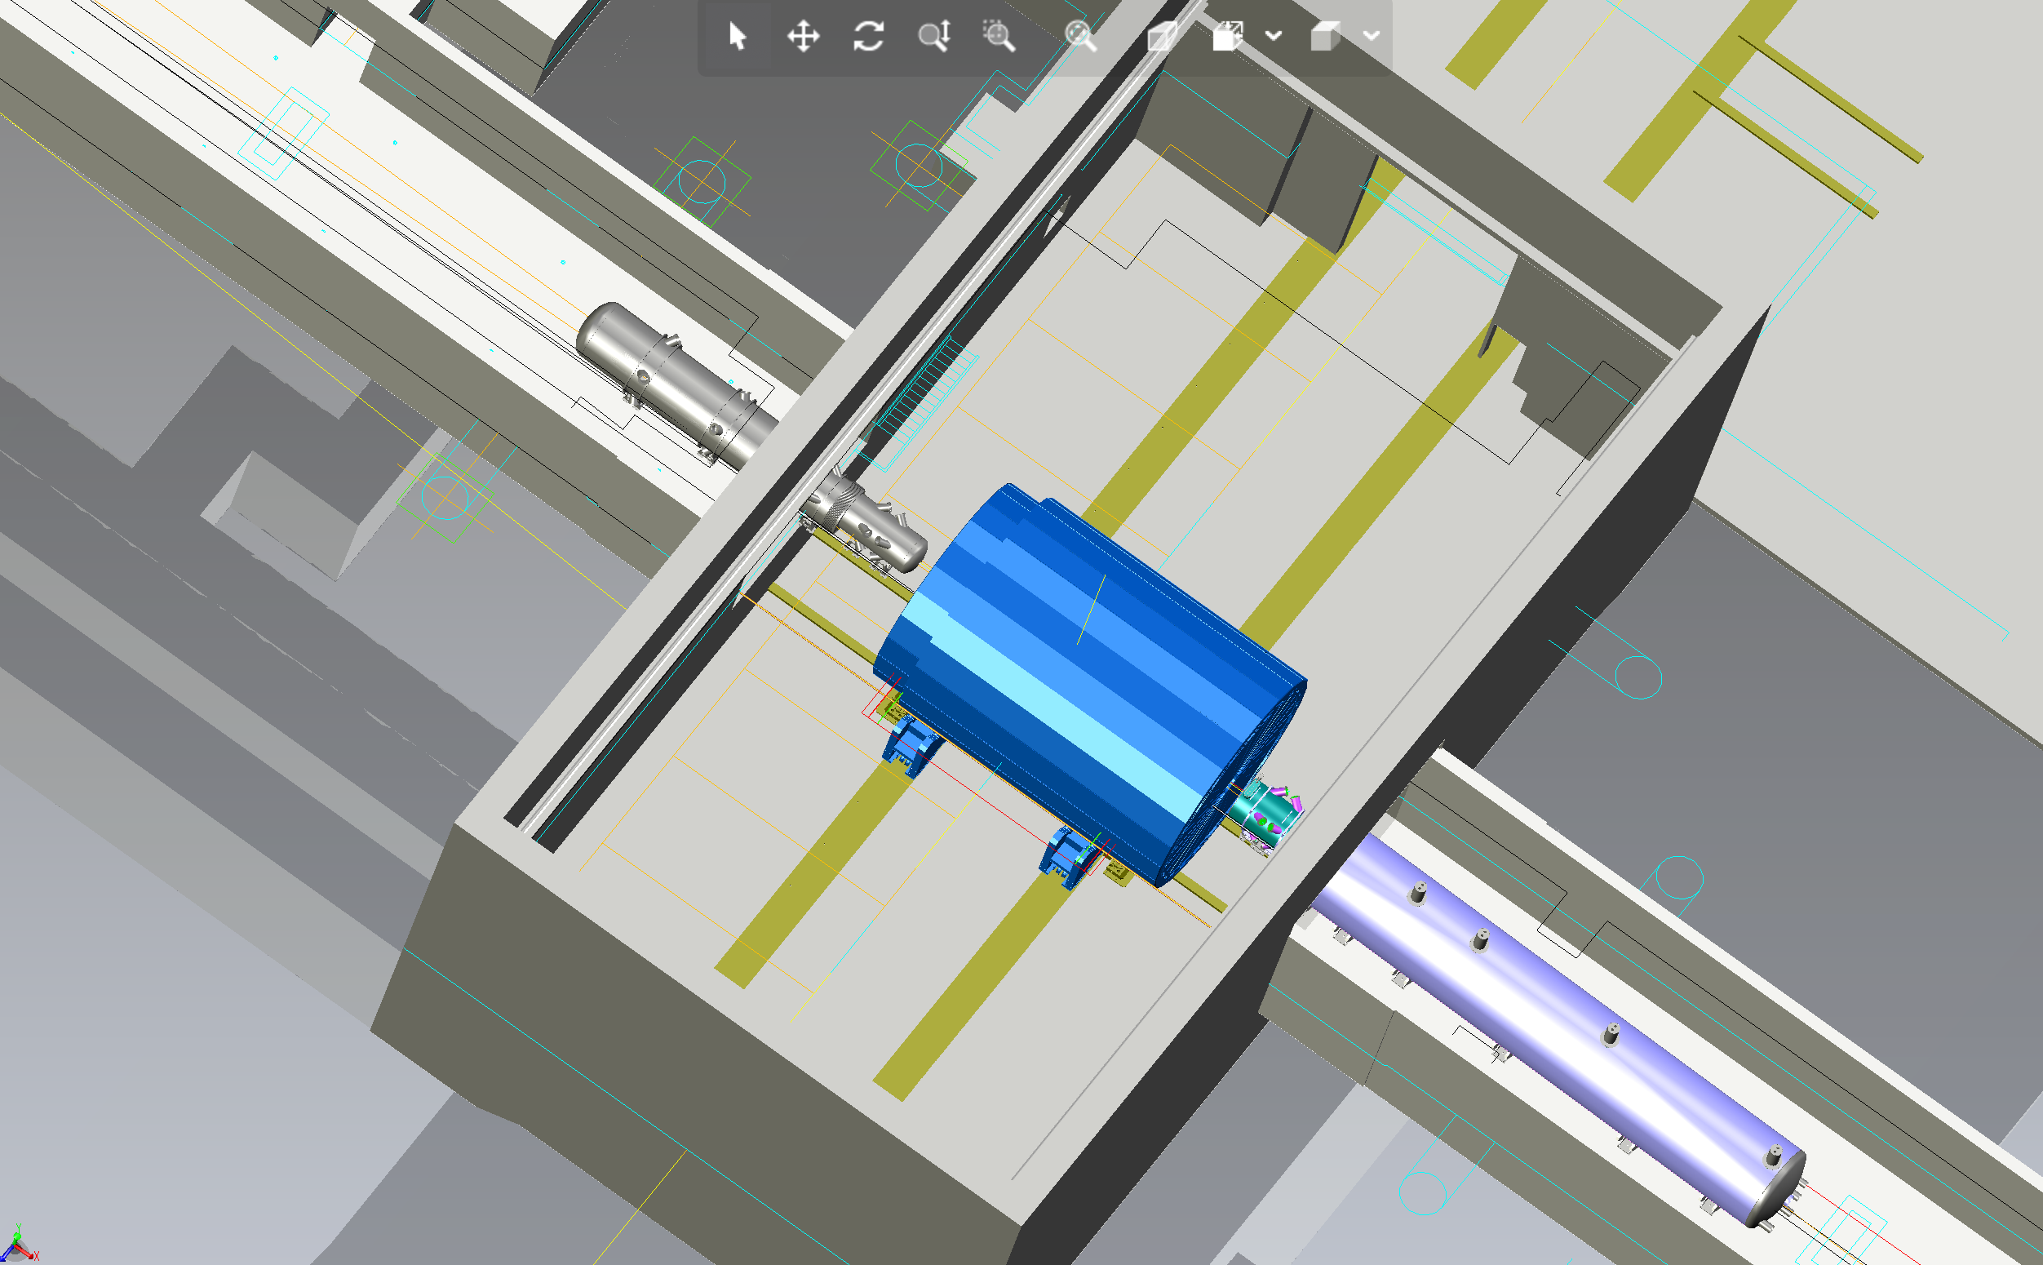
Constrains from IR-6 Design
RCS
More space constrains:
9.5 long detector does not fit through the door
Door-Size: 823 cm x 823 cm
endcap hadron calorimeters need to stay in collider hall, if detector rolls in
assembly hall
RCS to IP: radial distance 342 cm at a height of 372 cm from floor
Maximum outer radius 3.2 m

Slide 4
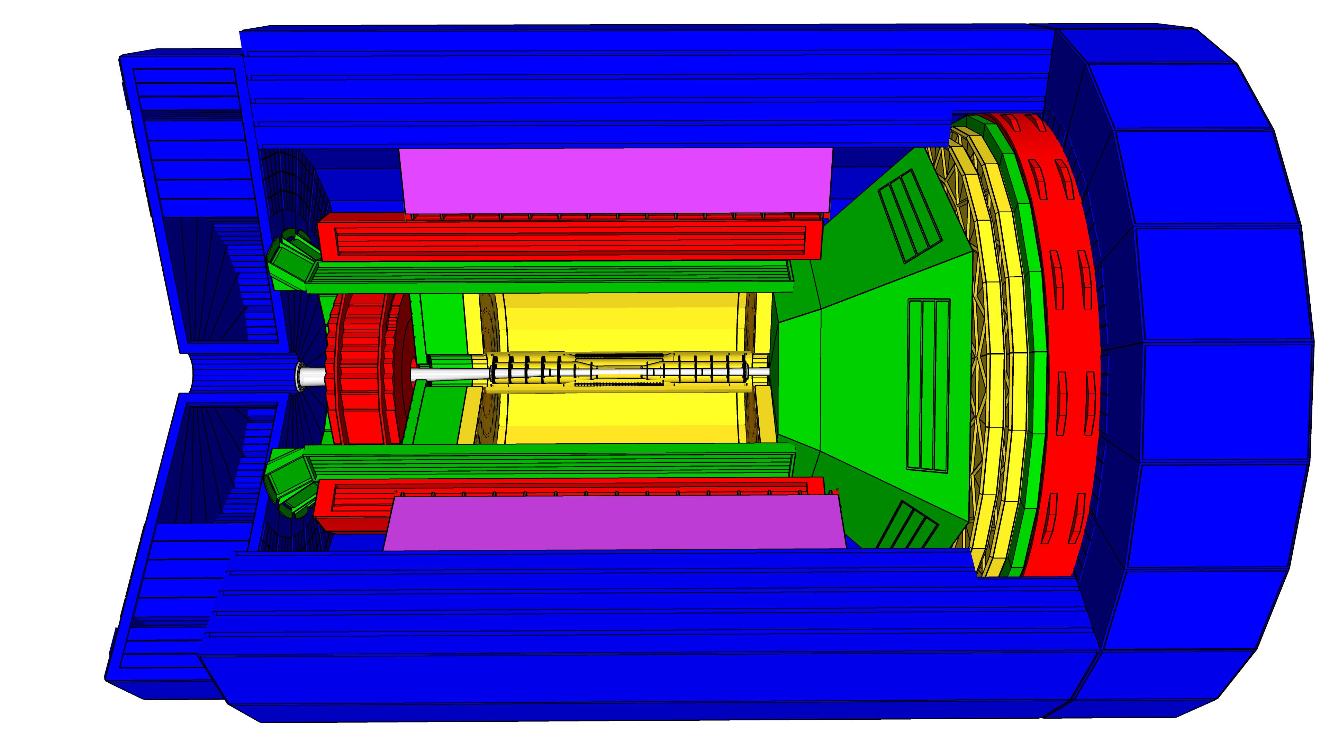
General Constrains
Fringe field for IR Magnets and RCS:
along z: 0.007 Tm
at 1st rear side quads Q1ApR/Q1eR: 5 gauss
impact on flux return design of ATHENA
Detector needs to be aligned with electron beam → 8 mrad rotation
Reuse of STAR cradle and its infrastructure (rail systems, platform components, …)
Installation sequence from outside to inside → account in support structure design
lower HCal
solenoid
upper HCal
Barrel ECal after DIRC – bars
e-ECAL → so heavy needs to stay during
any maintenance
everything else gets installed from hadron
endcap side
lepton and hadron HCal need to open
perpendicular to the beam line
Athena-calorimeter group: hECal coupled to hHCal → will move together
can be installed independent of other sub-detectors in collision hall
schedule needs to be coordinated with IR magnet installation and readiness for solenoid test

Slide 5
General Constrains
Service gaps for cables, cooling, …..
gaps should have minimal impact on fringe field
need not to be continuous in Phi, width: ~10 cm

Slide 6
Constrains on Si-μvertex
Should not be installed during first accelerator and detector commissioning
Big Picture of Pre-Ops Phase:
Magnet and sub-detector system tests in FY28 and FY29
location assembly hall
Full system cosmic test in FY30, and ramp-up to in-beam tests
location assembly hall
after accelerator has finished first beam commissioning detector is rolled into collision hall Beam commissioning in FY31.
after this move back to assembly hall to install Si-μvertex for start of data-taking and EIC operations at CD-4
→ all this is governed by KPPs for CD4a and CD4

Slide 7
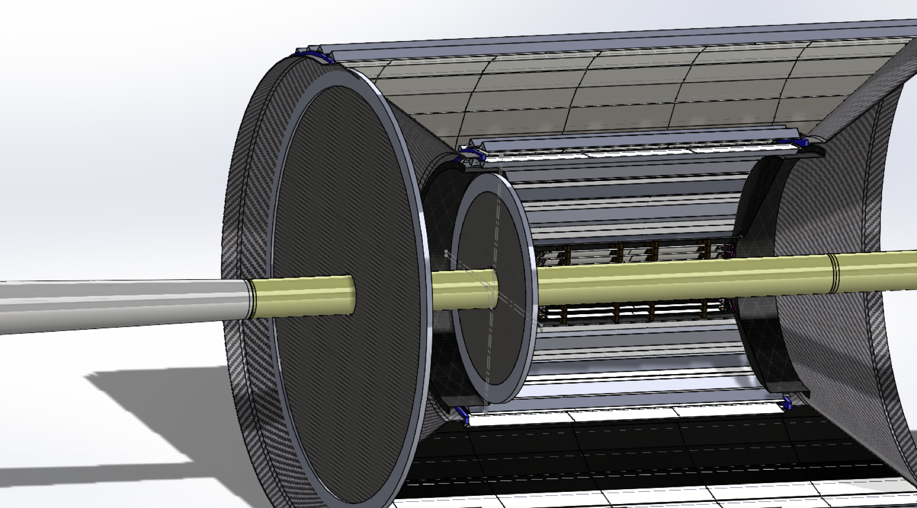
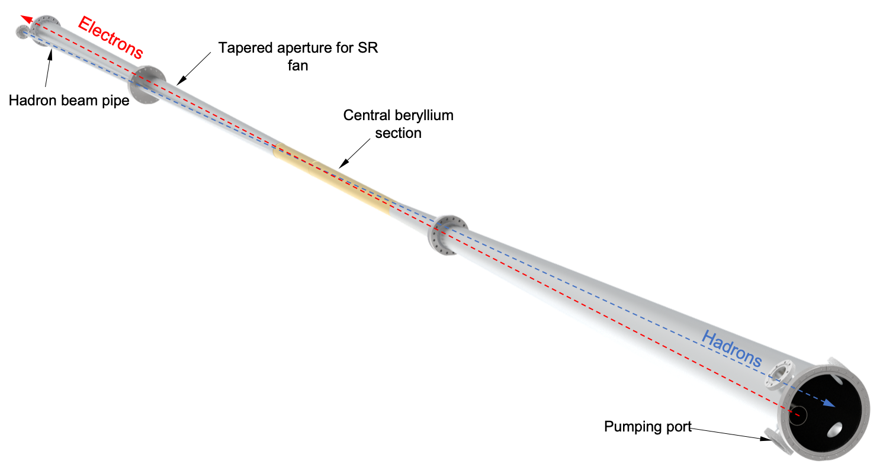
Constrains on Si-μvertex
Beam-pipe:
5 μm Au gold coating for sure along Be-section
NEG-coating every where else – maybe also on top of Au coating → R&D
beampipe stability needs to be in 1-2mm → beampipe support
beampipe needs to be backed out for excellent vacuum
cannot happen with Si in place → to high temperature
back-out before Si installation in assembly hall → flange off and keep under Neon to preserve backout
valves after Si-disks in electron and hadron beam direction
Si-μvertex needs to be a clam shell design
→ BUT to account for the non uniform beam pipe size along z and the valves
Si-μvertex detector-halves needs to be installed and then moved radially to close
around the beam pipe
Ring Outside
Ring Inside

Slide 8
People involved
Main work done by Roland Wimmer, Charles Hetzel, Walt Akers + designers, Rolf and Elke and the IR-EIC collider WG
STP-files are posted and will be continued to be posted here https://physdiv.jlab.org/EIC/Menagerie/
Help from outside BNL and JLab
Avishay Mizrahi visiting ME@MIT checking and further improving Generic Barrel ECal frame
ORNL engineer taking Roland’s concept of eHCal to the hadron side for hHCAL and hECal
engineers from French collaborators of eECal consortium work on detail design
Everybody is welcome to work in the team

Slide 10
KPPs for Detector
PreOps activities aligned with achieving KPPs
KPP | Performance Measure | Threshold KPP | Objective KPP | Ultimate PP
DET-4a | Detector | Detector subsystem component testing complete. | Detector subsystems constructed and tested with cosmic rays. | Same as Objective
Detector sits as a whole in the assembly hall and gets tested with cosmic
KPP | Performance Measure | Threshold KPP | Objective KPP | Ultimate PP
DET-4 | Detector | Detector installed and ready for beam operations. | Inelastic scattering events in e-p and e-A collisions measured in Detector. | Inclusive, semi-inclusive, and exclusive events measured as the basis for 3D maps of subatomic quark-gluon structure.
Detector is moved into the collision hall to take first collision data

