Slide 1
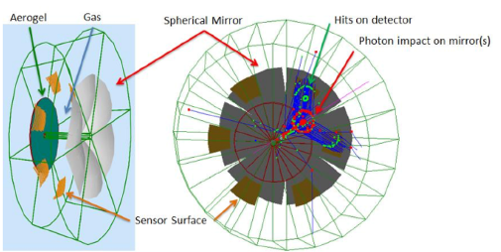
KEY COMPONETS & REQUIREMENTS IN THE dRICH
COMPONENTS
THE RADIATORs: AEROGEL & GAS
THE MIRROR SYSTEM
THE PHOTON DETECTORS
REQUIREMENTS
Gas radiator pressure up to 3 bar (absolute)
Preserve the position of:
  AEROGEL
  MIRRORS
  SENSORS
Thin vessel entrance and exit windows
Relative alignment of mirror elements
Operate sensors at – (30-40) ºC
without inducing temperature gradients inside the gas
Monitor AEROGEL, MIRROR, SENSOR position inside the vessel
Monitor gas T at various points inside the vessel
dRICH as in the YR
Please, note that:
Mirrors are embedded in the gas: the radiator gas pressure will not affect them
To preserve a thin exit window of the aerogel box better to flush it with nitrogen at the same radiator gas pressure
A pressure difference at the sensor arrangement must be avoided (see later)
not discussed today
S. Dalla Torre, 11 August 2021

Slide 2
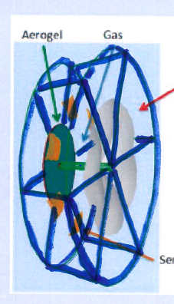
How can the dRICH vessel look like
COMPONENTS
THE RADIATORs: AEROGEL & GAS dRICH as in the YR
THE MIRROR SYSTEM
THE PHOTON DETECTORS
REQUIREMENTS
Gas radiator pressure up to 3 bar (absolute)
Preserve the position of:
  AEROGEL
  MIRRORS
  SENSORS
Thin vessel entrance and exit windows
Relative alignment of mirror elements
Operate sensors at – (30-40) ºC
without inducing temperature gradients inside the gas
Monitor AEROGEL, MIRROR, SENSOR position inside the vessel
Monitor gas T at various points inside the vessel
Form a rigid
backbone:
This is the support of AEROGEL, MIRRORS, SENSORS
The vessel walls are fixed onto the backbone.
The entrance/exit walls can deform up to 1-2 cm.
IMPORTANT: their deformation should not induce backbone deformations → elastic materials?
In this model they can be thin
The lateral walls can be thick and rigid: they can form the interface between the sensors and the backbone
S. Dalla Torre, 11 August 2021

Slide 3
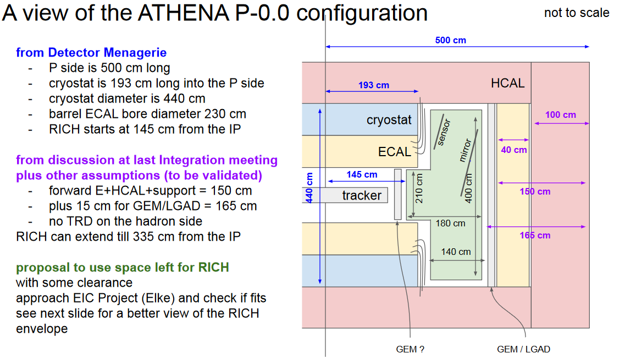
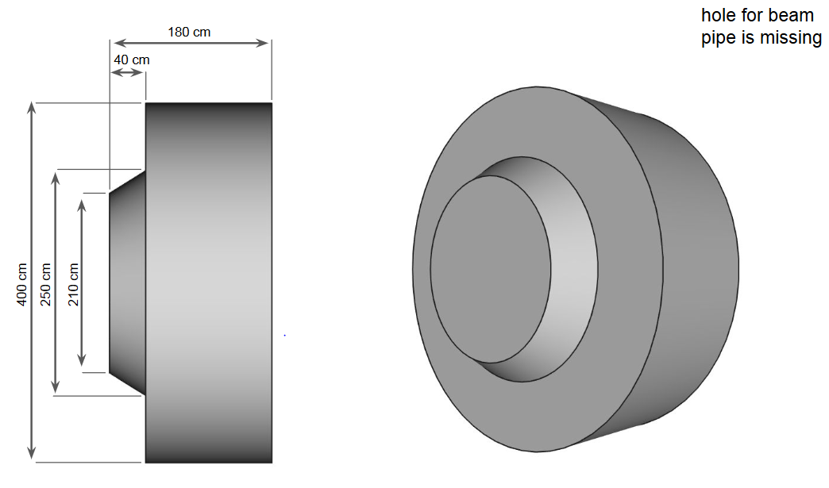
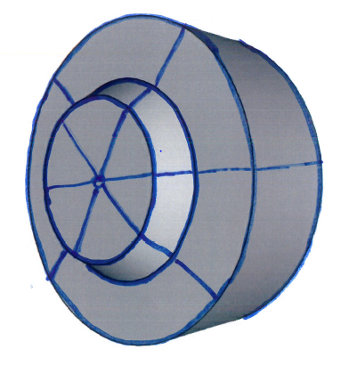
dRICH vessel shape
Now: 170 cm
Now: 130 cm
2 slides form R. Preghenella,
Global Design / Integration
Meeting, 28 Jul 2021
What the
backbone can become
S. Dalla Torre, 11 August 2021

Slide 4
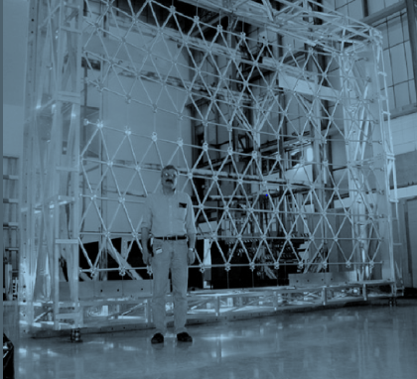
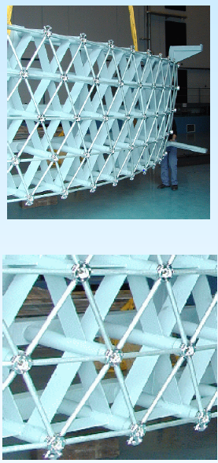
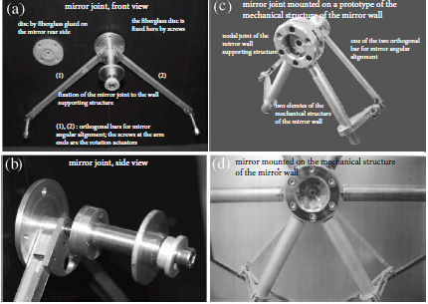
About MIRRORs, support and alignment
An effective example,
COMPASS mirror wall
A robust mould to form the correct
shape of the mirror support
Material budget of the mirror support:
equivalent to 2.5 % X₀
PRINCIPLE:
Supported by a very rigid and mechanical precise mirror-wall structure with rotation degrees of freedom for each mirror to allow for the most critical alignment: the angular alignment
Everything (= mirrors, supports) is immersed in the gas → no force causing displacement or deformations
Main missing ingredient:
Remote alignment option
By piezoelectric actuators:
Too expensive 20 y ago!
S. Dalla Torre, 11 August 2021

Slide 5
Photon detector integration, an initial idea
COMPONENTS
THE RADIATORs: AEROGEL & GAS
THE MIRROR SYSTEM
THE PHOTON DETECTORS
REQUIREMENTS
Gas radiator pressure up to 3 bar (absolute)
Preserve the position of:
  AEROGEL
  MIRRORS
  SENSORS
Thin vessel entrance and exit windows
Relative alignment of mirror elements
Operate sensors at – (30-40) ºC
without inducing temperature gradients inside the gas
Monitor AEROGEL, MIRROR, SENSOR position inside the vessel
Monitor gas T at various points inside the vessel
Sensors and their cooling closed in a box:
Nitrogen flux to keep them dry
Nitrogen at the same pressure of the radiator gas to allow for a thin window (quartz?)
Nitrogen flux to limit thermal exchange with the radiator gas
Back face of the box accessible from outside the vessel for mounting/interventions
  Interventions only when the pressure inside the vessel is also back to atmospheric pressure
not discussed today
S. Dalla Torre, 11 August 2021

Slide 6
MOST URGENT QUESTIONS
Is there anything fundamentally wrong in the ideas presented today?
Is it possible to get an initial estimate of the amount of material needed for the entrance/exit windows?
THANK YOU
S. Dalla Torre, 11 August 2021

Slide 7
SPARE SLIDES

Slide 8
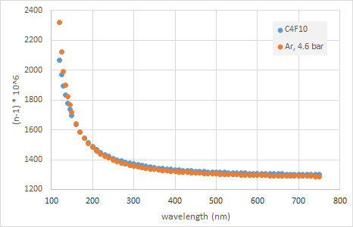
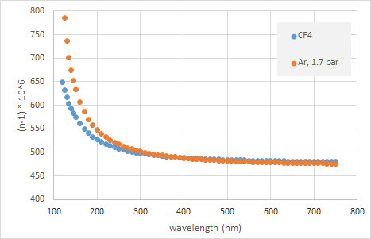
WHY a High Pressure RICH? REPLACING C-F GASES BY PRESSURIZED Ar
ISSUE:
Fluorocarbons are used in RICHes:
Limited chromaticity
High Cherenkov photon yield
Both these parameters depend on the refractive index and its evolution with the wavelength (λ)
These gasses are not eco-friendly
  They attack O₃
They have high Global Warming Potential (GWP) values (100 y)
    C₄F₁₀: 4800
    CF₄ : 6500
    CO₂ : 1 (for comparison)
These gasses are more and more banned
→
Procurement ? Costs?
Usage limitations ?
Pressurized Ar
can reproduce the fluorocarbon refractive index very accurately, in particular in the visible range
S. Dalla Torre, 11 August 2021

