Slide 1
Introduction -- MC plans
Marco & Anselm
August 11, 2021
Athena, SIDIS WG meeting

Slide 2
Timeline for full MC production (From Alexander’s email)
1) by August 5th the PWGs will provide their generated event
samples to SWG; some of the samples need to be redone in order
to account for the 25mrad angle sign change;
1a) 25mrad sign change: it was suggested that it happens NOW,
in all places rather than after the proposal submission;
2) by August 8th - either this or that way - the geometry of
the detector will be fixed in dd4hep and the G4 simulation pass
gets launched;
3) on August 12th the reconstructed ROOT files are given back to the
PWGs for evaluation;

Slide 3
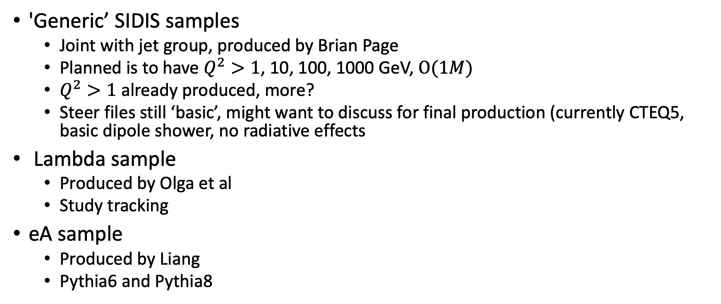
Samples and status
'Generic’ SIDIS samples
  Joint with jet group, produced by Brian Page
  Planned is to have $Q^{2}>1$, 10, 100, 1000 GeV, $Ο(1M)$
  $Q^{2}>1$ already produced, more?
  Steer files still ‘basic’, might want to discuss for final production (currently CTEQ5, basic dipole shower, no radiative effects
Lambda sample
  Produced by Olga et al
  Study tracking
eA sample
  Produced by Liang
  Pythia6 and Pythia8

Slide 4
Our current plan
Fast studies well underway (see Duane’s previous presentations)
First look at full simulations by Sanghwa (see her presentation today)
Started work on integrated framework for the analysis of full and fast simulations →see Chris’ presentation today → need for discussion
  Azimuthal modulations
  Weighted asymmetries
  Jets
  Allows easy comparison between full/fast simulations

