Slide 1



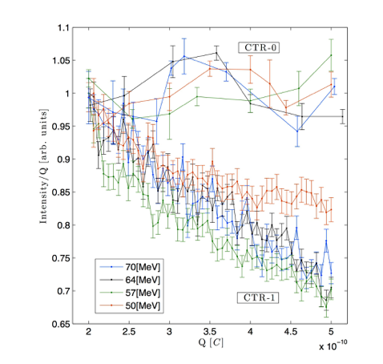
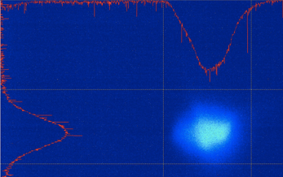
Current Noise Dynamics in a Long Drift Section – A Scaled Experiment
A. Nause
A. Gover
J. Rosenzweig
UCLA-BNL-TAU-SLAC
Collaboration

Slide 2
Motivation
In most cases, electron beams pass through a relatively short drift distances in terms of beam plasma oscillations (plasma Φ_{p}<<1).
Theoretical and experimental results (1st experimental demonstration was at ATF) showed that collective effects can have a significant effect on beam noise when the accumulated plasma phase is not small anymore.
For example: At LCLS-2, the beam is drifting for a distance of approximately 2000m! Consider beam parameters for LCLS-2: E=6 GeV, Current of I=4 kA and a transverse size of σ=300um for example, the accumulated plasma phase during such drift is Φ_{p}=5.
CAN’T NEGLECT COLLECTIVE EFECTS IN TRANSPORT!

Slide 3
Experimental Proposal Outline
We propose to investigate these effects at ATF II by performing a scaled experiment, in which we use a scaled drift for at much lower beam energy.
In this proposal we suggest to use a beam with:
E=100, I=200A (1nC@5pS), and transverse size of σ=150um.
The accumulated plasma Φ_{p} is similar to the LCLS2 drift but for manageably shorter distance L_{d}=10 m.
This scaled experiment will allow research in:
  noise dynamics starting from shot-noise,
  create a coherent modulation using a laser heater, checking its evolution near to one plasma oscillation.
This experiment will allow also develop a suppressed noise scheme for the LCLS2, which will exploitation of the long drift the existing beam.

Slide 4
Preliminary Experimental Plan
This experiment will use the main accelerator beam line available after upgrade.
The drift distance required can be achieved by using the first acceleration section (Linac 1) only, and drift along the non-bend beam line running along the main experimental hall
Measurements of noise will be done using OTR screens and/or a short undulator (spontaneous radiation only, UCLA-Kurchatov) which will be installed along the beam line.

Slide 5
Experimental Plan Layout

