Slide 1





Rubicon Helical Inverse Free Electron Laser Accelerator
J. Duris¹, P. Musumeci¹, M. Babzien², M. Fedurin², I. Gadjev¹, K. Kusche², R. K. Li³, J. Moody¹,
I. Pogorelsky², M. Polyanskiy², J. B. Rosenzweig¹, Y. Sakai¹, N. Sudar¹, C. Swinson²,
E. Threlkeld¹, O. Williams¹, V. Yakimenko³
¹UCLA Department of Physics and Astronomy, Los Angeles, CA 90095
²Accelerator Test Facility, Brookhaven National Laboratory, Upton, NY, 11973
³SLAC National Accelerator Laboratory, Menlo Park, CA, 94025
ATF User Meeting
October 1st, 2015

Slide 2
Overview
IFEL introduction
UCLA-BNL IFEL experiment
  Helical undulator
  High gain results
  High capture results
  Prebunch for better capture
Accomplishments

Slide 3
IFEL Interaction
In an FEL energy in the e-beam is transferred to a radiation field
In an IFEL the electron beam absorbs energy from a radiation field.
High intensity laser
Undulator magnetic field to couple high power radiation with relativistic electrons
Significant energy exchange between the particles and the wave happens when the resonance condition is satisfied.

Slide 4
Why the interest in IFELs?
Inverse Free Electron Laser suitable for mid to high energy range compact accelerators
Laser acceleration => high gradients 100’s of MeV/m to GeV/m
Vacuum acceleration => preserves output beam quality
Energy stability => output energy defined by undulator
Microbunching => manipulate longitudinal phase space at optical scale
High power IR lasers available (10 μm, 1 μm, 800 nm)
Permanent magnet undulators can be made with cm periods
Interest for IFEL driven collider lost as synchrotron losses limit energy to 10’s of GeV (so no IFEL based ILC)
Recent renewed interest in compact GeV accelerators for light sources

Slide 5
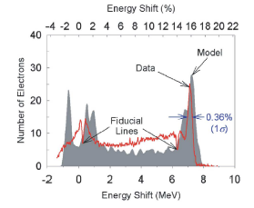
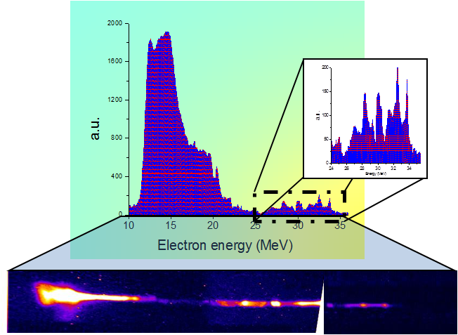
IFEL experiments
STELLA2 at ATF
- Gap tapered undulator
- 30 GW CO₂ laser
- Staged prebuncher + accelerator
- 80% of electrons accelerated
UCLA Neptune IFEL
- Strongly tapered period and amplitude planar undulator
- 400 GW CO₂ laser
- 15 MeV -> 35 MeV in ~25 cm
- Accelerating gradient ~75 MeV/m
W. Kimura et al. PRL, 92, 054801 (2004)
P. Musumeci et al. PRL, 94, 154801 (2005)
Notes:
old but not forgotten note vs has a niche

Slide 6
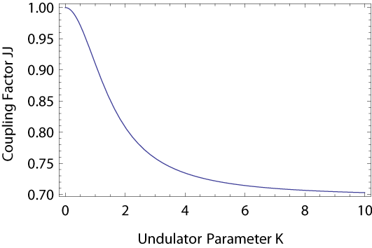

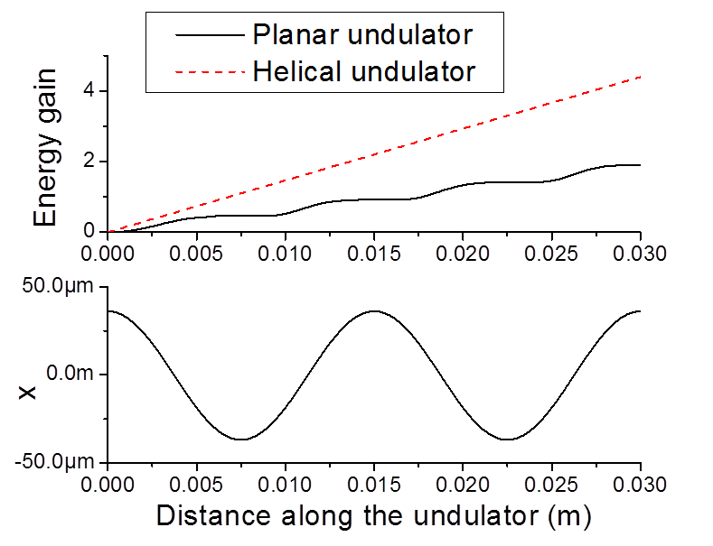


Helical undulator
Planar undulator: energy exchange stops twice per period
Helical undulator: electrons always moving transversely in helix so always transferring energy
Helical yields at least factor of 2 higher gradient.
Especially important for higher energy (high K) IFEL's.

Slide 7
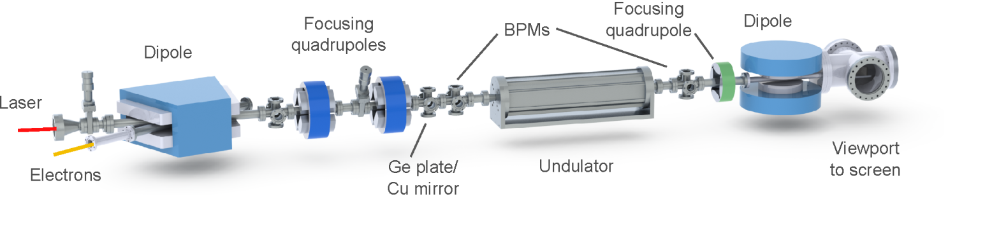
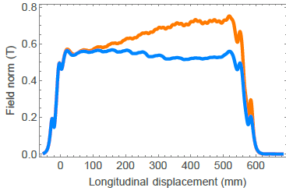
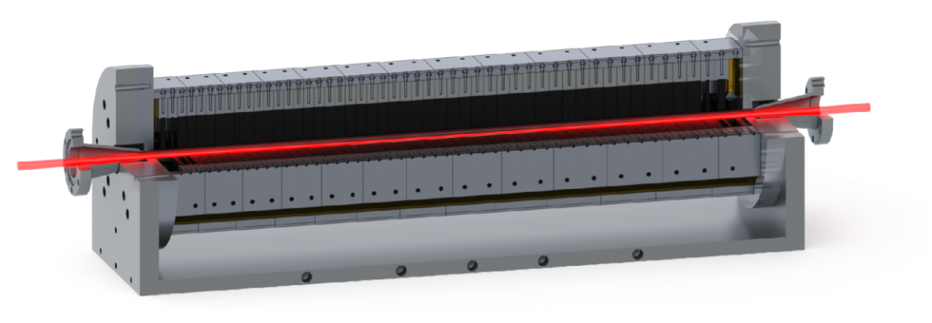
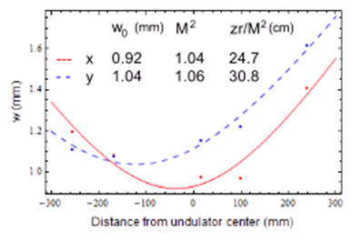
Rubicon IFEL experiment
Collaboration of two groups active in IFEL experiments
Helical geometry high gain high gradient IFEL
Two different tapers used
  Demonstrate control of the final beam properties by undulator tuning
Input e-beam energy | 50 MeV
Average accelerating gradient | 100 MV/m
Laser wavelength | 10.3 μm
Laser power threshold | 100 – 500 GW
Laser focal spot size (w) | 980 μm
Laser Rayleigh range | 30 cm
Undulator length | 54 cm
Undulator period | 4 – 6 cm
Magnetic field amplitude | 5.2 – 7.7 kG

Slide 8
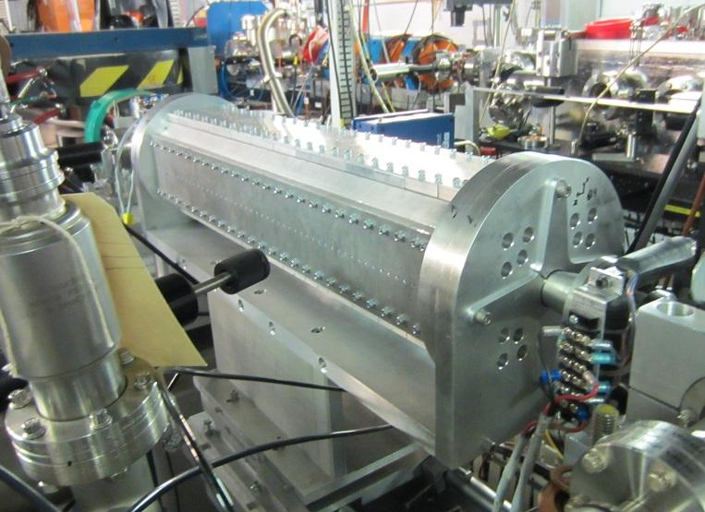
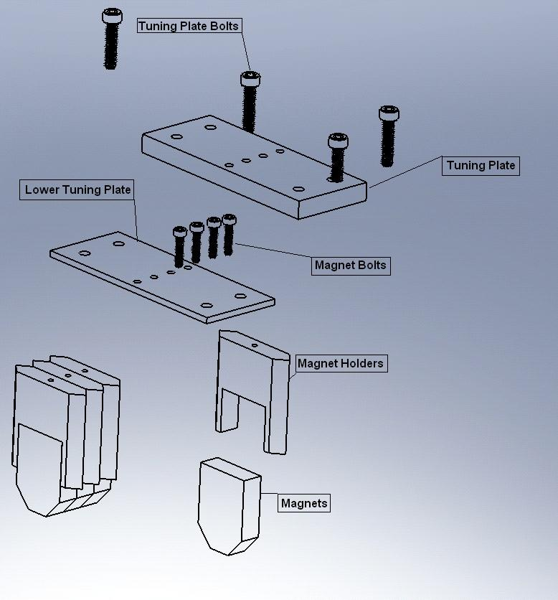
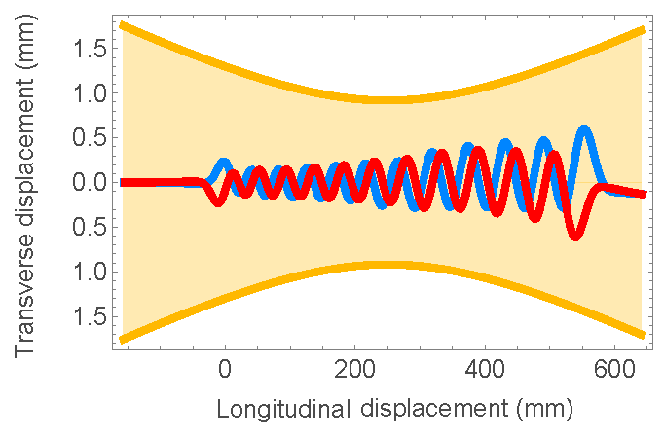
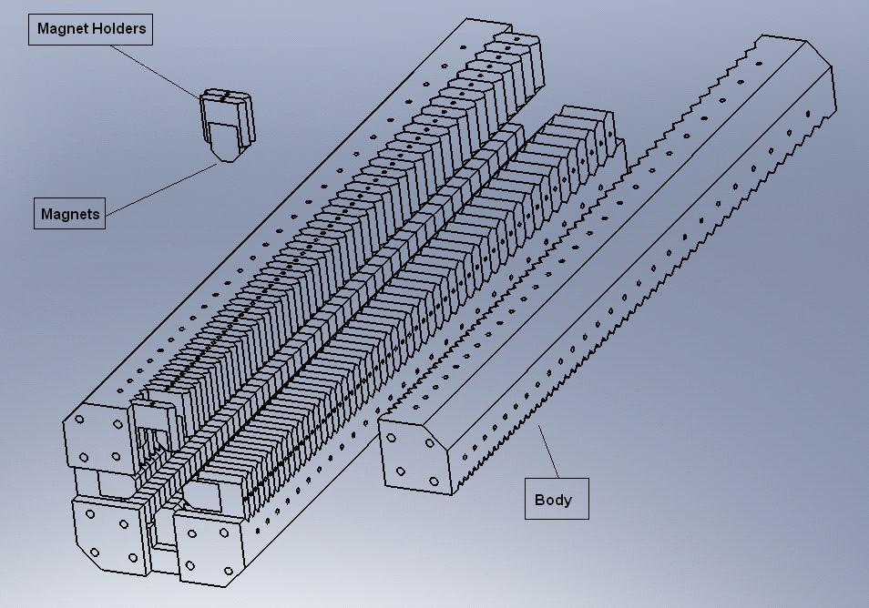
Undulator design
Designed and built at UCLA
First strongly tapered helical undulator
Two orthogonal Halbach undulators with varying period and field strength
NdFeB magnets B_{r} = 1.22T
Entrance/exit periods keep particle oscillation about axis
Pipe of 14 mm diameter maintains high vacuum and low laser loses
Estimated particle trajectories
Laser waist

Slide 9

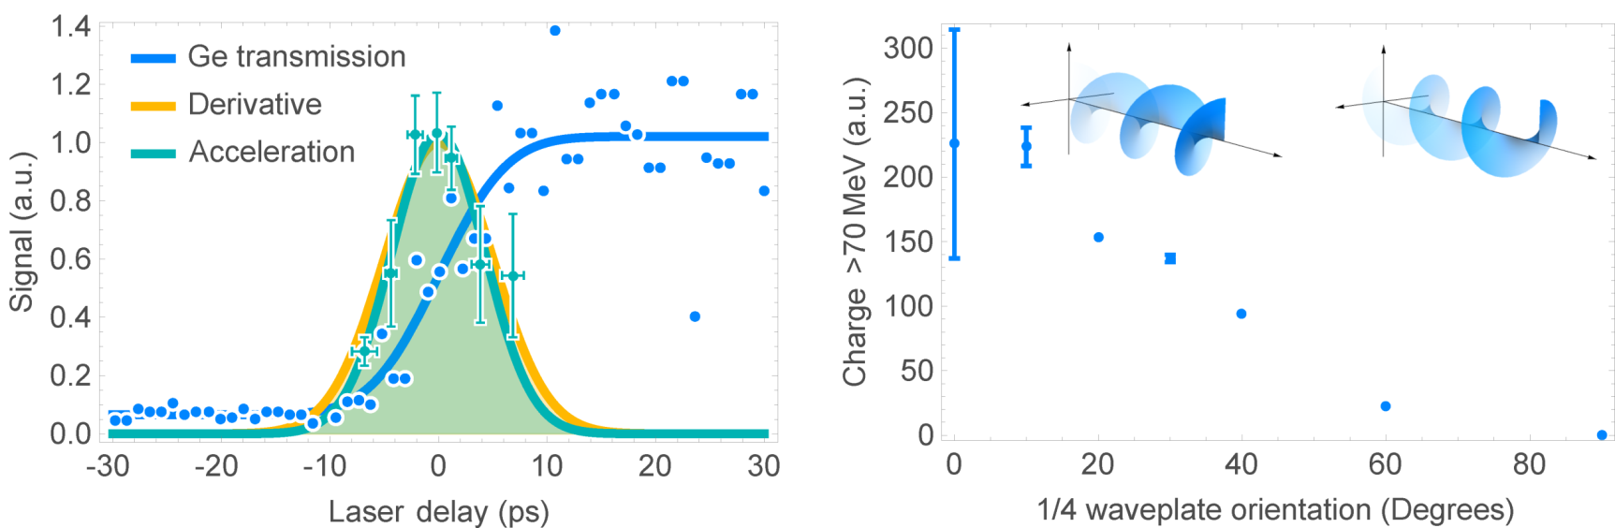
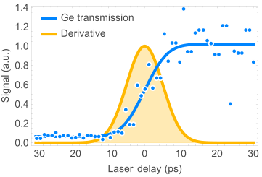
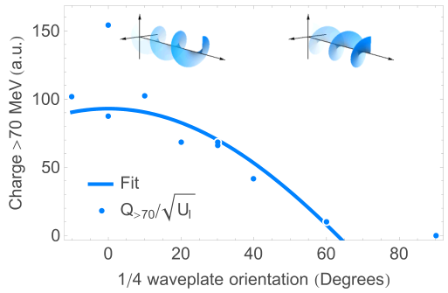

Timing & polarization
Right circular
Wrong circular
Linear
Sigma
= 4.5 ps
Germanium used for ps timing
Use Ge plate to modulate low power CO2 regen transmission
Temporal alignment achieved near threshold for transmission
Acceleration maximized when laser polarization handedness matches helical motion of electrons
No interaction with wrong handedness
Planar polarization angle had no effect

Slide 10
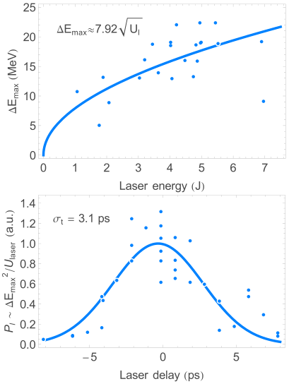

Laser-ebeam temporal cross correlation
Cross correlation measurement of laser and 1 ps long e-beam using IFEL acceleration as a benchmark
Power appears to grow linearly with respect to laser energy
Gradient scales proportional to the square root of the laser power so scale energy gain to estimate power
Estimated rms pulse width ~3 ps
Agrees with spectral measurements of regenerative amplifier output

Slide 11
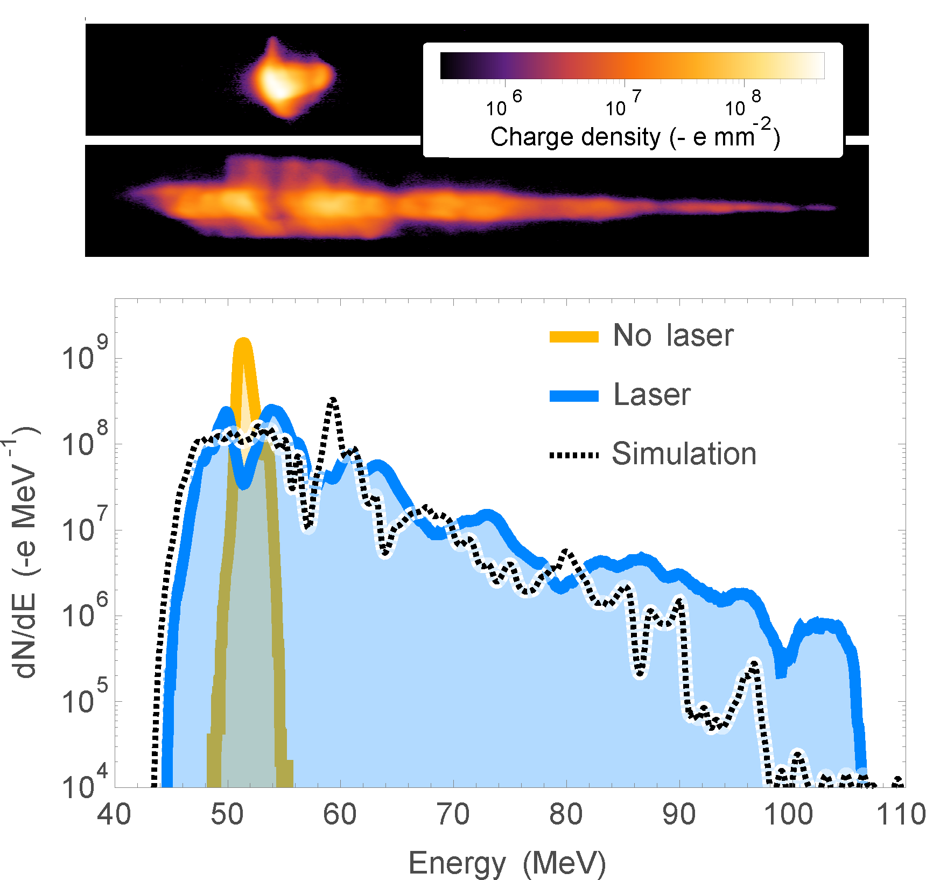
High gradient acceleration
52 to 106 MeV in 54 cm undulator
=>100 MeV/m average accelerating gradient
Notes:
Small fraction of charge accelerated from 52 to 106 MeV

Slide 12
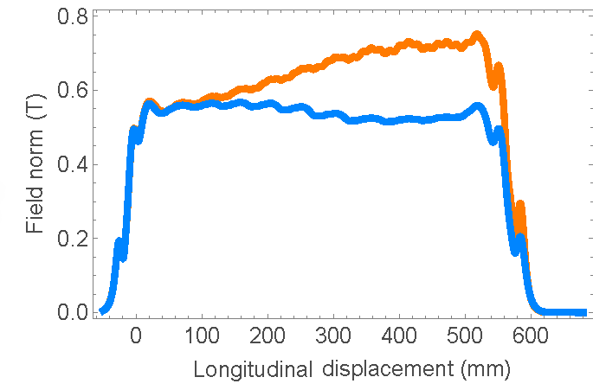
Improving capture
Undulator tapering determined by solving the equation
Experimental constraints limited Rayleigh range 30 cm => lower intensity => lower ponderomotive gradient
Undulator tapering gradient designed for use with 9.6 cm Rayleigh range
Solution: retaper undulator to match the tapering and ponderomotive gradients
Period is fixed. Shim out magnets to reduce field (as well as K and γ_{r})
=> Changed final energy
High gradient
Reduced gradient

Slide 13
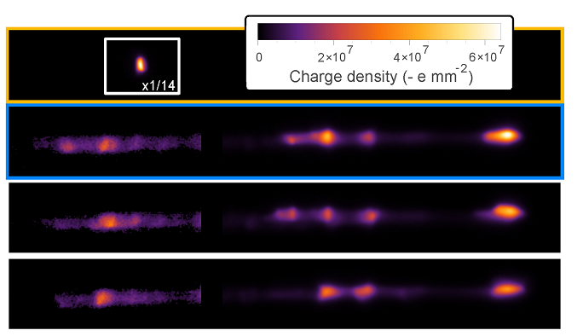
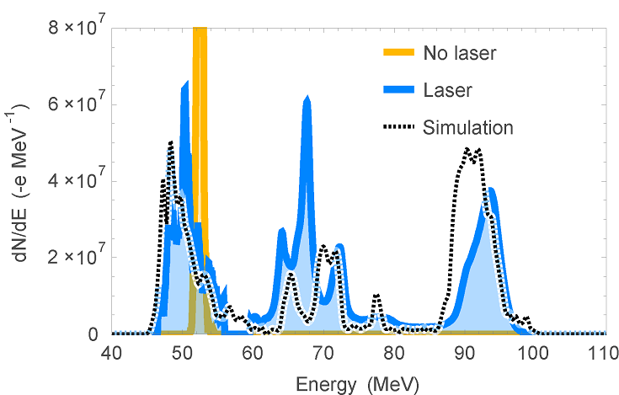
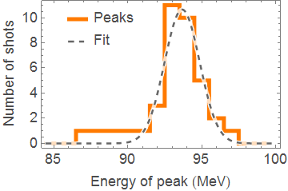
High capture acceleration
With retuned undulator
Full acceleration for nearly every shot
~30% of 100 pC accelerated
Energy spread < 2%
Energy stable to 1%
78 MeV/m average accelerating gradient
Peak charge density of accelerated beam
94 MeV
mean
1.8% rms

Slide 14
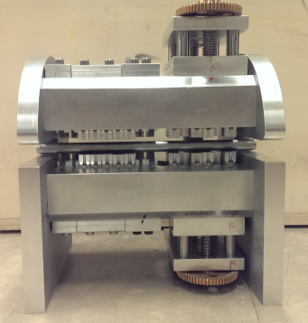


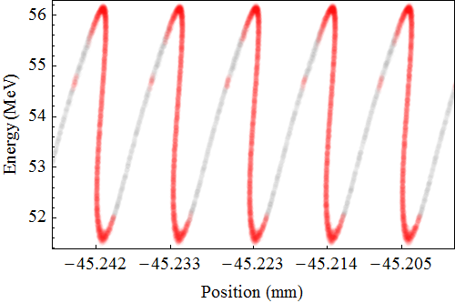
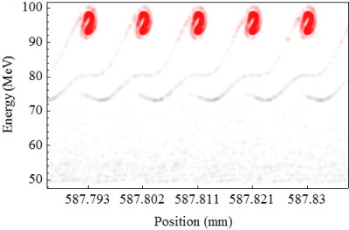

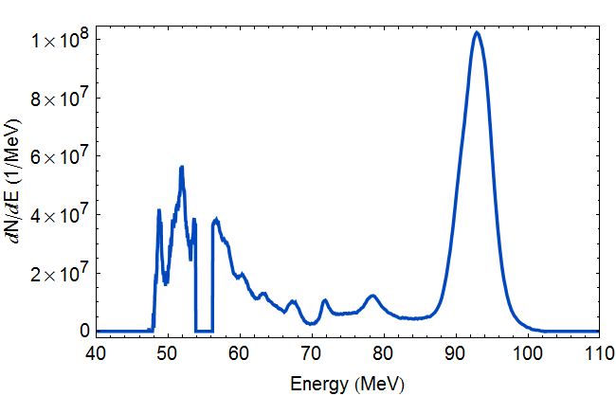
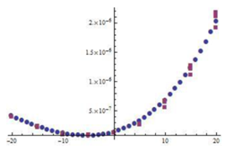
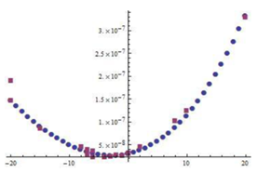
Rubicon + prebuncher run
~30 cm
UCLA permanent magnet based prebuncher
Permanent magnet chicane with adjustable R₅₆
Achieved > 50% capture
Better matching into undulator preserves emittance
GPT
First experiment using a CPA CO2 laser!
93 MeV peak
2% rms energy spread
90 pC
>90 MeV
Unaccelerated
emittance 2.3 um
Accelerated
emittance 2.4 um

Slide 15
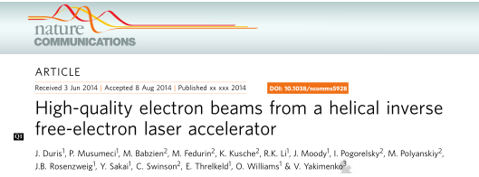
Rubicon helical IFEL accelerator at ATF
Experimental successes
Doubled e-beam energy: >50 MeV gain
High average gradient of 100 MeV/m over 0.5 m
Demonstrated output energy tuning
Captured ~30% of 100 pC beam with < 2% energy spread
& ~1% energy jitter
Captured >50% (>90 MeV) with prebuncher
Demonstrated transverse emittance preservation
Experience paves the way towards current and future projects
Nocibur IFEL decelerator
IFEL driven ICS
IFEL with recirculated CO2
GeV IFEL @ ATF2
Thank you ATF!

