Slide 1



Sub-femtosecond bunch length diagnostic
G. Andonian
BNL ATF Users Meeting 2015
Status Report AE62
October 1-2, 2015

Slide 2
Motivation
Characterize bunch profile of sub-ps pulses
  Machine performance optimization
  Understand beam variations in emittance, current
Bunch length measurement techniques currently limited to ~few fs
  Coherent radiation interferometry (ATF experience)
  Electro-Optical sampling
  RF Deflector
Femtosecond resolution required for investigation on ultra short pulses
  Microbunching instability of COTR
  Single-spike SASE FEL beam
  Properties of attosecond x-ray production
  Temporal properties of echo-enabled FELs

Slide 3
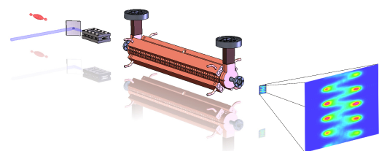
Schematic Description
e-beam
deflector
laser
undulator
screen
Laser (TEM₁₀ mode)/e-beam interaction in planar undulator
  Angular modulation of beam
  Dependent on longitudinal bunch coordinate
RF deflector provides vertical streak to observe modulation for long bunches
Angular modulation (“sweep”) observable on distant screen (x’ -> x)
  Resolvable with standard optics
Scheme provides enhanced resolution over RF deflector alone.
  “Attoscope”

Slide 4
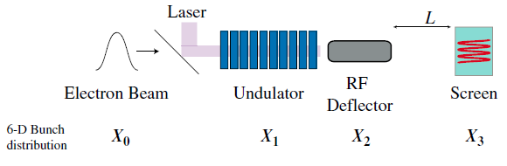
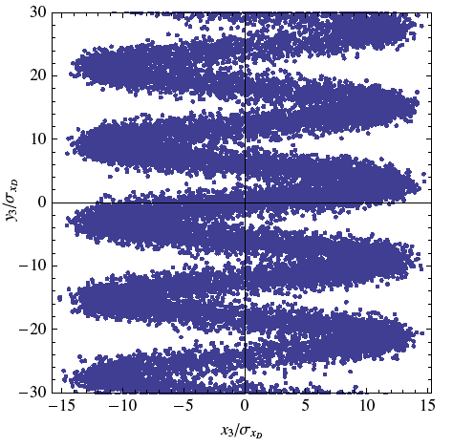


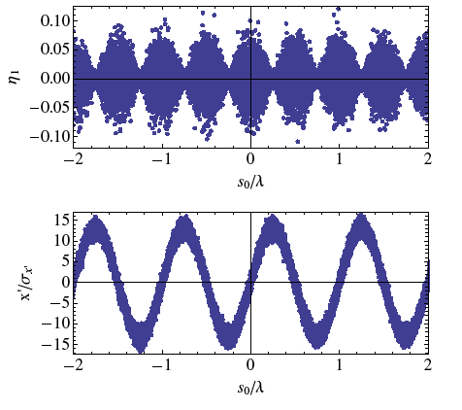


“Attoscope”: optical scale longitudinal diagnostic
Sub-fs diagnostic uses a higher-order mode IFEL interaction coupled to a transverse RF deflecting mode.
TEM₁₀
TEM₁₀ mode
Energy modulation
Panofsky-Wenzel theorem
Angular modulation
Andonian, et al. PRSTAB 14, 072802 (2011)

Slide 5
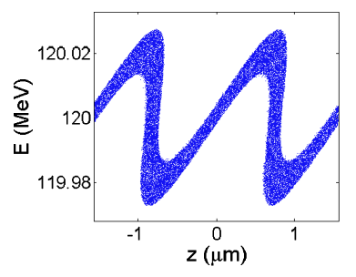
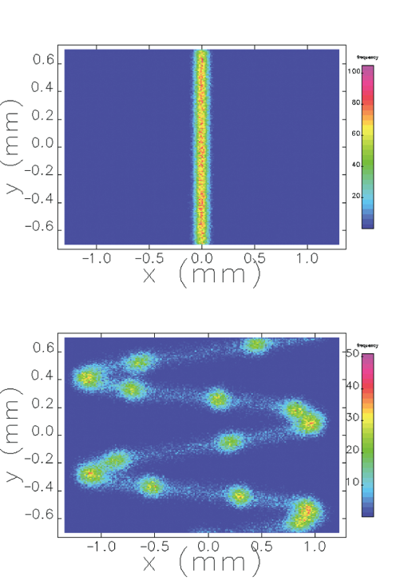
Illustrative example
Echo enabled FEL at SLAC
  D.Xiang, et al. PRL 105, 114801 (2010)
Beam modulation at laser wavelength scale
  (~3fs)
Experiment observation by indirect methods
  Limit on resolution of TCAV (<10fs)
Attoscope provides enhanced resolution
  ~100as
Phase Space -
With laser
modulation
deflector
only
“Attoscope”
(deflector + laser mod)
Simulations with Elegant

Slide 6
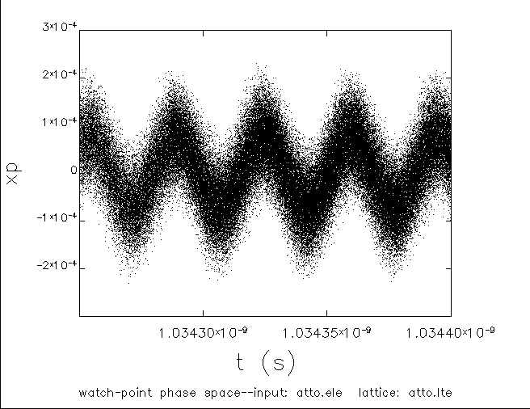
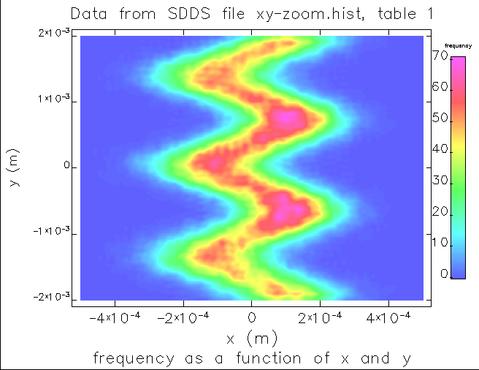
AE62 experiment @ BNL ATF
(Current Project)
ATF has long history w/ CO2 laser e-beam interactions (IFEL, ICS)
Parameters (simulation)
  E= 44 MeV, Q= 500pC, ε_{n} = 1mm-mrad
  λ_{u}=4cm, N= 10, B₀= 0.67T
  λ = 10.6 um, P_{L} = 300GW
  V_{d} = 10MV, L_{d} = 46cm
TEM₁₀ laser mode
  Simple Michelson style interferometer
Undulator
  Designed/built at Radiabeam
Deflector
  AE37 experiment
Simulations performed with Elegant
Angular modulation (top) and beam distribution at screen (bottom)

Slide 7
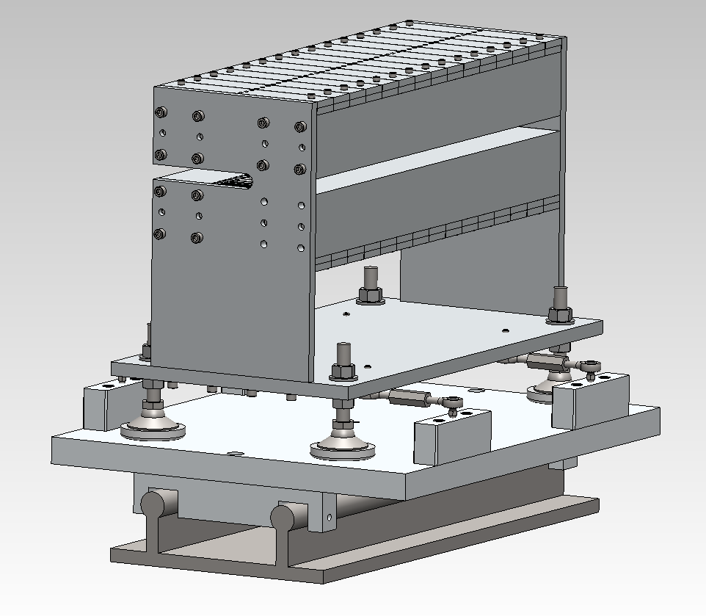
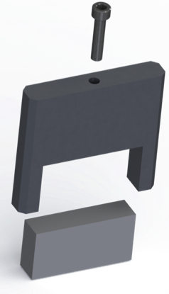
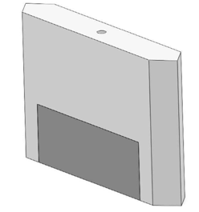
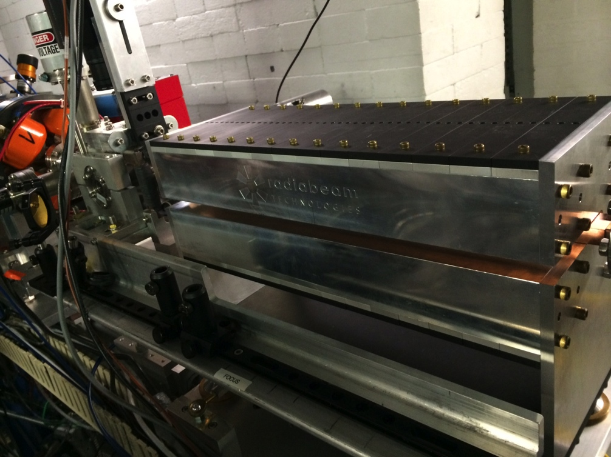
Undulator
N=10, B₀=0.67T, L=40cm
Complete design, engineering, fabrication, validation at RadiaBeam
  Hall probe scan
  Pulse wire scan
Undulator final tuning at ATF
CAD model with alignment
Pole fabrication
Installed on BL2
Field map
F. O’shea

Slide 8
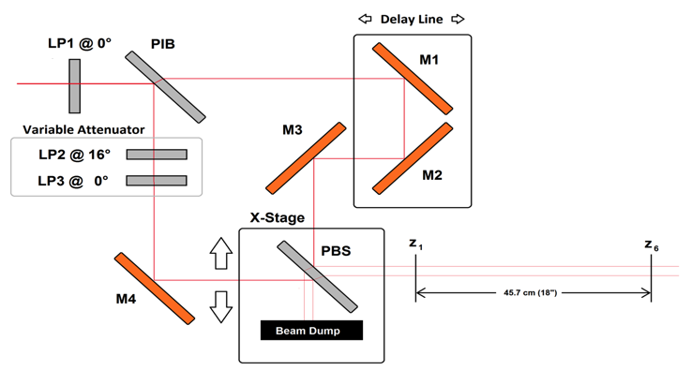
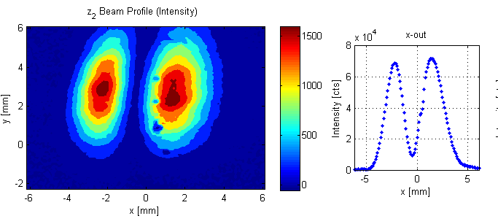
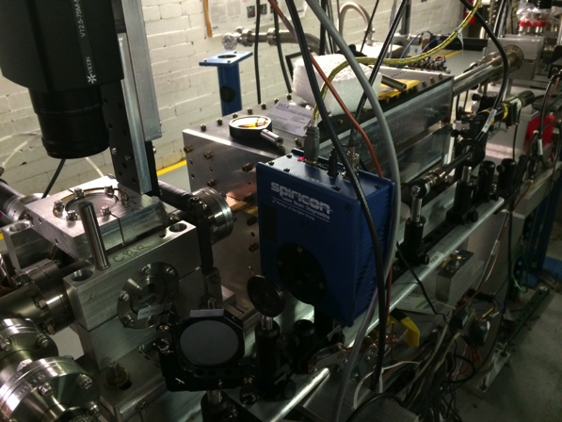
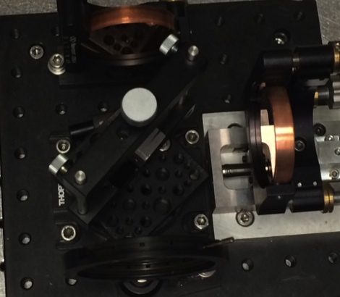
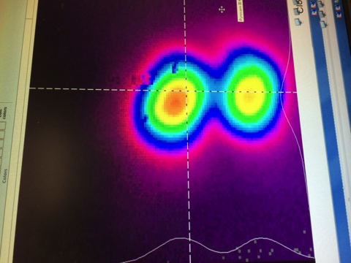
Laser Mode Converter
TEM₁₀ mode
w0= 1.1mm
= 10.3µm
RadiaBeam Bench
ATF Expt Hall
I. Pogorelsky
M. Polyanski
A. Ovodenko
pyrocam

Slide 9
AE62 Timeline Overview
Experimental stages
  0. Feasibility (August 2014 – #AF62)
    Testing optics, undulator, transport, etc.
  1. Test for interaction (February 2015 - #AE62)
    no deflector
    Observable is increase in beam angular modulation
  2. Full “attoscope” with deflector (coming soon)
✔
✔
Beamline 2 layout for February 2015 Run
IPOP2
Attoscope
Undulator
IPOP3
IPOP6
ID1
laser
IQ1
IQ2
Ge
Wafer
IQ3
IQ4
e-beam

Slide 10

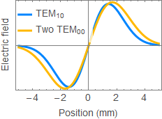
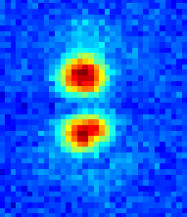
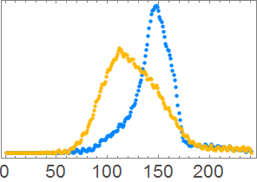
Results from run
Approximate TEM₁₀ mode with two TEM₀₀ modes at a small angle & out of phase
e-beam transverse profile monitor (IPOP6)
Laser at focus
Laser off
(380 µm rms)
Laser on
(500µm rms)
~1 mm
Preliminary results:
Effect of TEM10 laser evident even at “low” energy (~100mJ)
Spreading in horizontal (~25%)
“Butterfly” shape also seen in simulations
Prelim analysis
Next steps
  x-band deflecting cavity !
  Prebuncher + chicane
x (pixels)

Slide 11

AE62 Summary
Promising results from February run
  Observed angular modulation of beam in interaction
Analysis with full simulations ongoing
Benefit from Rubicon experience immediately prior
  Synchronization, alignment, etc.
Next run(s)
  Request: 2-3 weeks
    Reestablish laser conditions
    Realign/retune undulator
  Deflecting cavity commissioning (not included)
Acknowledgements:
  M. Harrison, A. Murokh, F. O’Shea, A. Ovodenko (RadiaBeam)
  J. Duris, P. Musumeci, J. Rosenzweig, Y. Sakai (UCLA)
  M. Babzien, M. Fedurin, K. Kusche, R. Malone, I. Pogorelsky, M. Polyanski, C. Swinson (BNL ATF)
Support from DOE SBIR Award # DE-SC0007701

Slide 12
Back up material

Slide 13
BL2 scheme
Attoscope
Undulator
ID1
IPOP2
IPOP3
IPOP6
laser
Ge
Wafer
IQ1
IQ2
IQ3
IQ4
e-beam

Slide 14
Experiment
Use TEM₀₀ mode first
Synchronize laser/e-beam (Ge wafer)
Observe e-beam energy spectrometer (IFEL interaction)
  Vary e-beam energy
  Vary laser power (1GW-10GW-100GW)
    Observe profile on IPOP4 or IPOP5
THEN
Use TEM₁₀ mode
Observe beam profile downstream
  Look for increase in e-beam horizontal divergence
Vary timing
Vary laser power (500MW- 1GW-10GW-100GW(?))

Slide 15
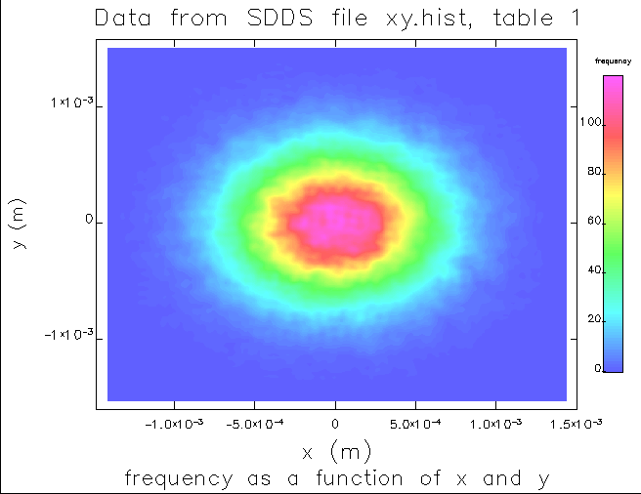
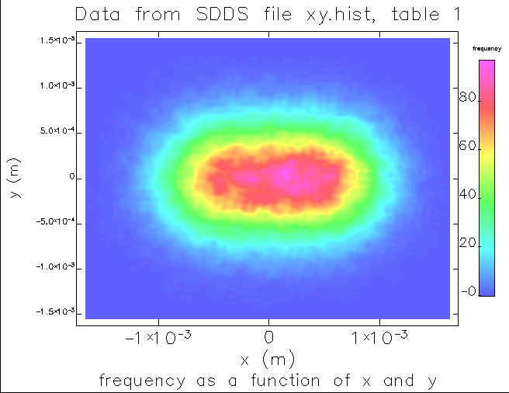
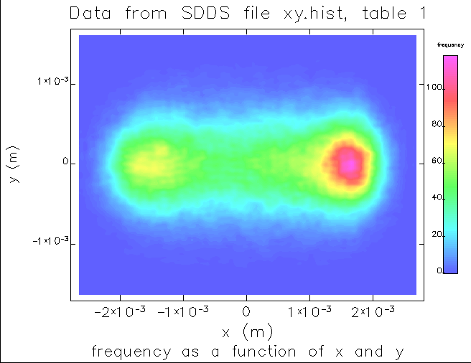
“Old” simulations
Only TEM₁₀ mode v. laser power (no deflector)
Does not include effects of transport
1 GW
10 GW
100 GW

