Slide 1
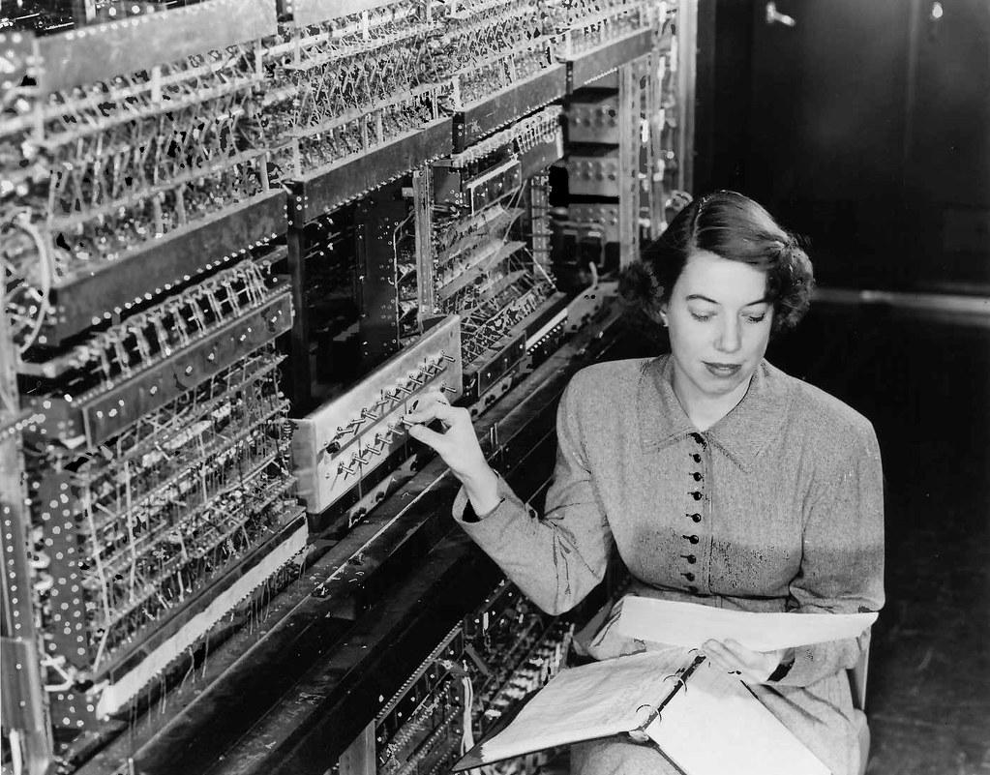
Software tasks Wednesday 2021-08-26
The Software and Computing WG Conveners: Andrea Bressan (University of Trieste and INFN) , Dmitry Romanov (Jefferson lab) , Sylvester Joosten (Argonne National Laboratory) , Whitney Armstrong (Argonne National Laboratory) , Wouter Deconinck (The University of Manitoba)

Slide 2
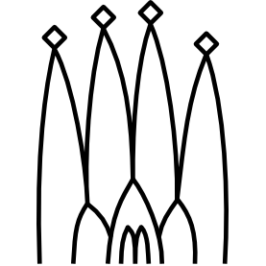
Oversimplified software stack
DD4hep: Geant4, geometry, detector Juggler: Digitization + reconstruction (Gaudi, Podio, ACTS for tracking)
Gaudi: Processing framework
ACTS: Experiment-independent tracking toolkit (ACTS’ geometry constructed from DD4hep via plugin)
Podio: Robust data model definition
MCEG
Automated
Tests,
Benchmarks
Validation
DD4Hep,
Geometry,
Geant4 (DDSim)
Juggler, Gaudi - processing ACTS - tracking,
Tensorflow - ML
Custom reco algorithms
Analysis/Benchmarks

Slide 3
Potential (incomplete) task lists from SWG
Reconstruction (C++, Gaudi, ACTS, Python)
Simple electron PID (medium/expert)
Advanced electron PID (expert)
Jet reconstruction (expert)
Event subcomponent matching (medium/expert)
RICH reconstruction (medium/expert)
MRICH reconstruction (medium/expert)
DIRC reconstruction (medium/expert)
Holistic calorimeter reconstruction (expert)
Vertexing (medium/expert)
Optimize tracking (medium/expert)
Kinematic reconstruction (easy/medium)
Far-forward reconstruction (easy/medium)
Far-backward reconstruction (easy/medium)
ML-accelerated algorithms (medium/expert)
Geometry/full simulation (XML, C++, DD4hep, GEANT)
Detector color scheme (easy)
Automatic marketing/publication figures (easy/medium)
Optimize parametrization of subsystems (medium)
Implement additional technology options (easy/medium/expert)
Add extra support & service material (easy/medium)
Detector Benchmarks (ROOT, Python)
Validate hit multiplicities in subsystems (easy)
Energy calibrations for calorimeters (easy/medium)
Validate optics in DRICH (medium/expert)
Study raw acceptance (easy)
Validate detector material budget (easy/medium)
Render results on dashboard webpage (all benchmarks)
Reconstruction Benchmarks (ROOT, Python, ...)
Validate/optimize digitization algorithms (easy)
Clustering performance (medium)
Subsystem performance (easy/medium)
Overall reconstruction performance (medium)
Study reconstructed acceptance (easy)
Physics Benchmarks (ROOT, Python)
Integrate analyses from PWGs into CI framework (easy)
Validation figures on kinematic variables (easy)
Collect and integrate available event samples (easy)

