Slide 1
ANSYS Structural Analyses of sPhenix Magnet Coil at Full Current
John Cozzolino
July 10, 2015

Slide 2
ANSYS FE Structural Analysis of sPhenix Coil
  2d axisymmetric steady-state FE analysis of complete coil
    Includes external aluminum bobbin and G-10 end fillers
    Geometry and forces taken from Wuzheng Meng’s magnetic model – 6/17/2015
      Coil center is shifted 3cm north relative to iron
      Coils divided into 24 blocks, each with corresponding radial and axial pressures due to the Lorentz forces at maximum current
    Thermal stresses from cool-down to 4K included
    Mechanical properties vs. temperature are included
      Coil properties E and CTE adjusted for percentage of insulation vs. conductor (Ref Ansaldo Dwg# 620RM07142, pg. 1)
        Radial direction 2.0% insulation (all coils)
        Axial direction 4.7% (middle coils)
        Axial direction 8.1% (end coils)
    All connections (contacts) are bonded
    Tensile and shear stresses are studied throughout the coil
      Shear stress limit: 30 MPa (4350 psi)
      Tensile stress limit: 30 MPa

Slide 3
Labels on 24 Solenoid Coils
(Not to Scale)
W. Meng
Coil-package ctr.
3.0 cm
Rout=155.06cm
Rin=150.98cm
(solenoids/yoke/poles common Axis)
Z
(Yoke axial ctr.)
Z=0

Slide 4
Radial Pressure (outward-force per unit area) Table (W. Meng):
 | Coils Ave. Ctr. | (MPa) | (PSI) | (MPa) | (PSI) | (MPa) | (PSI)
 | Zc (cm) | Inner | Inner | Outer | Outer | Inner+Outer | Inner+Outer
Coils 3b +7b | -165.10 | 0.7867 | 114.07 | 0.0032 | 0.46 | 0.7899 | 114.53
Coils 3a + 7a | -152.38 | 0.8978 | 130.19 | 0.0149 | 2.17 | 0.9128 | 132.35
Coils 4 + 8 | -133.30 | 0.9708 | 140.77 | 0.0751 | 10.89 | 1.0459 | 151.66
Coils 5 + 9 | -107.85 | 1.0461 | 151.68 | 0.1502 | 21.77 | 1.1962 | 173.45
Coils 6 + 10 | -82.40 | 1.0286 | 149.15 | 0.1677 | 24.32 | 1.1964 | 173.47
Coils 1 + 2 | -33.34 | 0.4864 | 70.53 | 0.1534 | 22.24 | 0.6398 | 92.76
Coils 11 + 12 | 39.34 | 0.4863 | 70.51 | 0.1532 | 22.22 | 0.6395 | 92.72
Coils 16 + 20 | 88.40 | 1.0275 | 148.98 | 0.1664 | 24.13 | 1.1939 | 173.12
Coils 15 + 19 | 113.85 | 1.0426 | 151.18 | 0.1463 | 21.21 | 1.1889 | 172.40
Coils 14 + 18 | 139.30 | 0.9004 | 130.55 | 0.0693 | 10.05 | 0.9697 | 140.61
Coils 13a + 17a | 158.38 | 0.9004 | 130.55 | 0.0180 | 2.61 | 0.9184 | 133.16
Coils 13b +17b | 171.10 | 0.7944 | 115.19 | 0.0095 | 1.38 | 0.8039 | 116.57

Slide 5
Axial Force Table (W. Meng):
 | Coils Ave. Ctr. | Fz (N) | Fz(Lb) | Fz (N) | Fz(Lb) | Fz (N) | Fz(Lb)
 | Zc (cm) | Inner | Inner | Outer | Outer | Inner+Outer | Inner+Outer
Coils 3b + 7b | -165.10 | 1.23E+06 | 2.771E+05 | 1.22E+06 | 2.73E+05 | 2.45E+06 | 5.505E+05
Coils 3a + 7a | -152.38 | 7.84E+05 | 1.761E+05 | 7.84E+05 | 1.76E+05 | 1.57E+06 | 3.520E+05
Coils 4 + 8 | -133.30 | 1.01E+06 | 2.258E+05 | 1.03E+06 | 2.30E+05 | 2.03E+06 | 4.560E+05
Coils 5 + 9 | -107.85 | 4.10E+05 | 9.196E+04 | 4.47E+05 | 1.00E+05 | 8.57E+05 | 1.924E+05
Coils 6 + 10 | -82.40 | -2.97E+05 | -6.675E+04 | -1.96E+05 | -4.41E+04 | -4.94E+05 | -1.108E+05
Coils 1 + 2 | -33.34 | -3.33E+05 | -7.479E+04 | -3.98E+05 | -8.93E+04 | -7.31E+05 | -1.641E+05
Coils 11 + 12 | 39.34 | 3.32E+05 | 7.449E+04 | 3.96E+05 | 8.89E+04 | 7.28E+05 | 1.634E+05
Coils 16 + 20 | 88.40 | 2.96E+05 | 6.638E+04 | 1.94E+05 | 4.36E+04 | 4.90E+05 | 1.100E+05
Coils 15 + 19 | 113.85 | -4.10E+05 | -9.212E+04 | -4.49E+05 | -1.01E+05 | -8.59E+05 | -1.928E+05
Coils 14 + 18 | 139.30 | -9.91E+05 | -2.225E+05 | -1.01E+06 | -2.27E+05 | -2.00E+06 | -4.490E+05
Coils 13a + 17a | 158.38 | -7.71E+05 | -1.730E+05 | -7.69E+05 | -1.73E+05 | -1.54E+06 | -3.457E+05
Coils 13b + 17b | 171.10 | -1.22E+06 | -2.749E+05 | -1.21E+06 | -2.71E+05 | -2.43E+06 | -5.462E+05
 |  |  |  |  | Total Fz = | 7.00E+04 | 1.57E+04 |  | (with 3 cm Shift)
 |  |  |  |  |  | (N) | (Lb)

Slide 6
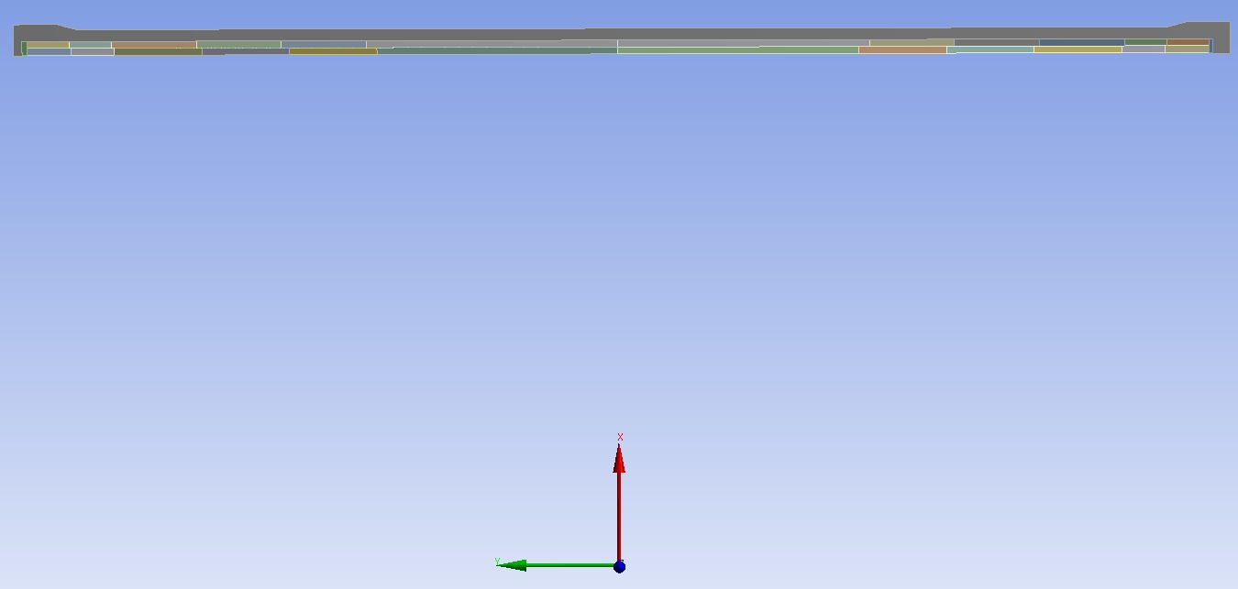
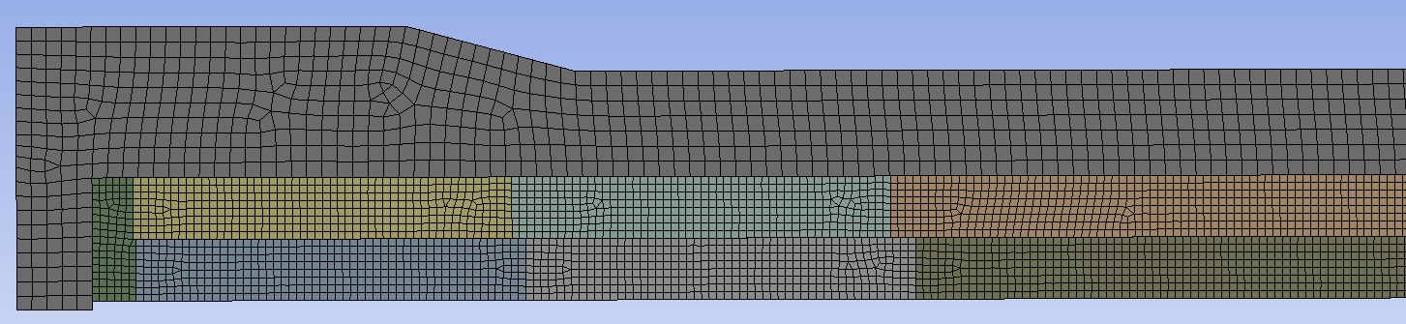
Full Geometry
Aluminum Bobbin
Outer Coil
Inner Coil
G-10 Filler
FE Mesh (Lead End)

Slide 7
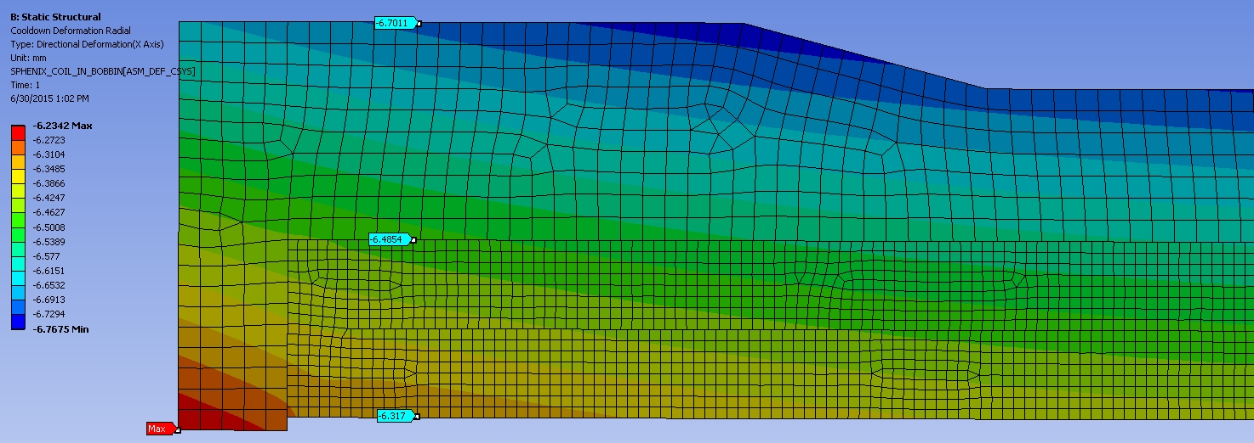
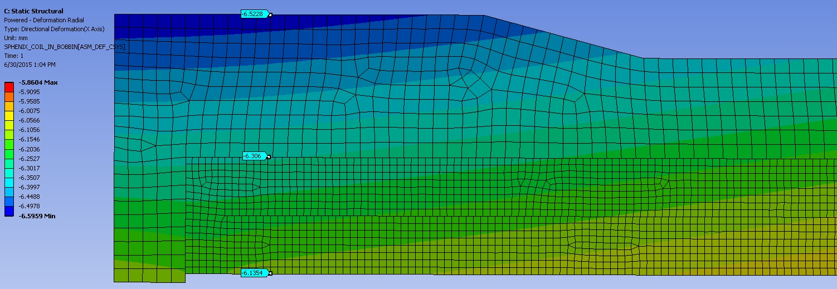
Radial Deflection @ Cool-down Followed by Max Current (LE View)

Slide 8
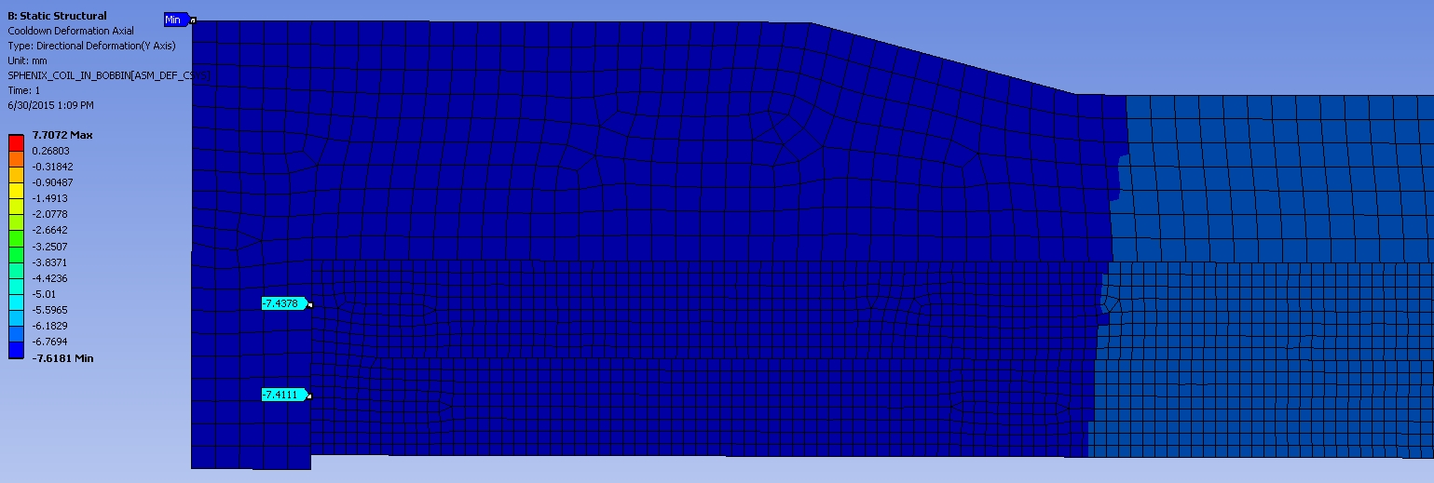
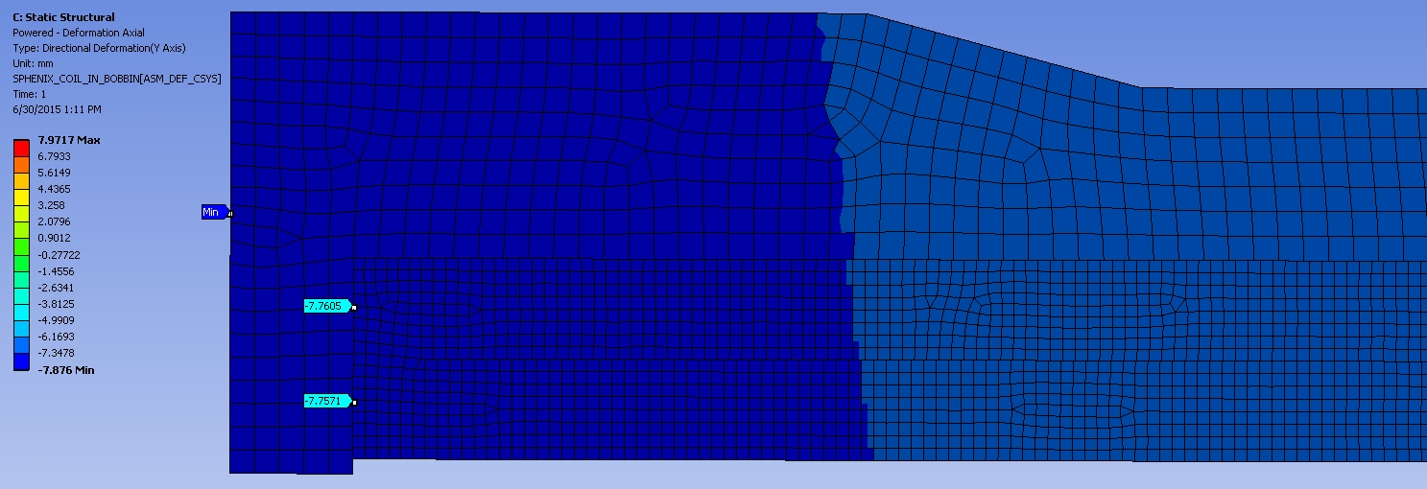
Axial Deflection @ Cool-down Followed by Max Current (LE View)

Slide 9
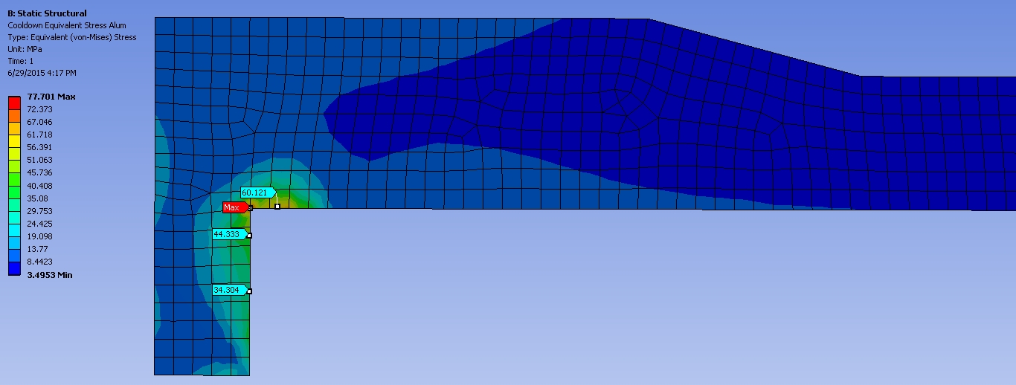
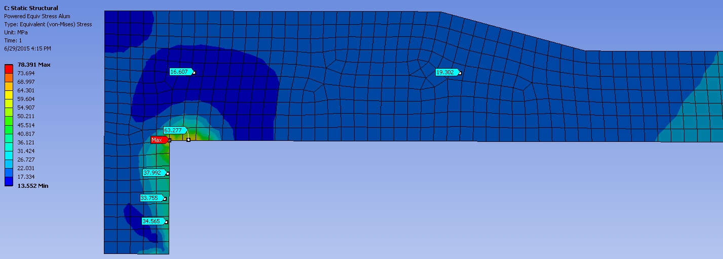
Equivalent Stress in Aluminum Bobbin @ Cool-down & Max Current (LE View)

Slide 10
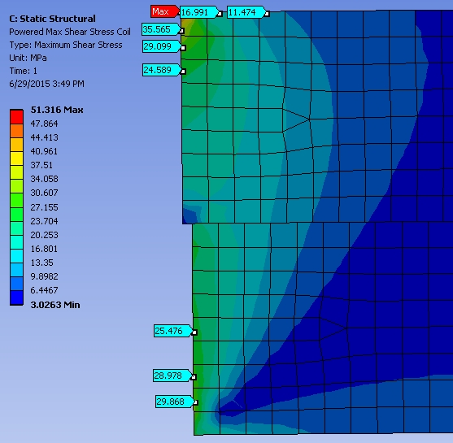
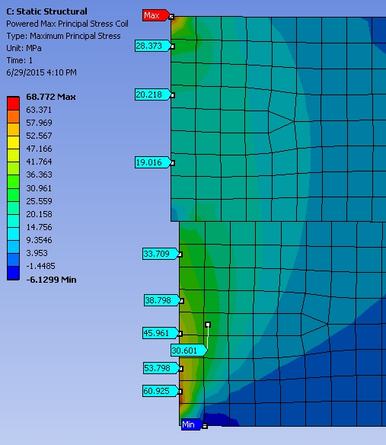
Lead End Max Shear and Tensile Stresses @ Full Power

Slide 11
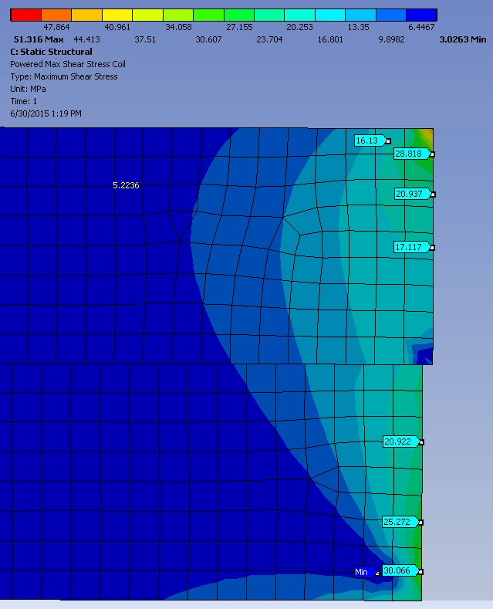
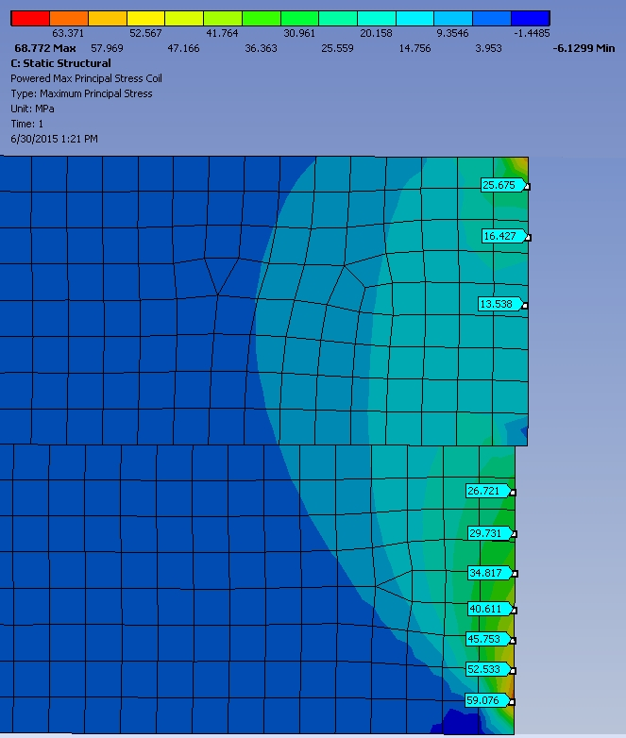
Non-Lead End Max Shear and Tensile Stresses @ Full Power

Slide 12
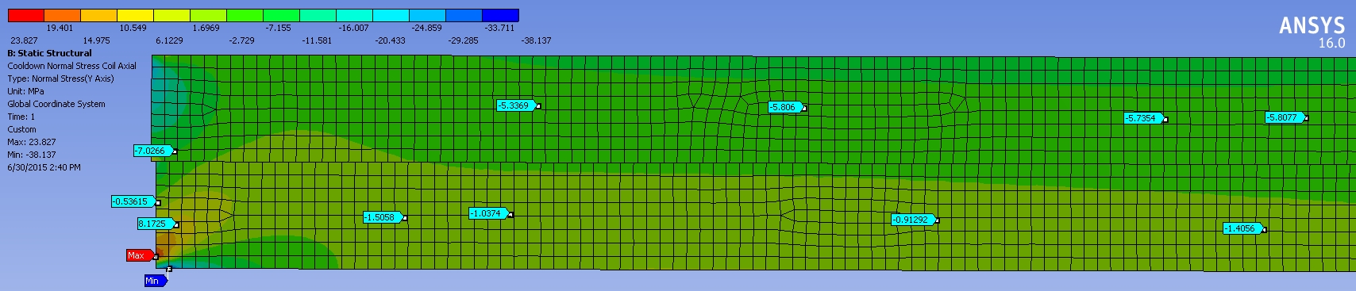
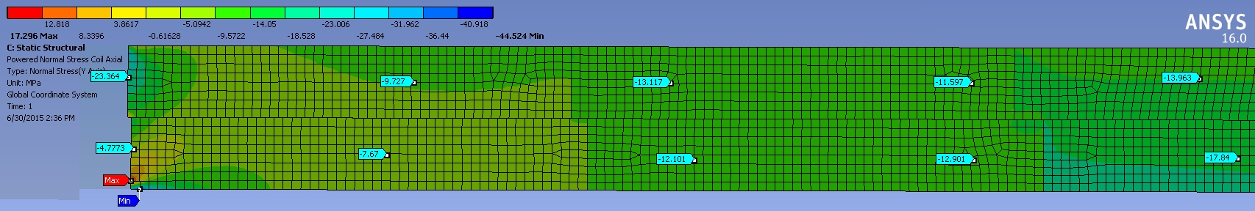
Lead End Axial Compressive Stresses at Cool-down & Full Power (MPa)

Slide 13
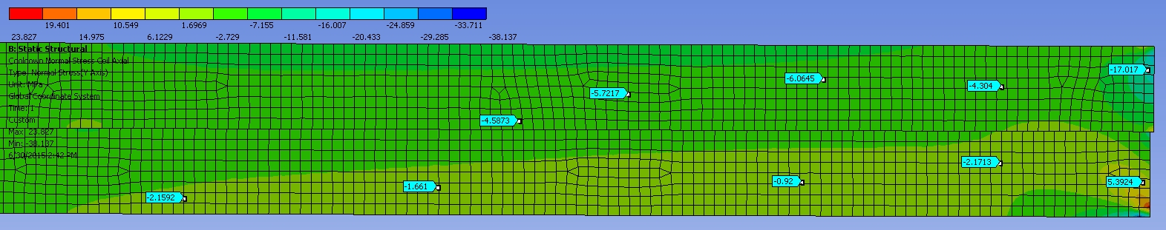
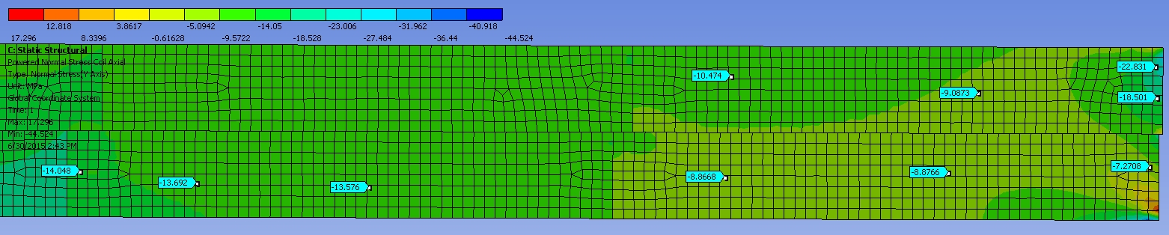
Non-Lead End Axial Compressive Stresses at Cool-down & Full Power (MPa)

Slide 14
Summary & Conclusions
  Cool-down and Lorentz forces will not yield the aluminum bobbin.
    Assuming 5083-0 (annealed) YP= 110 MPa (16 kpsi)
  Tensile stresses at the coil ends exceed the allowable limit (30 MPa) at maximum operating current.
    Based on the maximum principal stress (σ1)
  Shear stresses at the coil ends are at the allowable limit (30 MPa) at maximum operating current.
  Axial compressive stresses at the coil ends do not exceed the yield point of 99.5% pure aluminum (~30 MPa).

