Slide 1
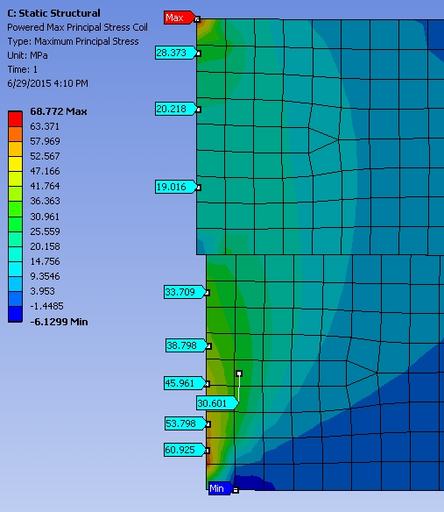
Agenda
Schedule
July 10, 2015: J. Cozzolino explained his ANSYS stress analysis on the sPHENIX Magnet.
Pasquale : No releasing agent between Coil / G10 flanges / Mandrel
The only real problem is between Coil & G10; D. Lynch: if the difference between cool-down and “powered” is small/several %, we’re OK.
J. Cozzolino will look at this difference and that area more closely
D. Phillips also wants to see whether G10 has the same stress
Jon Hock has “volunteered” to check on J. Cozzolino’s inputs as well as (possibly) the entire calculation
Do Finite-Element Analysis for other configurations such as High-field test and even forward-sPHENIX ?
Study/understand the tie-rod placement and understand the correlation between the forces and strain gauges/potentiometer ?
The last two items need more engineering support !

