Slide 1
Integration Meeting Wednesday 2021-08-18
The Software and Computing WG Conveners: Andrea Bressan (University of Trieste and INFN) , Dmitry Romanov (Jefferson lab) , Sylvester Joosten (Argonne National Laboratory) , Whitney Armstrong (Argonne National Laboratory) , Wouter Deconinck (The University of Manitoba)

Slide 2
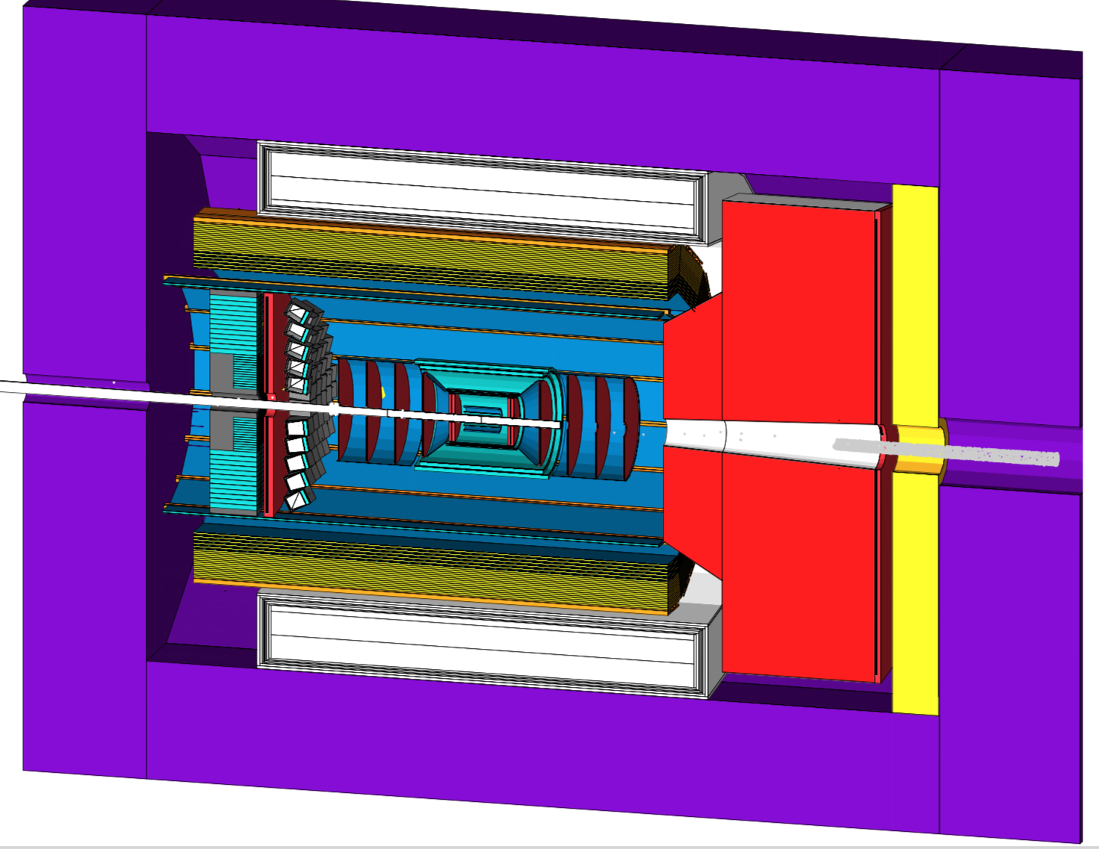
First tagged release
N0.0 - B0.0 - P0.0 configuration
Codenamed “acadia”
Preliminary first tag → acadia-v1.0-alpha
Acadia corresponds to N0-B0-P0 and will keep evolving
This way we can keep the git history from becoming non-linear (important!)
First tagged release

Slide 3
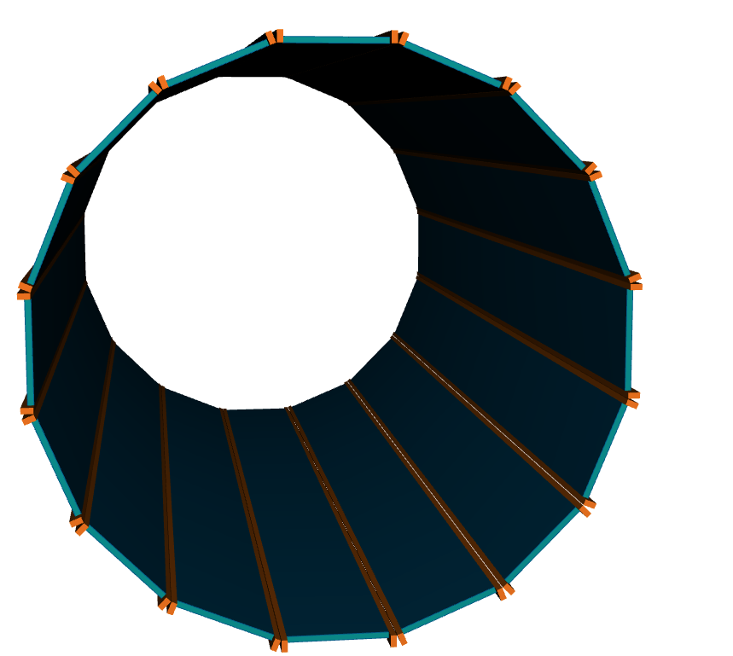
FakeDIRC geometry in acadia-v1.0-alpha (N0.0-B0.0-P0.0)
Module layers:
2.5mm carbon fiber
17mm quartz (sensitive)
2.5mm carbon fiber
Support frame
30mm x 40mm Stainless Steel bars at both sides of each module is this reasonable?
Support frame protrudes a 4cm past the bar end (to account for space required to mount)

Slide 4
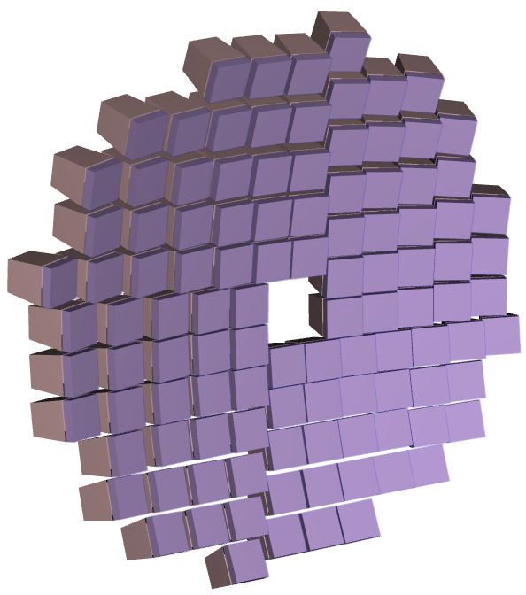
mRICH geometry in acadia-v1.0-alpha (N0.0-B0.0-P0.0)
Module layers:
1mm CF frame
30mm Aerogel
2mm foam frame
1.52mm Fresnel lens
Box
2mm thick mirror at sides of box
Photo detector (LAPPD stand-in)
2mm glass
0.1mm copper (should be more to also account for HV?)
0.2mm kapton (flex cables
Add silicon as stand-in for readout electronics?
Currently DIRC boxes floating in space (no support material yet)

Slide 5
Acadia-v1.0-alpha (N0.0-B0.0-P0.0)
Central tracking (negative half) 0cm to -137cm (∆: 137 cm)
rmin: beampipe, rmax: 95cm
Backward PID: -137 to -177cm (∆: 40cm)
rmin: beampipe, rmax: 95cm
Backward tracking -177cm to -185cm (∆: 8cm)
rmin: beampipe, rmax: 95cm
Backward ECAL -185cm to -245cm (∆: 60cm)
(40cm glass blocks + 20cm for readout) rmin: beampipe, rmax: 95cm
Empty space
-245m to -285cm (∆: 40cm)
30cm for DIRC expansion
10cm service gap
HCAL
-285cm to -390cm (∆: 105cm)
(60cm more available in negative direction)

Slide 6
Acadia-v1.0-alpha (N0.0-B0.0-P0.0)
Central tracking (positive half) 0cm to 155cm (∆: 155 cm)
rmin: beampipe, rmax: 95cm
Forward PID: 155cm to 335cm (∆: 180cm)
vessel: rmin: beampipe, rmax 200cm
snout: rmin: bmpp, rmax 92.5 → 122.5cm
Snout length: 50cm. 13cm gap between vessel and solenoid cryostat
Forward tracking (needs more space for upgrades!): 335cm to 340cm (∆: 5cm)
rmin: beampipe, rmax: dRICH rmax
Empty space
10cm service gap
Forward ECAL 350cm to 380cm (∆: 30cm) rmin: beampipe, rmax: solenoid rmax
HCAL
380cm to 500m (∆: 120cm)

Slide 7
Acadia-v1.0-alpha (N0.0-B0.0-P0.0)
Central tracking -137cm to 155cm (∆: 155 cm)
rmin: beampipe, rmax: 95cm
(same radial parameters for backward region)
Barrel PID (DIRC, 16 sectors): -275cm to -155cm (∆: 430cm)
rmin: 95cm, rmax 105cm (∆r: 10cm) space for expansion volume behind BECAL
Space for 10cm service gap in front of HCAL
Empty space for upgrades
rmin: 105cm rmax: 112cm (∆r: 7cm)
Barrel ECAL (including support) -245cm to -159cm (∆: 404cm) rmin: 112cm, rmax: 159cm (∆r: 47cm)
Solenoid
-192 to 192cm (∆: 384cm)
rmin: 160cm, rmax: 224cm (∆r: 64cm)
Barrel HCAL
-224cm to 324cm (∆r: 100cm)

