Slide 1
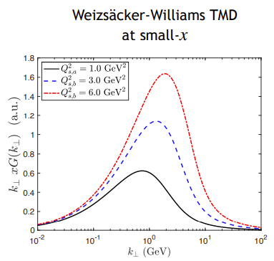
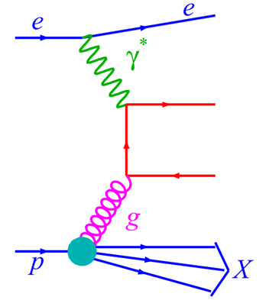
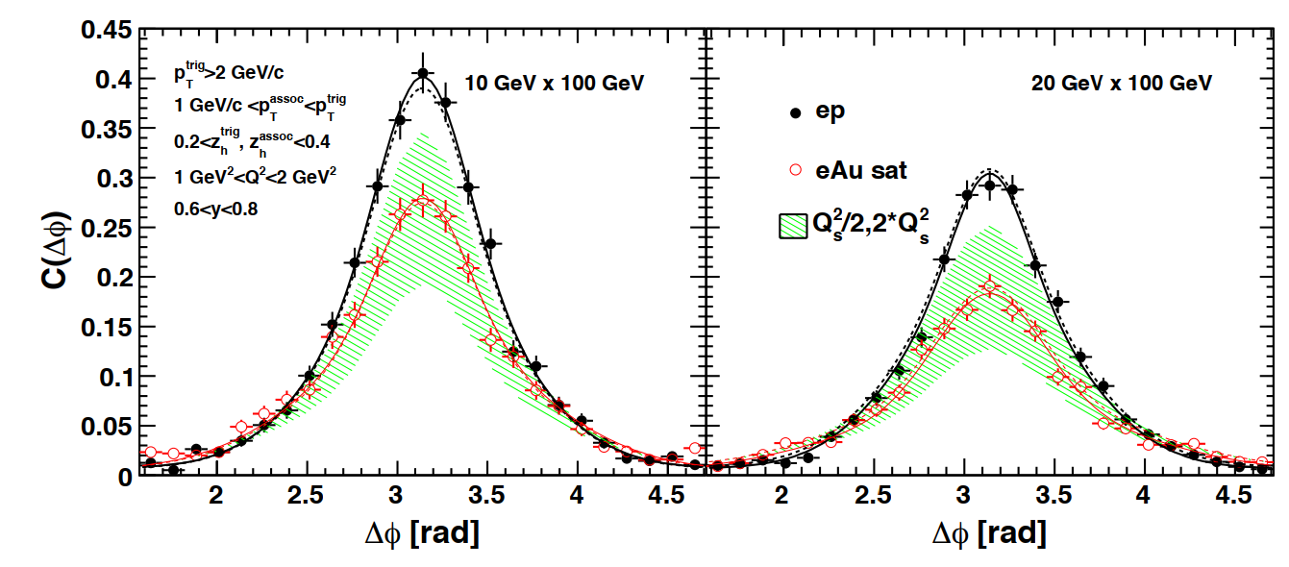
Dihadron production for gluon saturation
transverse plane
trigger
Δφ
associate
p_{T}^{trig}+p_{T}^{asso} ~ Q_{s}
Phys. Rev. D 89, 074037 (2014)
Back to back hadron pairs decorrelate
Strong suppression at away side predicted by saturation
Probe nuclei in k_{T} space.

Slide 2
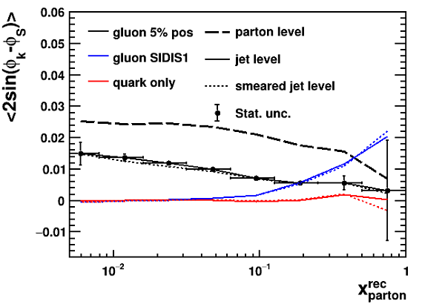
Dijet probe and its uncertainties
Sivers k_{T}
Strong suppression of gluon Sivers amplitude in dijet probe
Similar to saturation measurement, dijet momentum imbalance to reconstruct initial gluon k_{T}

Slide 3
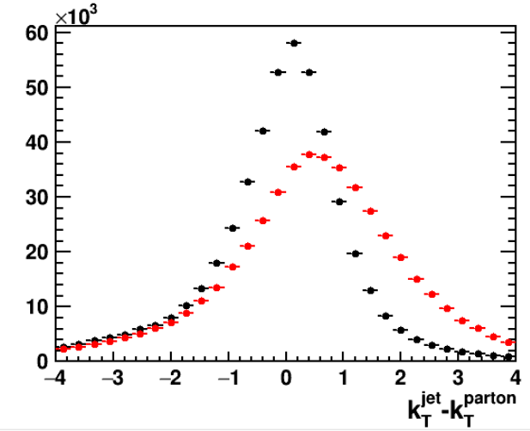
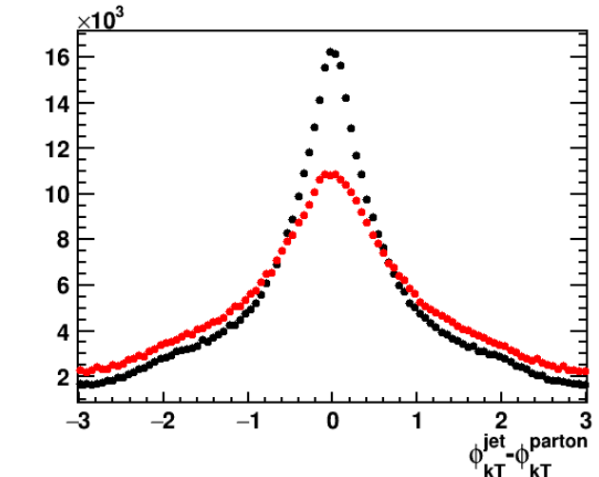
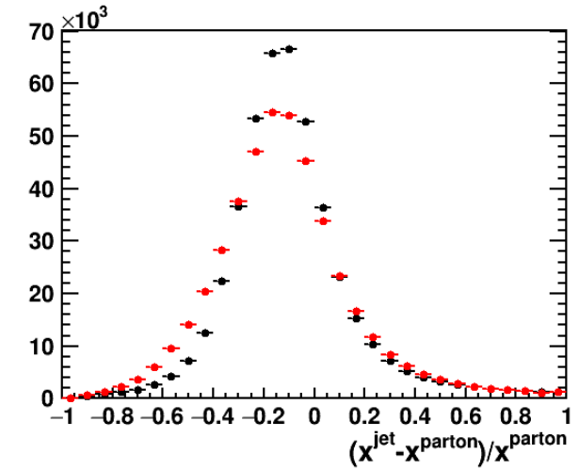
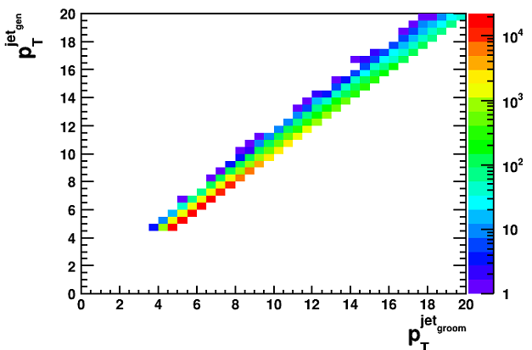
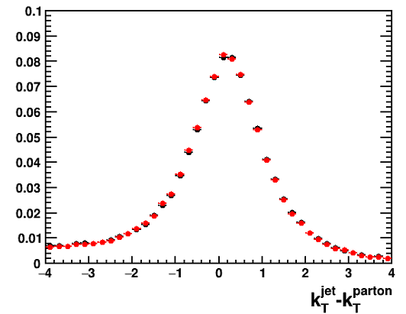
Dijet probe and its uncertainties
Escheme
WTA axis
Escheme
WTA axis
Escheme
WTA axis
WTA not improving dijet to parton k_{T} correlation
Soft-drop grooming weak impact on jet kinematics
Ungroomed
$$β=2$$

Slide 4
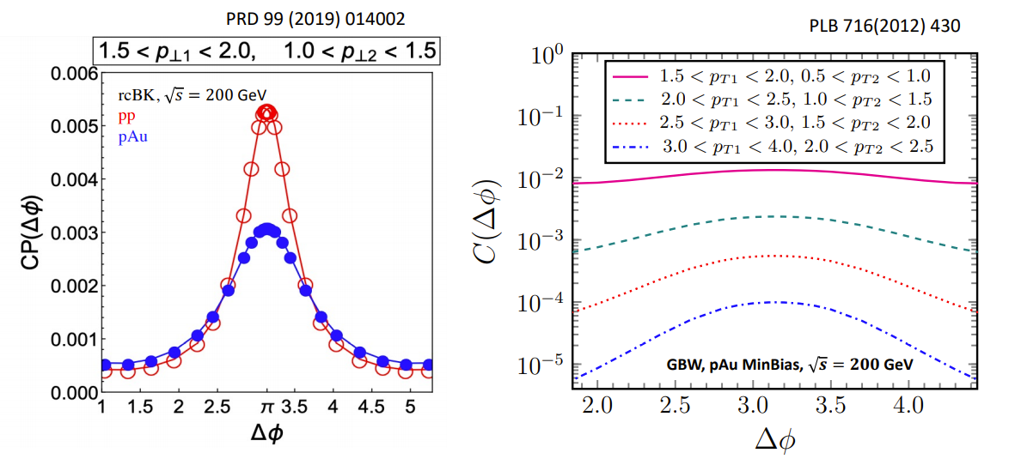
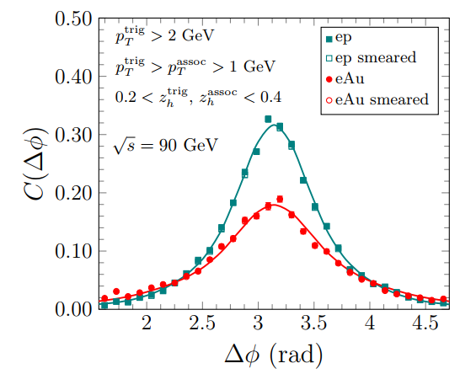
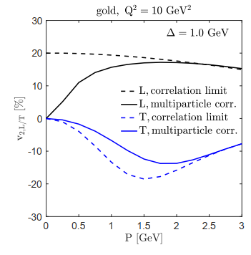
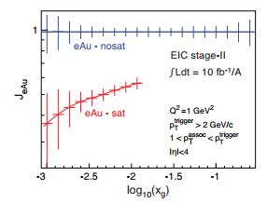
Outlook
GBW vs rcBK
PRL 124 (2020) 112301
Beyond correlation limit

