Slide 1
SIDIS Introduction
Marco & Anselm
8/18/2021

Slide 2
Physics Process | Key Measurement | Key Plots | Physics Message | Detector Performance Tests
SIDIS | Multiplicities of charged $π, K$ in $x,Q^{2},p_{⊥},z$ | Coverage orr projected statistical uncertainties for asymmetries (maybe compared with theory uncertainties) in $x,Q^{2},p_{⊥},z$ | Athena has a large lever arm, extends in previously unmeasured region | PID at high$p_{T}$(in particular in the barrel). If we include areas where kinematics have to be reconstructed with hadronic methods→Detector hermiticity
Sivers & TMD evolution | Azimuthal asymmetries of charged $π$ (could also do kaons, but theory models lacking) | Impact plots or experimental uncertainties vs theoy uncertainties. Plots vs $k_{T}$ for different $x$ bins | Lever arm in $Q^{2}$. This is a must-do measurement, so we should show that we can do it well. | Using existing models, our studies show that the impact of moderate energies (e.g. 10x100) is largest. So no particular detector performance requirements. If one shows projected uncertainties, then coverage, similar as plot above can be showcased.
Sea quark helicities | $A_{LL}$ for charged kaons | Impact on sea quark helicities (similar as previous publication) | Very high impact on sea quark helicities | PID, $x−$coverage
Suppression in eA | Di-hadron, di-jet correlations | Suppression vs $x$ | One of the key measurements on saturation | Coverage, tracking precision in the backward direction

Slide 3
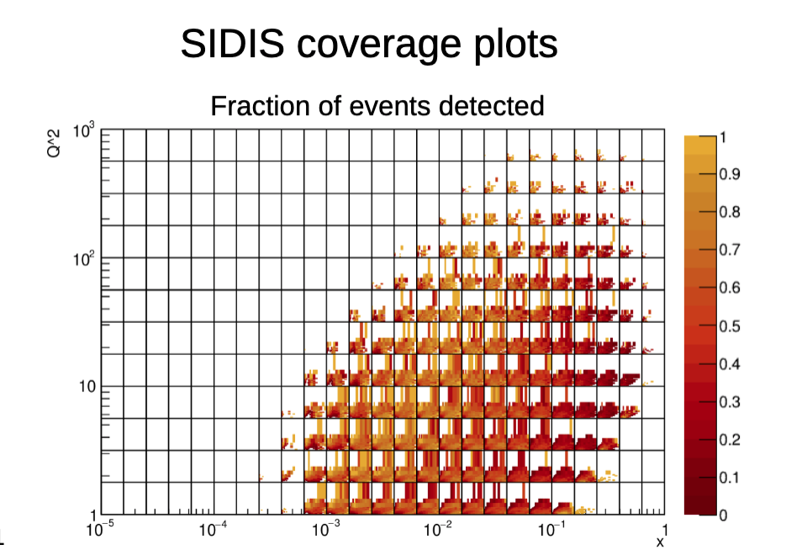
Action Items
Discussion of Kinematic Coverage Plot
Impact of crossing angle on observables
E.g. helicity in $A_{LL}$
*Analyze full simulations*
Still need to discuss observable for saturation observable

