Slide 1
Athena DAQ WG report
EICUG Meeting August 4th, 2021
Conveners:
Jeff Landgraf (BNL), Alexandre Camsonne (JLAB)

Slide 2
Athena DAQ Overview
Clock Distribution
(Front End Boards
on/near detector)
Front End Processors
(Electronics in DAQ room)
DAQ Network /
Computing (COTS)
Tape (SDCC)
Detector
Front End Boards
(on/near detector)
Detector
Front End Boards
(on/near detector)
Detector
(etc…)
We envision a triggerless streaming DAQ system following the outline described in the Yellow Report

Slide 3
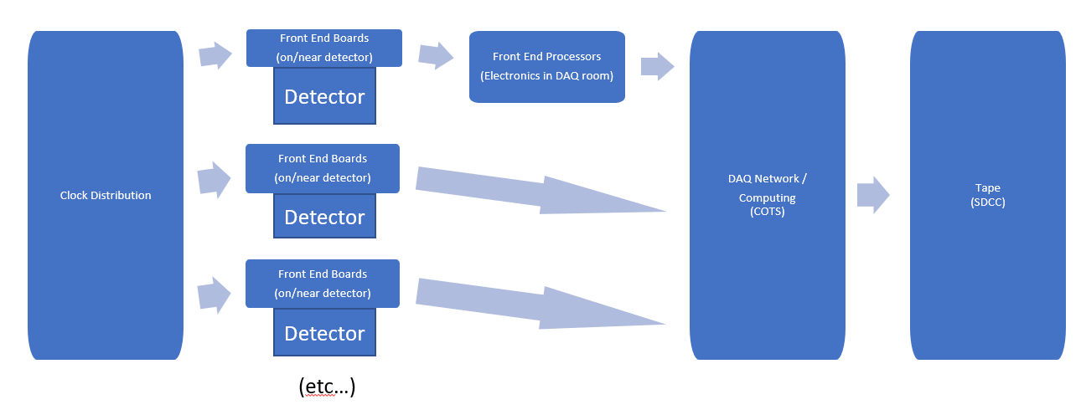
Clock Distribution:
Function:
Distribute a synchronized clock,
Synchronize detector timing with bunch structure,
Tag data with BX to synchronize detector data
share other information between detectors
bunch polarization
“prescaling”
Promising Technology:
lpGPT ecosystem
Attainable specs:
100Mhz clock rate (variable within reasonable parameters due to beam energy)
~5ps clock jitter

Slide 4
Front End Boards (FEB)
The collider performance:
~500KHz of collisions
~15M tracks per second
~60-100Gbps zero suppressed data
~15 KB/event
~100 bytes/bunch crossing
The Athena Detector current baseline:
More than 500M channels
Challenging data compression scheme
Noise reduction
Zero suppression
Background elimination
Detector | Readout Technology | Channel Count
Silicon Tracking | Si MAPS | 200M
GEM/MMG Layer | GEM | 217K
Cylindrical MPGD * | GEM | 60M? (calculated from baseline)
HP-DIRC | MAP/MT | 100-330k
ECAL | SiPM | 1.7K
HCAL | SiPM | 24K
HCAL imaging | Si MAPS | 480M
dRICH | PMT/SiPM | 350K
mRICH | PMT/SiPM | 330K
B0 | Si MAPS | 32M + 320K
Off-Momentum | AC-LGAD (eRD24) | 750K
Roman Pots | AC-LGAD (eRD24) | 500K
ZDC | LGAD + ASIC eRD27 | 225+366
TOF | AC-LGAD | 15M

Slide 5
Front End Processors (FEP):
Consist of:
FELIX boards
Crates with FPGA based boards (ATCA, open VPX)
Function:
Aggregation of links from the FEBs
Data Compression
Event finding / selection
For processing there are tradeoffs:
Pro
Low Latency
Deterministic timing
Well suited to Neural Nets / ML Algorithms
Cons
Harder to program and adapt than CPUs
Quickly become obsolete

Slide 6
DAQ Network and Computing:
Consists of:
Commercial Off-the-shelf Hardware / Networks
Function:
Final data compression
Format and transport data
System control and configuration
Event Selection and tagging, tracking and accounting
High Level Trigger
Scalers, counters databases
QA
System control and configuration
Strongly Advocate for a streaming model which
Builds events as early as possible

