Slide 1
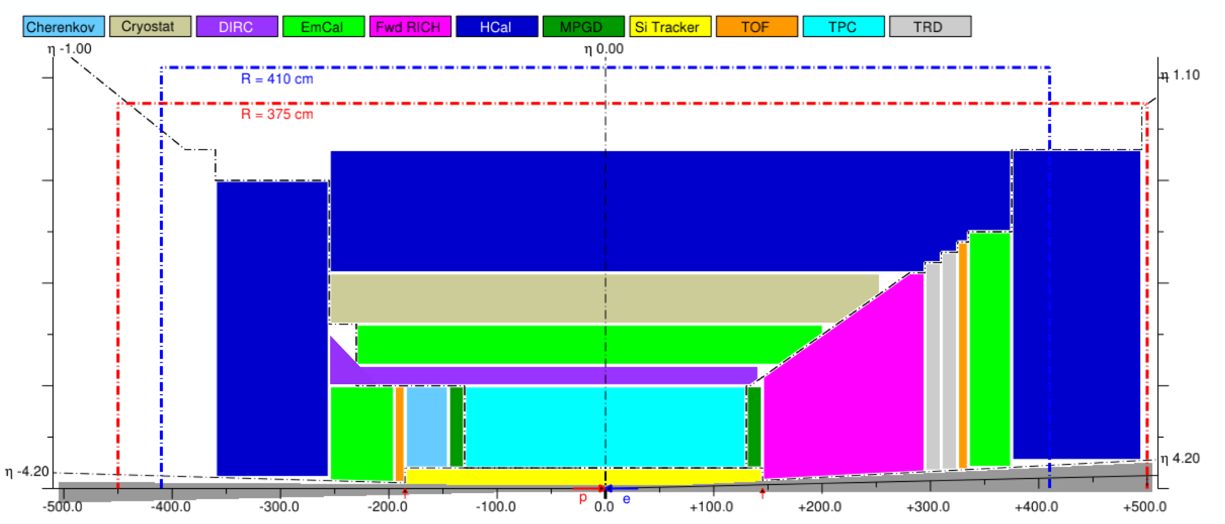
Open Calorimetry Tasks.
Barrel Hcal and nHcal need to be optimized.
The main functionality of these two detectors is to identify neutral hadrons.
Thick magnet coils beween bEMCal and bHCAL. Sufficient to instrument about 2 interaction length only for bHCal.
Both HCals implemented in dd4hep as a sandwich 2 cm thick Fe, 5 mm thick Sc.
Granularity 10 cm x 10 cm.
Single particle data files were generated
cHCal TBD
nHCAL
TBD
ANL
We need to figure out how many layers in Hcals sufficient for ‘good’ (need to be defined) identification of neutral hadrons.
plot efficiency of identification of NH vs number of layers
vs thickness of layers, i.e. 2 cm Fe, 4 cm Fe <- Cost reduction
study dependency of efficiency vs registration threshold. <- Requirements on LY
find optimal method of combining ECal and Hcal clusters for hadrons. (weighted sum)
Check reconstruction in dd4hep
Study effects of noise, digitization etc.
Please let us know if you are interested to work on this. Contact Paul, Vladimir or Oleg.

Slide 2
Barrel Calorimeter System
bECAL hybrid, Imaging layers + WScFi (GLUEX/KLOE type)
bHCal KLM Type. Re-using Sc. Tiles from STAR BEMC, and read each tile separately with SiPM.
Optimization need to be done for the whole system, for all probes we are interested.
Example e/h will benefit from better resolution of bECal which require large sampling fraction -> lead to smaller number of interaction length before coils. For jet measurements it will be better to have as ‘thick’ as possible Ecal -> small sampling fraction.
Granularity of WScFi section beyond imaging layers need to be optimized for neutral hadron pattern recognition/ shower separations.
Open Calorimetry Tasks. Barrel Calorimeters.
We want to design ATHENA calorimeters with ML/AI capabilities in mind. <- generally requires high granularity and segmentation, but this need to be optimized vs cost.

