Slide 1
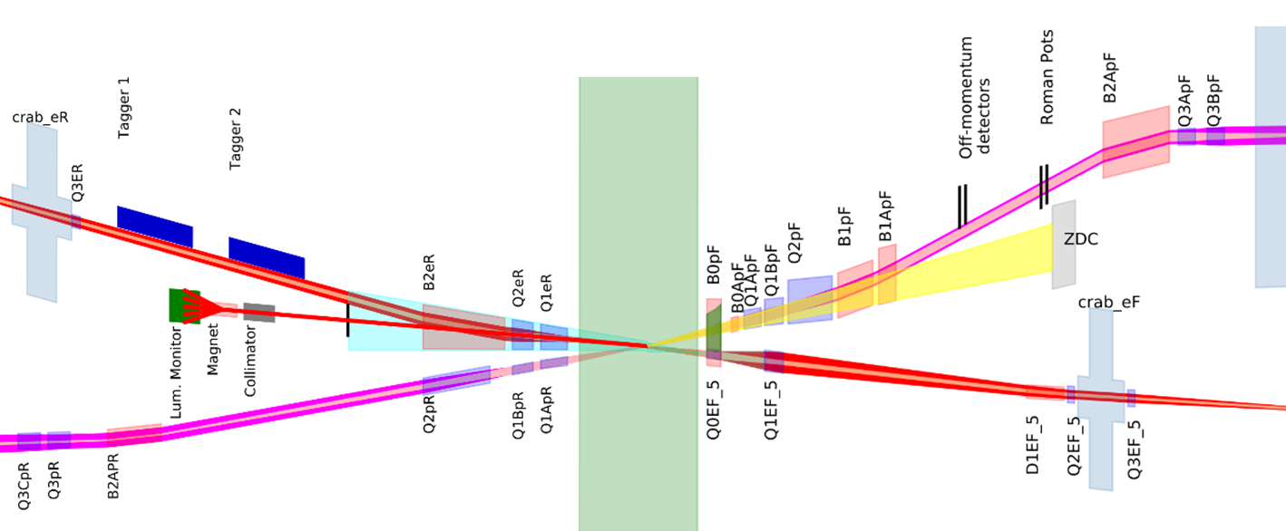
Interaction Region Overview
Hadrons
Electrons
Roman pots
(Complex chamber)
Low Q² taggers
(Beryllium windows)
Off momentum detectors
(Beryllium window)
SR absorber
Luminosity monitor
(Exit window TBD)
Forward spectrometer
(Thin wall exit window)
Rear cryostat
Forward cryostat

Slide 2
Interaction Region (1:1 Scale)
10.1m
9.5m
17.5m
Central detector chamber
Rear cryostat
Hadron rear chamber
Hadron forward chamber
Forward cryostat
Central detector
Hadrons
Electrons

Slide 3
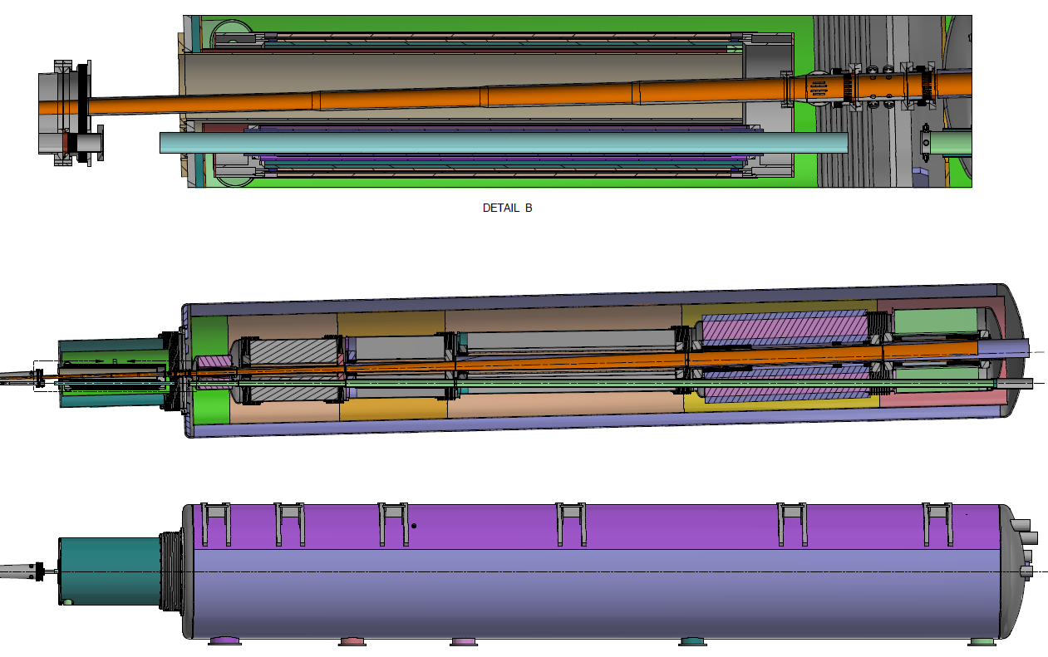
Forward Side Cryostat (1:1 scale)
Hadrons
Electrons
Q0eF
B0ApF
Q1ApF
Q1BpF
Q2pF
B1pF
B1ApF
B0pF
Q1eF
Q0eF
Atmosphere
BPMs
+/- 1.3GeV

Slide 4
Electron Beam Pipe
Electrons
D2eR
Q2eR
Q1eR
Detector
Q0eF
Q1eF

Slide 5
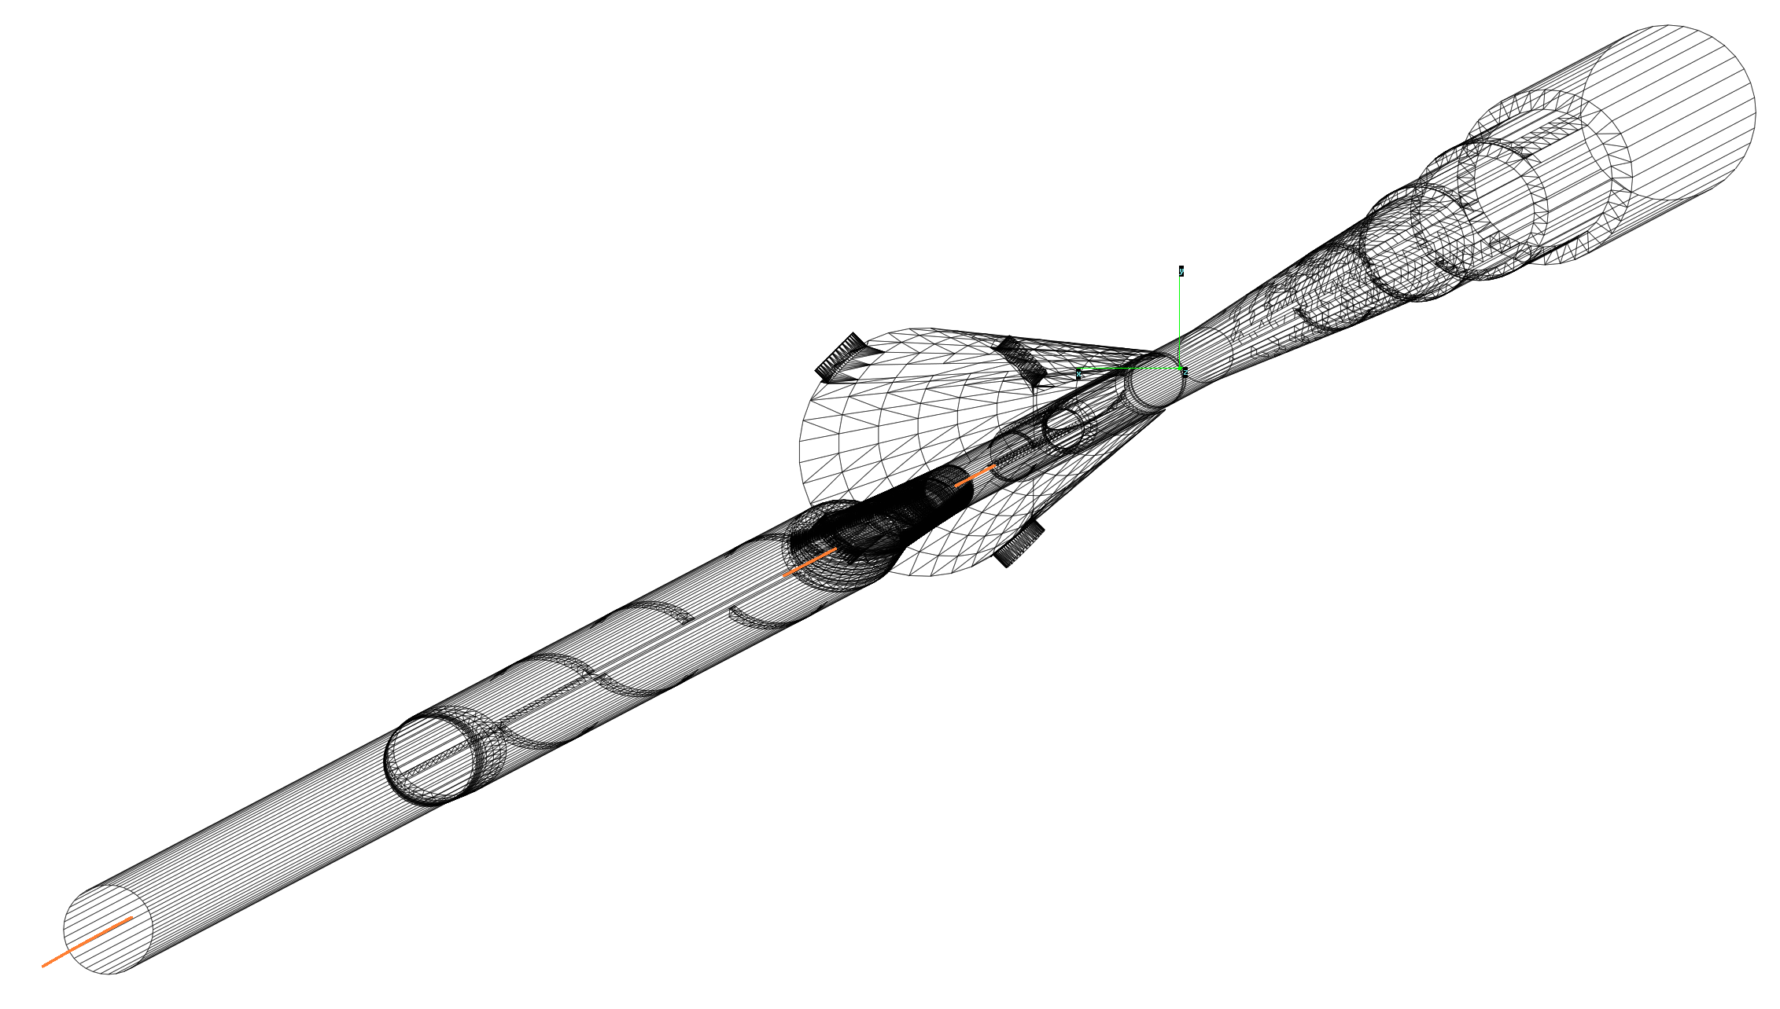
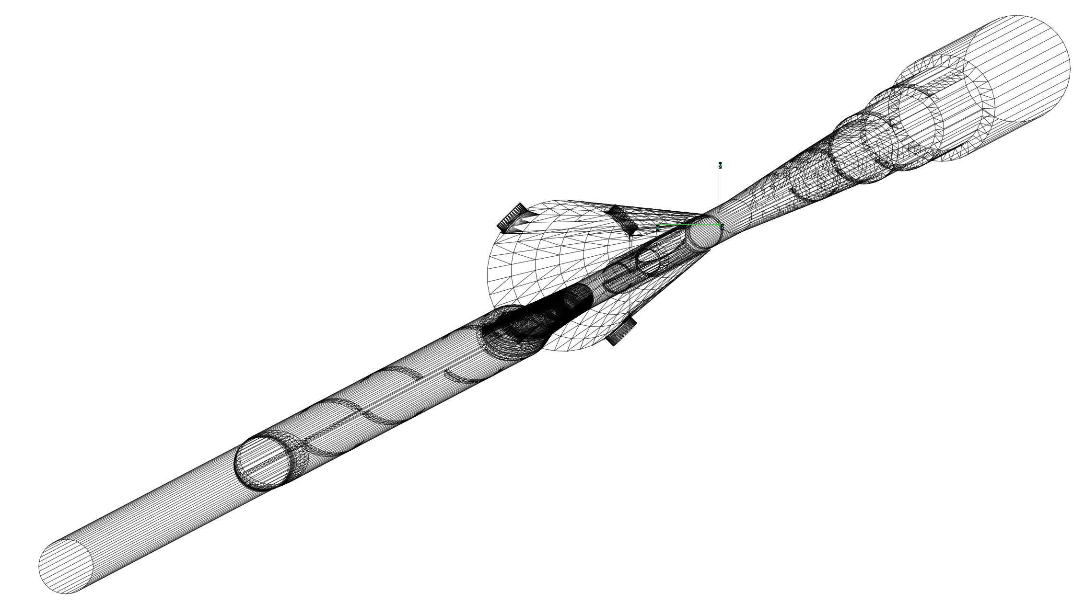
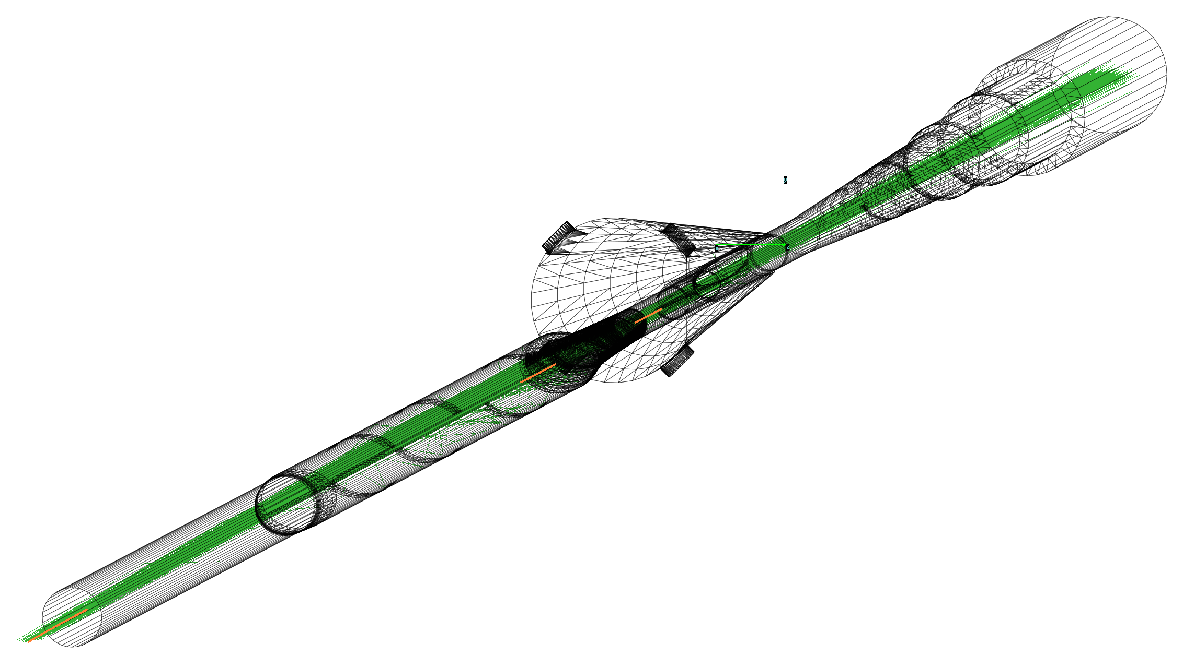
SynRad
Import geometry
Define surface materials
Setup textures and facet properties
Generate random seeds
Ray trace to determine interactions
Setup magnetic regions
Input lattice parameters

Slide 6
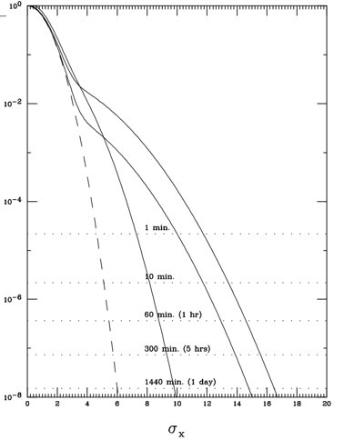
Synchrotron Radiation Studies -10 GeV High Divergence
SYNC-BKG (M. Sullivan)
10keV photons hitting beryllium
1.93e⁵ ph/crossing ~ 1.75x10¹³ ph/sec
SynRad (C. Hetzel)
10keV photons hitting beryllium
2.64x10¹³ ph/sec
Q1eF
SYNC_BKG
15σ beam tails
Double Gaussian
Core (90%)
Tails (10%)

Slide 7
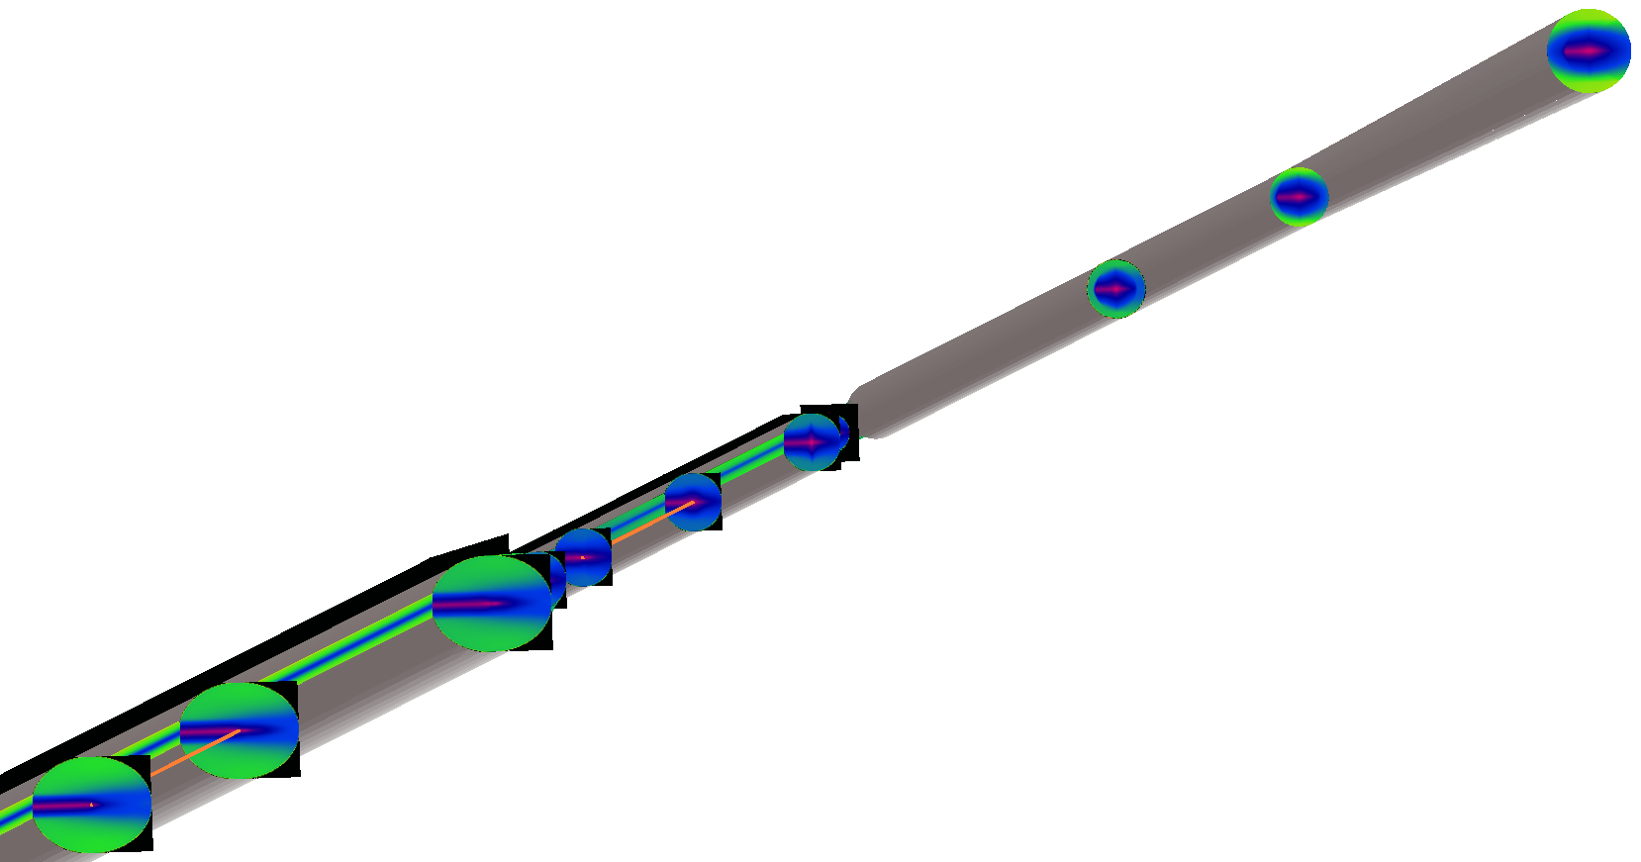
Background Studies
Detector exit (+4.5m)
End of beryllium
Virtual photons imported into Geant4
Start of beryllium
Dipole fan hitting chamber wall
Q1eF
Q0eF
Dipole fan hitting chamber wall

Slide 8
Heat Load in Cold Magnets
-5.00m
-5.00m
-7.00m
-7.20m
-10.76m
-12.37m
-22.50m
-7.50m
Detector
Q0eF
Q1eF
95W
9W
810W
80W
290W

Slide 9
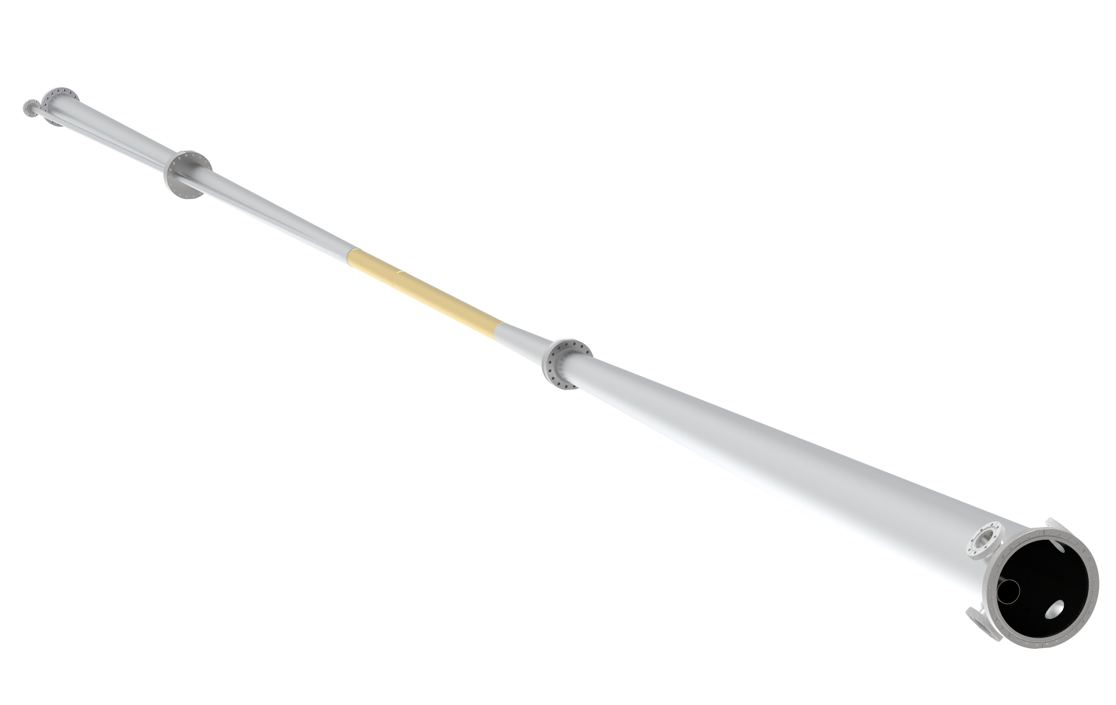
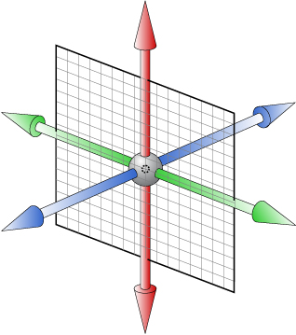
Electrons (+z)
Only includes front side magnets (Q0eF, Q1eF, D1eF)
Hadrons
D1eF
Central beryllium section
+y
Facet 22138 (φ = π )
Total flux = 1.10x10¹⁵ photons/sec
>5keV : 4.11x10¹³ photons/sec
+z (e beam)
+x
Hadrons
Electrons
Interaction Point
(0,0,0)

Slide 10
Electrons
φ = 0
Photons > 10eV
φ = π
Total Flux: 1.7x10¹⁶ ph/sec
Power absorbed: 1.6W
φ = 2π
z = 0.8m
z = 0.0m (IP)
z = -0.67m
φ = 0
Photons > 5keV
φ = π
Total Flux: 2.7x10¹⁴ ph/sec
Power absorbed: 0.3W
φ = 2π

Slide 11
eR IP1
FPA
eF IP1
eF IP2
eF IP3
eF IP4
eF IP5
Detector
Q0eF
Q1eF
10GeV, 2.5A, 100 Ahr
Final photon absorber
No pumps in cryostat
+5/-15m Avg: 1.5e-7
+4.5/-5m Avg: 3.5e-8
All pumps on
+5/-15m Avg: 3.4e-8
+4.5/-5m Avg: 2.9e-8

Slide 12
eR IP1
FPA
eF IP1
eF IP2
eF IP3
eF IP4
eF IP5
Detector
Q0eF
Q1eF
10GeV, 2.5A, 10,000 Ahr
No pumps in cryostat
+5/-15m Avg: 1.3e-8
+4.5/-5m Avg: 3.3e-9
Final photon absorber
All pumps on
+5/-15m Avg: 3.0e-9
+4.5/-5m Avg: 2.7e-9

