Slide 1
Background Sources we need to consider
Elke-Caroline Aschenauer (BNL)
Co-Associate Director for the
EIC Experimental Program

Slide 2
Lessons from HERA II upgrade
HERA performed an upgrade to increase luminosity by a factor of 5
Mainly by squeezing the beam more at the IP by redesign of the IR
The upgrade increased backgrounds dramatically → Several month shutdown to implement improvements
Main culprits:
no careful simulations prior to the upgrade
Proton beam-gas interactions most severe background
Needed an extremely good vacuum to mitigate this
Synchrotron radiation background
Background to detectors
Excess heating of beam pipe
Can damage flanges, etc.
Can heat beam pipe, decreasing vacuum
Electron beam-gas

Slide 3
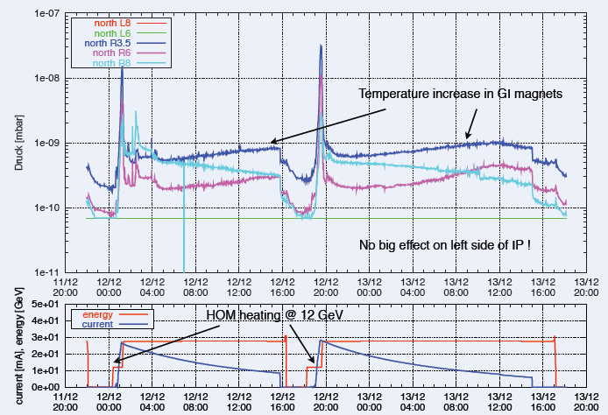
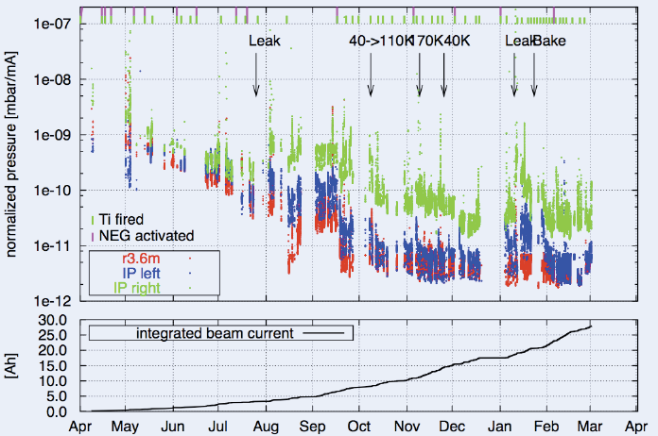
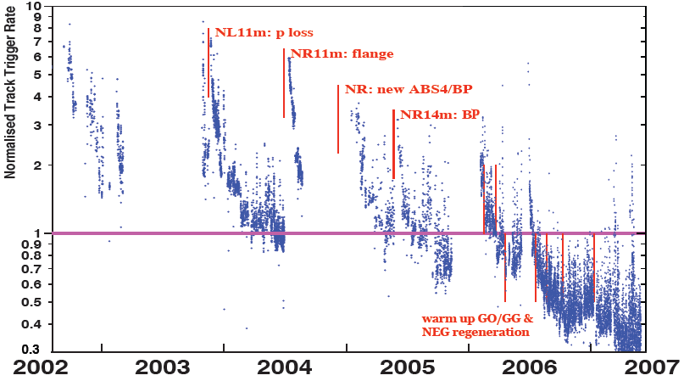
Lessons from HERA II upgrade
Dynamic pressure increase due
to thermal and photo desorption
Pressure vs. integrated electron
current 2002 - 03
Proton Beam Gas Background
Two time constants for vacuum
conditioning
Short term after leaks 20 – 30 days
Long term 600 days

Slide 4
Beam Background / Radiation at IR
The HERA and KEK experience show that having backgrounds under control is crucial for the EIC detector performance
There are several background/radiation sources :
primary collisions
beam-gas induced
synchrotron radiation
Note:
different to HERA and KEK the length of beam pipe the hadron and electron beam share is thanks to the crossing angle minimized compared to colliders with no crossing angle
GEANT4

Slide 5
Beam Background / Radiation at IR
Both beams
Touschek scattering is related to intra-beam scattering, leads to particle loss, and hence a reduction in the beam lifetime → simulated by accelerator colleagues → design of momentum collimators
Touschek: Single-scattering IBS, so to speak. Transfer of transverse momentum, from the transverse focusing, into the
longitudinal direction when two electrons scatter off each other. The resulting longitudinal momentum exceeds the bucket height.
Electron beam:
Synchrotron radiation
Backscattering → photon absorber design after IR → Do we need photon masks after IP?
→ continued refined simulations
Photo desorption
→ degradation of vacuum
Beam gas interactions
Off momentum electrons → will be shielded by collimators → simulations underway
generation of non-gaussian tails → accounted in accelerator simulations
Bethe-Heitler photons all along z
→ J. Adam is looking into it now with the new info from the 0.5 m shift
Higher order mode losses
Local heating at injection and ramp (short bunches) → not relevant for EIC
→ degradation of vacuum
background due to de-excitation of beam if bunches are replaced
There should be “no” background for the experiment as the idea is to shave off the electron tails beyond 6 sigma in the transfer line. If one injects on orbit and on energy (with reasonable errors) in one sigma also to keep the protons happy, a 6 σ beam would always be well within the apertures of 13/23 σ.
GEANT4

Slide 6
Beam Background / Radiation at IR
proton beam:
Low beam lifetime during injection and ramping → collimator setup → simulation by accelerator colleagues
Beam gas interactions, large hadronic cross section
Secondary interactions with aperture limitations, i.e. with magnets, beam pipe, masks
Beam-gas interactions are one of the main sources of neutrons that thermalize within the detector hall and can cause damage.
Vacuum pressure | 10⁻⁹ mbar
Beampipe temperature | Room temperature
Average atomic weight of gas | Hydrogen (H²)
Molecular density (for 10 m pipe) | 2.65 x 10¹⁰ molecules/cm²
Luminosity (Ring-Ring) | 10.05 x 10³³ cm⁻²s⁻¹
Bunch intensity (R-R) (e/p) | 15.1 / 6.0 x 10¹⁰
Beam Current (R-R) (e/p) | 2.5 / 1 A
Bunch spacing (Ring-Ring) | 8.7 ns → 1320 bunches
ElectronxProton beam energy | 10 GeV x 275 GeV
Ring-Ring :
DIS-event rate: 600 kHz
Beam-gas event rate: 9.818 kHz in 10m
Need to re-analyze the effect of the following assumptions:
Use the realistic beam pipe
What is the gas density profile
detector acceptance for BG-events?
Need vacuum profile for proton beam only pipe → start from RHIC
→ Zh. Zhang is looking into an update using this updates

Slide 7
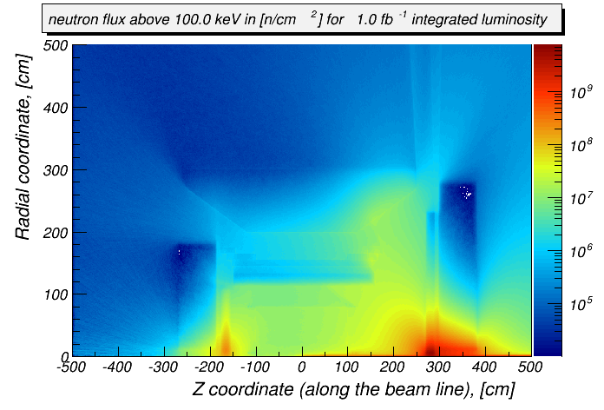
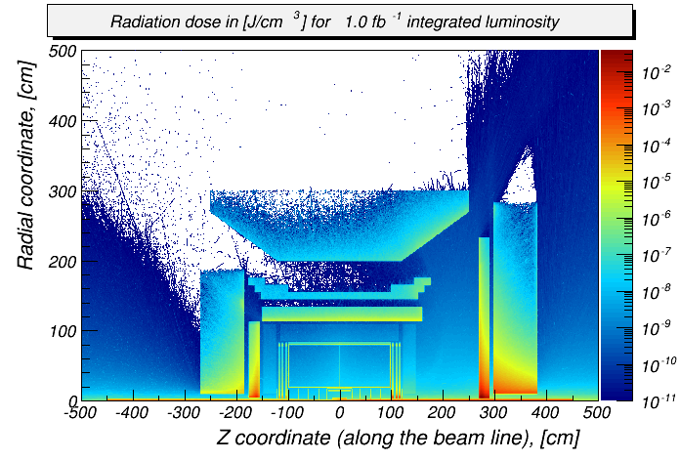
Beam Background / Radiation at IR
Primary collisions contribute a substantial fraction of the ionizing radiation and low energy neutron fluence in the experimental hall
→ forward EmCal: up to ~5*10⁹ n/cm² per fb⁻¹ (inside the towers); perhaps ~5 less at the SiPM location
→ backward EmCal: ~250 rad/year
(at “nominal” luminosity ~10³³ cm⁻² s⁻¹)
These studies need to be redone for the specific detector designs
be careful with GEANT-4 version some underestimate low energy neutron production → ask EIC-UG SW group for guidance
Validation: Yuri Fisyak et al. NIM A 756 (2014) 68-72, arXiv:1310.2495

Slide 8
Summary
Please remember everything needed by the collaborations to do simulations discussed here is posted at https://indico.bnl.gov/event/10974/contributions/
there are specific sub-links for IP-6 and IP-8
Beam parameters you need for simulations are in the CDR (Tables 3.3 to 3.5) https://www.bnl.gov/ec/files/EIC_CDR_Final.pdf

Slide 10
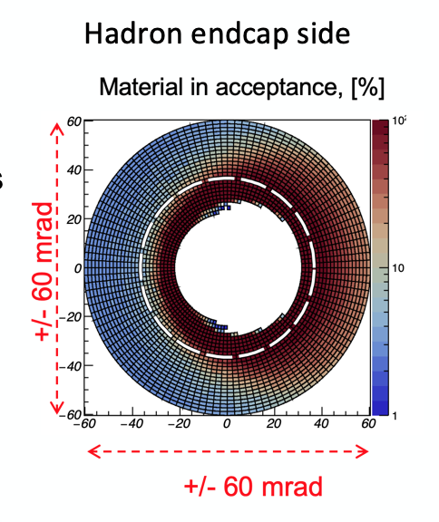
Tracking/Material Budget
Vertex + central + forward / backward tracker layout ( moderate momentum resolution, vertex resolution ~20 μm)
At most 3T central solenoid field (maximize B*dl integral at high |η|)
Low material budget
Minimize bremsstrahlung and conversions for primary particles
Improve tracking performance at large |η| by minimizing multiple Coulomb scattering
Minimize the dead material in front of the high resolution e/m calorimeters
Central area of beampipe (around IP):
~1.5m of beryllium to minimize multiple scattering for low Pt particles
Low-mass exit window for far-forward particles
Few % radiation length material thickness for the required angular range (low angle)

Slide 11
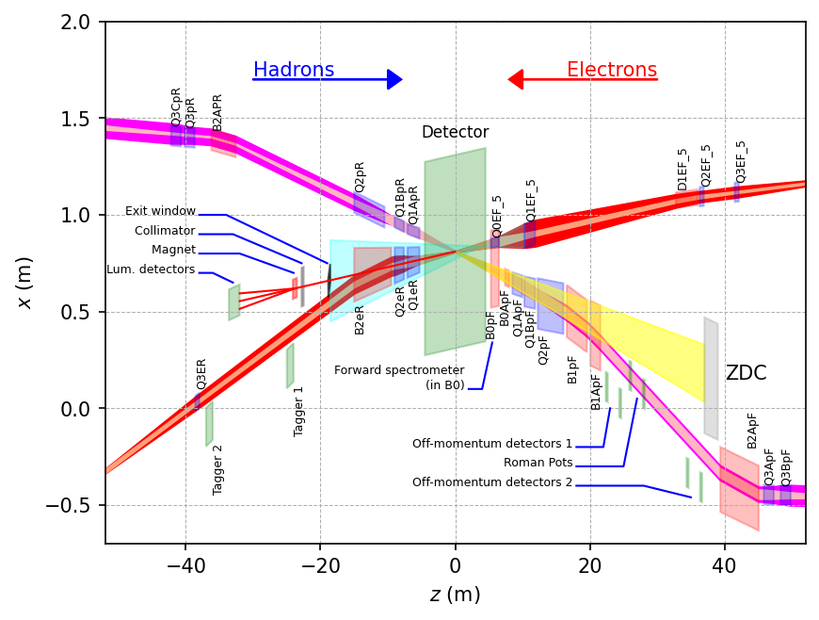
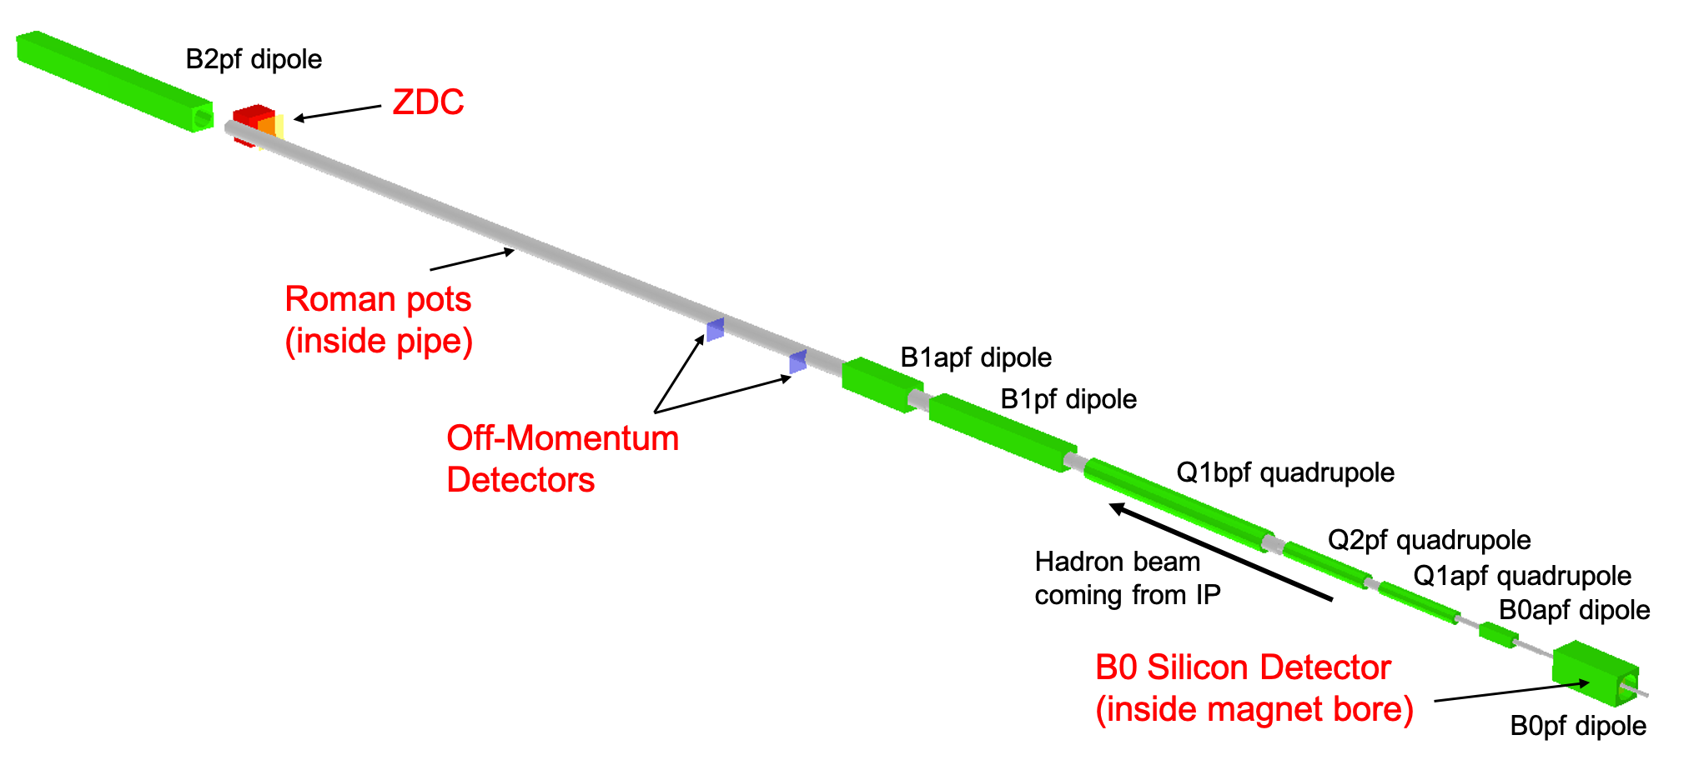
Far forward (hadron going) region
$$x_{L}=\frac{p_{z, nucleon}}{p_{z, beam}}$$
Detector | Angular accept. [mrad] | Pt coverage
ZDC @ ~30m | $θ$<5.5 ( $η>6)$ | pT<1.3 GeV
Roman Pots | 0*<$θ$<5.0 ( $η>6)$ | *Low pT(t) cutoff (beam optics)
Off-Momentum Detectors | 0.0< $θ$ < 5.0 ( $η>6)$ | Low-rigidity particles from nuclear breakups
B0 forward spectrometer | $$5.5<θ<20.0$$ (4.6< $η<5.9)$ | High pT(t)
p/A
IP

