Slide 1
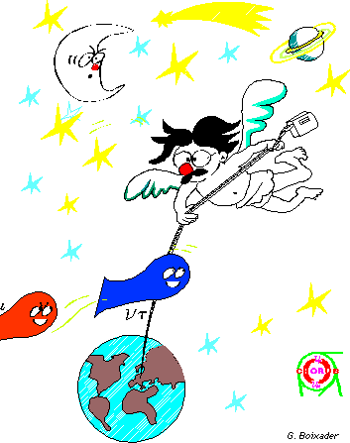
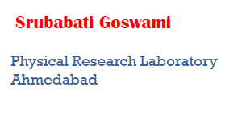
Global Picture of Neutrino Oscillations

Slide 2
Neutrinos in the limelight

Slide 3
Golden Era of Neutrino Physics
The results could be explained by dominant two flavour oscillations

Slide 4
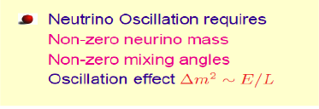
Neutrino Oscillations
If neutrinos have mass then
Two-Flavours
Not sensitive to the sign of
Not sensitive to the octant of
Not sensitive to the absolute masses

Slide 5
MSW effect
For antineutrinos the potential
changes sign
Resonance occur for
Matter effect is sensitive to the ordering of the mass states

Slide 6
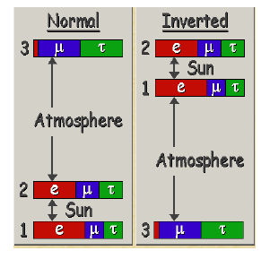
Three neutrino oscillation parameters
3 masses, 3 mixing angles, 1 phase
Interplay among different sectors
because of

Slide 7
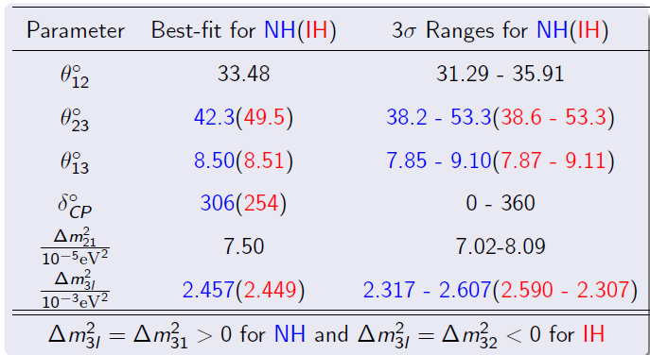
Status of oscillation parameters (2014)
No hierarchy sensitivity
Gonzalez-Garcia Maltoni Schwetz
JHEP 11 (2014) 052[arXiv:1409.5439]

Slide 8
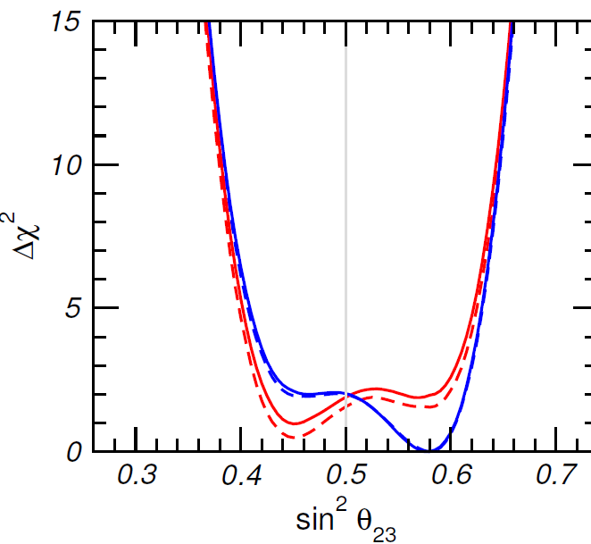
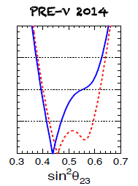
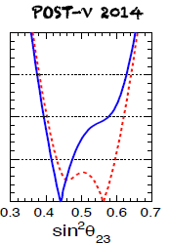
Status of (2014)
Nu-fit 2014
Forero et al 1405.7540
Capozzi et al. 1312.2878 1312.1878
Global best-fit at 2nd octant and IH
NH and IH separate fit
NH and IH separate fit
Best-fit at 2nd octant for both NH and IH
NH : local best-fit at 1st octant
Best-fit in 2nd octant for IH post Neutrino 2014

Slide 9
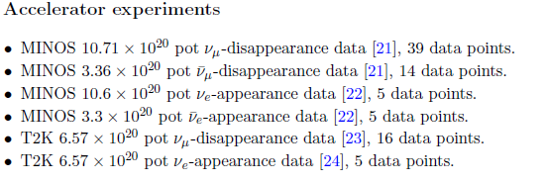
Data set included in Global Analysis

Slide 10
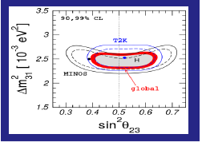
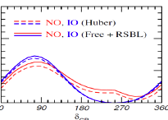
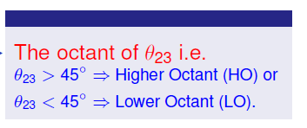
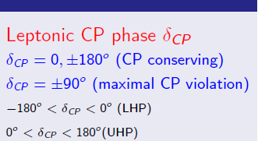
The unknowns
A non-zero value of crucial for all three

Slide 11
Measurement of
Latest Daya Bay Result
=0.084±0.005
Phys. Rev. Lett. 115, 111802
See talk by S. Wagner NNN15

Slide 12
Global Picture of
Slide Coursey: S. Jetter

Slide 13
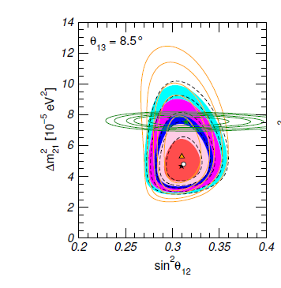
Current Status of Solar Parameters
The best-fit value of from KamLAND lies above that of solar
effect
controlled
by KamLAND
controlled
by solar
Gonzalez-Garcia
Maltoni Schwetz
JHEP 11 (2014) 052
Absence of low energy spectrum turn up of
spectrum as expected in LMA MSW
The indication of a non-zero day-night asymmetry in SuperKamiokande

Slide 14
Impact of non-zero
For solar and KamLAND prefer
different values of
For solar prefer higher
KamLAND prefer lower
Impact of non-zero
best-fit from solar andKamLAND
lies at the same value
Gonzalez-Garcia
Maltoni Schwetz
JHEP 11 (2014) 052

Slide 15
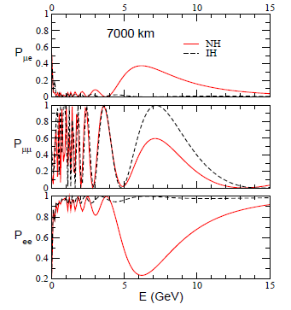
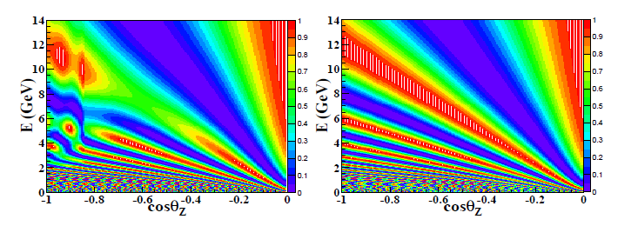
Three generation effect in Atmospheric Neutrinos
Matter effect starts becoming visible : Resonant enhancement of
Large matter effects for both and
Hierarchy Sensitivity
Oscillogram

Slide 16
Three generation effect in atmospheric neutrinos
For the 1-2 sector
gives excess while 1-3 sector gives
depletion
Peres and Smirnov , 2004
and
Gonzalez-Garcia, Maltoni,Smirnov, 2004

Slide 17
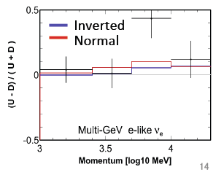
Three Generation analysis of SuperK data
Fixed
NH-HO
Driven by excess of upward going electron events
Mainly from SK-IV data
weakly favoured
See talk by M. Ikeda NNN15
J. Kameda, NuFact 2015

Slide 18
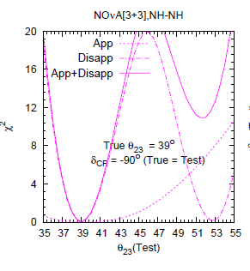
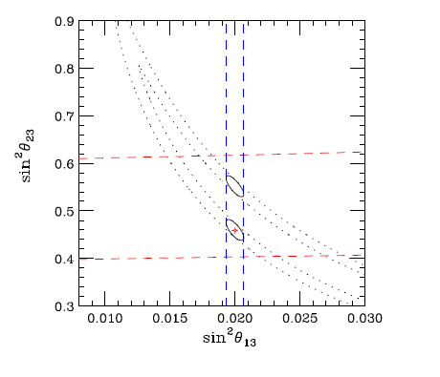
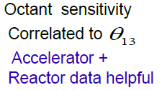
Three generation effect in Accelerator Neutrinos
Synergy between appearance and
disappearance channel
Octant Sensitivity
Coloma, Minakata, Parke, 2014

Slide 19
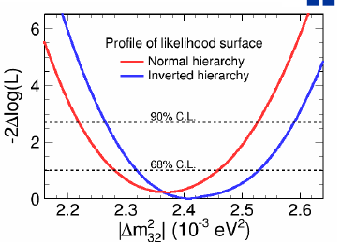
Three flavour oscillation analysis : MINOS
Full three flavour analysis combining appearance and disappearance data
Also included atmospheric neutrino data
IH-LO
Combined analysis improves
Previous constraints
See talk by L. Whitehead NNN15

Slide 20
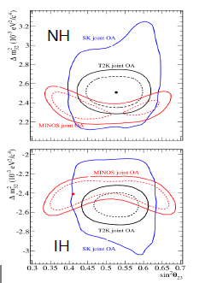
Three flavour oscillation analysis: T2K
Weak preference for Normal Hierarchy and HO
Best Precision for
See talk by T. Hiraki NNN15

Slide 21
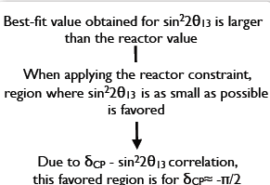
Hint of from T2K data
First hint for from T2k data
Using only 8% of proton on targets
L. Escudero, ICHEP 2014

Slide 22
Global Analysis 2015
See talk by A. Sousa NNN15
*LID (Likelihood Identification) = primary NOvA analysis
LEM (Library Event Matching) = alternative NOvA analysis
Frequentist Method using a statistics
Capozzi, Lisi& Marrone (Univ. & INFN, Bari)

Slide 23
Global Analysis 2015
Capozzi, Lisi& Marrone (Univ. & INFN, Bari)
E. Lisi, VLVNT_2015

Slide 24
Global Analysis 2015
E. Lisi, VLVNT_2015
Capozzi, Lisi& Marrone (Univ. & INFN, Bari)

Slide 25
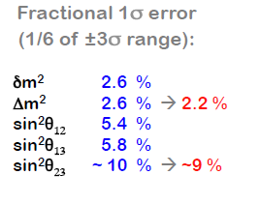
Known Parameters (2015)
E. Lisi, VLVNT_2015
Capozzi, Lisi& Marrone (Univ. & INFN, Bari)

Slide 26
sensitivity of T2K and Feldman-Cousin intervals
Wilkes theorem does
not hold good for
Non-linear dependence of
event rates on
Parameter degeneracy
Standard confidence
level definitions do not hold good
Monte Carlo simulation of data
to determine the FC confidence
intervals
Elevant
Schwetz
1506.07685
Large deviations from the Gaussian limit, depends on true hierarchy, ,
disfavoured at 2-3
Stronger rejection of as compared to Gaussian approximation

Slide 27
Bayesian vs Frequentist
NORMAL ORDERING
Gonzalez-Garcia
Maltoni Schwetz
arXiv:1507.04366

Slide 28
Results of Bayesian Analysis
Gonzalez-Garcia
Maltoni Schwetz
Determination of four parameters robust against statistical analysis
arXiv:1507.04366

Slide 29
Bayesian Analysis of
NO
IO
Bayesian analysis prefers the second octant more for NO
Gonzalez-Garcia
Maltoni Schwetz
arXiv:1507.04366

Slide 30
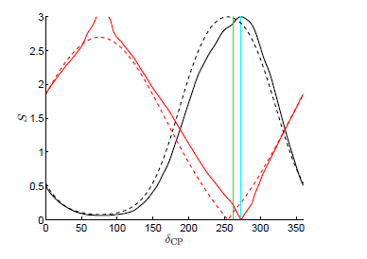
Bayesian analysis and
NO
IO
Marginal and Profile Likelihoods have
maxima at the same value of
Bayesian Analysis prefers larger
Gonzalez-Garcia
Maltoni Schwetz
arXiv:1507.04366

Slide 31
Future Projections
Topics Not covered
Systematic Uncertainties : Review Talk by Pilar Coloma NNN15
Sterile Neutrinos : Review Talk by C. Giunti, NNN15

Slide 32
Future determination of hierarchy, octant and
Current Generation Superbeam Experiments
NOvA : FNAL to Ash River , 810 km, 1.7 GeV, 0.7 MW, 14 kt TASD detector
T2K : Tokai to Kamioka, 295 km . 0.76 GeV , 0.75 MW , Detector: SuperK
Next generation Superbeam experiments
T2HK: JPARC to Kamioka, detector: HyperK, 1.6 Mw
DUNE : FNAL-LEAD , 1300km, 0.7 MW, Detector 10 (34) kt LiqArTPC
ESS: European Spallation source Linac , configurations under study , 540 km, 2 GeV
Proton decay at rest experiments
DAE DALUS : low energy, low distance (50 MeV, 20 km)
Reactor Experiments
JUNO (China), RENO50 (Korea) , reactor neutrinos, 50 km
See talks by Z. Yu,J. Zhao, T. Kutter, NNN15

Slide 33
Future Atmospheric Neutrino Experiments
Magnetized iron detector
Talk by M. Naimuddin, NNN15
Volume : 50 – 100 kton
Excellent muon energy and direction reconstruction
Charge identification
Can determine the neutrino energy through hadron shower reconstruction
Example : INO
Cerenkov Detectors
Talks by H. Tanaka. T. Deyong , M. Jongen, Y. Highnight, Y. Nishimura NNN15
Sensitive to both muon and electron events
No charge id
Mega ton Water detector (HyperKamiokade, Memphys)
Multi Megaton ice detector (PINGU of ICECUBE )
Multi Megaton under water detector (ORCA)
Liquid Argon TimeProjection Chambers
Talks by S. Murphy, S. Dorota, NNN15
Sensitive to both electrons and muons
Execellent energy and direction reconstruction for both
Charge id ?
Example: DUNE

Slide 34
Degeneracy Menace
unknown
Eightfold degeneracy :
Known

Slide 35
General picture of degeneracy : post
Coloma,Minakata,Parke , 1406.2551
Ghosh,Ghoshal,Goswami,Nath,Raut, 2015
Eight possibilities
(different from the earlier eightfold
degeneracy)
In literature mainly discussed III, IV, VII
X
V is often part of IV because of
poor CP precision
X
VI intrinsic CP degeneracy also
connsidered by Minakata and Parke
arXiv 1303.6178

Slide 36
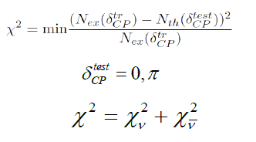
The diagnostics
Hierarchy Sensitivity
Theory marginalized
over relevant parameters (test)
Simulated Exptl data (true)
Octant Sensitivity
CP discovery

Slide 37
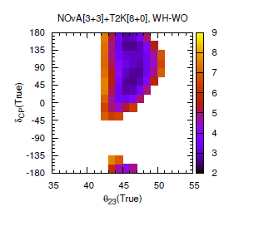
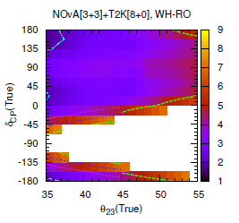
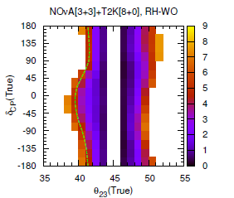
Degeneracies with T2K and NOVA
LHP
Contours in true plane (NH)
UHP
No degeneracy
No degeneracy
WH solutions for in UHP
WO solutions near
for the
whole range of
WH- WO solutions near
and in
UHP.
WH solution resolved at
for all for
More CP coverage for higher
G

Slide 38
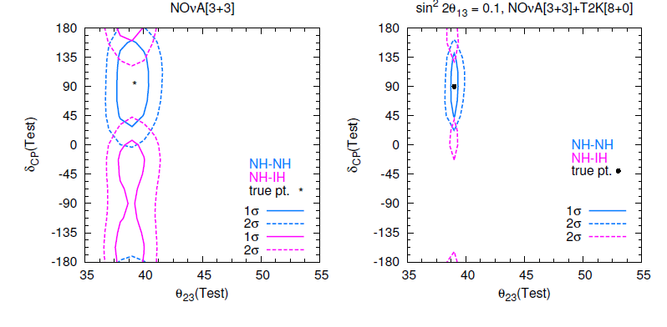
Removal of Degeneracy: Global Picture
Contours in test plane (NH)
WH-WO-RCP
WH-RO-WCP
WO-WCP solution is removed by combining neutrinos and antineutrinos
(since the neutrinos and antineutrinos have degeneracy for opposite octants)
WH solution is removed by adding T2K and NOVA
(different dependence on due to different baselines)

Slide 39
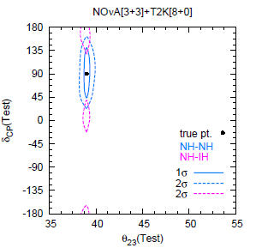
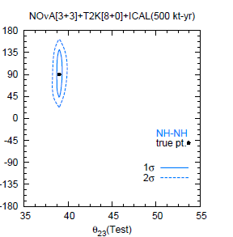
Removal of degeneracy : Global Picture
Contours in test plane (NH)
(10 kton)
WH –WCP solution removed by adding atmospheric data from ICAL
(matter effects break hierarchy degeneracies) (other atmospheric experiments/reactors)
Dune can remove WH and WO solutions at almost
(larger baseline and larger matter effects, pure beam , known direction)

Slide 40
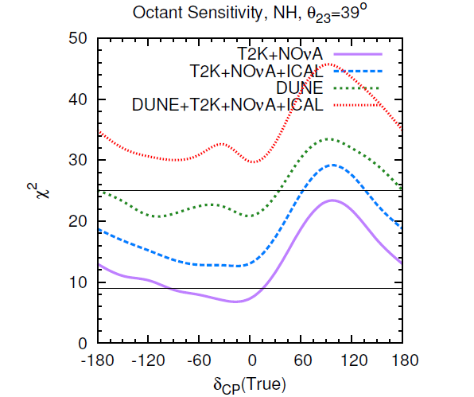
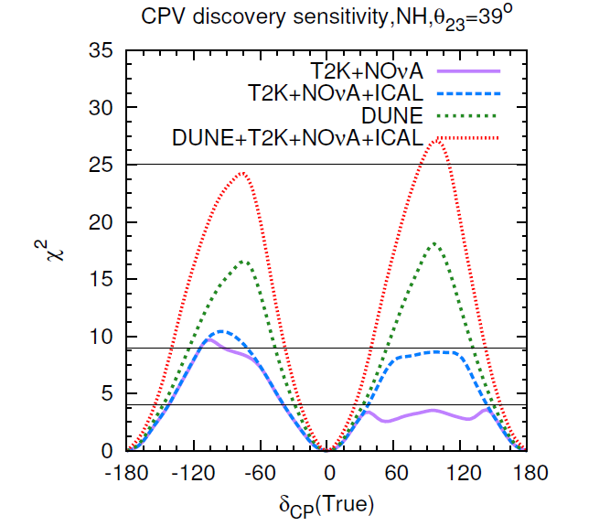
Global picture for hierarchy, octant and (future)
Addition of ICAL to T2K+NOVA increases the sensitivity in the unfavourable zones
ICAL can enhance the CP sensitivity of T2K+NOVA by removing the WH solutions
DUNE alone can reach more than sensitivity for hierarchy and octant for
favourable values and close to sensitivity for in the whole range
With addition of T2K+NOVA+ICAL to DUNE hierarchy and octant can reach more
than and close to over the full range
to

Slide 41
The Global Picture
The parameters are well determined and stable
across different statistical analysis
With discovery of non-zero the three generation effects are beginning
to be seen but not statistically significant yet
The major undetermined quantities are hierarchy, octant and
The determination of these are interrelated and suffer from degeneracies
For favourable values of parameters hint can come from T2K and NOVA
In the unfavourable zone improvement possible exploiting atmospheric neutrinos
DUNE can reach sensitivity
Synergy between different channels and experiments plays and important role

Slide 42
..
Monojit Ghosh, Newton Nath , Sushant Raut
Eligio Lisi for providing the latest results of their analysis
Thomas Schwetz and Michele Maltoni for correspondence
Acknowledgements

