Slide 1
Towards Realization of Very High Voltage for Liquid Argon TPCs: R&D Status and Challenges
Sarah Lockwitz, Fermilab
NNN 2015
October 28, 2015

Slide 2
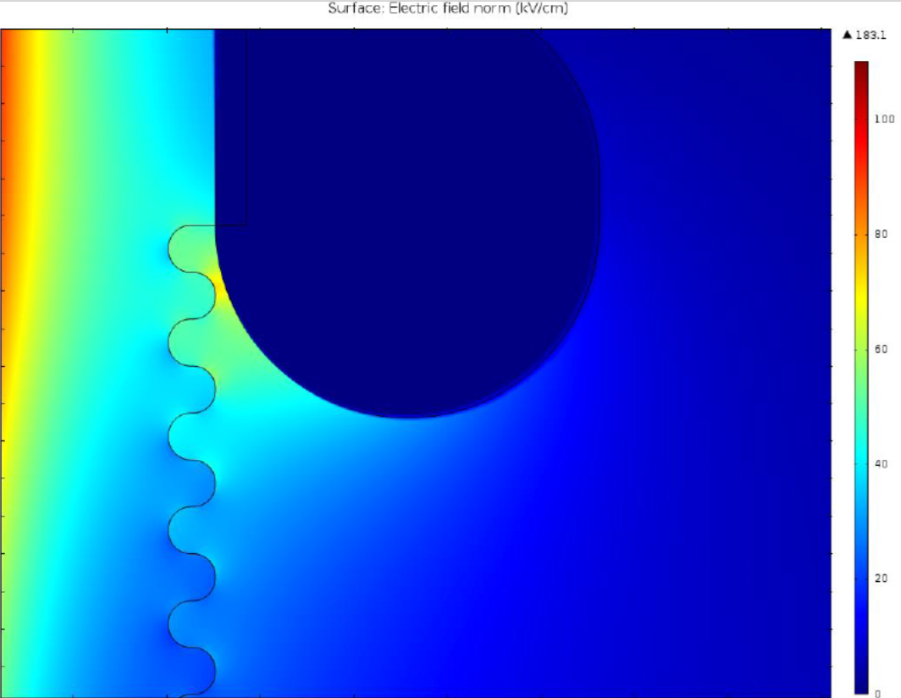
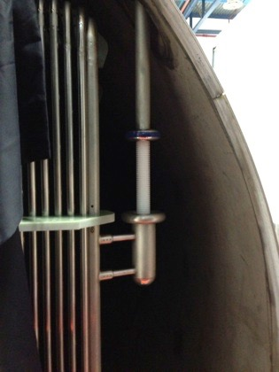
Motivation
Experiment | Design Voltage
ICARUS | 75 kV (150 kV)
Darkside 50 | 60 kV
MicroBooNE | 128 kV
CAPTAIN | 50 kV
DUNE | 180 kV / 600 kV
WA105 | 300-600 kV
LArTPCs are a popular detector choice for neutrino & DM experiments
These detectors rely upon HV to drift electrons from ionization
Such high cathode voltages can lead to very high fields on features of the TPC
New proposals are pushing the limits of HV design
Greater fiducial volume —> greater drift distance —> greater voltage
While experiments have run successfully in the past, parameters related to HV stability in LAr are not well known.
The max E field on the cathode is ~28 kV (~4in to ground)
H. Wang, HV Noble Liquids, 2013
Feedthrough
Cryostat Wall
TPC

Slide 3
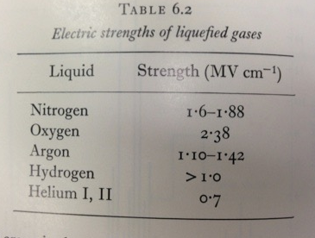
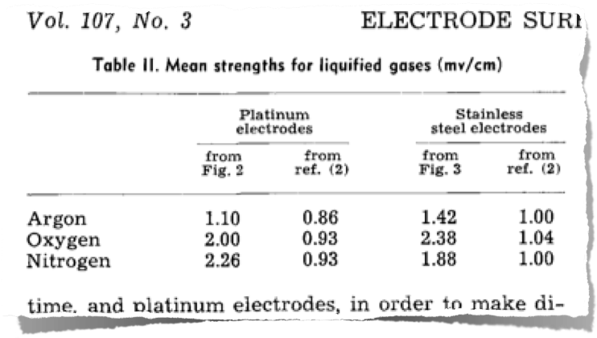
A Brief History
An often quoted dielectric strength of LAr used to be 1.4 MV/cm:
Recently found this is not generally true!
We saw breakdown when we should not have:
1.4 MV/cm was measured using 5 mm spheres at sub-mm spacings
from High-Voltage Technology, L.L. Alston ed. (1968)
D. Swan and T. Lewis, J. Electrochem. Soc. 107 (1960) 180.

Slide 4
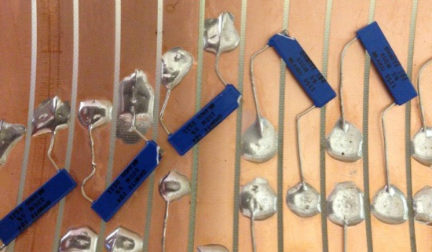
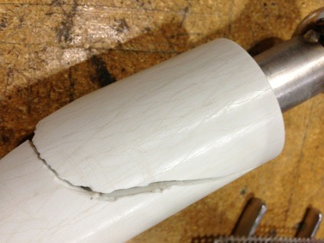
So What?
Long Bo TPC
Sparking can lead to downtime, and a risk of sparking may lead an experiment to run at a reduced field (less signal, more backgrounds)
Most importantly, HV discharges can be dangerous to the detector
Broken resistors
Damaged components with reduced or no functionality
Electronics
This has led to recent R&D on the topic…
This ring is open
Polyester HV test piece
Sustained many arcs
Eventually, severe mechanical damage

Slide 5
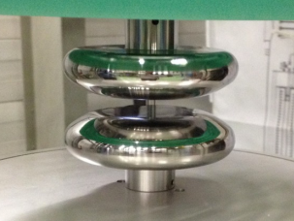
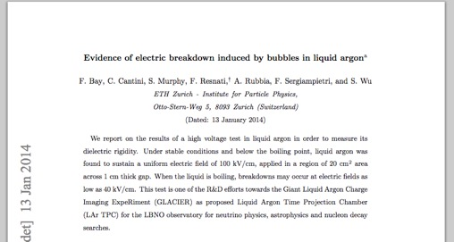
Recent R&D: ETH Zurich
The ETH Zurich group reported on a breakdown test in LAr using a Rogowski profile (uniform field between electrodes)
20 cm² profiles, 1 cm gap
Held 100 kV (limit of the supply) for four hours
In boiling LAr, breakdowns were observed at fields as low as 40 kV/cm
Agrees with an idea that bubbles likely induce breakdown (breakdown is easier in argon gas)
http://arxiv.org/pdf/1401.2777v1.pdf

Slide 6
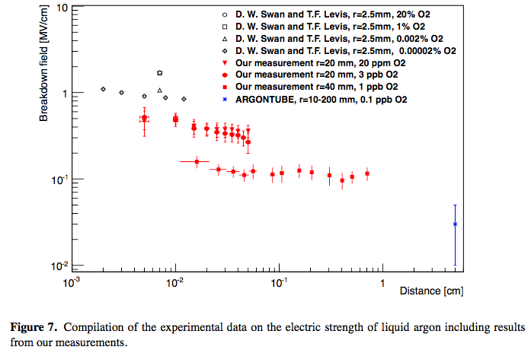
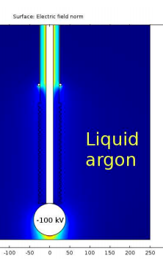
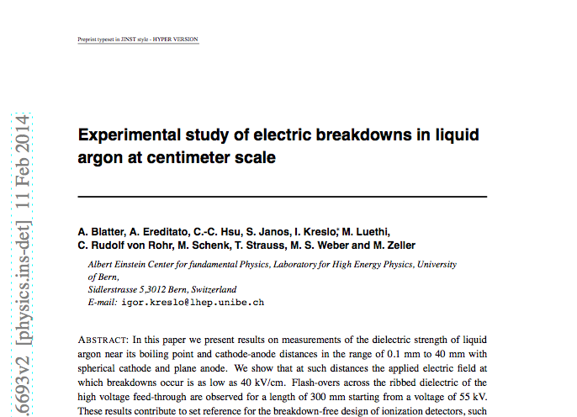
Recent R&D: LHEP Bern
The Bern group also reported on much lower observed dielectric strength measurements
Used a sphere-plate geometry
http://arxiv.org/abs/1406.3929
Breakdowns at fields as low as 40 kV/cm

Slide 7
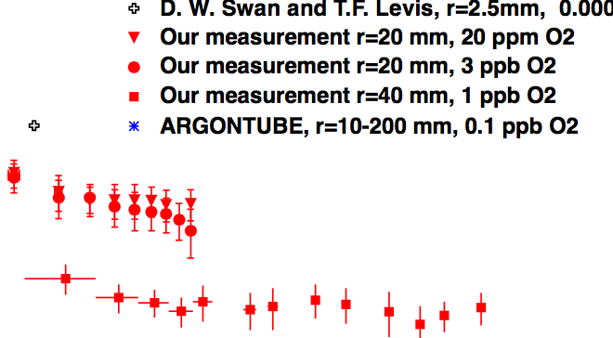
Recent R&D: LHEP Bern
Also observed a purity effect.
Breakdown field for the r=20 mm sphere at 5 mm spacing increased by ~40% when O2 contamination went from 1 ppb to > 1 ppm
Oxygen absorbs electrons

Slide 8
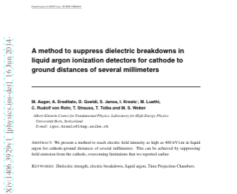
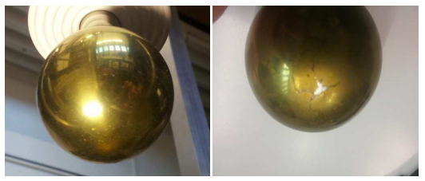
Recent R&D: LHEP Bern
The Bern group has investigated increasing the max field a component can withstand under HV with a polymer coating (http://arxiv.org/abs/1406.3929v1)
Fields as high as 400 kV/cm were reached over several mm before breakdown
This could remedy some issues with cathode discharge
This is significantly higher than the previous breakdown measurement
From http://arxiv.org/pdf/1406.3929v1.pdf

Slide 9
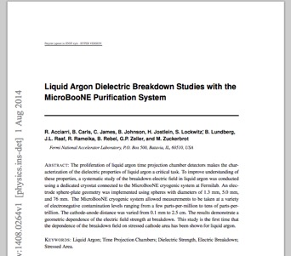
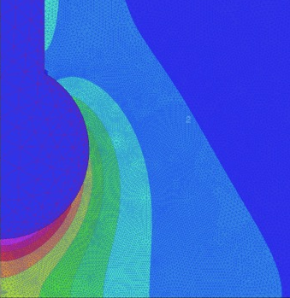
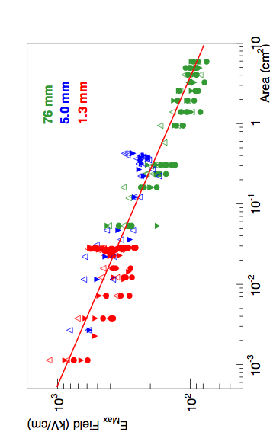
Recent R&D: FNAL
Stressed area, peak field is at the star, shaded pink has E>80%*Emax
At FNAL, we measured breakdown vs distance and varied contamination level (commercial to ~ms) and cathode size (http://arxiv.org/abs/1408.0264)
We had breakdowns with Emax between ~ 40 kV/cm (lowest data point) to > 1 MV/cm
We found a LAr purity effect with only the smallest cathode at distances ≳ cm
Breakdown V~1ppb = ~60% V100s ppb
Across cathode sizes, the parameter of interest seemed to be stressed area (or volume)
Shapes correspond to different purities

Slide 10
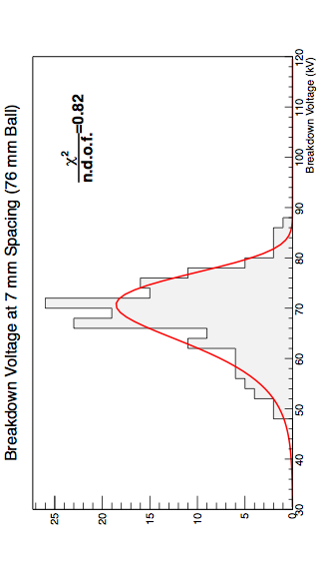
Recent R&D: FNAL
We also noted that the distribution of breakdown voltages for a given configuration followed a Weibull function as suggested by literature
Understanding the width and eventually how this varies in time will help define the breakdown probability for a given configuration

Slide 11
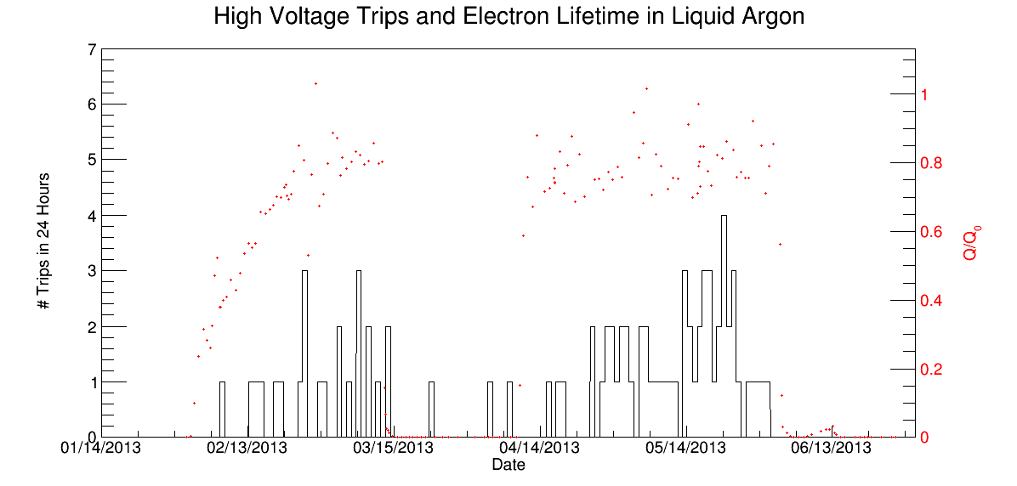
Recent R&D: FNAL
Long Bo TPC
Long Bo was a 2 meter drift TPC that operated in the Liquid Argon Purity Demonstrator (LAPD) at FNAL
During the run, the TPC was damaged by an external cable.
This movie was not during the run; it was at the end when we were trying to make it discharge
We had a tripping PS, and we tripped every so often while running
We were able to note a trend between the HV stability and the liquid argon contamination level (purity)
http://arxiv.org/abs/1504.00398
This ring is open
# of HV Trips
LAr Purity

Slide 12
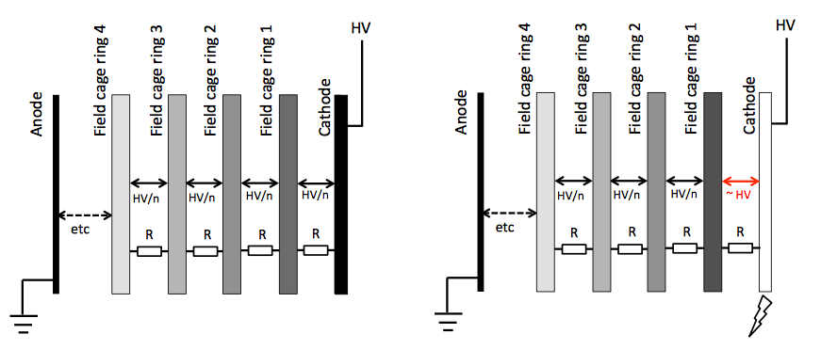
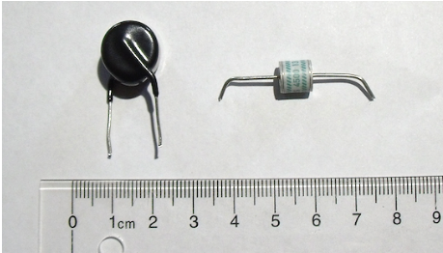
Recent R&D: FNAL
Groups within the MicroBooNE collaboration investigated protection devices for TPCs
If a component near the cathode discharges to ground, a large voltage can appear across the resistor to the next field cage tube
Resistor robustness: arxiv.org/abs/1408.4013
Which resistors can withstand a large transient over-voltage condition
Surge protection: http://arxiv.org/abs/1406.5216
Showed that TPC components were protected by GDTs and varistors from over-voltage conditions
From http://arxiv.org/pdf/1406.5216v2.pdf

Slide 13
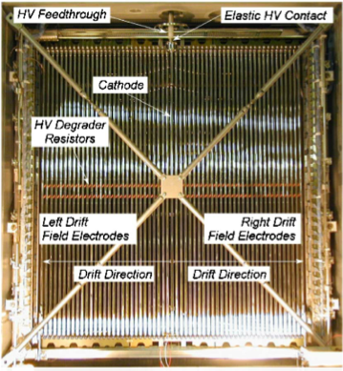
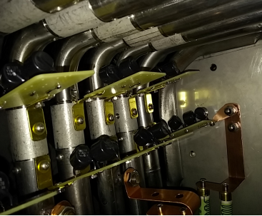
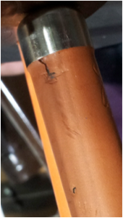
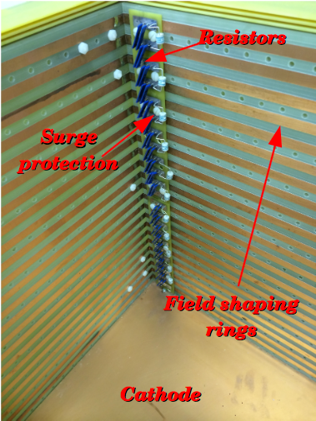
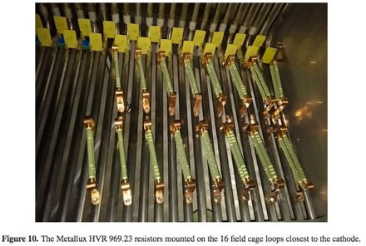
TPC Protection in Action
ICARUS used robust resistors (rated to 24 kV in air)
MicroBooNE used resistors rated to 48 kV in air on the first 1/4 of the TPC
Also added varistors
LArIAT added GDTs to their TPC chain.
from S. Amerio, et al. (2004)
From R. Acciarri

Slide 14
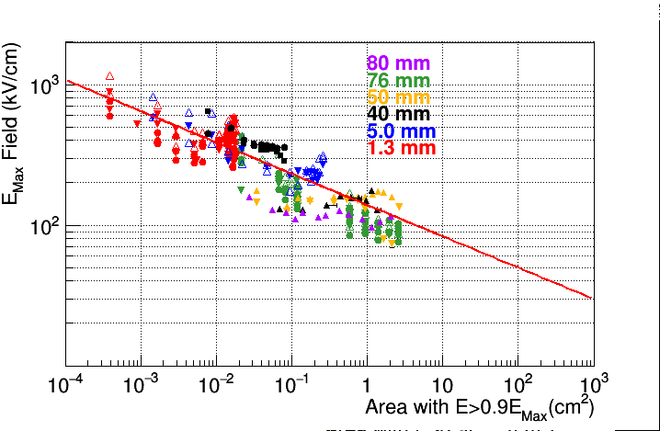
Current R&D: LHEP Bern
They are finalizing a paper on the existence of slow streamers:
The streamers last milliseconds and draw milliamps of current, before they turn into spark.
Updated the Bern/Fermilab data on the peak electric field at breakdown vs area.
They have reached 400 kV at the ARGONTUBE cathode with latex coating.
The voltage was limited by capacitor rating, one of them broke down internally.
There was no breakdown through the liquid!

Slide 15
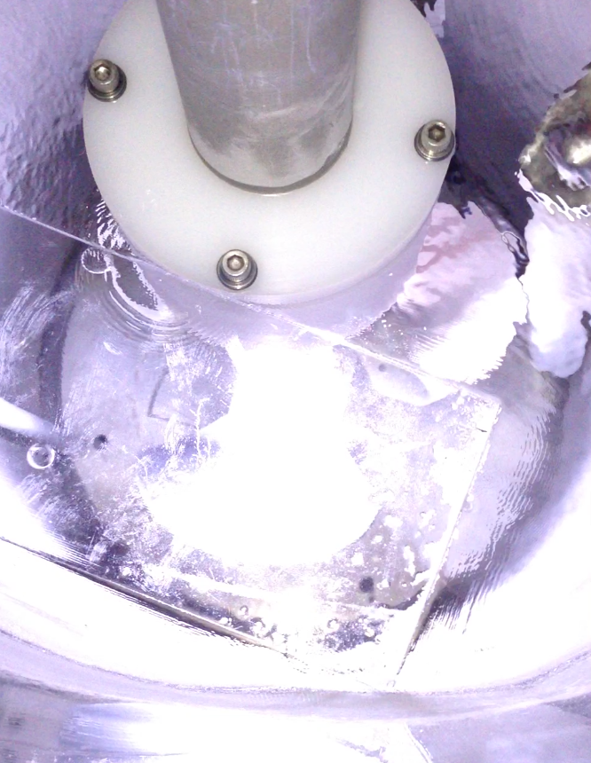
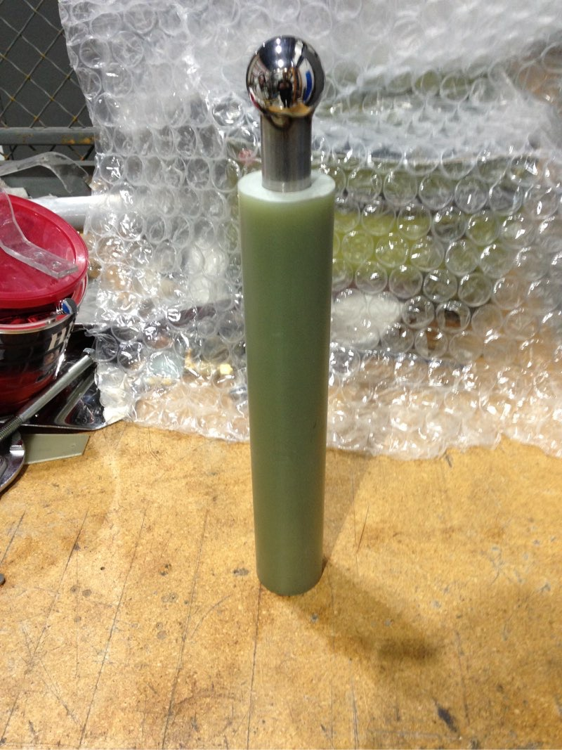
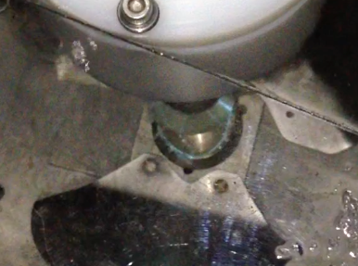
Current R&D: FNAL
At Fermilab, we recently performed a comparative test of insulators in a feedthrough-like geometry (http://arxiv.org/abs/1506.04185)
It was done in an open cryostat

Slide 16
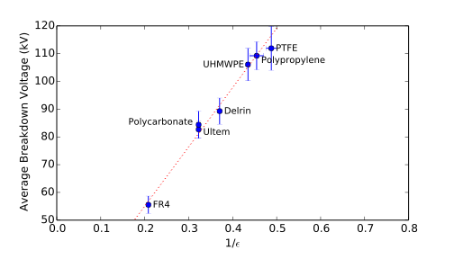
Current R&D: FNAL
We found that differences in breakdown voltage between materials could be explained by differing permittivities (—> resulting electric field at the insulator surface)

Slide 17
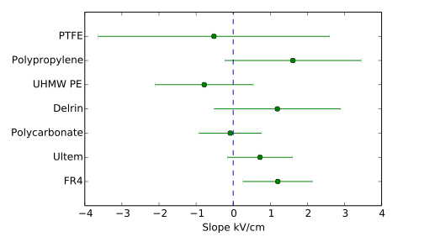
Current R&D: FNAL
We considered the exposed insulator length:
Broad experience at room temperature generally relates an increase in path to an increase in breakdown voltage
However, we found exposed insulator length had little, if any, effect on breakdown voltage (~1-12 cm)

Slide 18
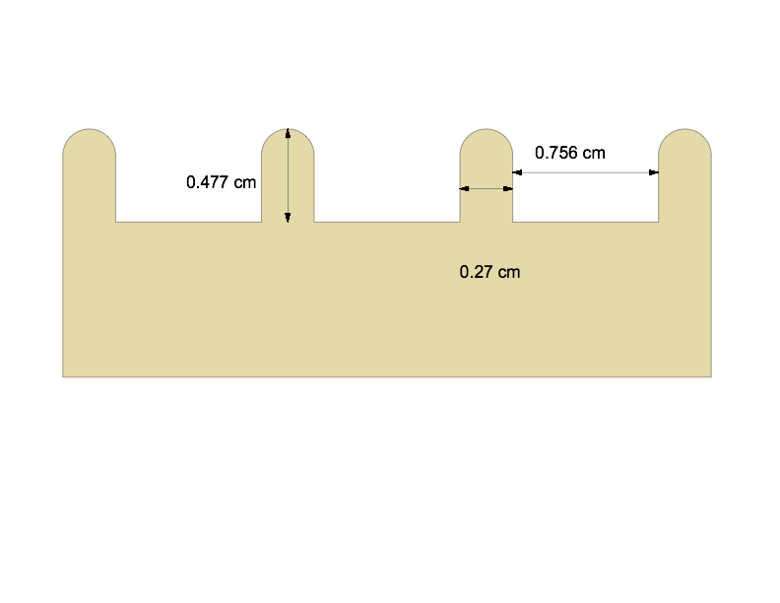
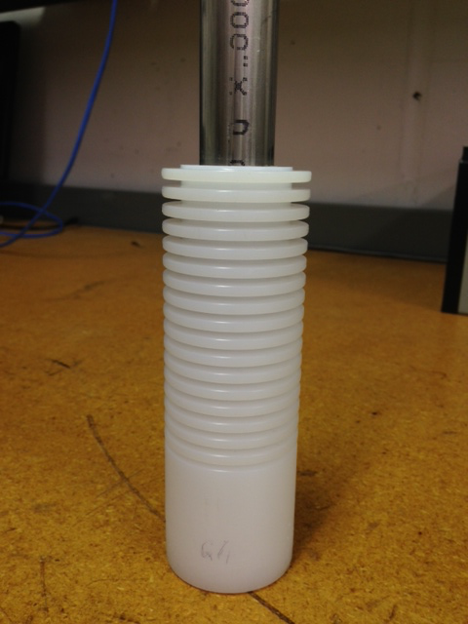
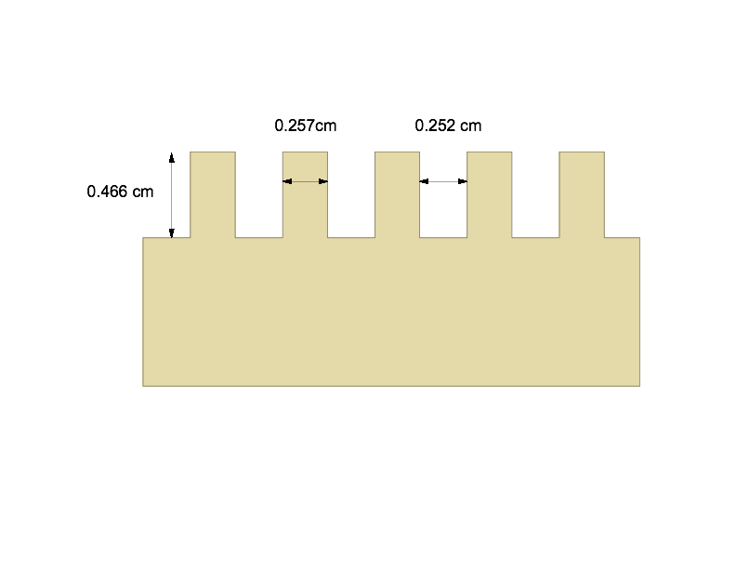
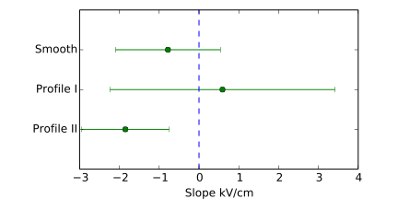
Current R&D: FNAL
Grooves are sometimes added to the surface of insulators to improve HV performance
However, an initial test of the effect of adding grooves to the surface showed little effect on breakdown voltage (at most ~10%).
The effect could be explained by the change in electric field simply by removing material (different permittivity changes the local field)
Example

Slide 19
Another Note on Insulators
The previous test used a feedthrough-like geometry
The center conductor’s contribution to the field keeps the streamer/spark near the insulator surface.
Without this field, sparks do not generally travel along the surface.

Slide 20
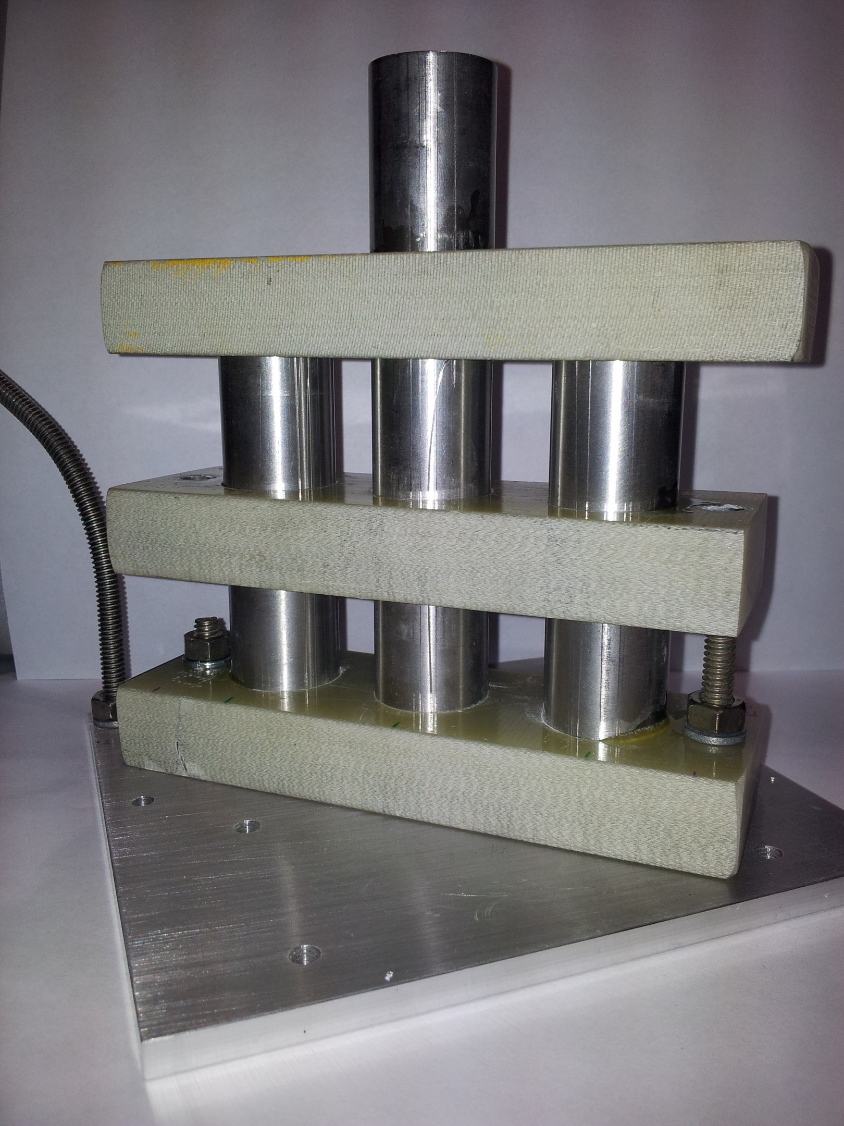
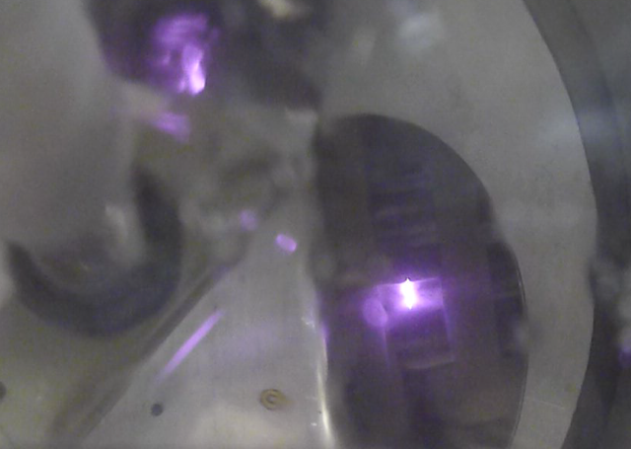
Another Note on Insulators
Test of MicroBooNE field cage tubes
Center at high potential
Outer tubes at ground
Looking from above, mirrors on the side
*Saw breakdowns between 80-105 kV

Slide 21
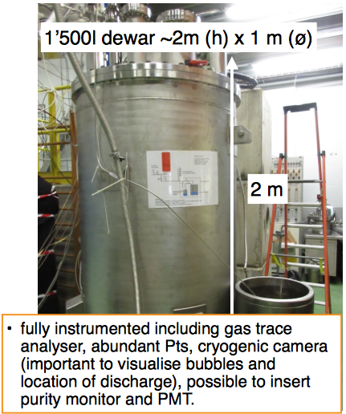
What needs to be done to get 180 kV and up to 1 MV in double/single phase detectors?
HV Generation:
Cockcroft-Walton/Greinacher: Bern has reached a cathode voltage of 400 kV
Feedthrough + Power supply
While testing the 35T feedthrough recently, H. Wang was able to get to 180 kV before sparking (35T HV ~113 kV)
He is in the process of making a full size feedthrough that will meet DUNE’s requirements (to be tested after the new year).
ETH Zurich group is working on a 300 kV feedthrough for WA105:
Have 300 kV Heinzinger PS — will test on existing feedthrough and make a new one by the beginning of next year
From S. Wu (from H. Wang) DUNE Collab. Meeting Sept. 0215
S. Wu DUNE Collab. Meeting Sept. 2015
From S. Murphy, DUNE Meeting 10/8/15

Slide 22
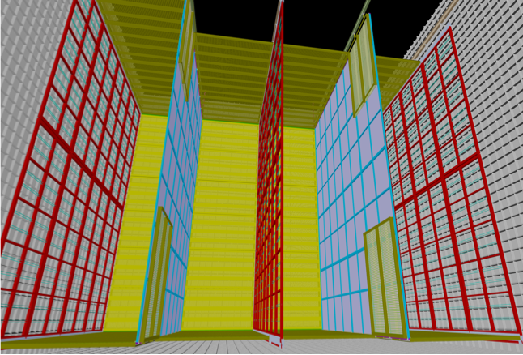
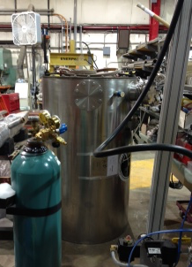
What needs to be done
From B.Yu, Dune Collab. 04/2015
We need to know how to take the measurements and apply them to the scale (size and HV) of “very high voltage LArTPCs”
The measurements of breakdown field vs. area are a good start
We need a to improve our understanding of how size/polarity/purity/time affect breakdown probabilities
Once we have this in hand, the goal is to define some engineering parameters to design future LArTPCs
Polarity: do these features matter?

Slide 23
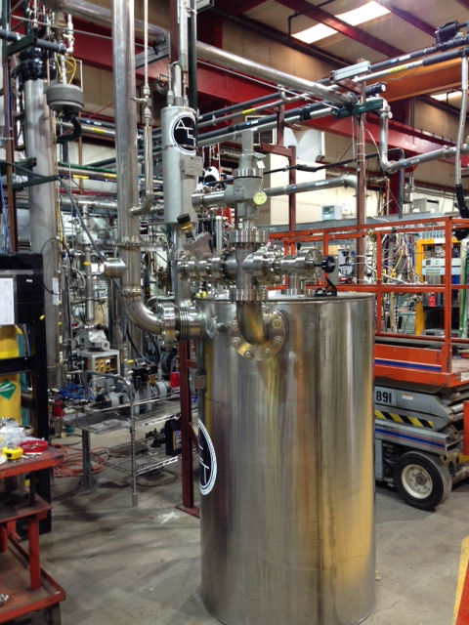
What needs to be done…
Continue some of the basic R&D that groups have started.
At FNAL, we’ve finally just filled our dedicated HV cryostat
The Breakdown (or Big) Liquid ArgoN Cryostat for High Voltage Experiment: Blanche
Will study size effects, purity & polarity effects, streamer formation, feedthrough improvements
We welcome collaboration!

Slide 24
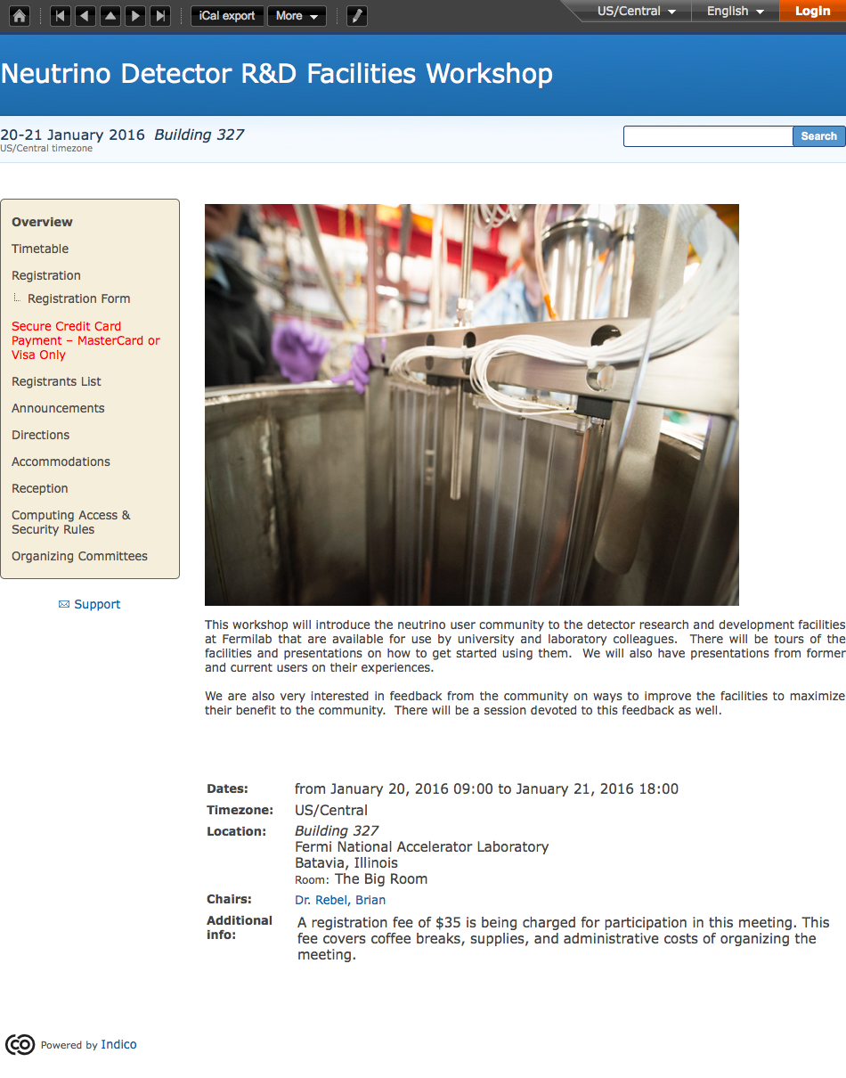
Advertisement:
Fermilab will have a Neutrino Detector R&D Facilities Workshop this winter
Goal is to introduce the neutrino user community to the lab’s facilities that are available for use
https://indico.fnal.gov/conferenceDisplay.py?confId=10548

Slide 25
Closing Thoughts
While LArTPCs have run successfully in the past, understanding the performance & limitations of HV in LAr is important in designing the next generation of LArTPCs
Recent results have been informative, but more R&D will improve future designs
Geometry and size effects: What is the relevant parameter that describes a probable breakdown scenario across geometries?
How does purity affect performance? What purity regimes or sizes does it matter?
Polarity effects — what features matter?
Streamer formation: basic understanding of how sparks develop may help lead to solutions
Bubbles? Under what conditions do they contribute?
What is a safe minimum field?
Mitigation strategies (coatings, TPC protection)
Eventually understand appropriate safety factors and develop engineering rules to design large LArTPCs

Slide 26
Extra Slides

Slide 27
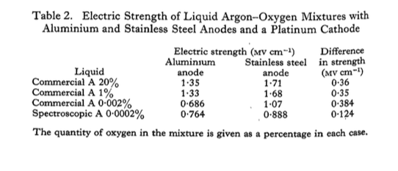
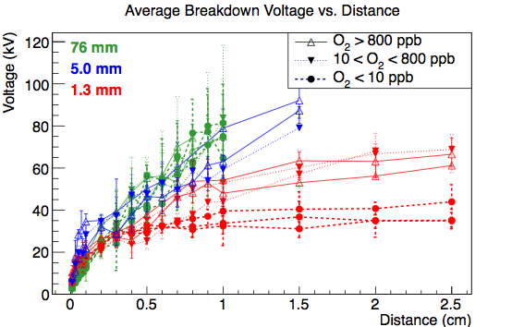
A Note on LAr Purity…
The literature points to an effect
At the HVC, we saw an effect only with the smallest sphere (1.3 mm)
Typical LArTPCs plan on operating with >1 ms lifetimes
200-1400 ppb O2 —> 1.5-0.2 us
0.29-1.8 ppb O2 —> 1-0.17 ms
Swan & Lewis, 1961
200-1400 ppb O2
0.29-1.8 ppb O2
0.29 ppb
1.8 ppb
0.35 ppb

Slide 28
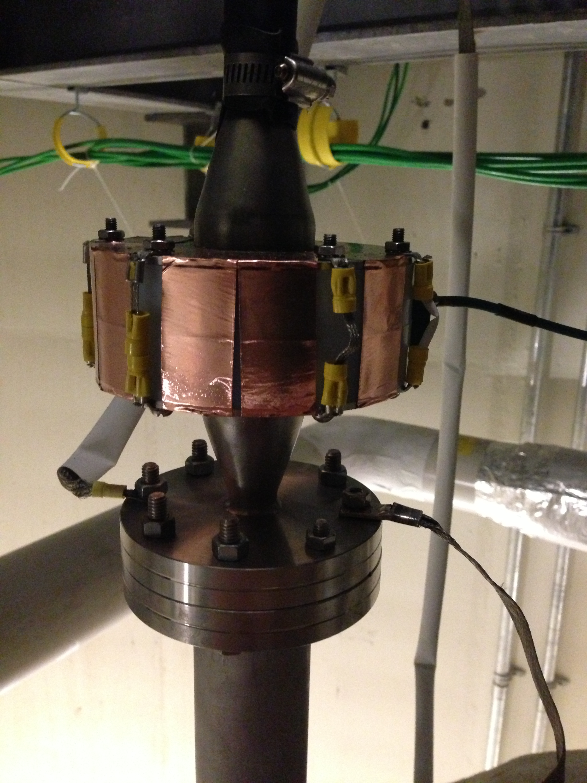
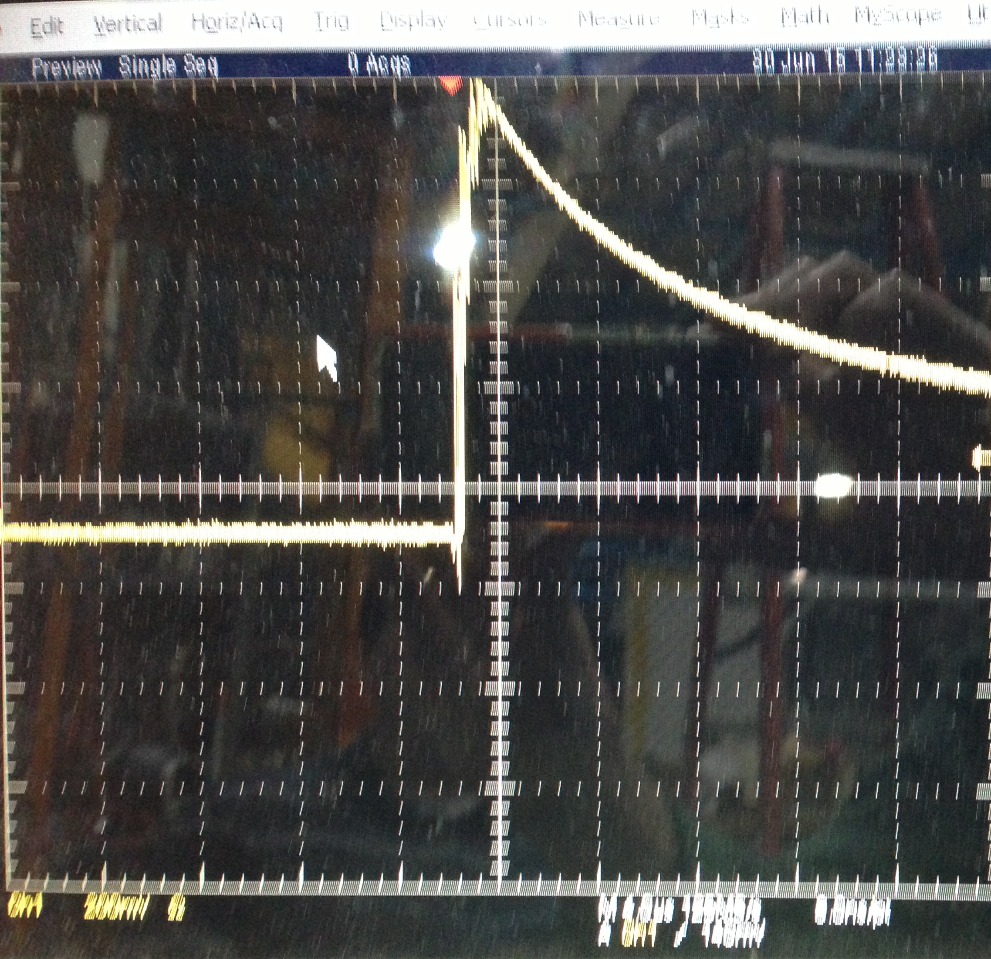
What should be done…
Monitoring Options (diagnostics) are useful to help determine what is happening in the cryostat
If a problem is seen, is it in an area where one can fix it?
In addition to monitoring the voltage and current from the supply, one can
Measure the voltage near the end of the field cage — this lets one know if any glitches seen in the PS read back are real, and could help determine where the issue is in the TPC chain
Look for any quick changes in current with a toroid near the HV feedthrough
We’re using this as a spark monitor in an HV test stand at the moment
Others (H. Wang) have used similar devices as monitoring while ramping the HV up.

Slide 29
