Slide 1
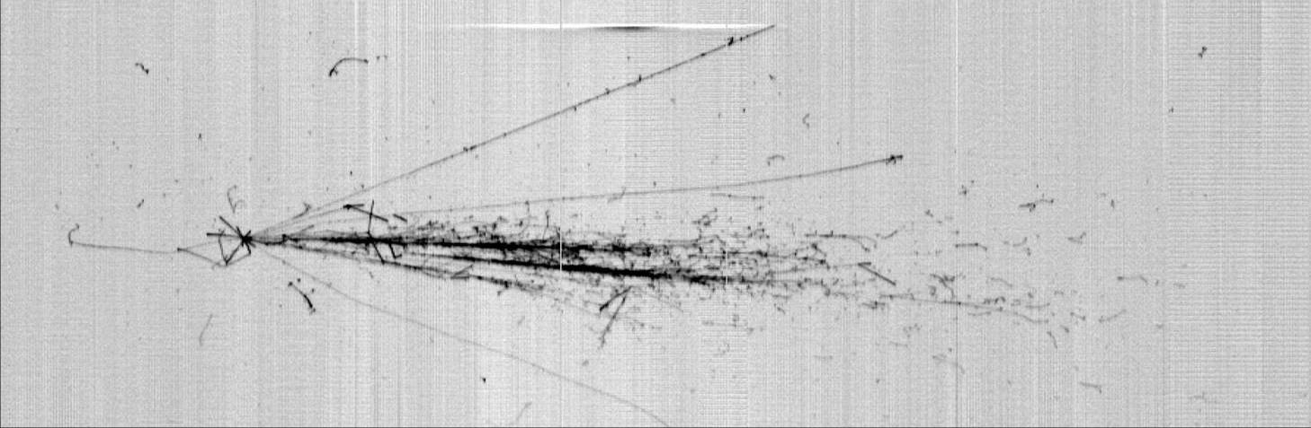
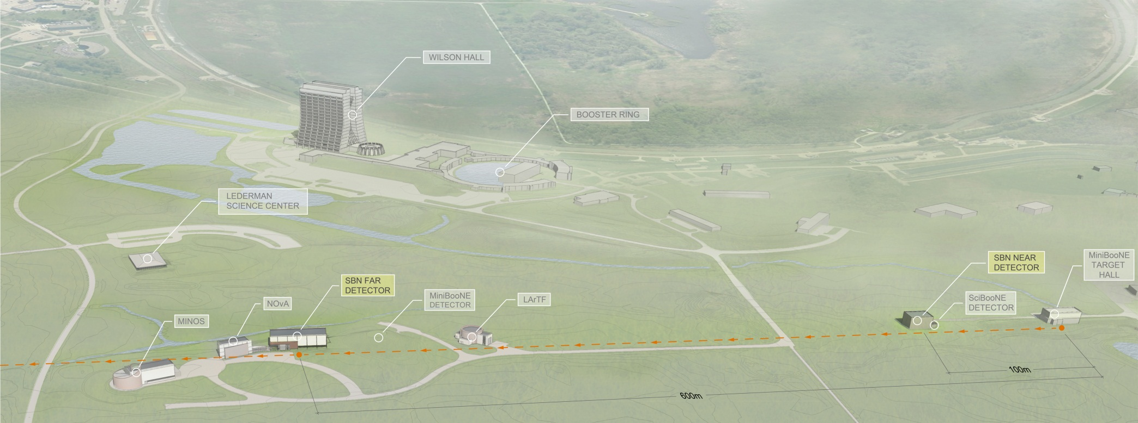
ICARUS T600:status and perspectives for sterile neutrino searches at FNAL
Alessandro Menegolli
University and INFN Pavia
on behalf of the ICARUS Collaboration
International Workshop for the Next Generation Nucleon Decay and Neutrino Detector (NNN2015) – 28/10/2015

Slide 2
The ICARUS Collaboration
M. Antonello⁸, P. Aprili⁸, B. Baibussinov⁴, F. Boffelli^{3,} A. Bubak¹⁴, E. Calligarich³, N. Canci⁸, S. Centro⁴, A. Cesana¹⁰, K. Cieslik⁶, A.G. Cocco¹¹, A. Dabrowska⁶, A. Dermenev¹², A. Falcone³, C. Farnese⁴, A. Fava⁴, A. Ferrari¹, D. Gibin⁴, S. Gninenko¹², A. Guglielmi⁴, M. Haranczyk⁶, J. Holeczek¹⁴, A. Ivashkin¹², M. Kirsanov¹², J. Kisiel¹⁴, J. Lagoda¹⁸, S. Mania¹⁴, A. Menegolli³, G. Meng⁴, C. Montanari³, S. Otwinowski¹⁷, P. Picchi⁷, F. Pietropaolo⁴, P. Płoński¹³, A. Rappoldi³, G. L. Raselli³, M. Rossella³, C. Rubbia*^{1,5,8}, P. Sala¹⁰, A. Scaramelli¹⁰, E. Segreto⁸, F. Sergiampietri¹⁹, D. Stefan¹⁰, R. Sulej¹⁶, M. Szarska⁶, M. Terrani¹⁰, M. Torti³, F. Varanini⁴, S. Ventura⁴, C. Vignoli⁸, H.G. Wang¹⁷, X. Yang¹⁷, A. Zalewska⁶, A. Zani³, K. Zaremba¹³
+ new WA104 members:
V. Bellini², P. Benetti³, S. Bertolucci¹, H. Bilokon⁷, M. Bonesini⁹, J. Bremer¹, N. Golubev¹², U. Kose¹, F. Mammoliti², G. Mannocchi⁷, D. Mladenov¹, M. Nessi¹, M. Nicoletto⁴, F. Noto¹, R. Potenza², J. Sobczyk¹⁵, M. Spanu³, C.M. Sutera², F. Tortorici², T. Wachala⁶
¹CERN, Geneve, Switzerland
²Department of Physics, Catania University and INFN, Catania, Italy
³Department of Physics, Pavia University and INFN, Pavia, Italy
⁴Department of Physics and Astronomy, Padova University and INFN, Padova, Italy
⁵GSSI, Gran Sasso Science Institute, L’Aquila, Italy
⁶Henryk Niewodniczański Institute of Nuclear Physics, Polish Academy of Science, Kraków, Poland
⁷INFN LNF, Frascati (Roma), Italy
⁸INFN LNGS, Assergi (AQ), Italy
⁹INFN Milano Bicocca, Milano, Italy
10Politecnico and INFN Milano, Milano, Italy
11INFN Napoli, Napoli, Italy
¹²Institute for Nuclear Research of the Russian Academy of Sciences, Moscow, Russia
¹³Institute for Radioelectronics, Warsaw University of Technology, Warsaw, Poland
¹⁴Institute of Physics, University of Silesia, Katowice, Poland
¹⁵Institute of Theoretical Physics, Wroclaw University, Wroclaw, Poland
¹⁶National Centre for Nuclear Research, Warsaw, Poland
¹⁷Department of Physics, UCLA, Los Angeles, California, USA
¹⁸National Centre for Nuclear Research, Otwock, Swierk, Poland
¹⁹University of Pisa and INFN, Pisa, Italy
+ ICAR-US : 6 new US groups:
Colorado Univ., Pittsburgh Univ., SLAC, FNAL, Argonne, Los Alamos
*Spokesperson

Slide 3
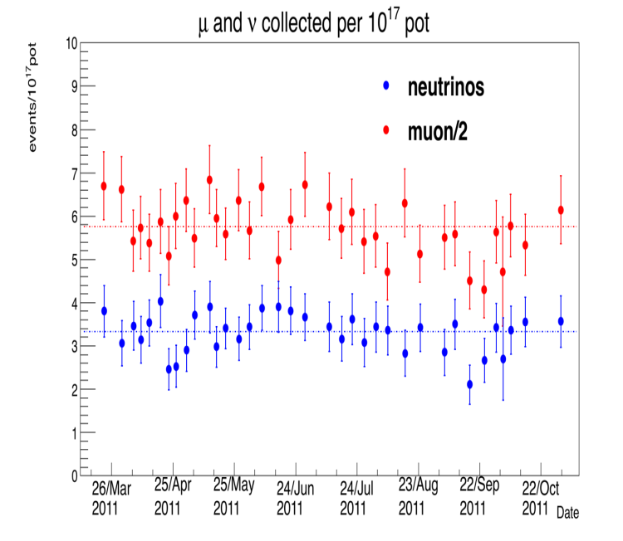
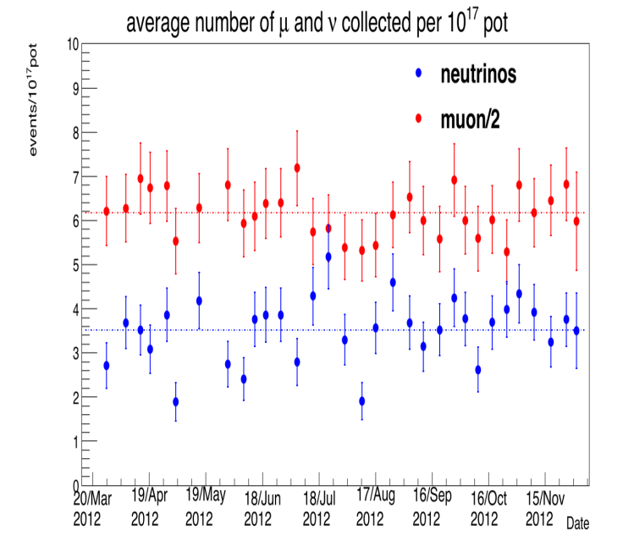
Evolution of LAr-TPC detectors
Cherenkov detectors in water/ice and liquid scintillator detectors have been main technologies so far for neutrino and rare event physics. Unfortunately these detectors do not permit to identify unambiguously each ionizing track.
As an alternative, the LAr-TPC technique, effectively an electronic bubble-chamber, was originally proposed by C. Rubbia in 1977 [CERN-EP/77-08], supported by Italian Institute for Nuclear Research (INFN).
    Thanks to ICARUS collaboration, LAr-TPC has been taken to full maturity with the T600 detector (0.6 kton) receiving CNGS neutrino beam and cosmic rays.
    ICARUS concluded in 2013 a very successful 3 years long run at LNGS, collecting 8.6 x 10¹⁹ pot event with a detector live time > 93%, recording 2650 CNGS neutrinos (in agreement with expectations) and cosmic rays (0.73 kty).
2011
2012

Slide 4
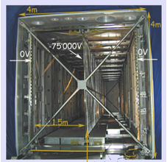

The ICARUS detector @ LNGS
LNGS -Hall B
cathode
LN2 storage
TPC wires
T600
Two identical modules…
3.6 x 3.9 x 19.6 m ≈ 275 m³
Total active mass ≈ 476 ton
… and four wire chambers
Two TPCs for each module, divided by the cathode -> 1.5 m drift length
HV = -75 kV -> Edrift = 0.5 kV/cm
vdrift = 1.55 mm/μs
Detectors
3 wire planes per TPC (0°, ±60°)
≈ 54000 total wires (150 μm Ø, 3 mm pitch)
54+20 photomultipliers (8’’ Ø) + wls (TPB), sensitive at 128 nm (VUV)
Electronics
FADC 10bit 1mV/ADC $\sim$ 1000e⁻/ADC
Slide# : 4

Slide 5
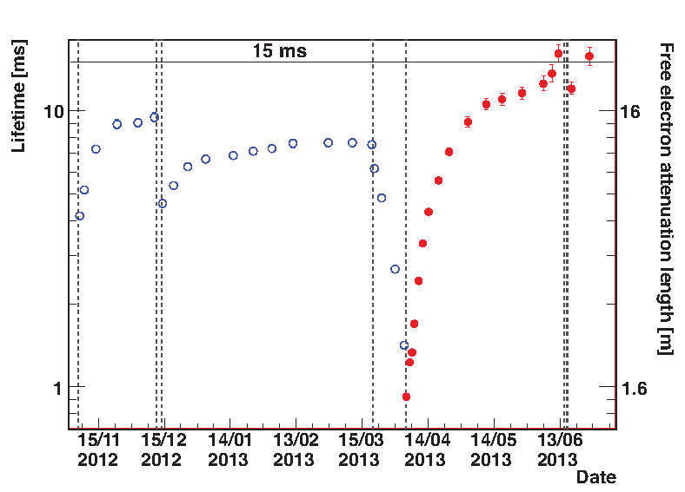
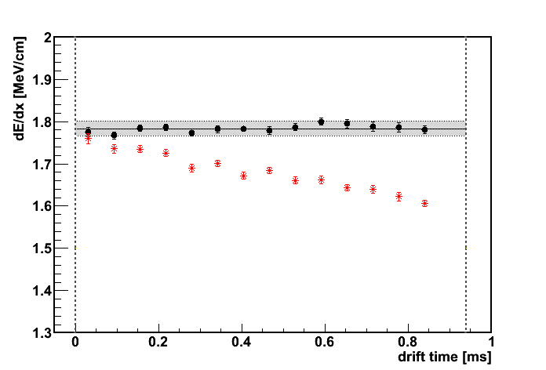
The key features of LAr imaging: very long e-mobility
    Level of electronegative impurities in LAr must be kept exceptionally low to ensure ~m long drift path of ionization e⁻ with very small attenuation.
    New industrial purification methods developed to continuously filter and re-circulate both in liquid (100 m³/day) and gas (2.5 m³/hour) phases.
    Electron lifetime measured during ICARUS run at LNGS with cosmic μ’s: τ_{ele} >7 ms (~40 p.p.t. [O₂] eq) →12% max. charge attenuation.
    With the new pump installed at the end of LNGS run: τ_{ele} > 15 ms (~20 p.p.t.).
Cross-check: dE/dx for CNGS muons after purity correction
dE/dx before purity correction
ICARUS demonstrated the effectiveness of single phase LAr-TPC technique, paving the way to huge detectors ~5 m drift as required for DUNE project.
Wires
Cathode

Slide 6
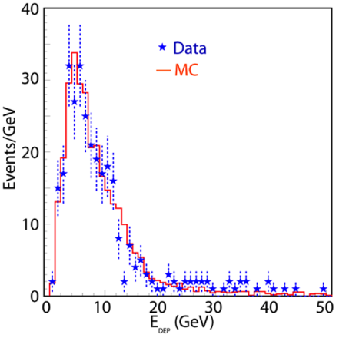
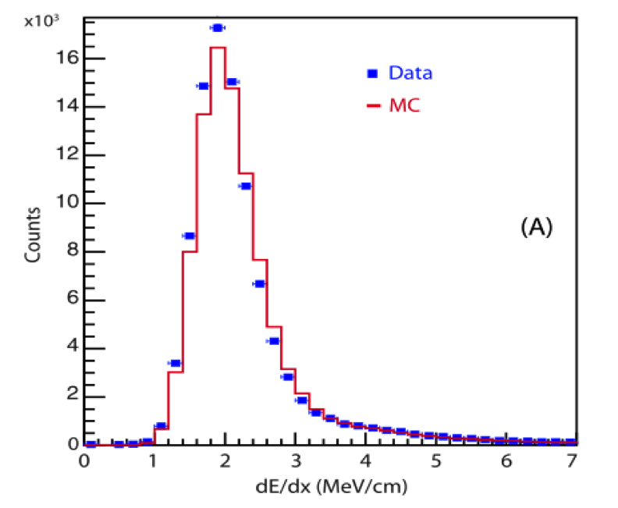
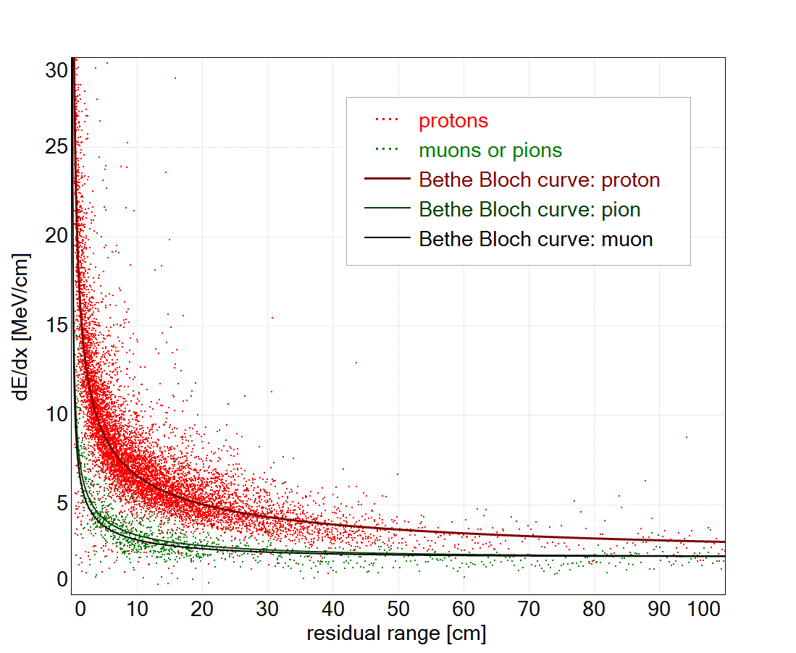
ICARUS LAr-TPC performance
    Tracking device: precise ~mm³ resolution, 3D event topology, accurate ionization measurement;
    Global calorimeter: total energy reconstruction by charge integration - excellent accuracy for contained events; momentum of non contained μ determined via Multiple Coulomb Scattering Δp/p ~15% in 0.4-4 GeV/c range;
    Measurement of local energy deposition dE/dx: e/γ remarkable separation (0.02 Χ₀ sampling, Χ₀=14 cm particle identification by dE/dx vs range);
dE/dx distribution
for real and MC
muon tracks from
CNGS events
dE/dx (MeV/cm) vs. residual range (cm) for protons,π,μ compared to Bethe-Bloch curves
Low energy electrons:
σ(E)/E = 11%/√E(MeV)+2%
Electromagnetic showers: σ(E)/E = 3%/√E(GeV)
Hadron shower (pure LAr): σ(E)/E ≈ 30%/√E(GeV)

Slide 7
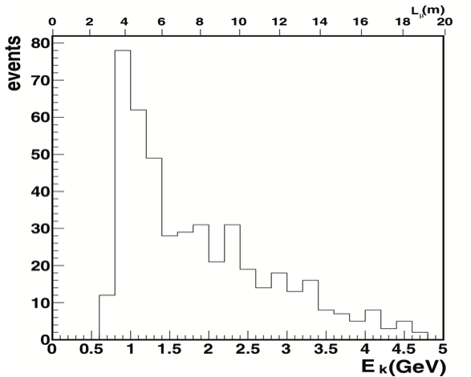
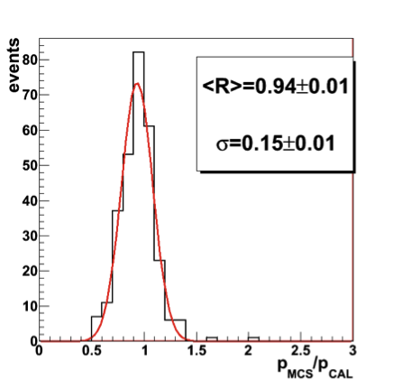
Measurement of muon momentum via multiple scattering
Multiple Coulomb Scattering (MCS) is the only way to measure momentum of non-contained muons.
Algorithm validated on ~400 stopping muons: produced in ν_{μ}CC interactions of CNGS neutrinos upstream of T600, and stopping/decaying inside the detector.
(Δp/p )CAL~1 %
Good agreement between MCS and calorimetric measurements.
Average resolution of ~15% on the stopping muon sample.
Resolution depends both on momentum and effective muon track length used for measurement.
L = 4 m
Ratio MS/
calorimetry
Some deviations for p > 3.5 GeV/c induced by non-perfect planarity of TPC cathode

Slide 8
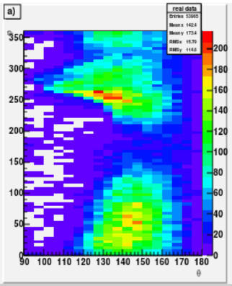
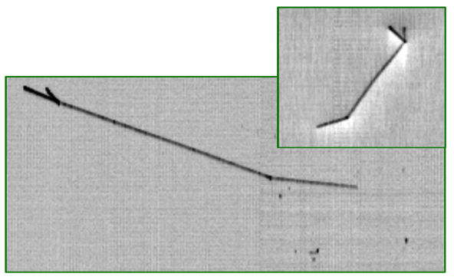
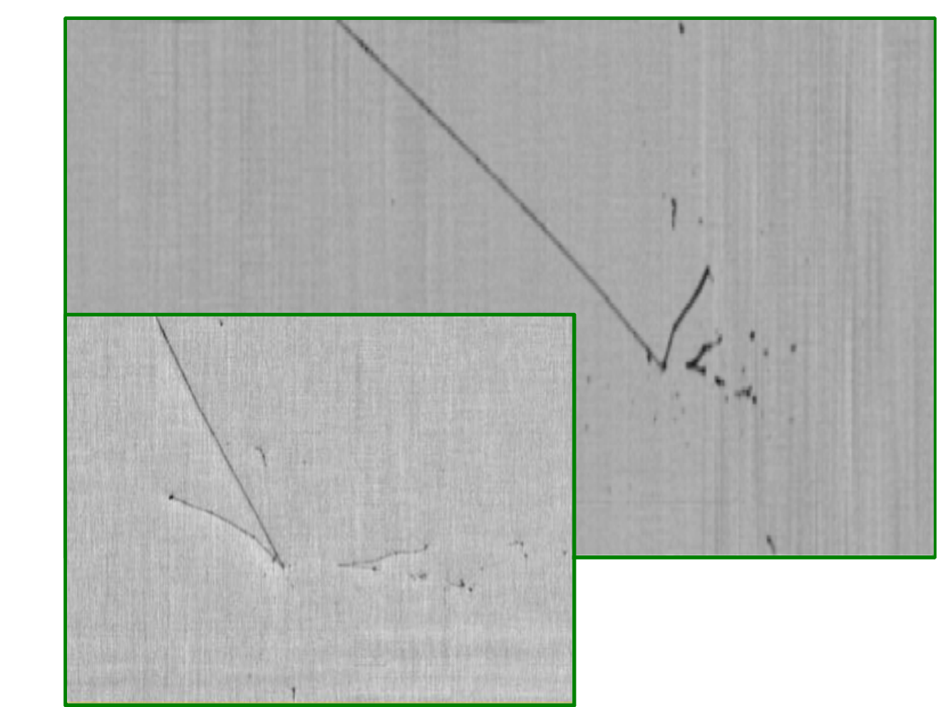
Search for atmospheric ν’s
Preparatory step: automatic 3D reco of cosmic μ’s
An algorithm for filtering of interaction vertex and multi-prong event topology has been developed, complemented by visual scanning;
Work in progress: 2 muon-like and 2 NC-like atmosph. ν candidates have been identified in 3 week data recording (1±0.4 μ−CC, 1±0.4 e-CC and 0.4±0.2 NC expected)
φ
Induction 2
θ
NC atm. candidate: EDEP ~ 200 MeV
2 charged particles emerge from interaction vertex
π track: 63 cm (interacting and generating 2 protons)
Collection
Collection
νµ CC atm. candidate: EDEP~ 350 MeV
μ and p/π tracks are visible
μ track candidate: 124 cm
Induction 2
~200 atm. ν expected for 0.73 kt y exposure

Slide 9
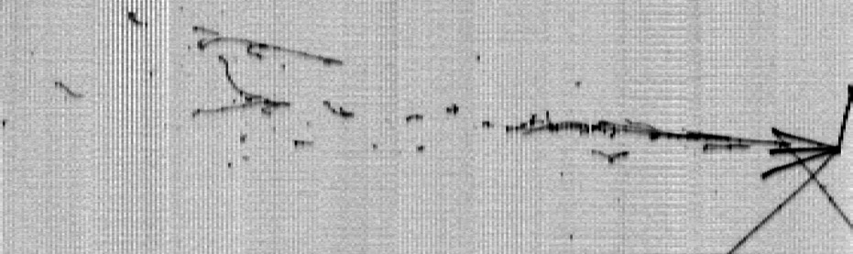
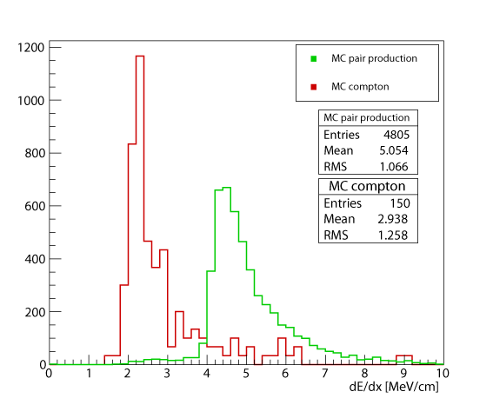
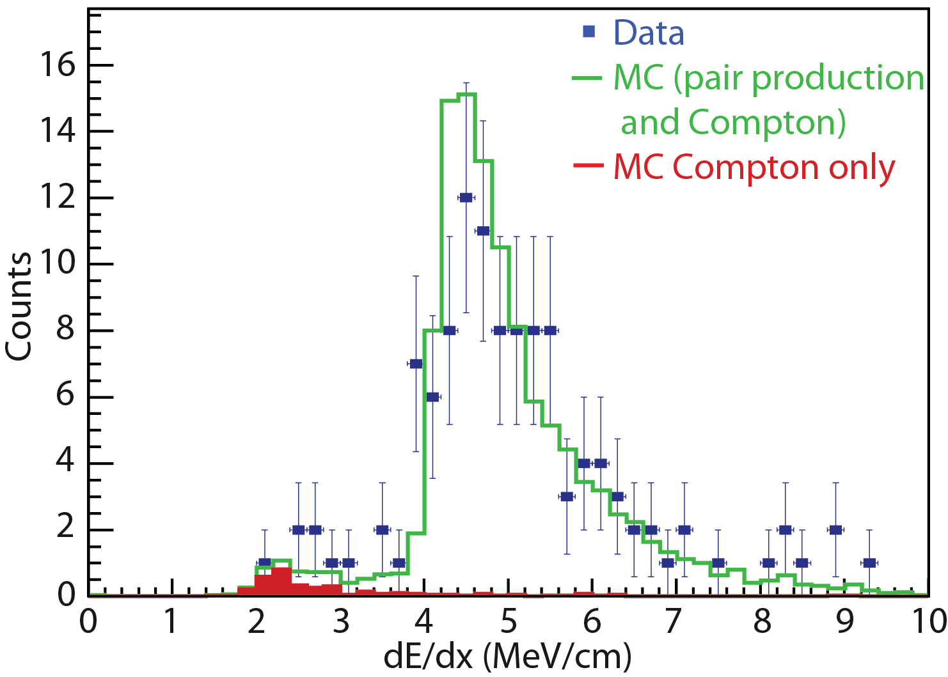
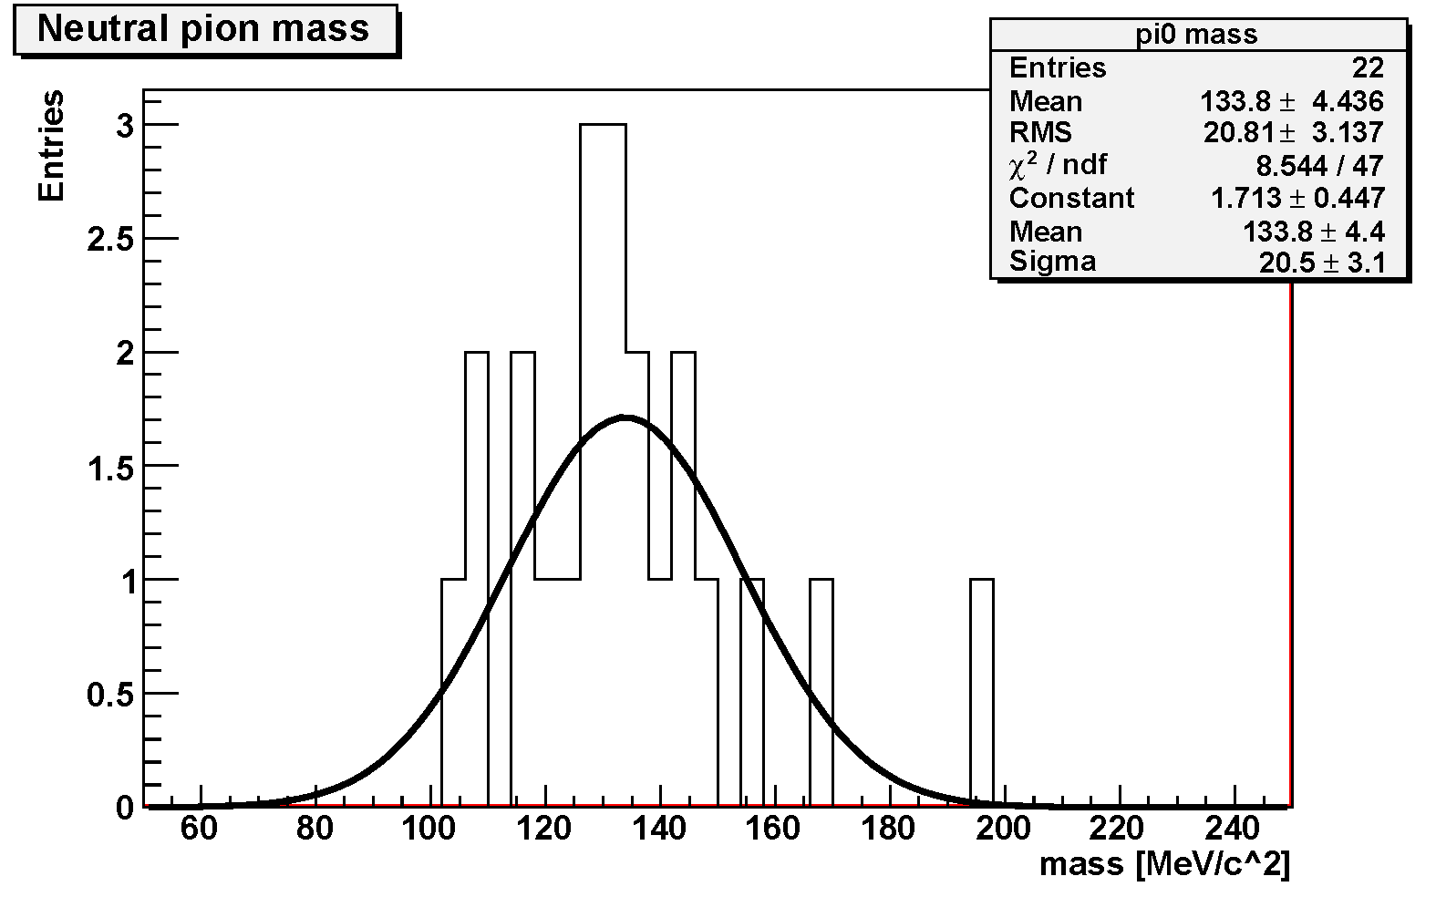
e/γ separation and π⁰ reconstruction in ICARUS
π0 reconstruction:
Ek = 102 ± 10 MeV
pπº = 912 ± 26 MeV/c
mπo = 127 ± 19 MeV/c²
θ
θ = 28.0 ± 2.5º
Ek = 685 ± 25 MeV
Sub-GeV event
Collection
Mγγ:
133.8±4.4(stat)±4(syst) MeV/c2
1 m.i.p.
2 m.i.p.
2 m.i.p.
1 m.i.p.
MC
Unique feature of LAr to distinguish e from γ and reconstruct π⁰
➔ Negligible background from π⁰ in NC and νμ CC estimated from MC/scanning

Slide 10
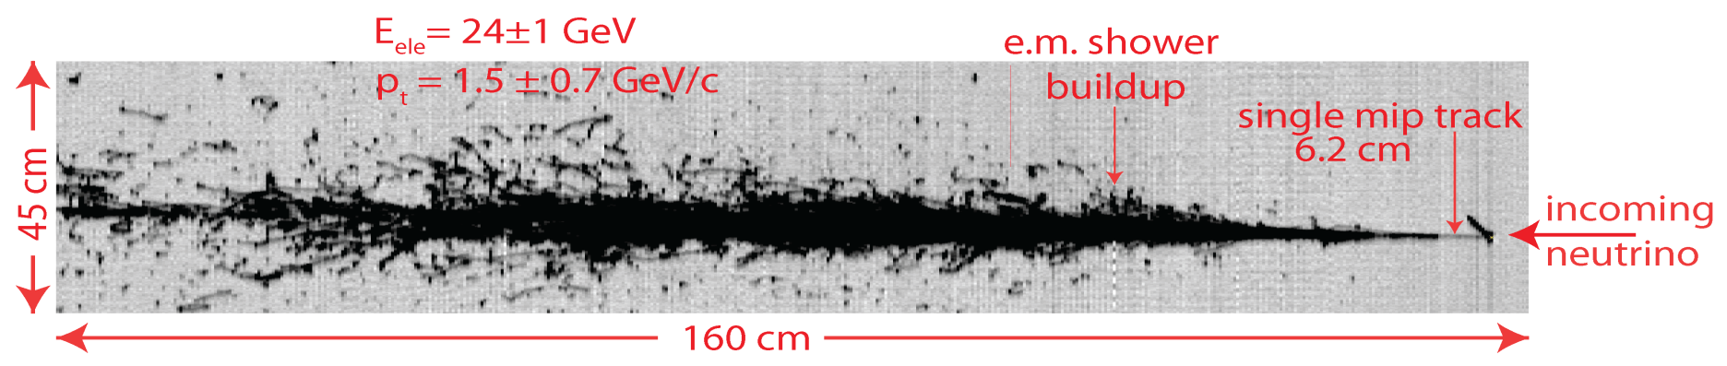
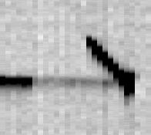
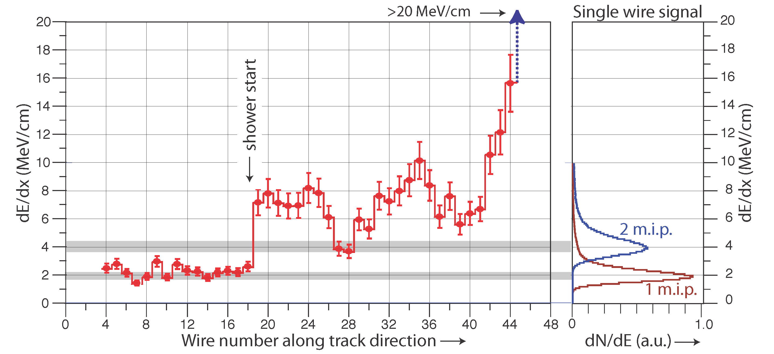
ν_{e} identification in ICARUS LAr-TPC
  The unique detection properties of LAr-TPC technique allow to identify unambiguously individual e-events with high efficiency.
The evolution of the actual dE/dx from a single track to an e.m. shower for the electron shower is clearly apparent from individual wires.
Single M.I.P

Slide 11
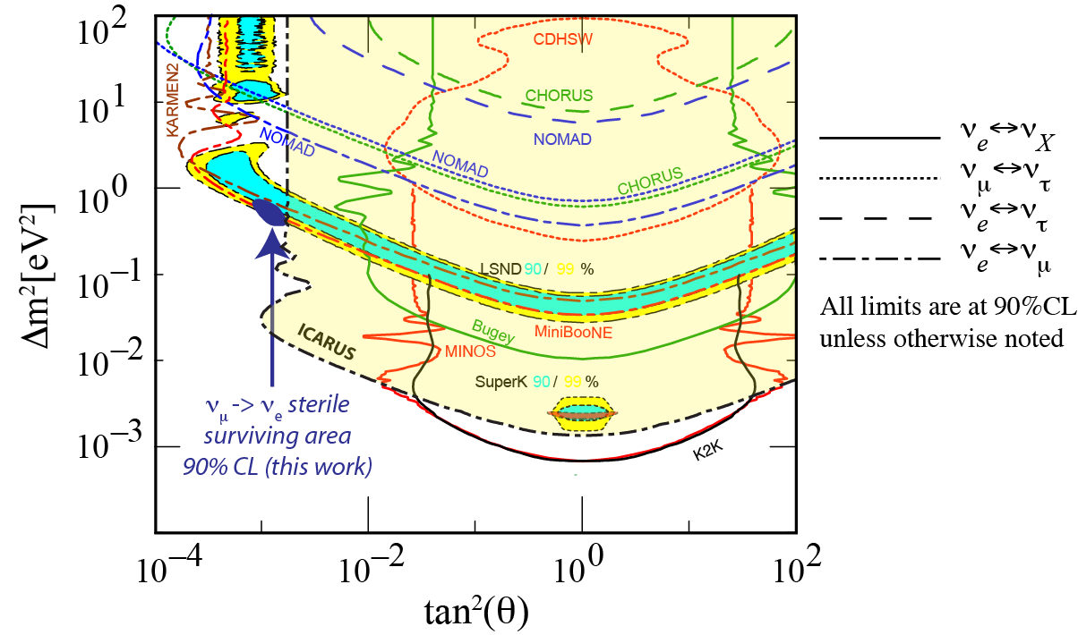
Search for LSND-like anomaly by ICARUS at LNGS
  ICARUS searched for νe excess related to LSND-like anomaly on the CNGS ν beam (~1% intrinsic νe contamination, L/Eν ~36.5 m/MeV). No excess was observed: number of νe events as expected in absence of LSND signal.
  Analysis on 7.23 x 10¹⁹ pot event sample provided the limit on the oscillation probability P(νμ→νe) ≤ 3.85 (7.60) x 10⁻³ at 90 (99) % C.L.
  ICARUS result indicates a very narrow region (Δm²~0.5 eV², sin²2θ~0.005) where all experimental results can be accommodated at 90% CL.
allowed MiniBooNE
allowed LSND 90%
allowed LSND 99%
Need for a definitive experiment on sterile neutrinos to clarify all the reported neutrino anomalies .
limit of KARMEN

Slide 12
SBN Sterile neutrino search at FNAL Booster ν beamline
    Joint ICARUS/SBND/MicroBooNE CDR received Stage 1 Approval from FNAL PAC Jan 2015. Three LAr-TPC’s at different distances from target: SBND (82 t), MicroBooNE (89 t) and ICARUS (476 t) at 100, 470 and 600 m.
    The experiment will likely clarify LSND/MiniBooNE, Gallex, reactor anomalies by precisely/independently measuring both νe appearance and νμ disappearance, mutually related through
    In absence of “anomalies”, three detector signals should be a close copy of each other for all experimental signatures.
    During its SBN operations, ICARUS will collect also ~ 2 GeV νeCC events with NUMI Off-Axis beam, an asset for the long baseline LAr project at FNAL:
      accurate determination of cross sections in LAr ;
      experimental study of all individual CC/NC channels to realize algorithms improving the identification of ν interactions.

Slide 13
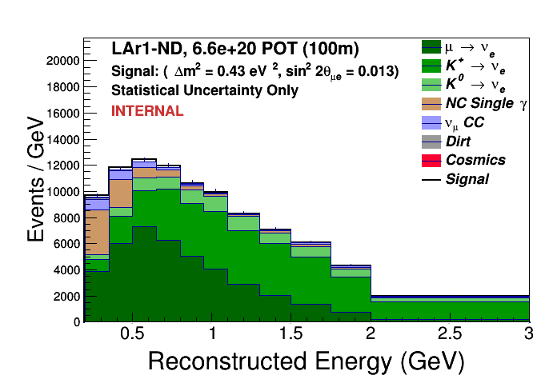
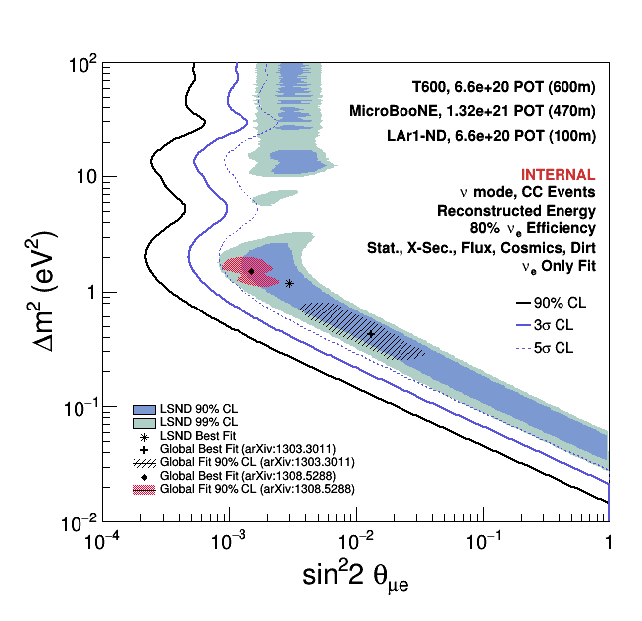
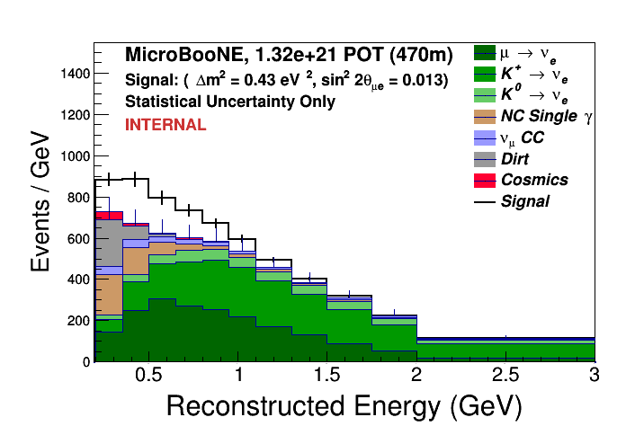
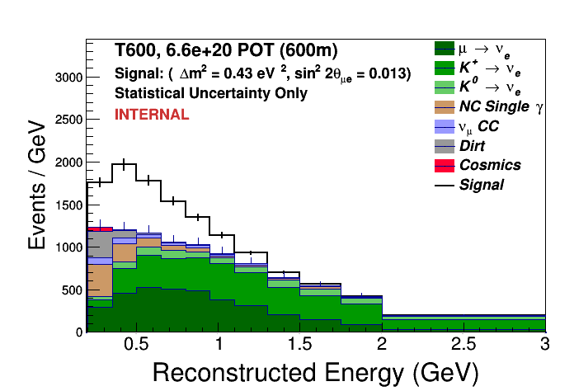
νμ → νe appearance sensitivity
Expected exposure sensitivity of ν_{μ} -> ν_{e} oscillations for 3 years - 6.6 10²⁰ pot BNB positive focusing (6 years for MicroBooNE).
SBND@ 100 m
MicroBooNE@ 470 m
Example for
(sin²(2θ)=0.013
Δm²=0.43 eV²)
T600@ 600 m
In absence of oscillations, the spectra should be copies of each other
The LSND 99%CL region
is covered at ~5σ level

Slide 14
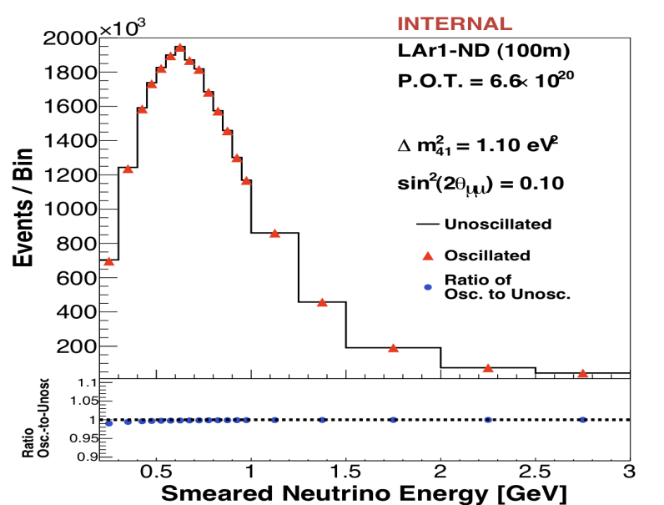
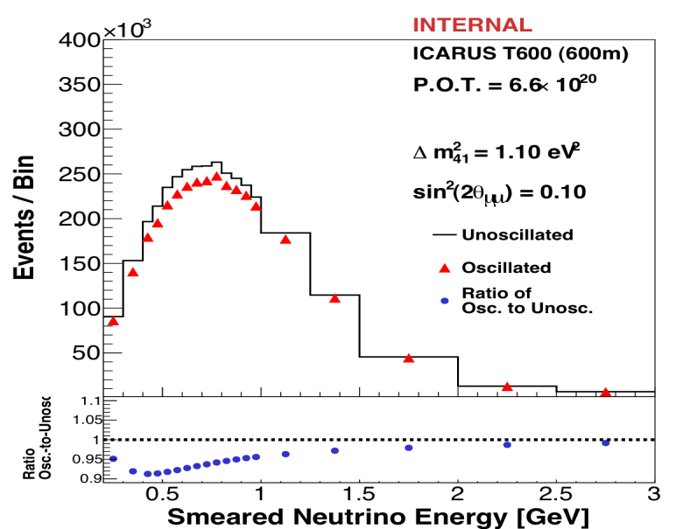
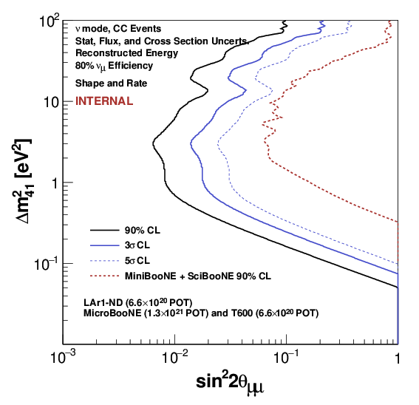
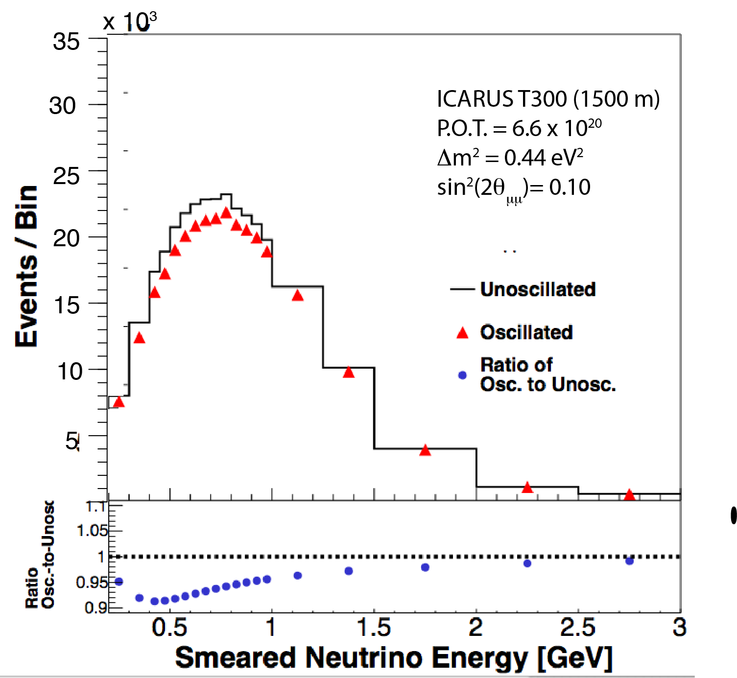
ν_{μ} disappearance sensitivity
Δm² = 1.1 eV²
Sin²2θ = 0.1
Δm² = 1.1 eV²
Sin²2θ = 0.1
High event rates/ correlations between 3 LAr-TPC ‘s will allow extending sensitivity by one order of magnitude beyond present limits.
However for Δm²< 0.5 eV² ν_{μ} disappearance at 600 m will be limited at lowest ν energy bins 0.2-0.4 GeV.
In order to amplify the effect we may move at a later stage one ICARUS T300 module to 1500 m distance.
Δm² = 0.44 eV² Sin²2θ = 0.1

Slide 15
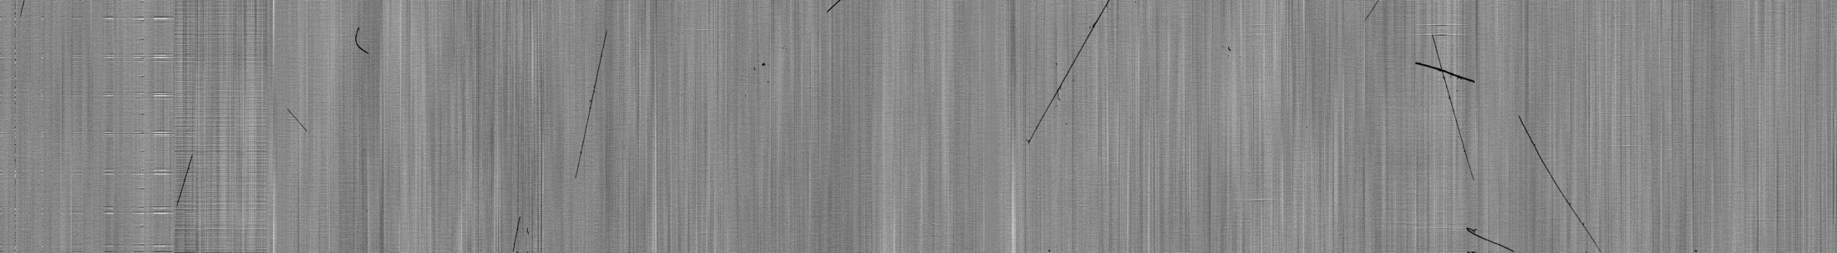
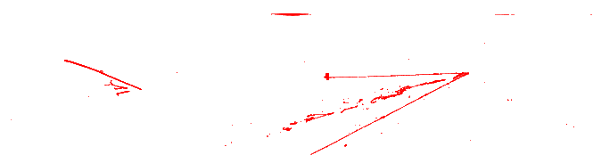
Facing a new situation: the LAr-TPC near the surface
At shallow depth ~12 uncorrelated cosmic rays will occur in T600 during 1 ms drift window readout at each triggering event.
This represents a new problem compared to underground operation at LNGS: the reconstruction of the true position of each track requires associating to each element of TPC image the occurrence time with respect to trigger time.
  Moreover, γ’s associated with cosmic μ’s represent a serious background for the ν_{e} appearance search since electrons generated in LAr via Compton scattering/ pair production can mimic a ν_{e} CC genuine signal.
  A 4π Cosmic Rays Tagger (total surface ~ 1200 m²) of plastic scintillators around the LAr active volume will unambiguously identify all cosmic ray particles entering the detector providing timing/position to be combined with the TPC reconstructed image.
Cosmic rays + low energy CNGS beam events

Slide 16
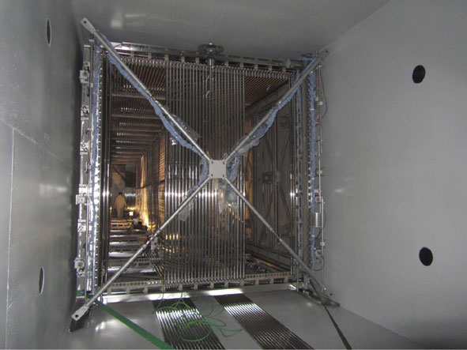
WA104 Project at CERN: overhauling of the T600
    INFN has signed a MoU for WA104 project at CERN for T600 overhauling in the framework of CERN Neutrino Platform for LAr-TPC development for short/ long baseline neutrino experiment.
    T600 is being upgraded introducing technology developments while maintaining the already achieved performance:
  new cold vessels (purely passive insulation);
  refurbishing of cryogenics/purification equipment;
  a cathode with better planarity;
  upgrade of the light collection system;
  new faster, higher-performance read-out electronics.
    Common items for ICARUS and other SBN LAr-TPCs: muon tagging systems to be designed/constructed; tools for event reconstruction have to be developed
    The detector is expected to be transferred to FNAL before end 2016 for installation, commissioning and start of data taking (end 2017).

Slide 17
Cold vessels, thermal insulation and cryogenic plant
New LAr cold vessels made by extruded aluminum profiles welded together: vacuum-tight double-walled container. Completion of the first vessel foreseen by the start of 2016; second one ready ~6 months later.
    Purely passive insulation coupled to a renovated, standard cooling shield with two-phase Nitrogen. Expected heat loss through the insulation: ≈ 6.6 kW (10-15 W/m²)
The original layout of the T600 cryogenic/purification plant is being revised: it will be re-organized into self-consistent sub-units (skids) to be built and fully tested at CERN, prior to delivery to FNAL. Re-usable components from the old installation are being selected.
Slide# : 17

Slide 18
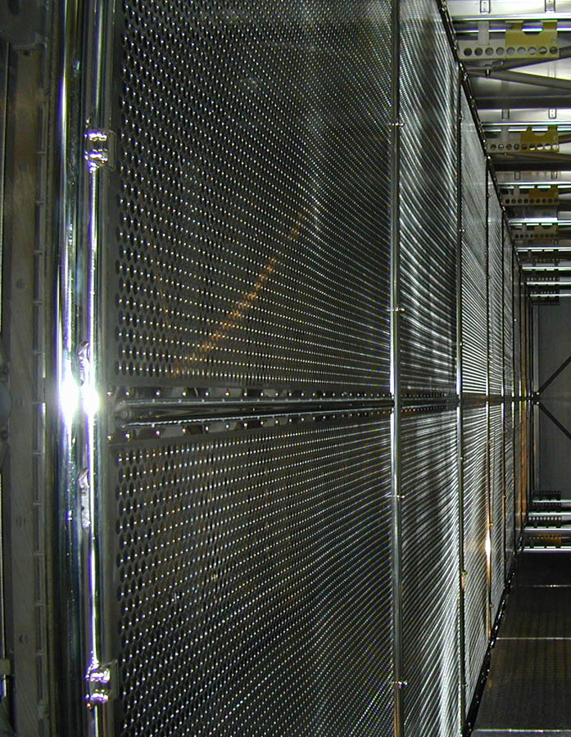
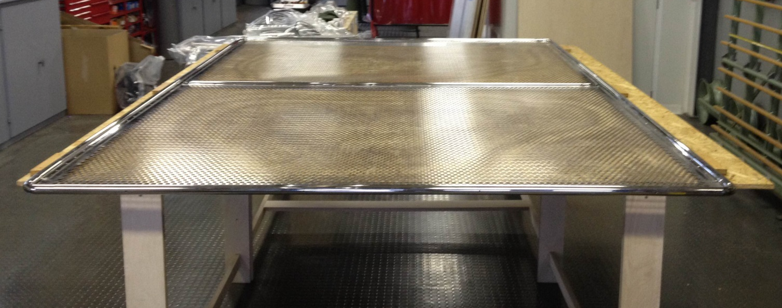
Cathode panel flattening
The old cathode panels were dismounted and thermally flattened with the help of CERN main workshop.
Original deformations were reduced from around 2.5 cm to few mm.
The re-installation inside the TPC will be completed within October.
Slide# : 18

Slide 19
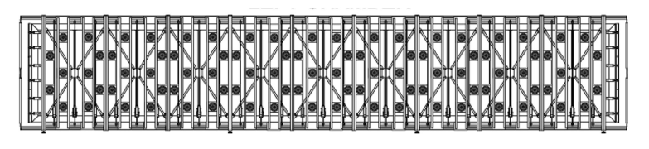
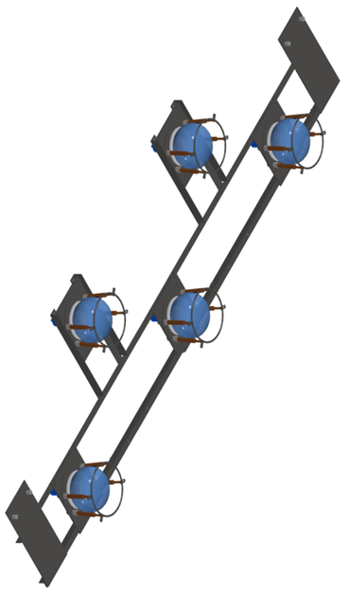
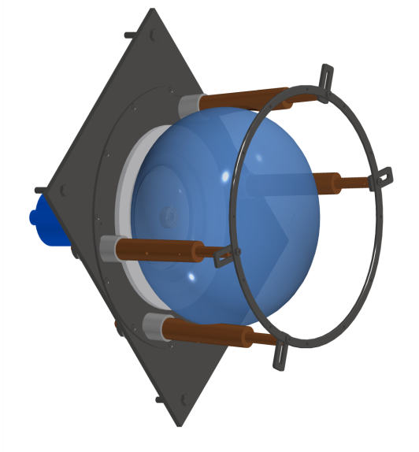
Upgraded Light Collection System
    Large surface, Hamamatsu 8” PMTs will be adopted, as in LNGS, but major improvements in space/time event localization capabilities will be required to reject cosmic backgrounds:
    higher quantum efficiency HAMAMATSU R5912-MOD;
    the T600 light detection system will be extended to 90 PMT per TPC, (5% area coverage). ~15 phe/MeV allowing to efficiently trigger low energy events.
    new voltage divider and shielding, to avoid induced
    spurious signals on TPC wire planes;
Shielding grid
new mechanical design of the scintillation light
collection system;
Test, characterization and TPB deposition of all 400 PMTs underway in CERN dedicated labs.
PMT
Slide# : 19

Slide 20
Event localization and identification with PMTs
Main requirements for the refurbished light detection system:
  High detection coverage, to be sensitive to low Eν deposition (~ 100 MeV)
  High detection granularity, to localize events and unambiguously associate the collected light to deposited charge;
  Fast response - high time resolution, to be sensitive to timing of each event in the T600 DAQ windows (~ 1 ms); a ~1 ns precision is advisable to exploit the 2ns/19ns bunched beam structure .
Cosmic μ’s: 4%
νμCC+showers: 93%
Cosmic μ’s: 96%
νμCC+showers:7%
95 % events localized within 30 cm
Neural Networks can provide a clear
cosmic muon identification

Slide 21
Conclusions
ICARUS T600 detector has successfully completed the LNGS operation with the CNGS beam, demonstrating that LAr-TPC is a leading technology for future short/long baseline accelerator driven neutrino physics.
The accurate analysis of the CNGS ν events provided no evidence of oscillation into sterile neutrinos in ICARUS L/E interval: the global fit of all SBL data + ICARUS limits the window of parameters for a possible LSND anomaly to a very narrow region around 0.5 eV².
A joint ICARUS/SBND/MicroBooNE collaboration (SBN neutrino experiment at FNAL Booster) has been set up to definitively clarify LSND/MiniBooNE, Gallex, reactor anomalies, profiting of the presence of three LAr-TPCs at different baselines.
The T600 detector has now been moved to CERN for a significant overhauling in view of its transportation to FNAL, where it is expected to start data taking by end 2017 with the Booster Neutrino Beam.
ICARUS will also provide a significant amount of data in the energy range of interest for the next Long Baseline experiment.

Slide 22
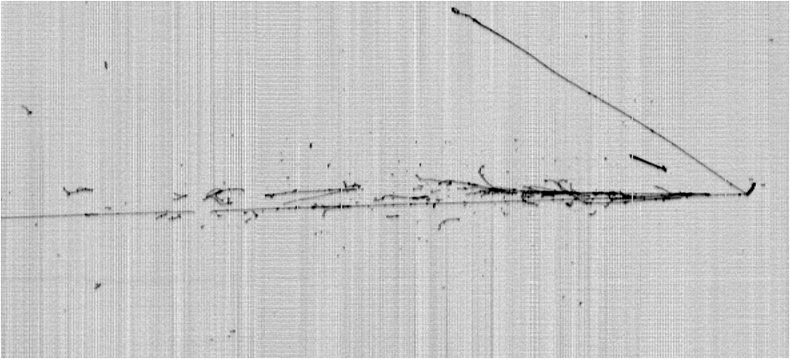
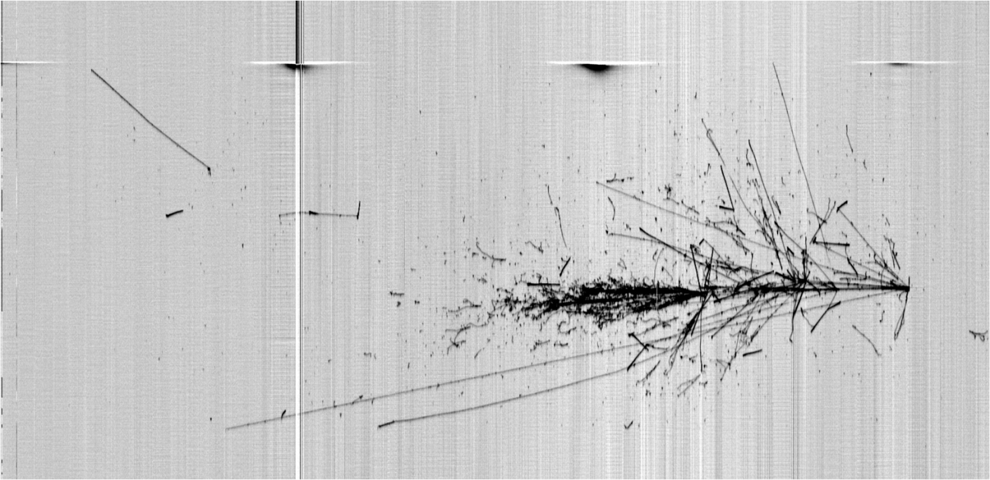
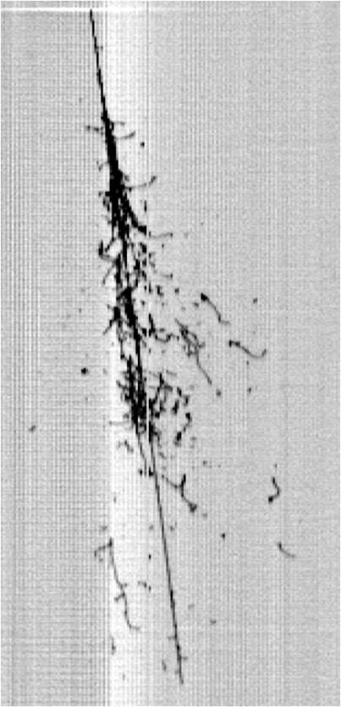
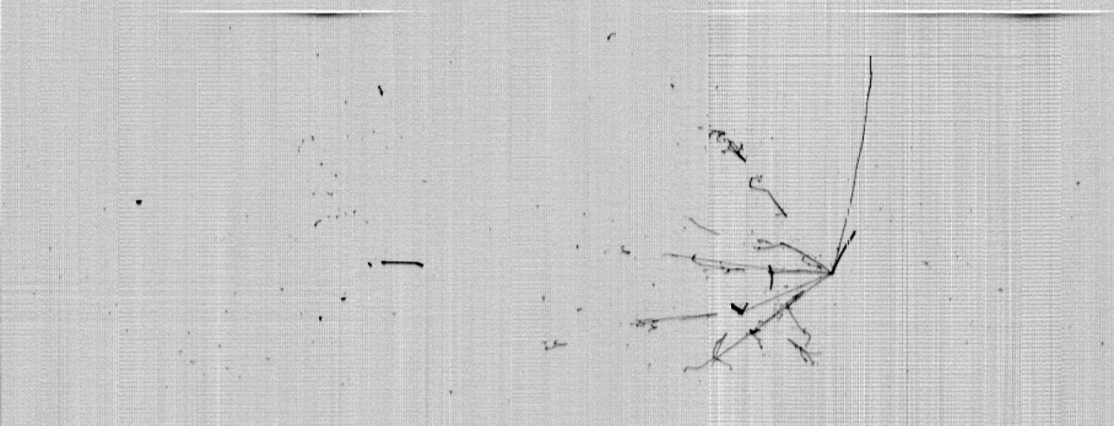
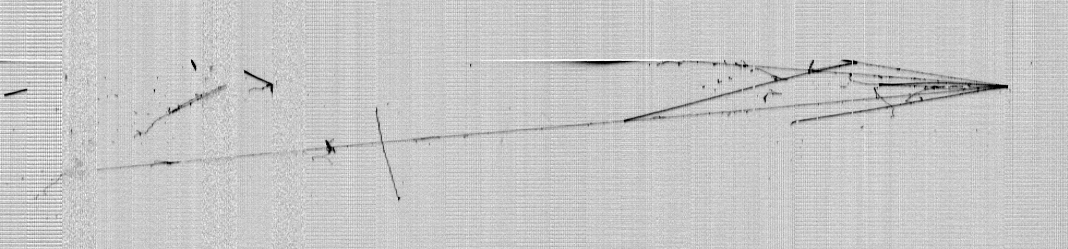
Thank you !

Slide 23
Backup

Slide 24
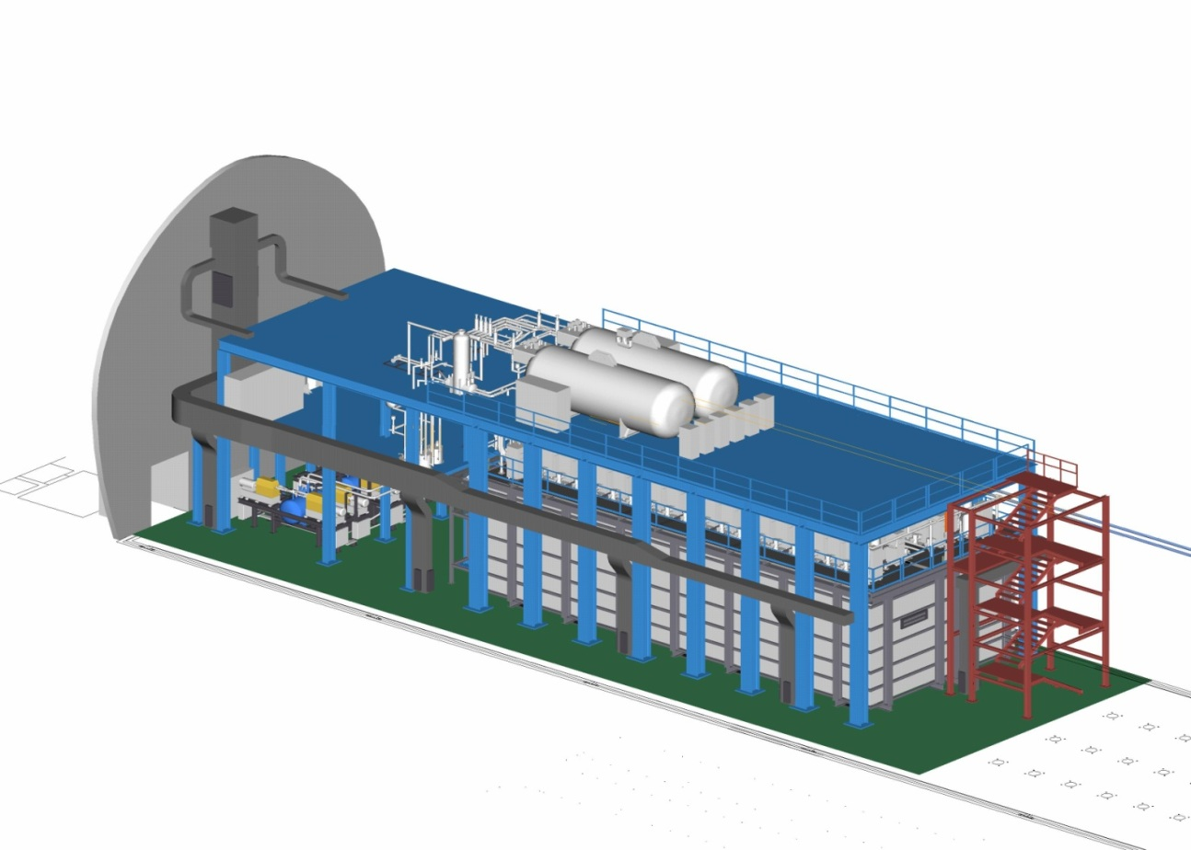
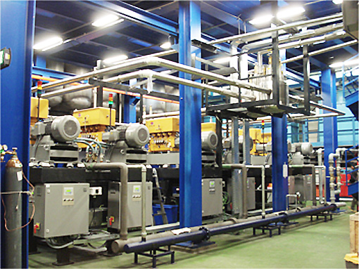
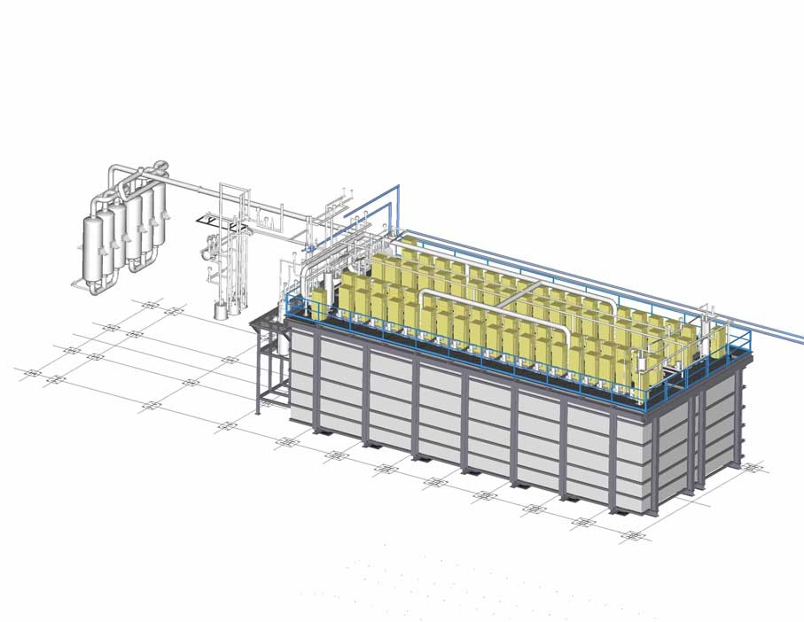
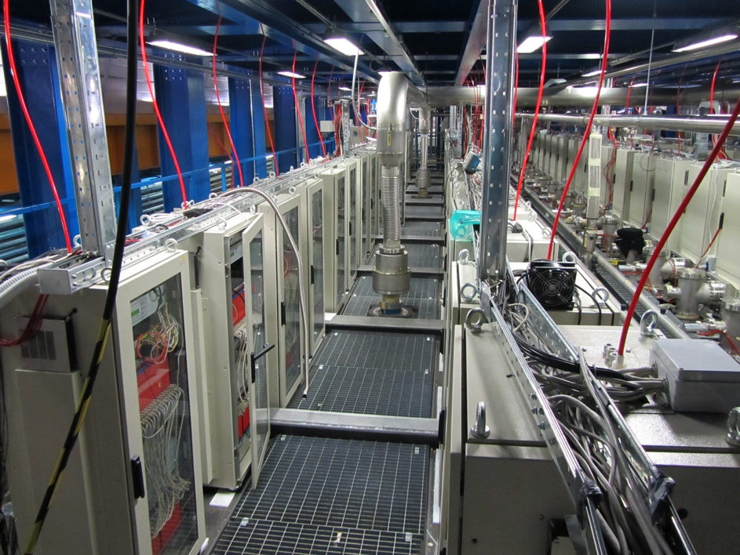
ICARUS-T600 @ LNGS Hall B: 0.77 kton LAr-TPC
N2 Phase separator
30 m³ Vessels for LN2 cooling circuit
N2 liquefiers: 12 units, 48 kW total cryo-power
54000 electronic ch, low noise charge amplifiers + digitizers, S/N > 10
LAr purification systems
GAr purification systems
Slide: 24

Slide 25
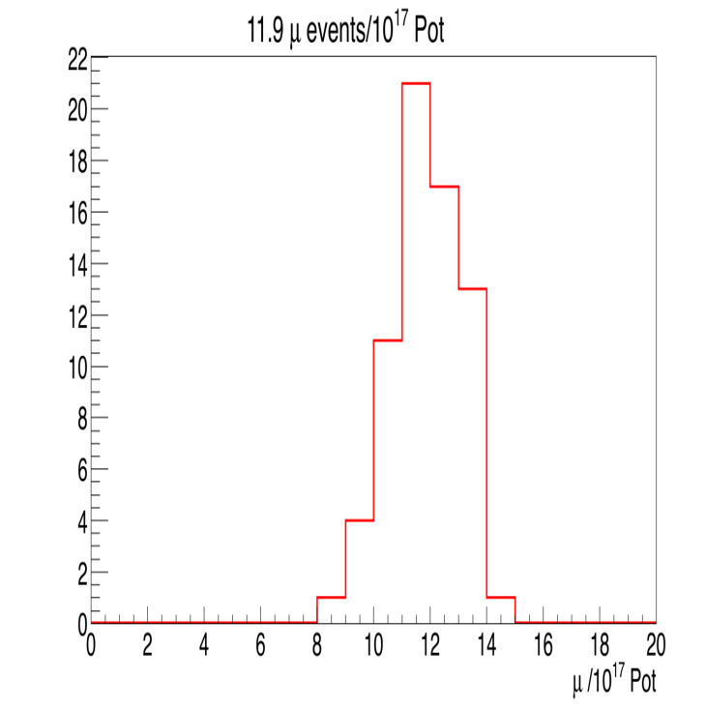

ICARUS: summary of collected data with CNGS
A total sample of 2650 ν interactions corresponding to 7.93 10¹⁹ over 8.6 10¹⁹ pot collected has been filtered, scanned & preliminarly analyzed
Distributions of collected neutrinos and of beam related μs normalized by 10¹⁷pot statistics and DAQ efficiency: 3.4 νs 12 μs events on average
2011
2012
Data are consistent within 6% with MC predictions for corresponding exposure

Slide 26



Cosmic Ray Tagger
Design and development of the CRT is under way, as a common tool to be applied to the three SBN detectors (T600, SBND, MicroBooNE).
The present solution involves plastic scintillators, with embedded optical
fibres read by SiPMs.
The amount of coverage results from the balance between the need to efficiently tag external CR muons and not veto internal νCC events with outgoing muons.
Presently 95% coverage is foreseen; US groups and CERN are working on material testing and electronics development
Foreseen detector CRT coverage

Slide 27
PMT calibration system
A time resolution of~1 ns is required for an efficient rejection of the background but PMT are affected by transit-time drift.
Equalization of each single channel may be obtained by analyzing crossing muons or by routinely delivering a fast laser pulse to each PMT.
A calibration system, made by fused fiber splitters, optical switches and optical patch-cords, has been designed and an optical fiber will be installed for each PMT.
The system will include a fast laser diode, a 1xN optical switch and 25 (1x16) or 50 (1x8) fused optical splitters, in addition to the necessary optical feed-throughs and patch-cords.
The internal part has been defined (50/125 optical fibers), but some critical issues, such as the availability of high-performance (vacuum tight) fiber feed throughs are under study.

Slide 28


An upgraded electronics
Architecture of ICARUS electronics is based on analogue low noise “warm” front-end amplifier, a multiplexed 10-bit 2.5 MHz AD converter and a digital VME module for local storage, data compression & trigger.
A signal to noise ratio > 10 and ~ 0.7 mm single point resolution were obtained at LNGS run, resulting in precise spatial event reconstruction and μ momentum by multiple scattering.
Some limitations: asynchronous sampling of ch.s within 400 ns sampling-time slightly affecting MCS measurement, data throughput mainly due to VME.
Some relevant ongoing changes/improvements:
  Serial ADCs (10-12 bits, one per channel) in place of the multiplexed ones;
  Synchronous sampling of all channels (400 ns sampling time) of whole detector;
  Digital part contained in a single, high performance FPGA per board, that handles signal filtering, organizes information provided by the serial ADCs;
  Housing/ integration of electronics onto detector; serial bus with optical links for faster transmission.
From 595
to 10 liters

