Slide 1

Testing SUSY SO(10) at the LHC
Stuart Raby
NNN15/UD2
Stony Brook
October 28, 2015

Slide 2
Outline
SUSY SO(10) minimal model
Yukawa unification – first order effects
Global χ² analysis
Fits
Predictions
Fine-tuning
Conclusions

Slide 3
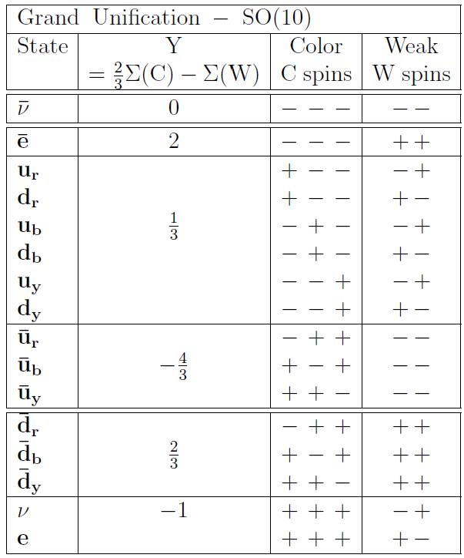
SO(10) Grand Unification
Georgi
Fritzsch & Minkowski
spinor repsn.
of SO( 10 ) –
16
tensor product
of 5 spin ½
w/even no. + signs

Slide 4
Soft SUSY breaking terms

Slide 6
Yukawa Unification & Soft SUSY breaking
Blazek, Dermisek & Raby PRL 88, 111804 (2002)
PRD 65, 115004 (2002)
Baer & Ferrandis, PRL 87, 211803 (2001)
Auto, Baer, Balazs, Belyaev, Ferrandis & Tata
JHEP 0306:023 (2003)
Tobe & Wells NPB 663, 123 (2003)
Dermisek & Raby Phys. Lett. B 622, 327 (2005)
Baer, Kraml, Sekmen & Summy JHEP 0909 :005 (2009)
Anandakrishnan, Raby & Wingerter arXiv:1212.0542
Anandakrishnan & Raby arXiv:1303.5125
Anandakrishnan, Bryant & Raby arXiv:1404.5628
Poh & Raby arXiv:1505.00264

Slide 7
Note, CANNOT predict top mass due to
large SUSY threshold corrections to
bottom and tau mass
Hall, Rattazzi & Sarid
Carena, Olechowski, Pokorski & Wagner
So instead use Yukawa unification to predict
soft SUSY breaking masses !!

Slide 8
Bottom mass corrections
Needed to fit data

Slide 9
Outline
SUSY SO(10) minimal model
Yukawa unification – first order effects
Global χ² analysis
Fits
Predictions
Fine-tuning
Conclusions

Slide 10
Anandakrishnan, Raby & Wingerter
arXiv:1212.0542
Anandakrishnan, Bryant & Raby
arXiv:1404.5628
Global χ² analysis
3rd family only

Slide 11
Yukawa Unification
~ Universal Gaugino Masses
Fit t,b,tau requires

Slide 12
Inverted scalar mass hierarchy
Bagger, Feng, Polonsky & Zhang
PLB473, 264 (2000)
Third family scalars lighter than first two !
Suppresses flavor & CP violation

Slide 13
Heavy scalars

Slide 14
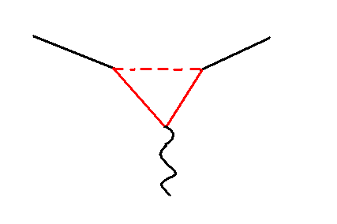
Need Heavy scalars !
b
s
γ

Slide 16
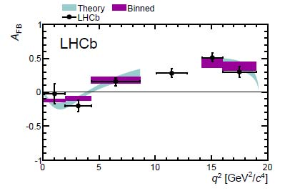
arXiv: 1304.6325

Slide 17
tension between b → s γ & b → s l⁺ l⁻
Albrecht, Altmannshofer, Buras, Guadagnoli, & Straub
JHEP 0710:055 (2007)

Slide 18
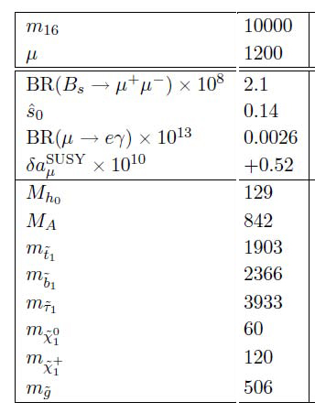
Albrecht, Altmannshofer, Buras, Guadagnoli, & Straub
JHEP 0710:055 (2007)

Slide 19
Light Higgs
SM-like

Slide 20
Br( B_{s} -> μ⁺ μ⁻ ) :
Light Higgs SM-like
SM : 3 x 10⁻⁹ MSSM : ~ (tan β)⁶ /m_{A}⁴

Slide 21
Summary
First order results
Third family only
Universal scalar masses > 8 TeV
Third family scalars much lighter
Light Higgs is SM-like
Gluino mass < 2.4 TeV

Slide 22
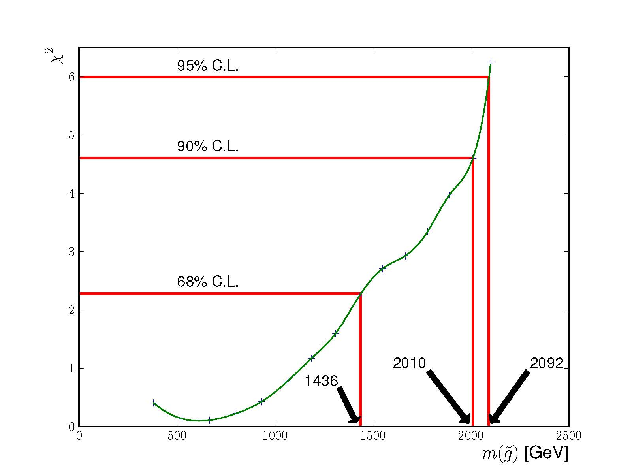
Gluino mass bound - Third family only
Anandakrishnan, Raby & Wingerter
m₁₆ = 20 TeV, M_{1/2} varied -> 2 d.o.f.

Slide 23
Three family model
gives good fits
to low energy data

Slide 24
Outline
SUSY SO(10) minimal model
Yukawa unification – first order effects
Global χ² analysis - 3 families
Fits
Predictions
Fine-tuning
Conclusions

Slide 25
3 Family SO(10) + family symmetry
Dermisek & Raby PLB 622:327 (2005).
Dermisek, Harada & Raby PRD74, 035011 (2006)
Albrecht, Altmannshofer, Buras, Guadagnoli & Straub
JHEP 0710:055 (2007)
Anandakrishnan, Raby & Wingerter
arXiv:1212.0542
Poh & Raby
arXiv:1505.00264

Slide 26
3 family SO₁₀ SUSY Model
D₃ x U(1) Family Symmetry
Superpotential
Yukawa couplings
Global χ² analysis
Charged fermion masses & mixing
Neutrino masses & mixing

Slide 27
Superpotential for charged fermion
Yukawa couplings
Familon VEVs
assumed

Slide 28
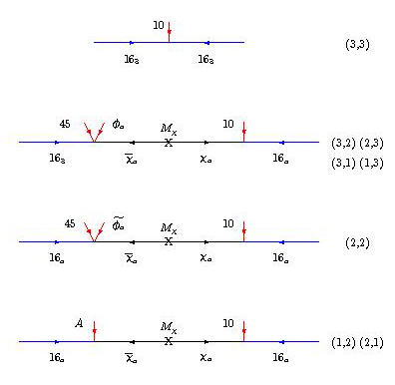
Effective
higher
dimension
operators

Slide 29
SO(10) x [ D₃ x U(1) family sym. ]
Yukawa Unification for 3rd Family
7 real para’s
+ 4 phases
Dermisek & Raby
PLB 622:327 (2005).

Slide 30
SO(10) x [ D₃ x U(1) family sym. ]
Yukawa Unification for 3rd Family

Slide 31
Extend to neutrino sector
Assume 3 new real para’s

Slide 33
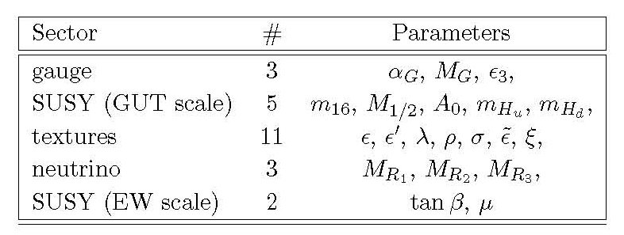
Global χ² analysis
parameters at GUT scale
+ α for Mirage (well-tempered DM)
45 Low energy observables

Slide 34
Outline
SUSY SO(10) minimal model
Yukawa unification – first order effects
Global χ² analysis - 3 families
Fits - Poh & Raby arXiv:1505.00264
Predictions
Fine-tuning
Conclusions

Slide 35
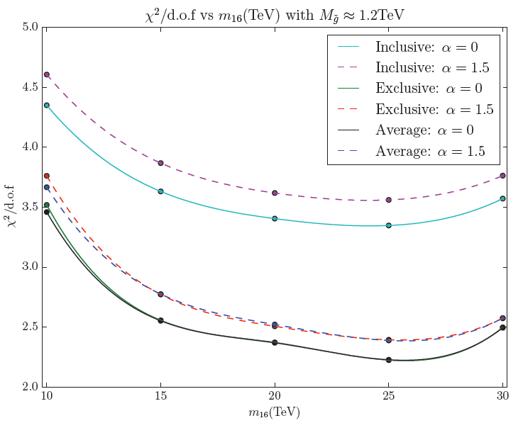

Slide 36
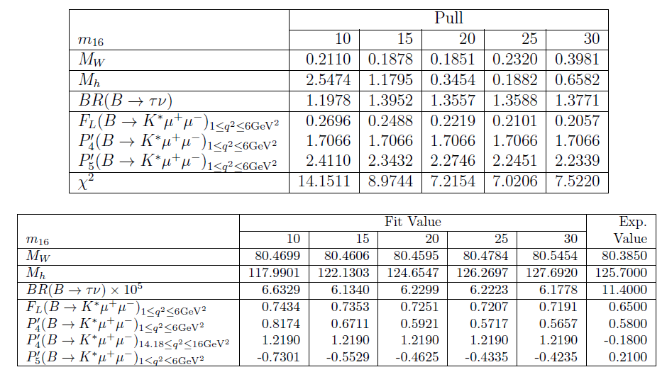

Slide 39
Carena,
Quiros &
Wagner ‘95

Slide 42
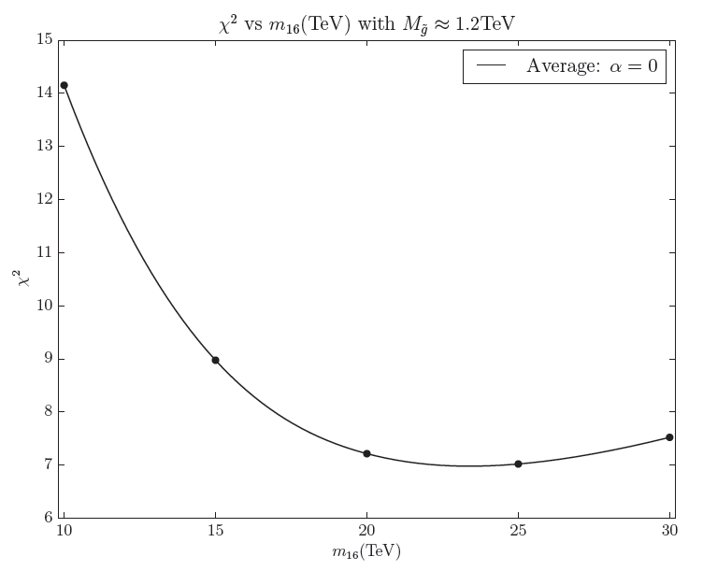
6 Observables only

Slide 44
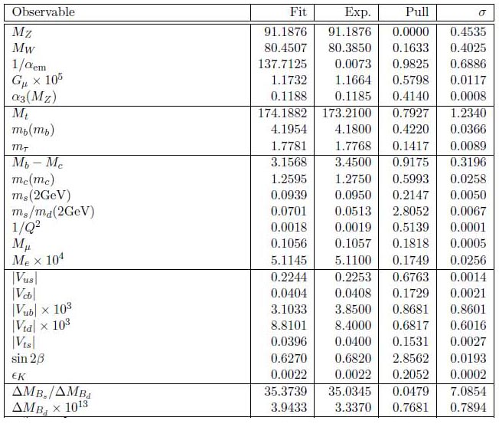

Slide 45
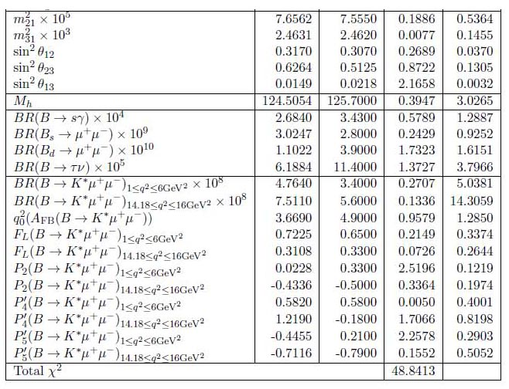

Slide 46
Outline
SUSY SO(10) minimal model
Yukawa unification – first order effects
Global χ² analysis - 3 families
Fits
Predictions - Poh & Raby arXiv:1505.00264
Fine-tuning
Conclusions

Slide 47
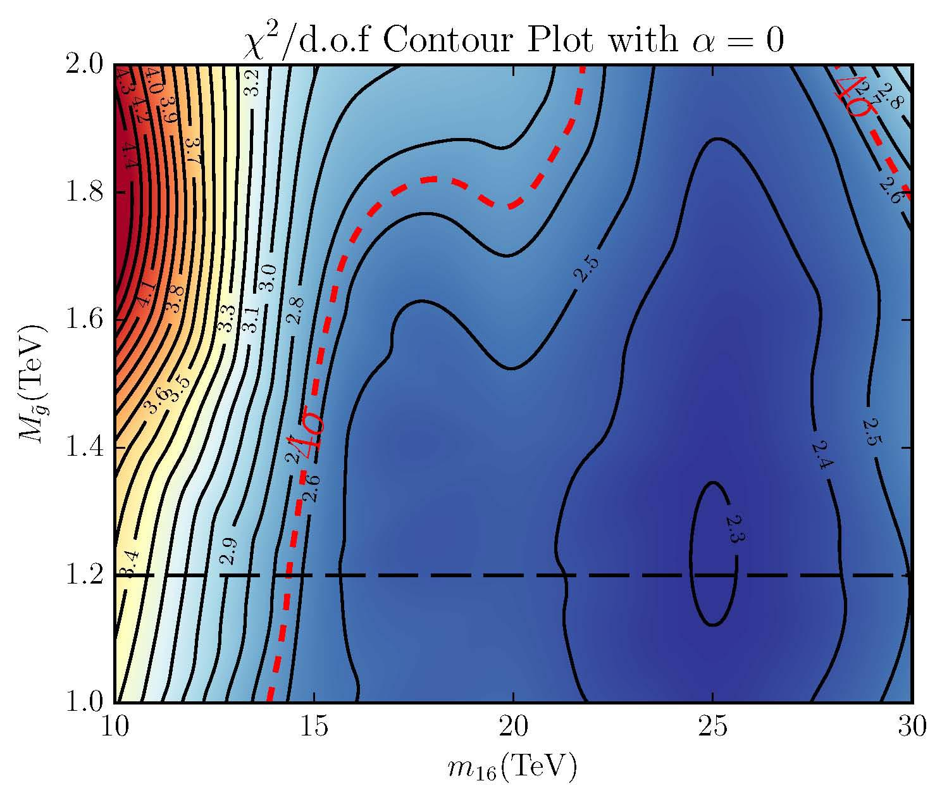
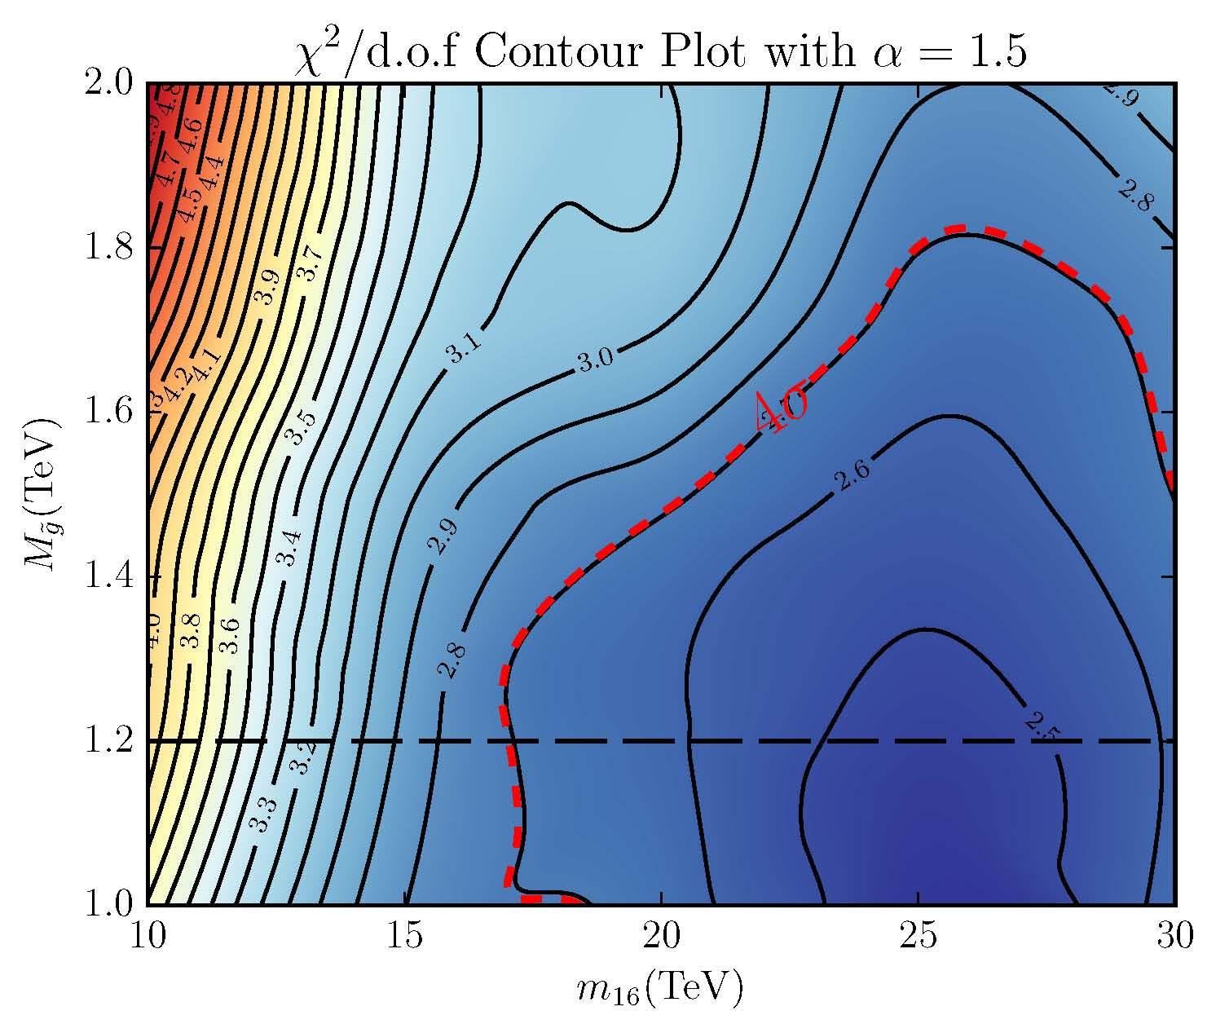

Slide 48
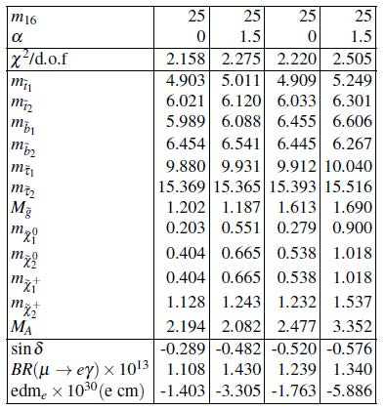
Some Benchmark points

Slide 49
A BRIEF ASIDE
LHC bounds on the gluino mass
using benchmark points with m₁₆ = 20 TeV and
α = 0 and 1.5 compared to CMS and ATLAS data
gluino branching ratios
NOT simplified models !!
Anandakrishnan, Bryant & Raby arXiv: 1404.5628

Slide 50
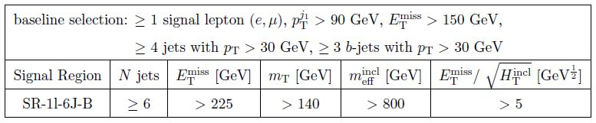
Most stringent signal region
ATLAS-CONF-2013-061
final states with large missing transverse momentum,
at least four, six, or seven jets, at least three jets
tagged as b-jets, and either zero or at least one lepton.

Slide 51
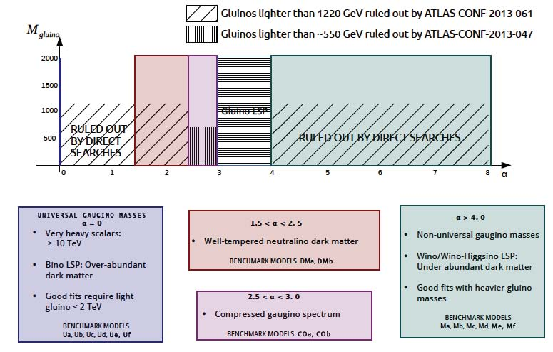
CMS & ATLAS data using CHECKMATE

Slide 52
Outline
SUSY SO(10) minimal model
Yukawa unification – first order effects
Global χ² analysis - 3 families
Fits
Predictions - Poh & Raby arXiv:15
Fine-tuning
Conclusions

Slide 53
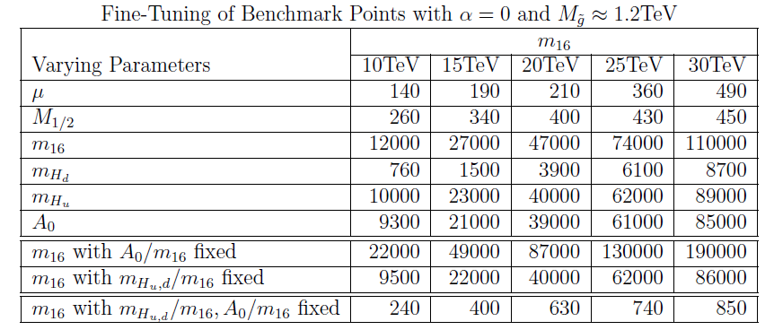
Fine-tuning
Fundamental Physics ??

Slide 54
Conclusions
SO(10) Yukawa unification
Boundary conditions at M_{GUT}
~ Universal or “Mirage” gaugino masses
Light Higgs - SM-like
Three family model fits low energy data !!
SUSY at Run II of LHC !
BR( μ −> e γ ) observable !

Slide 55
NOT “Natural” SUSY
BUT SUSY does not completely decouple
NOT “Split” SUSY
BUT gravitino & moduli sufficiently heavy
so NO cosmological problems

Slide 56

“SUSY on the Edge”
painting by Hans Werner Sahm

