Slide 1


NNN15/UD2
Realistic F-theory Compactifications
Mirjam Cvetič

Slide 2
Outline:
Motivation: F-theory & Particle Physics
II. Key Ingredients of F-theory Compactification
(non-Abelian gauge symmetry, matter, Yukawas)
III. Particle Physics Model Building
(highlight concrete example of MSSM)
IV. Further Developments:
Abelian & Discrete Symmetries in F-theory
Emphasize geometric perspective
Apologies: Upenn-centric

Slide 3
F-theory?
F-theory = Type II String
  Coupling g_{s} part of
  geometry (12dim)
  Torus fibered
  Calabi-Yau manifold
back-reacted
D-branes
regions with large
g_{s} on non-CY space
g_{s} –string coupling

Slide 4
F-theory?
M-theory (11dim SG)
on S¹
F-theory = Type IIB
  Coupling g_{s} part of
  geometry (12dim)
back-reacted
D7-branes
regions with large
g_{s} on non-CY space
g_{s} –string coupling

Slide 5

F-theory?
M-theory
Type II A
On T²
Limit vol(T²) 0
on S¹
E₈xE₈ Het.
Certain
setups
F-theory = Type IIB
  Coupling g_{s} part of
  geometry (12dim)
back-reacted
D7-branes
regions with large
g_{s} on non-CY space
Certain
setups
Type I
SO(32) Het.
S-duality

Slide 7
F-Theory Motivation
At finite coupling → broader domain of string theory landscape w/ promising particle physics
SU(5) GUT couplings that are absent in perturbative string theory w/ D-branes, e.g.,10 10 5
appearance of exceptional gauge symmetries (E₆ )
(will not address moduli stabilization, though promising)
.
.
[Donagi,Wijnholt’08]
[Beasley,Heckman,Vafa’08]….
Conceptual: geometric description at large string coupling
Determine discrete data:
gauge symmetry, matter reps. & multiplicities, Yukawa couplings

Slide 9
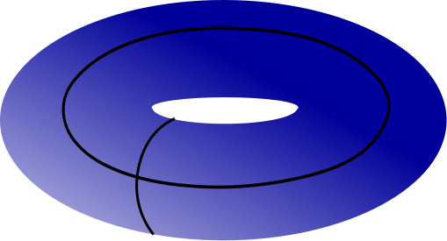

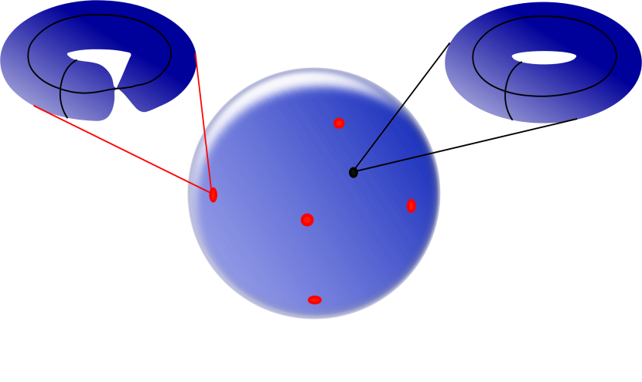
F-theory: basic ingredients
F-theory is a geometric formulation of string theory w/D-branes, where one adds a geometric object: torus w/ SL(2,Z) symmetry
τ- torus complex structure: - string coupling (axion-dilaton)
Torus – fibered over a compactified (base) space B
i.e. torus coordinates depend on the base B
Torus= elliptic curve
Weierstrass form:
f, g- function fields on B
[z:x:y] coords on P²(1,2,3)
1
τ(z)
B

Slide 10
F-theory: basic ingredients
F-theory is a geometric formulation of string theory w/D-branes, where one adds a geometric object: torus w/ SL(2,Z) symmetry
τ- torus complex structure: - string coupling (axion-dilaton)
Torus – fibered over a compactified (base) space B
i.e. torus coordinates depend on the base B
1
τ(z)
D₇
B
At brane location in B torus degenerates w/ g_{s}➔∞ singular:
String Theory in non-perturbative regime

Slide 11
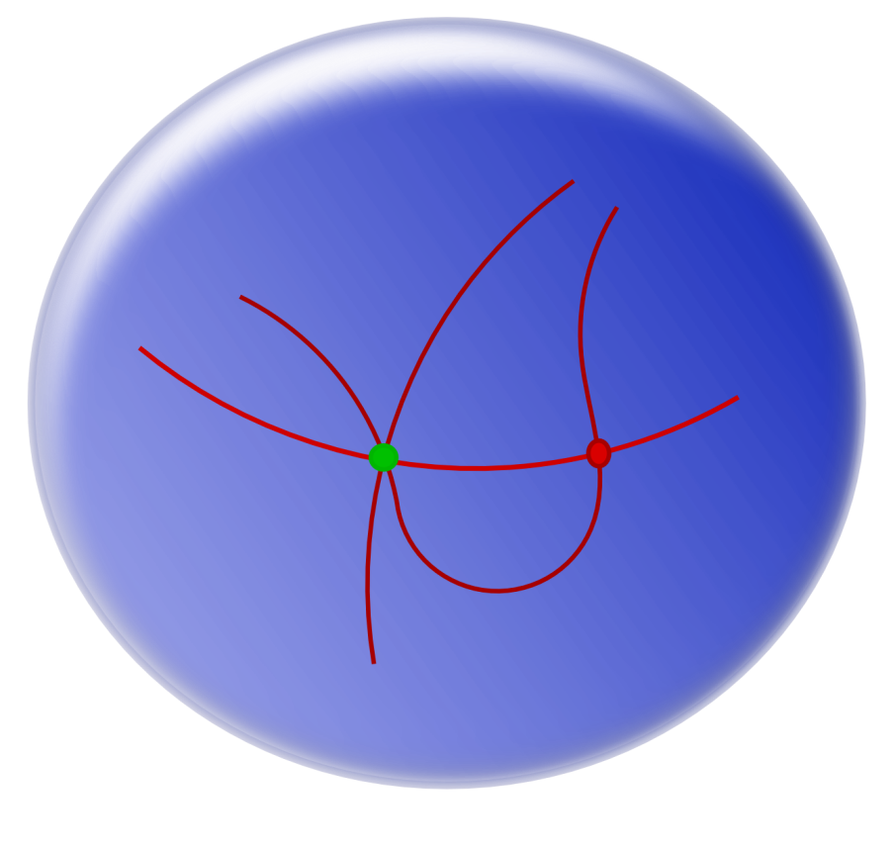
F-theory: basic ingredients
Total space of torus-fibration: singular elliptic Calabi-Yau manifold X
D=4, N=1 vacua: fourfold X₄ [all dimensions complex]
Singularities encode complicated set-up of intersecting D-branes:
B

Slide 12
F-theory: basic ingredients
Total space of torus-fibration: singular elliptic Calabi-Yau manifold X
D=4, N=1 vacua: fourfold X₄
Singularities encode complicated set-up of intersecting D-branes:
Non-Abelian gauge symmetry in codimension-one singul. in B (divisors wrapped by branes)
B

Slide 13
F-theory: basic ingredients
Total space of torus-fibration: singular elliptic Calabi-Yau manifold X
D=4, N=1 vacua: fourfold X₄
Singularities encode complicated set-up of intersecting D-branes:
Non-Abelian gauge symmetry in codimension-one singul. in B (divisors wrapped by branes)
Matter in codimension-
two singul. in B
(intersecting branes)
B

Slide 14
F-theory: basic ingredients
Total space of torus-fibration: singular elliptic Calabi-Yau manifold X
D=4, N=1 vacua: fourfold X₄
Singularities encode complicated set-up of intersecting D-branes:
Non-Abelian gauge symmetry in codimension-one singul. in B (divisors wrapped by branes)
Matter in codimension-
two singul. in B
(intersecting branes)
B
Yukawa couplings in
codimension-three singul.
in B

Slide 15
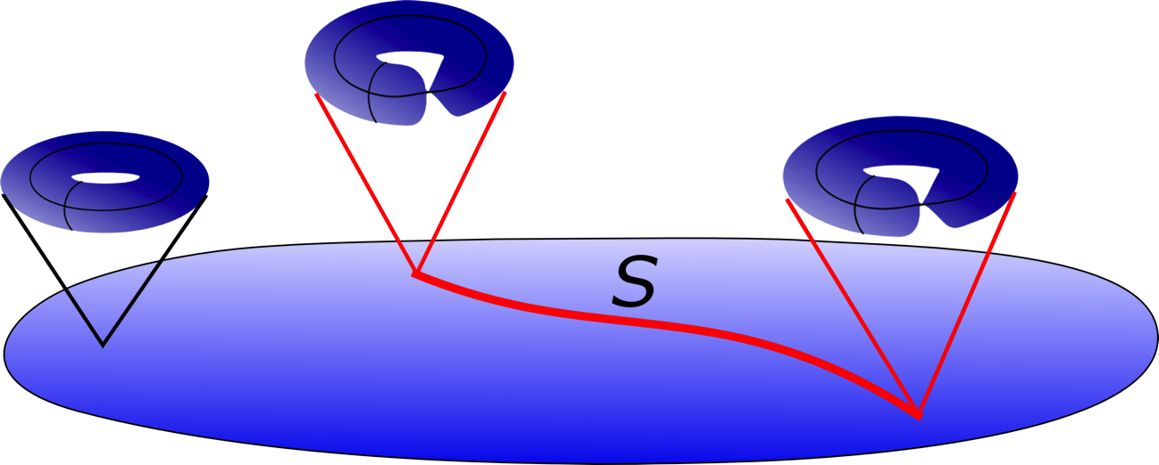

Highlights: Non-Abelian Gauge Symmetry
[Kodaira; Tate; Vafa; Morrison,Vafa;…]
1. Weierstrass form for elliptic fibration of X
2. Severity of singularity along divisor S in B:
3. Resolution: singularity type ←→ structure of a tree of ‘s over S
B
[ord_{S}(f),ord_{S}(g),ord_{S}(Δ)] ←→ Singularity type of fibration of X
I_{n}-singularity ←→ SU(n) Dynkin diagram
Deformation: [Grassi, Halverson, Shaneson]
Cartan generators for A^{i} gauge bosons: in M-theory via Kaluza-Klein (KK) reduction of C₃ potential along (1,1)-forms on X
Non-Abelian generators: light M2-brane excitations on ‘s
[Witten]

Slide 16
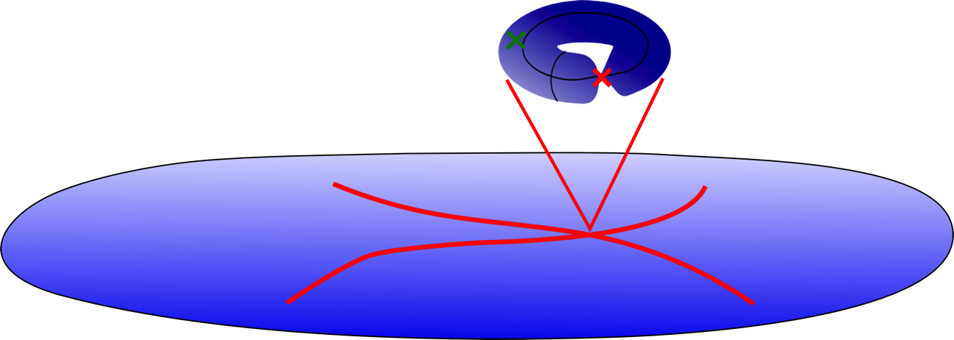
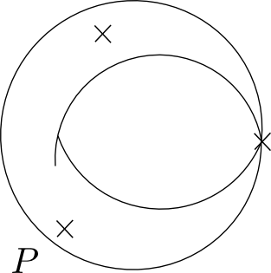
Highlights: Matter
Singularity at codimension-two in B:
I₂ fiber Singular fiber
resolved
B

Slide 17
Highlights: Matter
Singularity at codimension-two in B:
I₂ fiber Singular fiber
resolved
B
w/isolated (M2-matter) curve wrapping → charged matter
(determine via intersection theory)

Slide 18
Initial focus: F-theory with SU(5) Grand Unification
[Donagi,Wijnholt’08][Beasley,Heckman,Vafa’08]…
Model Constructions:
[Donagi,Wijnholt’09-10]…[Marsano,Schäfer-Nameki,Saulina’09-11]…
Review: [Heckman]
[Blumehagen,Grimm,Jurke,Weigand’09][M.C., Garcia-Etxebarria,Halverson’10]… [Marsano,Schäfer-Nameki’11-12]…[Clemens,Marsano,Pantev,Raby,Tseng ’12]…
a bit more later
c.f., Hebecker’s talk
Recent progress on other Particle Physics Models:
Standard Model building blocks (via tops of dP₂) [Lin,Weigand’14]
First Global 3-family Standard, Pati-Salam, Trinification Models
[M.C., Klevers, Peña, Oehlmann, Reuter 1503.02068]
highlights

Slide 19
I. Particle Physics & F-theory
concrete examples

Slide 20
Construction of Torus Fibrations
Torus = elliptic curve
Examples of constructions via toric techniques:
as a Calabi-Yau hypersurface in the two-dimensional toric variety ,
(generalized projective spaces, associated with 16 reflexive polytops ):
[Klevers, Peña, Piragua, Oehlmann, Reuter’14]
ii. Elliptically fibered Calabi-Yau space:
Impose Calabi-Yau condition:
coordinates in and coeffs. of lifted to
sections on (specific functions of) B

Slide 21
Model Building Strategy:
i. Construction of X_{Fi} w/ Particle Physics
gauge symmetry (codim-1), matter reps. (codim-2) & Yukawas (codim-3)
F₁₁ - Standard Model
F₁₃ - Pati-Salam Model
F₁₆ - Trinification Model
focus
[hypersurface constraint in dP₄ ( [u:v:w] with four blow-ups [e₁:e₂:e₃:e₄])

Slide 22
ii. Chiral index for D=4 matter:
a) construct G₄ flux by computing
b) determine matter surface (via resultant techniques)
iii. Global consistency – D3 tadpole cancellation:
a) satisfied for integer and positive n_{D3}
b) check, all anomalies are cancelled

Slide 23
Standard Model:
Base B =
Divisors in the base:
Solutions (#(families);n_{D3}) for allowed (n₇,n₉):

Slide 24
Pati-Salam Model
Solutions (#(families);n_{D3}) for allowed (n₇,n₉):

Slide 25
Trinification Model
Solutions (#(families);n_{D3}) for allowed (n₇,n₉):

Slide 26
Yukawa Couplings (codimension-3 singularities)
Generically there for all gauge invariant couplings
(for MSSM example → μ-problem; R-parity violating terms)
Magnitudes?
Technology not developed, yet
- possibly tuned by adjusting complex structure moduli
- construction of MSSM w/ discrete symmetry
[work in progress, M.C., Klevers,Reuters]
Techniques in local models [Marchesano et al.]
Non-perturbative (D3-instanton) effects
[Martucci,Weigand]
Detailed Phenomenology →
Long shot

Slide 27
II. U(1)-Symmetries in F-Theory

Slide 28
(F-theory applications [Antoniadis,Leontaris,King,..])
Abelian sector rather unexplored
A lot of recent progress ’12-’15: [Grimm,Weigand;… Morrison,Park; M.C.,Grimm,Klevers;… Borchmann,Mayrhofer,Palti,Weigand; M.C.,Klevers,Piragua; MC,Grassi,Klevers,Piragua;…
Braun,Grimm,Keitel; … M.C.,Klevers,Piragua,Song;…Morrison,Taylor;…
M.C.,Klevers,Piragua,Taylor]

Slide 29
Torus Points
s
points
dual to codimension-one divisors
only I₁-fibers

Slide 30
Torus Points
s
points
Torus=elliptic curve has a marked ``zero’’ point P.
For a special shape there can be additional
marked ``rational’’ points Q.
Rational points form a group under addition on torus.

Slide 31
Q
Point
torus

Slide 32
Q
Point
torus

Slide 33
Explicit Examples with n-rational sections – U(1)^{n}
Torus=elliptic curve
n=0: with P - generic CY in (Tate form)
n=1: with P, Q - generic CY in
n=2: with P, Q, R - specific example: generic CY in dP₂
- generalization: nongeneric cubic in
n=3: with P, Q, R, S - CICY in
n=4 determinantal variety in
higher n, not clear…
[Morrison,Park’12]
[Borchmann,Mayerhofer,Palti,Weigand’13;
M.C.,Klevers,Piragua 1303.6970,1307.6425;
M.C.,Grassi,Klevers,Piragua 1306.0236]
[M.C.,Klevers,Piragua,Taylor 1507.05954]
[M.C.,Klevers,Piragua,Song1310.0463]
…

Slide 34
U(1)²: Concrete Example
[M.C., Klevers,Piragua]
[Borchmann,Mayrhofer,Palti,Weigand]
  representation as hypersurface in dP₂
  [u:v:w:e₁:e₂] –homogeneous coordinates of dP₂
u v w e₁ e₂
  Sections represented by intersections
  of different divisors in dP₂ with p

Slide 35
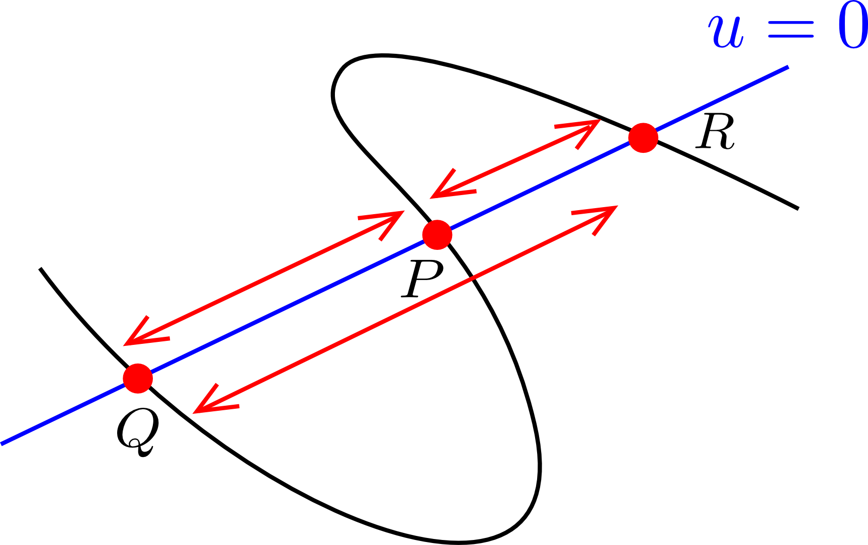
U(1)²: Further Developments
General U(1)² construction: [M.C., Klevers, Piragua, Taylor 1507.05954]
degree two polynomial in
Study of non-Abelian enhancement (unHiggsing) to SU(3)xSU(2)²
by merging rational points P,Q,R → generalizations
Study of SU(5) w/ U(1)’s
[…M.C.,Grassi,Klevers,Piragua’13…]
via tops [Borchman,Mayrhofer,Weigand’13;Braun,Grimm,Keitel’13;… ]
Systematic analysis
[Kuntzler,Schäfer-Nameki;Sacco,Lawrie; Lawrie,Schäfer-Nameki,Wong’14]
Study of SU(5)xU(1)xU(1) for Frogatt-Nielson flavor textures
[Krippendorf, Schäfer-Nameki,Wong 1507.0596]

Slide 36
III. Discrete Symmetries in F-Theory

Slide 37
Why Discrete Symmetries in F-theory?
Physics: important ingredient of beyond the Standard Model physics
forbid terms for fast proton decay and other R-parity violating terms,
e.g., R-parity (Z₂ ), baryon triality (Z₃ ) and proton hexality (Z₆ ); family textures
(F-theory implications [Leontaris,King,…])
Geometry: new Calabi-Yau geometries with genus-one fibrations
These geometries do not admit a section, but a multi-section
Earlier work:[Witten; deBoer, Dijkgraaf, Hori, Keurentjes, Morgan, Morrison, Sethi;…]
Recent extensive efforts’14-’15: [Braun, Morrison; Morrison, Taylor;
Klevers, Mayorga-Pena, Oehlmann, Piragua, Reuter; Anderson,Garcia-Etxebarria,
Grimm; Braun, Grimm, Keitel; Mayrhofer, Palti, Till, Weigand; M.C.,Donagi,Klevers,Piragua,Poretschkin; Grimm, Pugh, Regalado]

Slide 39
n=2 example
Torus fibration degenerates at
co-dimension two loci →matter

Slide 40
n=2 example

Slide 41
n=2 example
ϕ with charge 2
<ϕ>≠0
U(1) → Z₂

Slide 42
Z₂
Z₃
1502.06953
Geometries with n-section Tate-Shafarevich Group Z_{n}
No time

Slide 43
Summary and Outlook
Highlights of F-theory Compactification
Geometric perspective - discrete data:
gauge symmetry; matter reps and multiplicity;Yukawa couplings
Construction of Particle Physics Models
SU(5) GUT’s & first examples of three family
Standard, Pati-Salam and Trinification models (tip of the iceberg)
Conceptual developments:
Abelian & Discrete Symmetries (related to MW & TS groups, respectively)
highlight U(1)² & applications
Issues: continuous data such as coupling magnitudes,…
moduli stabilization,…supersymmetry breaking,…
Further study

