Slide 1
Relating Flavor Physics and Nucleon Decay
S.M. Barr and Heng-Yu Chen
University of Delaware
OUTLINE:
I will
1. Explain a model of flavor mixing we proposed in 2012, by
in which all flavor change is controlled by a single “master matrix”.
Review how it gives testable predictions for neutrino masses/mixings
and precise post-dictions for quark properties.
[SMB and H-Y Chen, JHEP 1211 (2012) 092]
Review how it gives predictions for proton decay branching ratios,
(the same master matrix controls mixing with the GUT multiplets Q and L).
[SMB and H-Y Chen, JHEP 1310 (2013) 039]
Show that if the flavor scale is near TeV there will be FC processes from scalar
exchange (governed by the same master matrix) and predictions for the
processes $τ→μγ, τ→eγ, μ→eγ.$ [SMB and H-Y Chen, JHEP 1508 (2015) 144]
Discuss a simpler, more predictive variant of the model in which all the flavor
physics is controlled by two master matrices: one controls all mass hierarchies
one that controls all mixing.
[SMB and H-Y Chen (2015), in preparation]
1/18

Slide 2
Basic Ideas of the model:
$∃$ SU(5) symmetry relates quarks and leptons.
All family mixing is due to the 3 chiral families mixing with
extra vector-like fermions.
Three chiral families: ${10}_{i} + {\overline{5}}_{i}$ (i = 1,2 3)
An abelian family symmetry makes the Yukawa couplings of these families
diagonal in family space $⟹$ DIAGONAL MASS MATRICES
Extra vectorlike fermion multiplets: ${5′}_{A} + {\overline{5}′}_{A}$ (A = 1,2, …)
These have no family symmetry.
The key is that the ${\overline{5}}_{i}$ and ${\overline{5}′}_{A}$ mix with each other. This does not break SU(5), but
it involves the spontaneous breaking of the family symmetry. This mixing is
characterized by a 3x3 matrix we call A.
This induces mixing among the three chiral families.
Because $\overline{5}$ fermion multiplets contain LH leptons, and RH quarks,
LH mixing is greater for leptons than quarks: MNS mixing is larger than CKM mixing (“lopsided” mixing idea).
All flavor mixing is controlled by the “master matrix” A. 2/18

Slide 3
Recall that in SU(5) fermion multiplets look like this:
$$10= \left(ℓ^{+} \left(\begin{matrix}u \\ d\end{matrix}\right) u^{c}\right)$$
$$\overline{5}=\left(\left(\begin{matrix}ν \\ ℓ^{−}\end{matrix}\right) d^{c}\right)$$
The mass matrix for the down-type quarks is
$Ω$, $Ω_{j}$ are SU(5) and SM singlets
with large VEVs.
$\left\langle Ω_{j}\right\rangle$ spontaneously breaks the
abelian family symmetries
diagonal
$$\left(d\left({10}_{i}\right) D\left({5′}_{A}\right) \right) \left(\begin{matrix}{\left(m_{d}\right)}_{ij} & 0 \\ Δ_{Aj} & M_{AB}\end{matrix}\right) \left(\begin{matrix}d^{c}\left({\overline{5}}_{j}\right) \\ D^{c}\left({\overline{5}′}_{B}\right)\end{matrix}\right)$$
$$y_{Aj} {5′}_{A}{\overline{5}}_{j}\left\langle Ω_{j}\right\rangle$$
$$Y_{AB} {5′}_{A}{\overline{5′}}_{B}\left\langle Ω\right\rangle$$
This gets block diagonalized into the known three families and the heavy extra fermions by unitary matrices as follows:
where
So that the mass matrix for d, s, and b is
$\underset{{U_{L}}^{†}}{\underbrace{\left(\begin{matrix}I & G^{†} \\ −G & I\end{matrix}\right)}}\left(\begin{matrix}m_{d} & 0 \\ Δ & M\end{matrix}\right)\underset{U_{R}}{\underbrace{\left(\begin{matrix}A & B \\ C & D\end{matrix}\right)}}=\left(\begin{matrix}{\overline{m}}_{d} & 0 \\ 0 & \overline{M}\end{matrix}\right)$,
$$A={\left[I+ Δ^{†}M^{−1†}M^{−1}Δ\right]}^{−1/2}$$
$$B={\left[I+ Δ^{†}M^{−1†}M^{−1}Δ\right]}^{−1/2}Δ^{†}M^{−1†}$$
$$C=−M^{−1}Δ{\left[I+ Δ^{†}M^{−1†}M^{−1}Δ\right]}^{−1/2}$$
$$D={\left[I+ M^{−1}ΔΔ^{†} M^{−1†}\right]}^{−1/2}$$
$$G^{†}=−m_{d}Δ^{†}M^{−1†}D^{2}M^{−1}$$
$${\overline{m}}_{d}=m_{d}A$$
diagonal
“master matrix”
3/18

Slide 4
$$u⊂ {10}_{i}$$
$$u^{c} ⊂{10}_{i}$$
$$m_{u}$$
$$d⊂ {10}_{i}$$
${\overline{5}}_{i}$
$$d^{c} ⊂ \overline{5}$$
${\overline{5}}_{i}$ ${\overline{5}′}_{A}$
(mixture of and )
$$m_{d}$$
$$A$$
$$ℓ^{−} ⊂ \overline{5}$$
${\overline{5}}_{i}$
$ℓ^{+}⊂ {10}_{i}$
$$A^{T}$$
$$m_{ℓ}$$
$$ν⊂ \overline{5}$$
${\overline{5}}_{i}$
${\overline{5}}_{i}$
$$ν ⊂ \overline{5}$$
$$A^{T}$$
$$m_{ν}$$
$$A$$
$${\overline{m}}_{u}=m_{u}$$
$${\overline{m}}_{d}=m_{d}A$$
$${\overline{m}}_{ℓ}=A^{T}m_{ℓ}$$
$${\overline{m}}_{ν}=A^{T}m_{ν}A$$
$$\left(10 10\right) 5_{H}$$
$$\left(10 \overline{5}\right) {\overline{5}}_{H}$$
$$\left(\overline{5} 10\right) {\overline{5}}_{H}$$
$\left(\overline{5} \overline{5}\right) 5_{H}5_{H}/M_{R}$
4/18

Slide 5
$${\overline{m}}_{u}=m_{u}$$
are diagonal
$${\overline{m}}_{d}=m_{d}A$$
so CKM mixing comes from A
A is a hermitian 3x3 matrix 9 parameters. Too many?
But A can be written in the form
$$⟹$$
D
where is diagonal, $U$ is unitary, and
$$A_{Δ}=\left(\begin{matrix}1 & b & ce^{iθ} \\ 0 & 1 & a \\ 0 & 0 & 1\end{matrix}\right)$$
$$A= A_{Δ}U$$
D
So
THIS matrix controls
all flavor mixing
$${\overline{m}}_{d}=\left(m_{d} \right)\left(\begin{matrix}1 & b & ce^{iθ} \\ 0 & 1 & a \\ 0 & 0 & 1\end{matrix}\right)U ⟶ ≅\left(\begin{matrix}m_{d} & 0 & 0 \\ 0 & m_{s} & 0 \\ 0 & 0 & m_{b}\end{matrix}\right)\left(\begin{matrix}1 & b & ce^{iθ} \\ 0 & 1 & a \\ 0 & 0 & 1\end{matrix}\right)$$
D
U can be absorbed into a redefinition of the right-handed quarks
$${\overline{m}}_{d}=\left(\begin{matrix}m_{d} & m_{d}b & m_{d}ce^{iθ} \\ 0 & m_{s} & m_{s}a \\ 0 & 0 & m_{b}\end{matrix}\right)$$
$$⟹ V_{us}≅\frac{m_{d}}{m_{s}}b$$
$$V_{cb}≅\frac{m_{s}}{m_{b}}a$$
$$V_{ub}≅\frac{m_{d}}{m_{b}}ce^{iθ}$$
5/18

Slide 6
$$⟹ a≅V_{cb}\left({m_{b}}/{m_{s}}\right) ≅\left(0.04\right)\left(50\right) ≅2$$
$$b≅V_{us}\left({m_{s}}/{m_{d}}\right) ≅\left(0.2\right)\left(20\right) ≅4$$
$$ce^{iθ}≅V_{ub}\left({m_{b}}/{m_{d}}\right) ≅\left(0.004 e^{iδ_{KM}}\right)\left({10}^{3}\right) ≅4e^{iδ_{KM}}$$
This allows us to find mixing for leptons. The lepton mass matrices are given by
${\overline{m}}_{ℓ} =A^{T}m_{ℓ} ={ U}^{T}{A_{∆}}^{T}{\text{D} m}_{ℓ}$
$${\overline{m}}_{ν} = A^{T}m_{ν}A ={ U^{T}A_{∆}}_{}^{T}\text{(}\text{D}m_{ν}{\text{D})A}_{∆}U$$
The factors $U^{T}, U$ can be absorbed into a change of basis for the left-handed neutrinos
and charged leptons. Since it is the same change of basis for both, ${ U}_{MNS}$ is unaffected.
The matrix${\text{D} m}_{ℓ}$ is diagonal and so the charged lepton mass matrix can be written
${\overline{m}}_{ℓ}=\left(\begin{matrix}1 & 0 & 0 \\ b & 1 & 0 \\ ce^{iθ} & a & 1\end{matrix}\right)\left(\begin{matrix}m_{e} & 0 & 0 \\ 0 & m_{μ} & 0 \\ 0 & 0 & m_{τ}\end{matrix}\right)=\left(\begin{matrix}m_{e} & 0 & 0 \\ m_{e}b & m_{μ} & 0 \\ m_{τ}ce^{iθ} & m_{τ}a & m_{τ}\end{matrix}\right)$
The off-diagonal elements of this can be rotated away by $O\left({m_{i}}/{m_{j}}\right)$ rotations off the RH charged
leptons and $O\left({{m_{i}}^{2}}/{{m_{j}}^{2}}\right)$ (and thus negligible) rotations of the LH leptons. So we are already in the
“mass basis” of the LH charged leptons to very good approximation. In that basis, then
${\overline{m}}_{ν} = {A_{∆}}^{T}\text{(}\text{D}m_{ν}{\text{D})A}_{∆}=$ $μ_{ν} \left(\begin{matrix}1 & 0 & 0 \\ b & 1 & 0 \\ ce^{iθ} & a & 1\end{matrix}\right) \left(\begin{matrix}qe^{iβ} & 0 & 0 \\ 0 & pe^{iα} & 0 \\ 0 & 0 & 1\end{matrix}\right)\left(\begin{matrix}1 & b & ce^{iθ} \\ 0 & 1 & a \\ 0 & 0 & 1\end{matrix}\right)$
6/18

Slide 7
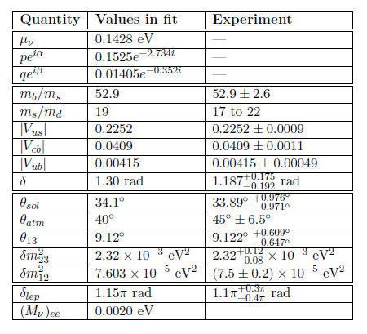
Therefore, all 9 neutrino properties --- the 3 masses, 3 MNS mixing angles, 1 Dirac CP phase,
and 2 Majorana CP phases --- follow from this matrix below, which depends on 5 parameters:
$${\overline{m}}_{ν}= {A_{Δ}}^{T} \left(diag\right) A_{Δ} = μ_{ν} \left(\begin{matrix}1 & 0 & 0 \\ b & 1 & 0 \\ ce^{iθ} & a & 1\end{matrix}\right) \left(\begin{matrix}qe^{iβ} & 0 & 0 \\ 0 & pe^{iα} & 0 \\ 0 & 0 & 1\end{matrix}\right)\left(\begin{matrix}1 & b & ce^{iθ} \\ 0 & 1 & a \\ 0 & 0 & 1\end{matrix}\right)$$
7/18

Slide 8
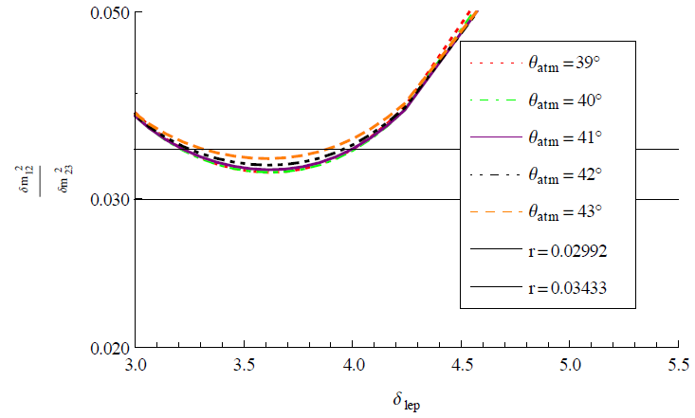

Slide 9
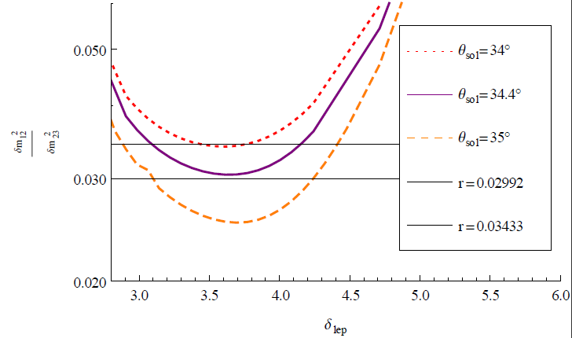

Slide 10
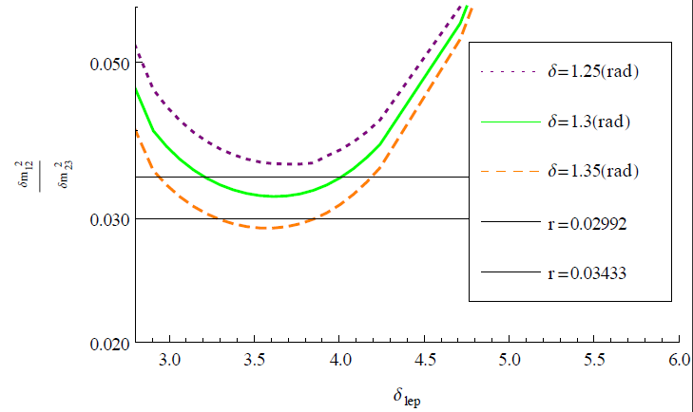

Slide 11
Proton decay branching ratios
There are other mixing angles that describe how quarks and leptons are put together
in SU(5) multiplets. These are also controlled by the matrix . One can show that the
fermion multiplets in this model look like this:
$$A_{Δ}$$
$$10≅\left[e^{−iΘ}V_{ℓ^{+}}{\tilde{ℓ}}^{c} \left(\begin{matrix}\tilde{u} \\ V_{CKM}\tilde{d}\end{matrix}\right) { e}^{−iΦ}{\tilde{u}}^{c}\right]$$
$$\overline{5}≅ \left[\left(\begin{matrix}U_{MNS}\tilde{ν} \\ {\tilde{ℓ}}^{−}\end{matrix}\right) {\tilde{d}}^{c}\right]$$
where
$$V_{ℓ^{+}}≅\left(\begin{matrix}1 & −\frac{m_{e}}{m_{μ}}b & −\frac{m_{e}}{m_{τ}}ce^{iθ} \\ \frac{m_{e}}{m_{μ}}b & 1 & −\frac{m_{μ}}{m_{τ}}a \\ \frac{m_{e}}{m_{τ}}ce^{−iθ} & \frac{m_{μ}}{m_{τ}}a & 1\end{matrix}\right)$$
The only element of $V_{ℓ^{+}}$ that is significant for nucleon decay is $ζ=\frac{m_{e}}{m_{μ}}b=0.02$.
The effect of this is very small. But larger effects would arise if the model is
embedded in SO(10). In that case, there is an additional mixing matrix describing
how the $10$and $\overline{5}$ are aligned within the $16−$plets of fermions.
One can straightforwardly calculate branching ratios in proton decay that comes
from d=6 gauge-boson-mediated operators.
8/18

Slide 12
$κ≡{\left|{\text{D}}_{11}\right|}^{2}\frac{{{g_{10}}^{2}}/{{M_{10}}^{2}}}{{{g_{5}}^{2}}/{{M_{5}}^{2}}}$,
Defining where ,
one finds
where
So, though very difficult, in principle the model parameter b could be
independently determined in nucleon decay.
$$A=\text{D}A_{Δ}U$$
$$\frac{Γ\left(p⟶π^{0}μ^{+}\right)}{Γ\left(p{⟶π}^{0}e^{+}\right)}≅\frac{{\left(bκ\right)}^{2}+{\left|sinθ_{C} −2e^{−iα_{1}} ζ\right|}^{2} }{{\left(1+ κ\right)}^{2}+4\cos^{2}θ_{C}}$$
$$\frac{Γ\left(p⟶K^{0}e^{+}\right)}{Γ\left(p{⟶π}^{0}e^{+}\right)}≅R\frac{{\left(bκ\right)}^{2}+{\left|2sinθ_{C} −e^{−iα_{2}} ζ\right|}^{2}}{{\left(1+ κ\right)}^{2}+4\cos^{2}θ_{C}}$$
$$\frac{Γ\left(p⟶{K^{0}μ}^{+}\right)}{Γ\left(p{⟶π}^{0}e^{+}\right)}≅R\frac{{\left(1+b^{2}κ\right)}^{2}+\cos^{2}θ_{C}}{{\left(1+ κ\right)}^{2}+4\cos^{2}θ_{C}}$$
$$R≡2{\left(1−\frac{{m_{K}}^{2}}{{m_{p}}^{2}}\right)}^{2}{\left(\frac{1+\frac{m_{p}}{m_{B}}\left(D−F\right)}{1+D+F}\right)}^{2}=0.105±0.005$$
9/18

Slide 13
New: Flavor-changing mediated by exchange of
$$\tilde{Ω}$$
$\left(\begin{matrix}d & D\end{matrix}\right)\left(\begin{matrix}m_{d} & 0 \\ ∆ & M\end{matrix}\right)\left(\begin{matrix}d^{c} \\ D^{c}\end{matrix}\right) ⟹\left(\begin{matrix}d & D\end{matrix}\right)\left(\begin{matrix}0 & 0 \\ 0 & \frac{M}{\left\langle Ω\right\rangle }\tilde{Ω}\end{matrix}\right)\left(\begin{matrix}d^{c} \\ D^{c}\end{matrix}\right)$
$$D\left(Y\left[\left\langle Ω\right\rangle +\tilde{Ω}\right]\right)D^{c}=D\left(M+\frac{M}{\left\langle Ω\right\rangle }\tilde{Ω}\right)D^{c}$$
To see how couples to the three known families, one must go through the
block-diagonalization we did before
$$\tilde{Ω}$$
$$\underset{{U_{L}}^{†}}{\underbrace{\left(\begin{matrix}I & G^{†} \\ −G & I\end{matrix}\right)}}\left(\begin{matrix}0 & 0 \\ 0 & \frac{M}{\left\langle Ω\right\rangle }\tilde{Ω}\end{matrix}\right)\underset{U_{R}}{\underbrace{\left(\begin{matrix}A & B \\ C & D\end{matrix}\right)}}=\left(\begin{matrix}G^{†}MC & G^{†}MD \\ MC & MD\end{matrix}\right)\left(\frac{\tilde{Ω}}{\left\langle Ω\right\rangle }\right)$$
$$\tilde{Ω}$$
So, couples to the 3 known families by the effective Yukawa coupling matrix
$$\frac{1}{\left\langle Ω\right\rangle }G^{†}MC = \frac{1}{\left\langle Ω\right\rangle }{\left(−m_{d}Δ^{†}M^{−1†}D^{2}M^{−1}\right)}^{†}\left(M\right)\left(−M^{−1}ΔA\right)$$
$$=\frac{1}{\left\langle Ω\right\rangle }m_{d} \left[Δ^{†}M^{−1†}\right]{ D}^{2} \left[M^{−1}Δ\right] A$$
10/18

Slide 14
$$\tilde{Y}=\frac{1}{\left\langle Ω\right\rangle }m_{d} \left[Δ^{†}M^{−1†}\right]{ D}^{2} \left[M^{−1}Δ\right] A$$
11/18
$$= \frac{1}{\left\langle Ω\right\rangle } m_{d}\left[Δ^{†}M^{−1†}\right]{\left[I+M^{−1}{ΔΔ}^{†}M^{−1†}\right]}^{−1}\left[M^{−1}Δ\right]A$$
$$=\frac{1}{\left\langle Ω\right\rangle } m_{d} \left[Δ^{†}M^{−1†}M^{−1}Δ\right]{\left[I+Δ^{†}M^{−1†}M^{−1}Δ\right]}^{−1}A$$
$$= \frac{1}{\left\langle Ω\right\rangle } m_{d} \left[A^{−2}−I\right]A^{2}A = \frac{1}{\left\langle Ω\right\rangle }m_{d}\left[A−AA^{†}A\right]$$
$$A= A_{Δ}U$$
D
$$=\frac{1}{\left\langle Ω\right\rangle }m_{d} \left[A_{Δ}−A_{Δ} {A_{Δ}}^{†} 𝒟^{2} A_{Δ}\right]U$$
D
is absorbed by redef. of RH fields
$$\tilde{Y}≅ \frac{1}{\left\langle Ω\right\rangle }\left(m_{d} { A}_{Δ}\right)\left[I−{A_{Δ}}^{†} 𝒟^{2} A_{Δ}\right]=\frac{1}{\left\langle Ω\right\rangle }{\overline{m}}_{d}\left[I−{A_{Δ}}^{†} 𝒟^{2} A_{Δ}\right]$$
D
$$\text{D}=\left(\begin{matrix}δ & 0 & 0 \\ 0 & ε & 0 \\ 0 & 0 & ξ\end{matrix}\right)$$
$${\tilde{Y}}_{FC}≅−\frac{1}{\left\langle Ω\right\rangle }{\overline{m}}_{d}{A_{Δ}}^{†} 𝒟^{2} A_{Δ}$$
$${\overline{m}}_{d}=\left(\begin{matrix}m_{d} & 0 & 0 \\ 0 & m_{s} & 0 \\ 0 & 0 & m_{b}\end{matrix}\right)$$
$A_{Δ}=\left(\begin{matrix}1 & b & ce^{iθ} \\ 0 & 1 & a \\ 0 & 0 & 1\end{matrix}\right)$

Slide 15
The expression for the Yukawa couplings of to the charged leptons looks the same,
but with Left-handed and Right-handed fermions interchanged. It ends up
looking as follows:
$$\tilde{Ω}$$
$${τ^{+}}_{L}$$
$${μ^{−}}_{L}$$
$$\frac{m_{τ}}{\left\langle Ω\right\rangle }\left[{\left|δ\right|}^{2}bce^{−iθ}+{\left|ε\right|}^{2}a\right]≡\frac{m_{τ}}{\left\langle Ω\right\rangle }Δ_{μτ}$$
$$\tilde{Ω}$$
$${τ^{+}}_{L}$$
$${e^{−}}_{L}$$
$$\frac{m_{τ}}{\left\langle Ω\right\rangle }\left[{\left|δ\right|}^{2}ce^{−iθ}\right]≡\frac{m_{τ}}{\left\langle Ω\right\rangle }Δ_{eτ}$$
$$\tilde{Ω}$$
$${μ^{+}}_{L}$$
$${e^{−}}_{L}$$
$$\frac{m_{μ}}{\left\langle Ω\right\rangle }\left[{\left|δ\right|}^{2}b\right]≡\frac{m_{μ}}{\left\langle Ω\right\rangle }Δ_{eμ}$$
$$\tilde{Ω}$$
$$\frac{Γ\left(τ⟶eγ\right)}{Γ\left(μ⟶eγ\right)}={\left|\frac{Δ_{eτ}}{Δ_{eμ}}\right|}^{2}={\left|\frac{c}{b}\right|}^{2}\sim 1$$
$$\frac{Γ\left(τ⟶μγ\right)}{Γ\left(μ⟶eγ\right)}={\left|\frac{Δ_{μτ}}{Δ_{eμ}}\right|}^{2}={\left|c\right|}^{2}≅16$$
And if the $δ^{2}$ term dominates for $τ ⟶μγ$
12/18

Slide 16
One can derive bounds on the unknown parameters and .
$${\left|δ\right|}^{2},{\left|ε\right|}^{2}, {\left|ξ\right|}^{2}$$
$$AA^{†}={\left[I+ {\left(M^{−1}Δ\right)}^{†}\left(M^{−1}Δ\right)\right]}^{−1}=\left(\begin{matrix}δ & 0 & 0 \\ 0 & ε & 0 \\ 0 & 0 & ξ\end{matrix}\right)A_{Δ}{A_{Δ}}^{†}\left(\begin{matrix}δ^{∗} & 0 & 0 \\ 0 & ε^{∗} & 0 \\ 0 & 0 & ξ^{∗}\end{matrix}\right)$$
the elements of this matrix bounded from above
$$BR\left(τ⟶μγ\right)=24{\left(\frac{α}{π}\right)}^{3}{\left(\frac{v}{\left\langle Ω\right\rangle }\right)}^{4}f^{2}\left(\frac{M_{F}}{M_{\tilde{Ω}}}\right) {\underset{<2}{\underbrace{\left|{\left|δ\right|}^{2}bce^{−iθ}+{\left|ε\right|}^{2}a\right|}}}^{2}$$
$BR\left(τ⟶μγ\right)$ < ${10}^{−8}{ \left({TeV}/{\left\langle Ω\right\rangle }\right)}^{4}$
13/18

Slide 17
Combining the “BC model” with an old idea about mass hierarchies.
old idea = “BB model” = K.S. Babu and SMB, Phys. Lett B381, 202 (1996).
So the BC model is a model of family mixing, but has
little to say about the fermion mass hierarchies.
The BB model is the opposite. It says little about mixing, but seeks
to explain something about the fermion mass hierarchies.
The models are complementary to each other and can be combined.
The “BC model” gives the mass matrices as products of factors of one master matrix A,
which is non-hierarchical and non-diagonal and gives all mixing, and
hierarchical, diagonal matrices $m_{f} (f=u,d,ℓ,ν)$, which give the mass hierarchies.
These latter matrices are four in number and not predicted --- they are free parameters.
In the “BB model” the one master matrix, call it H, is the hierarchical, diagonal one,
whereas the non-hierarchical, non-diagonal matrices that give the mixing, are
four arbitrary matrices ${\hat{m}}_{f} (f=u,d,ℓ,ν)$, whose elements are not predicted.
In the BB idea, the fermion content consists of the usual three chiral families ${10}_{i}+ {\overline{5}}_{i}$
and extra vectorlike ${10′}_{A}+{\overline{10}′}_{A} pairs.$ The hierarchical, diagonal master matrix H
comes from the mixing of the ${10}_{i}$ with the ${10′}_{A}$.
14/18

Slide 18
$$u⊂10$$
$${10}_{i}$$
$${10}_{j}$$
$$u^{c}⊂10$$
(mixture of ${10}_{i}$ and ${10′}_{A}$)
H
$${\hat{m}}_{u,ij}$$
H
$$d⊂10$$
$${10}_{i}$$
$d^{c}⊂{\overline{5}}_{j}$
H
$${\hat{m}}_{d,ij}$$
$$ℓ^{−}⊂{\overline{5}}_{i}$$
$${10}_{j}$$
$$ℓ^{+}⊂10$$
$$H= \left(\begin{matrix}α & 0 & 0 \\ 0 & β & 0 \\ 0 & 0 & 1\end{matrix}\right)h, α≪β≪1$$
$${\hat{m}}_{ℓ,ij}$$
H
$$d^{c} ⊂ \overline{5}$$
$$ν⊂{\overline{5}}_{i}$$
$$ν⊂{\overline{5}}_{j}$$
$${\hat{m}}_{ν,ij}$$
This leads to fermion mass matrices of the form
$$m_{u}=H{\hat{m}}_{u}H$$
$$m_{d}=H{\hat{m}}_{d}$$
$$m_{ℓ}={\hat{m}}_{ℓ}H$$
$$m_{ν}={\hat{m}}_{ν}$$
$$\left(10 10\right) 5_{H}$$
$$\left(10 \overline{5}\right) {\overline{5}}_{H}$$
$$\left(\overline{5} 10\right) {\overline{5}}_{H}$$
$\left(\overline{5} \overline{5}\right) 5_{H}5_{H}/M_{R}$
15/18

Slide 19
$m_{u} = \left(\begin{matrix}α & 0 & 0 \\ 0 & β & 0 \\ 0 & 0 & 1\end{matrix}\right){\hat{m}}_{u}\left(\begin{matrix}α & 0 & 0 \\ 0 & β & 0 \\ 0 & 0 & 1\end{matrix}\right)h^{2} \sim \left(\begin{matrix}α^{2} & αβ & α \\ αβ & β^{2} & β \\ α & β & 1\end{matrix}\right)μ_{u}$
So:
$$m_{d} = \left(\begin{matrix}α & 0 & 0 \\ 0 & β & 0 \\ 0 & 0 & 1\end{matrix}\right)h{\hat{m}}_{d} \sim \left(\begin{matrix}α & α & α \\ β & β & β \\ 1 & 1 & 1\end{matrix}\right)μ_{d}$$
$$m_{ℓ} ={\hat{m}}_{ℓ}\left(\begin{matrix}α & 0 & 0 \\ 0 & β & 0 \\ 0 & 0 & 1\end{matrix}\right)h \sim \left(\begin{matrix}α & β & 1 \\ α & β & 1 \\ α & β & 1\end{matrix}\right)μ_{ℓ}$$
$$m_{ν}={\hat{m}}_{ν} \sim \left(\begin{matrix}1 & 1 & 1 \\ 1 & 1 & 1 \\ 1 & 1 & 1\end{matrix}\right)μ_{ν}$$
$$m_{u} : m_{c} : m_{t} \sim α^{2} : β^{2} : 1$$
$$≈ \frac{1}{150,000} : \frac{1}{400} : 1$$
$$m_{d} : m_{s} : m_{b} \sim α : β : 1$$
$$≈ \frac{1}{1,000} : \frac{1}{50} : 1$$
$$m_{e} : m_{μ} : m_{τ} \sim α : β : 1$$
$≈ \frac{1}{3,400} : \frac{1}{17} : 1$
$$m_{ν_{1}}: m_{ν_{2}} : m_{ν_{3}} \sim 1 : 1 : 1$$
$$≈ ? : \frac{1}{5} : 1$$
$V_{CKM} \sim \left(\begin{matrix}1 & \frac{α}{β} & α \\ \frac{α}{β} & 1 & β \\ α & β & 1\end{matrix}\right), U_{MNS} \sim \left(\begin{matrix}1 & 1 & 1 \\ 1 & 1 & 1 \\ 1 & 1 & 1\end{matrix}\right)$
16/18

Slide 20
One can combine the two ideas.
The fermion content is
Assume that there is an SO(3) family symmetry, under which the three chiral families
are triplets and the 5-plets of Higgs fields are singlets.
Then the “underlying” mass matrices will be proportional to the identity matrix.
The following structure can arise:
where
$$A$$
$${10}_{i} + {\overline{5}}_{i} + {10′}_{A} + {\overline{10}′}_{A} + {\overline{5}′}_{m} + {5′}_{m}$$
$$H$$
$m_{u}=|HH|{ μ}_{u}$
$m_{d}=H^{′}A μ_{d} ⟶ |H^{′}𝓓| A_{Δ}{ μ′}_{d}$
$m_{ℓ}=A^{T}H^{′′}μ_{d}{{⟶A}_{Δ}}^{T}|𝓓H^{′′}|{ μ′}_{d}$
$m_{ν}=A^{T}A{ μ}_{ν}⟶{A_{Δ}}^{T} 𝓓^{2} A_{Δ}{ μ^{′}}_{ν}$
$$m_{u} :m_{c} :m_{t}= α^{2} :β^{2} :1$$
$$m_{d}:m_{s}:m_{b}=αδf\left(x_{d}\right) :βεg\left(x_{d} \right):1$$
$$m_{e}:m_{μ}:m_{τ}=αδf\left(x_{ℓ}\right) :βεg\left(x_{ℓ} \right):1$$
$$q :p :1= δ^{2} {: ε}^{2} :1$$
$H=\left(\begin{matrix}α & 0 & 0 \\ 0 & β & 0 \\ 0 & 0 & 1\end{matrix}\right)h, 𝓓=\left(\begin{matrix}δ & 0 & 0 \\ 0 & ε & 0 \\ 0 & 0 & 1\end{matrix}\right)d, A_{Δ}=\left(\begin{matrix}1 & b & ce^{iθ} \\ 0 & 1 & a \\ 0 & 0 & 1\end{matrix}\right)$
$$α=\sqrt{\frac{m_{u}}{m_{t}}} \sim \frac{1}{400}$$
$$β=\sqrt{\frac{m_{c}}{m_{t}}} \sim \frac{1}{20}$$
$$δ=\sqrt{q}=\frac{1}{8.44}$$
$$ε=\sqrt{p}=\frac{1}{2.56}$$
17/18

Slide 21
$$αδ : βε : 1 = \frac{1}{3,400} : \frac{1}{51} : 1$$
$$m_{d} : m_{s} : m_{b} ≈ \frac{1}{1,000} : \frac{1}{50} : 1$$
Improved over BB idea by itself
$$m_{e} : m_{μ} : m_{τ} ≈ \frac{1}{3,400} : \frac{1}{17} : 1$$
$$α : β :1 = \frac{1}{400} :\frac{1}{20} :1$$
$$δ=\frac{1}{8.44}$$
$$ε=\frac{1}{2.56}$$
The values and are what one needs to fit the neutrino properties, and also the values that give good fits to the inter-family mass hierarchies of the down quarks and charged leptons .
But one can show that they are also the “most likely” values, a priori. Recall where these
parameters come from:
$$A ={\left[I+ T^{†}T\right]}^{−1/2} = 𝓓A_{Δ}U = \left(\begin{matrix}δ & 0 & 0 \\ 0 & ε & 0 \\ 0 & 0 & 1\end{matrix}\right)d\left(\begin{matrix}1 & b & ce^{iθ} \\ 0 & 1 & a \\ 0 & 0 & 1\end{matrix}\right)U$$
A is a hermitian matrix of a specific form in terms of an unknown matrix T. If one takes
a “random” matrix T, computes A from it, and then brings it to the form , one
finds that the values of and are correlated with the (known) values of a,b, and c
In fact, typically $δ \sim \frac{1}{ab} \sim \frac{1}{8},$ and $ε \sim \frac{1}{a} \sim \frac{1}{2}$.
$$𝓓A_{Δ}U$$
$$δ$$
$$ε$$
18/18

