Slide 1
Large Underground Cavity Excavations
Design, Cost, Schedule & Risk Issues.
Stony Brook University of New York, Long Island, Oct 31st 2015.
Chris Laughton, P.E., Ph.D., C.Eng., Eur. Ing.
ILF Principal Engineer
Email: chris.laughton@ilf.com
Office: 425.209.4989 Cell: 425.559.0190
440 112th Ave. NE, Suite 204, Bellevue, Washington 98004.

Slide 2
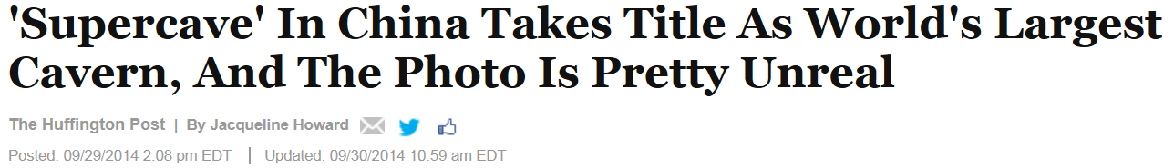
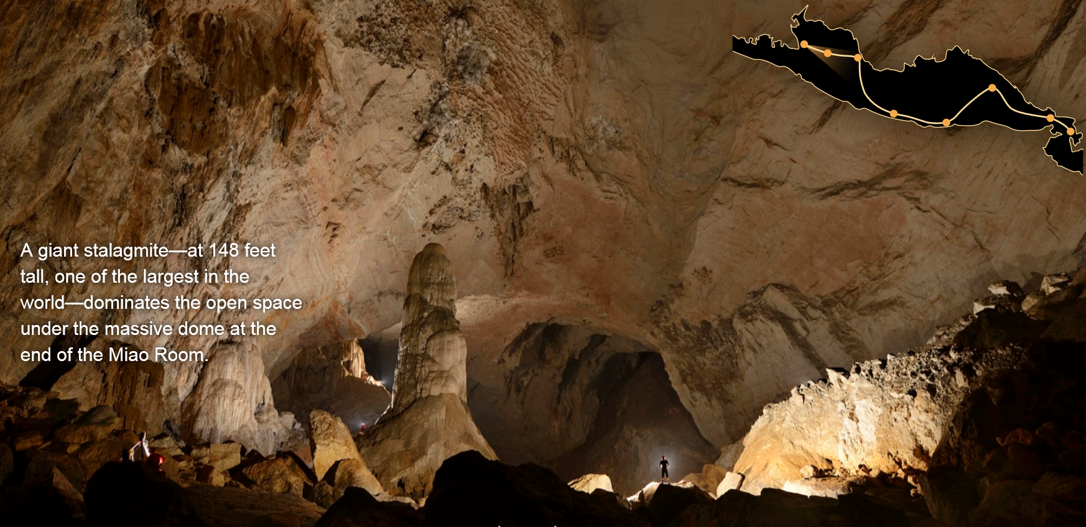

“Supercave” by Nature..
100m+
Laughton, ILF Consultants NNN15/UD2.

Slide 3
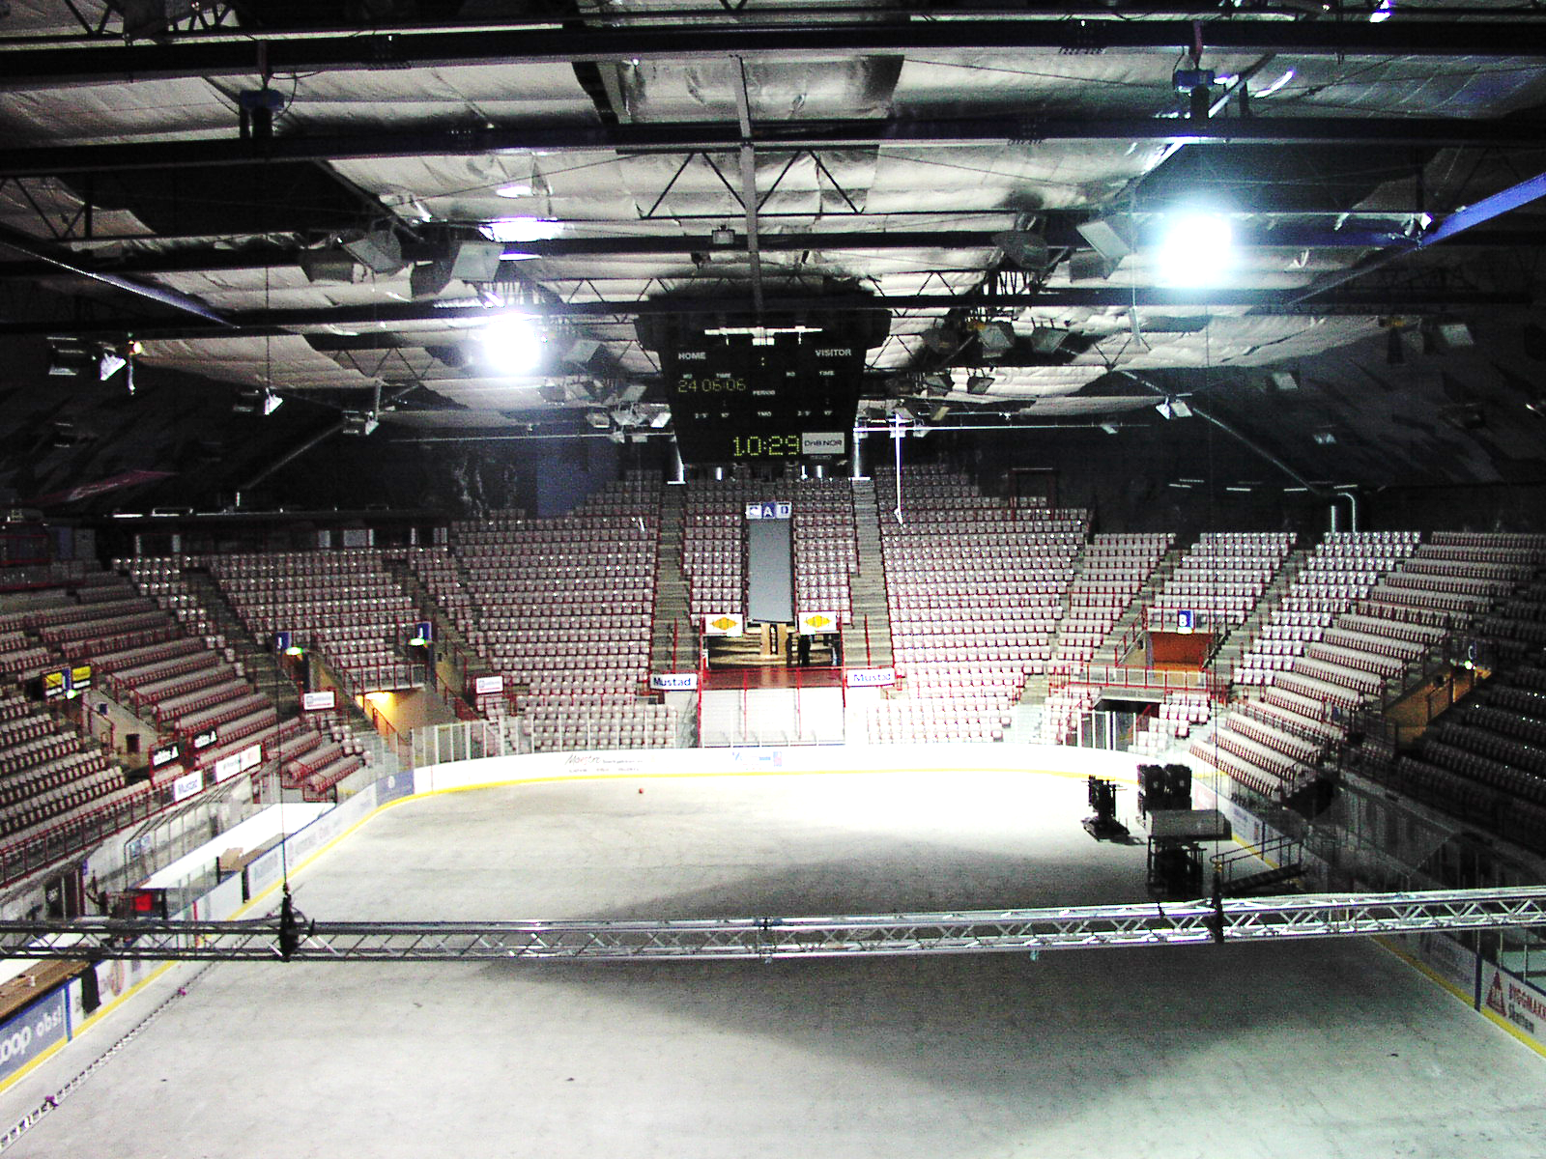
Super Cavern by Man
Gjovik, Norway.. Olympic Ice Rink ~ 62m Span
60m+
Laughton, ILF Consultants NNN15/UD2.

Slide 4
Presentation Outline
Design
Cost and Schedule Drivers
  Why does it cost so much?
  Why does it take so long?
Risks
  Why is underground work so susceptible to cost overruns & delays?
Questions
Laughton, ILF Consultants NNN15/UD2.

Slide 5
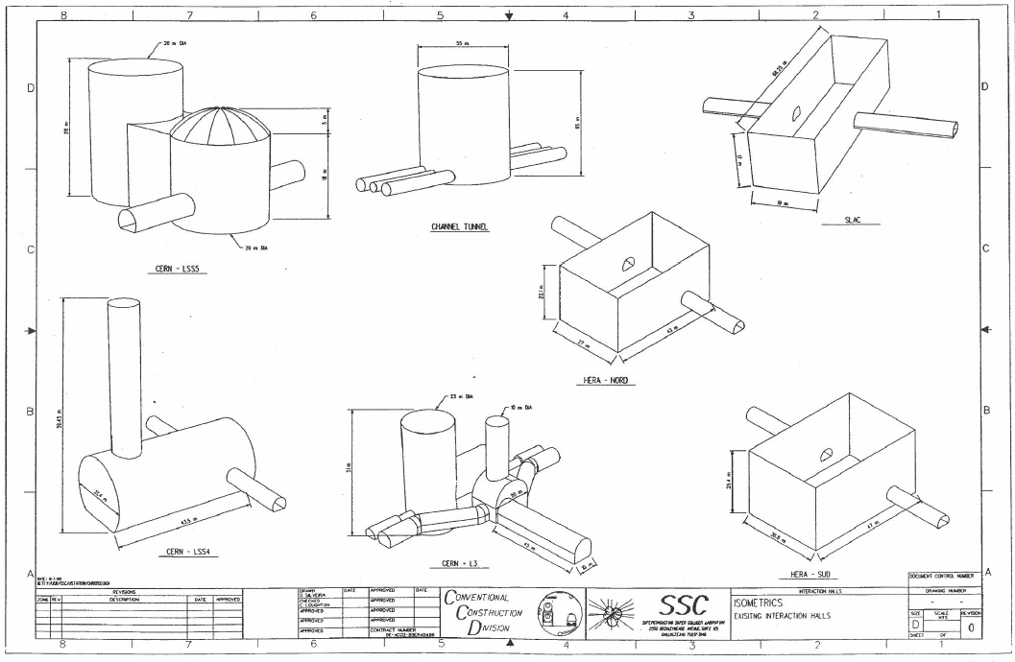
Designing Large Excavations..
Engineering solutions for many Box/Cylinder-Type Excavations
Relatively Simple
Relatively Complex
..can excavate/fit-out to accommodate most science requirements..
..but are budgets reasonable & risks well-mitigated?
Laughton, ILF Consultants NNN15/UD2.

Slide 6
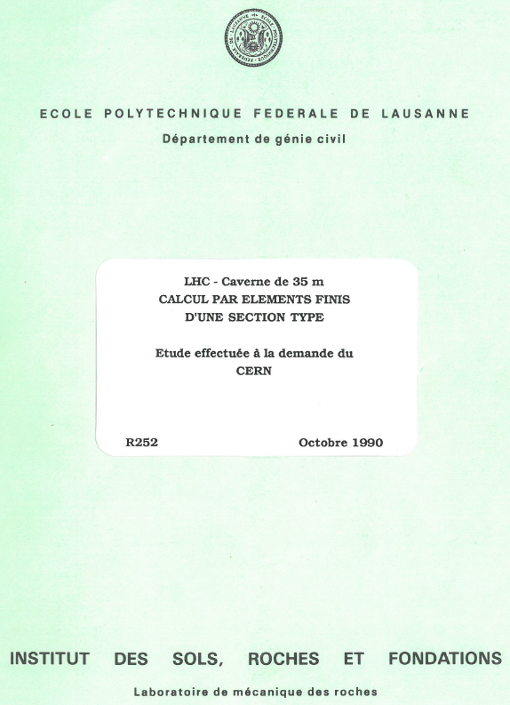
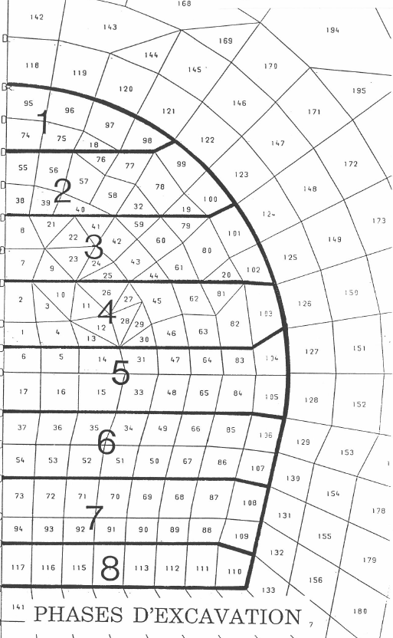
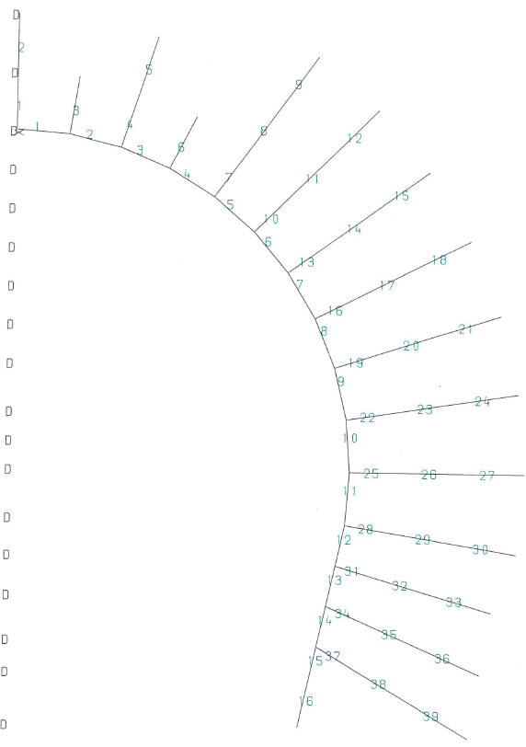
Designing Excavations in “Soft Rock”
Model
Excavate
Support
Bolts
Key Consideration.. focus on maintaining a continuum response of the host rock material(s)
Laughton, ILF Consultants NNN15/UD2.

Slide 7
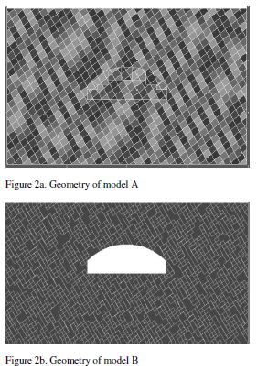
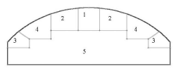
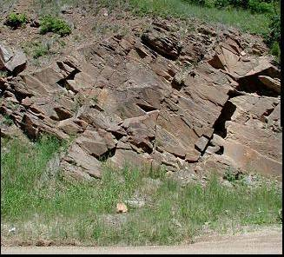
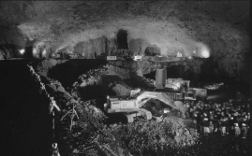
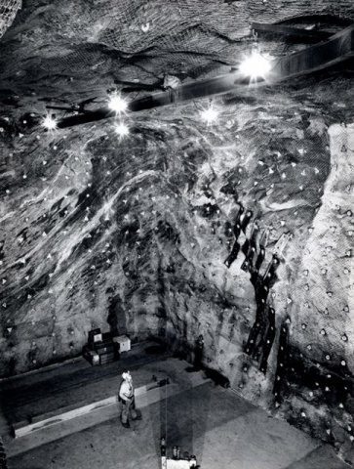
Designing Excavations in “Hard, Blocky Rock”
Model
Excavate/Support
Key Consideration.. in hard, blocky rocks prioritize design against discontinuities-bound failures; wedge/block fall-out (+stress at depth)
Laughton, ILF Consultants NNN15/UD2.

Slide 8
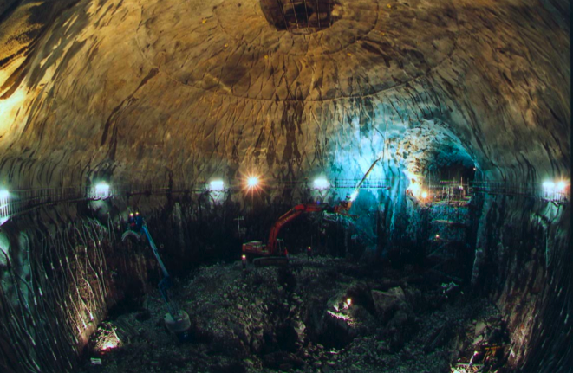
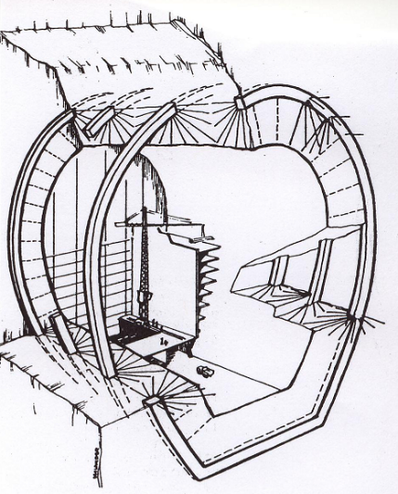
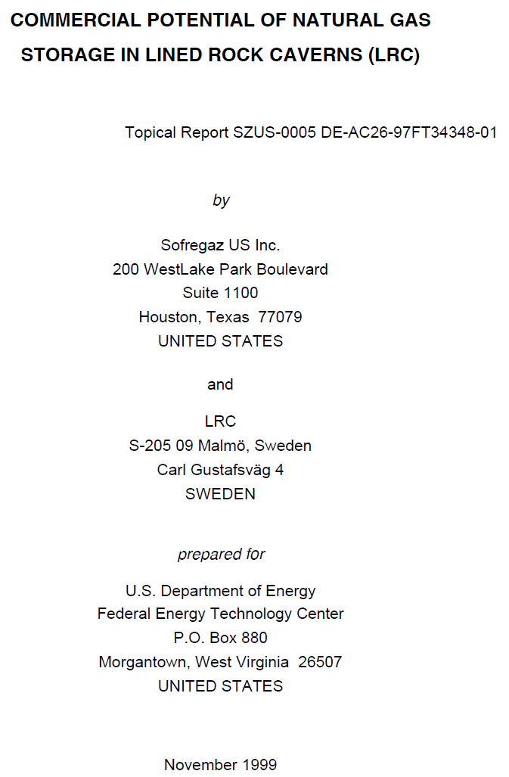
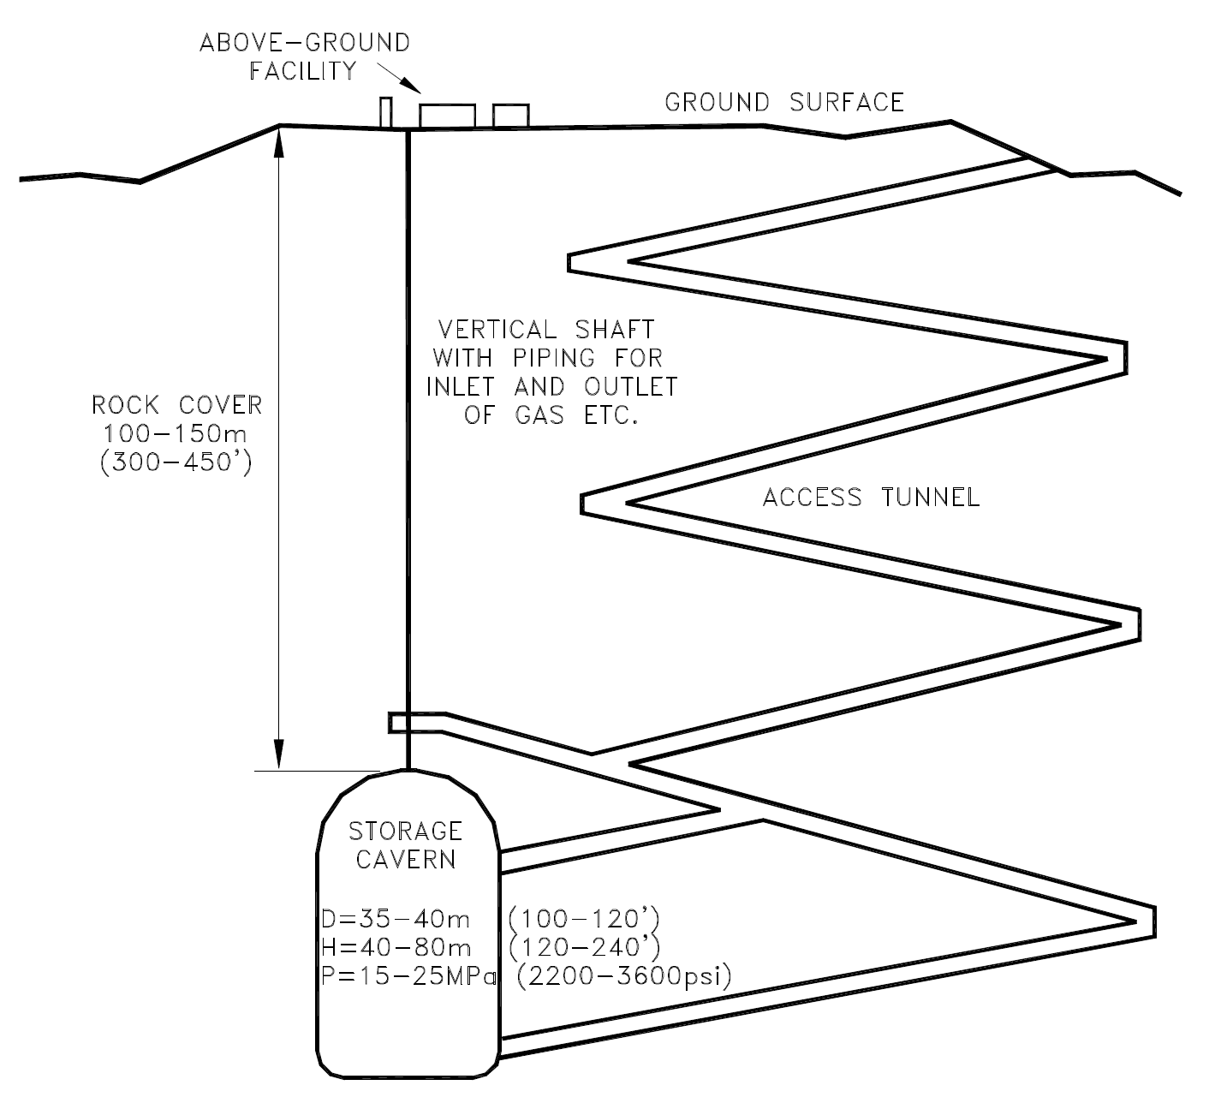
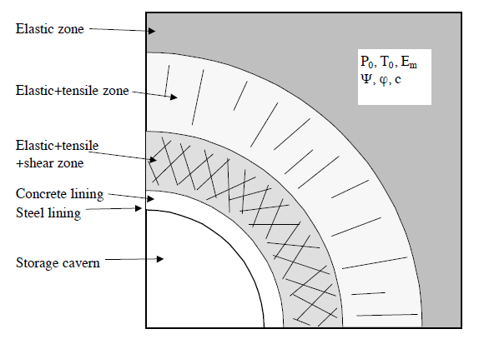
Designing Excavations in Hard Rock
If the rock mass is strong it can make a major contribution to overall stability
First goal isto find a “good” rock mass - strong enough to support stress changes during construction and over time.
Reinforcement and liners can help mobilize rock mass strength.. e.g. “Sandwich Liner” for Lined Rock Cavern.
~40m
Lined Rock Cavern
“Rib-in-Rock Reinforcement
Source: http://www.netl.doe.gov/File%20Library/Research/Oil-Gas/Natural%20Gas/other/34348_final.pdf
Laughton, ILF Consultants NNN15/UD2.

Slide 9
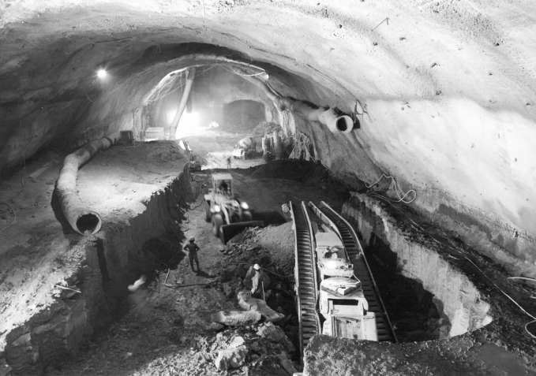
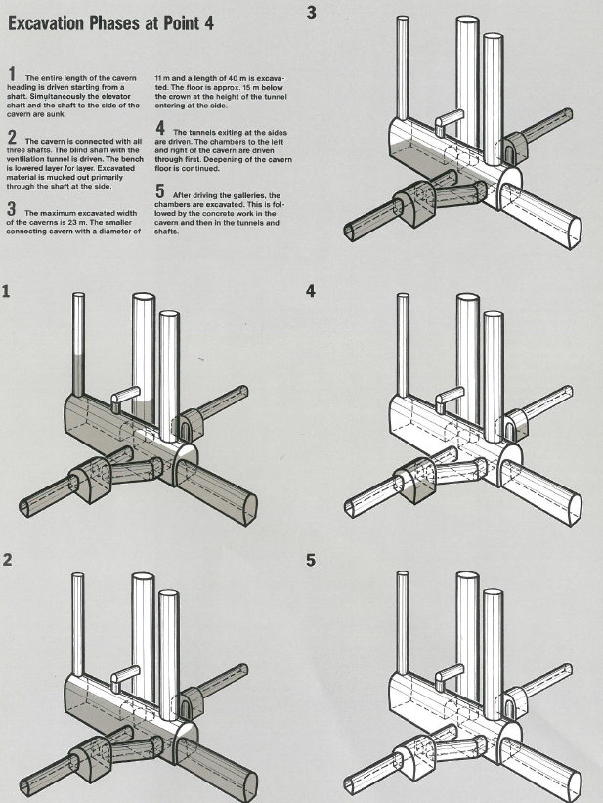
Designing Large Excavations.. “Top Down” Excavation Phases
Access
Sources: CERN & Phillip Holzmann
Key Consideration.. Physical Size precludes a “Full Face” Excavation Approach - Excavation from “Top-Down” installing support as you go
Laughton, ILF Consultants NNN15/UD2.

Slide 10
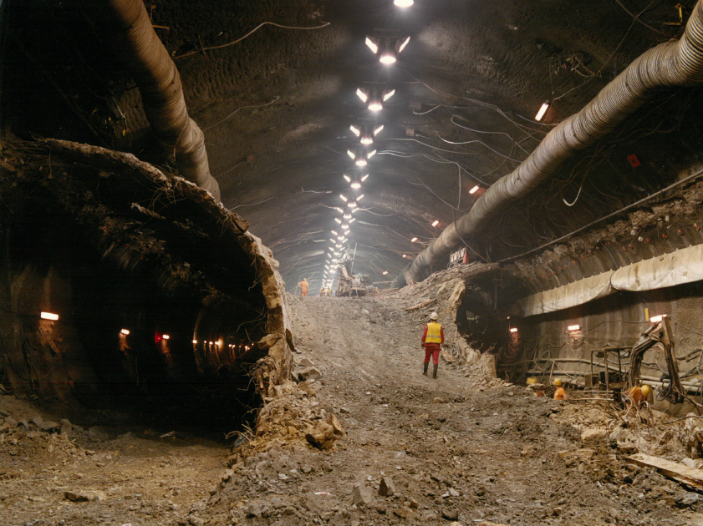
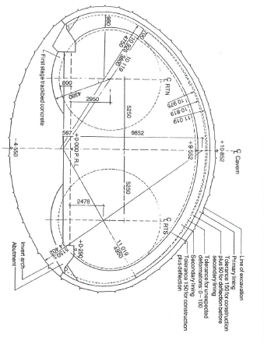
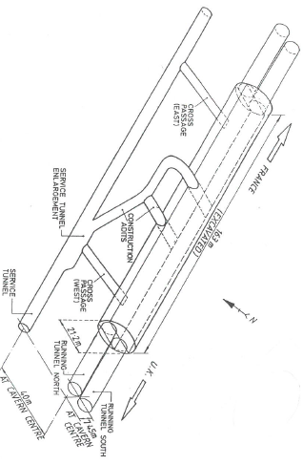
Designing Large Excavations..
“Bottoms-Up” Excavation Phases
Access
Sources: Eurotunnel & Crighton/Leblond, 1989
Key Consideration.. Excavation can be ”bottoms-up”, but temporary support still has to be provided (shell liners above)

Slide 11
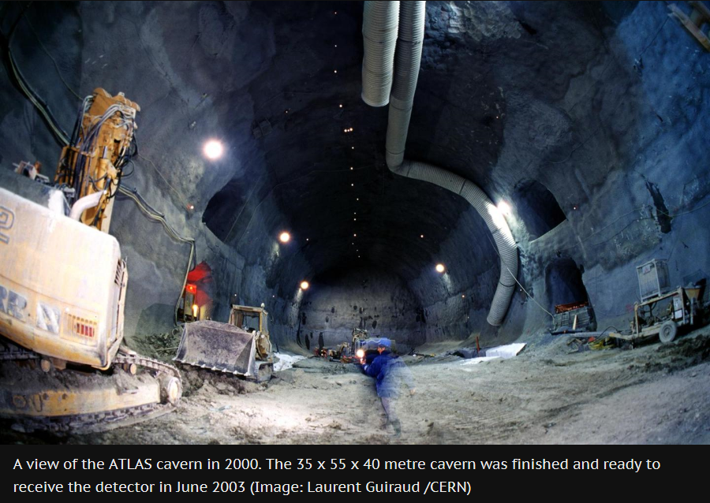
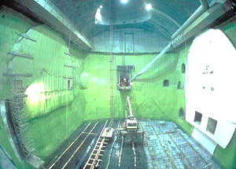
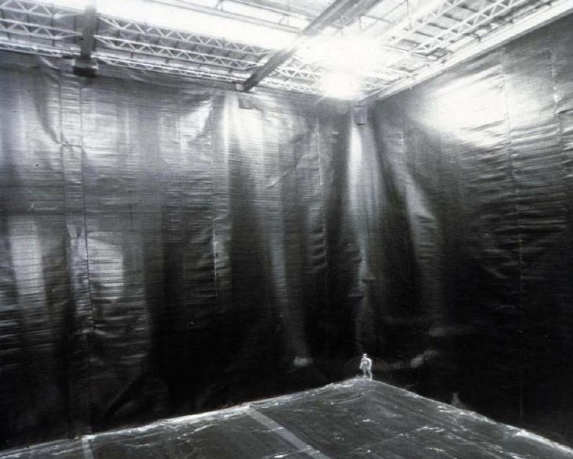
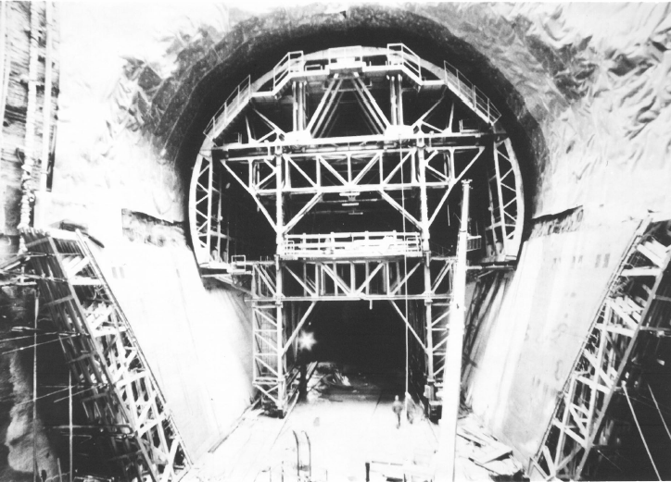
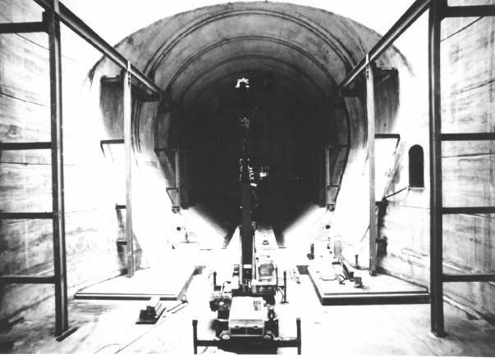
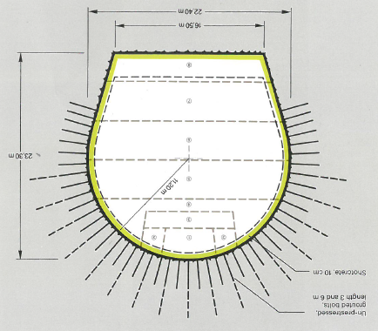
Designing Large Excavations..
Water Control and Final Lining Options
Source: CERN, Geneva, Phillip Holzmann
LHC
LHC
IMB
Excavation & Support
Waterproofing - Drained
Cast-in-Place Concrete Lining
LEP
LEP
LEP
Key Considerations.. Waterproofing and Final Liner for the Long-Term.. to Meet Operations/Maintenance/Stability Needs
Laughton, ILF Consultants NNN15/UD2.
11

Slide 12
Designing Large Excavations..
Investigate First..
Spend first dollars on site investigation.. avoid designs based on too much “geo-assumption”.
Geo-surprises lead to late changes, increased costs and delays.
Start with questions (risks) - collect data - provide answers and THINK.
“Too many site investigations for tunnels comprise a regular pattern of boreholes, a conventional package of tests and a sigh of relief when it is all over.” Muir Wood (1972).
Laughton, ILF Consultants NNN15/UD2.

Slide 13
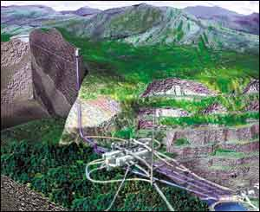
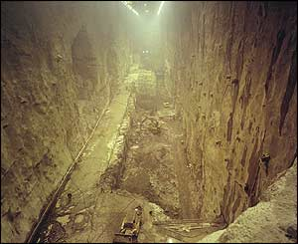
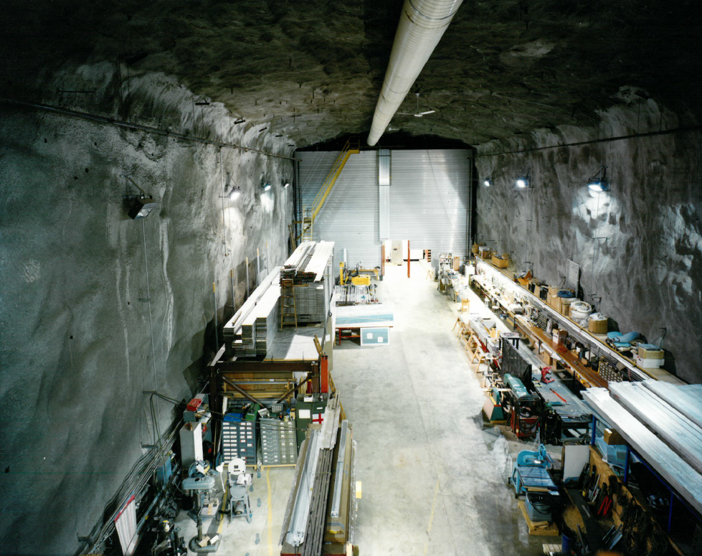
Designing Large Excavations..
Referencing Substantial Research Precedent
  Research applications.. Aberdeen, Amelie, Asse, Aspo, Baksan, Baradello, Bern, Bernburg, Boulby, Broken Hill, Bure, Canfranc, Cascades, CERN, Chooz, Cornell, Daya Bay, DESY, Edgar Mine, Fairport Harbor, Fanay-Augeres, Fermilab, Frejus-Modane, Gorleben, Gotthard, Gran Sasso, Grimsel, Hagerbach, Haut-Marne, Homestake Mine, Honronobe, Kaariainen, ILC, JUNO, Jingping, Kamaishi, Kamioka, Kimbalton, Kolar Gold Fields, Konrad, Lake Lynn, La Vue des Alpes, Linac Coherent Light Source, Lodz, LSBB, Meuse, Mizunami, Monaco, Mont Blanc, Mol, Mont Terri, Morsleben, Nevada Test Site, Next Generation Light Source, Nizhnekansky, Ogoya, Olkiluoto, Oto Cosmo, Peks, Pyhasalmi, Silver Fox, SLC, Solotvina, Soudan Mine, SNOLab, Stripa, SURF, Tono, Tournemire, Tumbling Creek, Tynwarnhale, Val D’Or, Walferdange, Whiteshell, WIPP, Yang-Yang, Yucca Mountain..
ISRM Commission on Underground Research Laboratory (URL) Networking
Laboratory Installations can place unusual demands for stability, dryness, dust control, vibration, temperature control, cosmic shielding, occupancy, access, isolation etc. These requirements can drive costs and increase construction time..
Laughton, ILF Consultants NNN15/UD2.

Slide 14
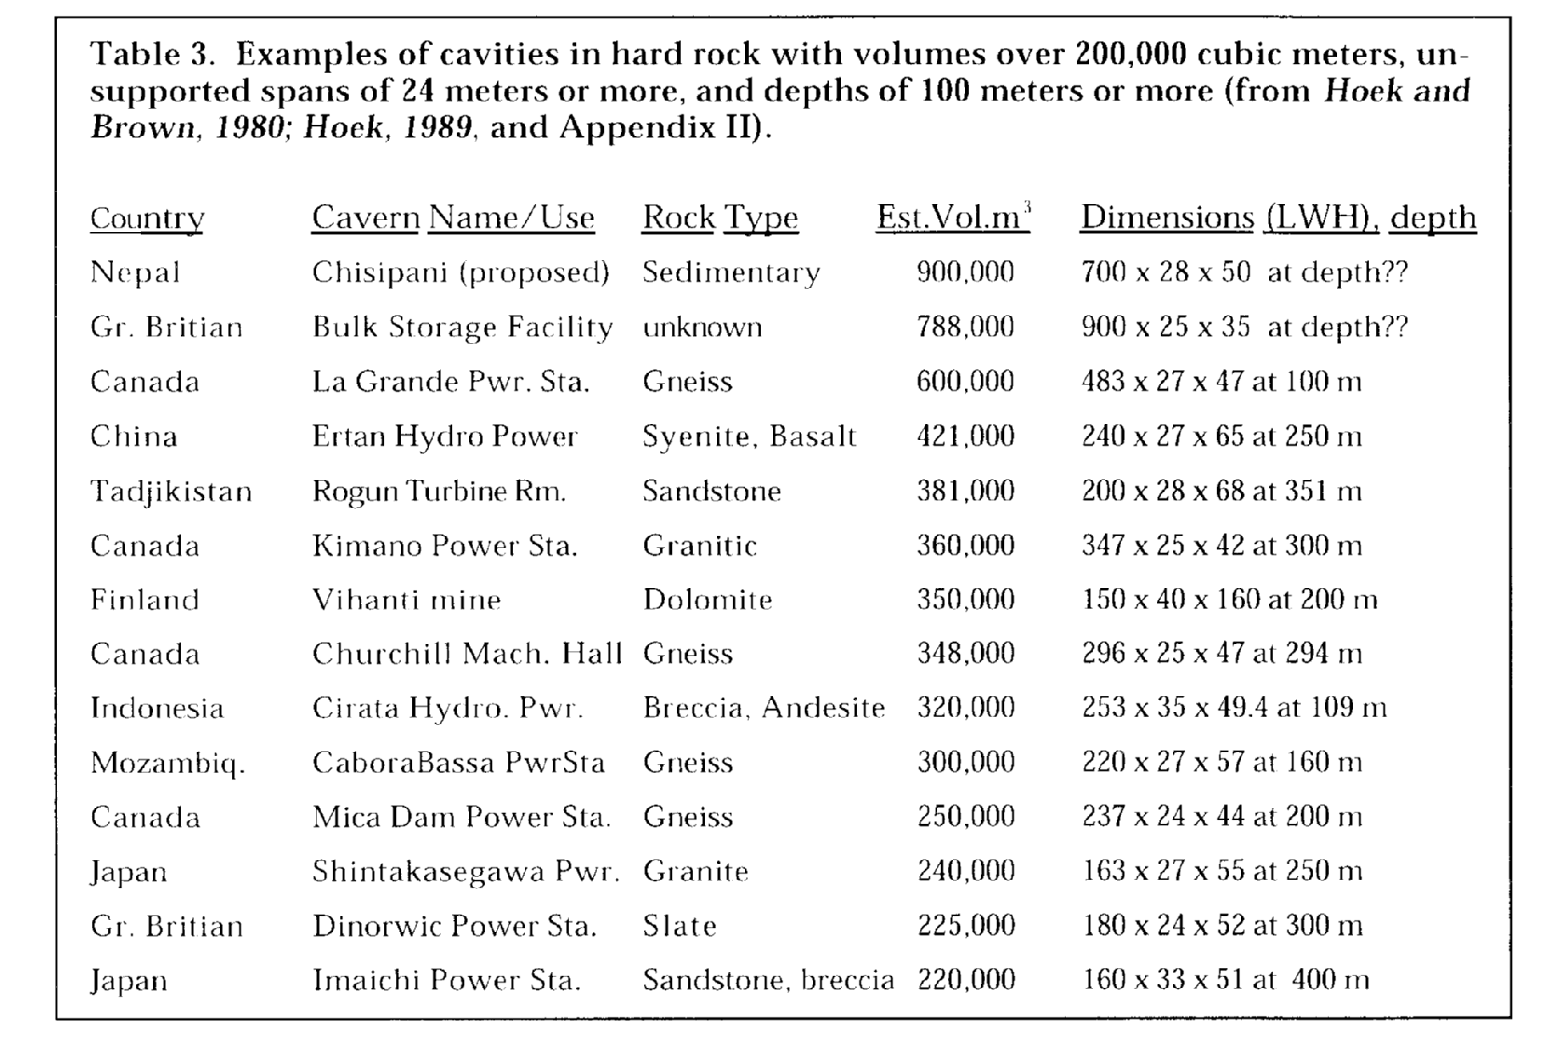
Designing Large Excavations..
Referencing Substantial Industry Precedent
Hard Rock Caverns (200,000+ cubic meters / 24+ meter span / 100+ m deep)
Laughton, ILF Consultants NNN15/UD2.

Slide 15
Cost & Schedule Drivers
Hydro-Geology, + Requirements, Locaition, Access, Logistics
Hydro-Geologic Conditions
Opening
Methods & Means
Size
Mining Method(s)
Shape
Support/Lining
Systems
Orientation
In Situ Stresses
After Kovari, 1979
“Geology is undoubtedly the most important single factor determining the nature, form and final cost of a tunnel.” After Muir Wood ’72
However, there are other things that strongly influence cost/schedule..
Laughton, ILF Consultants NNN15/UD2.
30

Slide 16
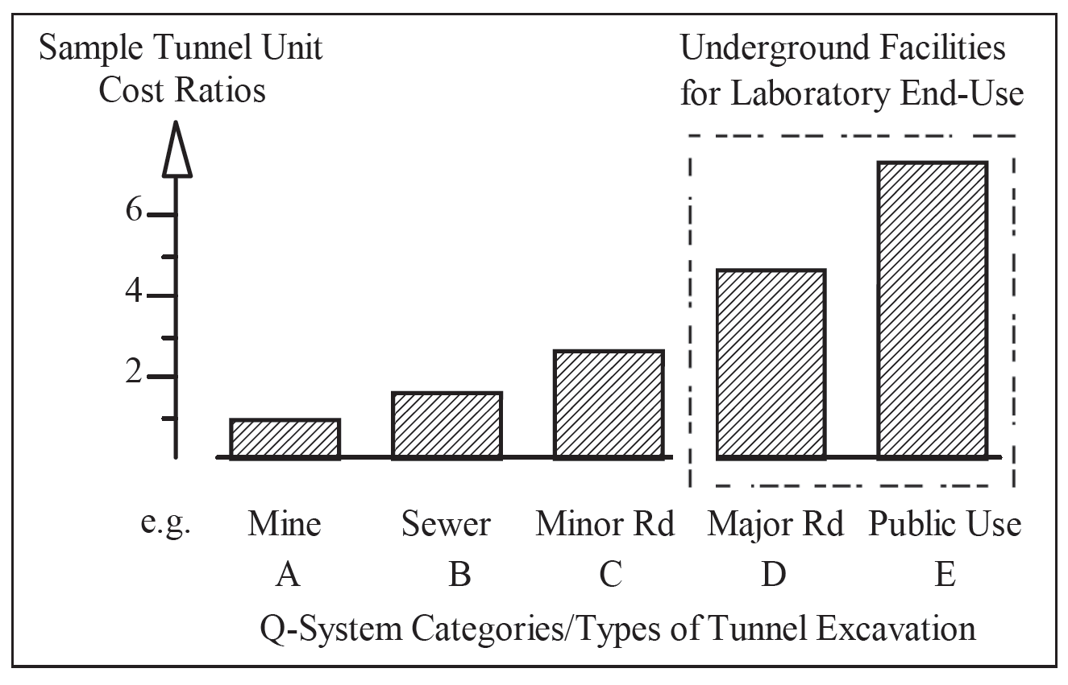
Cost & Schedule Drivers
Requirements that call for space/conditioning for egress, refuge, dryness, electrical and mechanical systems etc..
Mine and sewer tunnels; attractively priced, but rarely an appropriate basis for a URL planning budget
Laughton, ILF Consultants NNN15/UD2.

Slide 17
Cost & Schedule Drivers - Access Constraints
Underground work is expensive relative to surface work.. Country location can also strongly influence cost..
Investment Cost Comparison Lined Rock Cavern - U.S. vs. Scandinavia
Item | US Cost | Scandinavia Cost | Ratio US to Scandinavia
Preconstruction | 5,800 | 5,800 | 1.0
Below Ground | 125,550 | 54,600 | 2.3
Above Ground | 31,000 | 34,000 | 0.9
Total | 162,350 | 94,400 | 1.7
Below Ground
Versus
Above Ground
..also reference
G. Nuijten talk
NNN14. Paris,
Dec. 2014.
Investment Cost Comparison Lined Rock Cavern - Underground Works
Underground Excavation Type | Cost Ratio US:Scandinavia
Tunnels | 3.2
Caverns | 3.4
Shafts | 1.7
USA
Versus
Scandinavia
“The cost differences are caused mainly by different union rules in the United States compared to Scandinavia.” LRC Study
Source: http://www.netl.doe.gov/File%20Library/Research/Oil-Gas/Natural%20Gas/other/34348_final.pdf
Laughton, ILF Consultants NNN15/UD2.

Slide 18
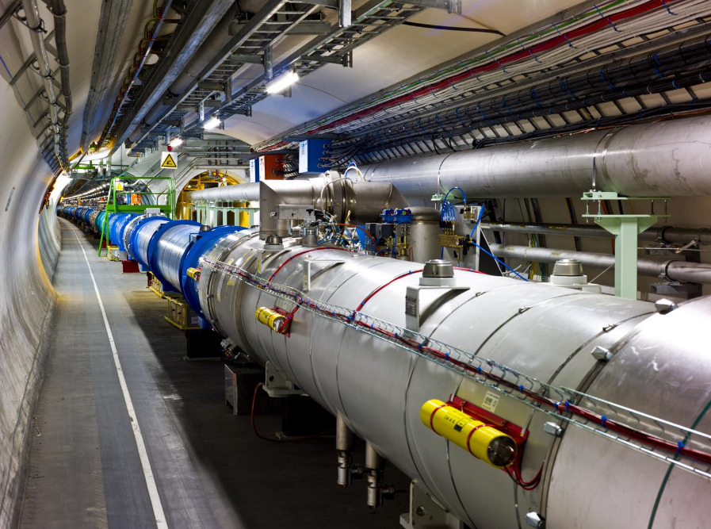
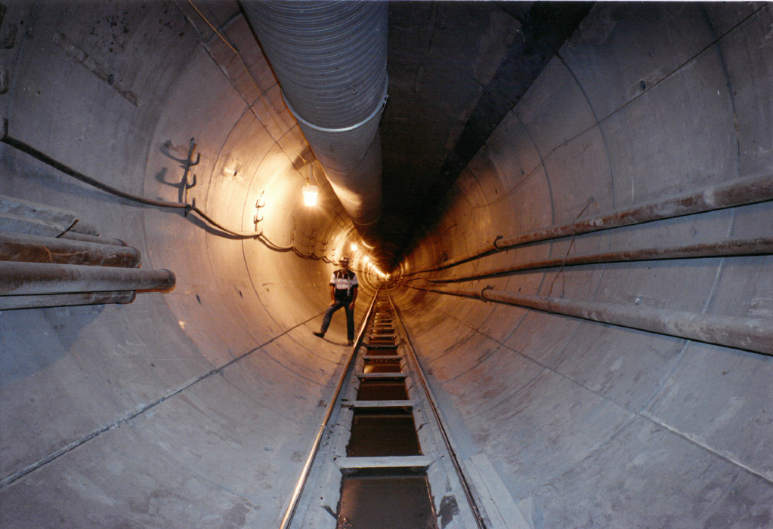
Cost & Schedule Drivers - Labor is much more expensive in some countries than others..
Reconciling underground estimates is problematic, but US underground work typically more expensive than it is in other countries*, e.g. CaHSR.
Large Electron Positron
~ $1000 per Meter in ~1988
Superconducting Super Collider
~ $1000 per Foot in ~1990
*LRC Report cites “Labor Rules” ~ higher burdened rates + larger crew sizes
Laughton, ILF Consultants NNN15/UD2.

Slide 19
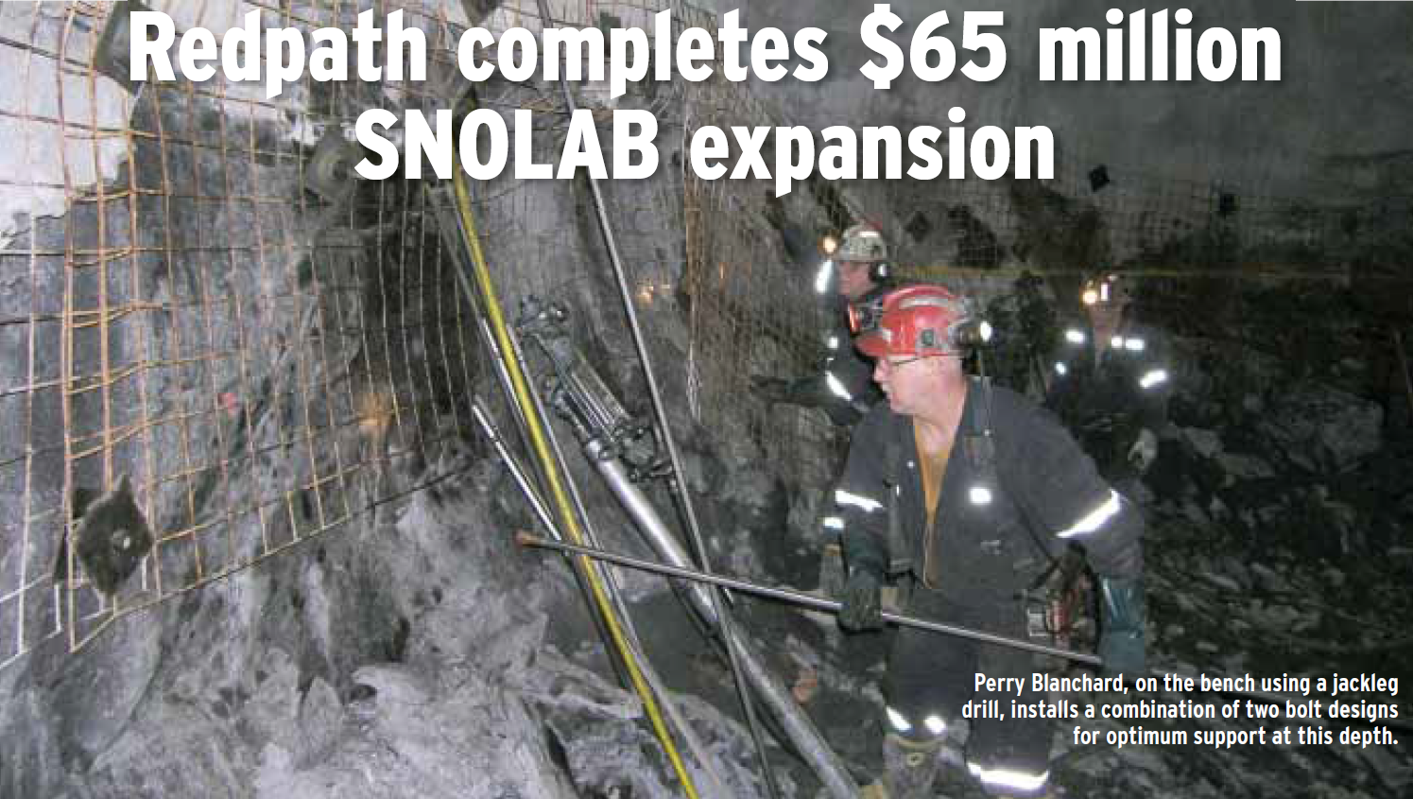
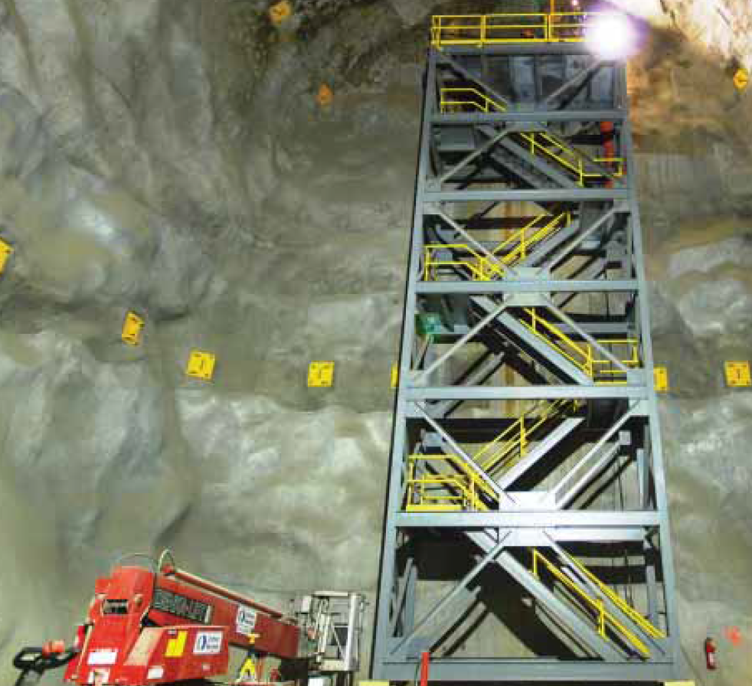
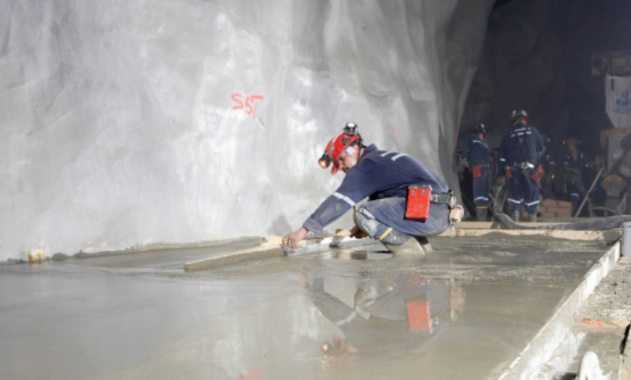
Cost & Schedule Drivers
Requirements that call for labor intensive finish-out tasks
“Four and a half years of meticulous work brings one-of-a-kind underground construction job to completion.” Sudbury Mining Solutions Journal
“meticulous” = time and money
Laughton, ILF Consultants NNN15/UD2.

Slide 20
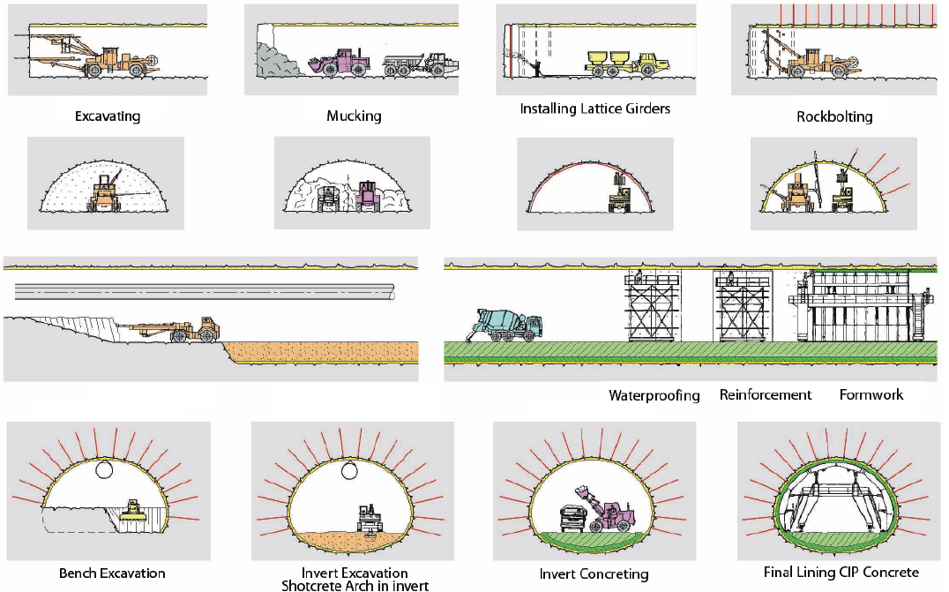
Cost & Schedule Drivers
Design choices (requirements) that extend the Critical Path
Indirect Cost for Underground Work Can be High ($100k’s/day for a “standing army” not uncommon)
+/- Sequential Set of Activities Difficult to Overlap
(many tried few succeeded)
Remove
Cast-in-Place
Liners Saves Time/Money
Source: Tunnel Operations, Maintenance, Inspection & Evaluation Manual
Laughton, ILF Consultants NNN15/UD2.

Slide 21
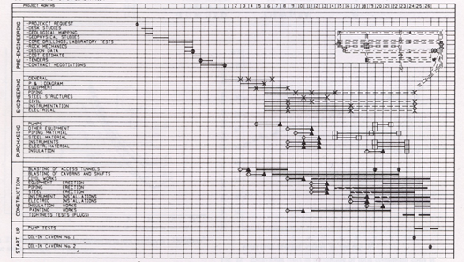
Cost & Schedule Savings - Task Overlap (D-B)
Near-surface sites with multiple access points..
Pre-Eng., 12 months
Engineering, 24 months
Purchasing, 19 months
Construction, 24 months
Start Up, 3 months
Master Schedule for 1,000,000 cubic meter Cavern Project for Underground Oil Storage
In Scandinavian Shield Hard Rock (Granites & Gneisses).. Drive-in Access
Laughton, ILF Consultants NNN15/UD2.

Slide 22
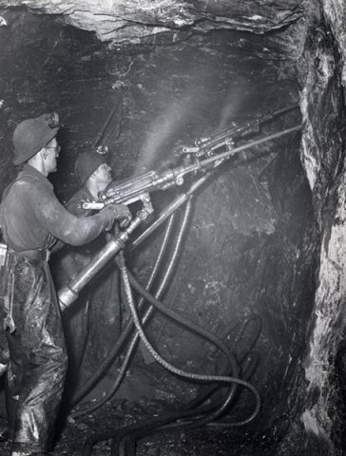
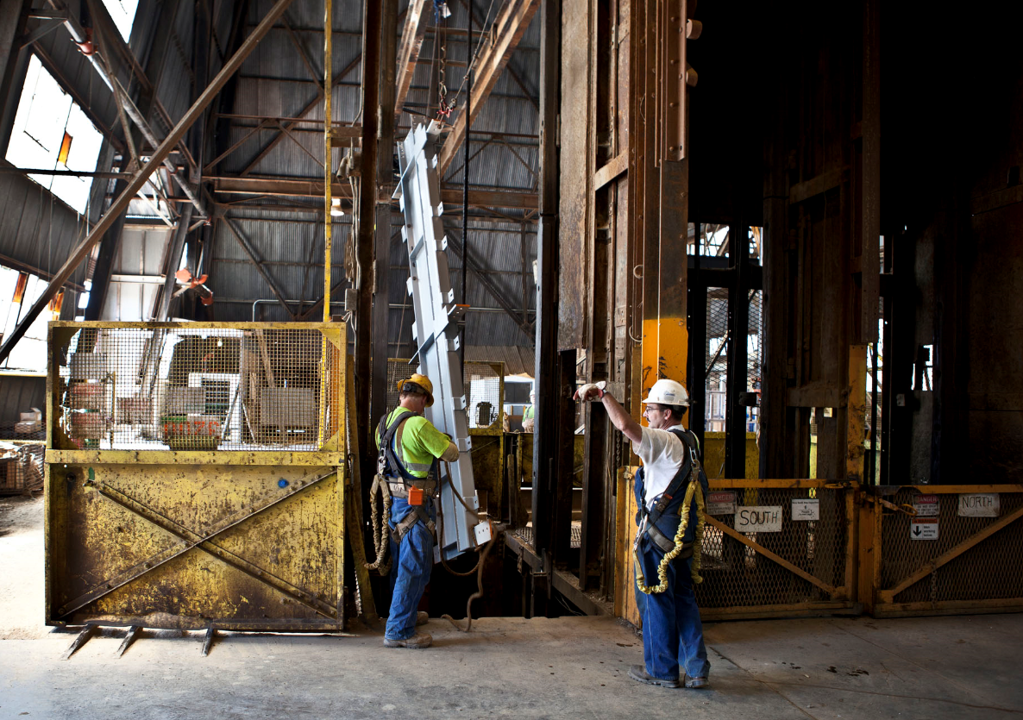
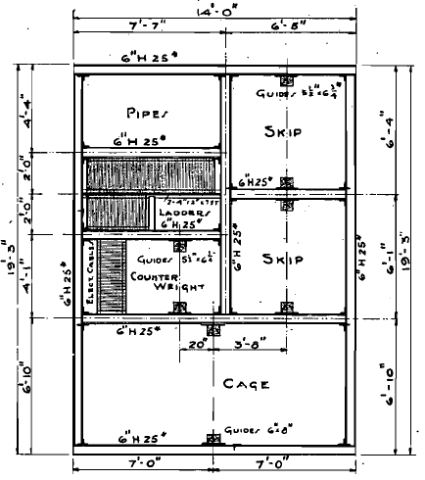
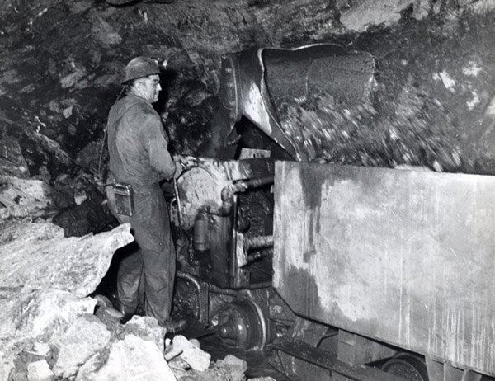
Cost & Schedule Drivers: Shaft Bottlenecks
Shaft Services; Power & Utilities, Rock Hoisting, Construction Supplies, Ventilation, Equipment Drops, Lab/Construction Personnel, Explosives & Fuel Transport, Air Monitoring (dust/diesel particulates)
Mine shafts/tunnels sized to match operating underground production profiles/rates
Laughton, ILF Consultants NNN15/UD2.

Slide 23
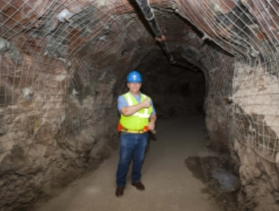
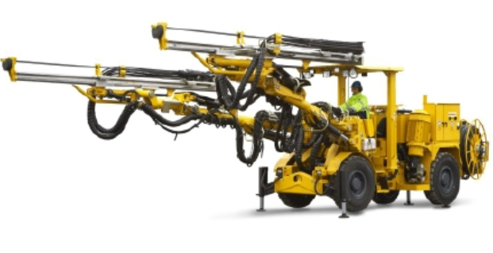
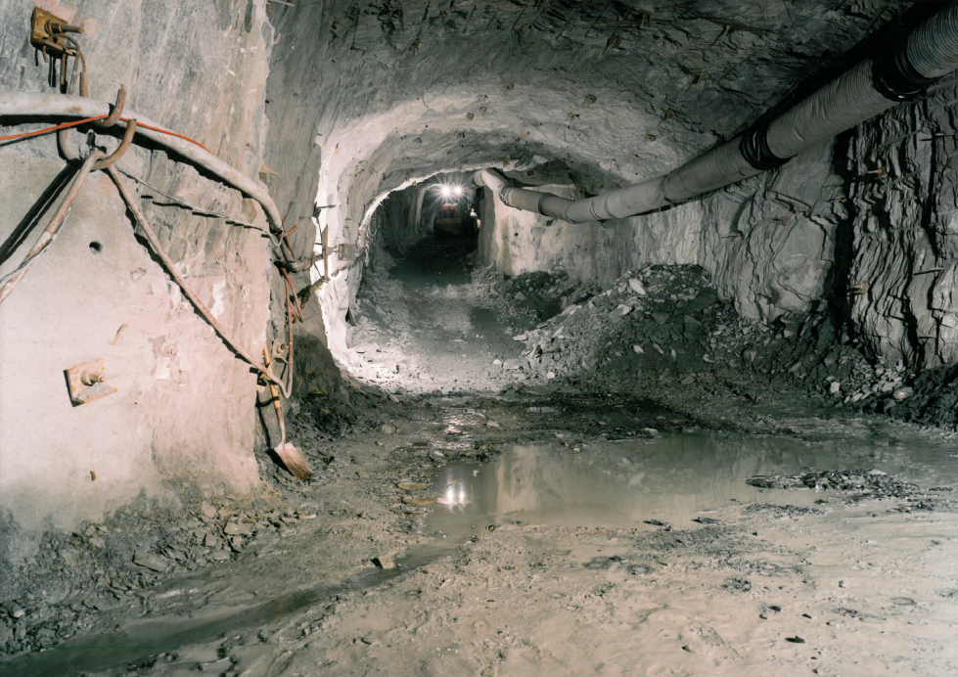
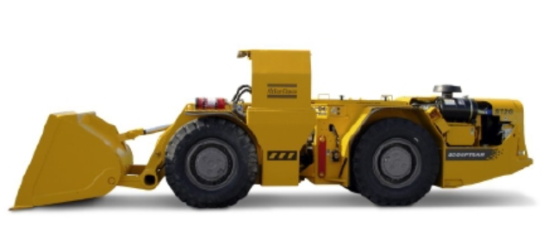
Cost & Schedule Drivers: Tunnel Bottlenecks
Larger equipment/high peak productivity/larger tunnels/storages capacities
Other Constraints; Garage, Turnaround/Bypass, Intermediate Muck Storage (large blasts/small shaft bins), Fuel Storage, Lay-Downs, Workshops, Air Supply, etc.
Laughton, ILF Consultants NNN15/UD2.

Slide 24
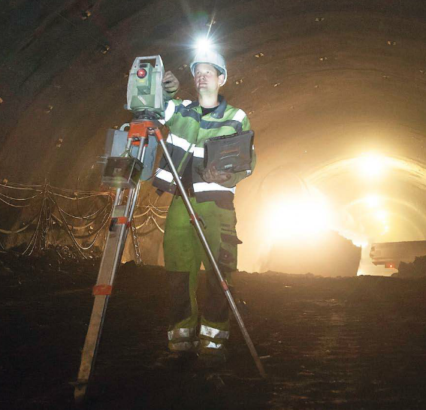
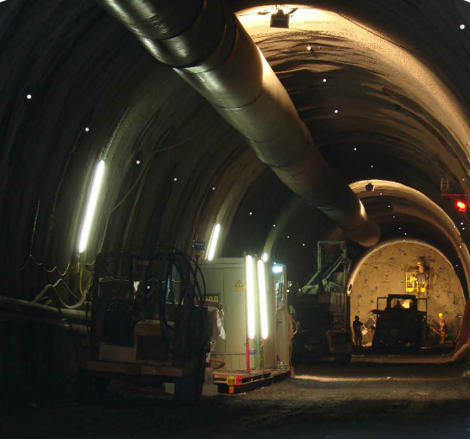


Cost & Schedule Drivers: Blast Restrictions
Drill
Blast-holes
Charge Blast-holes
Survey Next Round
Blast Warning & Evacuation
Install Rock Support
Ventilate Blast Dust/Gases
Scale Loose Rock
Remove Muck (Store/Skip)
Potential Blast-Related Constraints; Explosives Transport and Magazine Storage on Surface and Underground, Vibration Limitations/Monitoring, Post-Blast Ventilation Capacity, etc.. Dedicated “Contractor Space” will be at a premium on 4850L.
Laughton, ILF Consultants NNN15/UD2.

Slide 25




Cost & Schedule Drivers - Ideal Site Attributes
Uniform rock mass conditions, simple excavations, at a greenfield site, with drive-in access..
Near-surface excavations can be constructed rapidly (reservoirs, natural gas, hydroelectric power, radioactive waste (Forsmark)
High advance rates in “good rock”
  Average excavation rate >18k cubic m/month
  Includes Drainage & Grouting (near surface)
  Includes Rock Bolts & Shotcrete Support
330,000 bank cubic meters
in 18 months
Fast
Low Cost
Low Risk
Drive-In Access
Tunnels*
Laughton, ILF Consultants NNN15/UD2.
* Ideally two ways in/out – safety/ventilation/etc.

Slide 26






Cost & Schedule Drivers - VE Options
Opportunities to Reduce Cost - Ask the Contractor Early..
Pumped Concrete Delivery
Multitasking Crews
Modular Installation
Mechanized
Excavation
Mechanized
Support
26
Target methods and means that mechanize, streamline work flow, use better materials, allow work in parallel, cut-out tasks, improve productivity and/or reduced crew size, etc.
Laughton, ILF Consultants NNN15/UD2.

Slide 27





Risks: Managing Uncertainties in Ground Conditions and Behaviors
18” of Crown Deformation.. 18” of Lining “Adjustment”
22.4m
Laughton, ILF Consultants NNN15/UD2.

Slide 28


Risks: Delays, Overruns & Claims.. Happen
Tunnel.. optimistic engineer at one end, lawyer at the other
High Risk Projects: Critical Path Delays Frequent AND Expensive
Laughton, ILF Consultants NNN15/UD2.
28

Slide 29



Risks: Managed Systematically
Use a Disciplined, Industry-Specific Approach
Where this Code of Practice uses the words ‘shall’ and ‘must’, the procedure to which it applies is compulsory. Where the word ‘should’ is used then the procedure is recommended best practice.
Use Best-in-Practice Rules
Benefit from the collective experience of others
Insurers expect the insured to follow Best Practice
Don’t Make it up as You Go!
Underwriters had threatened to pull-out of industry!
Laughton, ILF Consultants NNN15/UD2.

Slide 30


Risks: Identify Them Early
Define Risks while there are more design options
It is critical that proactive steps are taken in a timely manner to predict and mitigate adverse conditions BEFORE design is detailed/contract is signed.
Site conditions that differ from those described in the contract cause major construction problems, delays, cost overruns and legal fees..
Define site-specific risks while more mitigation options are possible, see 1.
Risk %
Common Tunnel Problems & Claims
Lined Rock Cavern Risks, %
Laughton, ILF Consultants NNN15/UD2.

Slide 31


Risks: Don’t Start ‘til Mitigations In-Place
What if the Ground Behaves Differently and Method/Means Change Needed?
What if the Excavation Equipment Breaks Down?
Establish Mitigation Plans to Limit the Impact of Risk Events on Overall Schedule
For Tunnel Work Focus on the Excavation Work +/- Always on the Project Critical Path
Laughton, ILF Consultants NNN15/UD2.

Slide 32



In Summary
Strong experience in URL Design/Operation to draw on.
Optimize for cost/risk early in design process (builder input).
Use a rigorous, industry-proven approach to risk management.
Thanks to BNL, CERN, Fermilab, IHEP, LBNL, SLAC, SURF, SNOLAB, Virginia Tech., University of Chicago, University of Colorado, University of Minnesota, South Dakota School of Mines, and all in the Community.
Thanks for your attention..
Chris Laughton, P.E., Ph.D., C.Eng., Eur. Ing.
ILF Principal Engineer
Email: chris.laughton@ilf.com
Questions?
34

Slide 33

International web-link: www.ilf.com
US web-link: www.ilf-usa.com

