Slide 1
ATHENA – PWG Coordination Progress
14th July 2021:
A slide with two pages. One giving the broad sequence of steps we are generally expecting. We can fine-tune the steps based on your inputs and suggestions.
The second slide has a table with a request to each PWGs to help start filling up whatever is possible and share with us.
https://wiki.bnl.gov/athena/index.php/Main_Page
19th August 2021:
Emails request to individual convenors of PWG
May I now request that can we have some sample key plots for the measurements (older versions, placeholders etc, X and Y axis etc ). This includes physics and detector performance plots. It will help to discuss and move things ahead as we wait for the simulated data. If it is available at some link, kindly please point those to us. Also, please note that the proposal will have only 40 pages to make the case (excluding the cost details), hence we need to arrive at few key impactful plots, this should include a subset that shows ATHENA uniqueness.
20th August 2021:
Email request to software group
(a) Final geometry configurations (some representative figures)
(b) What are the event generators and what are the event statistics being processed?
(c) Production timeline and plan chart
(d) A reading macro and information stored in the output
https://doc.athena-eic.org/en/latest/

Slide 2
PWG
handle crossing angle
Baseline Detector Configuration (GEANT)
Event Generator
Physics results
Conditions:
Polarized electron ( 70%) and proton ( 70%)
Ion beams: deuterons and gold
e+p center-of-mass energies: 20 - 100 GeV
Electron-nucleon luminosity 10³³ and10³⁴ cm⁻² s⁻¹
Conclusions on performance / sensitivity
+
Plots for proposal
Configuration#1
Configuration#2
Proposal wiki page for more details: https://wiki.bnl.gov/athena/index.php/Main_Page
Other useful link: http://www.eicug.org/web/documents/public

Slide 3
Key Minimum Physics
Physics Process | Key measurements | Key Plots | Physics Message | Detector Performance Tests

Slide 4
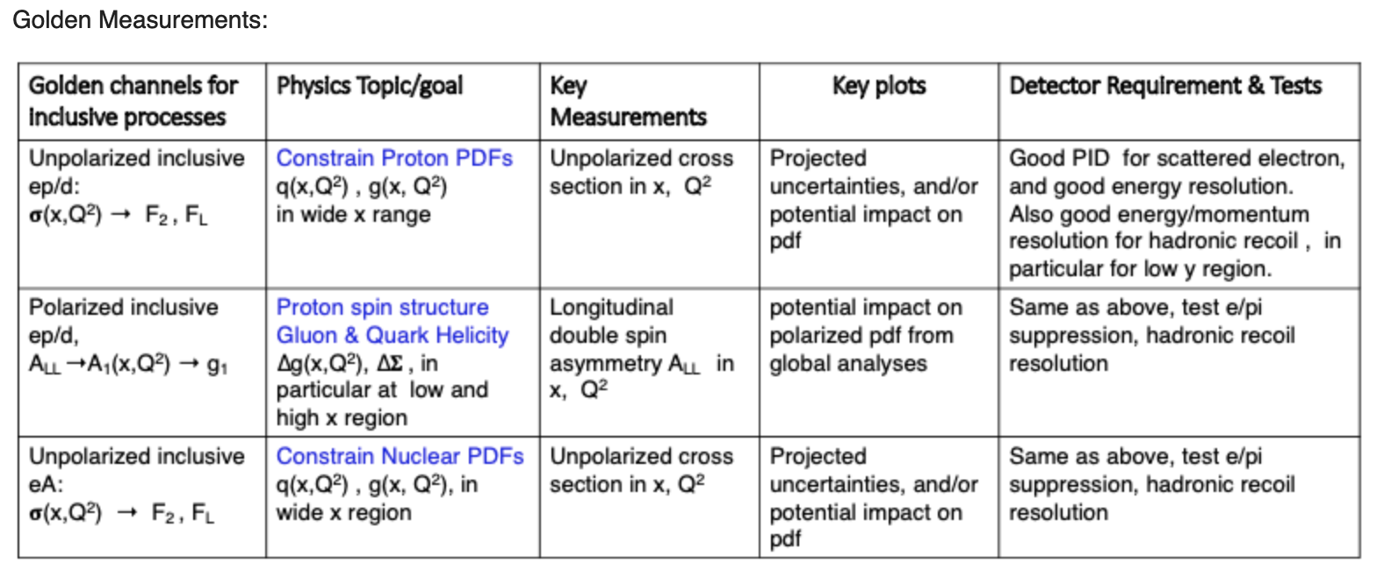
Inclusive PWG

Slide 5
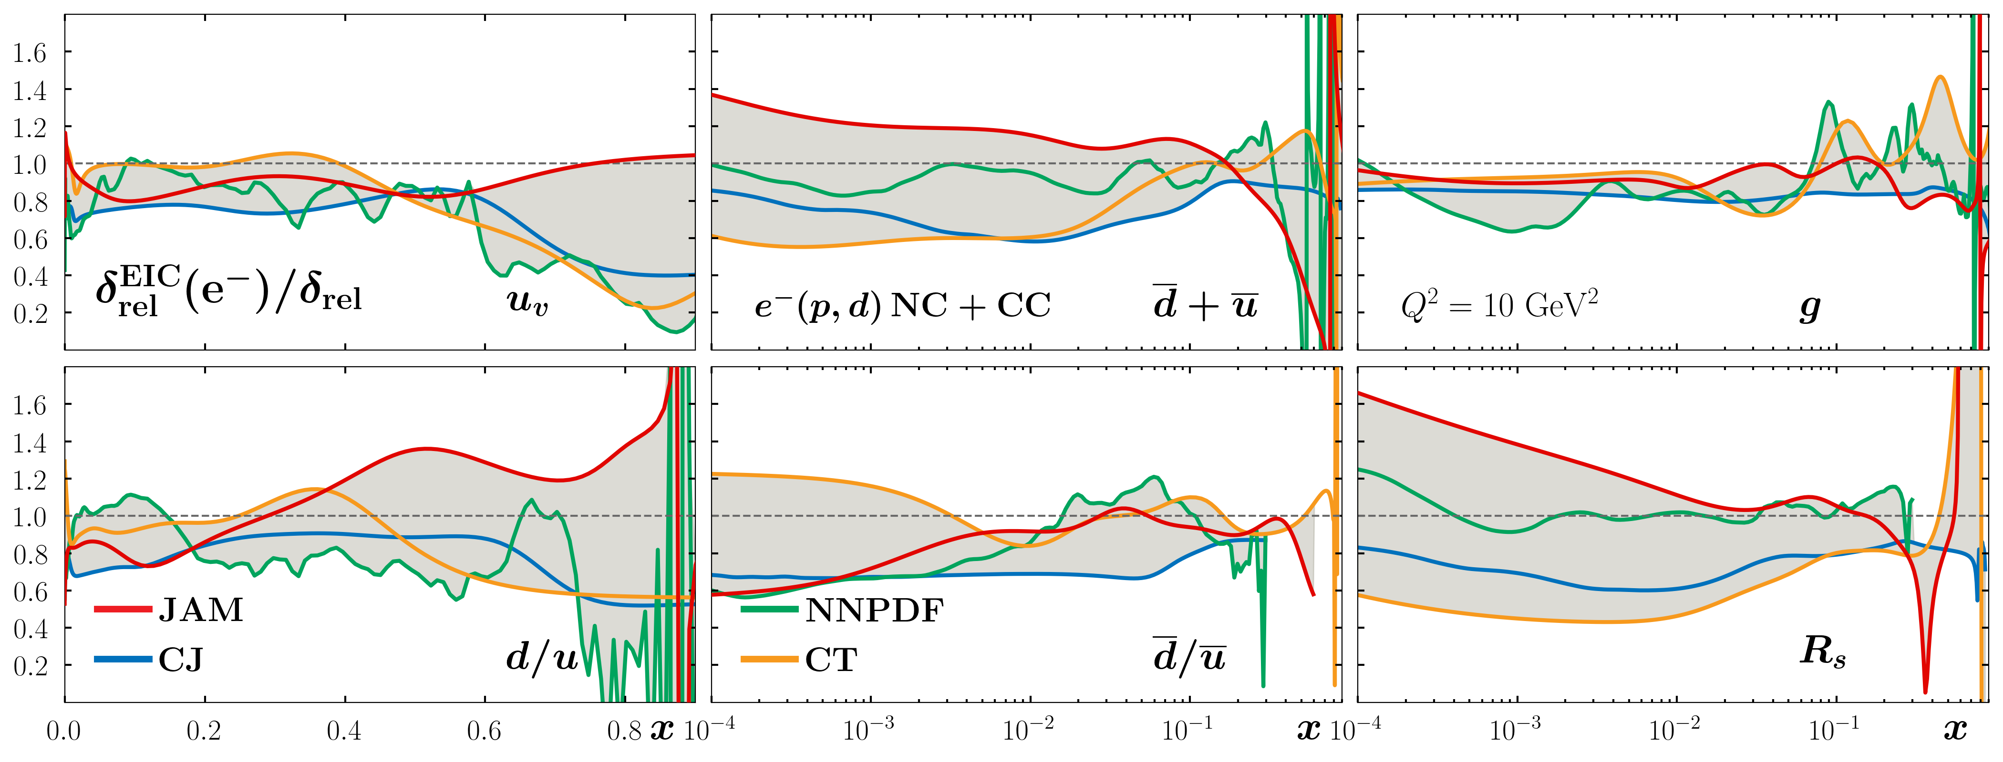
Inclusive PWG
300 million Pythia 6 events.

Slide 6
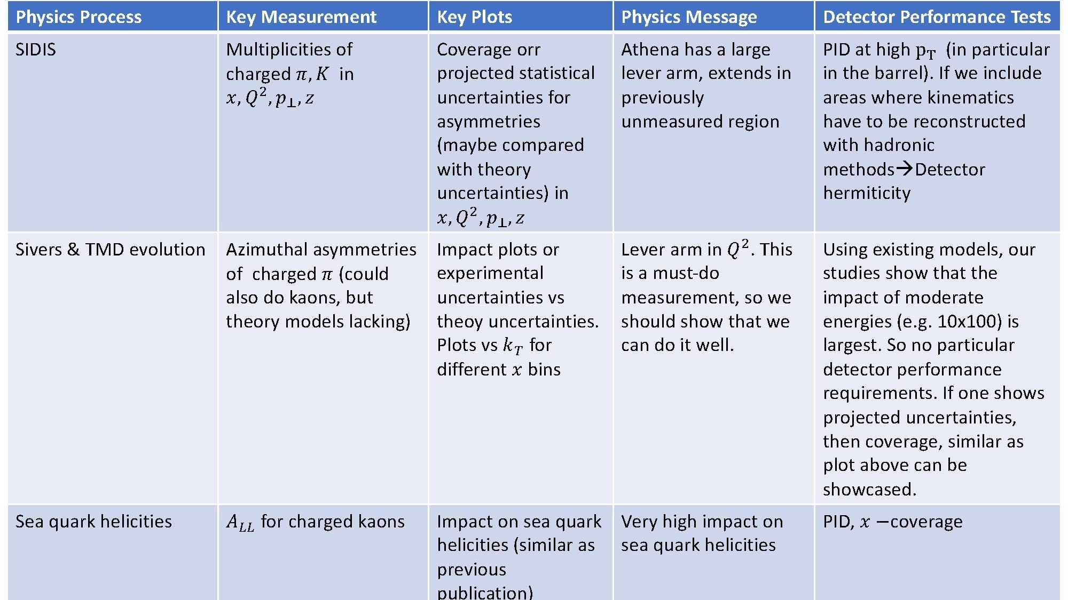
SIDIS PWG

Slide 7
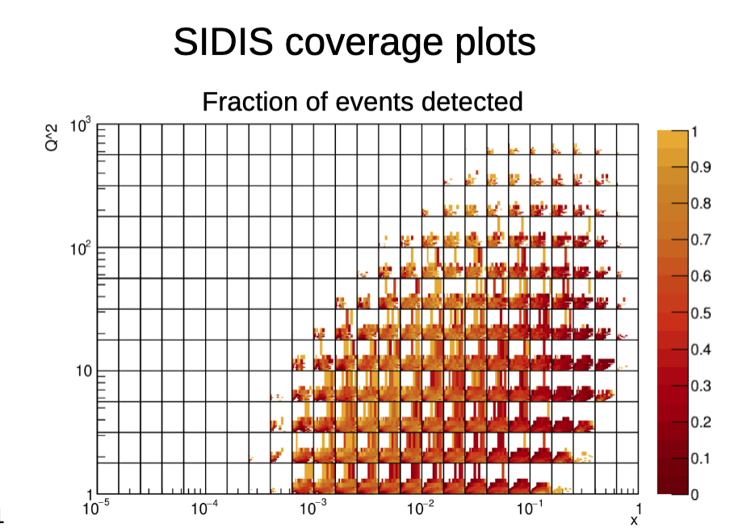
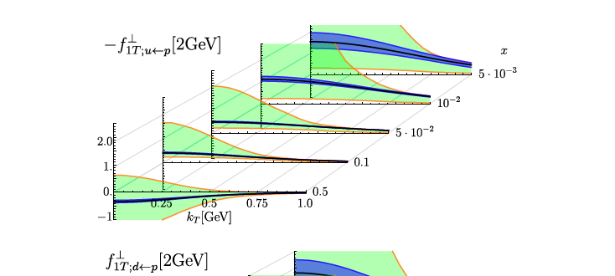
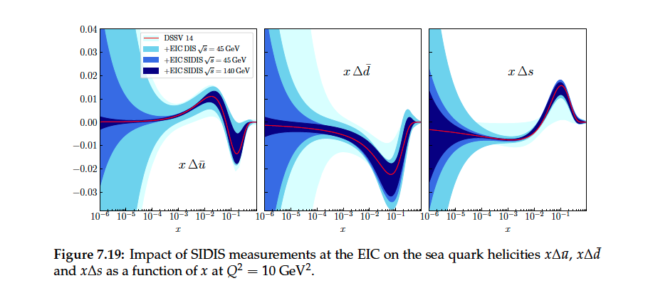
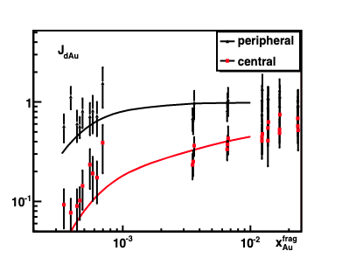
SIDIS PWG

Slide 8
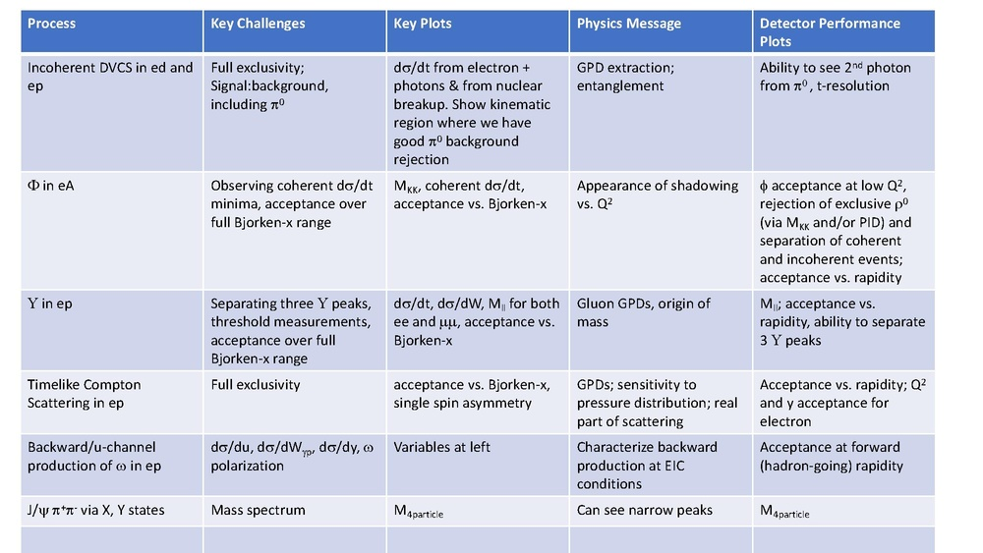
Exclusive PWG

Slide 9
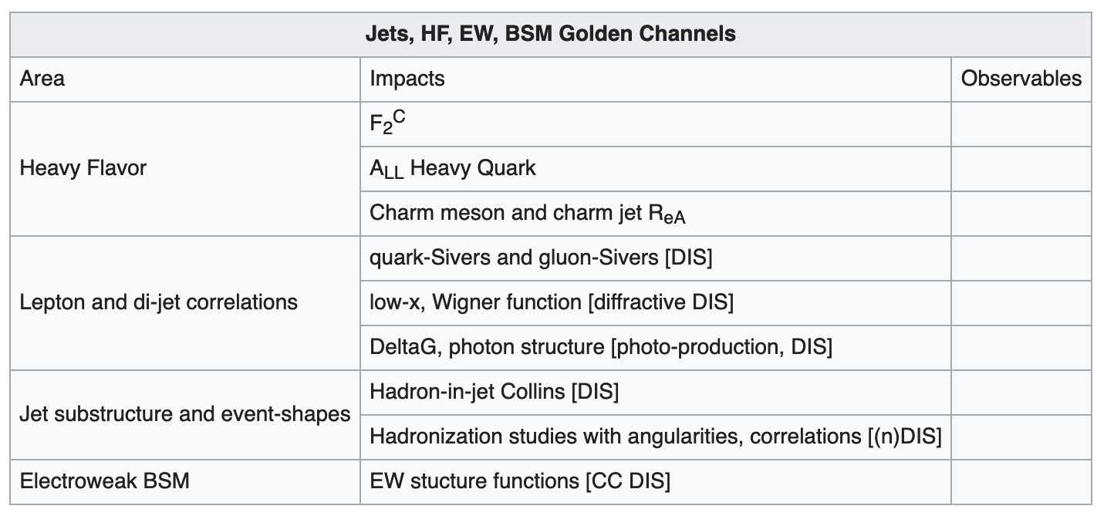
Jets, HF, EW, BSM PWG

Slide 10
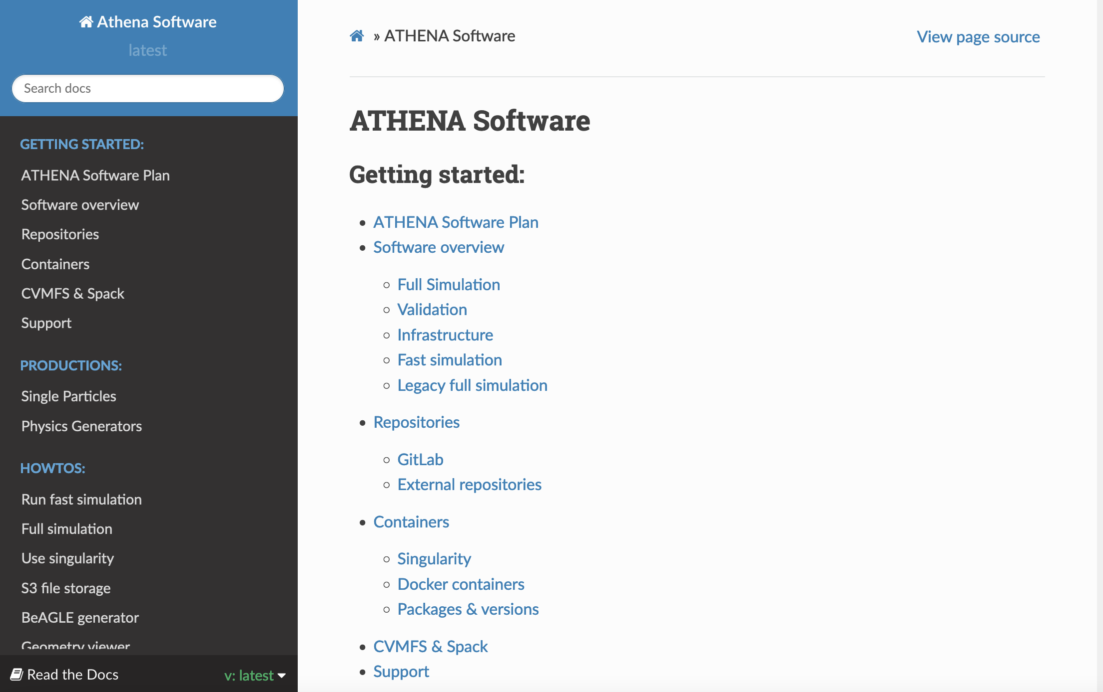
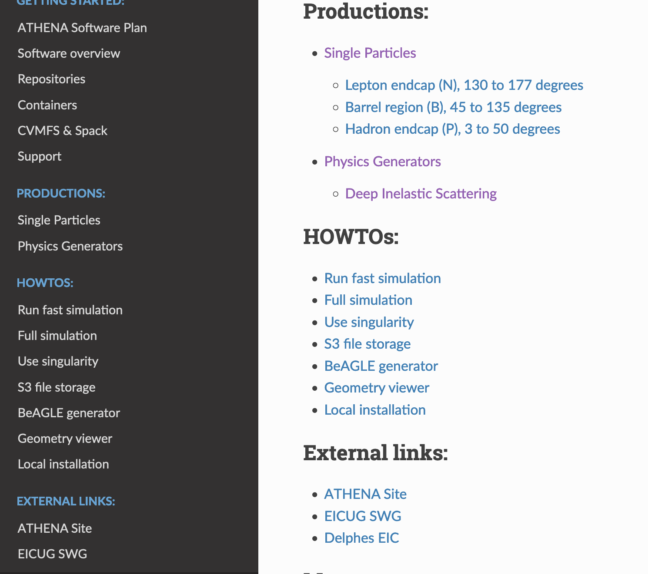
ATHENA Software Page
https://doc.athena-eic.org/en/latest/

Slide 11
Requests
Place holder plots /Sample plots needed for discussion
Link the PWG discussion to the main page
https://wiki.bnl.gov/athena/index.php/Main_Page
Consolidated list of event requirements from PWG
Some relevant software information in main page
https://doc.athena-eic.org/en/latest/

