Slide 1
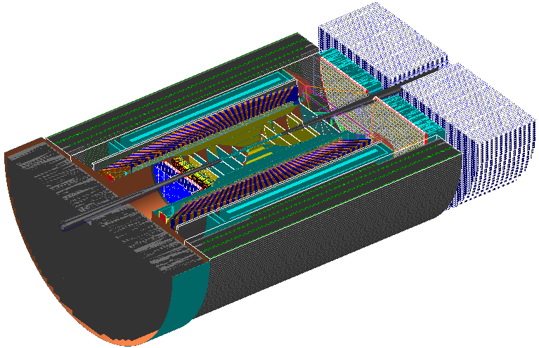
Tracking Simulations
Campaign 1 to Campaign 2
Cameron Dean, for the simulations team
09/10/2021
Tracking Working Group Meeting

Slide 2
Overview
Major changes between campaigns 1 & 2:
Most trackers were repositioned
  EEMCal, DIRC and RICHs moved
Detector resolutions were updated
Some detectors were removed
Support structure was added between EHCal and dRICH

Slide 3
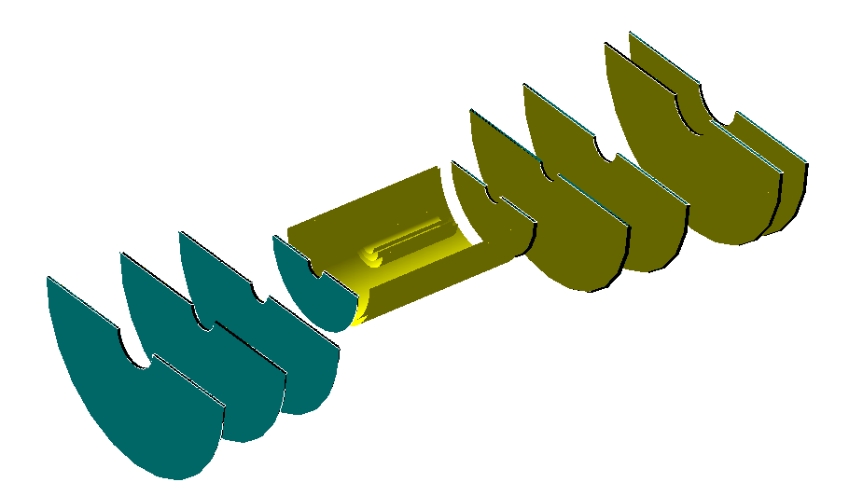
Barrel
Barrel detector reduced from 4 layers to 2 layers
Vertex detector increased from 2 layers to 3 layers
Barrel thickness reduced from 0.55%X₀ to 0.05%X₀

Slide 4
FST
FST was pitch reduced from 20→36 microns to uniform 10 micron
1 layer dropped in e-going direction (was at -125cm)
Last e-going tracker mover from -115cm to -107.1cm

Slide 5
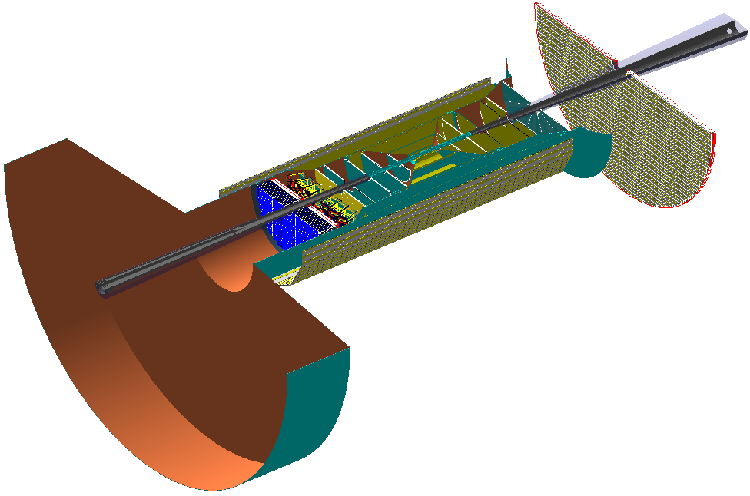
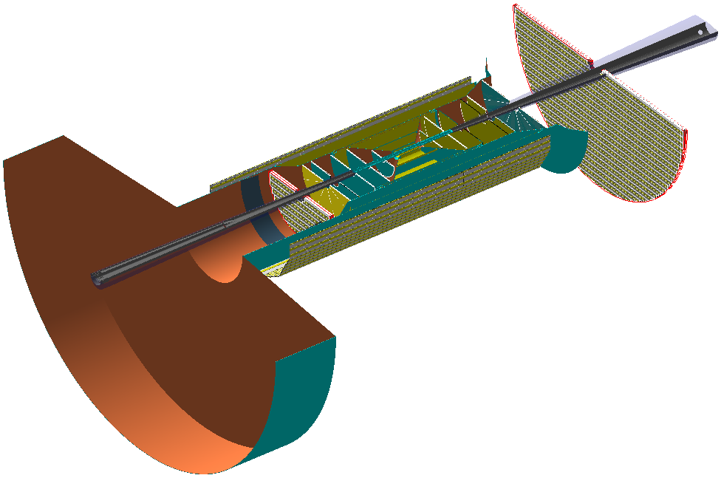
GEMs and TTLs
E-going GEM moved from -160cm to -120cm
E-going TTL moved to accommodate closer EEMCal

Slide 6
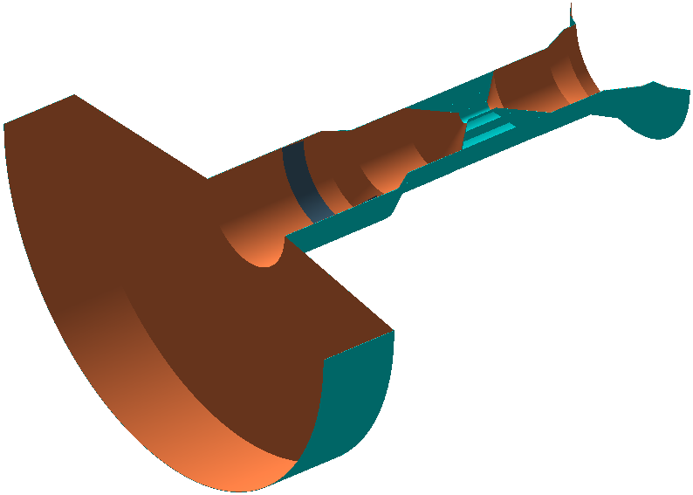
Support
Support structure added between EHCal and dRICH
  Inner barrel HCal is too close to wrap support around it
Structure covers all barrel layers and passes near discs
Barrel cylinders are half-thickness of FST cylinders (0.5mm vs 1mm)
Layers are given appropriate thickness of copper, water, plastic, carbon fibre where needed
Iron cone connects support to EEMCal (5.7%X₀)

Slide 7
Tracking and Outputs
Campaign 1 tracking used ROOT GenFit
Detector smearing was setup in each macro for resolution
Campaign 2 will also use ROOT GenFit
Sebastian Araya is working on implementing ACTS in to ECCE
Aim to run this over campaign 2 events to get more realistic tracking estimates
Will be run as a second stage process
Tracking evaluator was run in all campaigns
All simulations are with sims team
  Jin and I are ironing out overlaps in subsytems

