Slide 1
Crossing Angle Group Meeting: Introduction and Frame Discussion
Brian Page
August 27th, 2021
Ad-Hoc Crossing Angle Group

Slide 2
Crossing Angle Group Goals
Verify the Beam Effects Afterburner being developed by Dmitry is consistent with the Pythia-8 implementation
  Afterburner code from Jin was extensively tested against Pythia-8 implementation and found to agree very well
  Jin’s code is dependent on fun4all framework and can’t be ported directly to ATHENA
  Need to verify all is still consistent after the transfer
  Add automatic benchmarks into the CI pipeline to verify simulation has correct beam effects applied
Agree on procedure to move from laboratory frame (with crossing angle) to a head-on frame and possibly others, such as Breit frame
  No unique axis in the lab frame – how do we define pT, pseudorapidity, etc. for physics quantities
  Kinematic calculations taking into account the hadronic final state will be distorted by the crossing angle
  Boost procedure is relatively simple, we just need to agree on a method and make the rest of the collaboration aware – possibly develop a small library / utility people can use
Generate a short document or wiki entry with our findings
Longer term: Think about impact on (Longitudinal) spin measurements. Are there theory formalisms which could handle crossing angle natively?

Slide 3
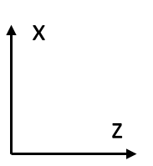
Boost to Head-On Frame
Boost
(6.896/293.29,0.022/293.29,257.15/293.29)
(0.003,-0.001,-18.026,18.026)
(6.892,0.023,275.176,275.264)
Initial Configuration in the Lab Frame (beam momenta from a random event)

Slide 4
Boost to Head-On Frame
(-1.402,-0.006,-70.420,70.434)
(1.402,0.006,70.420,70.440)
Initial Configuration in the Lab Frame (beam momenta from a random event)
Boost by sum of beam 4-momenta to get to CM Frame

Slide 5
Boost to Head-On Frame
(0.0,-0.006,-70.434,70.434)
(0.0,0.006,70.434,70.440)
Initial Configuration in the Lab Frame (beam momenta from a random event)
Boost by sum of beam 4-momenta to get to CM Frame
Rotate about y-axis to eliminate x-component of momentum

Slide 6
Boost to Head-On Frame
Boost
(0.0,0.0,-257.15/293.29)
(0.0,0.0,-18.048,18.048)
(0.0,0.0,274.890,274.891)
Initial Configuration in the Lab Frame (beam momenta from a random event)
Boost by sum of beam 4-momenta to get to CM Frame
Rotate about y-axis to eliminate x-component of momentum
Rotate about x-axis to eliminate y-component of momentum (not shown)
Boost back along z to (nearly) restore original beam energies

Slide 7
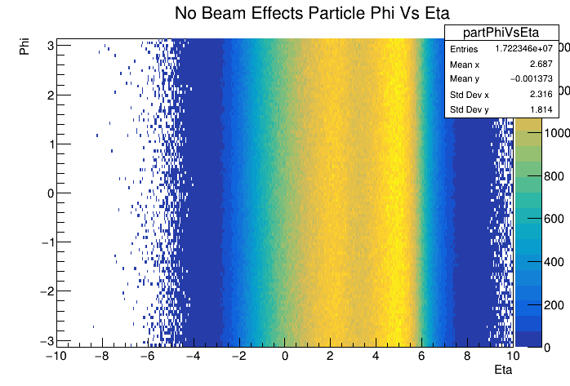
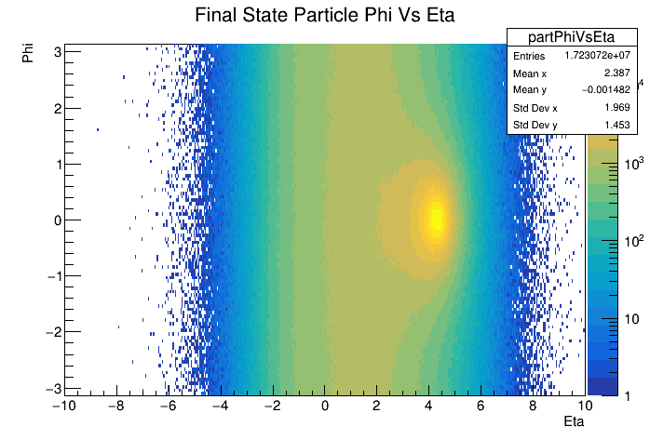
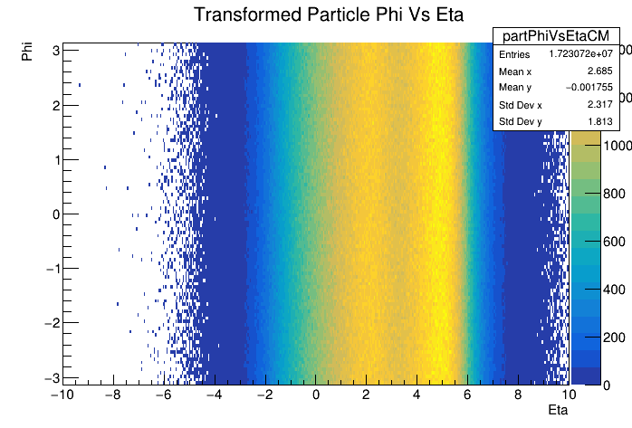
Frame Comparison: Phi Vs Eta
Transform
Crossing angle introduces a hot-spot at phi = 0 and eta = ~4.2 in the lab frame (top left)
Transformation described above removes phi modulation and smooths out eta (bottom right)
Matches very well with distribution obtained from default Pythia with no beam effects included (top right)

Slide 8
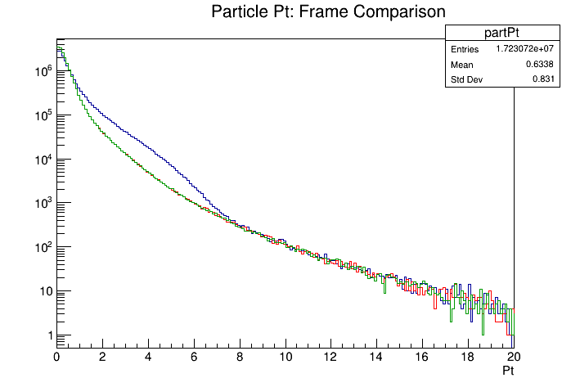
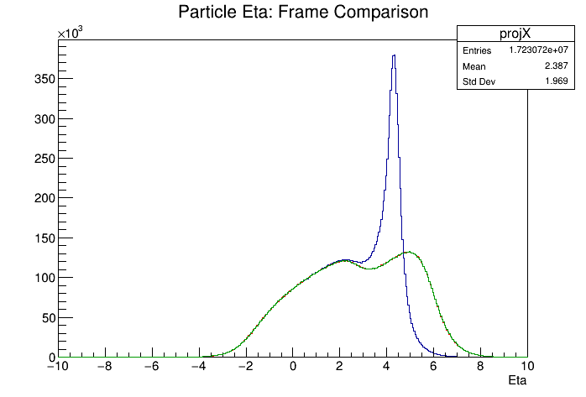
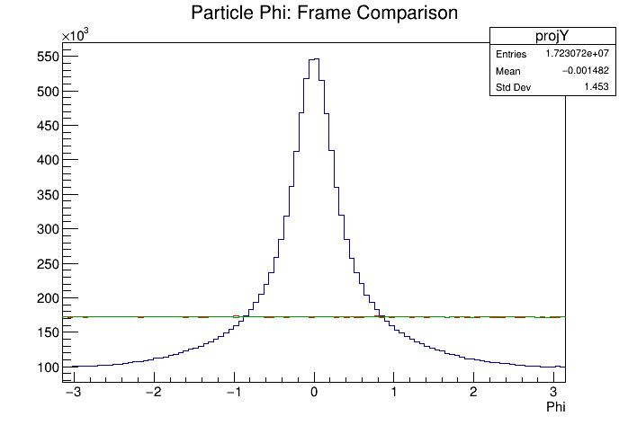
Frame Comparison: Pt, Eta, & Phi
Transformed eta and phi distributions from Pythia sample with beam effects matches exactly the lab frame distributions from default Pythia
Particle Pt distributions match as well
Transformation does what we expect
Lab Frame (Beam Effects)
Transformed (Beam Effects)
Lab Frame (No Beam Effects)

Slide 9
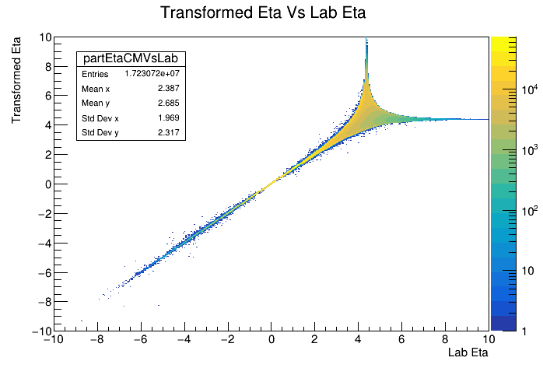
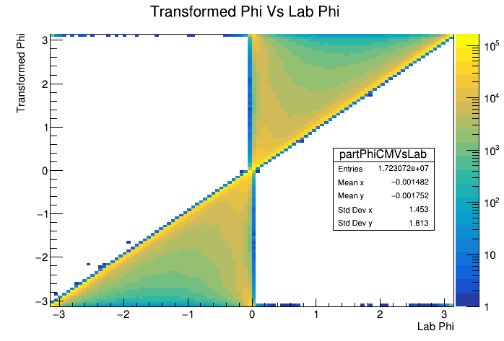
Transformed Vs Original Phi and Eta
Correlation between transformed and lab eta for Pythia sample with beam effects is one-to-one for low eta
Correlation begins to smear out at higher eta with singular behavior near eta = 4.2

Slide 10
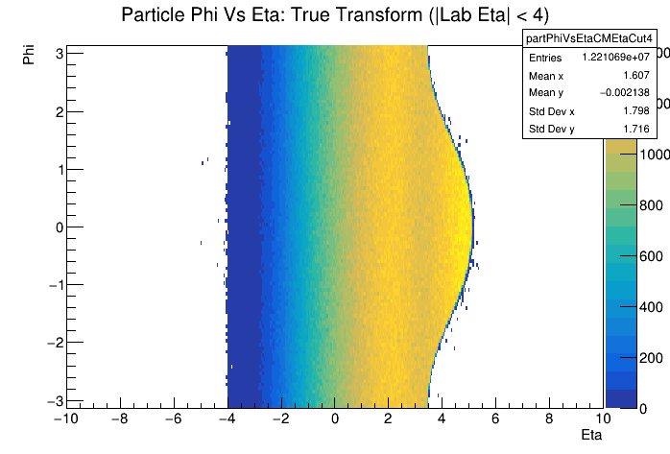
Acceptance Effects: Lab Eta < 4
We have seen that the transformed eta/phi distributions match the default Pythia values very well when considering all particles
How does limiting acceptance due to finite detector acceptance effect transformed distribution
See the ‘bulge’ from crossing angle, but particle distribution is still flat in phi within this region

Slide 11
To Boost or not to Boost
Or
A Tale of Two Frames
Need to stay in the lab frame when considering detector responses and acceptance effects because particles in this frame represent what the detector will actually see
When do we want to boost into the head-on frame? Will this effect the calculation of event kinematics?

Slide 12
Kinematic Reconstruction Methods
Figure from Owen Long
While in principle, one can reconstruct the event kinematics solely from the scattered electron, in practice there are many cases where this is not practical because of resolution issues, acceptance effects, or in the case of CC DIS, the lack of an electron all together
There are many methods for reconstructing the event kinematics which make use of hadronic final state information – how are these effected by the crossing angle and frame change?
Compare three methods:
  Electron – Uses only electron info. Invariant under our frame transforms. This is our baseline
  Hadron – Makes maximal use of the HFS information
  Sigma – Mixes information from scattered electron and HFS

Slide 13
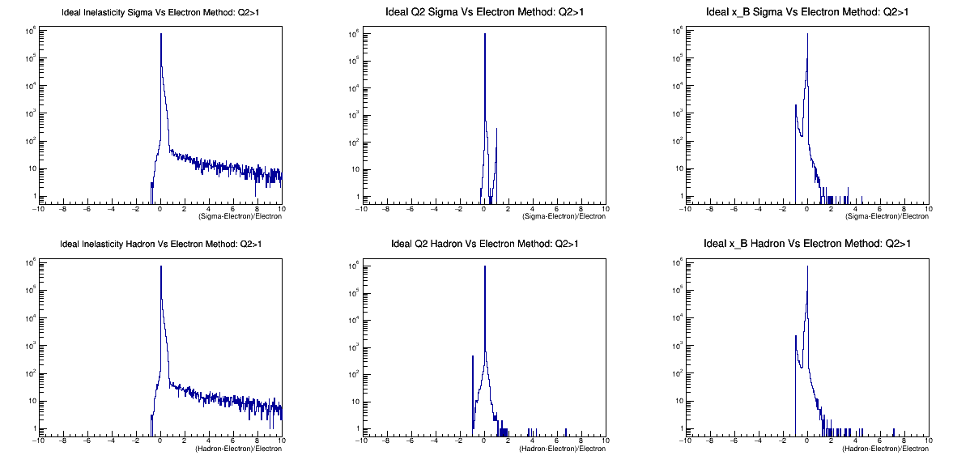
Ideal Comparison: Q² > 1 GeV²
y
Q2
X_B
Comparison of Electron Method and Ideal Sigma and Hadron Methods – how well do these methods agree in best case scenario
Ideal means all particles are collected
Some edge cases with disagreement, but overall, excellent matching
Sigma
Hadron
(Sigma or Hadron – Electron) / Electron

Slide 14
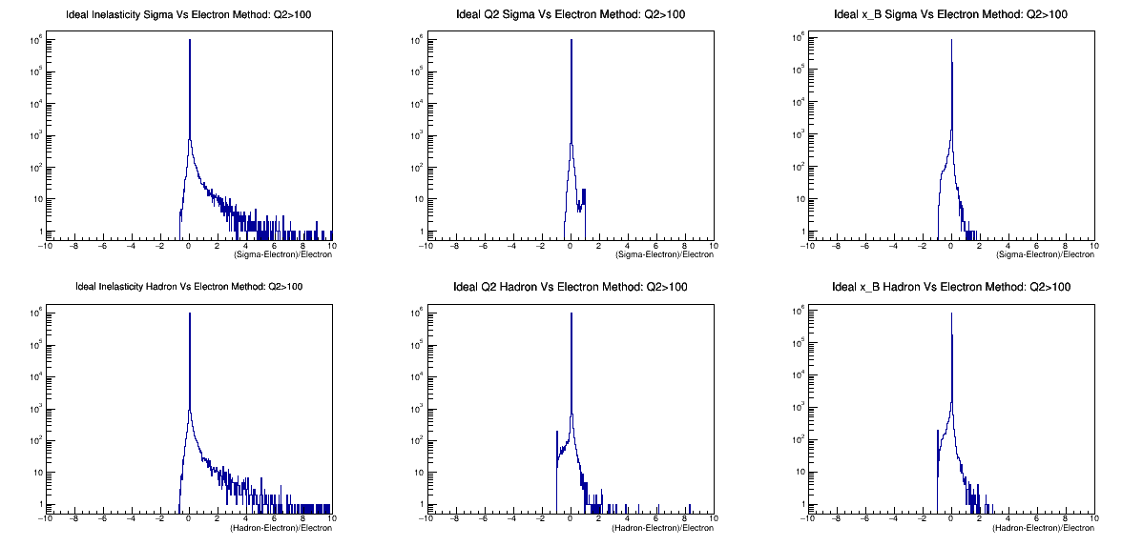
Ideal Comparison: Q² > 100 GeV²
y
Q2
X_B
Agreement seems somewhat better at higher Q2
Sigma
Hadron
(Sigma or Hadron – Electron) / Electron

Slide 15
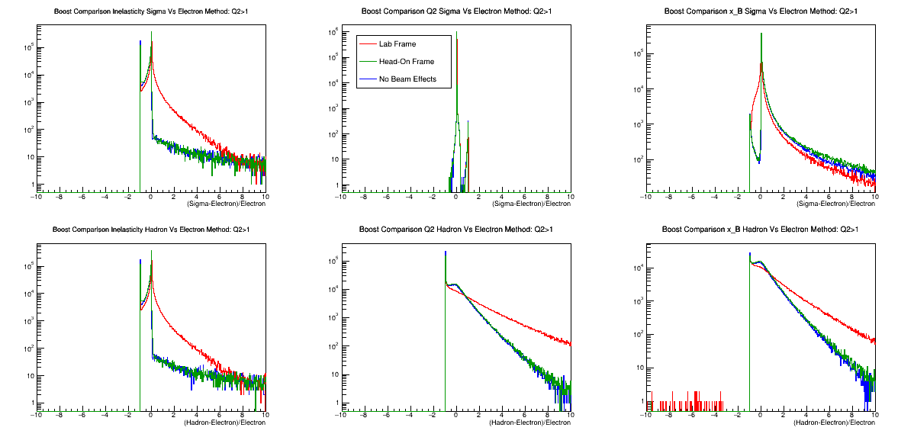
Frame Comparison: Q² > 1 GeV²
y
Q2
X_B
Look at comparisons of kinematic quantities in different frames: The Lab Frame (with crossing angle), The Head-On Frame, and a sample with no crossing angle for comparison
Limit HFS to |Eta| < 4
The Head-On Frame matches exactly the sample with no beam effects
Sigma and Hadron methods better match Electron Method in Head-On Frame
Sigma
Hadron
(Sigma or Hadron – Electron) / Electron

Slide 16
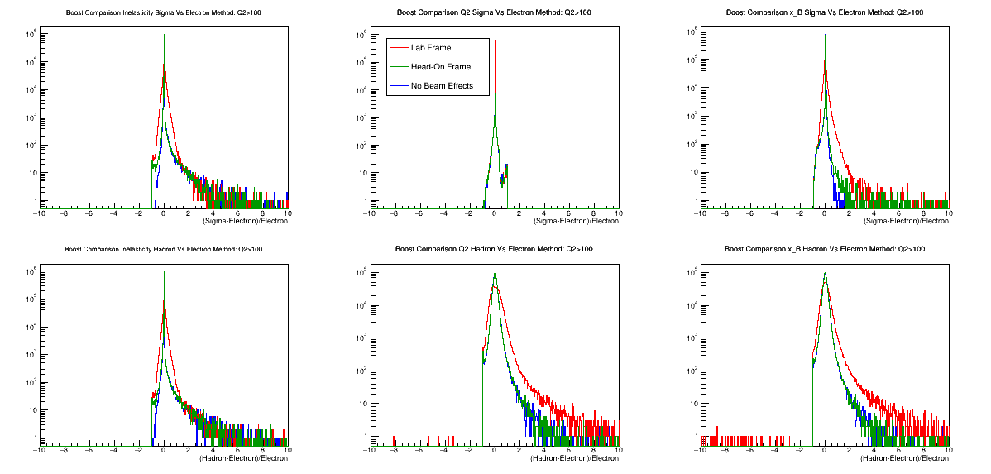
Frame Comparison: Q² > 100 GeV²
y
Q2
X_B
Again, high Q2 distributions are better behaved – less outliers and better matching between Lab and Head-On Frames
Sigma
Hadron
(Sigma or Hadron – Electron) / Electron

Slide 17
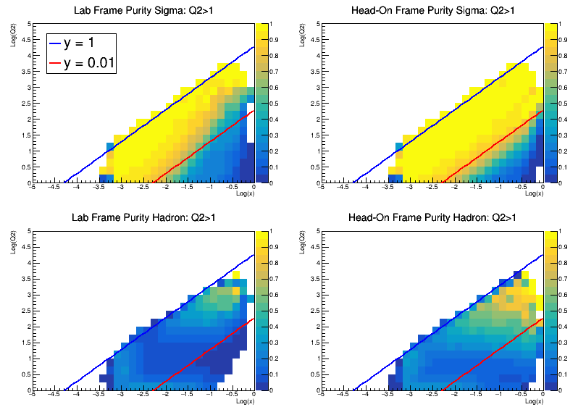
Q² Vs X Purity Plots: Q² > 1 GeV²
Previous distributions were averaged over all other kinematic quantities – hard to tell where the improvement in kinematic reconstruction due to moving to Head-On Frame comes in x-Q2 space. Look at Purity!
Purity = (N_{Gen} – N_{Out})/(N_{Gen} – N_{Out} + N_{In}) where N_{Gen} is the number of events in a bin as determined by the electron method, N_{Out} is the number of events reconstructed outside the bin via the Sigma or Hadron Methods, and N_{In} is the number of events reconstructed in the bin from other bins
Purity better for Head-On Frame
Hadron Method purity is lousy at low Q² – no surprise

Slide 18
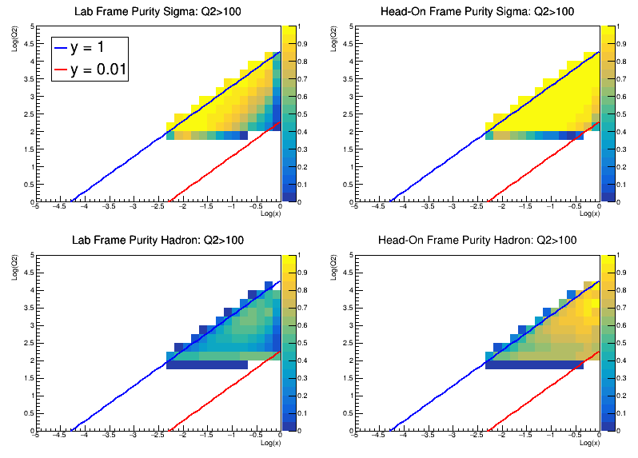
Q² Vs X Purity Plots: Q² > 100 GeV²
Look at Q² > 100 GeV² to get better statistics in high Q² region
Hadron Method sees dramatic improvement by moving to Head-On frame

Slide 19
Summary and Next Steps
Provided an example of a boost which brings the beams into a head-on frame – pT, eta, etc. well defined
This boost restores the final state particle distribution to that which one would see if no crossing angle was implemented (modulo finite acceptance) and improves the determination of event kinematics
Should boost into head-on frame when calculating ‘physics’ quantities and when determining event kinematics – stay in lab frame for studies of detector response, acceptance, etc.
So far, I assume perfect knowledge of initial beam kinematics and final state particle 4-momentum – this is not realistic. What effects do beam divergences and momentum/energy smearing have on the boost and event kinematics reconstruction
Look at more realistic detector acceptances
Look at different methods and other energies

Slide 20
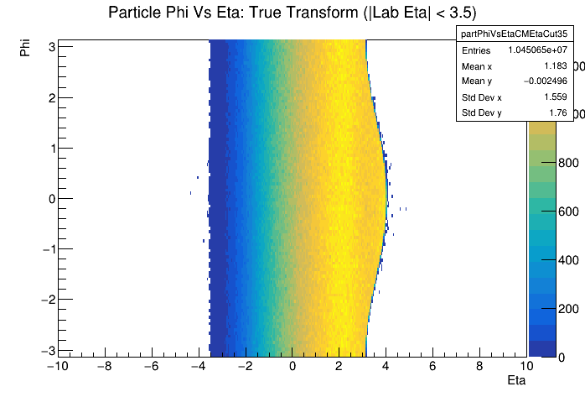
Acceptance Effects: Lab Eta < 3.5
If we look at acceptance of eta between +/- 3.5 in the lab frame (nominal tracking range), ‘bulge’ decreases, but eta range also decreases (no surprise)

Slide 21
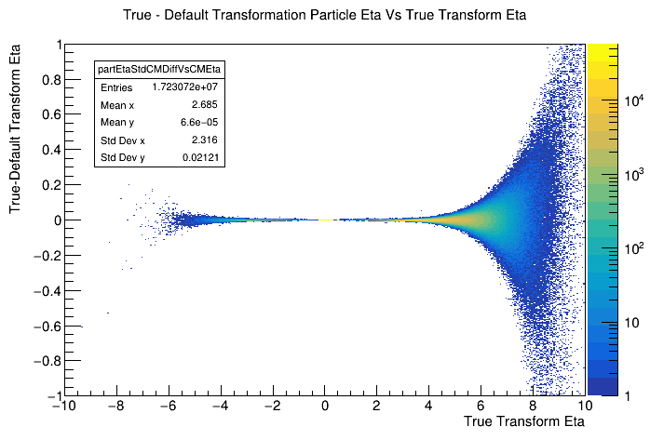
Beam Smearing Effects
All plots above used transformation constructed assuming perfect knowledge of incoming beams
Divergence, beam energy spread, etc introduce momentum deviations which cannot be measured event by event
Compare true transformation (assuming perfect knowledge) with default transformation (assume nominal beam energies and crossing angle)
Deviations are small at mid-rapidity but grow sizable as you move forward

Slide 22
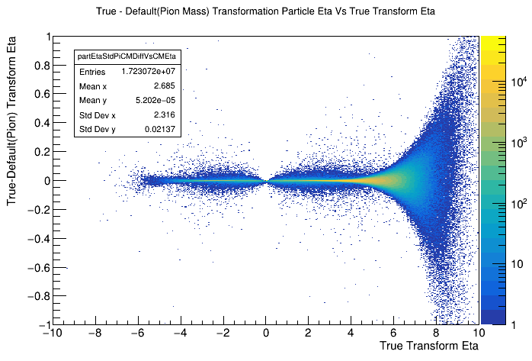
Beam Smearing Without PID
Lorentz transformation depends on momentum and energy of the particle being transformed
How is the transformation affected if we don’t know the energy of the track
Assume all tracks are pions and all neutrals are massless
Look at deviation between true transformation and transformation assuming nominal crossing angle and beam energy as well as the pion mass and massless neutrals assumptions
TODO: Look at detector smearing

