Slide 1
Fractional Authorship in Nuclear Physics
Boris Pritychenko
National Nuclear Data Center, BNL, Upton, NY 11973

Slide 2
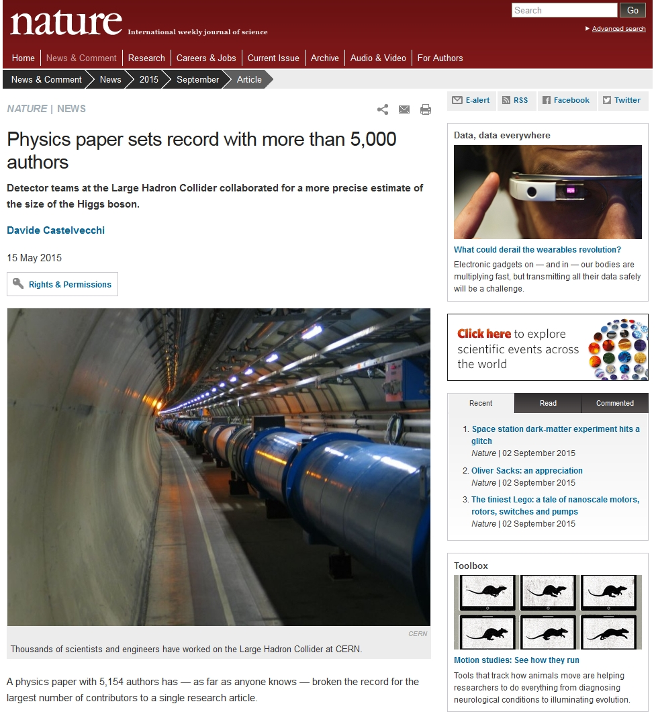
Record for the Largest Number of Authors
Aad, G. et al. (ATLAS Collaboration, CMS Collaboration) (2015). Combined Measurement of the Higgs Boson Mass in pp Collisions at s√=7 and 8 TeV with the ATLAS and CMS Experiments, Phys. Rev. Lett. 114, 191803.
Castelvecchi, D. (2015). Physics paper sets record with more than 5,000 authors, Nature, 15 May 2015; doi:10.1038/nature.2015.17567.
5,154 authors is a new record in science publications that impacts performance metrics.

Slide 3
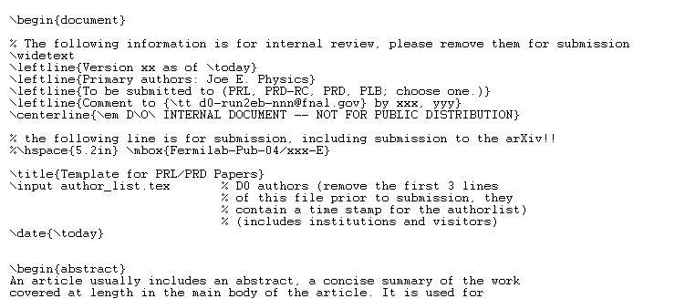
Complementary Information
Large collaborations introduce their own rules for authorship.
Researchers play their roles: `There is no “I” in team’
Many authors never read their own papers: Authors comment on authorship commentary (2012). Physics Today: August 2012, 65 Issue 8, 8-11.
Separation of content and authorship, both items are handled separately.

Slide 4
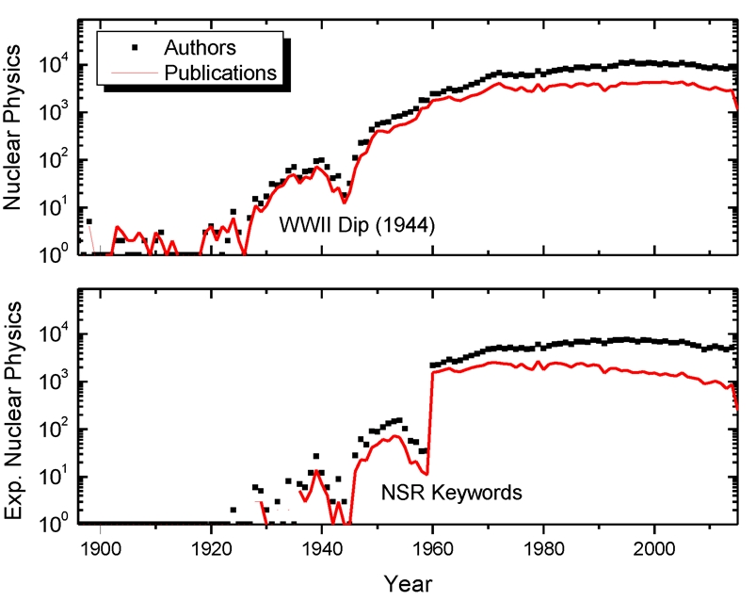
Historic Trends in Nuclear Physics
Science publication trends define past, present, and help to predict the future.
NSR database, where entries are based on single articles, is well suited for data mining; EXFOR often combines entries into single entry. NSR includes
219,000 publications
94,000 authors
Step functions in NSR experiments
Start of experimental campaigns in the 30ies
WWII Dip (1944)
1960 is not the sputnik effect; it is start of Oak Ridge compilations. It made NSR keywords more reliable.

Slide 5
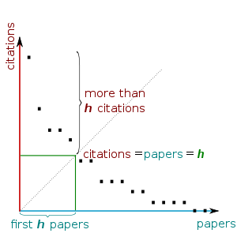
Science Performance Metrics
Databases provide foundation for metrics.
Any metric has its limitations, and scientists always will find the way to beat it.
Traditionally we use: Number of Publications, Number of Citation, and h-index.
Hirsch writes: A scientist has index h if h of his/her N_{p} papers have at least h citations each, and the other (N_{p} − h) papers have no more than h citations each.
The previous slide indicates that ATLAS & CMS collaboration members would be at the top of traditional metrics.
Individual performance (contribution) is clearly missing in many metrics.

Slide 6
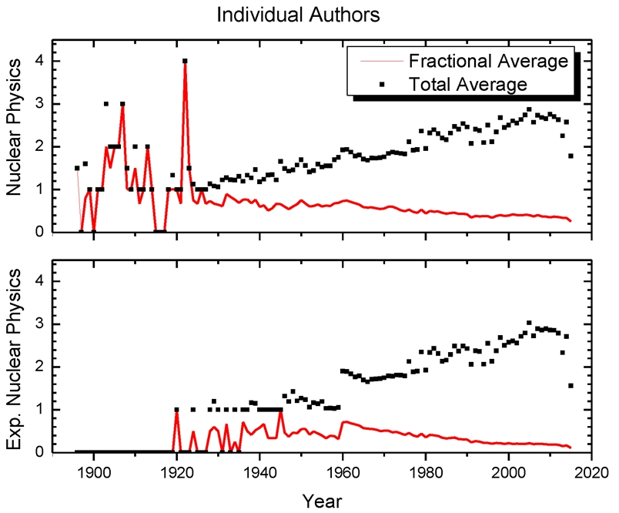
Fractional Authorship
Fractional authorship is the claiming of credit for authorship of the published articles by more than one individual.
Reflects the number of written papers by a single author.
NSR database scope does not reflect the complete list of publications for many scientists; it is a lower limit.
Timescale start and end fluctuations.
Nuclear physics publication Scissors effect between the total and (flat) fractional numbers.
Present worldwide averages: 0.2 and 0.4 for experimental and entire nuclear physics, respectively.

Slide 7
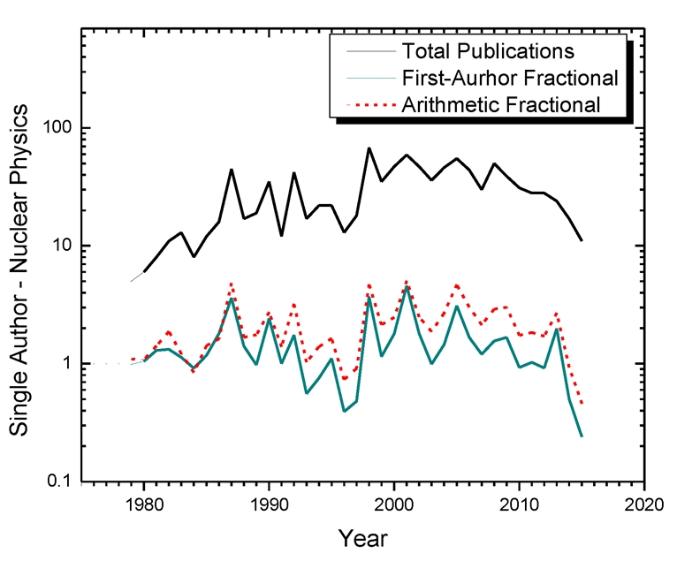
Limits of Fractional Contributions
5,134 authors paper is the lower limit,
The most prolific NSR author will define the upper limit.
1,038 publications in 37 years; 25 first-author papers including 4 single-author papers.
Fractions calculations: simple arithmetic & first author (50% first, and split the rest) .
Maximal fractional contributions: 4-5 papers/year.
Elsevier journals average for 2000-2013 is 0.56 papers/year (Plume, A., Weijen, D. (2014). Publish or perish? The rise of the fractional author…, Research Trends, Issue 38 –September 2014).

Slide 8
A Changing Face of Research
A 1962 Nobel prize winner L.D. Landau was one of the most prolific theoretical physicists who had many graduate students (School) and published classical textbooks. Landau’s productivity
98 official + 17 extra = 115 articles
8 books => 115 + 8 =123 works
Multiple editions of his books raise the last number to 603 (Google Scholar).
Present day NSR authors
12 of them have more than 603 publications
The research operations have changed over the last 50 years.
Fractional authorship helps to explain this discrepancy.

Slide 9
American Trophy Culture
The NSR authors could accumulate large numbers of publications because of the lenient nuclear physics authorship rules when even minor contributions or participations in experimental campaigns could justify the credit.
These lenient authorship rules can be compared with an American trophy culture when all the sports players get awards (Banks, P. M. (2015). HBO Real Sports to vivisect “Everyone gets a trophy” culture).
The scientific authorship should not be merely a participation award (i.e. participated in the experiment); it should be a reflection of substantial contributions. It supposed to represent some degree of individualism in successfully accomplished projects because `There is no “I” in team but there is in win’ (Jordan, M. (2009). Hall of Fame Inductee Address).

Slide 10
Conclusions
Recent developments in experimental nuclear physics authorship render obsolete the performance metrics solely based on the annual publication and citation counts.
A complementary criterion of fractional authorship helps to remedy this issue, and improves the metrics.
This additional metrics parameter reflects a number of written papers by individual authors and solves discrepancies between small- and large-author list publications.
The fractional authorship has been investigated using the nuclear data mining of relational database contents. The historic averages have been examined and the current range for fractional contributions has been deduced.
Further analysis of averages indicates an anti-correlation effect between an increase in total number of publications and decrease in fractional authorship, and relatively flat individual productivity in the recent years.

