Slide 1
B(E2) Evaluation for the first 2+ States in Even-Even Nuclei
Boris Pritychenko
National Nuclear Data Center, BNL, Upton, NY 11973
Michael Birch, Balraj Singh
Department of Physics & Astronomy, McMaster University, Hamilton, Ontario L8S 4M1, Canada
Mihai Horoi
Department of Physics, Central Michigan University,
Mount Pleasant, MI 48859

Slide 2
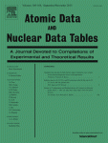
Introduction
Brookhaven-McMaster-Central Michigan Universities compilation and evaluation of B(E2)↑ values of all even-even nuclei has been accepted for publication in ADNDT journal (articles in press, corrected proof):
Compilation of experimental transition probabilities or B(E2) values for the known first 2+ states in even-even nuclei.
Evaluation of B(E2) values, lifetimes and deformation parameters for 447 even-even nuclei.
Extensive discussion on data evaluation policies and procedures.
Nuclear shell model calculation of the first 2+ states energies and B(E2) values in even-even nuclei.

Slide 3
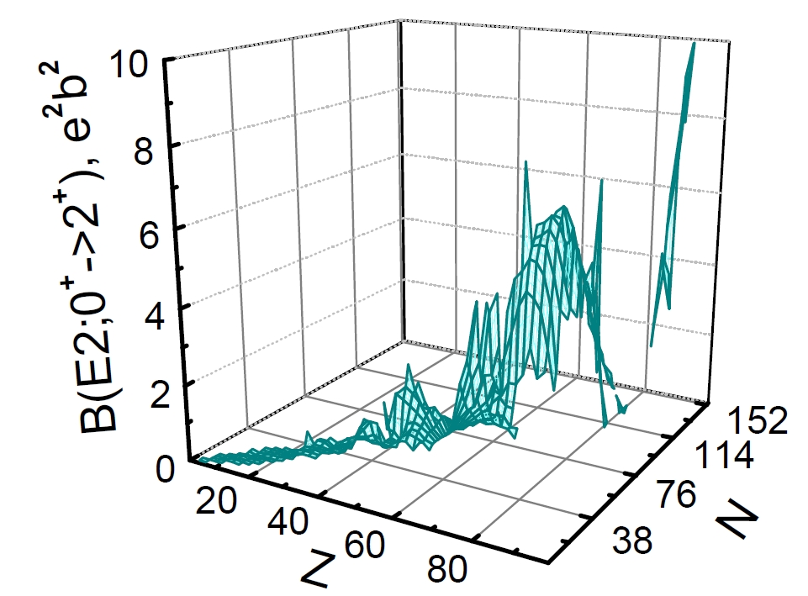
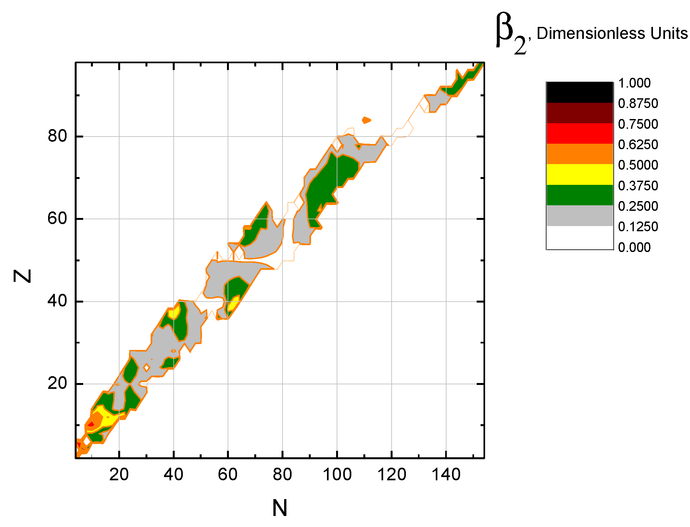
B(E2)↑ Compilation & Evaluation
B(E2)↑ values and deformation parameters are very helpful for understanding of nuclear structure effects across the chart of nuclides.
Literature cut-off is September 2015.
447 evaluated even-even nuclei vs. 328 in Raman et al. (2001).
Extended list of compiled experimental quantities: nuclear reaction kinematic parameters.
Addresses direct research need of FRIB community and researchers worldwide.

Slide 4
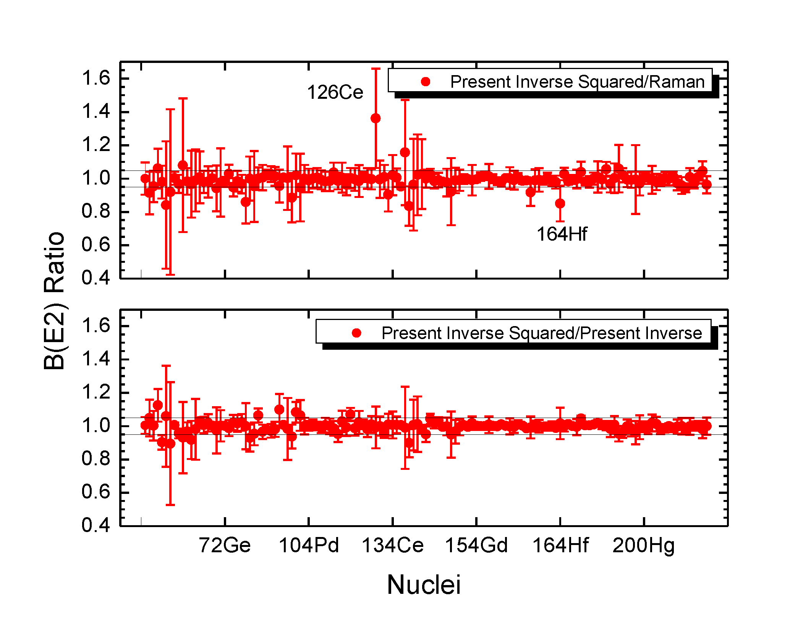
Comparison with Previous Results
Consistency between the present results and the work of S. Raman et al. is an important issue.
Raman was not very specific about evaluation criteria; we have discovered 120 papers that are absent in Raman.
We have selected 135 nuclides where no new measurements have been reported since the previous evaluation, and B(E2)↑ value for each nuclide value was measured at least twice.
The majority of the B(E2)↑ values are within 5% agreement. Notable deviations from unity in ¹²⁶Ce and ¹⁶⁴Hf are due to missing data and adoption by Raman of the earliest results.
To extend this analysis we calculate both the inverse squared and inverse B(E2)↑ averages for these nuclides.

Slide 5
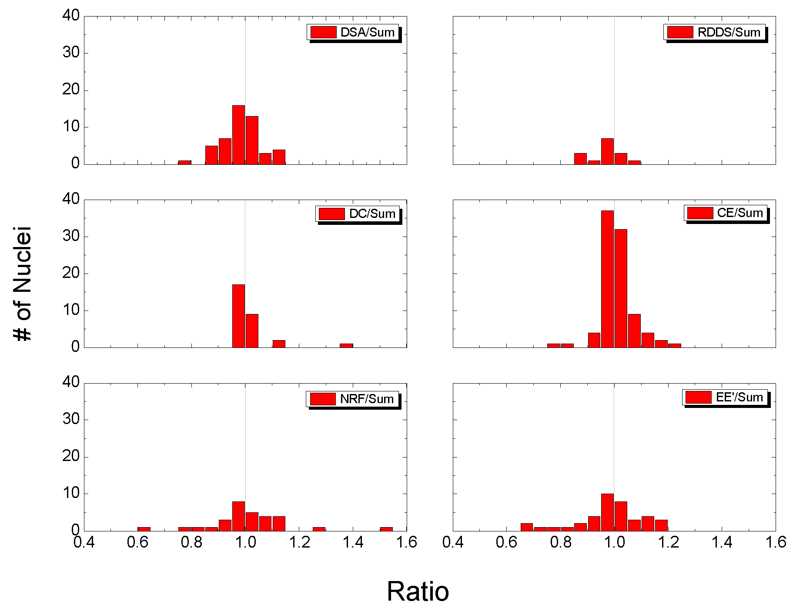
Current Work on the Equivalency of Experimental B(E2) Values: 6 ≤ Z ≤ 94
100 even-even nuclei that have been measured with multiple DSA, RDDS, DC, NRF, CE and EE’ methods and each experiment has been conducted at least twice.
The ratios of individual B(E2)↑ to the cumulative values for each nuclide were grouped in bins.
Figure demonstrates general consistency between individual methods and cumulative values.
Possible differences between the DSA and CE B(E2) ↑ values near closed neutron and proton shells could be explained by the experimental deficiencies.

Slide 6
Conclusions
B(E2)↑ evaluation for 447 even-even nuclei has been produced and accepted for publication in ADNDT journal.
Evaluation work has been complemented by compilation of experimental results for 1950-2015 timeframe and nuclear shell model calculations.
The present results have been compared with the previous evaluation of Raman in details and analyzed.
The analysis indicates a need for publication of the ENSDF evaluation procedures by nuclear structure community in scientific journals (Nuclear Data Sheets, NIM, …).
Ongoing compilation and evaluation project, website maintenance, work on equivalency and Grodzins’ fits.
Good relations with nuclear theory and experimental research communities.

