Slide 1
What’s up with 1991Re02, 1995ReZZ, 2008ReZZ?
J. Kelley

Slide 2
Asked Dave Vieira what the story was…
1991Re02,
P. L. Reeder, R. A. Warner, W. K. Hensley, D. J. Vieira, and J. M. Wouters
Phys. Rev. C 44, 1435
Half-lives and delayed neutron emission probabilities of neutron-rich Li–Al nuclides
LANL/LAMPF/TOFI
Ions implanted into a Si ΔE-E telescope
Counted in poly-moderated ³He counter

Slide 3
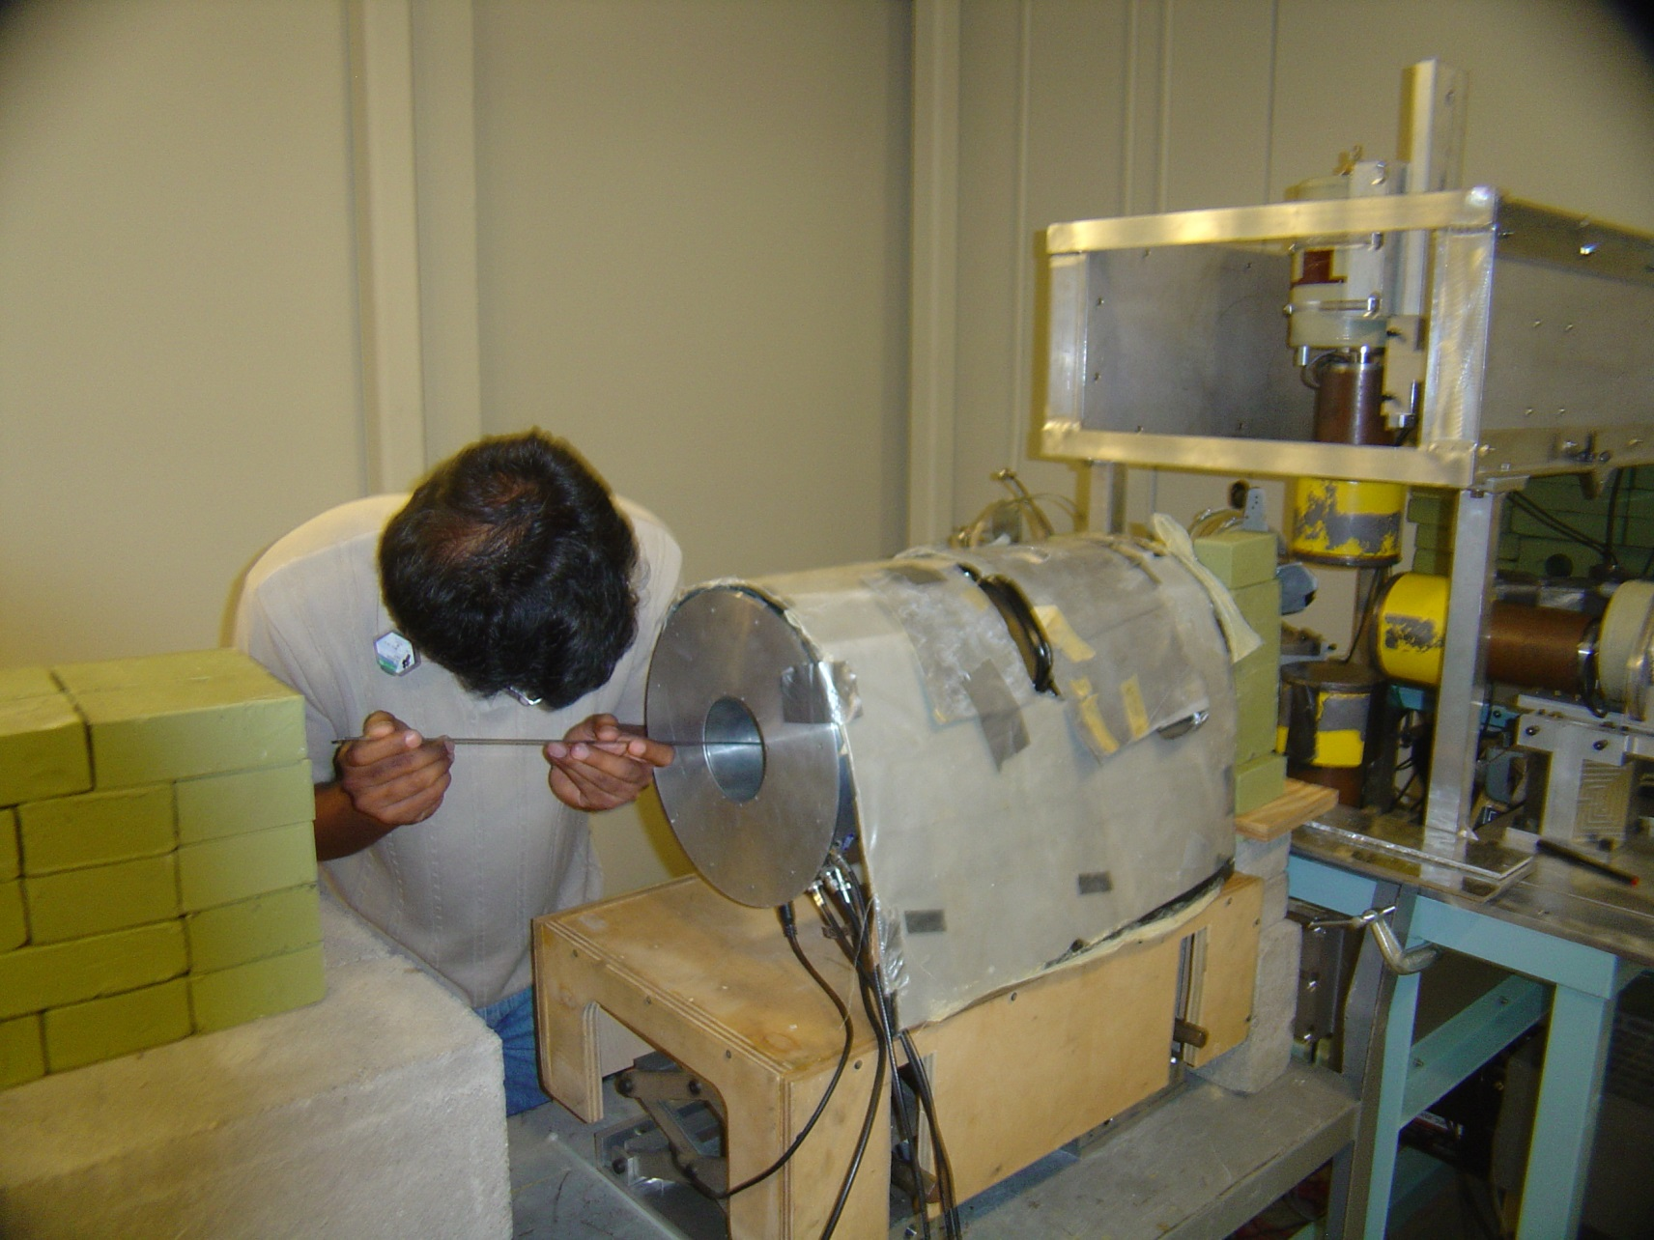
³He counter now resides at TUNL

Slide 4
β-n decays for A<45
Initial work was expanded by Y. Kim
Presented at several conferences
Y. Kim Dissertation
There is a story that goes along with it….
Prominent citations
ENSDF 1991Re02, 1995ReZZ sometimes 2008ReZZ
AME 1995Re.A

Slide 5
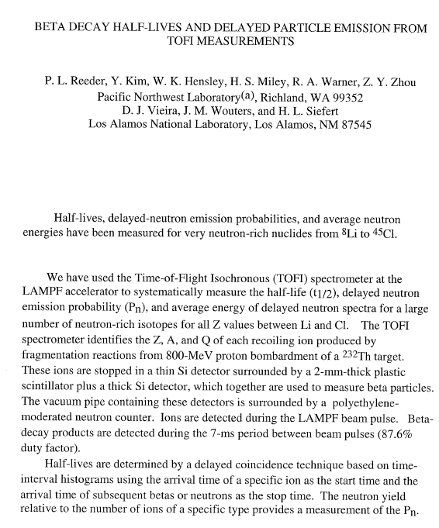
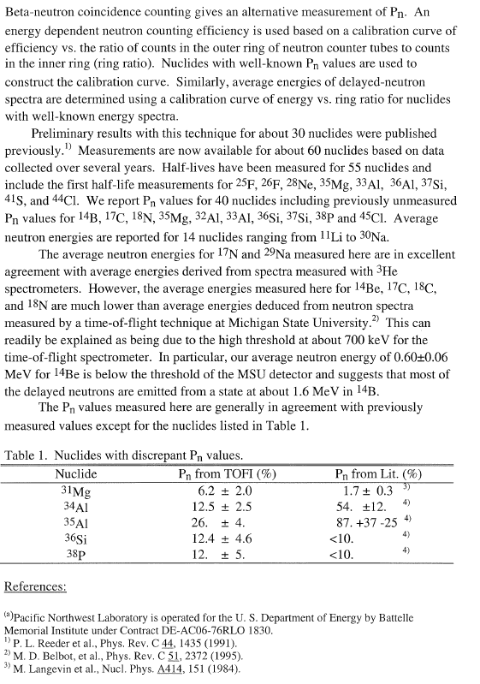
1995ReZZ/1995Re.A P.L. Reeder Proc.Intern.Conf on Exotic Nuclei and Atomic Masses, Arles, France, June 19-23, 1995, p.587 (1995) Connected to many Nuclides (not really) 1995ReZZ/1995Re.A

Slide 6
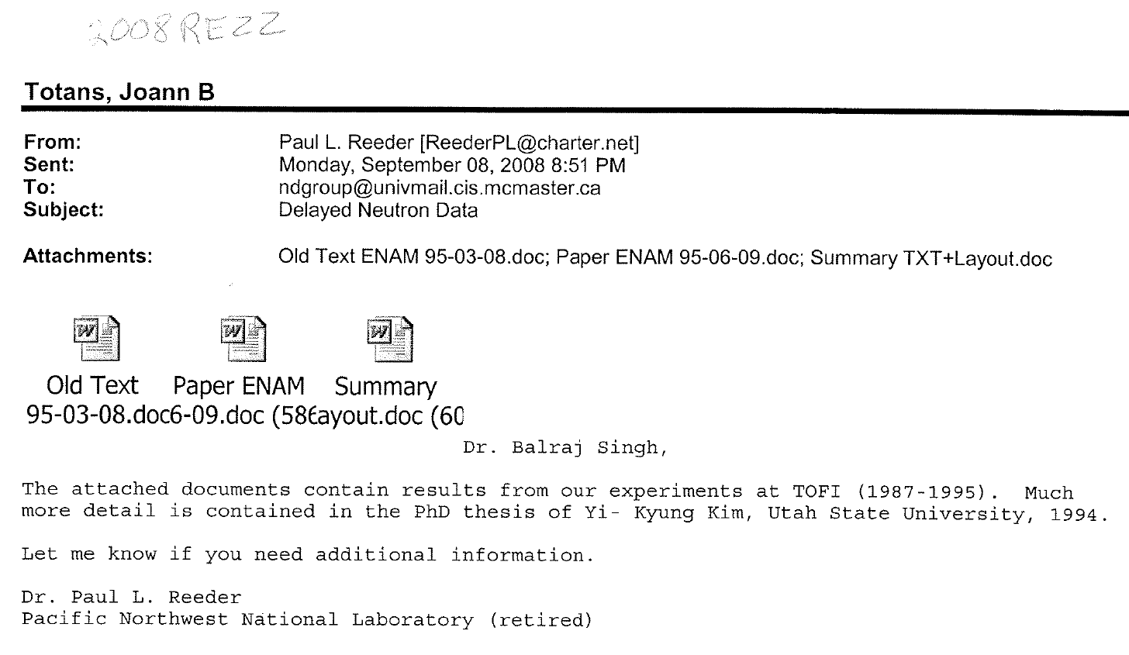
What is 2008ReZZ?

Slide 7
2008ReZZ is an improper citation
It is a private communication from Paul Reeder that includes three works that have been published.
2008ReZZ{
Old Text+Table {much from Gatlinburg conference manuscript}
1995ReZZ /1995Re.A P.L. Reeder Proc.Intern.Conf on Exotic Nuclei and Atomic Masses, Arles, France, June 19-23, 1995, p.587 (1995)
Summary table
Differs from 1994KiZU: Thesis: Yi-Kyung Kim, Utah State University, 1994.}

Slide 8
Who are the real players?
1991Re01,
P. L. Reeder, R. A. Warner, W. K. Hensley, D. J. Vieira, and J. M. Wouters
Phys. Rev. C 44, 1435
Half-lives and delayed neutron emission probabilities of neutron-rich Li–Al nuclides
1994KiZu: Thesis: Yi-Kyung Kim, Utah State University, 1994.
2008ReZZ {collection of above non-peer reviewed}
Old Text / with Table
1995ReZZ /1995Re.A P.L. Reeder Proc.Intern.Conf on Exotic Nuclei and Atomic Masses, Arles, France, June 19-23, 1995, p.587 (1995)
Summary table
1994: P.L. Reeder et al., Int. Conf. on Nucl. Data for Science and Technology, May 9-13, 1994, Gatlinburg, Tennessee
1993ReZX: Proc.6th Intern.Conf.on Nuclei Far from Stability + 9th Intern.Conf.on Atomic Masses and Fundamental Constants, Bernkastel-Kues, Germany, 19-24 July, 1992,

Slide 9
Who are the real players?
1991Re01,
P. L. Reeder, R. A. Warner, W. K. Hensley, D. J. Vieira, and J. M. Wouters
Phys. Rev. C 44, 1435
Half-lives and delayed neutron emission probabilities of neutron-rich Li–Al nuclides
1994KiZu: Thesis: Yi-Kyung Kim, Utah State University, 1994.
1994: P.L. Reeder et al., Int. Conf. on Nucl. Data for Science and Technology, May 9-13, 1994, Gatlinburg, Tennessee
1995ReZZ /1995Re.A
P.L. Reeder Proc.Intern.Conf on Exotic Nuclei and Atomic Masses, Arles, France, June 19-23, 1995, p.587 (1995)
2008ReZZ {collection of above & non reviewed info}
1993ReZX

Slide 10
All are important works
Each should be separately cited
Most are available
Caution in first draft of unpublished work
Gatlinburg Conf proceeding should be assigned a Keynumber
Kim’s thesis is available at NNDC.

Slide 11
Comparison with Adopted lifetime values
Reeder data was collected in two parts
All data is included in later works
Be an evaluator…………

Slide 12
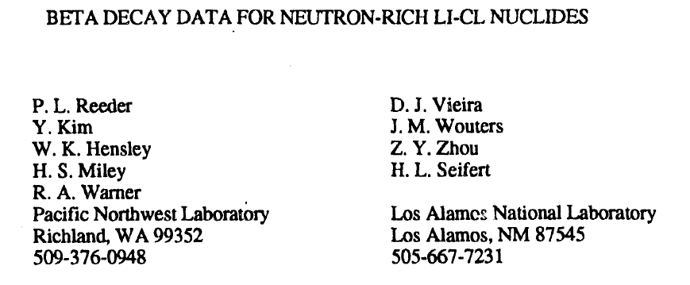
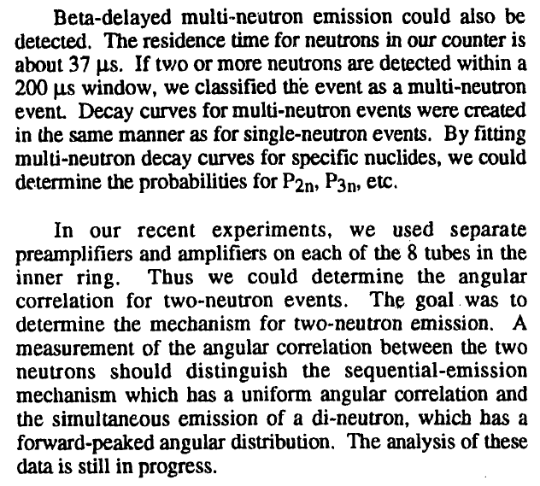
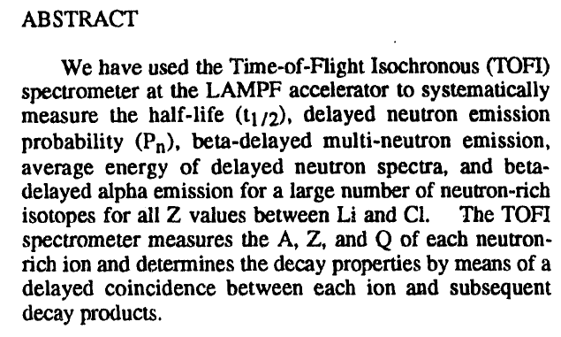
Gatlinburg Conference suggests interesting information

