Slide 1
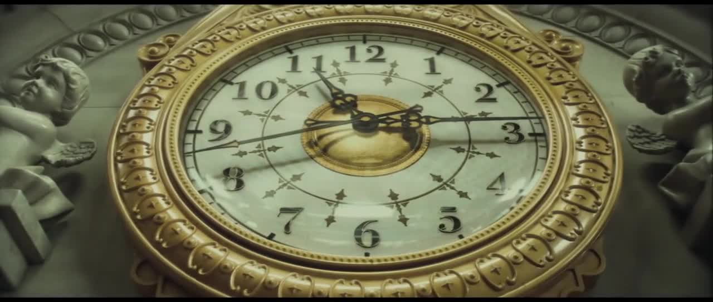
The Curious Case of ¹⁴C John Kelley (NCSU/TUNL)

Slide 2
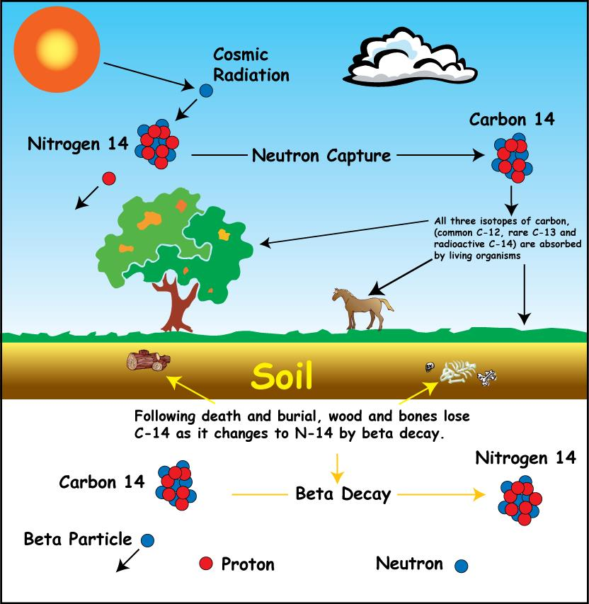
Radiocarbon Dating
http://rses.anu.edu.au/services/radiocarbon-dating-laboratory/radiocarbon-dating-background

Slide 3
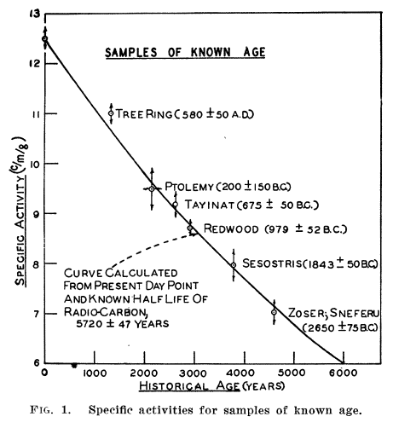
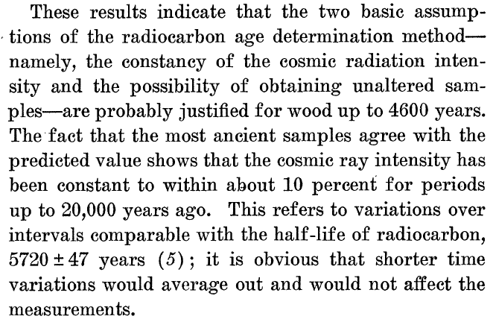

Slide 4
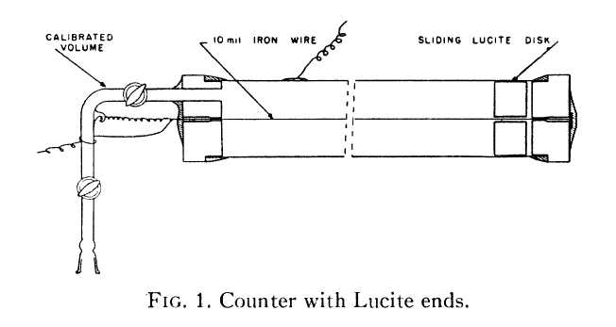
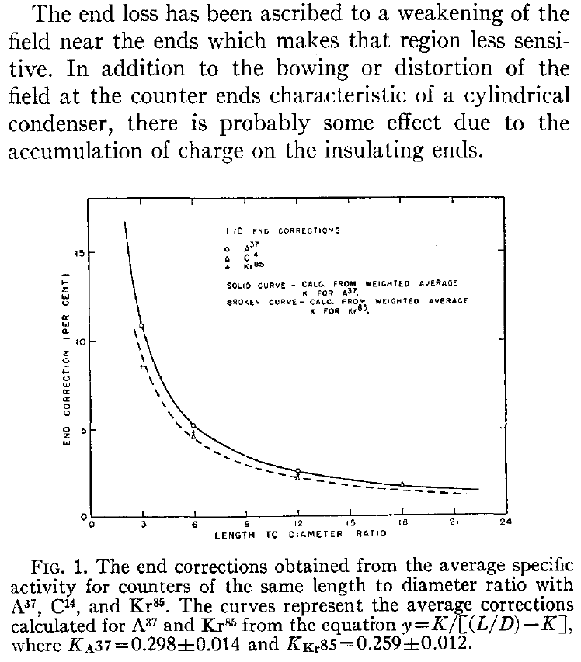
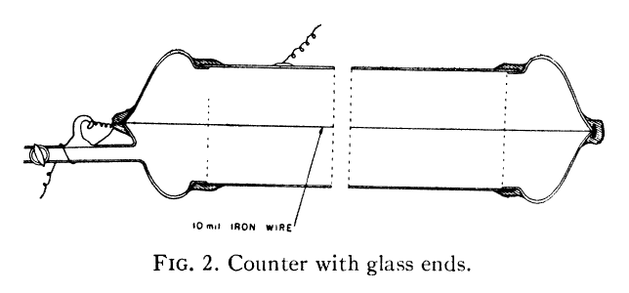

Slide 5
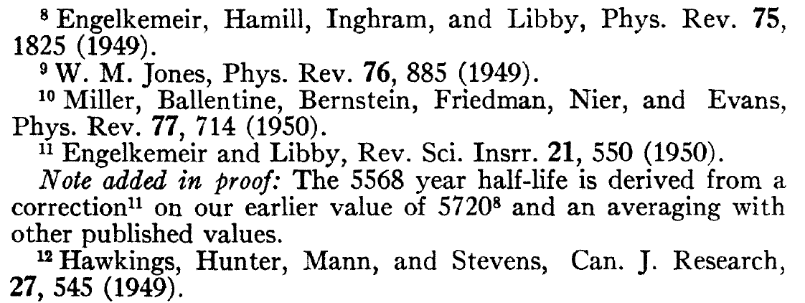
8)Engelkemeir
5580 +/- 45 yr (revised from
5720 +/- 47 yr in ref 11)
9) Jones
5589 +/- 75 yr
10) Miller
6360 +/- 190 yr
5513 +/- 165 yr
11) Engelkemeir: rev of 8
12) Hawkings
6360 +/- 200 yr
Other results not directly cited
1946Re12: 4700 +/- 400
1948Ya02: 7200 +/- 500
1948No02: 5100 +/- 200
(1951Ma30: 5370 +/- 200)

Slide 6
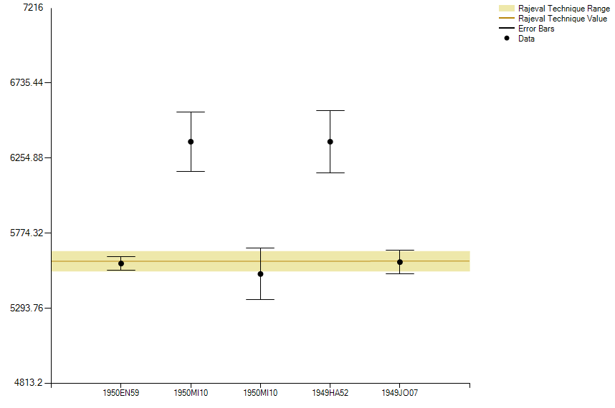
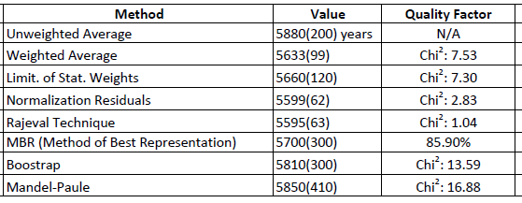
Visualization
5568 +/- 30 years Adopted
8)Engelkemeir
5580 +/- 45 yr (revised from
5720 +/- 47 yr in ref 11)
9) Jones
5589 +/- 75 yr
10) Miller
6360 +/- 190 yr
5513 +/- 165 yr
11) Engelkemeir: rev of 8
12) Hawkings
6360 +/- 200 yr

Slide 7
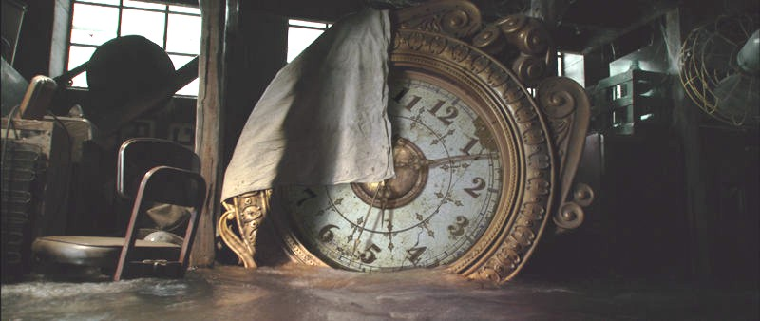
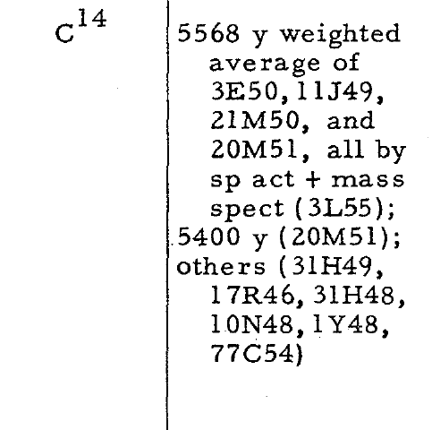
The value was widely accepted.

Slide 8
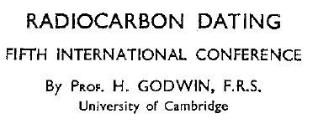
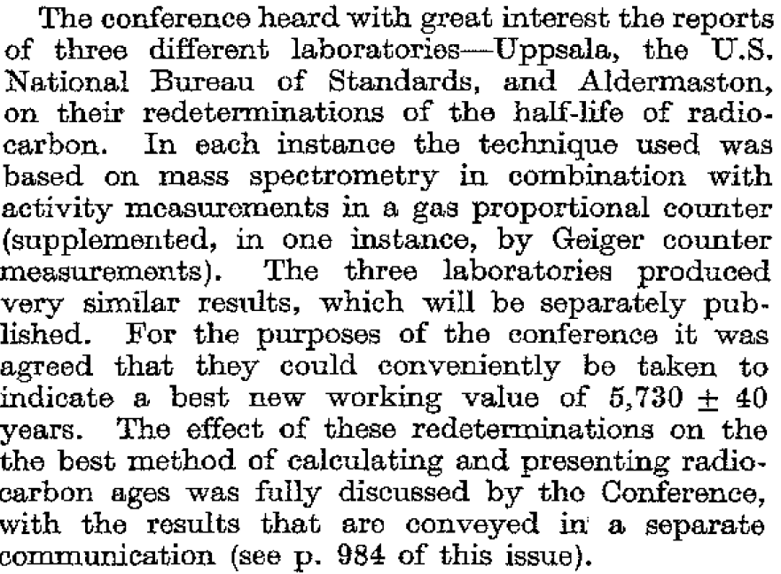
Unweighted average

Slide 9
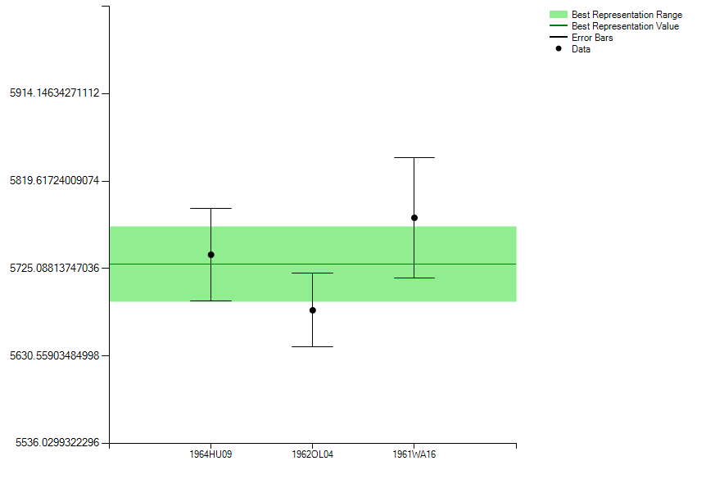
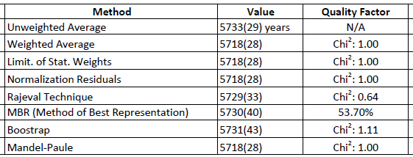
5730 +/- 40 years adopted

Slide 10
Widely Accepted (even as new data comes in)

Slide 11
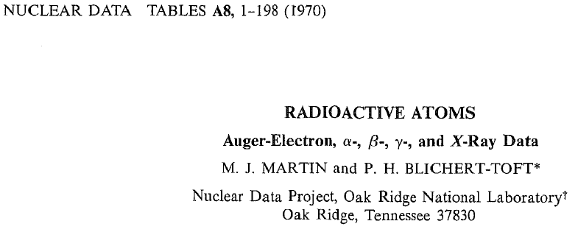
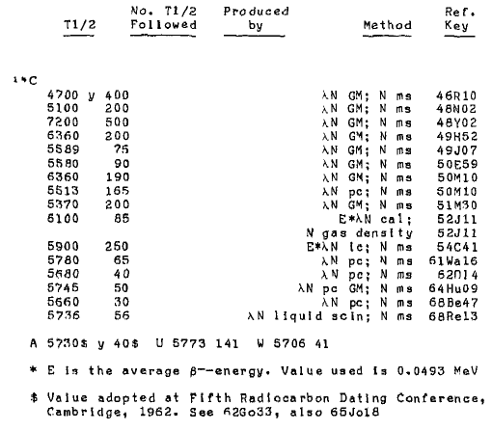

Slide 12
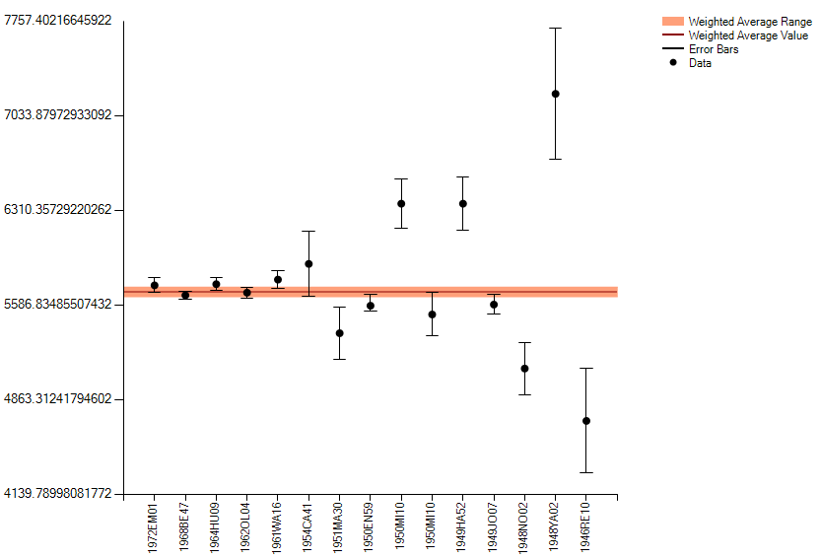
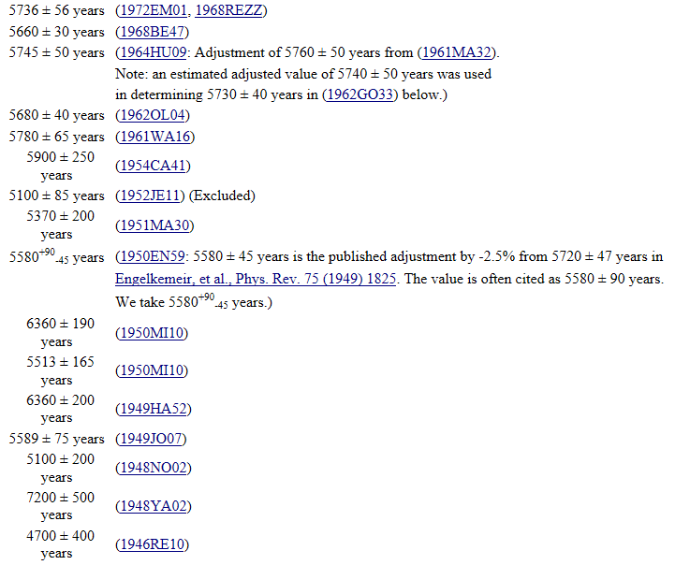
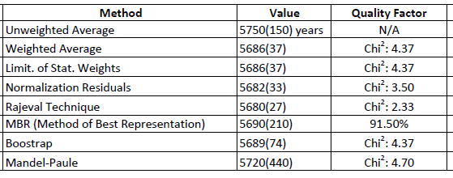
So What’s the Real Story?
5686 ± 40 years: Weighted average of all values below excluding (1952JE11).
Note: Weighted average of the five most recent values is 5699 ± 20 years.
Compare with: 5730+/- 40 y (5th radiocarbon conf) or 5568 +/- 30 y (Libby)

Slide 13
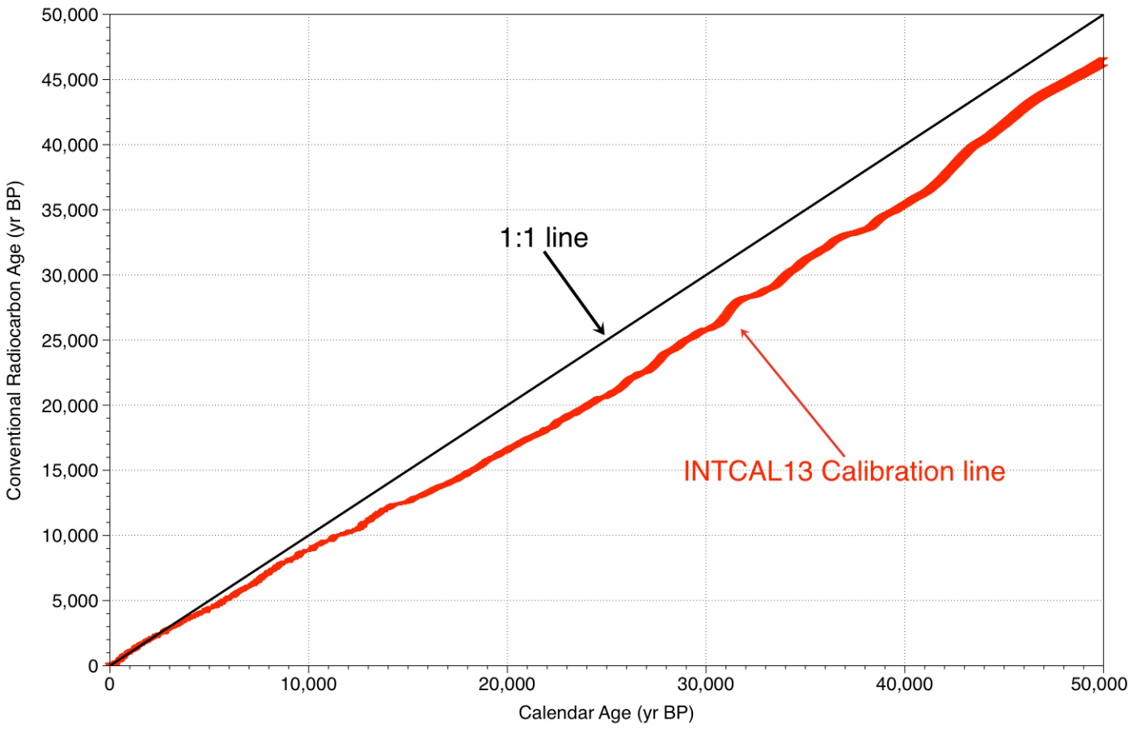
An imperfect science, but much effort has gone into developing appropriate fudge factors
Radiocarbon is a useful means for obtaining the age of death of a carbon-bearing organism. A robust and internationally agreed calibration has been developed back to 50,000 years ago. Annual tree rings provide the calibration back to ~12,594 yr BP and dated leaves in varved lake deposits alongside speleothems, corals and forams helped refine this calibration back to 50,000 years ago.
http://rses.anu.edu.au/services/radiocarbon-dating-laboratory/radiocarbon-dating-background

