Slide 1
Current status of the NSR project
Boris Pritychenko
National Nuclear Data Center, BNL, Upton, NY 11973

Slide 2
NSR Database Scope
We compile all low- and intermediate-energy references for broad use, not just nuclear structure and decay as before 90ies.
Nuclear Reactions papers
CINDA database is no longer supported
Consequently NSR is filling the gap for NRDC network
Extended keywords allow to extract statistics using bibliography metadata
Theoretical papers
NSR is the only USNDP database where nuclear theory papers are systematically compiled

Slide 3
NSR Operation in FY2015
Five people were directly involved in NSR operation (B. Pritychenko, E. Betak, B. Singh, J. Totans, IAEA:V. Zerkin).
NSR References
4,215 new articles vs. 3,100 required; including 1,159 missing articles from EXFOR
189 modified (corrected) article entries
3,058 keyworded article abstracts
NSR computer operation
120 database content updates
209,415 Web retrievals worldwide (>50% by researchers)
NSR Dictionaries content update
1,908 new authors
6 new journals
178 new nuclides
147 new reactions
21 new decays

Slide 4
NSR & EXFOR Cooperation
There are 6-10 K EXFOR references that are missing in NSR.
V. Zerkin, IAEA has written a Java code, and started to produce NSR entries in collaboration with J. Totans; each entry is verified by NSR manager (1,159 in total for FY2015):
62 PRL, PLB, PRD
40 Nuclear Physics A
152 Nuclear Physics
18 Physical Review C
742 Physical Review
16 ZPhys
31 Zphys A
39 NIMA
77 NIMB

Slide 5
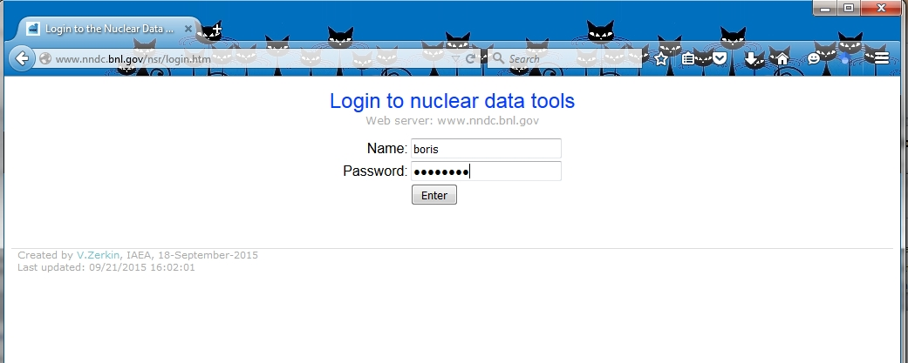
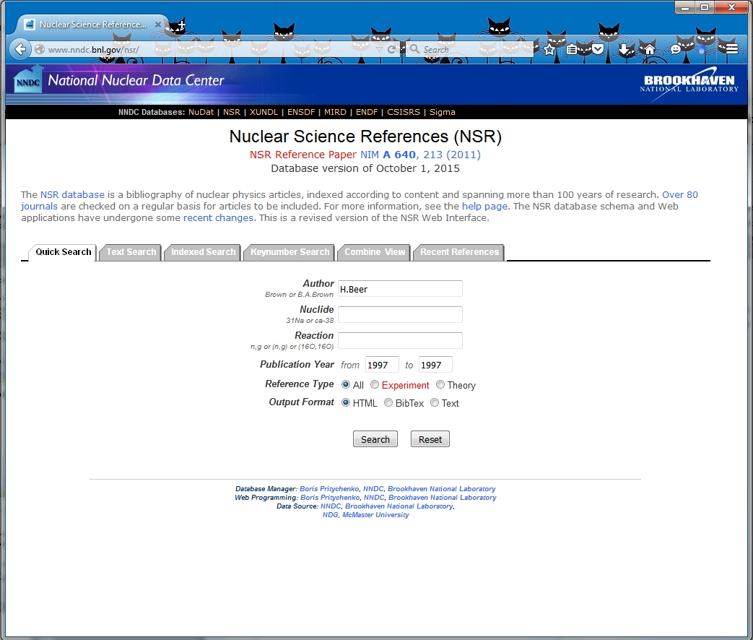
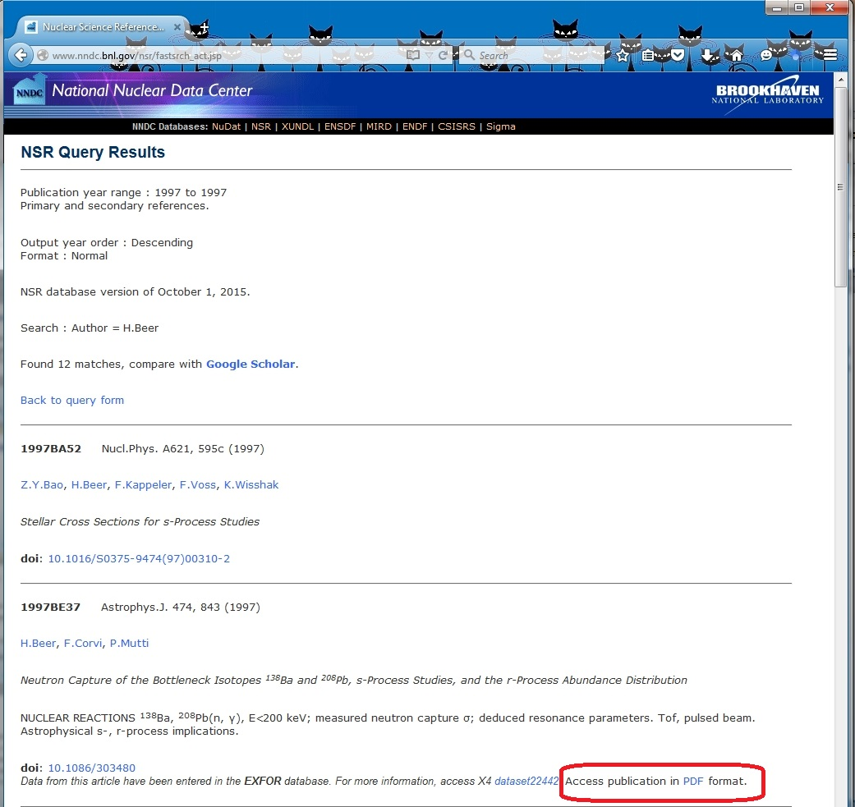
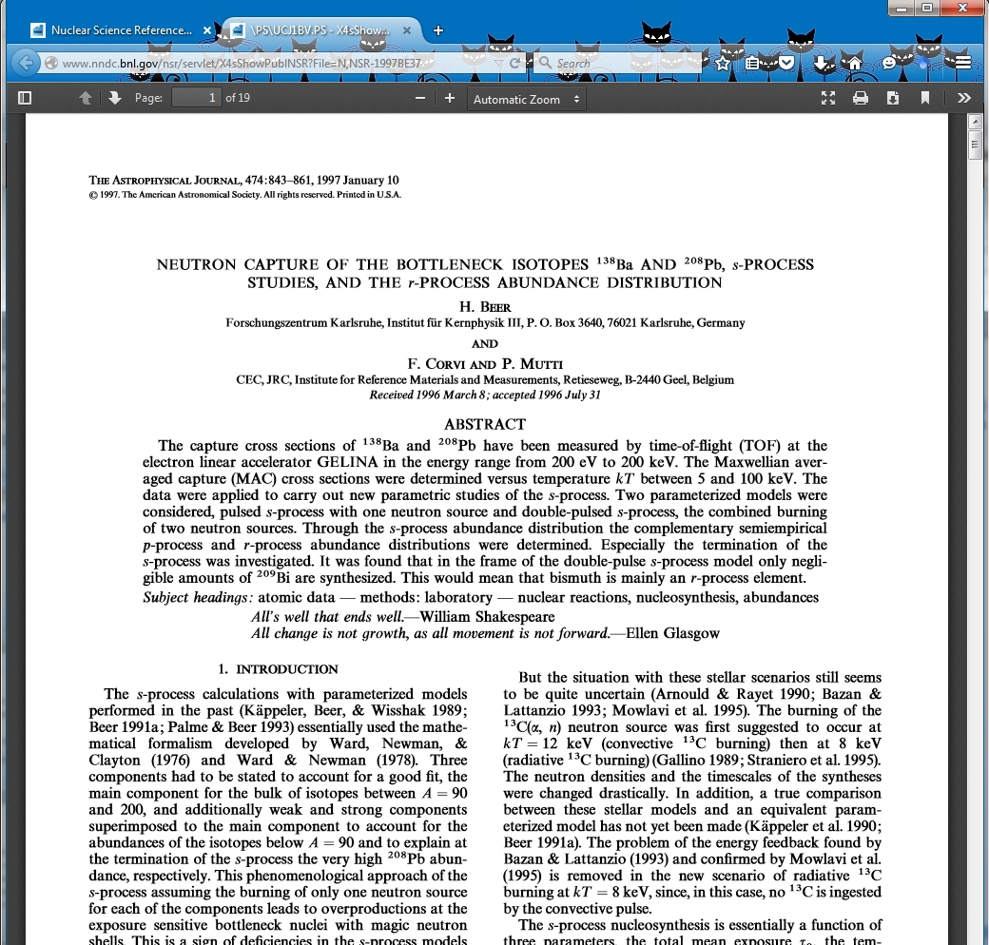
E-library for NSR and EXFOR
PDF library for NSR users, in collaboration with the IAEA.
http://www.nndc.bnl.gov/nsr/login.htm
Username: Your name
Password: ********

Slide 6
E-library Present Status
Very attractive option for researchers if copyright is not a problem.
DOE PAGES (Public Access Gateway for Energy & Science): Access journal articles and accepted manuscripts resulting from DOE research funding.
NNDC library scan cost estimate was $50 K in 2012.
Financial issues are slowing us down. Under present conditions it may take years and years before this project will be completed.
ORNL library scan requires contribution from Oak Ridge.
All ENSDF evaluators should join the effort and help with PDF files following the lead of Alexander Rodionov (PNPI) and B. Singh (McMaster University)!!!

Slide 7
Conclusions
NSR project is in a good shape.
We will continue to support nuclear structure evaluations and do our best to support nuclear reactions and theory.
We will keep NSR website http://www.nndc.bnl.gov/nsr current and up-to-date.
We will continue to improve NSR completeness and address research needs.
We have started the import of missing references from EXFOR database.
We have started to work on a joint E-library for EXFOR and NSR.

