Slide 1
ASTM Workshop
Alejandro Sonzogni
National Nuclear Data Center

Slide 2
Some comments following the
ASTM C26.08 Workshop on Decay Algorithms
Thursday, June 18, 2015
Anaheim, CA
Most participants were from National Labs, such as LANL, ORNL, Sandia and SRNL.
The half-lives values for some nuclides are of great importance ($).
Are half-lives for these nuclides properly evaluated in ENSDF?

Slide 3
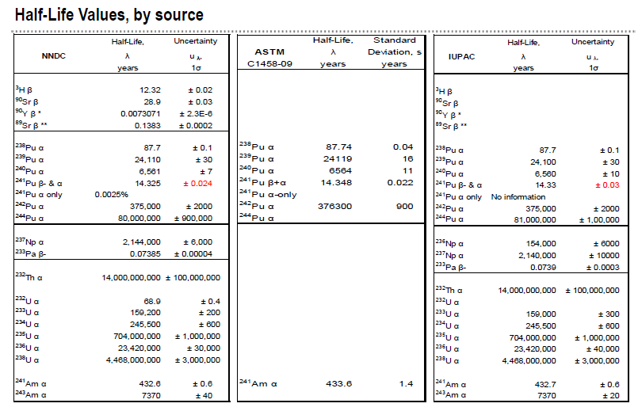
From M.K. Holland talk, Savannah River National Lab.

Slide 4
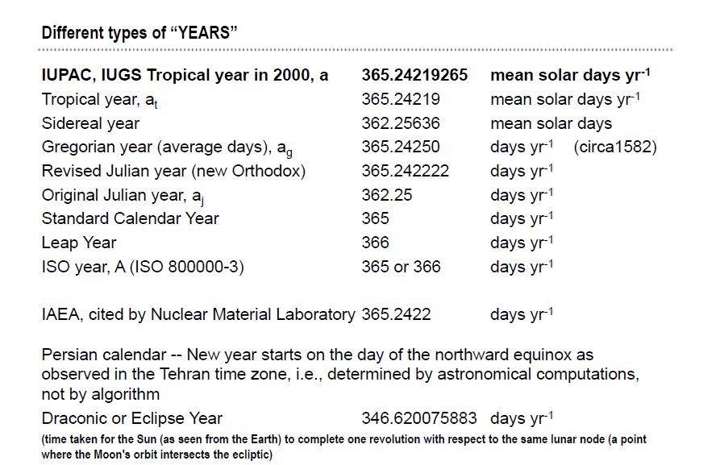
From M. Holland talk, Savannah River National Lab.

Slide 5
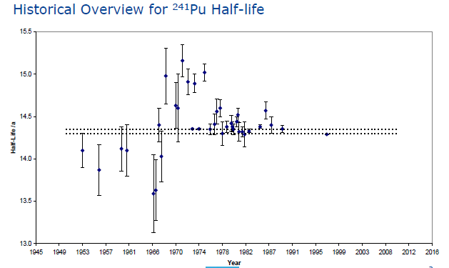
From S. Richter talk, IRRM

Slide 6
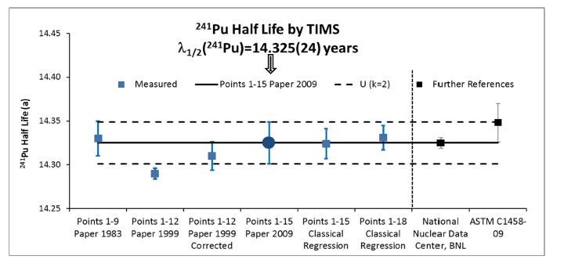
From S. Richter talk, IRRM

Slide 7
From S. Richter talk, IRRM
²³⁴U T_{1/2}, important for the ²³⁴U/²³⁰Th Chronometer.

Slide 8
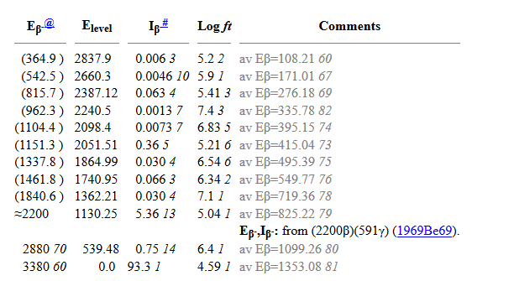
Another issue, beta energy in disagreement with Q-value
But early on the file
Perhaps, old measurements of end point energies should be put in comments.

Slide 9
Recommendations
Indicate in the NDS general policies what a year is.
Revise T_{1/2} evaluation of ²⁴¹Pu and ²³⁴U, including all measurements.
Organize a meeting with ASTM participants to make sure we support their needs.

