Slide 1



UC-Berkeley/LBNL Activities
(other than NDNCA)
L.A. Bernstein
Nuclear Data Week
BNL
November 6, 2015
LLNL-PRES-678764
This work was performed under the auspices of the U.S. Department of Energy by Lawrence Livermore National Laboratory under contract DE-AC52-07NA27344 and Lawrence Berkeley National Laboratory under contract # DE-AC02-05CH11231.

Slide 2
Our group is engaged in a wide range of compilation, evaluation and experimental activities
Evaluation/Compilation Activities
  Neutron capture γ-ray data evaluation for EGAF
  Inelastic scattering data compilation from the Baghdad Atlas and other (n,n’γ) sources
Database Activities
  Hurst ENSDF2XML converter
Experimental Activities
  ⁵⁶Fe(p,p’γ) measurement using GRETINA+Phoswich wall
  Cross section measurements at the HFNG
  Cross section measurements at the 88-Inch

Slide 3
EGAF status update
LBNL led IAEA CRP completed 2007 –
  All elemental targets with Z=1-82,90,92 except for Z=2,61.
  ≈32,000 prompt γ-ray cross sections and ≈3,000 decay γ-ray cross sections.
EGAF contents
  Prompt - E_{γ}, σ_{γ}, σ₀, S_{n}
  Activation – E_{γ}, σ_{γ}
EGAF 2007-present
  Enriched isotope measurements
  P_{γ} and total radiative cross sections, σ₀, for ^{1,2}H, ^{6,7}Li, ⁹Be, ^{10,11}B, ^{12,13}C, ^{14,15}N, ^{16,17,18}O, ²³Na, ^{39,40,41}K, ⁵⁶Fe, ^{102,104,105,106,108m,108g}Pd, ^{152m,152g,154}Eu, ^{155,157}Gd, ^{180,182,183,184,186}W^{m+g}, ²³⁸U published or submitted for publication.
  11 journal publications and 2 books
  S_{n} contributions to 2012 AME evaluation
  2 ENDF partial evaluations
  Revised ENSDF evaluation of ⁵⁷Fe
  Photon strength function studies
Outgrowths from EGAF
  ARC and resonance data cross sections
  (n,n’γ) data
  IAEA CRP on photon strengths
Two new papers in the past month!
A.M. Hurst et al., PRC92 034615 (2015)
A.M. Hurst et al., NIMB 362 p. 38-44 (2015)

Slide 4
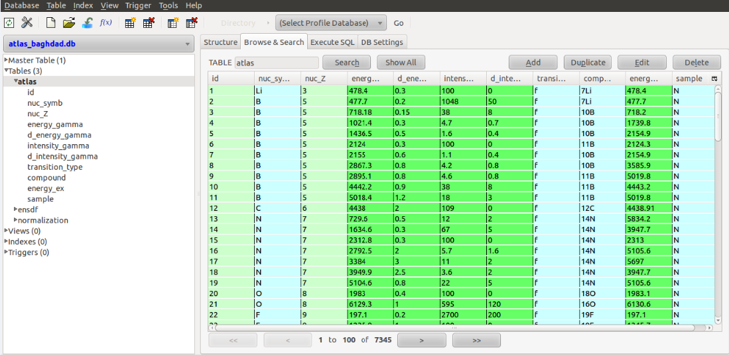
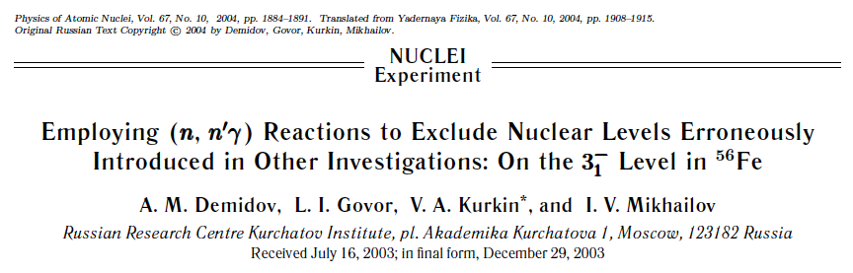
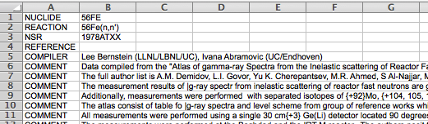
After capture we are moving up to inelastic scattering
Inelastic scattering serves both structure & reaction data needs
We have a 4 tier evaluation plan
  Compile the “Baghdad Atlas” into SQL and excel formats (A. Hurst) - DONE
  Compile the more recent paper (2004De49) to aid in the removal of spurious levels from ENSDF (34 data sets)
  Assign γ-rays in observed but unplaced in the Atlas - LAB & J. Labrum – UC undergrad
  Perform a horizontal evaluation for (n,n’γ) nuclides
Hurst SQL database (Excel available too)
Student compilation using xls2ens

Slide 5
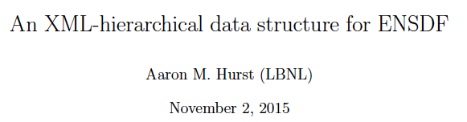
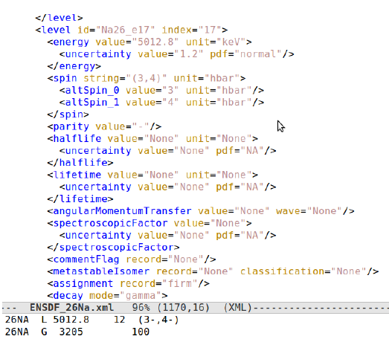
Aaron’s been busy…
We now have a ENSDF-to-XML parser
At the 2015 NSDD meeting LBNL/UCB was charged to work on the development of a new structure data format
A new format and converter has been prepared by Aaron
  Handles 15 of 16 ENSDF records
  No treatment of comments or continuation records.
Format features
  No space limitations!
  Asymmetric uncertainties
  Final level connection done via indexing.
  Gammas are “children” of levels

Slide 6
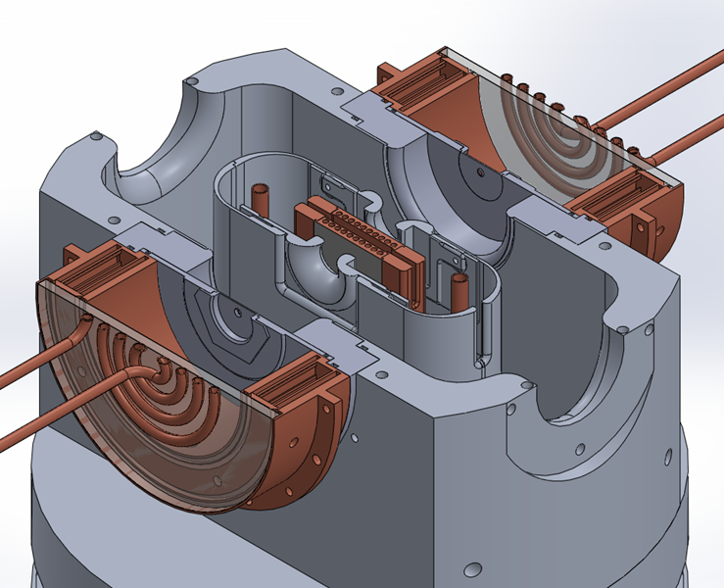
(n,p) measurements can be performed using the High Flux Neutron Generator (HFNG) on campus
Foils are co-loaded with ¹¹⁵In
for relative cross section
measurements
Flux Monitor
Target | Nuclide | Q (keV) | Threshold (keV) | % abundance | t_1/2 (s) | Reaction fraction /n/mb | # seen in a 0.5% Ge detector | Rate in a 0.5% detector
32S | 32P | -928 | 985 | 95% | 1.23E+06 | 3.68848E-06 | 0.00E+00 | 0.00
47Ti | 47CA | 182 | 0 | 7.44% | 3.92E+05 | 5.77471E-06 | 1.24E+05 | 1.44
64Zn | 64Cu | 203 | 0 | 49.20% | 4.57E+04 | 6.71829E-06 | 5.03E+05 | 5.82
67Zn | 67Cu | 221 | 0 | 4.04% | 2.23E+05 | 6.41747E-06 | 5.45E+04 | 0.63
89Y | 89Sr | -718 | 726 | 100% | 4.32E+06 | 3.02589E-06 | 1.25E+02 | 0.00
105Pd | 105Rh | 215 | 0 | 22.33% | 1.27E+05 | 6.89548E-06 | 1.27E+05 | 1.47
149Sm | 149Pm | -289 | 291 | 11.24% | 4.58E+06 | 2.9718E-06 | 4.47E+03 | 0.05
153Eu | 153Sm | -25 | 25 | 52.19% | 1.67E+05 | 2.06401E-06 | 1.36E+05 | 1.58
159Tb | 159Gd | -189 | 190 | 100% | 6.65E+04 | 3.11288E-06 | 1.58E+05 | 1.83
161Dy | 161Tb | 189 | 0 | 18.89% | 5.95E+05 | 3.19839E-06 | 2.66E+04 | 0.31
166Er | 166Ho | -1073 | 1079 | 33.50% | 9.66E+04 | 3.28888E-06 | 4.39E+03 | 0.05
169Tm | 169Er | 429 | 0 | 100% | 8.11E+05 | 3.32136E-06 | 1.87E+01 | 0.00
175Lu | 175Yb | 311 | 0 | 97.40% | 3.61E+05 | 3.38643E-06 | 1.88E+05 | 2.18
177Hf | 177Lu | 281 | 0 | 18.60% | 5.74E+05 | 4.52841E-06 | 3.77E+04 | 0.44
List of important fast neutron reaction cross sections from
S. Qaim

Slide 7
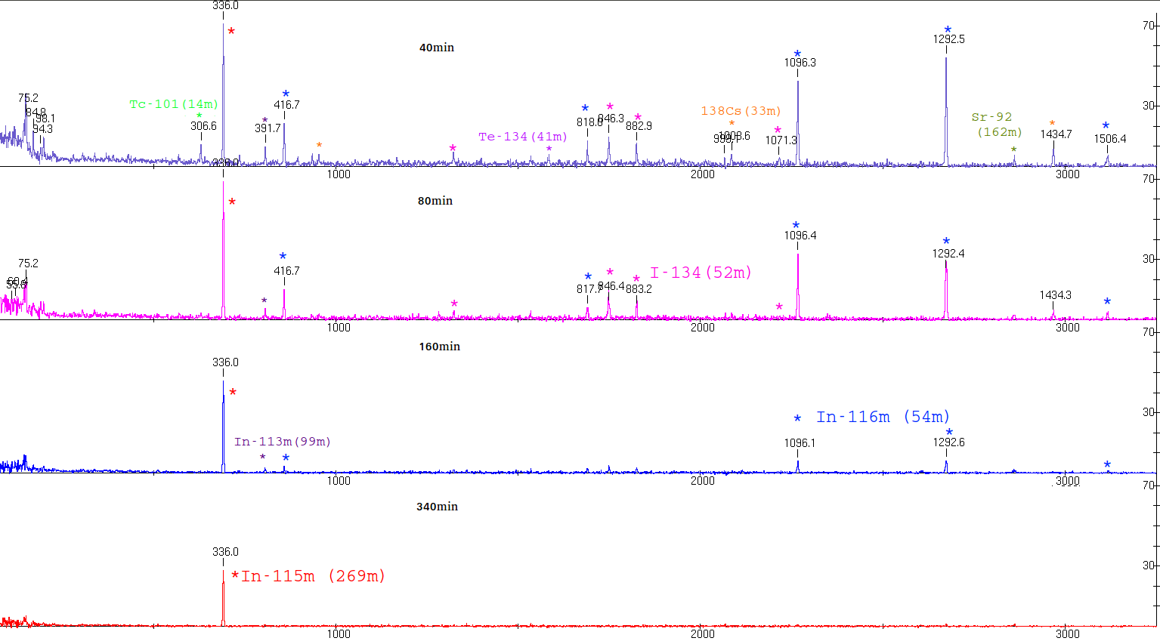
We performed the first activation experiments at the HFNG on a 99.999% ²³⁸U foil co-loaded with ^{nat}In (80% HPGe data)
40 min
80 min
160 min
340 min
Thanks to Leo Kirsch!

Slide 8
Hot off the presses: Data from ⁶⁴Zn(n,p)⁶⁴Cu (t_{1/2}=12.1 h)
11/4/15 – 14:00-15:00
¹¹⁶In β⁻ decay (I>1%)
^{115m}In IT decay
⁶⁴Cu decay
Thanks to Andrew Voyles!

Slide 9
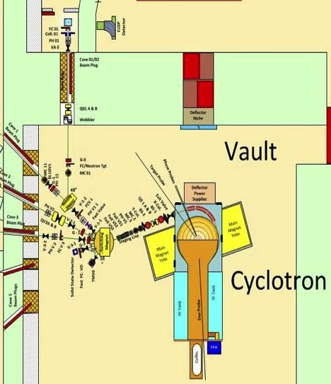
The LBNL 88-Inch cyclotron is well-poised to perform
(p/d/α,x) and (n,x) cross section measurements
Charged-particle irradiation
Location (TAG target)
Cave 0: High-Intensity charged particles:
  p (E_{max}≤ 55 MeV)
  d (E_{max}≤ 65 MeV)
  α (E_{max}≤ 130 MeV)
  Max power: 1.2 kW
Vault: High-intensity quasi-monoenergetic neutrons from ⁷Li(p,n)
  Neutron dosimetry from fission chamber, ⁷Be production and Cave 2 faraday cup
Faraday cup
For p beam
Li(p,n) neutron
production target
²³⁸U
fission
chamber
Target
Irradiation
location

Slide 10
Collaborators on this work
I. Abramovic¹, M.S. Basunia², L.A. Bernstein^{1,2,3},
D.L. Bleuel³, J.A. Brown¹, J.W. Engle⁴,
R.B. Firestone¹, B.L. Goldblum¹, A.M. Hurst²,
M. W. Herman⁵, L. Kirsch¹, J. Labrum¹,
R. Slaybaugh¹, B.W. Sleaford³, K.A. Van Bibber¹,
J. Vujic¹, C.S. Waltz¹, A. Voyles¹
¹ University of California-Berkeley Dept. of Nuclear Engineering
² Lawrence Berkeley National Laboratory
³ Lawrence Livermore National Laboratory
⁴ Los Alamos National Laboratory
⁵ Brookhaven National Laboratory-NNDC

