Slide 1
Possible New Distribution Scheme
Attempt to somewhat automate process and make papers more readily available to the compilers
Using either Dropbox or Google Drive (to start)
MSU
MSU_done
Available papers
ORNL
ORNL_done
LBNL
LBNL_done
Email notification of file move
Email notification of file move/upload

Slide 2
Re-assessment of effort
Ball park numbers
We need to compile ~300 papers / year
Current commitments (approximate)
TUNL 50
Are these correct?
ORNL 50
New compiler added specifically to “free” up experienced ENSDF evaluators
BNL 50
MSU 100
Millsaps 50
McMaster 50
Volunteers to reduce effort?
LBNL 50
Argonne 20
= 420 / year !!!

Slide 3
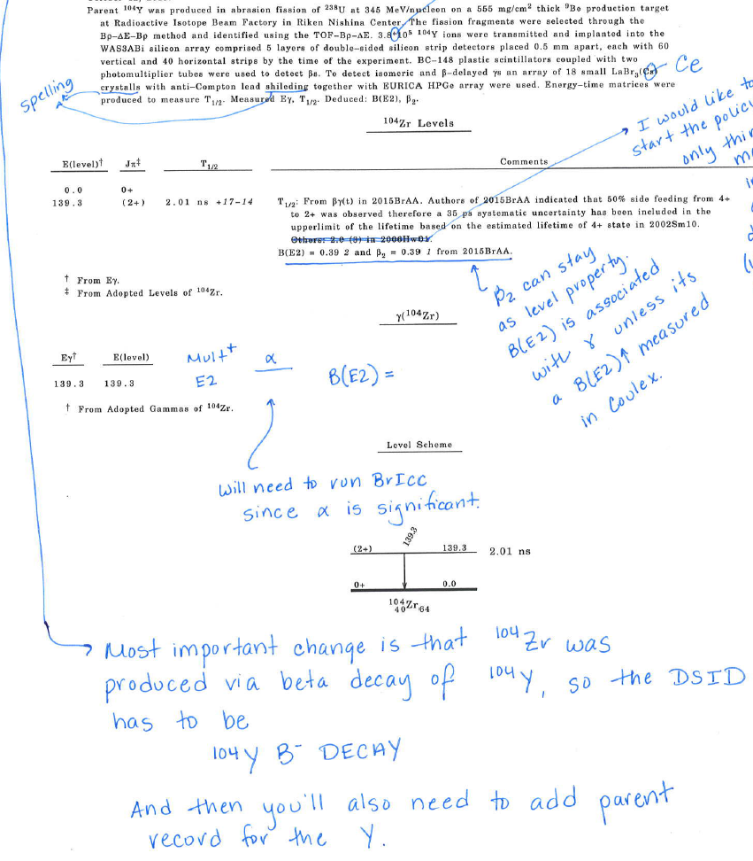
Changes to “checking” compilations
I am nowhere near as efficient as Balraj (no one is)
Minimal changes (typos, grammar, small tweaks)
Same procedure as before
Substantial changes
Scanned printout with my suggestions, you make the changes
Missing data, serious errors
Email from me outlining issues, you submit a revised version

Slide 4
Miscellaneous Business
I will wait till keynumbers are uniquely assigned prior to adding to database (unless strong objections)
Please add XUNDL # to the DSID: XUNDL-2
For simple cases where ENSDF can be updated,
would like to switch to the policy where we create
both an XUNDL and ENSDF file – open for discussion

