Slide 1
Slide courtesy of F. Kondev

Slide 2
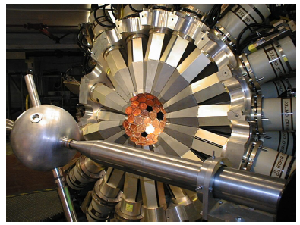
BLIP-collaboration: two main objectives
Decay Data
To fully characterize the decay scheme of radioisotopes and accurately quantify the emissions and radiation dose to guide their application in medical imaging and radiotherapy.
Sources produced at BLIP
Shipped to world’s largest γ-ray array Gammasphere (100 HPGe detectors) for high-precision γ-ray spectroscopy
Cross Sections
To determine cross sections for nuclear reactions of high energy protons to provide guidance for the cost effective large scale production of radioisotopes.
Foil irradiations performed at BLIP (possibility of BNL tandem)
Gamma-ray spectroscopy performed at BNL, UMASS-Lowell (Compton-suppressed array) or Gammasphere

Slide 3
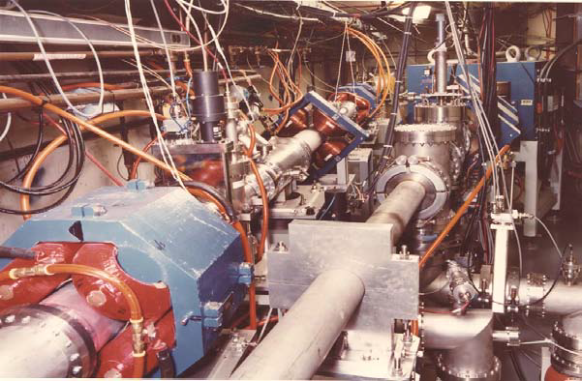
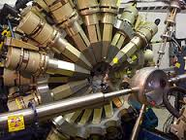
Use a “best-practice”, synergistic approach
Combine expertize in all skills needed to develop a world-class program to enhance production and application of radioisotopes
Target design
Radiochemistry
Medical relevance
Structure & Decay Data
Reaction Data
Reaction Modeling
γ-ray spectroscopy
State-of-the-art detector systems
BLIP
USNDP
ANL
UMASS
With eager participation from all collaborators, we have made substantial progress in past year with ZERO additional funding

Slide 4
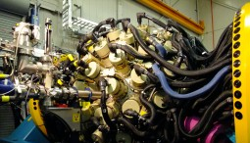
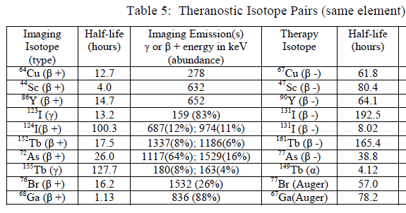
Why Decay Data ?
30 Years ago: 1-2 small detectors
Essential for determining:
Overall dose
Specific dose
Imaging background
Production planning
Present: 10-100 detectors
Over half were last studied >30 years ago !!

Slide 5
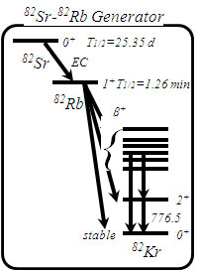
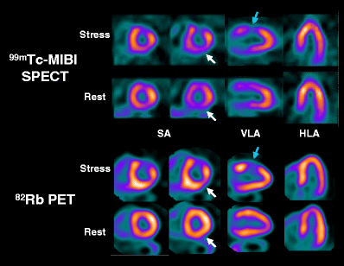
Starting point : ⁸²Rb for Cardiac PET
D. Le Guludec et al., Eur. J. Nucl. Med. Mol. Imaging 35, 1709 (2008).
2 Ge(Li) detectors
R.A. Meyer et al., Phys. Rev. C 27, 2217 (1983).

Slide 6
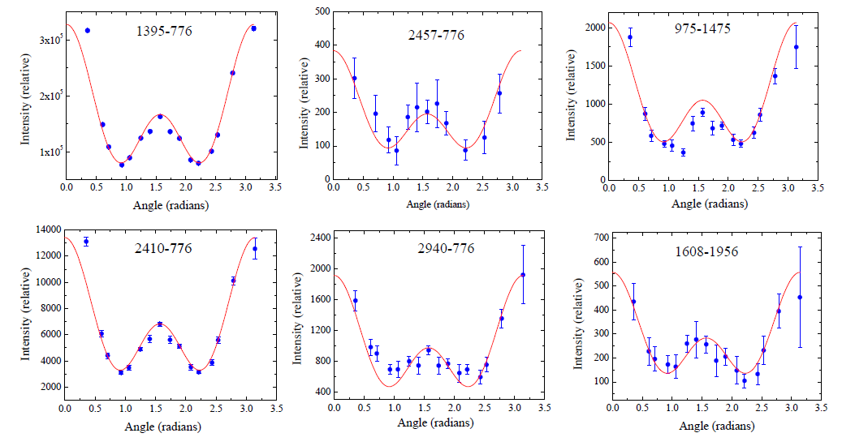
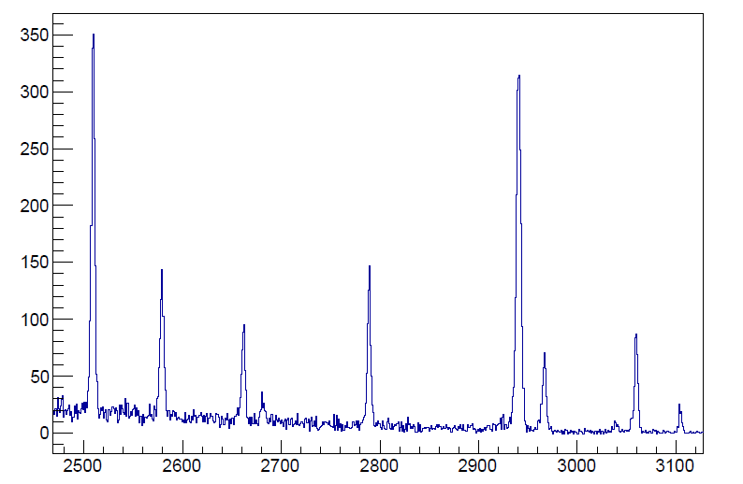
The power of Gammasphere
Prior Singles
Identified six new 0⁺ states
Gate on 2⁺→0⁺

Slide 7
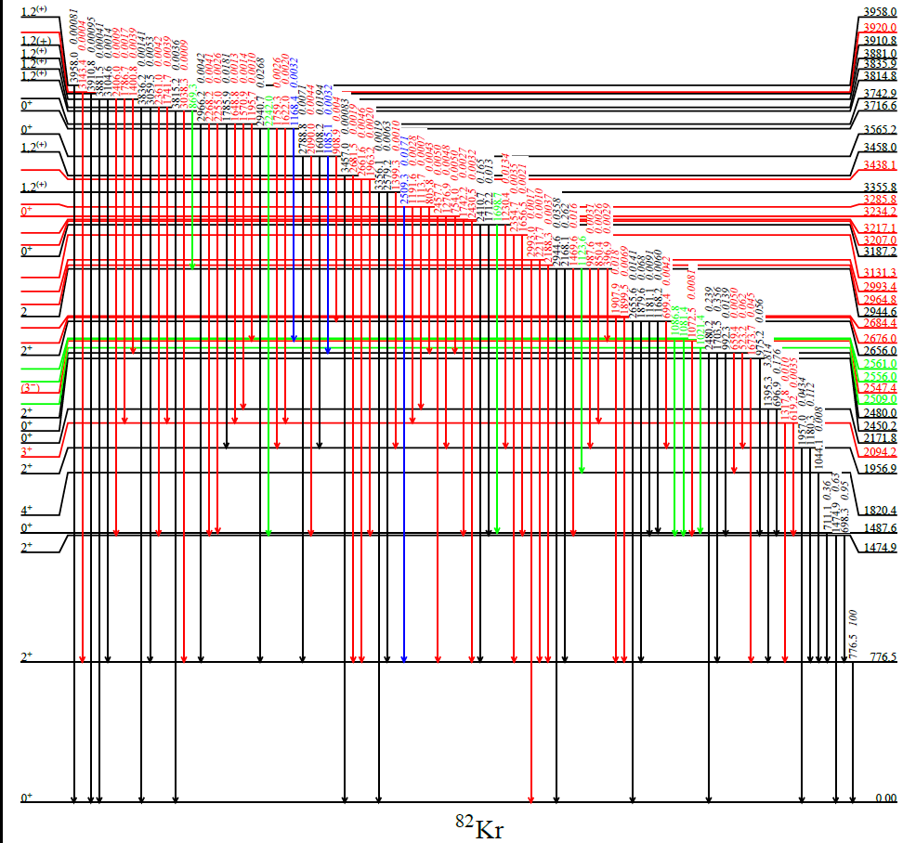
Revised decay scheme for ⁸²Rb
New
Confirmed
Removed
Moved
Analysis by Michael Nino (Hofstra) –
Summer SULI
M. Nino et al, PRC – nearly accepted

Slide 8
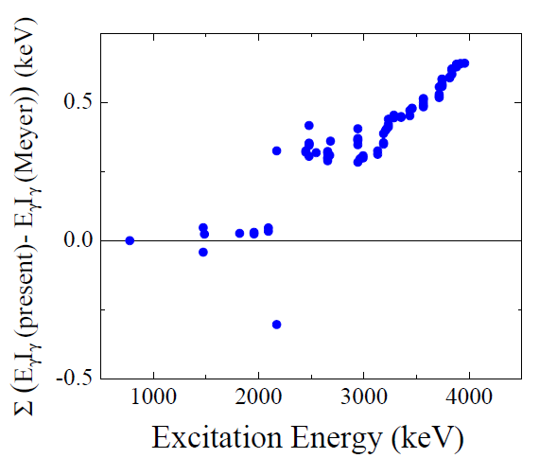
Impact on Dosimetry
Change in ΣE_{γ}I_{γ} < 1 keV
Fortunately for dosimetry …
⁸²Rb
1.1%
14.1%
84.8%
⁸²Kr
⁸²Rb is “ideal” PET agent
New non-conventional PET agents have numerous, high intensity gamma-ray transitions
Accurate quantification of their decay properties is essential
⁷²As – Completed – paper in preparation
¹²³I, ^{61,62}Cu – approved “beamtime” at Gammasphere
⁷⁶Br, ⁸⁶Y – proposed to Nov 2015 ANL PAC

Slide 9
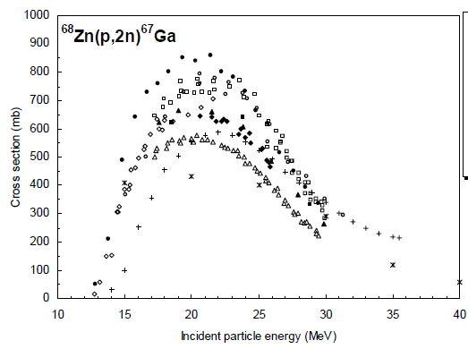
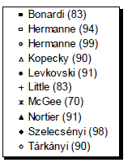
Why cross sections?
Necessary for cost-effective, large scale production of radioisotopes
?
Cross Section
Very little data
Potential for discovery
Imaging
100
150
200
Proton Energy (MeV)
Even for routinely used medical isotopes some (actually many) cross sections are not well determined
New measurements tuned to BLIP/IPF energies have potential for discovery science

Slide 10
Platinum Radioisotopes
Over 25% of cancer patients receive platinum based chemotherapeutic agents
Pair these with
Imaging agents (monitor dose and tissue uptake)
Therapeutic agents (localized radiation)
Many platinum isotopes with range of half-lives and emissions

Slide 11
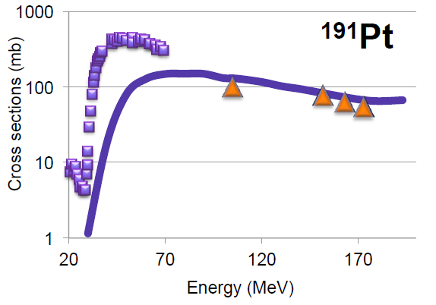
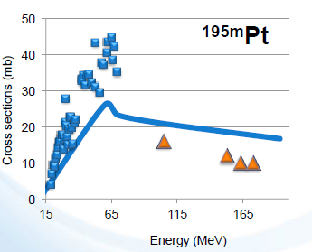
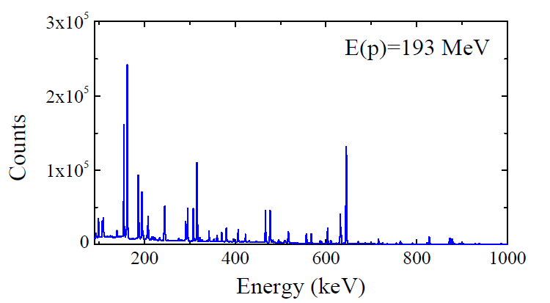
New cross section measurements at BLIP
Protons on Natural Platinum foils
Viable cross section for platinum radioisotopes with 100-200 MeV protons
Ref [1]
BLIP
Using results to help tune EMPIRE calculations
Compton-suppressed, γγ coincidence spectroscopy is a must here
EMPIRE
Ref [1]: A.F. Tarkanyi et al., NIMB 226, 473 (2009).

Slide 12
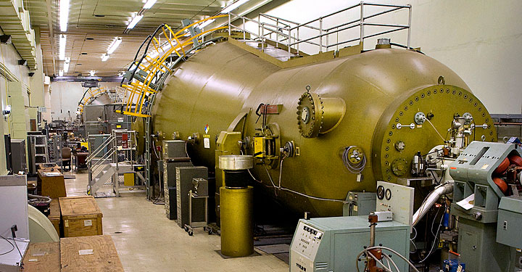
The consistency issue at lower energies
BLIP has
Limited access (only operational Jan-June)
Limited projectiles (only 40-200 MeV protons)
Limited energy precision
RHIC Injector Tandem
Up to 30 MeV protons
High intensity p,d,α, and
heavy ions
Energy and species overlap with capabilities of cyclotron radioisotope production

Slide 13
Slide courtesy of L. Bernstein

Slide 14
Slide courtesy of L. Bernstein

Slide 15
The Opportunity We See
New techniques from nuclear structure (Compton suppression, high efficiency multi-detector arrays) can vastly improve the precision and accuracy of data needed for isotope production and application
This is a great opportunity for our data community, as we have the skills, connections, and can rapidly integrate the data into our databases.
To seize the opportunity needs effort. Ideally, staff member to oversee/coordinate experiments and analysis.
At the very least we need some modest funds for
Travel, Target Materials, Shipping, etc

Slide 16
BACKUPS

Slide 17
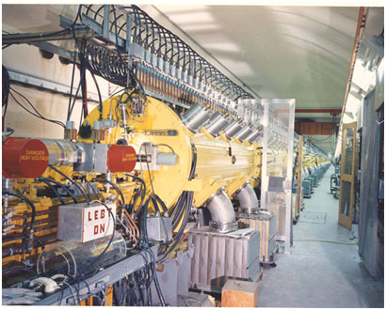
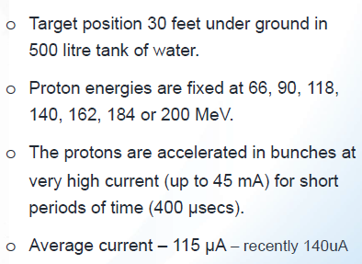
Brookhaven Linear Isotope Producer (BLIP)
Runs parasitic to RHIC – 90% BLIP, 10% RHIC

