Slide 1
Compilation Databases
Boris Pritychenko
National Nuclear Data Center, BNL, Upton, NY 11973

Slide 2
Compilation Databases
There are three major and two minor compilation databases at NNDC: NSR, EXFOR, XUNDL and B(E2)↑, ββ-decay.
We will concentrate on NSR and EXFOR databases:
Nuclear Science References (NSR): all low- and intermediate-energy references for a broad use, not just nuclear structure and decay as before 90ies.
Experimental Nuclear Reaction Data (EXFOR): all low- and intermediate-energy reaction data sets for neutron-, charged- and photo-induced reactions, not just neutron-induced as before 80ies.
The compilation scope and quality controls for NSR and EXFOR database have evolved over the many years of operation. These facts plus lack of advanced computer tools in the past are responsible for missing references and data sets.

Slide 3
Compilation Operations
Compilations represent a middle layer between research operations and evaluated data.
Compilation databases are fundamental for nuclear data evaluation activities.
Compilations of experimental results are done once while evaluations are revisited on 10-12 years basis. QA requirements are strict.
Compilation activities rely on significant contributions of contractors.
ENDF
ENSDF
EXFOR
XUNDL
B(E2)↑
NSR
ββ
Research Operations

Slide 4
NSR Compilations in FY2015
NSR team: 1.5 NNDC, 2 contractors and 1 IAEA collaborator.
Our goal is provide the coverage for current publications; however, due to many historical and technical reasons a substantial number of articles was missed in the past and we are we are proactively recovering these references.
NSR References
4,215 articles = 3,056 new + 1,159 missing articles from EXFOR
189 modified (corrected) article entries
3,058 keyworded article abstracts
NSR References import from EXFOR: V. Zerkin, IAEA has produced a Java code, and started to produce NSR entries in collaboration with NNDC; each entry is verified by NSR manager.
NSR QA: Manager + Users + Evaluators + Compilers Inputs.
Direct communication with Phys. Rev. C: ~15% of authors submit keywords to NSR.
NSR database is updated 2-3 times a week (Most frequently-updated database).

Slide 5
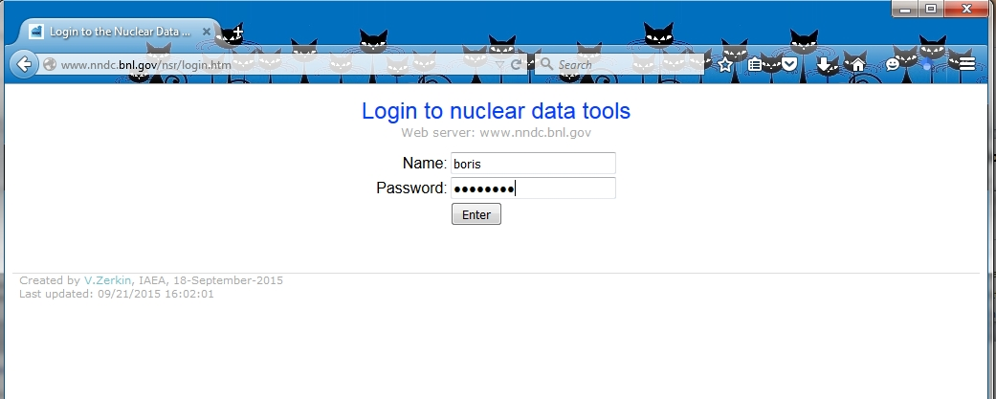
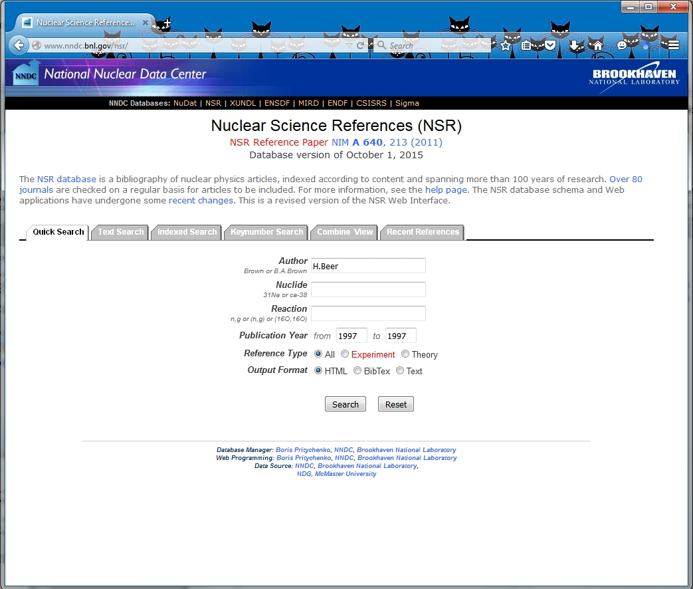
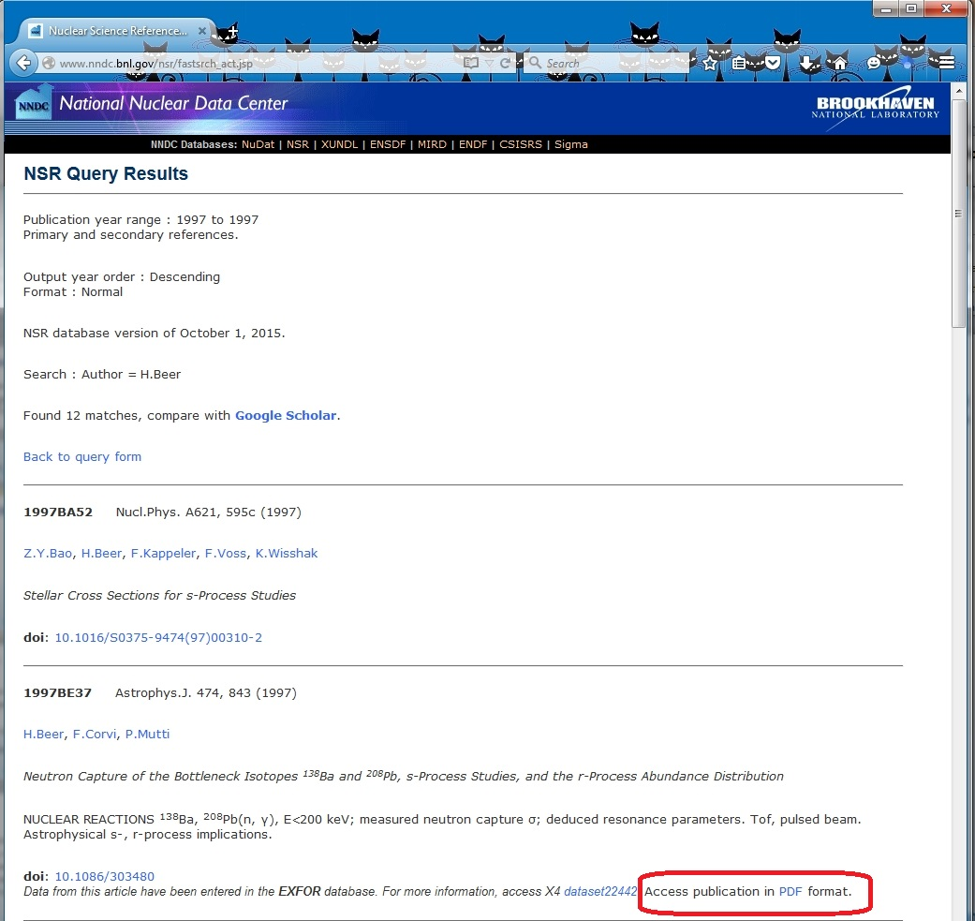
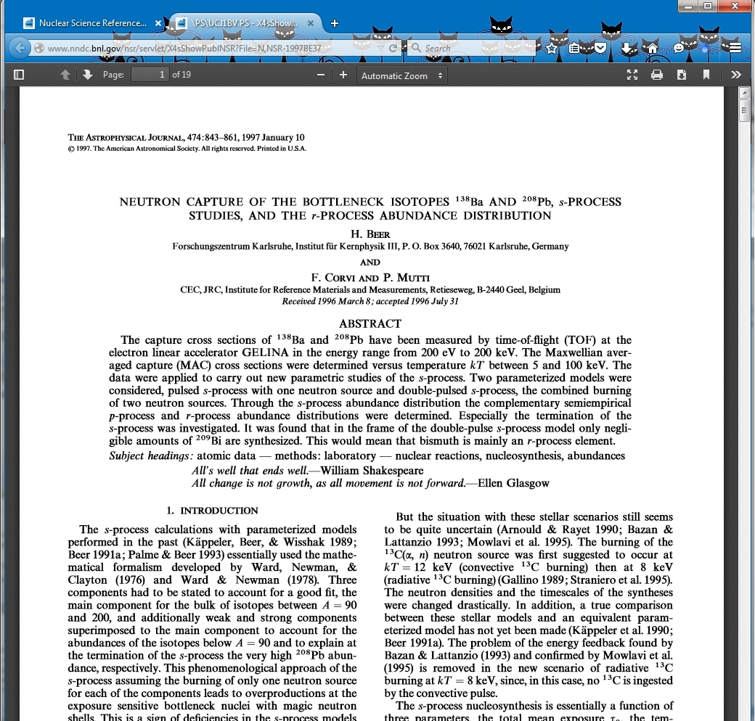
E-library for NSR Users
Previously EXFOR publications were scanned and loaded into database by V. Zerkin, IAEA.
In FY2015 this project has been extended to NSR references.
PDF files can be accessed directly at NNDC and IAEA. Authorization is available for external users.
http://www.nndc.bnl.gov/nsr/login.htm
Username/Password
Presently ~25 K out of 219 K NSR references, work continues.
All evaluators should follow the lead of A. Rodionov and B. Singh and and help with PDF files.

Slide 6
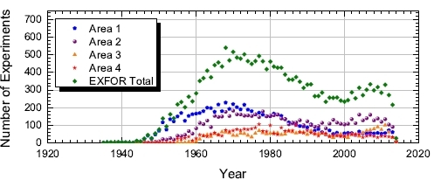
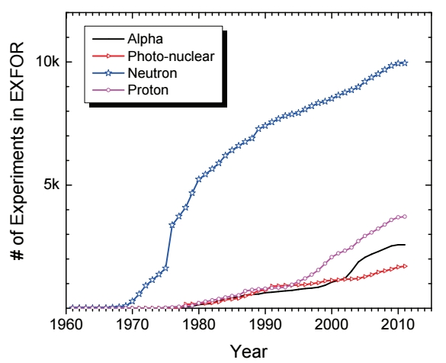
EXFOR Effort in the U.S. and Canada
NNDC is a member of Nuclear Reaction Data Centers (NRDC) network. We are responsible for compilation of nuclear reaction data sets from the U.S. and Canada (Area #1):
Area 1: USA/Canada – 37.16%,
Area 2: Europe – 34.79%,
Area 3: Asia/Africa/Australia/LA – 13.35%,
Area 4: Former SU/RF – 14.70%.
Authors asked to submit original data sets and approve compilations for EXFOR.
Combined international compilation and Quality Assurance (QA) efforts.
Papers are grouped by experiments neutrons, charged particles, photons.
EXFOR Team: 0.5 NNDC, 2 contractors, and 1 IAEA collaborator.

Slide 7
EXFOR Compilations in FY2015
New EXFOR entries (experiments): 105, corrected: 75
A substantial number of charged particle and photonuclear experiments are still missing in EXFOR, some existing compilations are incomplete due to many reasons. We continue to address these issues.
Data recovery mission at Oak Ridge lab in March of 2015. Many thanks to M. Dunn and K. Guber.
UNOBT data entries for the area #1 are reduced by 1/3, including all H, C, O, Fe, U and Pu.
EXFOR Web application was upgraded in collaboration with the IAEA.
Database is updated on a monthly basis.

Slide 8
Conclusions
Compilation activities are essential for nuclear data evaluations and fundamental research.
Compilation of current nuclear science references is going well, NNDC is proactively recovering missing references.
Compilation of current experimental nuclear reaction data sets is going well, NNDC is proactively recovering missing and unobtainable data sets.
Collaboration with the IAEA and contractors are essential for compilation activities. It is a very cost-effective way of doing business.
We will continue to work on E-library for nuclear structure and reaction papers by adding new PDF references.
We will continue to work on the new approaches and technical tools for recovery of missing and unobtainable data sets and publications.

