Slide 1
USNDP Dissemination
Alejandro Sonzogni
National Nuclear Data Center

Slide 2
Outline
Web Dissemination
  NNDC Web
  LBNL plans
  ORNL Web
Nuclear Data Sheets
NNDC GForge Server

Slide 3
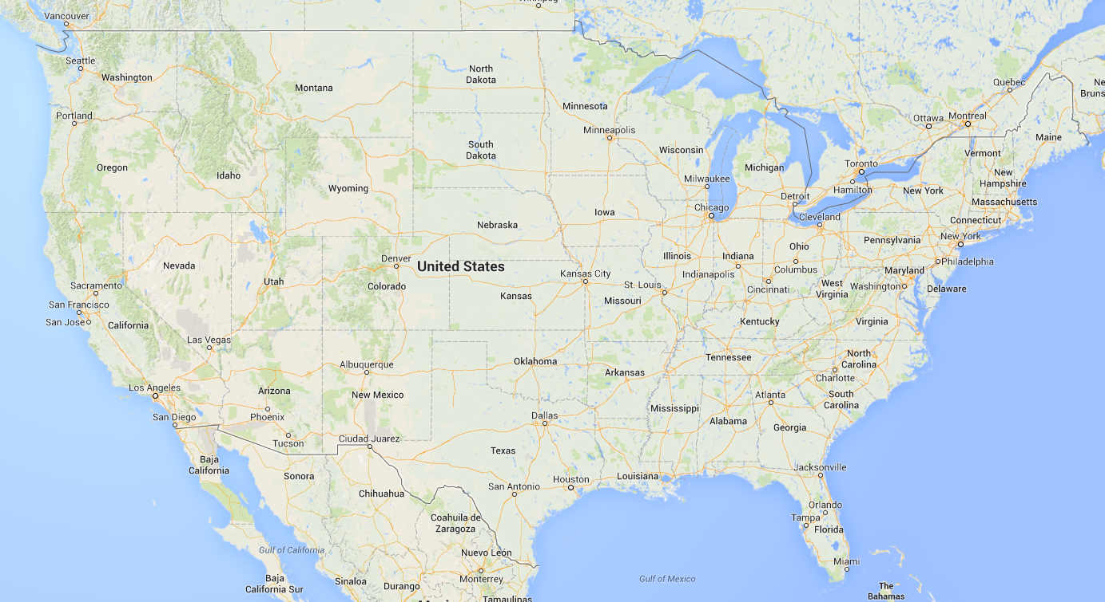
USNDP Groups Involved in Web Dissemination
ANL
NNDC
TUNL
LANL
ORNL

Slide 4
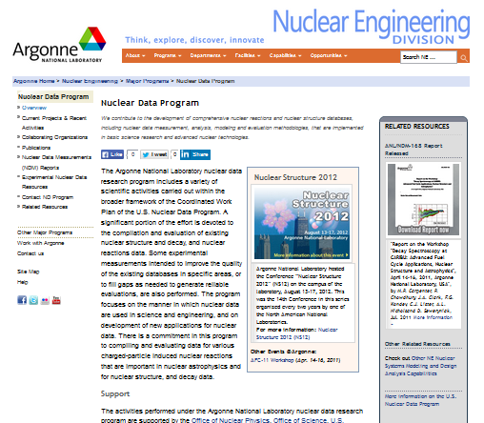
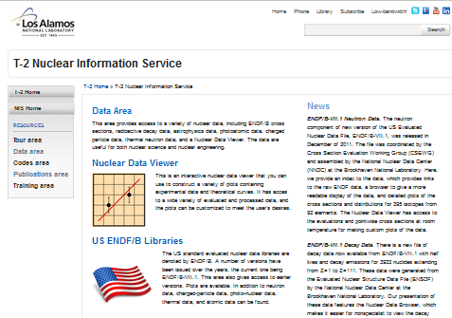
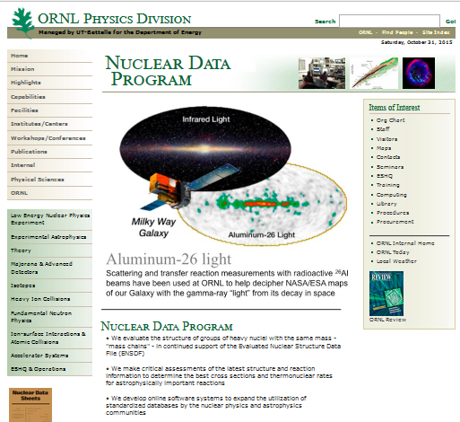
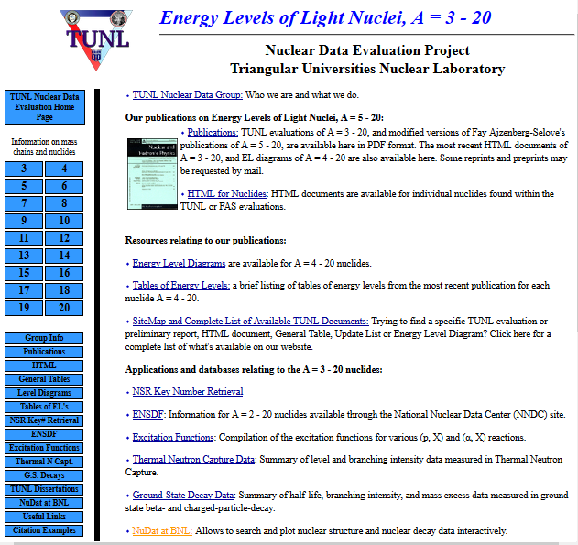
www.ne.anl.gov/capabilities/nd/
http://t2.lanl.gov/nis/data.shtml
www.phy.ornl.gov/groups/astro/data/data.html
http://www.tunl.duke.edu/NuclData/

Slide 5
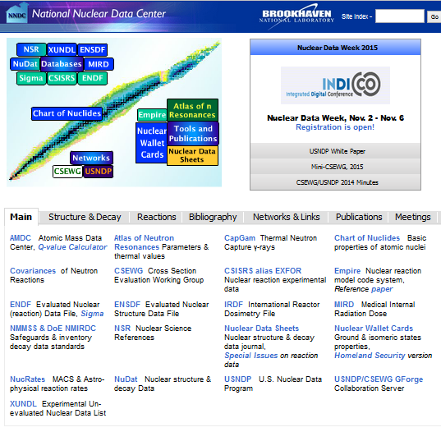
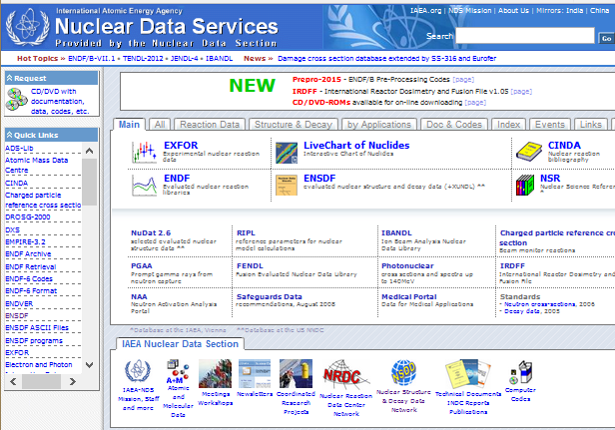
www.nndc.bnl.gov
https://www-nds.iaea.org/
There has been a strong collaboration between the IAEA and NNDC web disseminations efforts

Slide 6
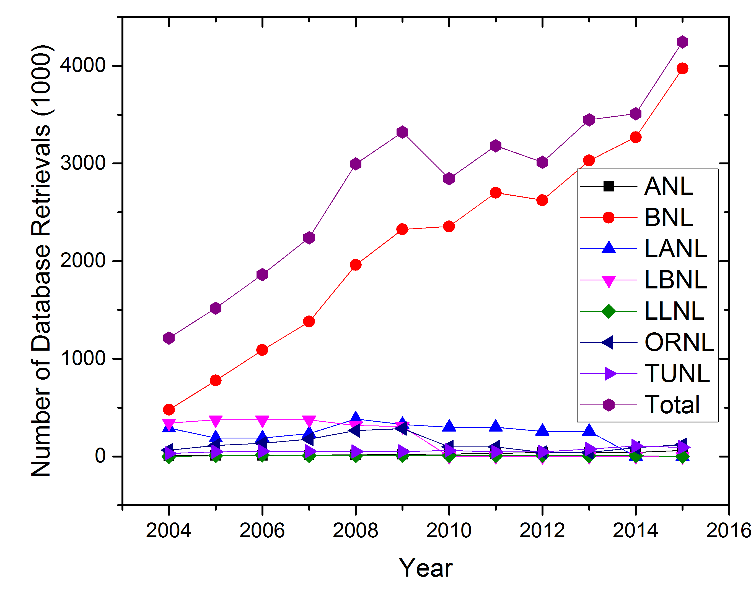
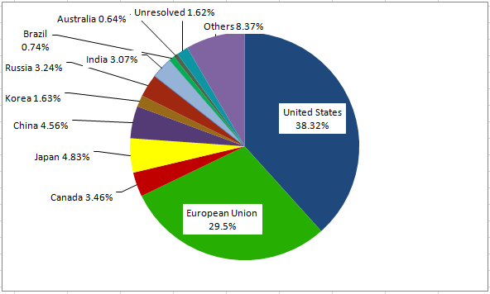
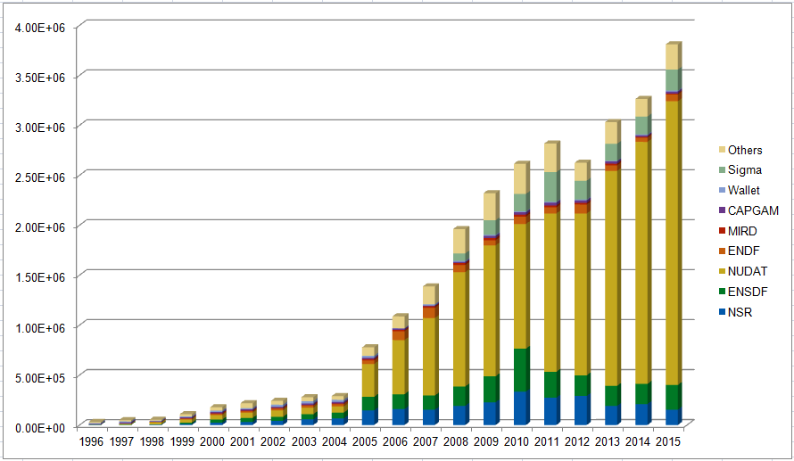
USNDP Web Retrieval Statistics
Distribution of NNDC web visitors
NNDC retrievals per product

Slide 7
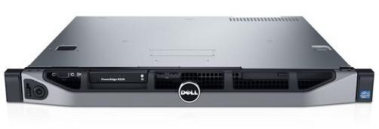
NNDC Servers
5 Dell Servers
Intel Xeon Dual 2.9 MHz 8 core
128 GB RAM
About $20K each
Dissemination and
Archival.
Load Balancer
Web Server #1
Web Server #2
Made possible by:
$150K CE DoE grants in 2003, 2008, 2013
BNL’s ITD support
Outside Database Server
Ramon Arcilla, admin.
Tim Johnson, webmaster
Programmers:
T. Johnson, B. Pritychenko, A. Sonzogni, V. Zerkin
Development & Nuclear Data Sheets Server
Inside Database Server

Slide 8
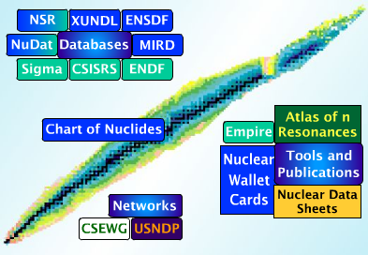
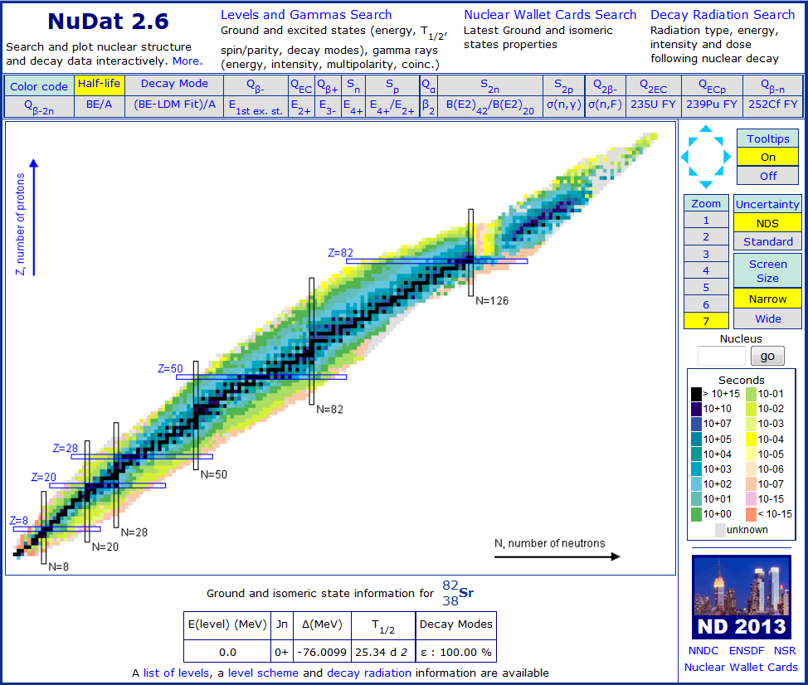
Access to USNDP databases and products
NuDat, the friendly face of ENSDF

Slide 9
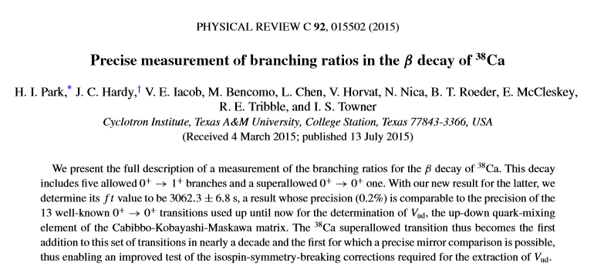
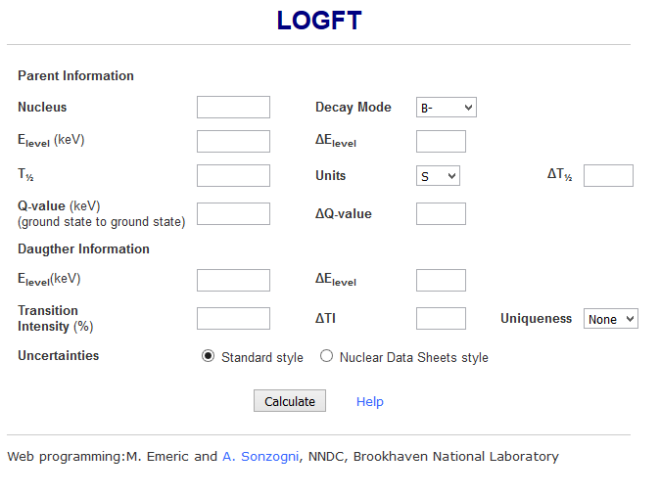
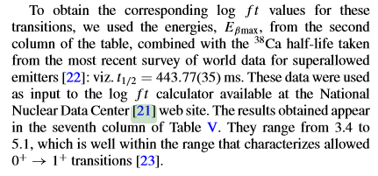
Another Example
On page 10
In 2015 LOGFT was redone to conform with cyber-security audit

Slide 10

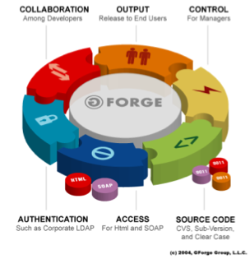
GForge site: collaborative environment for nuclear data development.
(“Facebook” of nuclear data)
Features:
File uploading/downloading
Subversion (SVN) versioning system
Management of releases
Document management
News announcements
Issue (bug) tracking
Mailing lists
Used by USNDP for development of:
codes, ENDF/B, new data structure, manuals, Web services,…
(47 projects, 115 users)
￼

Slide 11
NNDC Dissemination Challenges & Opportunities
Maintain 99.9 % reliability.
Fend off hackers and cyber attacks.
Pass cyber-security audits (Lots of effort).
New servers expected in 2017.
Lots of $ saved thanks to synergy with BNL ITD (Administration and housing of the servers as well as software: Red Hat, MySQL, SSL certificate).
Update services, keep up with current technology.

Slide 12
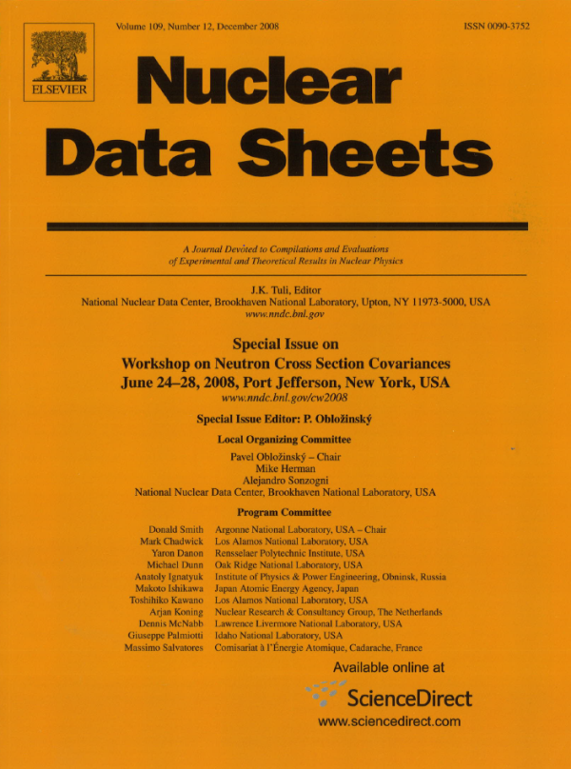
Nuclear Data Sheets
Started in 1966. Currently published by Elsevier.
J.K. Tuli, Editor. E.A. McCutchan, Assistant Editor.
Originally mission was to publish ENSDF evaluations and Recent References (NSR).
Starting in 2006, the December issue is devoted to nuclear reactions related articles.
It has published proceedings for the 2008 Covariance Workshop (36 articles), ND2013 (344 articles) and the 2014 Covariance Workshop (39 articles).

Slide 13
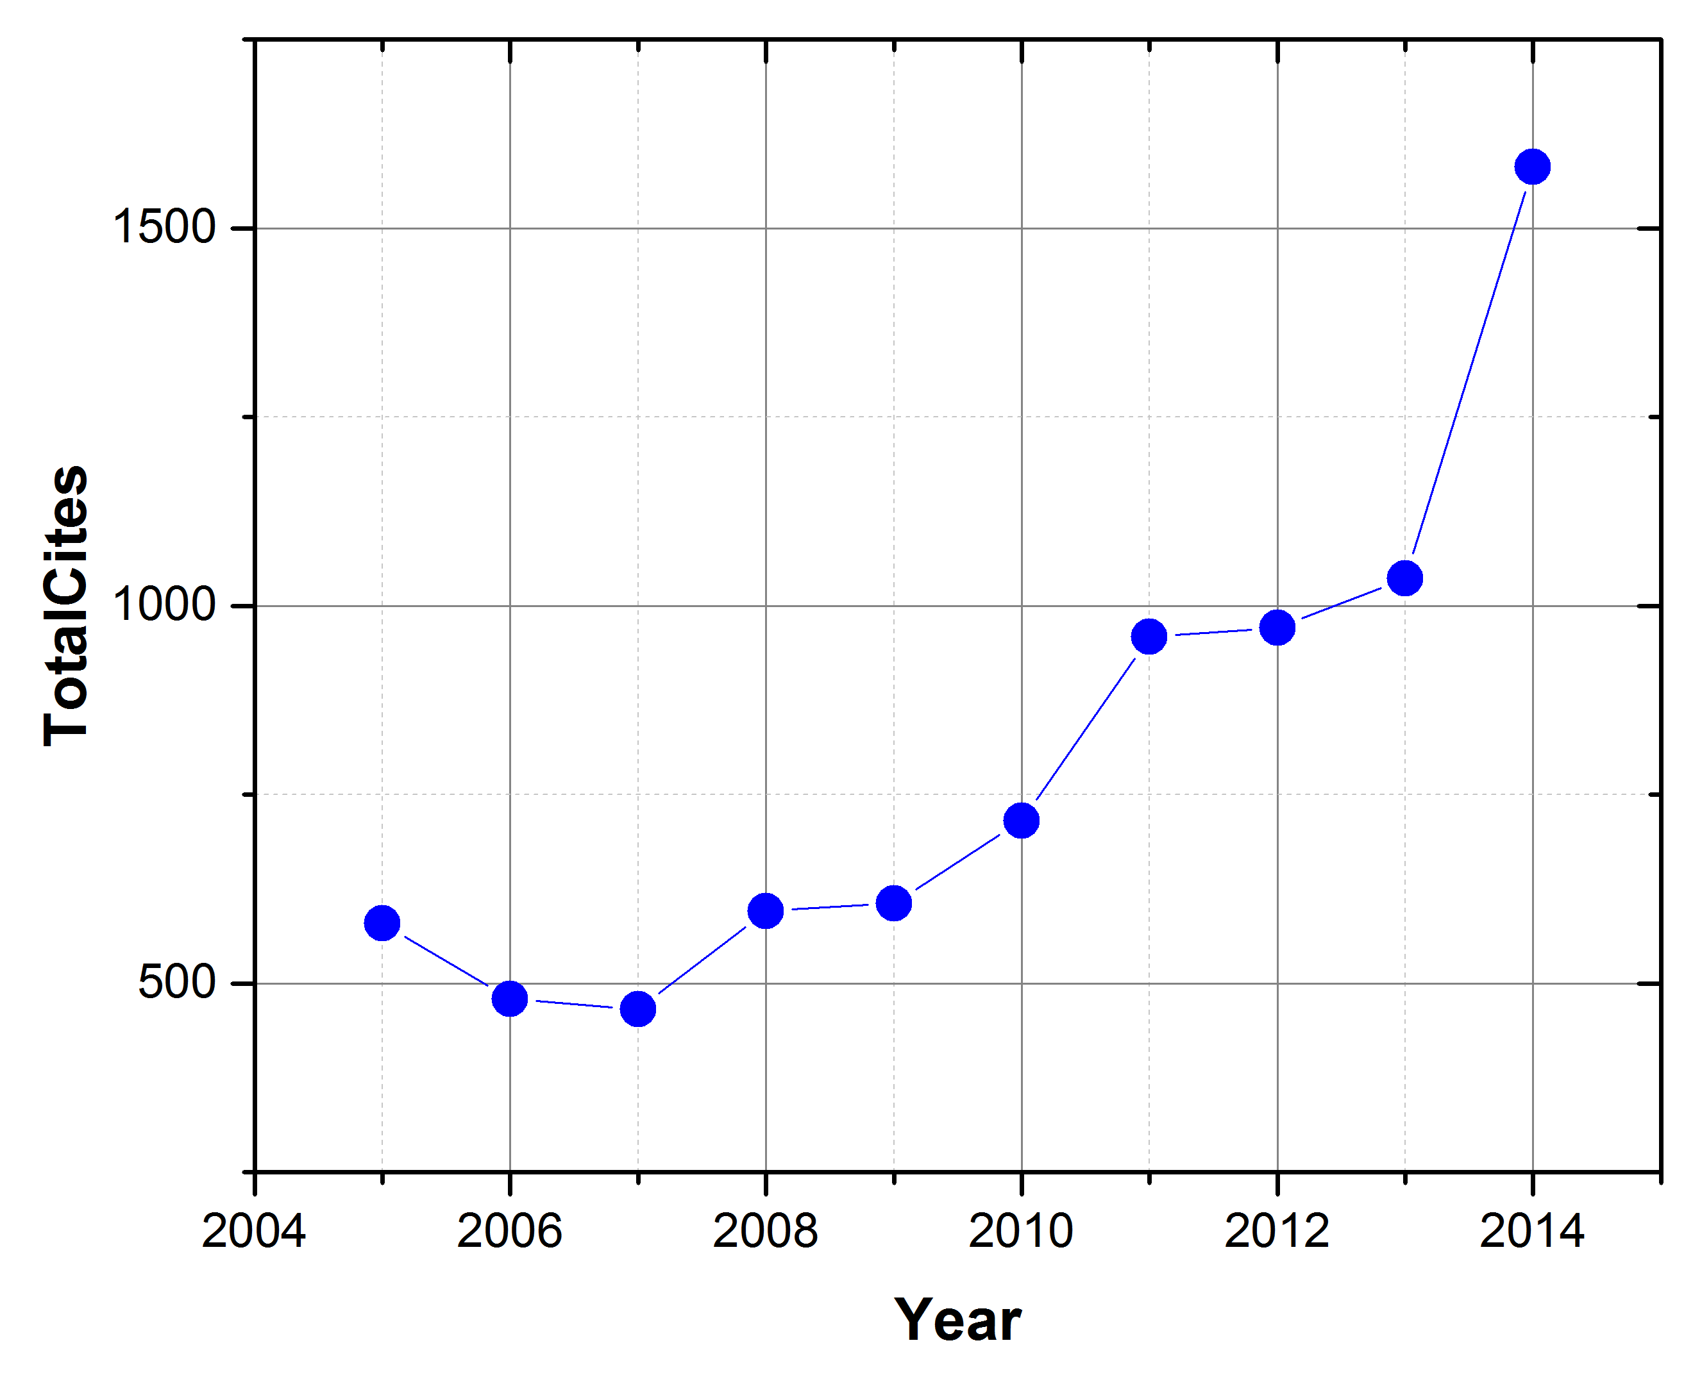
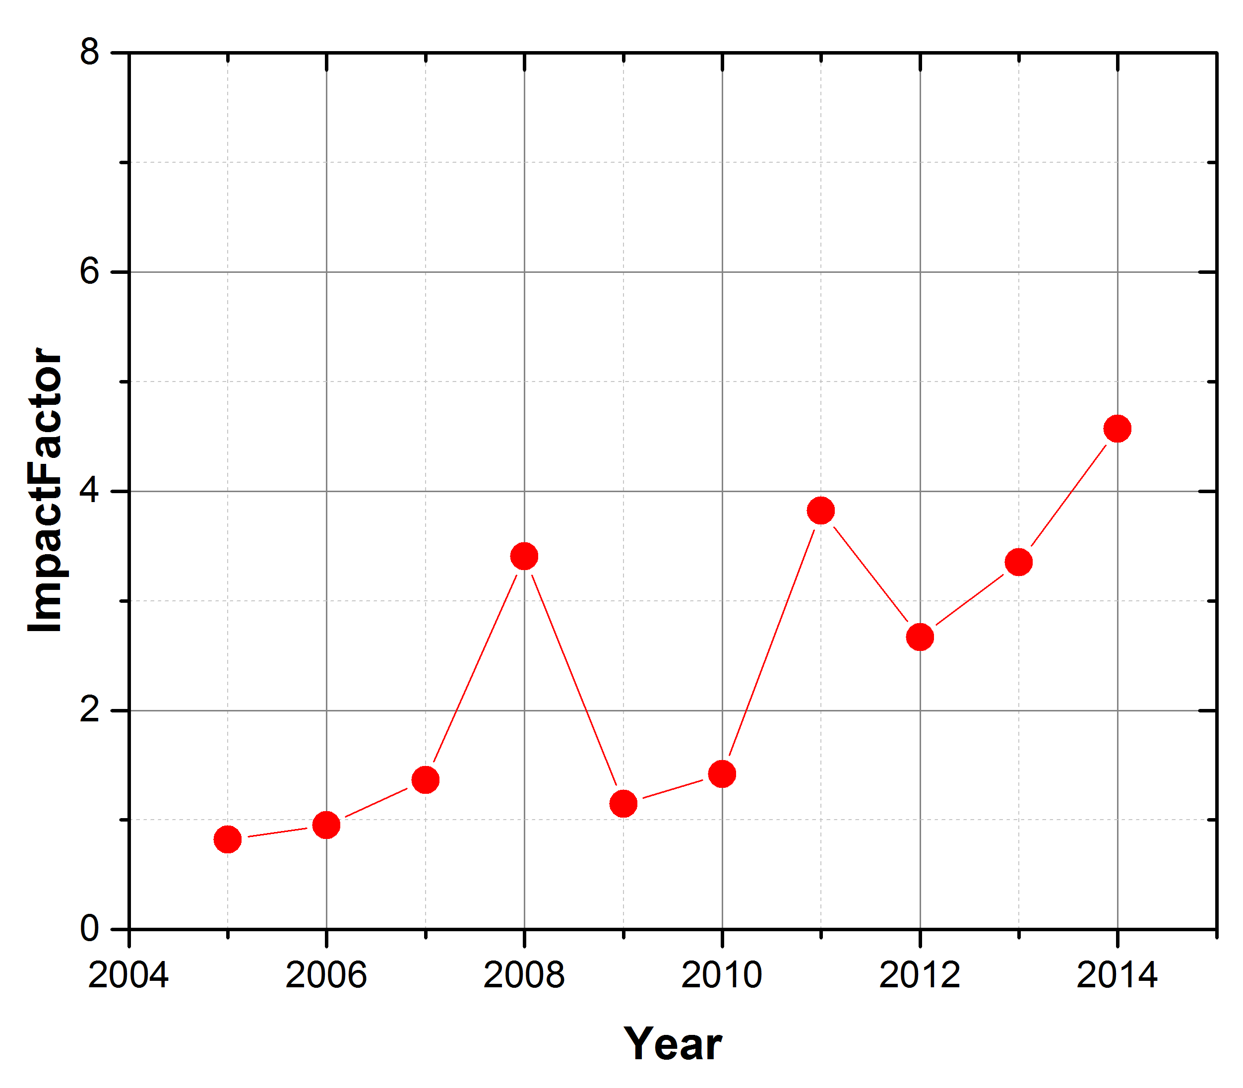
Nuclear Data Sheets
Parameters from The Journal Citation Report.
Journal | 2014 Cites | 2014 Impact Factor
PRL | 387,635 | 7.512
PRC | 43,656 | 3.773
EPJ A | 4,244 | 2.736
AD&NDT | 2,828 | 2.458

Slide 14
Nuclear Data Sheets Special Issues
A few selected articles
Topic | Authors | # pages | Publication Date | # citations
ENDF/B-VII.0 | Chadwick et al | 130 | 12/2006 | 1,330
EMPIRE | Herman et al | 60 | 12/2007 | 341
Standards | Carlson et al | 110 | 12/2009 | 116
RIPL | Capote et al | 107 | 12/2009 | 391
ENDF/B-VII.1 | Chadwick et al | 110 | 12/2011 | 572
NJOY | MacFarlane & Kahler | 98 | 12/2012 | 112
NDS provides a venue to publish long articles on very widely used products.
Publishing long articles represents a lot of work on the NNDC!

Slide 15
Nuclear Data Sheets Challenges & Opportunities
Moving into LaTex / JAVA system to replace ageing postscript output (McMaster / MSU effort) for ENSDF publications.
Limited editorial support following M. Blennau retirement. Grace Sheu from TUNL has been working to fill this need.
We will need a new Special Issues editor once Pavel Oblozinsky decides to step down.

Slide 16
LBNL Dissemination Site (http://ie.lbl.gov/toi/)
Access to LBNL site for Table of Isotope from outside is blocked due to older operating system
Users are communicating
Effort and resource will be explored to bring it back
“On Thu, Oct 22, 2015 at 1:54 PM, Burke, Jason T. <burke26@llnl.gov> wrote:
Rick Norman and I were looking for the England and Rider Tables in digital form that used to be on the LBL data website. We cannot find the website anywhere. Do you know what happened? There are decades of work on that site.”
On Thu, Oct 22, 2015 at 2:44 PM, Burke, Jason T. <burke26@llnl.gov> wrote:
The table of radioactive isotopes is also on your server and is very useful. It would be great if you guys could get your server back up. It is a very useful resource. Campus uses it all the time to help teach the courses.

Slide 17
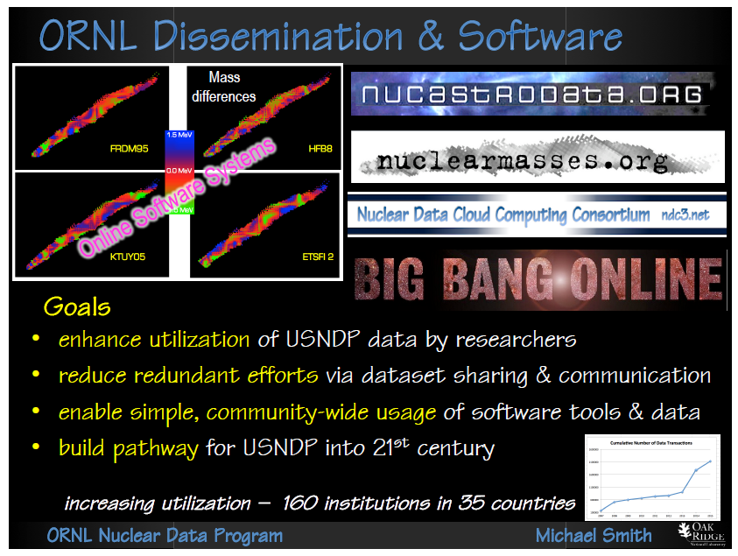

Slide 18
