Slide 1
Nuclear Reaction Physics
Toshihiko Kawano
David Brown

Slide 2
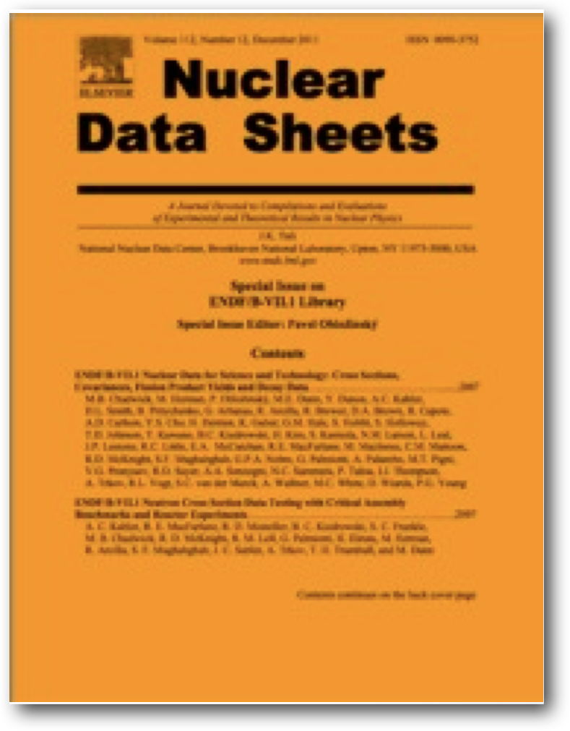
ENDF/B-VIII Status
ENDF/B library is product of CSEWG, an informal yet very long running collaboration (50 years in June 2016)
ENDF/B is the US’s most important data library for nuclear applications
Next major release due in FY17-18 time frame
Major new items, so far:
CIELO evaluations: ¹⁶O, ⁵⁶Fe, ^{235,238}U, ²³⁹Pu
Neutron standards
EPICS2014 (atomic reaction data)
New TSL evaluations
Many bugs fixes & other improvements
Release in legacy ENDF and new GND formats
ENDF/B-VII.0 contains 393 evaluations; 1325 citations since 2006 (Google Scholar)
ENDF/B-VII.1 contains 423 evaluations 669 citations since 2010 (Google Scholar)

Slide 3
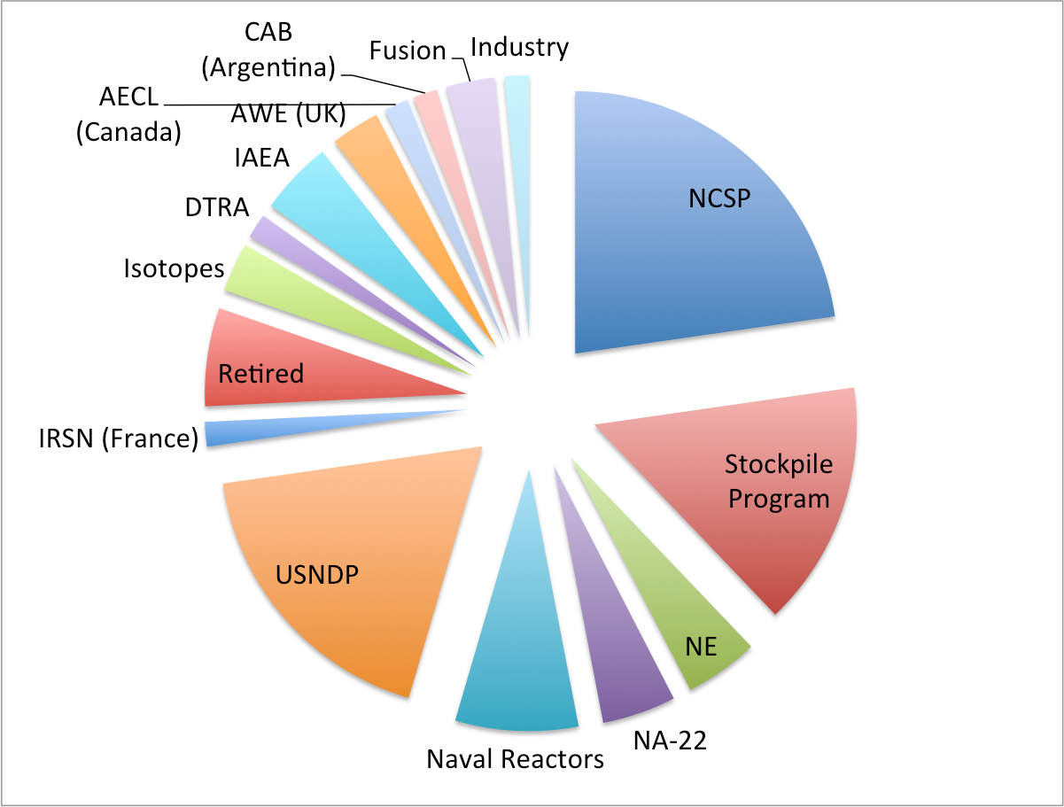
USNDP is an important part of CSEWG
Due to CSEWG’s informal nature, it is hard to assess precise contribution to ENDF/B in either $$ or FTEs
Chart reflects attendance of CSEWG meeting earlier in week
Double counting alert: some people counted twice since funded from multiple pots of $$

Slide 4
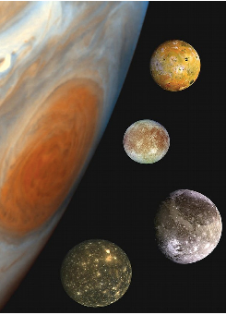
USNDP Funding @LANL
CoH₃
Theory
Reaction model development, in support of LANSCE experimental data and NNSA mission
Nuclear data file production, formatting, tool development
Release of DeCE, ENDF file manipulation program, as an open source under GPL v.2 in process
Experiment
Largely supported by other projects. USNDP is to coordinate many experimental programs with external activities including LANL theory group

Slide 5
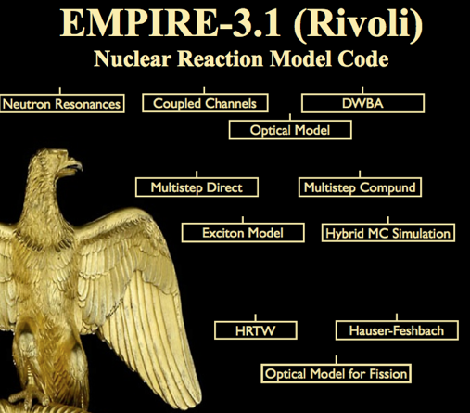
USNDP Funding @BNL
EMPIRE-3.2 (Malta)
Theory
Reaction model development
Release of EMPIRE, under GPL
Nuclear data file production, formatting, tool development
Developer of FUDGE open-source nuclear data processing code, next release due ~Dec under BSD license
Active developer of new nuclear data structure (WPEC/SG38)
Library Support
Collaboration & dissemination infrastructure
Maintain NNDC website, Gforge system
Library QA
Develop and maintain ADVANCE continuous integration system

Slide 6
USNDP Funding @LLNL, LBNL & NIST
LLNL
Largely supported by other projects. Nuclear data file production, formatting, tool development
Lead developer of FUDGE open-source nuclear data processing code, next release due ~Dec under BSD license (Stockpile program funded)
Active developer of new nuclear data structure (WPEC/SG38)
LBNL
Largely supported by NA-22. Develop EGAF and update ENDF thermal capture data
NIST
Lead US participation in Standards evaluation

Slide 7
Unlike other data projects, CSEWG does not restrict who can contribute: FY15 evaluations
Program | Full evaluations | Partial evaluations | Bug fixes
NCSP | 1
AECL (Canada) | 1.5
CAB (Argentina) | 1.5
JAEA (Japan) | 18
Retirees |  |  | 305
Stockpile Program |  |  | 16
USNDP |  | 9 | 33

Slide 8
Contributions to CSEWG are not just evaluations
Program | Measurement | Theory | Compilation | Evaluation | QA (V&V, IE) | Infrastructure (Gforge, etc.)
DTRA | ✓
International (IAEA, NEA, …) |  | ✓ | ✓ | ✓ | ✓ | ✓
NA-22 | ✓ | ✓ |  | ✓
Naval Reactors | ✓ |  |  |  | ✓
NCSP | ✓ | ✓ |  | ✓ | ✓
NE |  |  |  |  | ✓
Other (NP, Fusion, …) | ✓ | ✓ |  |  | ✓
Stockpile | ✓ | ✓ |  | ✓ | ✓ | ✓
USNDP | ✓ | ✓ | ✓ | ✓ | ✓ | ✓

Slide 9
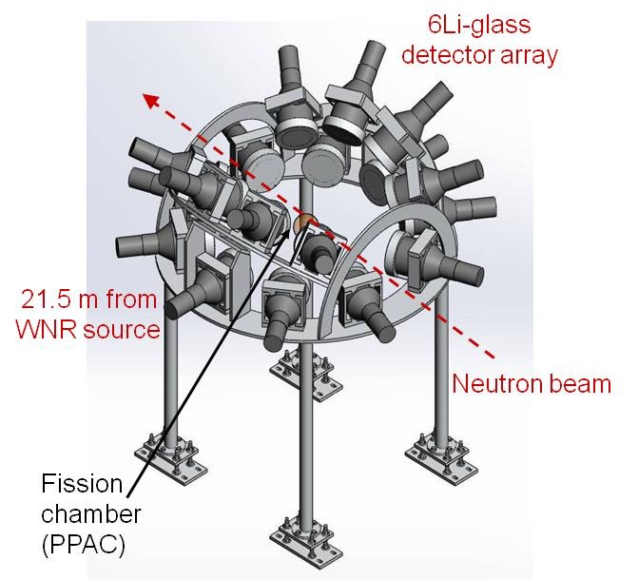
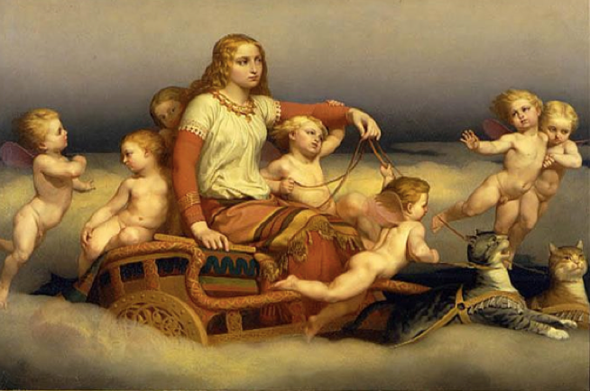
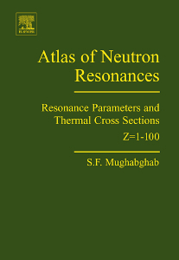
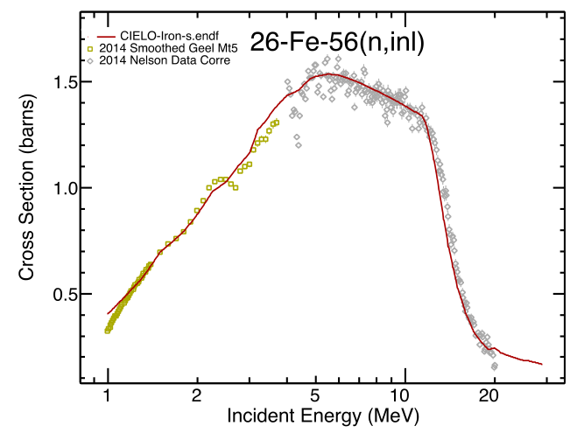
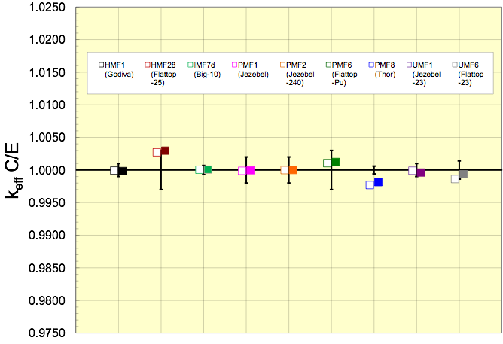
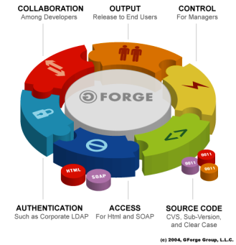
Measurement | Theory | Compilation | Evaluation | QA (V&V, IE) | Infrastructure (Gforge, etc.)
Freya

Slide 10
Measurement | Theory | Compilation | Evaluation | QA (V&V, IE) | Infrastructure (Gforge, etc.)
Freya

Slide 11
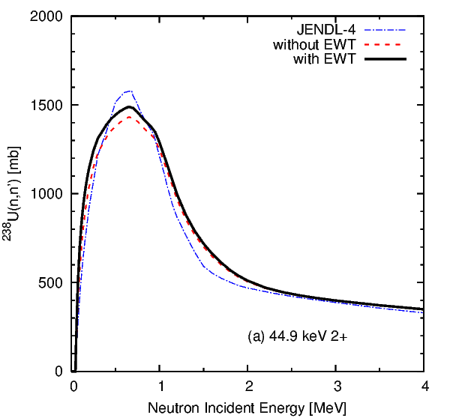
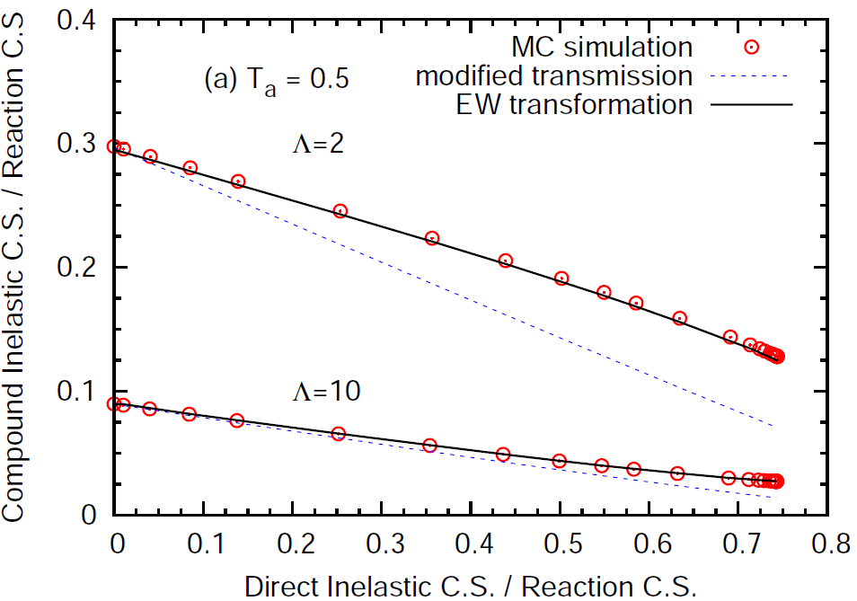
Direct Channels in Hauser-Feshbach
Engelbrecht-Weidenmueller transformation for the statistical model with strongly coupled channels, fully implemented in CoH₃ and under development for EMPIRE
S-matrix diagonalization formulation derived, when radiative capture and fission channels are involved
One Phys. Rev. C paper published, and another paper under preparation (joint paper LANL/IAEA/BNL/CEA)
A conventional treatment of the direct channels justified in the Hauser-Feshbach limit (no fluctuation)

Slide 12
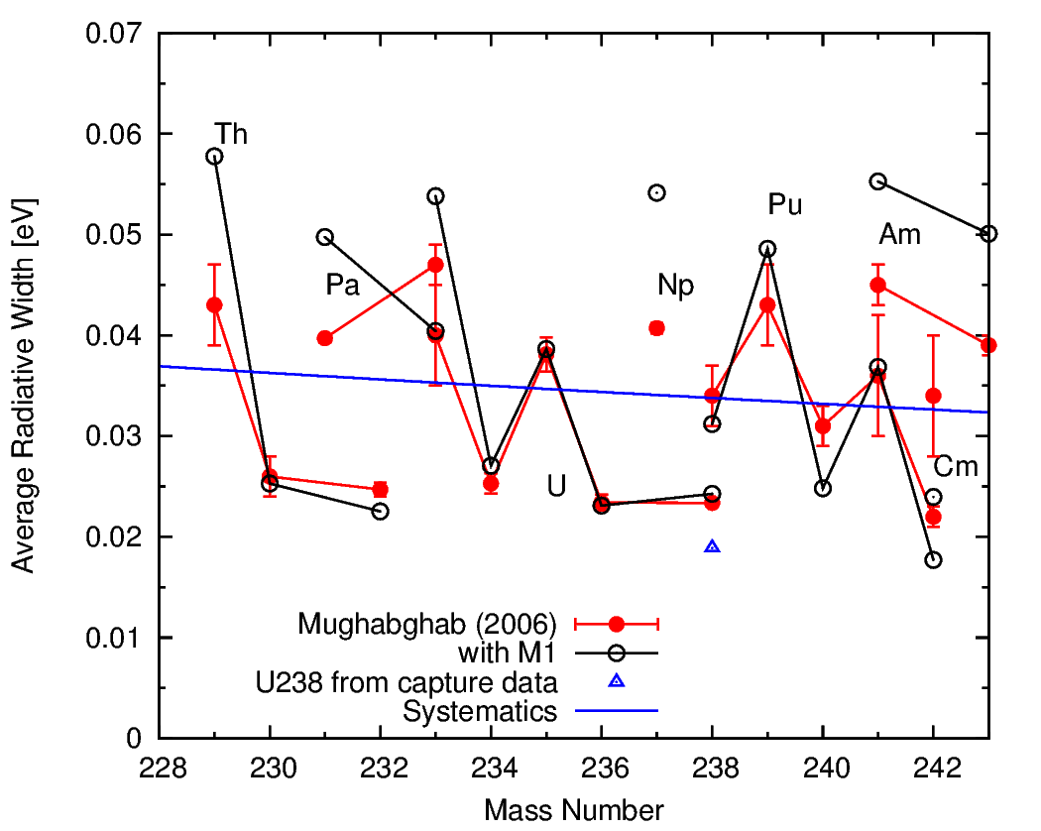
Photon Strength Function and DANCE Data
DANCE detector at LANSCE suggested M1 scissors mode for actinides
Neutron capture cross section strongly enhanced
Estimation of M1 photon strength from evaluated capture cross sections
Capture cross section calculations for more than 100 nuclei in the FP region performed
M1 strength and nuclear deformation studied
Empirical Lorentzian shape for M1 scissors mode obtained
Uncertainty in level density still remains
Plan to perform microscopic level density calculation
With M1, we are able to reproduce
evaluated average photon width

Slide 13
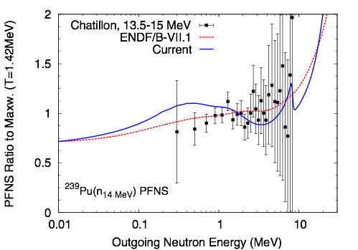
Chi-Nu Array of Fast Neutron Detectors
Detectors designed for fission neutron measurements
22 Li-6 glass scintillation detectors, or
54 liquid scintillation neutron detectors
Preliminary data for out-going neutron energy of below 1MeV obtained
Complementary theory and modeling effort to include pre-fission neutrons
Calculated prompt fission spectrum, including pre-fission neutrons

Slide 14
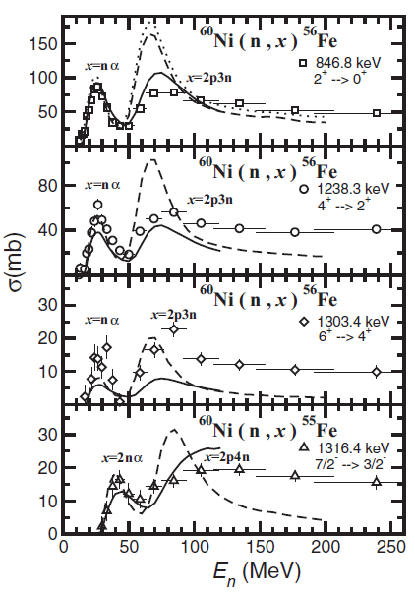
GEANIE Gamma-Ray Production Data
Array of HPGe detectors for measuring gamma-rays with high resolution
Neutron-induced many particle production cross sections studied
Different reaction paths often end up with the same residual nucleus, such as (n,α), (n,n³He), (n,2n2p), (n,2d),….
Partial gamma-ray production data compared with CoH₃ calculations, and PRC paper published
CoH₃ is not so suitable for high energy reactions
Support of high energy reaction data is limited, such as by the isotope production
Additional efforts are needed for detailed analysis of GEANIE data

Slide 15
Measurement | Theory | Compilation | Evaluation | QA (V&V, IE) | Infrastructure (Gforge, etc.)
Freya

Slide 16
Rejuvenating resonance evaluation capabilities in the US
US resonance evaluation capability flagging
L. Leal retired from ORNL, moved to IRSN (France)
S. Mughabghab (BNL) retired for years
ORNL training new evaluator (V. Sobes)
LANL (M. Paris) & LLNL (S. Quaglioni) working on maintaining their capabilities
BNL started own project to both train new evaluator(s) and produce new edition of Atlas (PI: D. Brown)

Slide 17
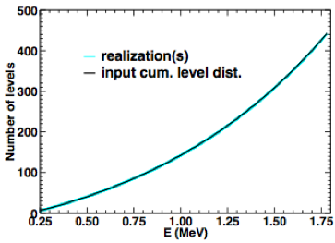
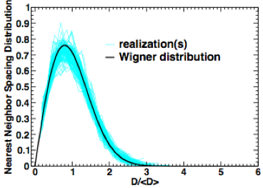
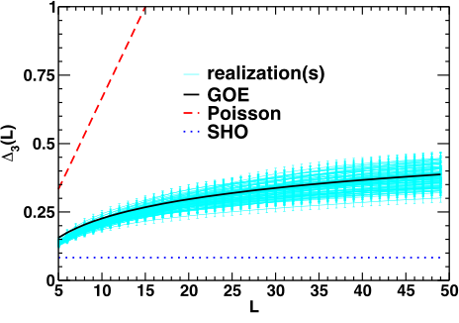
Year 1: develop alternative approach to probability table generation in URR ($50k, NCSP)
Approach #1: Monte-Carlo resonance realizations like NJOY & AMPX
Now generate fully GOE consistent sets, with folding trick to match level densities
Roughly follow approach in T. Kawano, P. Talou, H. A. Weidenmueller, Phys. Rev. C 92, 044617 (2015)
Approach #2: Analytic approximation of P(σ|E) using GOE triple integral
Have analytic expressions for cov(σ_{x,}σ_{y})=<σ_{x}σ_{y}>-<σ_{x}><σ_{y}>
Assume P(σ|E) log-normal or similar
This is “an ambitious program”:
the project will require much more time and effort than NCSP can provide

Slide 18
Measurement | Theory | Compilation | Evaluation | QA (V&V, IE) | Infrastructure (Gforge, etc.)
Freya

Slide 19
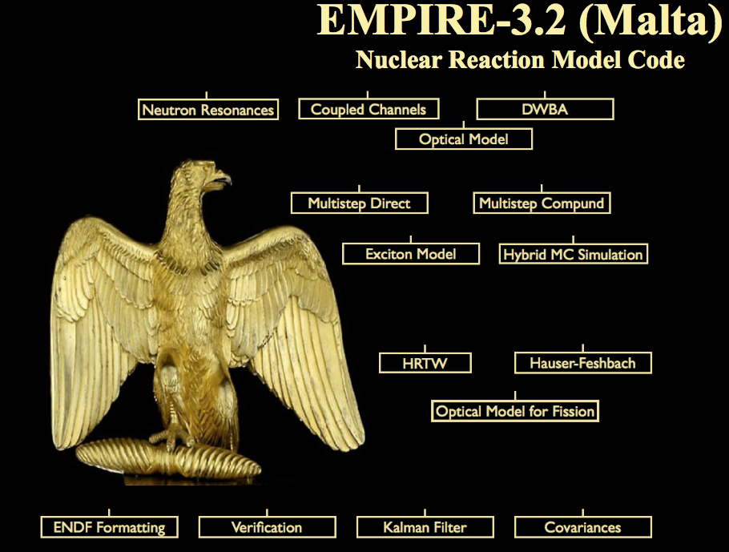
CIELO ⁵⁶Fe evaluation
CIELO dedicated updates in EMPIRE
BB for compound nucleus elastic angular distributions
T_{lj} instead of T_{l}
Moldauer WFF
Kawano’s elastic enhancement factor in HRTW and Moldauer
56Fe evaluation: BNL, ORNL, IAEA, CNDC, IRM, RPI, LANL, JSI collaboration
Exp. data analysis CNDC
Resonance range ORNL
Fast neutron range EMPIRE (BNL, IAEA)
File assembly BNL, IAEA
Testing IAEA, RPI, BNL, LANL, JSI
Two beta releases
Focus on:
Angular distributions
Neutron spectra
Inelastic scattering cross sections
Validation shows sensitivity to
Elastic ang. distributions
Inelastic scattering
Capture on 56Fe and 235U

Slide 20
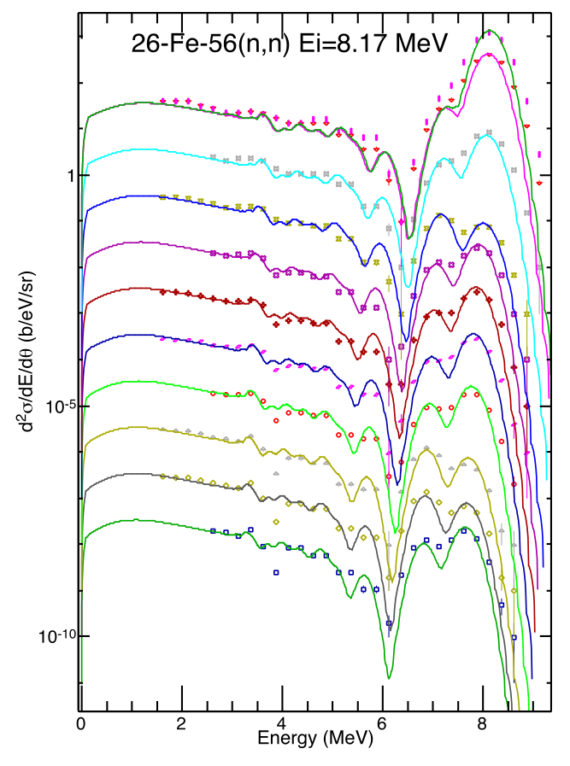
CIELO ⁵⁶Fe evaluation
30
40
50
65
85
95
105
115
130
140
150
Good reproduction of neutron channels
with modest adjustment of proton and
alpha emission

Slide 21
Standards
The Neutron Cross Section Standards have a unique role since they are the basis for most cross section measurements. They provide the foundation for the neutron cross section database
Improvements in a cross section standard lead to improvements in all cross sections that have been measured relative to that standard
It also leads to improvements in cross sections that will be measured in the future relative to that standard
In order to improve the standards, it is essential to maintain an active program of measurements and evaluation activities concerning the standards. This work is supported by the DOE and an IAEA Nuclear Data Development Project “Maintenance of the Neutron Cross Section Standards”.

Slide 22
Future Directions for Neutron Standards

Slide 23
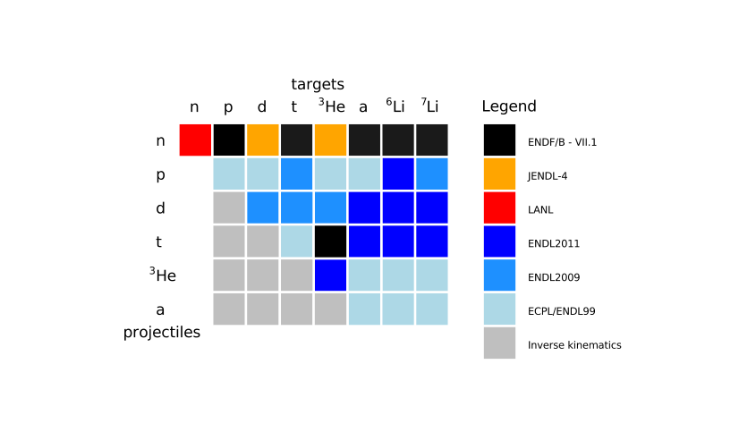
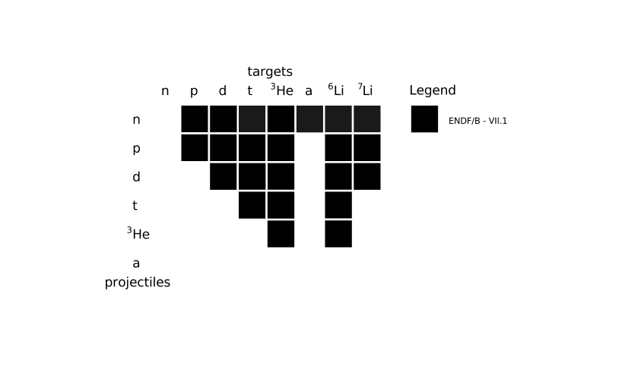
Charged-particle Evaluations for ENDF
LLNL has ~30 evaluations in ECPL useful for next ENDF release
Progress is underway to translate all in figure via GND using fudge
Preliminary translations done, but some fixes needed
Future LLNL/USNDP work will improve these with R-matrix methods
Work with IAEA for reactions on heavier targets, including resonance data
S. Quaglioni is developing breakup methods, to go to higher neutron energies.

Slide 24
Measurement | Theory | Compilation | Evaluation | QA (V&V, IE) | Infrastructure (Gforge, etc.)
Freya

Slide 25
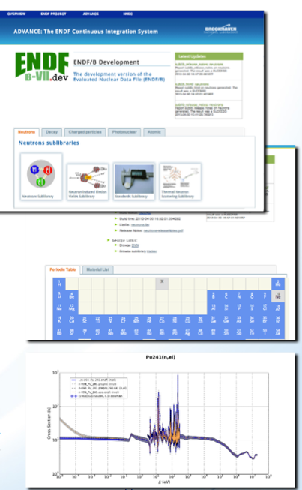
ADVANCE quality assurance system for ENDF
On every commit of every evaluation in ENDF
Check out evaluation
Run through a battery of tests
Process with customer processing codes
Generate comparison plots
Generate HTML report of evaluation
Automation is better!
Find data problems before the customers!
Far faster/better than old PHASE I review
Available at http://www.nndc.bnl.gov/endf/b7.dev/qa/index.html

Slide 26
NEA is now standing up their own continuous integration system
F. Michel-Sendis, WONDER ‘15

Slide 27
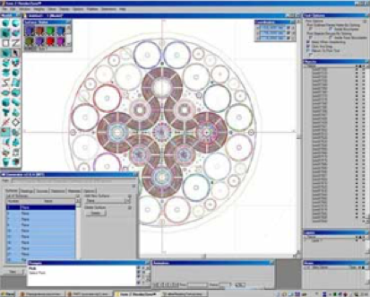
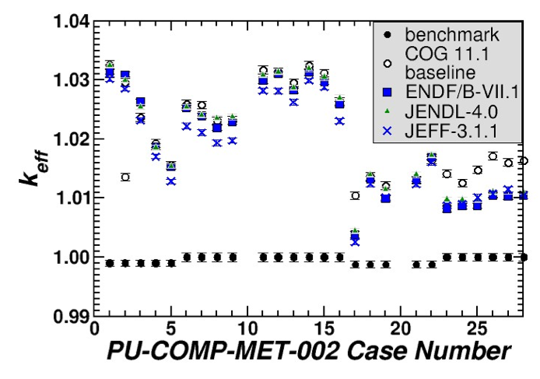
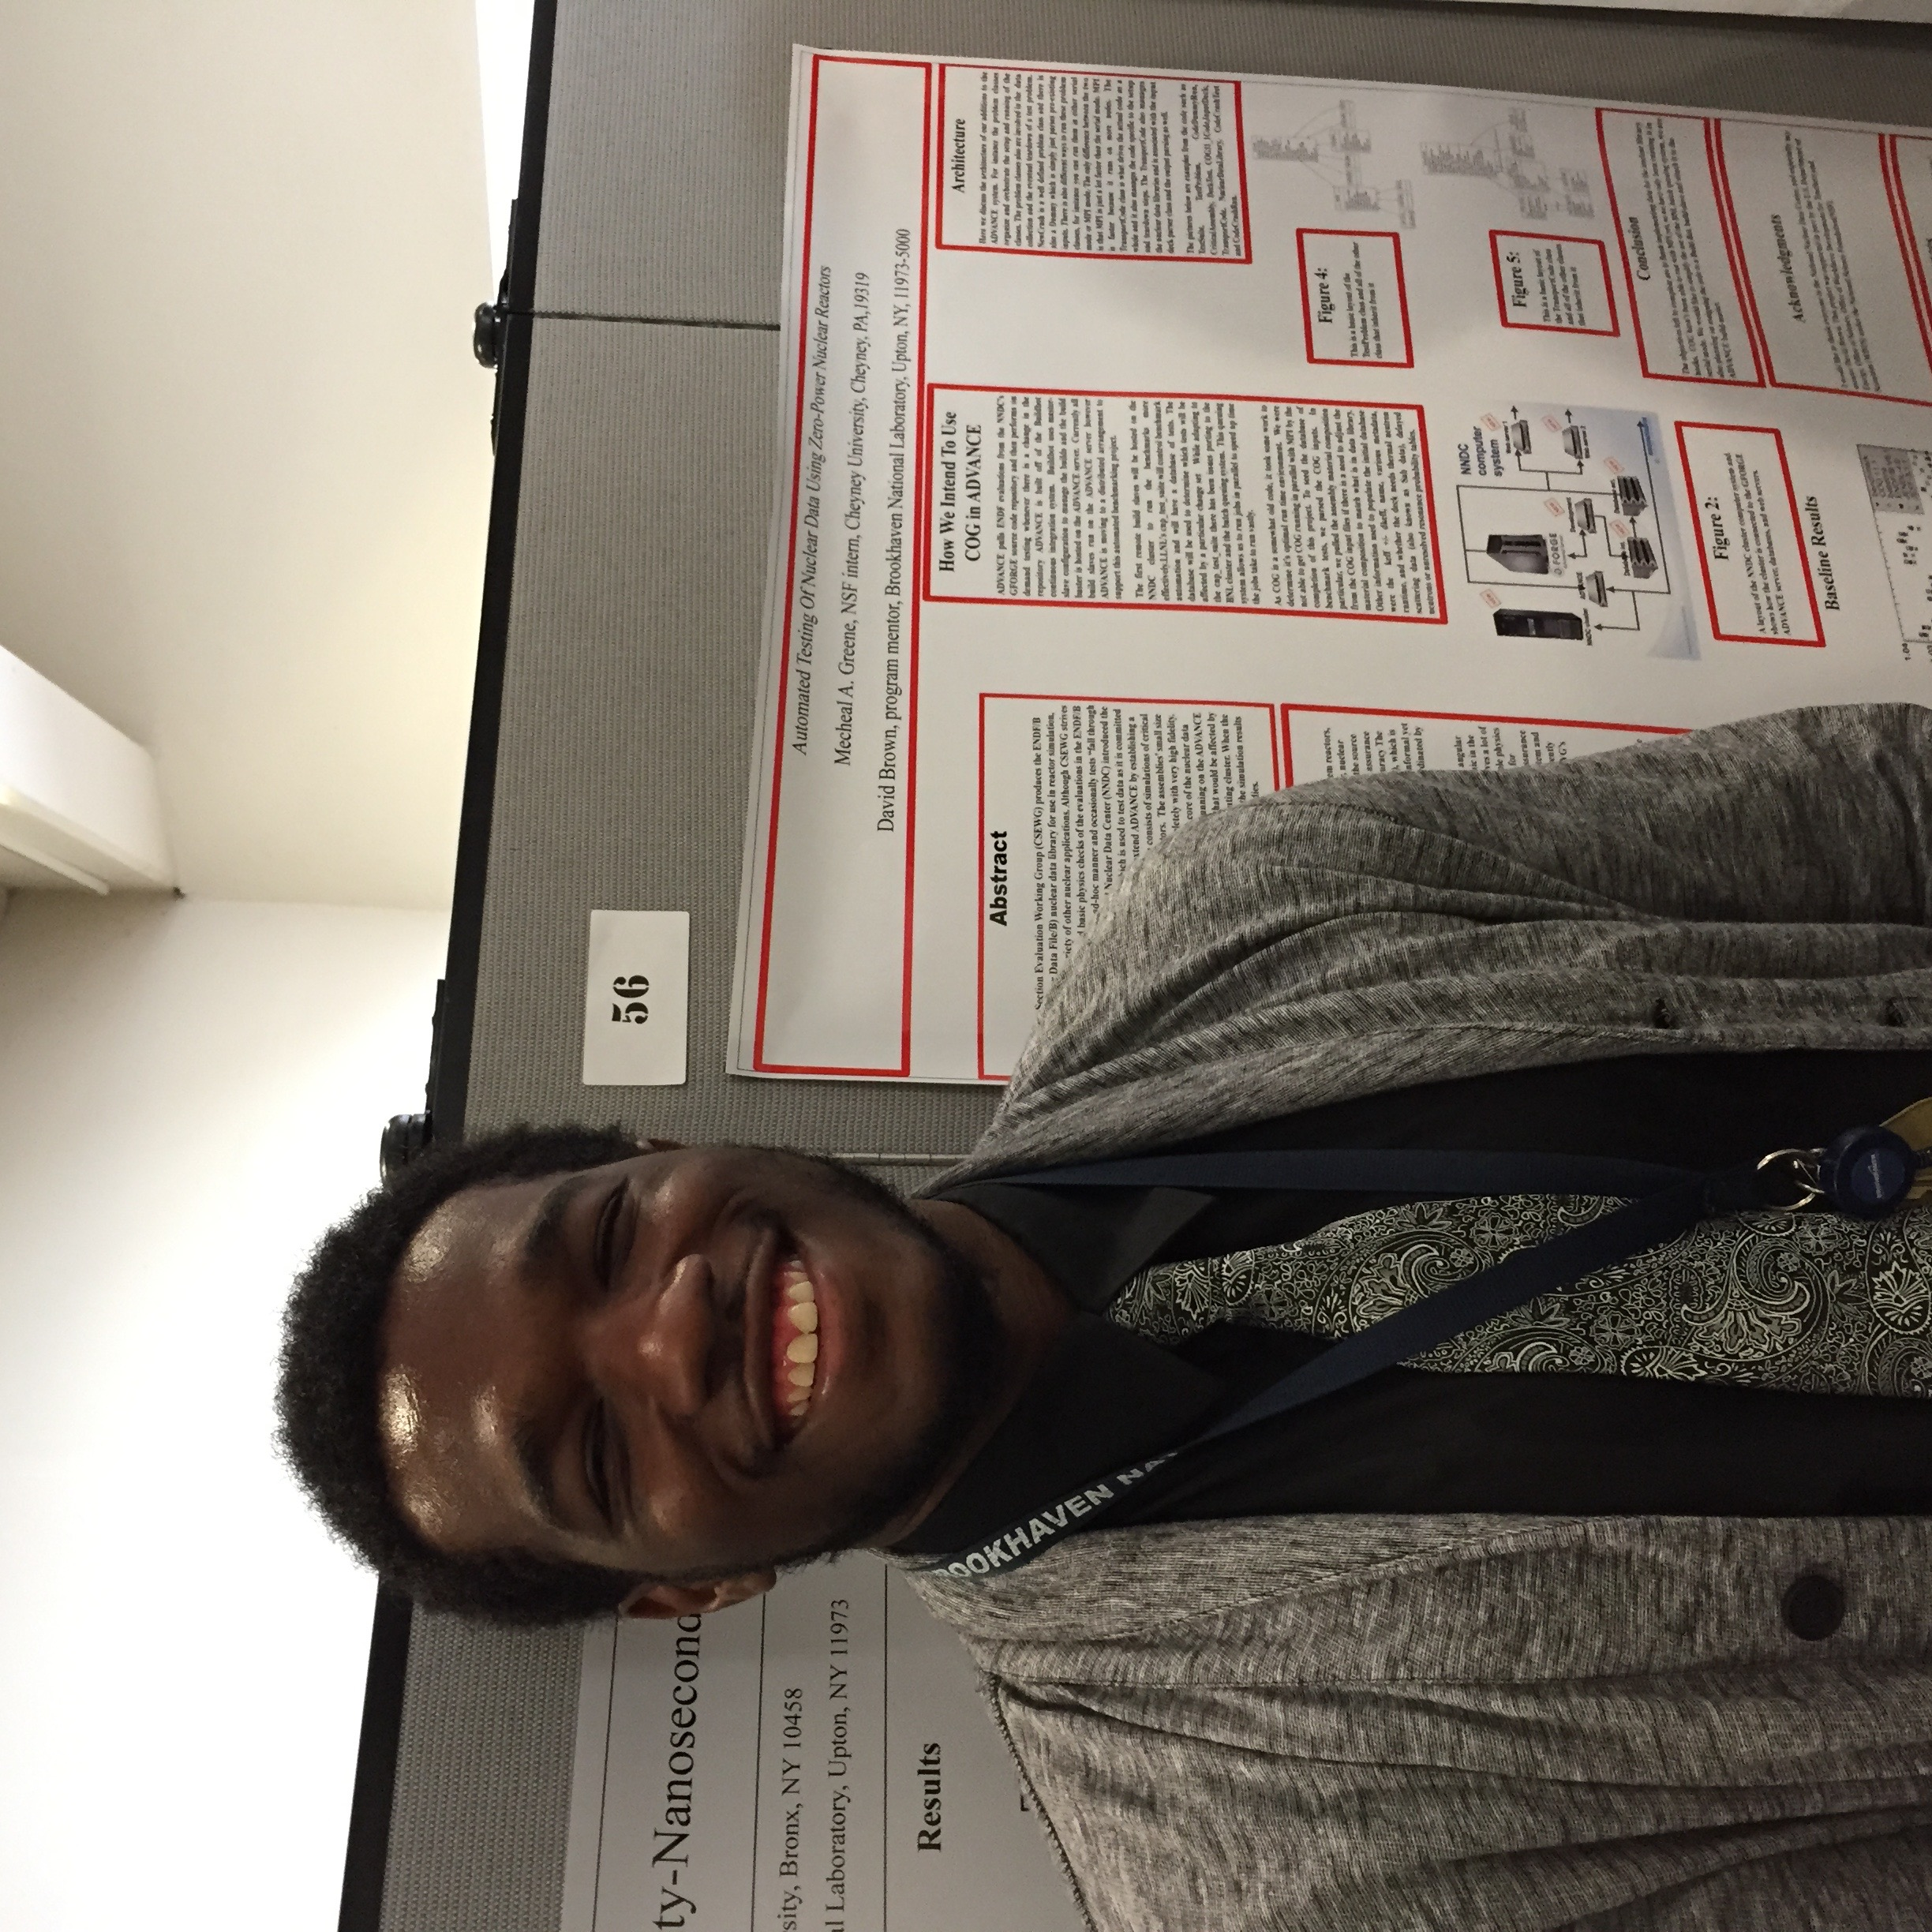
We have begun adding automated benchmarking
M. Greene (Cheney Univ.) began standing up an automated benchmarking capability for ADVANCE
COG (LLNL) wrapped in cnp_test_suite (LLNL)
Built relational database of test decks with 359 HEU cases, 145 Pu cases
Much to do yet
Effort paid by Office of Workforce Development for Teachers and Scientists (WDTS) under the National Science Foundation (NSF)
While main development of ADVANCE is NSCP funded, benchmarking currently unfunded

Slide 28
Measurement | Theory | Compilation | Evaluation | QA (V&V, IE) | Infrastructure (Gforge, etc.)
Freya

Slide 29
Development of Fudge and GND
Current Status
Next Steps
Fudge-4.1 (with GND-1.3) available
Next release (Fudge-4.2 + GND-1.8) early 2016
Implements recommendations from WPEC SG-38
License changed from GPL to BSD
ENDF-to-GND translation supports most of ENDF-VII.1 (not decay sub-library yet)
Supports visualizing data, physics checking, processing for MC and deterministic transport codes
API for transport under development with Mercury team at LLNL.
Early version also implemented in Geant4 (G4LEND package)
currently only supports incident neutrons and photons
Improve handling of thermal neutron scattering
Expand API to handle incident charged particles, thermal neutrons and to support deterministic transport codes
Support ENDF-VIII
apply Fudge testing to improve data quality
make simultaneous release in ENDF-6 and GND
Current estimate of available effort: totals ~1 FTE
B. Beck and C. Mattoon at LLNL, D. Brown at BNL
Main support coming from WCI at LLNL. They understand need to standardize and support broader

Slide 30
Towards a common particle properties format
GND includes a particle dictionary: standard location for masses, spins, levels, decays, etc.
Question raised early on: can ENDF and ENSDF communities converge on a common format for storing particle data?
Major advantage: facilitates integrating new nuclear structure evaluations into reaction evaluations
Needs of ENDF/ENSDF communities are somewhat different
ENDF: focus on ‘complete’ level scheme, need assignments even if experimental data are lacking or contradictory
ENSDF: focus on accurate representation of experiment. Firm assignments are made only when backed by evidence
Tentative conclusion: ENDF/ENSDF particle formats may have common elements, but will likely differ in level of detail.

