Slide 1
JAVA-GAMUT and V.AveLib Update
Michael Birch and Balraj Singh
McMaster University
US-NDP, BNL
Nov 4-6, 2015

Slide 2
Motivation
A necessary and important feature in ENSDF evaluations is to produce a set of recommended values of gamma-ray energies and intensities (or relative branching ratios) for a nuclide. These data are useful in a variety of fields.
Involves consideration of gamma-ray data from different experiments involving radioactive decays and nuclear reactions
Current approach for evaluating data for Adopted datasets:
“Gamma-by-gamma”: Manually take the weighted average of selected set of measurements for each gamma-ray that has been observed
Disadvantages:
Labour intensive, time consuming
Does not account for inconsistencies in energy and efficiency calibrations between experiments
Possible non-uniformity in handling of data by different evaluators

Slide 3
Background – GAMUT
The GAMUT code
Originally ~1983 developed by Richard B. Firestone (LBNL)
Implemented a least-squares gamma-ray fitting procedure for evaluation purposes; also gamma-ray intensity procedure from Tepel and Lederer [IAEA report INDC(NDS)-115/NE, 1980; Priv. Comm.]
Automated evaluation process; flagged outliers; adjusted uncertainties in an iterative manner until acceptable reduced χ2 reached.
Helped correct calibration inconsistencies between experiments
Major drawback: Dated code, no longer supported

Slide 4
Proposed Programme
Develop GAMUT-like code in Java (platform independent)
Step 1: “Gamma-by-gamma” averaging approach including option for user-specified systematic energy shifts to correct for calibration differences between experiments
Step 2: Add algorithms in Firestone’s original code as an alternative method to the “gamma-by-gamma” approach
Need library of averaging methods to use in the gamma-by-gamma” approach
Re-write V.AveLib in Java (to make it available as a stand-alone program on all platforms)

Slide 5
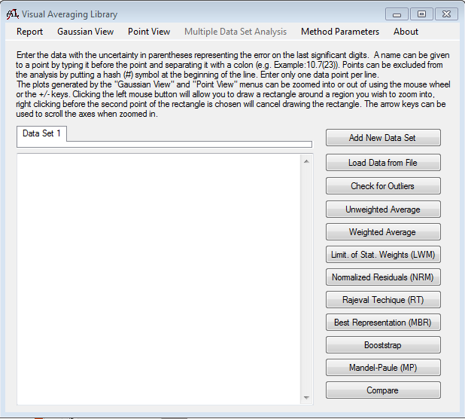
Background – V.AveLib
The Visual Averaging Library (V.AveLib)
Originally developed by Michael Birch
Implements 8 averaging techniques; 3 outlier detection methods
Graphical interface with visualization features
Current major drawback: available for Windows only (hence need for re-development in Java)

Slide 6
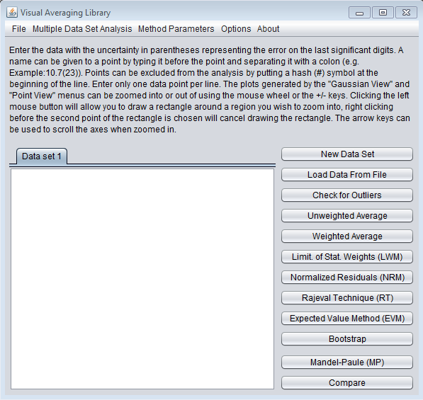
Progress So Far…
V.AveLib (JAVA):
All averaging and outlier methods are functional
Graphical interface is fully functional except for the data plotting feature (work in progress)
New: Asymmetric uncertainties handled now using R. Barlow’s approach.
Work on “gamma-by-gamma” automated averaging routine is completed.

Slide 7
Progress
J-GAMUT Development:
Averaging (to be used in “gamma-by-gamma” approach); i.e. V.Ave.Lib
Parsing ENSDF file for gamma and level data, match gamma rays measured in different datasets
Output data into an editable intermediate format for evaluator
Using (edited) data in intermediate file to obtain adopted values using “gamma-by-gamma” averaging and output result in ENSDF format to include in Adopted data set
Using (edited) data in intermediate file to obtain adopted values using the original GAMUT algorithms and output result in ENSDF format to include in Adopted data set

Slide 8
JAVA-GAMUT
Some comments received at the IAEA-ENSDF-Codes meeting in October 2015. Work is in progress on these.
Beta version will be made available to the network at the end of Nov 2015 for comments, suggestions, improvements, etc.
Michael Birch’s work on this code supported by IAEA-NDS with a contract from Sept 2014 to Sept 2015.
Thanks to LBNL/UCB group for hosting Michael’s visit to LBNL for ten days to have consultations with Rick Firestone on GAMUT formalism

