Slide 1



Highlights and Summary of the
Nuclear Data Needs and Capabilities for Application Workshop 2015
(NDNCA)
L.A. Bernstein
Nuclear Data Week
BNL
November 4, 2015
LLNL-PRES-678764
This work was performed under the auspices of the U.S. Department of Energy by Lawrence Livermore National Laboratory under contract DE-AC52-07NA27344 and Lawrence Berkeley National Laboratory under contract # DE-AC02-05CH11231.

Slide 2
The workshop was rooted in the recent review of the US Nuclear Data Program (USNDP)
In July 2014 the first review in ≈20 years of the US Nuclear Data Program (USNDP) was performed
The review called for a “targeted experimental” component of the USNDP to “address deficiencies”
Another recommendations was to “Develop mechanisms to assess community data needs.”
This led to the call for a workshop: Nuclear Data Needs and Capabilities for Applications (NDNCA)
The workshop was co-sponsored by the DOE-NP (LBNL-NSD) and NNSA/NA-22 (UCB-Nuclear Science & Security Consortium) to exploit the unique intersection between basic and applied nuclear science in the Bay Area.
All talks are at https://bang.berkeley.edu/events/NDNCA/agenda

Slide 3
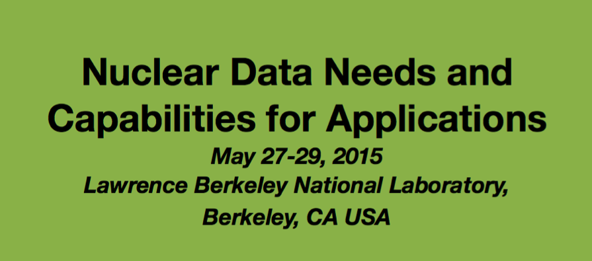
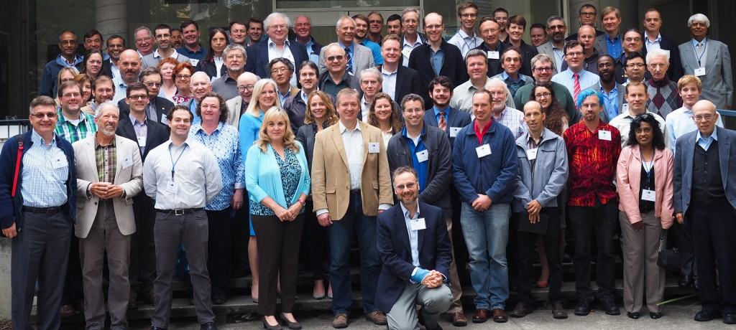

The NDNCA Workshop – LBNL, May 27-29, 2015
101 Participants and registrants from 30 institutions
Days 1 & 2 features plenary talks on:
  The US Nuclear Data Program (1)
  Nuclear Energy/Dosimetry Data Needs (5)
  National Security Data Needs (6)
  Isotope Production Data Needs (4)
  Capabilities/Facilities (8)
Day 3: Topical breakout sessions

Slide 4
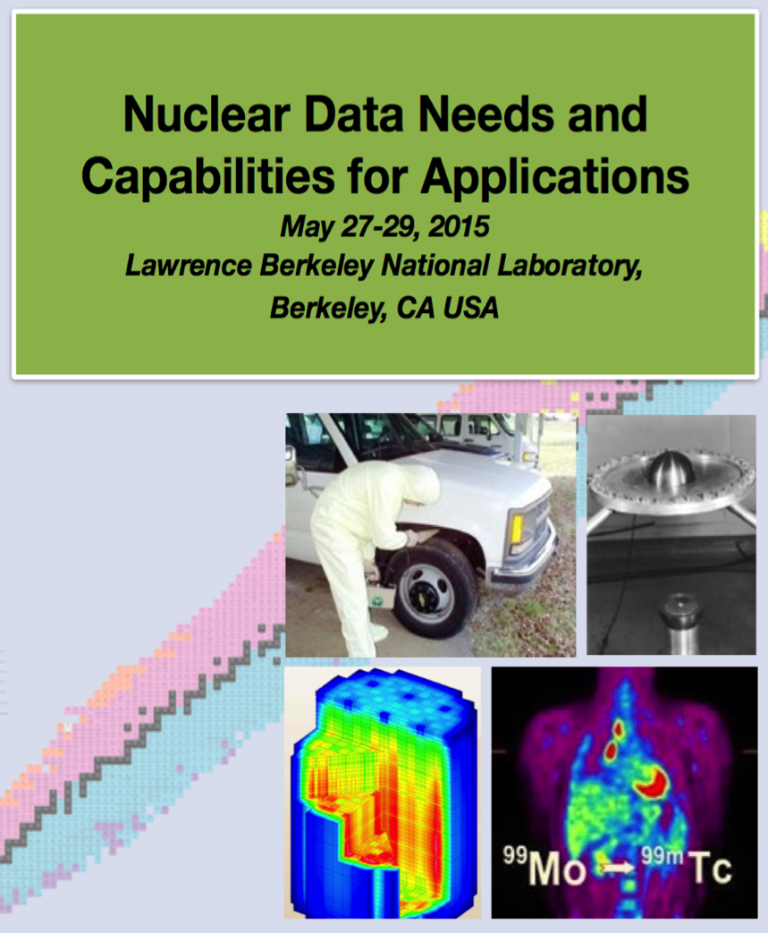
The results of the workshop and a survey of the needs from current literature can be found in the NDNCA whitepaper
http://bang.berkeley.edu/events/NDNCA/whitepaper
4

Slide 5
The main body of the whitepaper presents “Cross-cutting” needs important to multiple applications
Executive summary
“In summary, the assessment of this Workshop was that although the USNDP can help address the problem of making the most accurate nuclear data available to the (application) users in a timely fashion, it cannot solve this problem alone.”
Cross-cutting needs
Dosimetry Standards
“standards for E_{n} up to 60 MeV to support IFMIF, ADS, and spallation sources”
Fission
“the ‘Mother of All Fission Experiments,’ where TKE(A), ν, γ’s fragment yields for a range of Actinides for E_{n}=thermal-20+ MeV”
Decay Data & γ−Branching Ratios
“The IAEA has prioritized decay data needs of certain medical isotopes”
Neutron Transport Covariance Reduction
“Large uncertainties in … Actinide cross (n,x) sections… especially from 1-500 keV”
Expanded Integral Validation
“More semi-integral data (e.g., pulsed sphere) to diagnose (n,n_{el}), (n,n_{inel}) shortcomings ”
Antineutrinos from Reactors
“New data for ^{235,238}U and ^{239,241}Pu…fission yields for odd-odd nuclei and β-spectral measurements”

Slide 6
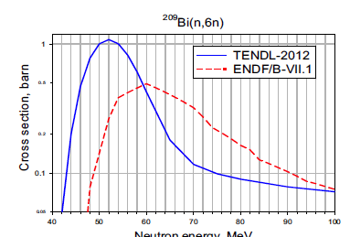
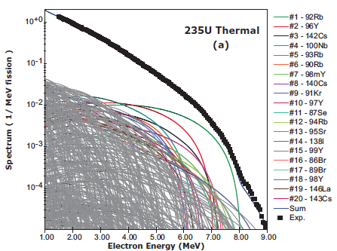
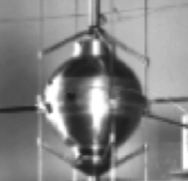
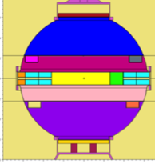
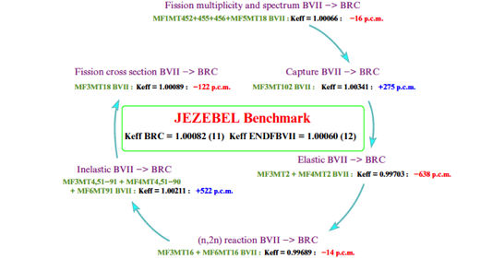
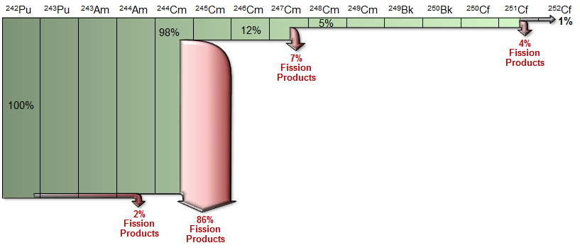
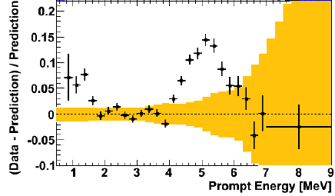
A major workshop “take-away” was that many nuclear data needs are “cross-cutting” across multiple applications
Dosimetry standards
A deeper understanding of nuclear fission
Decay data and gamma branching ratios
Targeted covariance reduction in neutron transport
Expanded integral validation
Antineutrinos from nuclear reactors
²⁵²Cf production
Collaboration between different nuclear data users is a “no brainer”

Slide 7
The whitepaper includes 4 appendices to help facilitate the prioritization and planning
Appendix A: Matrix of Nuclear Data Needs
  Tabular description of 79 distinct data needs to aid in prioritization and planning (described in the next slide)
Appendix B: Nuclear Reaction Data Needs
  Comprehensive listing of all of the reaction data needs enumerated in the workshop
Appendix C: Historical Perspective
  How we got to where we are
Appendix D: Capabilities (facilities)
  Detailed description of 17 major nuclear research centers in the US (domestic only)

Slide 8
Cross-cutting needs were compiled into a series of matrices* that reflect the overlap between different application areas
Matrix A.1: National Security + Counter-Proliferation + Nuclear Energy
Matrix A.2: National Security + Counter-Proliferation + Isotope Production
Matrix A.3: National Security + Nuclear Energy + Isotope Production
Matrix A.4: National Security + Counter-Proliferation
Matrix A.5: Counter-Proliferation + Nuclear Energy
Matrix A.6: Nuclear Energy + Isotope Production
Matrix A.7: National Security + Isotope Production
Matrix A.8: Single Area Nuclear Data Needs
Nuclides and Topic | Nuclear Data Need
¹⁶O: CIELO high-priority nucleus. Improved evaluated nuclear data needed to create accurate ENDF-formatted files for general purpose transport applications, e.g., criticality, shielding, and activation. | Discrepancies of up to 30% in both measured and evaluated ¹⁶O(n,γ) are problematic for fission applications. These discrepancies impact criticality predictions for reactors, and helium production rates. New measurements are needed in the 2.5-20 MeV region to reduce uncertainties to within 5-10%.
79 distinct needs were identified and tabulated
*Thanks to Cathy Romano (NA-22/ORNL) for the matrix concept
and A.M. Hurst for the initial compilation

Slide 9
The whitepaper made a set of specific recommendations
Regular (bi-annual) repetition of the meeting
  Ensure that improvements are taken into account and new needs are added
Creation of a “Super” High-Priority List (S-HPRL)
  Modeled after the nuclear energy HPRL where experts review needs and look for connections between different application areas
National Academy Review
  Expert impartial panel review of nuclear data needs across the entire application space
We also continue to reach out to the communities
(APS/DNP 2015 mini-symposium, ANS 2015 Winter Meeting)

Slide 10
There’s no way to cover a representative sample of the material presented at the workshop in the time we have for this talk
Dosimetry
  Neutron standards - Allan Carlson
Isotope Production – Caroline Nesaraja
Reactor Antineutrinos – Alejandro Sonzogni/Libby McCutchan
Neutron transport uncertainties - LAB
I’ll return at the end with a wrap-up
and discussion of the path forward

Slide 11
Allan Carlson

Slide 12
Allan Carlson

Slide 13


Isotope Production – Medical Applications (S.M. Qaim)
Caroline Nesaraja
Aim
Provide database for optimum production and application of radionuclides
- remove discrepancies in existing data
- search alternative production routes of established
radionuclides
- develop novel radionuclides
Areas of work
Experimental measurements
Nuclear model calculations
Standardisation and evaluation of data

Slide 14
Nuclear data research needs –(S.M. Qaim)
Caroline Nesaraja
Types | Nuclear Data Needs | Comments
Charged Particle reactions | Strengthen database | Evaluate existing data and validate evaluated data through integral measurements
High Energy Photons | Extensive effort needed to improve database | Limited application to medical isotope production
Fast Neutron Induced Reactions | Data needs are extensive | Fast neutron spectral sources need to be developed for medical radionuclide production

Slide 15
Qaim’s summary and conclusion
Caroline Nesaraja
Radionuclide production technology is rapidly progressing.
Accurate knowledge of nuclear data is absolutely necessary for production and application of radionuclides in medicine.
Nuclear data needs are more stringent in accelerator production of radionuclides than in reactor production.
Constant nuclear data research is necessary to meet changing trends in medical applications.
Future needs of production data will be related to extensive use of intermediate-energy charged particle accelerators, some selective use of high-intensity photon generators, and enhancing use of spallation neutron sources.
Notes:
15

Slide 16
Medium Energy Radionuclide at LANL- Engle
Caroline Nesaraja
Iso-tope | Half-life | Main Use
⁸²Sr | 25.5 d | Parent of ⁸²Rb used in cardiac perfusion studies with PET
⁶⁸Ge | 270 d | Parent of ⁶⁸Ga being tested for diverse PET applications
²²Na | 2.6 a | PET isotope used as a tracer and sources material
³²Si | 153 a | Environmental tracer; produced in partnership w/ TRIUMF
⁷³As | 80.3 d | Tracer for toxicology studies
¹⁰⁹Cd | 462.6 d | Source for X-ray fluorescence
²²⁵Ac | 10 d | Alpha emitter used in cancer therapy clinical trials
^{186g}Re | 90.6 h | Bone pain palliation, cancer therapy
⁴⁴Ti | 58.9 a | Generator for PET isotope ⁴⁴Sc
²³⁶Np | 1.5 x10⁵ a | Standard for Np quantification by IDMS
¹¹⁹Sb | 38.5 h | Auger emitter for cancer therapy
Nuclear Excitation Functions needed
Predict yields and impurities
Guide target design
Useful for codes and models

Slide 17
Proposal: J. Engle and L. Bernstein
Nuclear Excitation Functions with fast neutrons
Caroline Nesaraja
S.M. Qaim
d/Be beak-up and spallation neutrons could be advantageously used for radionuclide production, especially for neutron threshold reactions
Fast neutron spectral sources need to be developed for medical radionuclide production; data needs are extensive
NSAC
Neutron irradiations at ten to hundreds of MeV are expected to produce radionuclides, among them several prioritized by the recent DOE commissioned report
Activation based cross section measurements to aid in the production of radionuclides for medical applications with Berkeley’s 88” cyclotron using the ⁷Li(p,n)⁷Be reaction

Slide 18
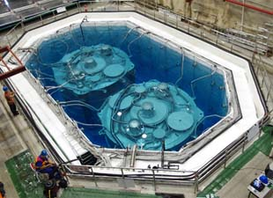
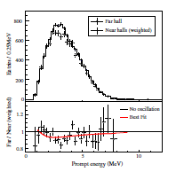
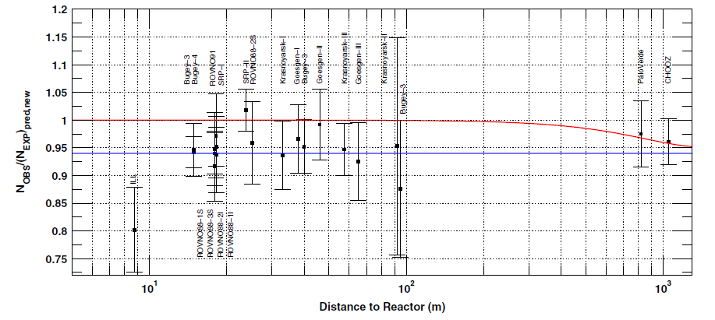
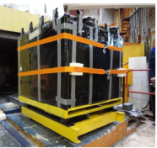
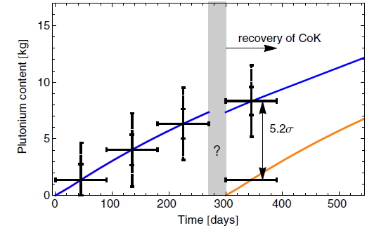

Antineutrinos from reactors
Alejandro Sonzogni
A “hot” topic …
Reactor Anomaly
Daya Bay/RENO
Applications
Physics beyond the standard model
4th sterile neutrino
Non-proliferation
New results for θ₁₃
E. Christensen et al.,
PRL 113, 042503 (2014)
F.P. Ann et al., PRL 108, 171803 (2012)
G. Mention et al., PRD 83, 073006 (2011).

Slide 19
Alejandro Sonzogni
Reactor Antineutrinos Data Needs:
New measurements of the electron spectra following fission for the 4 main fuel component nuclides, ²³⁵U, ²³⁸U, ²³⁹Pu, and ²⁴¹Pu, to confirm the Institut Laue-Langevin (Grenoble, France) data.
New fission yield measurements, in particular for odd-Z, odd-N nuclides with two long-lived levels of low and high spin.
Precise measurements of beta intensities for some 20-30 relevant nuclides.

Slide 20
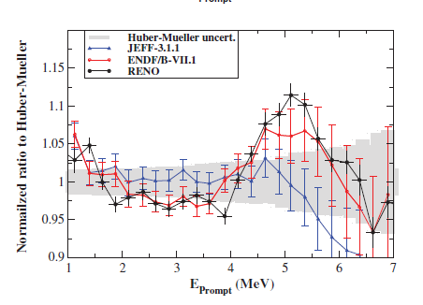
Alejandro Sonzogni
Example of Fission Yields Issues
The JEFF (blue line) and ENDF/B (red line) lead to different antineutrino spectrum for thermal neutrons on ²³⁵U, which is the dominant source in power reactors.
A.C. Hayes et al, Phys. Rev. D 92, 033015 (2015)

Slide 21
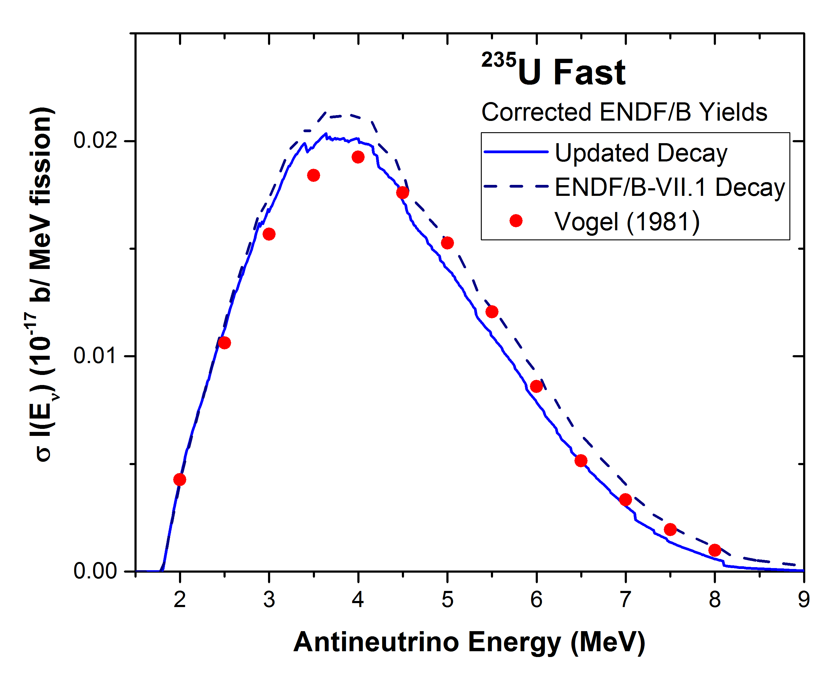
Example of TAGS effects
Alejandro Sonzogni
HEU reactors, ²³⁵U contributes most of the fission.
Needed for future experiments pursuing the anomaly, such as PROPSPECT at ORNL.
Currently, it can only be obtained by summation.
Incorporate TAGS results.
Significant differences in the shape with 1981 values.
TAGS data make a big difference.

Slide 22
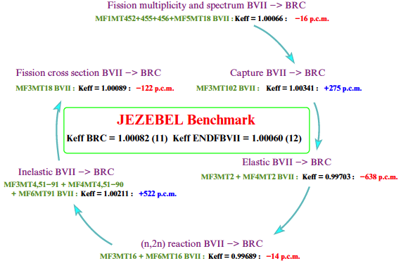
Highlight #1 from the NDNCA whitepaper:
Compensating Errors in the Jezebel k_{eff}
Eric Bauge [39] reported on an analysis where components of the Bruyères-le-Châtel (BRC) ²³⁹Pu evaluation were replaced with those from ENDF/B-VII.1. At each step in the replacement process, k_{eff} of the Jezebel critical assembly was computed. While both the BRC and ENDF/B-VII.1 give the same k_{eff} for Jezebel, they do so for very different reasons. This replacement study shows how different parts of the evaluation substantially shift the reactivity of Jezebel. We do not know if either evaluation is “correct” but both get the “correct” answer.
-16 p.c.m.
-122 p.c.m.
+275 p.c.m.
-638 p.c.m.
+522 p.c.m.
-14 p.c.m.
*E. Bauge et al., Eur. Phys. J. A (2012) 48: 113
We do not know if either evaluation is “correct” but both get the “correct” answer.

Slide 23
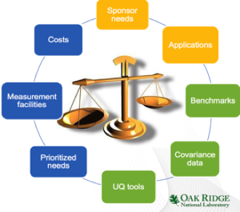
Highlight #2 from the NDNCA whitepaper:
ORNL Isotope Uncertainty Quantification
Many isotope production processes involve multiple neutron captures with associated combined uncertainties make it difficult to establish which reaction rates are the most important limiting factors in production.
ORNL is accordingly developing high fidelity sensitivity and uncertainty analysis tools capable of assessing the importance of energy-dependent cross sections, in determining reaction rates and their ratios.
This work relies on accurate covariance estimates and heavy-actinide data.
These tools could be incorporated ORIGEN (in development) to analyze the effects of energy dependent cross sections on isotope yields providing a powerful tool for identifying and prioritizing isotope production nuclear data needs

Slide 24
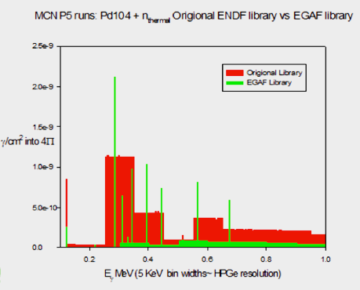
Highlight #3 from the NDNCA whitepaper:
Neutron Capture Gammas
The Evaluated Gamma-ray Activation File (EGAF) project was initiated and led by LBNL through the USNDP in collaboration with an IAEA CRP to provide improved gamma-ray cross sections for over 260 isotopes from capture-gamma measurements using natural targets of all stable elements.
For many elements only data for the isotopes with the largest cross sections and/or abundances could be obtained with natural targets leading to many gaps and inadequacies inherent in the EGAF database as currently constructed.
This was highlighted recently by a recent study of W isotopes in collaboration with Global Security at LLNL where isotopically-enriched cross section measurements were found to differ considerably from those in the current EGAF database.

Slide 25
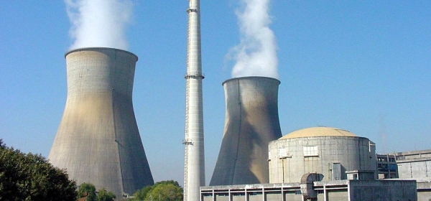

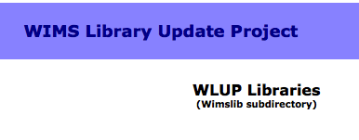
Highlight #4 from the NDNCA whitepaper:
The need for up-to-date nuclear data
March 10, 2004, Kakrapar Atomic Power Station Unit 1 (KAPS-1) in Gujarat, India
An incapacitation of reactor regulating system, led to an unintended rise in reactor power from 73% to ≈100% full power.
The slow rise overpower transient could not be explained by the Design Manual (DM)
The DM was based on the 27 group WIMS1971 (Winfrith Improved Multi-group Scheme) library.
The Indian Atomic Energy Regulatory Board shut down KAPS until incident was understood. The 2005 release of the WIMS nuclear library provided an explanation and brought the plant back into operation (S. Ganesan, 2005).
Sometimes the problem is in the way the data is processed

Slide 26
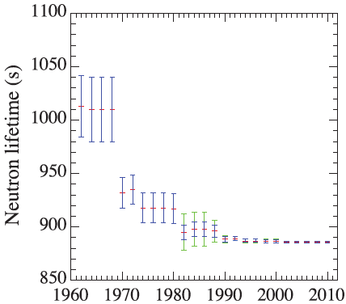
Morgan White (LANL) eloquently described the dangers of experiment - “The Data Dilemma”
If you don’t have data, you get to make it up
If you have one data set, it must be correct
If you have two data sets, they are both wrong
  And everyone is just going to pick their favorite
When you have many data sets, you get to make it up again
3% error followed by 3-sigma shift
1% error followed by 3-sigma shift
It’s not enough to make the most accurate measurement since it will be viewed within the historical context
We must understand all systematic errors.

Slide 27
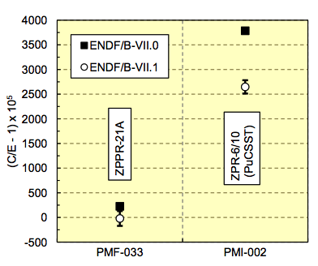
Specific example: Actinide data deficiencies are bigger at intermediate (1-500 keV) rather than thermal or fast E_{n}
They involve more scattering, a more complex transport, and are more sensitive to inelastic, elastic, reactions
Neutron-incident reactions in the 1-500 keV region are often less well understood, e.g. actinide capture, inelastic scattering
Reaction rates (fission, n2n, …) modeled more poorly here too
80% fissions>100 keV
33% fissions>100 keV
Ratio to ²³⁵U(n,f)
Reaction | “Pure” Fast | Intermediate
²³⁸U(n,f) | 1.030(51) | 0.832(42)
²³⁹Pu(n,f) | 1.039(52) | 0.985(49)
²⁴¹Am(n,f) | 0.914(46) | 0.784(39)
²³⁶U(n,f) | 0.922(46) | 0.672(34)
MCNP calcs with As-Built models for Pu metal
FAST and INTER ZPR/ZPPR Assemblies
Thanks for Mark Chadwick (LANL)

Slide 28
Part of the problem is that most experimental facilities have focused on thermal and hard neutrons
The workshop included a comprehensive review of experimental facilities capable of measuring high-priority nuclear data needs

Slide 29
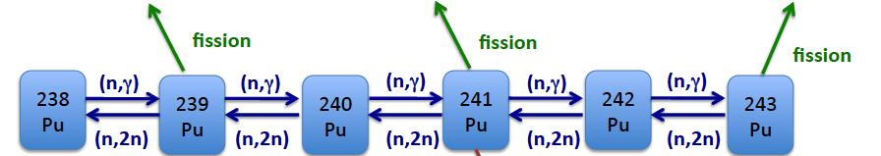
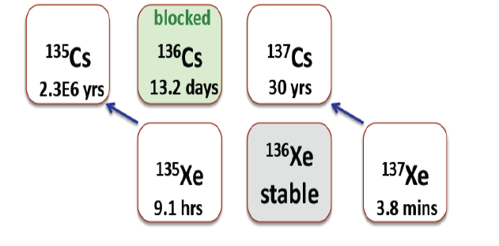
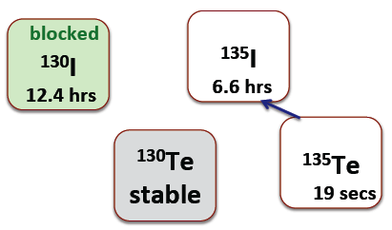
Anna Hayes highlighted the importance of actinide and fission fragment ratios for nuclear forensics
Separate key actinides and measure their isotopic ratios by mass spec.
Actinides provide the most detailed information, but they are slower to yield data due to difficult U and Pu chemistry
Shielded fission fragments offer a faster alternative
Fission type | ¹³⁶Cs | ¹³⁷Cs | ¹³⁰I | ¹³⁵I
²³⁵U 1 MeV | 2.05 | 1.003 | 0.08 | 1.0
²³⁵U 14 MeV | 45.4 | 1.015 | 138 | 0.78
²³⁹Pu 1 MeV | 22.7 | 1.03 | 20.8 | 1.02
²³⁹Pu 14 MeV | 164 | 0.905 | 655 | 0.68

Slide 30
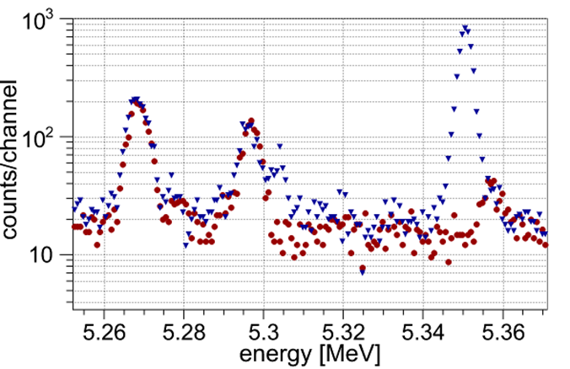
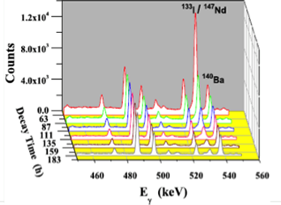
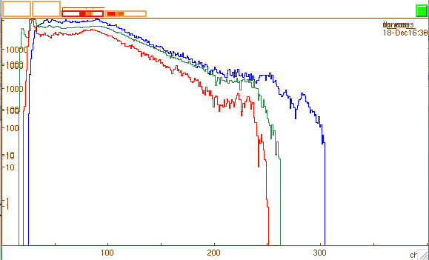
ENDF’s lack of energetic γ-ray data limits actinide & fission fragments diagnostic (Brad Sleaford)
Primary ²³⁷Np capture
line at 5.35 MeV
Even low-resolution
γ-rays can differentiate actinides
The LBNL group is addressing this need for (n_{th},γ) and (n,n’γ)
U
Th
Pu
Fission product decay γ-rays

Slide 31
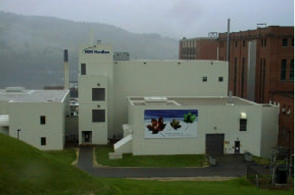
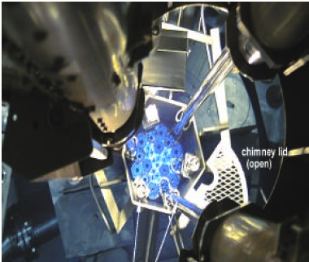
What happens when you ignore hidden compensating errors in nuclear data: The Maple reactor fiasco
The Maple reactors were dedicated medical isotope production reactors fueled with LEU using HEU targets
AECL discovered that the reactor had a positive power coefficient of reactivity in June 2003.
This behavior was deemed by the Canadian Nuclear Safety Commission to be a safety issue.
AECL engaged the services of organizations such as BNL, INL, and INVAP, from 2005 to 2008 to identify the cause of the discrepancy.
The cause was never determined and in May 2008,
AECL discontinued the project.
Following this decision, AECL was served with a $1.6 billion lawsuit against for breach of contract.
If you don’t have good data you’ll always have to watch your back

Slide 32
Fast Neutron Induced Reactions (S. Qaim)
Fission neutrons extensively used for medical radionuclide production.
Special data needs will always arise.
d/Be beak-up and spallation neutrons could be advantageously used for radionuclide production, especially for neutron threshold reactions
cf. Spahn et al., RCA 92, 183 (2004); Al-Abyad et al., ARI 64, 717 (2006)
Examples: βˉ emitters
Some α-emitting radionuclides, such as ²²⁵Ac, ²²³Ra, ²²⁷Th, etc. can also be produced using spallation neutrons
Spallation neutrons could be used to induce fission of ²³²Th or ²³⁸U to produce ⁹⁹Mo (avoid criticality problem)
Fast neutron spectral sources need to be developed for medical radionuclide production; data needs are extensive.
³²S(n,p)³²P; ⁴⁷Ti(n,p)⁴⁷Ca, ⁶⁴Zn(n,p)⁶⁴Cu; ⁶⁷Zn(n,p)⁶⁷Cu; ⁸⁹Y(n,p)⁸⁹Sr;
¹⁰⁵Pd(n,p)¹⁰⁵Rh; ¹⁴⁹Sm(n,p)¹⁴⁹Pm, ¹⁵³Eu(n,p)¹⁵³Sm,
¹⁵⁹Tb(n,p)¹⁵⁹Gd; ¹⁶¹Dy(n,p)¹⁶¹Tb; ¹⁶⁶Er(n,p)¹⁶⁶Ho; ¹⁶⁹Tm(n,p)¹⁶⁹Er;
¹⁷⁵Lu(n,p)¹⁷⁵Yb; ¹⁷⁷Hf(n,p)¹⁷⁷Lu, and several other reactions

Slide 33
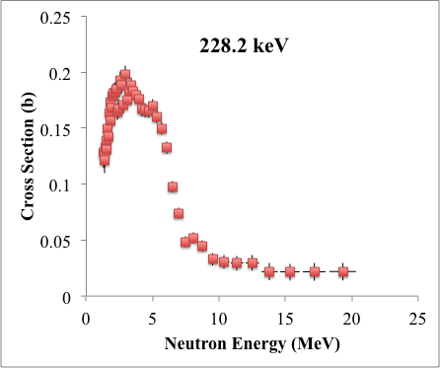
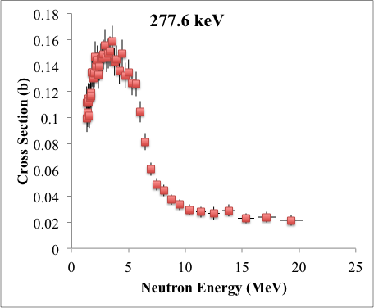
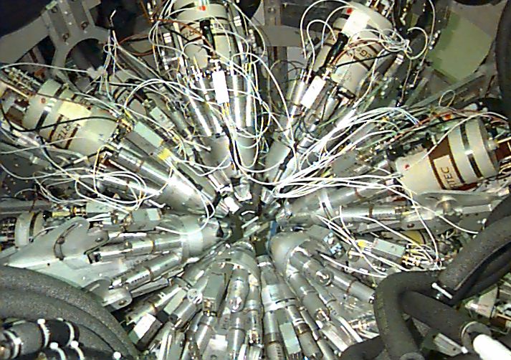
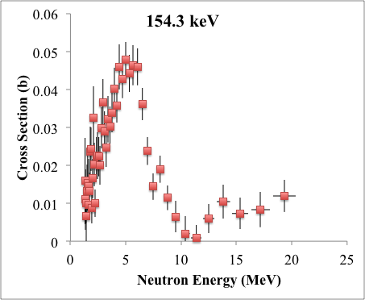
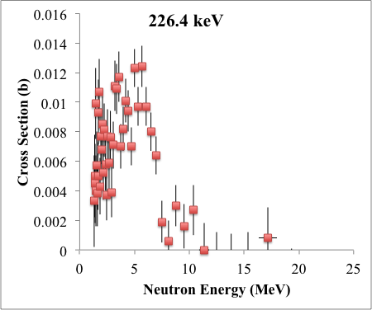
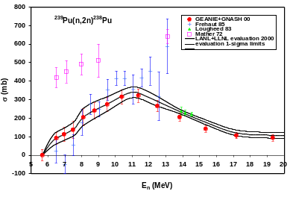
We have started an effort at improving neutron transport data by revisiting (n,n’γ) data taken at GEANIE
GEANIE (nee HERA)
@ LANSCE/WNR
²³⁹Pu(n,n’γ)
²³⁹Pu(n,n’γ)
²³⁹Pu(n,n’γ)
²³⁹Pu(n,2n)
²³⁹Pu(n,n’γ)

Slide 34
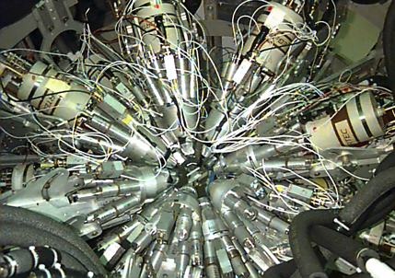
Our work on improving neutron transport data includes revisiting ²³⁹Pu(n,n’γ) GEANIE data (Thanks to Toshihiko Kawano – LANL)
GEANIE @ LANSCE/WNR
Hi Lee,
IAEA is working on compiling your Pu239 data. The original EXFOR entry 13787 has (n,2n) only, but adding your inelastic and (n,3n) gamma production data.
They need your approval before make it online. Could you check the first attachment, esp. SUBENT 13787004 and 5?
I believe these numbers should not have any problems, as
they were scanned from your report. But the header part is important.
And, you should report this to USNDP, saying "Important Pu experimental data were made available to the nuclear data community through a nuclear-data-archaeologist, Naohiko Otsuka of IAEA."
Cheers, Toshihiko

Slide 35
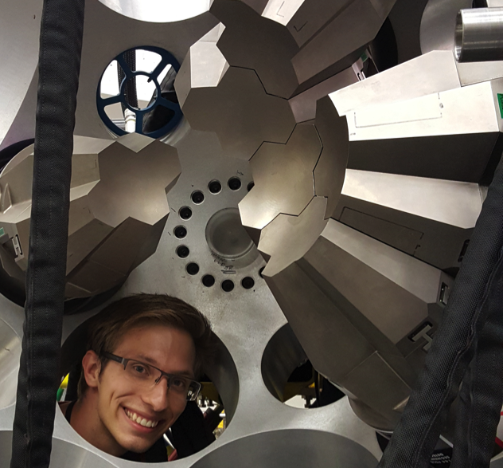
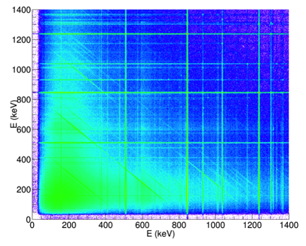
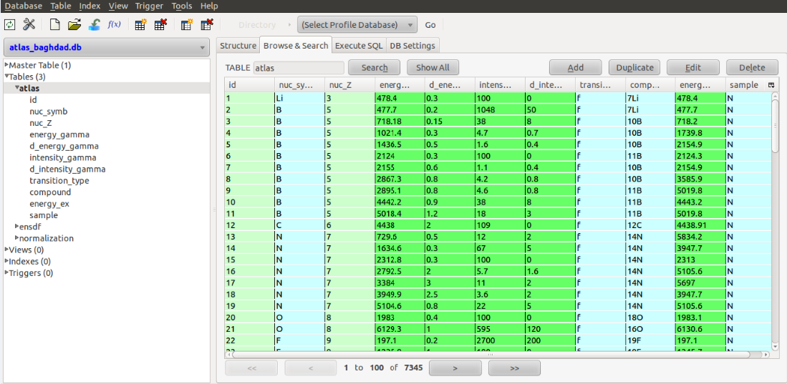
The BAND group has launched a compilation/evaluation effort on (n,n’γ) involving the Baghdad atlas and a measurements program
Atlas Specifics
7090 γ-rays
105 targets, 75 elements
Absolute γ-ray yields normalized to the ⁵⁶Fe 2 ➔0 @ 847 keV
GRETINA ⁵⁶Fe(p,p’γ) experiment being analyzed by BAND student L. Kirsch
SQL Atlas database (A.M. Hurst)

Slide 36
Aaron Hurst translated the Atlas into an SQL database
GUI can be used to manipulate data or execute SQL code
All γ-ray information from the ATLAS entered.

Slide 37
Next Step – An inter-agency nuclear data working group (C. Romano – NA-22/ORNL)
Overarching Goal of Working Group: Plan and execute, based on approval and funding from program managers, a collaborative 5 year nuclear data collection project based on best practices that leverages facilities, expertise and funding across the DOE/NNSA complex that meets cross cutting nuclear data needs while minimizing costs.
The working group members have the responsibility to embrace a collaborative and cooperative environment, and to put the success of the program above the interests of their home labs and personal interests.
The working group can enable international collaboration and provide a point of contact for national and international efforts.

Slide 38
The first working group telecon took place on 10/27/15 (and a couple of you participated)
Partners | Program Manager | Program Area | Working Group Member | Lab
NA-22 | Jim Peltz/David Beach | Enabling Capabilities / Nuclear Weapons and Material Security Teams | Catherine Romano | ORNL
DOE/OS/NP | Ted Barnes/Tim Hallman | Nuclear Data | Lee Bernstein | LLNL
NA-22 | Tom Kiess | Forensics / Post Det. | Todd Bredeweg/Jason Burke | LANL/LLNL
DNDO / TAR | Namdoo Moon | Nuclear Detection | Doug Mayo | LANL
NA-511/ NCSP | Jerry McKamy | Criticality Safety | Skip Kahler | LANL
DTRA | Dave Peterson | Basic Research/Forensics/ detection | TBD
NA-113 | Ralph Schneider Staci Brown | Defense Programs/ Research and Development | Dennis McNabb | LLNL
NA-114 | Douglas Wade Adam Boyd | Defense Programs/Physics and Engineering Models | Bob Little | LANL
NE | Rob Versluis | Nuclear Energy | Phillip Finck | INL
DNDO / NTNFC | William Ulicny Jeff Morrison | Forensics | Richard Essex | NIST
NA-45/83 | Tom Black/Steve Goldberg | Nuclear Technical Forensics | Bob Rundberg | LANL
NA-82 | Rick Christensen | Nuclear Threat Science | John Maenchen
Cathy’s first “homework assignment” to the NDWG was to ask people to rank the items in the whitepaper matrices by importance to their program

