Slide 1
Current status of the EXFOR project
Boris Pritychenko
National Nuclear Data Center, BNL, Upton, NY 11973

Slide 2
Compilations & Evaluations
Compilations of experimental papers are often done once while evaluations are revisited on 5-10 year basis
Updated evaluations are counted as new evaluations while compilations are not regardless of the change
Compilations have to be done right during the first try because there are no periodic updates
CSEWG should pay more attention to the quality of EXFOR instead of just mechanic fitting to experimental points
EXFOR has many issues due to scope change, lack of advanced computer technologies in the past, sloppiness and desire to exceed the performance expectations by some compilers
We need more resources to improve EXFOR

Slide 3
EXFOR Effort in the U.S. and Canada
EXFOR Team: B. Pritychenko, S. Hlavac, O. Schwerer and V. Zerkin (IAEA).
NNDC: Overall database and contracts management, website support, compilation and correction of missing and older references.
Bratislava: New references compilation.
Vienna: Overall quality assurance and transmission handling.
IAEA: Web and database development.
Smooth operation based on efforts of BNL stuff, contractors and collaborators.

Slide 4
X4 Highlights
Data recovery mission at Oak Ridge lab in March of 2015. Many thanks to M. Dunn and K. Guber.
Data from K. Guber’s measurements have been compiled, J. Harvey and B. Spencer are in the pipeline.
UNOBT data entries for the area #1 are reduced by 1/3, including all H, C, O, Fe, U and Pu.
EXFOR Web application was upgraded in collaboration with the IAEA.
Database was updated 12 times in FY2015.

Slide 5
X4 Statistics
New entries: 67 + 38 (older) = 105
Corrected entries: 23 + 52 (older) = 75
Large numbers of charged particle and photonuclear experiments are still missing in EXFOR, many existing compilations are incomplete.
Web retrievals using the IAEA system of counting (12 months adjusted due to summer scans)
EXFOR: 58004
ENDF: 72899
CINDA: 1937
More details in the IAEA system based on calendar years: http://www-nds.iaea.org/exfor-master/x4compil/

Slide 6
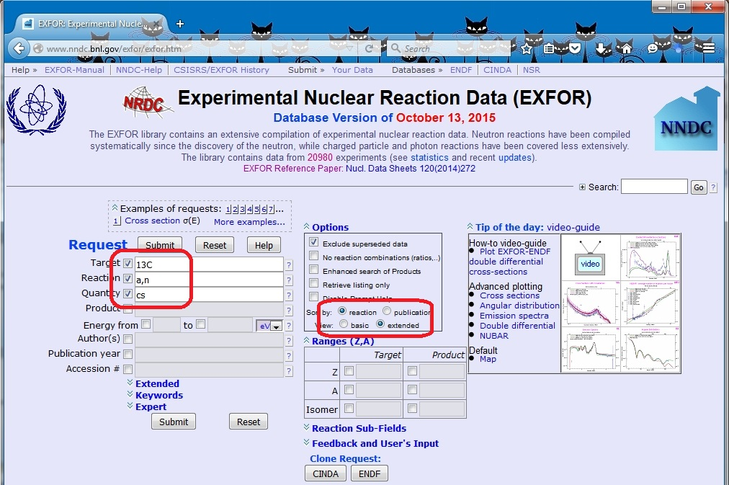
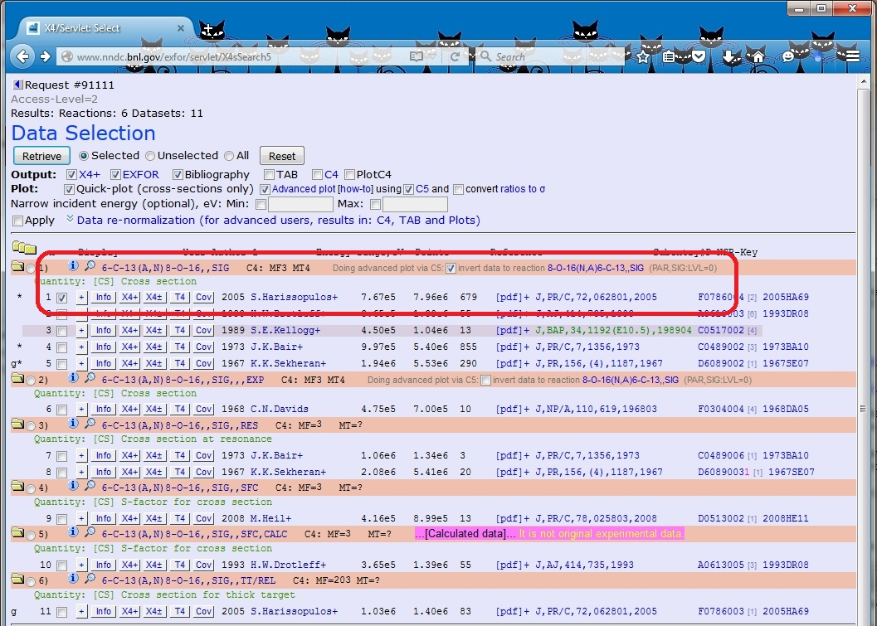
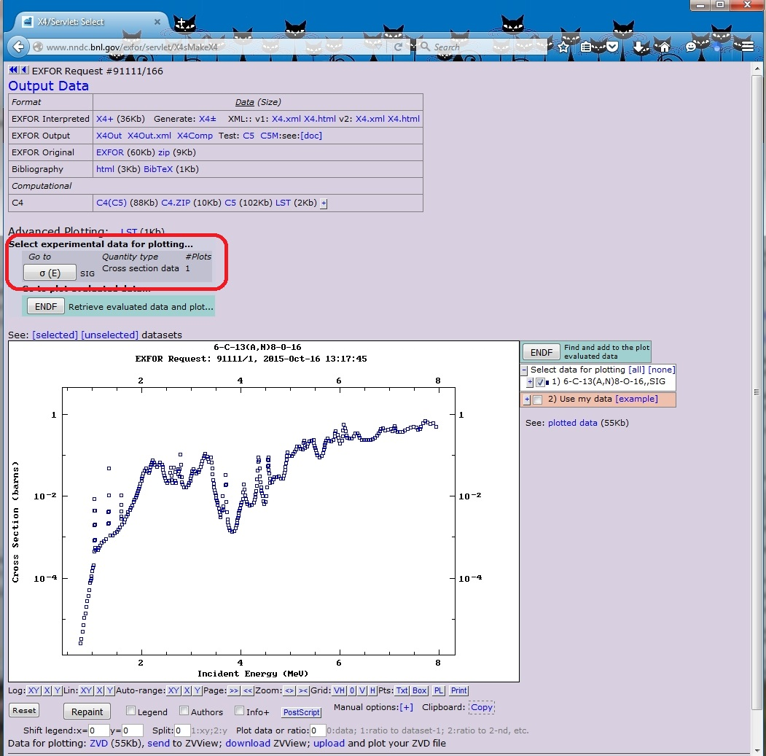
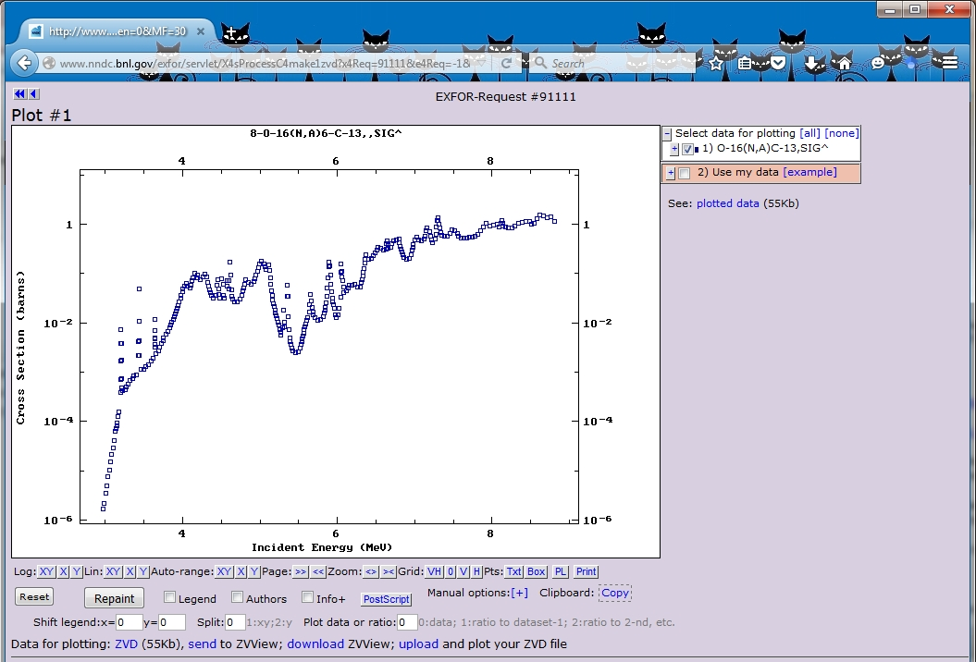
Inverse Reaction Calculations
New Feature of X4 Web Interface developed by V. Zerkin, IAEA.
Conversion of the existing EXFOR data sets using the reciprocity theorem.

Slide 7
Conclusions & Outlook
EXFOR compilation effort is complex and well-organized.
We address compilation of current articles, correct previous entries and add missing articles.
EXFOR database is incomplete due to multiple historical and technological reasons. We should continue to work on compilation of missing articles, correct previous entries.
It is a team effort that is conducted in close cooperation with the IAEA.

