Slide 1
ATHENA – PWG Coordination Progress
14th July 2021:
A slide with two pages. One giving the broad sequence of steps we are generally expecting.
The second slide has a table with a request to each PWGs to help start filling up whatever is possible and share with us.
https://wiki.bnl.gov/athena/index.php/Main_Page
19th August 2021:
Emails request to convenors of PWG
-- some sample key plots for the measurements, his includes physics and detector performance plots
-- Proposal will have only 40 pages to make the case (excluding the cost details), hence we need to arrive at few key impactful plots, that shows ATHENA uniqueness.
20th August 2021:
Email request to software group
(a) Final geometry configurations (some representative figures)
(b) What are the event generators and what are the event statistics being processed?
(c) Production timeline and plan chart
(d) A reading macro and information stored in the output
26th August 2021
ATHENA PWG Convenors and Indian Group
https://indico.bnl.gov/event/12811/
27th August 2021
Further discussion during the joint ATHENA Convenor and Proposal Committee meeting
https://indico.bnl.gov/event/12897/
https://doc.athena-eic.org/en/latest/

Slide 2
PWG
handle crossing angle
Baseline Detector Configuration (GEANT)
Event Generator
Physics results
Example Conditions:
Polarized electron ( 70%) and proton ( 70%)
Ion beams: deuterons and gold
e+p center-of-mass energies: 20 - 100 GeV
Electron-nucleon luminosity 10³³ and10³⁴ cm⁻² s⁻¹
Conclusions on performance / sensitivity
+
Plots for proposal
Configuration#1
Configuration#2
Proposal wiki page for more details: https://wiki.bnl.gov/athena/index.php/Main_Page
Other useful link: http://www.eicug.org/web/documents/public

Slide 3
Key Minimum Physics
Physics Process | Key measurements | Key Plots | Physics Message | Detector Performance Tests

Slide 4
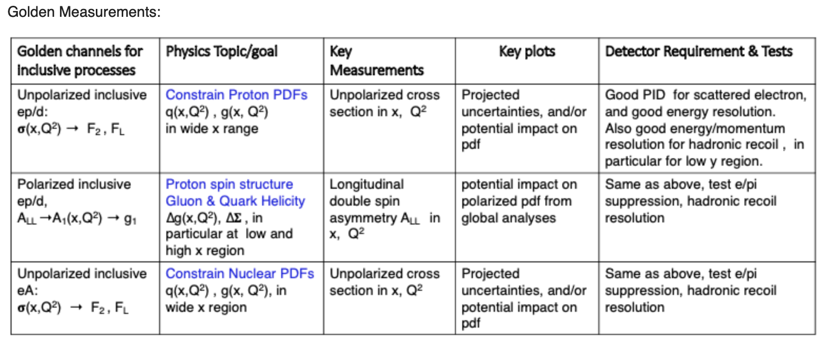
Inclusive PWG

Slide 5
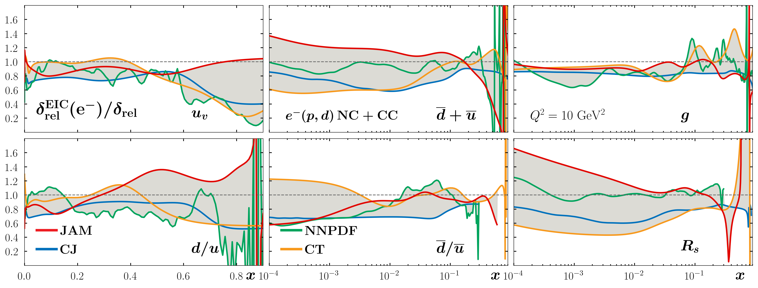
Inclusive PWG
300 million Pythia 6 events.

Slide 6
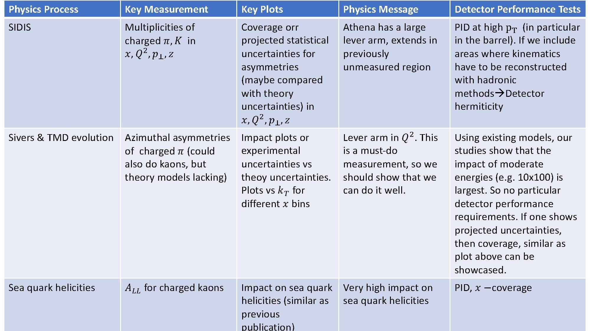
SIDIS PWG

Slide 7
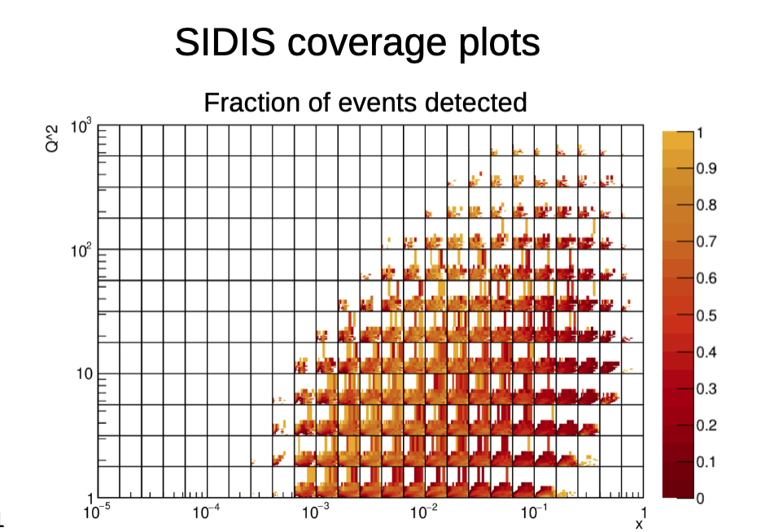
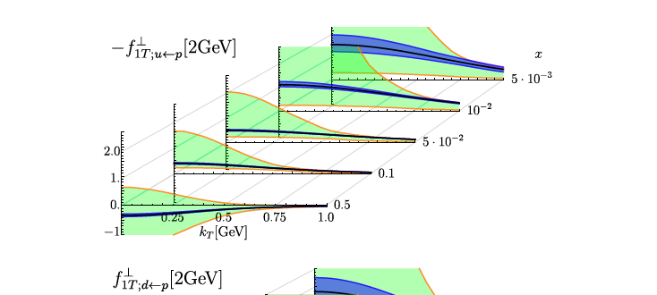
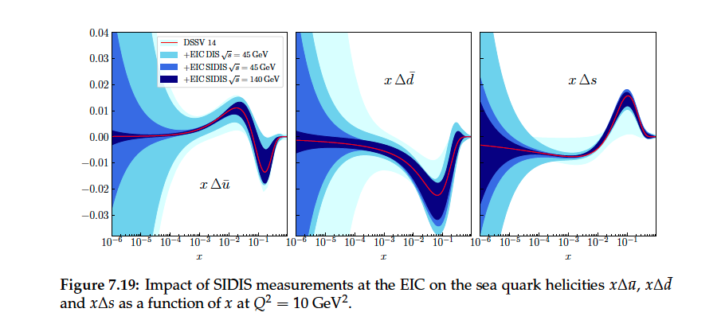
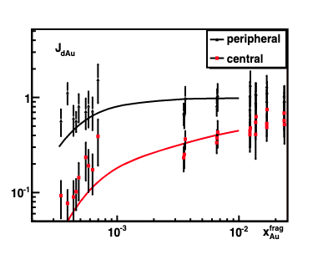
SIDIS PWG

Slide 8
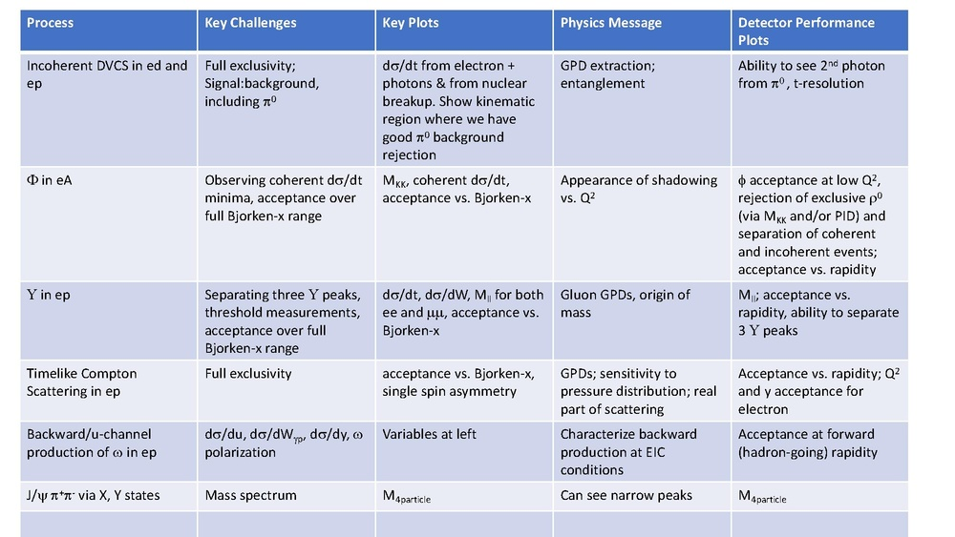
Exclusive PWG

Slide 9
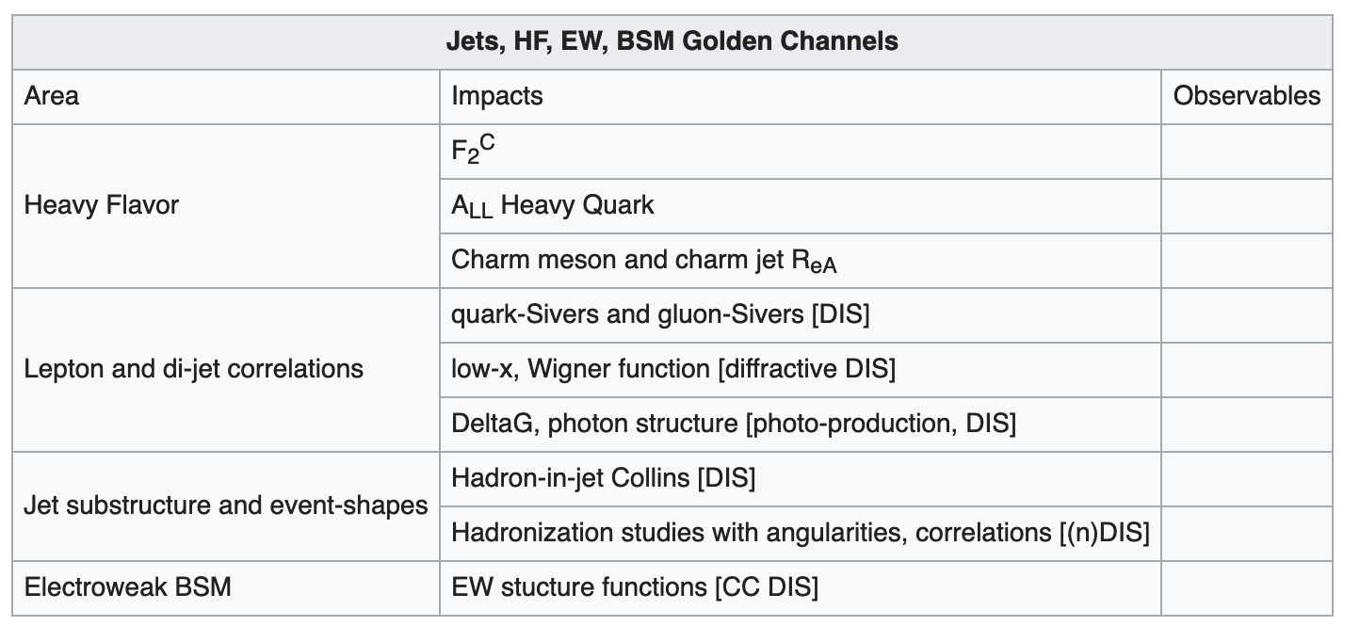
Jets, HF, EW, BSM PWG

Slide 10
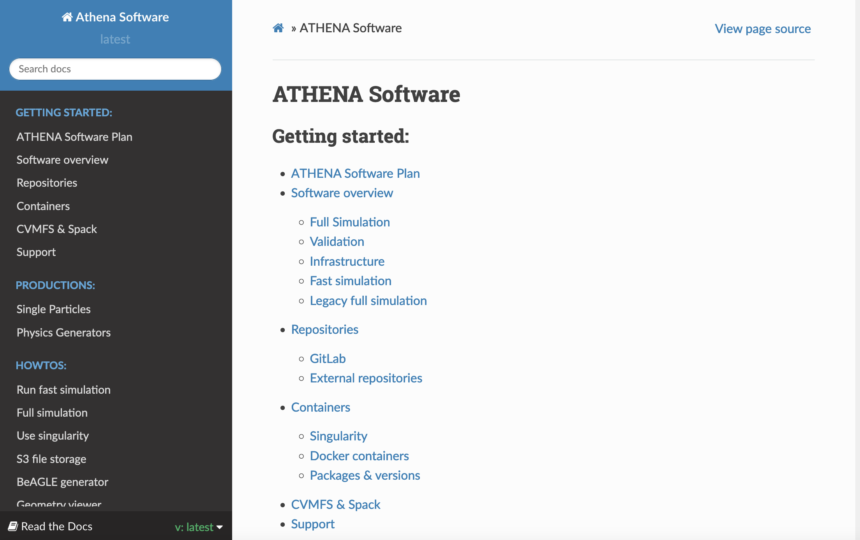
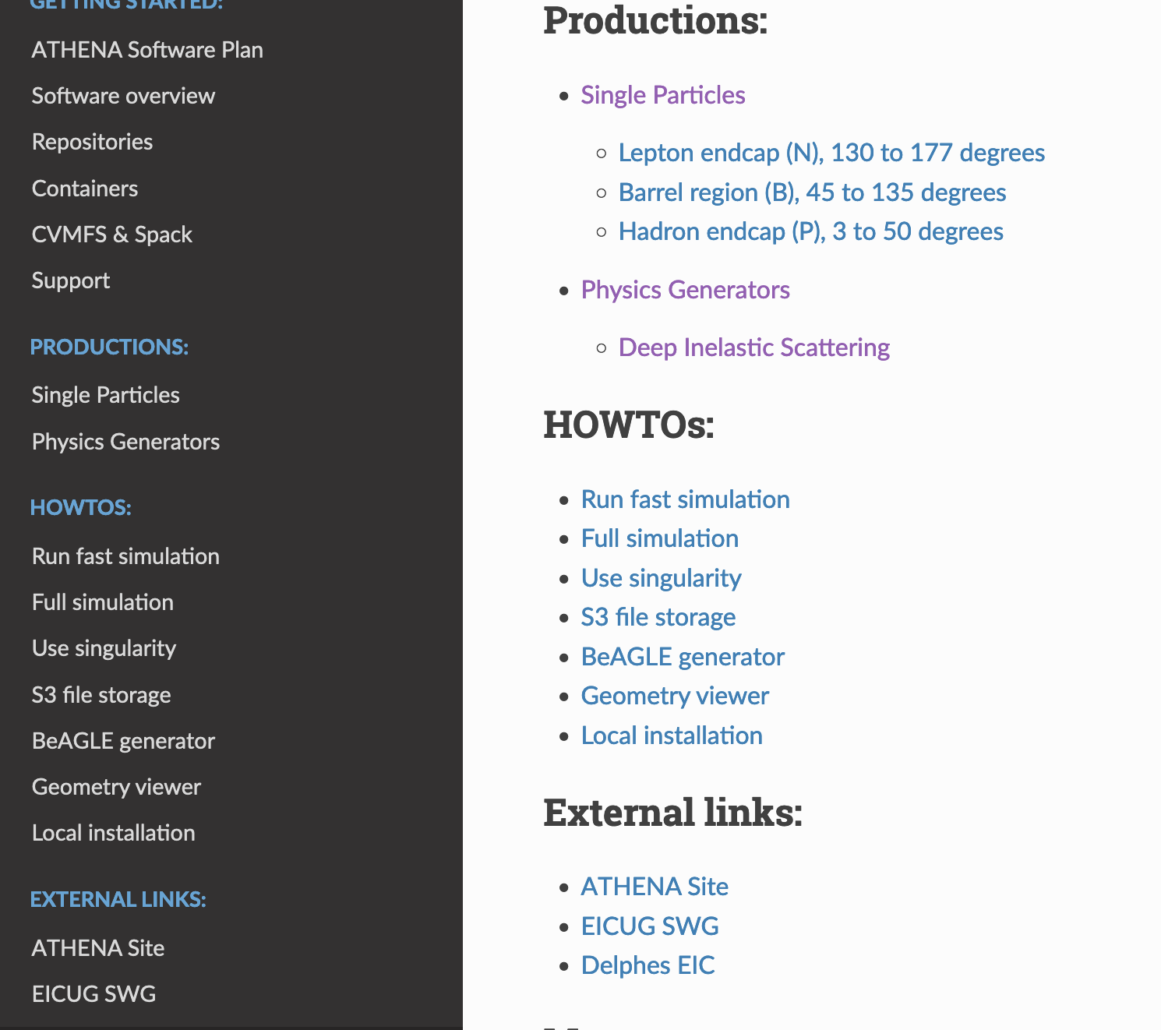
ATHENA Software Page
https://doc.athena-eic.org/en/latest/

Slide 11
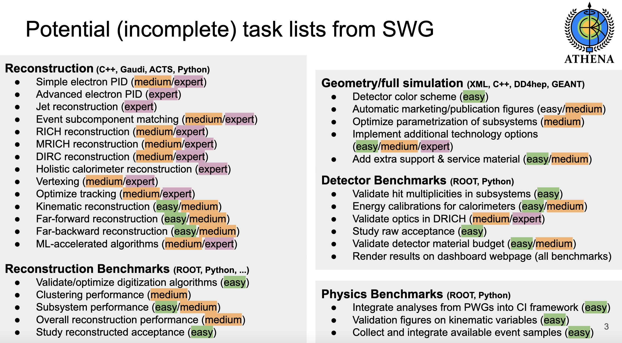
Sylvester Joosten

Slide 12
Performance Plots (Examples)
Acceptance
Q² vs. x
φ Acceptance vs.
Q² vs. y (electron)
PID
PID vs. p_{T} (electron and hadron)
PID vs. x (electron and hadron)
e/π suppression
Mass resolution vs. rapidity (Υ)
Resolution
t-resolution
Momentum resolution
Energy resolution
Hadronic recoil resolution vs. y

Slide 13
Physics Plot (Example)
https://arxiv.org/pdf/2103.05419.pdf
Physics: Proton Parton (q and g) Distribution Functions (PDFs) in a wide range in “x”.
X-axis: “x” values
Y-axis: [uncertainties on xf(x) with ATHENA measurements included] / [uncertainties on xf(x) with pre-EIC-ATHENA measurements]
The uncertainties in the numerator are dictated by the detector performance. Ideally, the values in Y-axis is expected to be below unity.
Is there a better way to re-present the same thing showing detector performance?
Can we take a particular group PDF and show the effect of energy/momentum resolution from the two ATHENA configurations, PID purity from two different ATHENA configurations and effect of magnetic field (two field values) ?
Measurement: Cross sections of reactions (proceeding both via neutral current and charged current processes) as a function of x and Q² in unpolarized e+p/d collisions. This can be translated to inclusive structure functions and finally to PDFs.
Detector performance role: The measurements require (a) Scattered Electron energy and angle (b) Hadronic recoil measurements – PID and momentum. Hence, energy resolution, momentum resolution, PID purity, and magnetic field uniformity and strength come into play. … etc

Slide 14
Requests to WGs
PWG are looking at simulated data ….
As they are working on it … some requests
Link the PWG discussion to the main page
https://wiki.bnl.gov/athena/index.php/Main_Page
Consolidated list of event requirements from PWG
Some relevant software information in main page
https://doc.athena-eic.org/en/latest/

