Slide 1
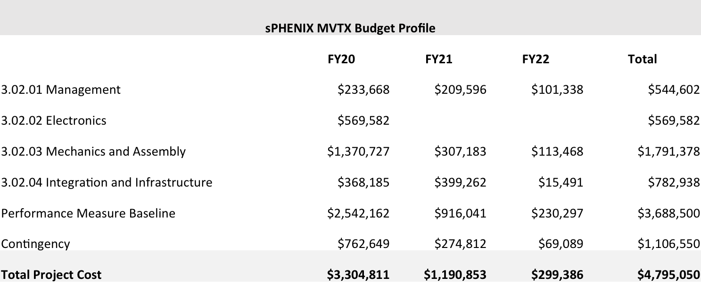
MVTX Estimate at Completion
The MVTX is a $4.8M BNL capital project. The project is not tracked with earned value due its small size, though we receive monthly technical reports from the MVTX group and regular financial reports from BNL. It is within budget and on schedule to be installed in sPHENIX in the Fall of 2022.

Slide 2
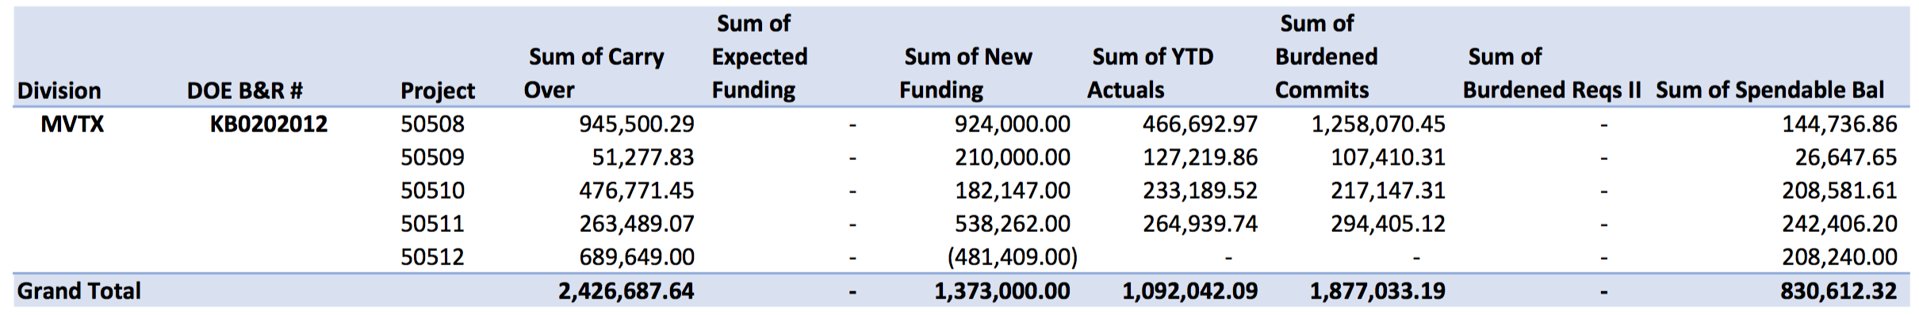
MVTX Remaining Funds and Cost to Go
Spendable balance at BNL $830.6k.
Remaining Costs $300k to cover final testing, assembly, installation support and management.
Finances are tracking to ~$500k in contingency remaining at the end of the project

Slide 3
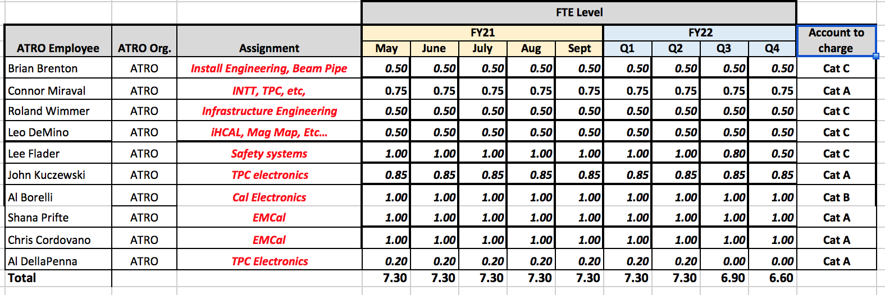
ATRO Cat C Labor in FY22
Very similar Cat A, B and C labor from IO in FY21 and FY22.
Direct labor total will be ~$410k for ATRO Cat C labor in FY21
In addition we expect 1 sPHENIX person to move from PO to IO in FY22

Slide 4
Back Up

Slide 5
Key Remaining I&F Orders
1008 I&F
IHCal installation stanchions (Final component of IHCal assembly/installation fixtures)
TPC installation fixtures and bracketry
Supports for Beam pipe + MBD + sEPD
Magnet Mapping
Fiber Optics trunk cables
HVAC Improvements (partially submitted)
MVTX+INTT brackets and installation fixtures
Seismic restraints
Tray, pipe, hangers (partially submitted)

Slide 6
Key Remaining MIE Orders
MIE
DCMII’s + crates + backplanes + controllers
TPC diffuse lasers
TPC fibers
GL1/GTM boards
JACK board

