Slide 1
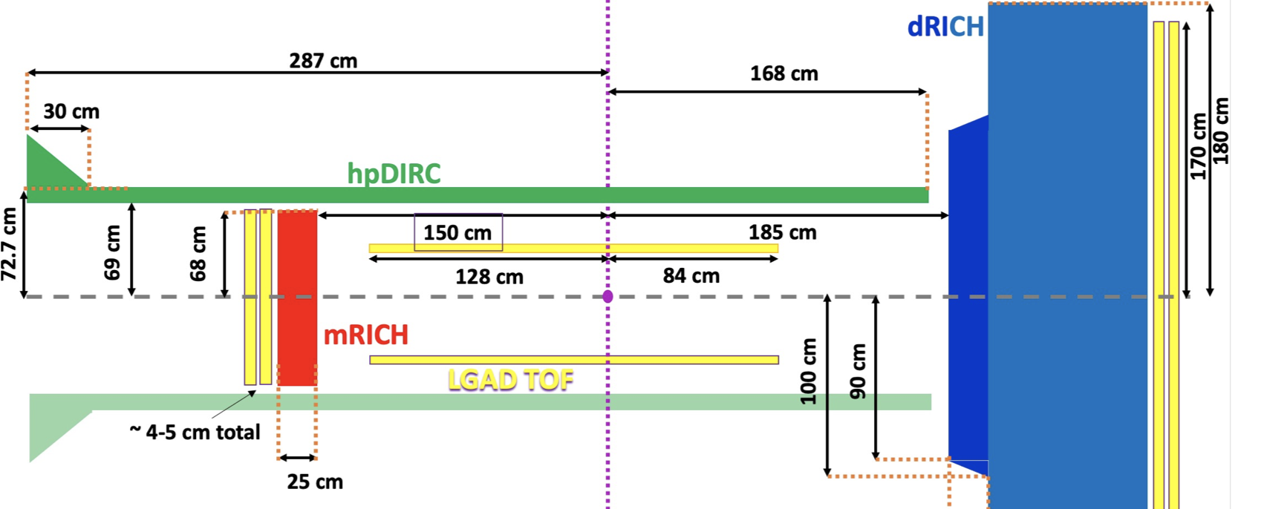
ECCE PID: Cherenkov + TOF
TOF
TOF
TOF
TOF

Slide 2
ECCE PID: Cherenkov + TOF
TOF
TOF
TOF
TOF

Slide 3
Cherenkov PID Coverage
TOF PID Coverage
h-endcap: dRICH
Ring imaging:
π/K < 50 GeV/c
e/π <15 GeV/c
“Veto” mode:
e/ π above few MeV/c (up to ~15 GeV/c)
π/K,p above 0.7 GeV/c (or ~1 GeV/c at "full efficiency")
K/p > 2.5 Gev/c (or ~3 GeV/c at "full efficiency")
e-endcap: mRICH
Ring imaging:
π/K: 2-8 GeV/c
e/π : 0.6-2./2.5 GeV/c
“Veto” mode:
k/π : 0.6-2 GeV/c
e/π : <0.6 GeV/c
k/P <3.8 GeV/c
barrel: hpDIRC
Ring imaging:
π/K <6-7 GeV/c
e/π <1.2 GeV/c
“Veto” mode:
e,k/π >0.2/0.3GeV/c
k/P >1 GeV/c
e/π covered by dRICH
π/K < 1 (2) GeV/c need ~230 (65) ps resolution (3m path)
K/p < 3 (4) GeV/c need ~80 (45) ps resolution (3m path)
e/π covered by mRICH (@ low-p)
π/K < 0.6 (1) GeV/c need ~380 (150) ps resolution (1.75m path)
K/p < 3.8 GeV/c covered by mRICH
e/π < 0.3 (0.5) GeV/c need ~65 (25) ps resolution (0.8m path)
π/k < 0.3 (0.5) GeV/c need ~500 (230) ps resolution (0.8m path)
K/p < 1 (2) GeV/c need ~160 (45) ps resolution (0.8m path)

Slide 4
TOF Technologies
Barrel (20m²):
AC-LGAD (~20ps). [~$13M*]
LYSO (~30ps). [~$4M* + uRWELL cost]
mRPC (~ 30 – 60ps) [~$3M** + uRWELL cost]
Endcap (10.5m², 1.0^{e-cap} + 9.5^{h-cap}):
AC-LGAD (~20ps) [~$6.8M*]
mRPC (~ 30 – 60ps) [~$1.6M** + uRWELL cost]
* Scaling CMS cost from LHCC-P-009: https://cds.cern.ch/record/2296612/files/LHCC-P-009.pdf
** eRD14 assumed 200k/m² [eRD14: http://phynp6.phy-astr.gsu.edu/eRD14/index.php/Time_of_Flight_Detector_(TOF)]; Recent estimates are ~150k/m².

Slide 5
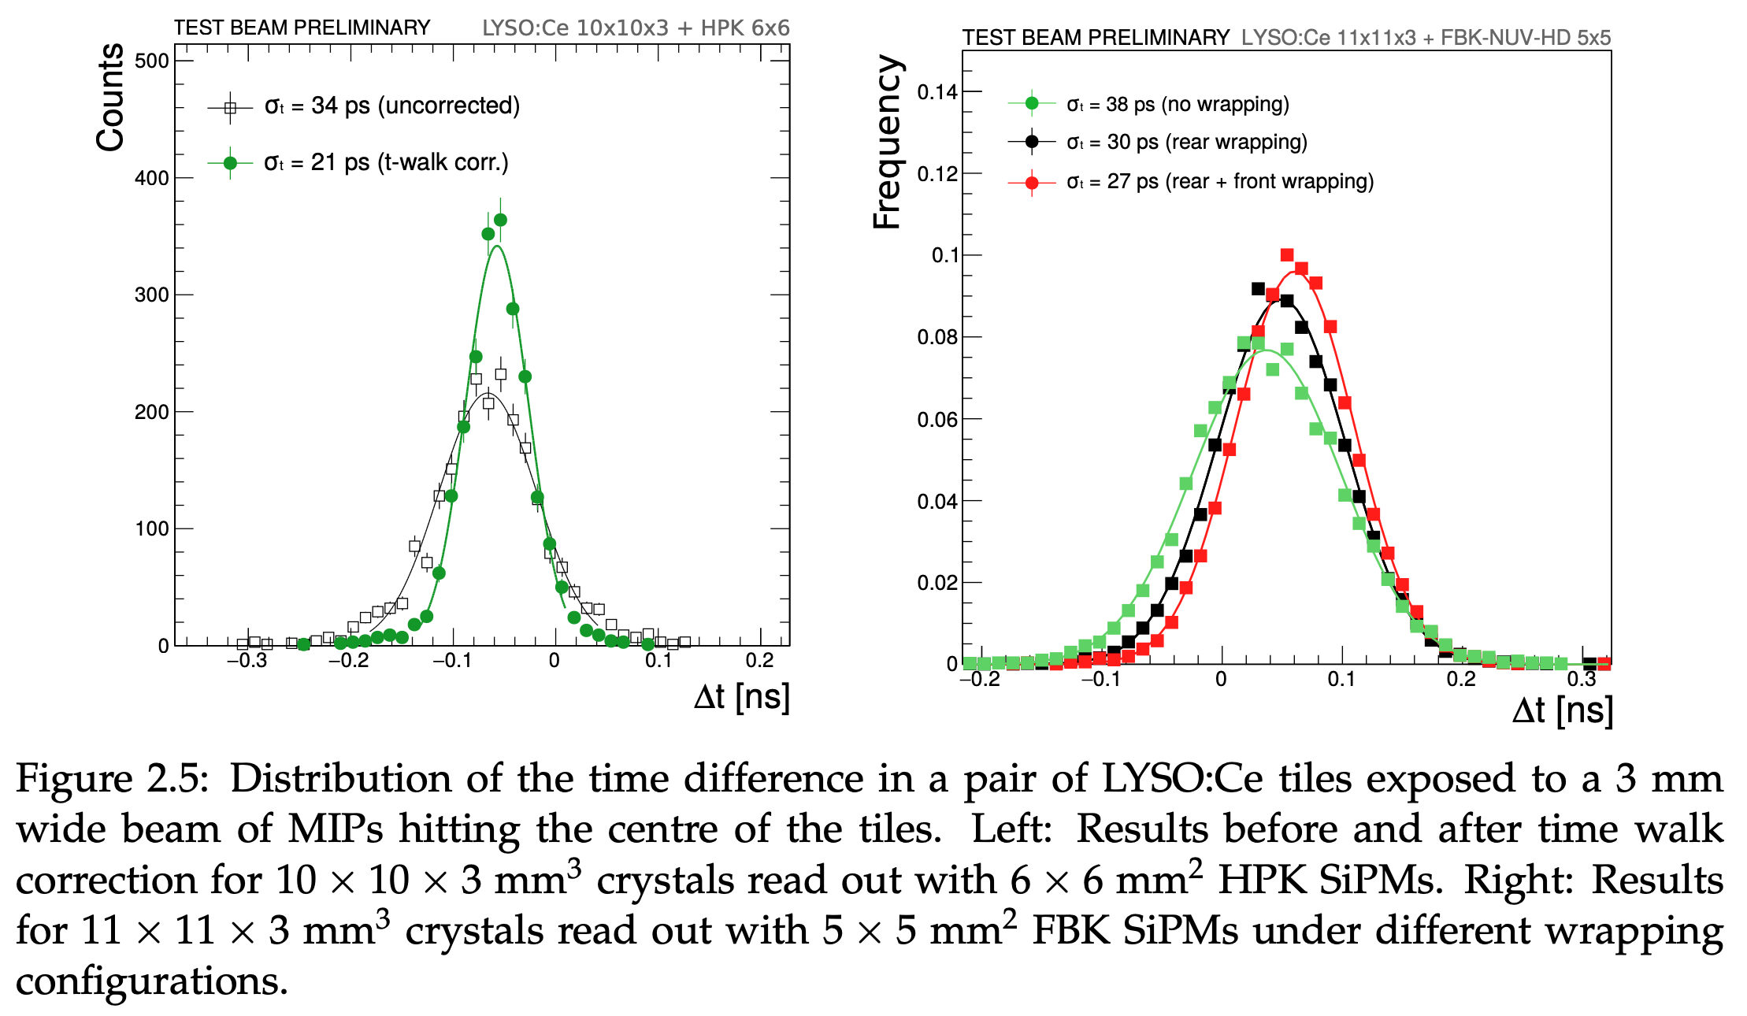
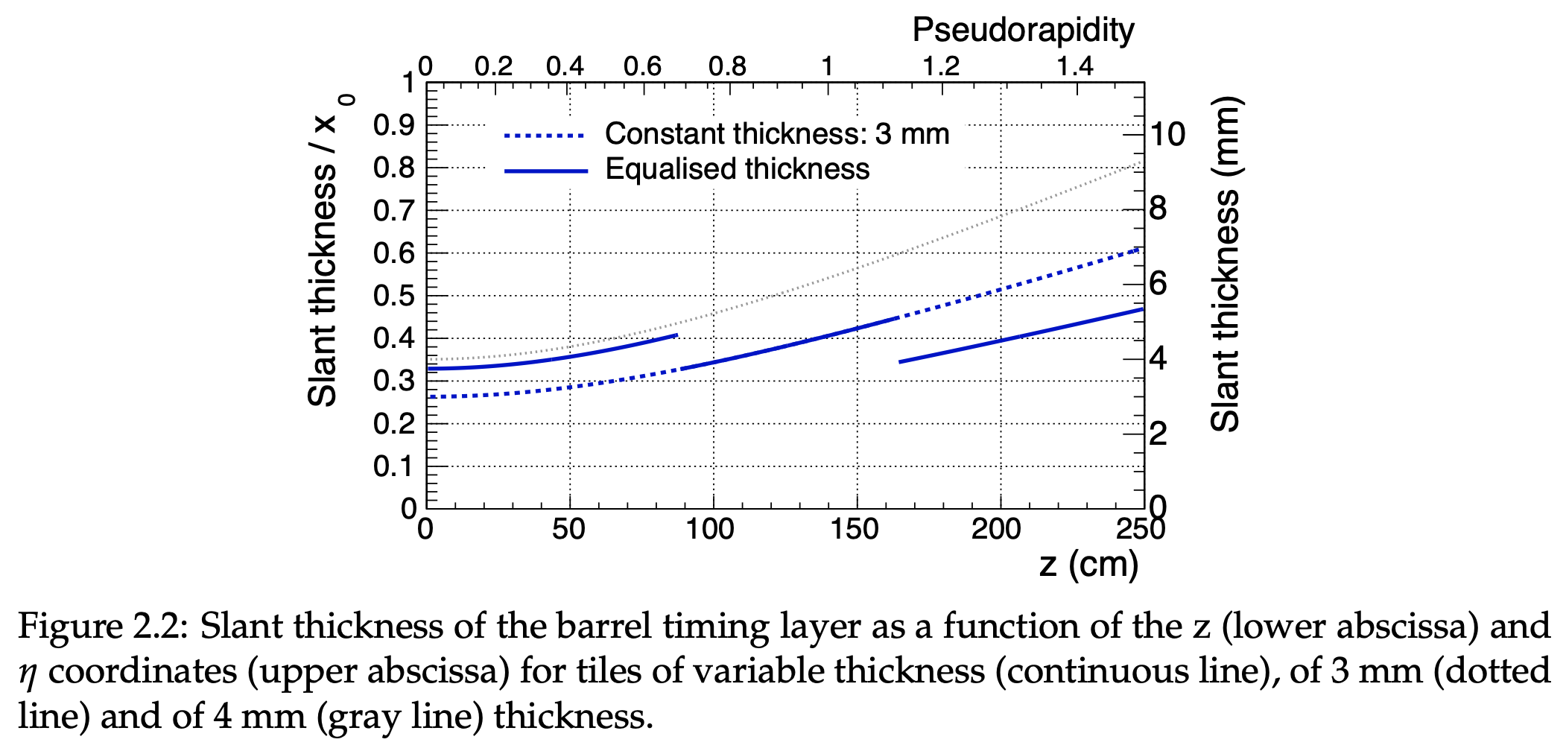
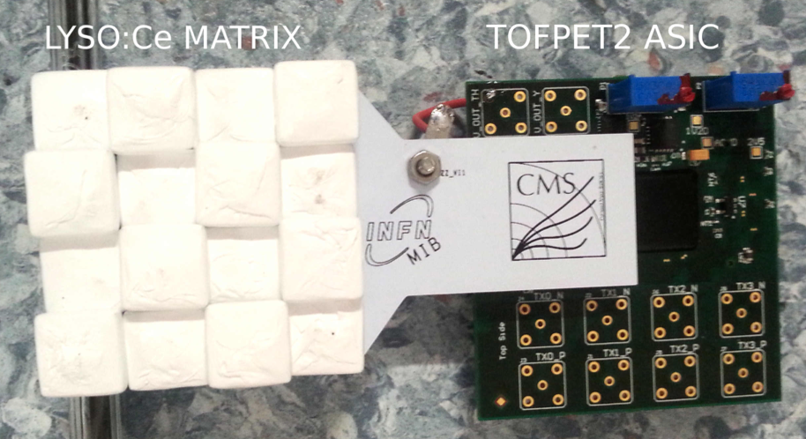
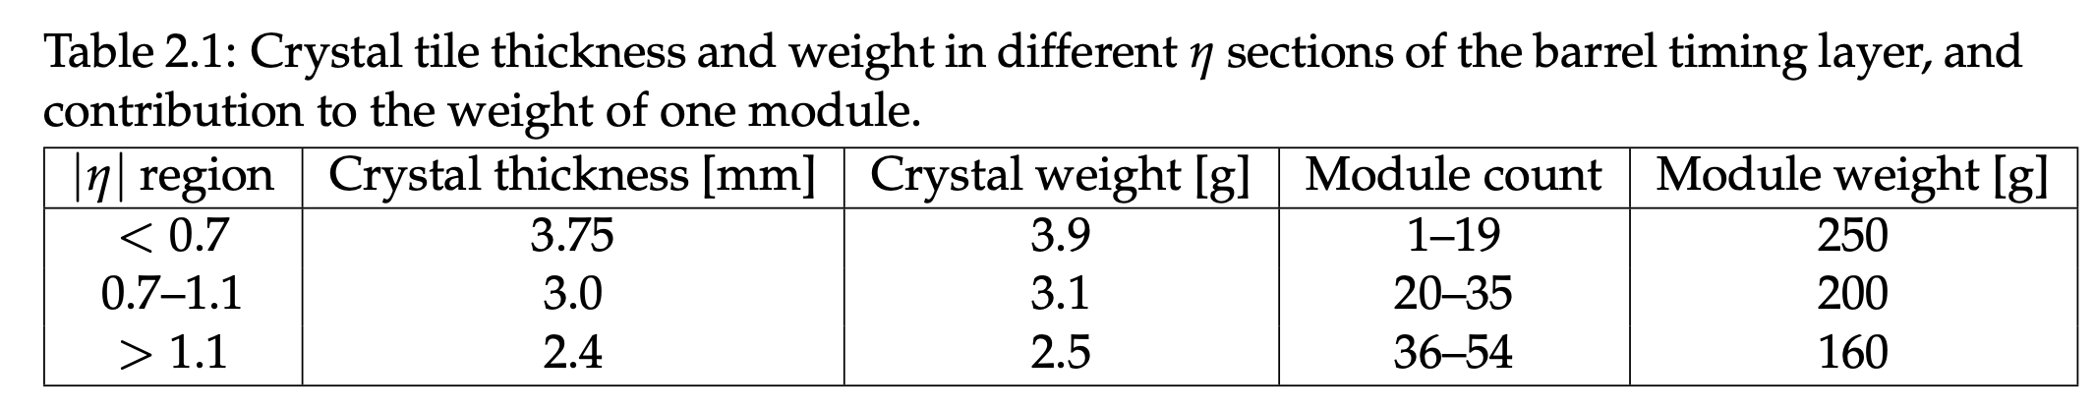
LYSO (Barrel)
Base unit: 2.5mm – 3.75mm thick LYSO ‘pixels’
\w SiPM+ASIC readout.
Total thickness: 2.5 cm (crystal+SiPM+readout
+service). ~ 0.5% X₀.
TOF Performance: ~30ps resolution (established).
Efficiency: close to 100%.
Risk: Minimal. Builds on (copy from) CMS.
Cost: $4M (scaling CMS cost of $8M for 40m²).
Cost Saving: ~$1M by using YAG:Ce instead of LYSO
(R&D still ongoing).
LHCC-P-009: https://cds.cern.ch/record/2296612/files/LHCC-P-009.pdf

Slide 6
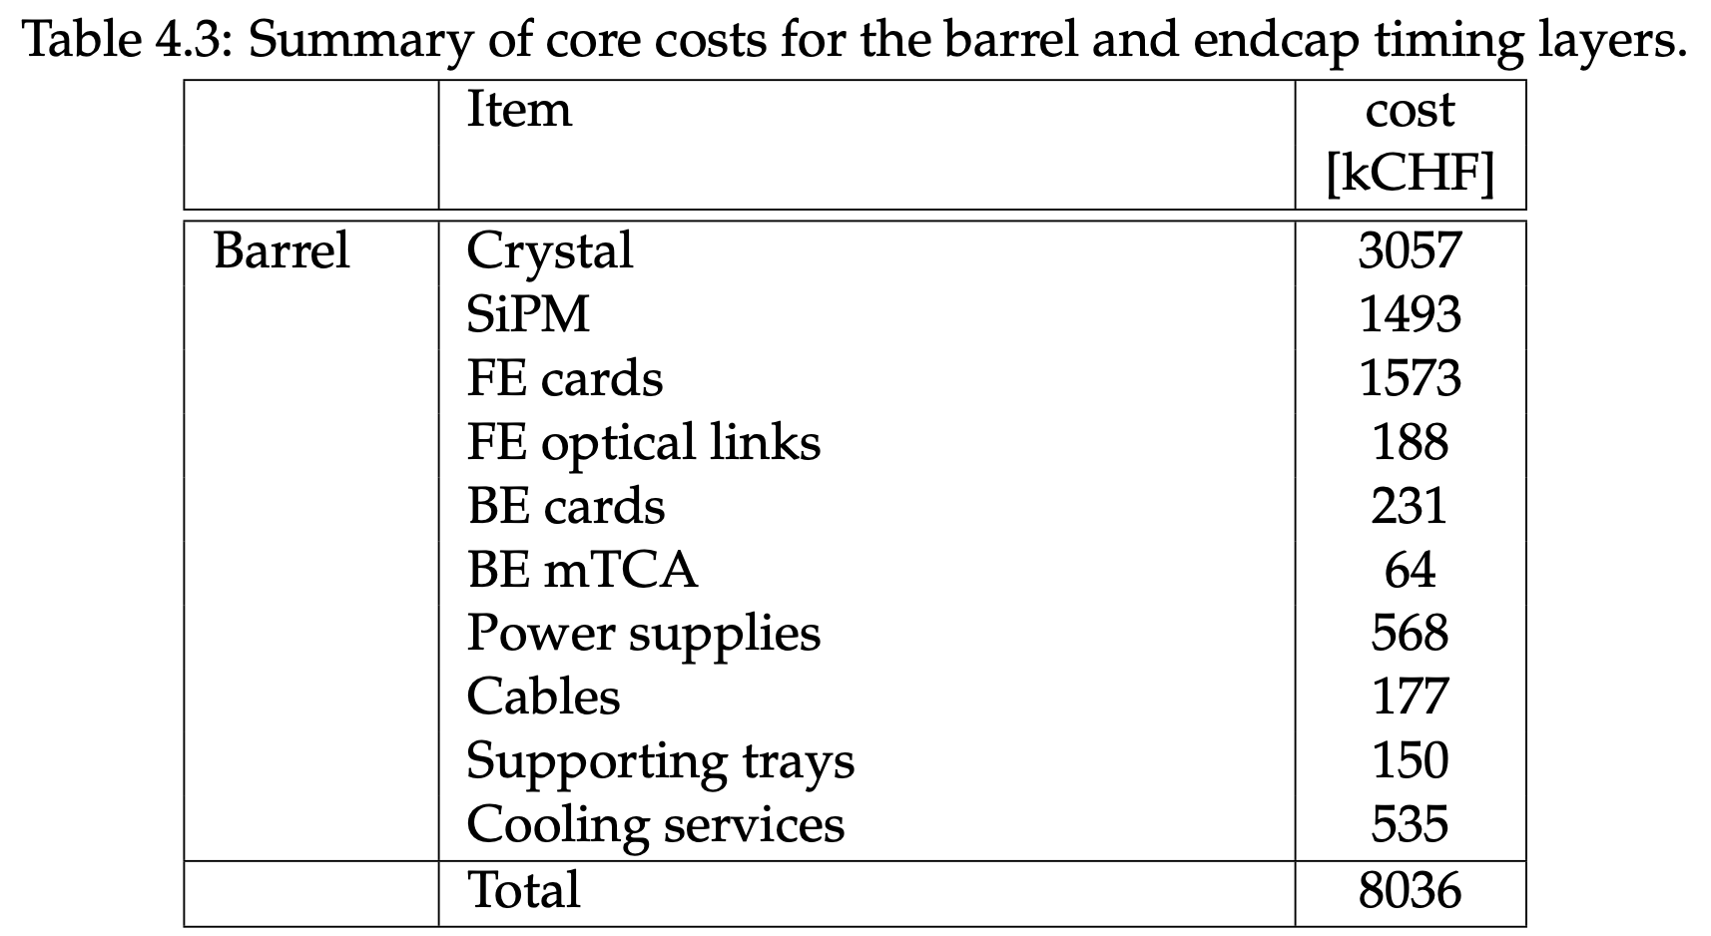
LYSO (Barrel)
Base unit: 2.5mm – 3.75mm thick LYSO ‘pixels’
\w SiPM+ASIC readout.
Total thickness: 2.5 cm (crystal+SiPM+readout
+service). ~ 0.5% X₀.
TOF Performance: ~30ps resolution (established).
Efficiency: close to 100%.
Risk: Minimal. Builds on (copy from) CMS.
Cost: $4M (scaling CMS cost of $8M for 40m²).
Cost Saving: ~$1M by using YAG:Ce instead of LYSO
(R&D still ongoing).
LHCC-P-009: https://cds.cern.ch/record/2296612/files/LHCC-P-009.pdf

Slide 7
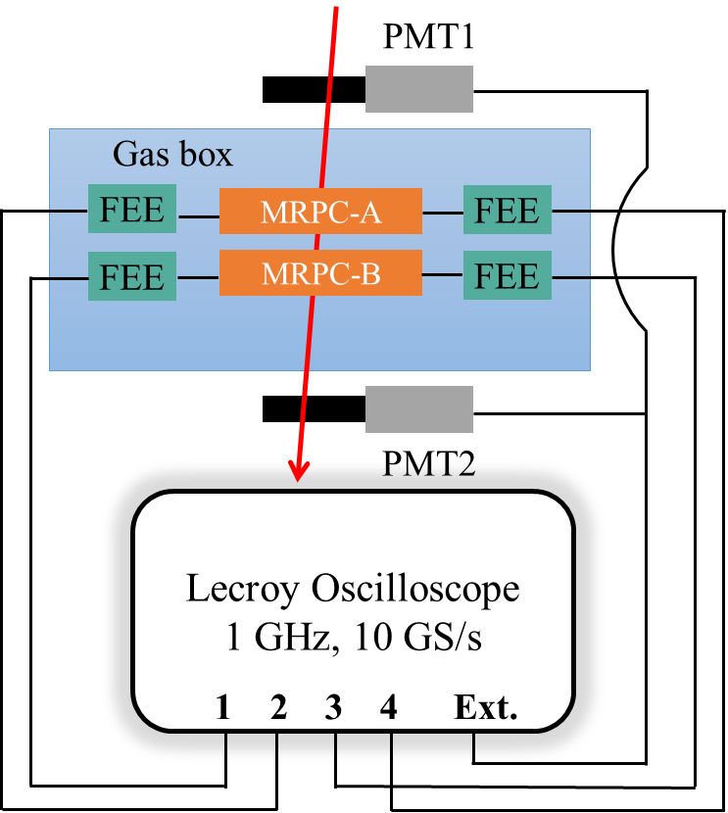
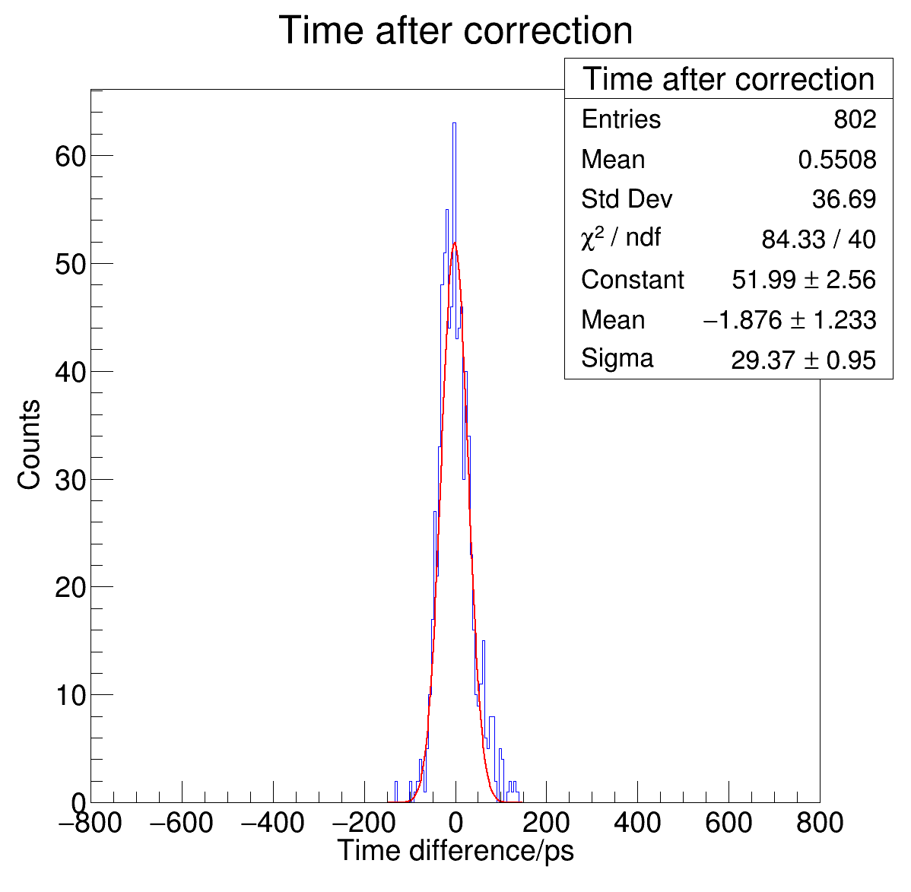
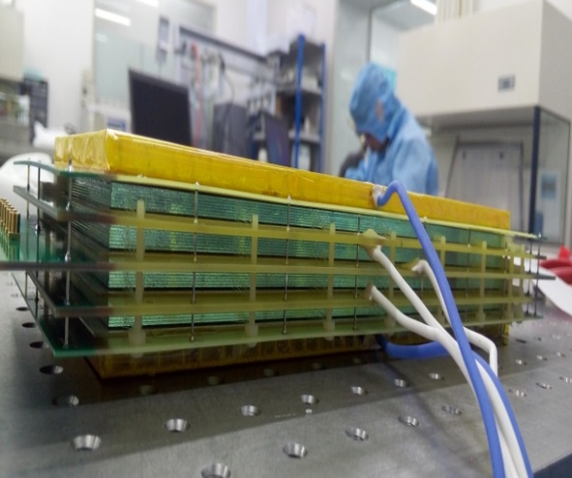
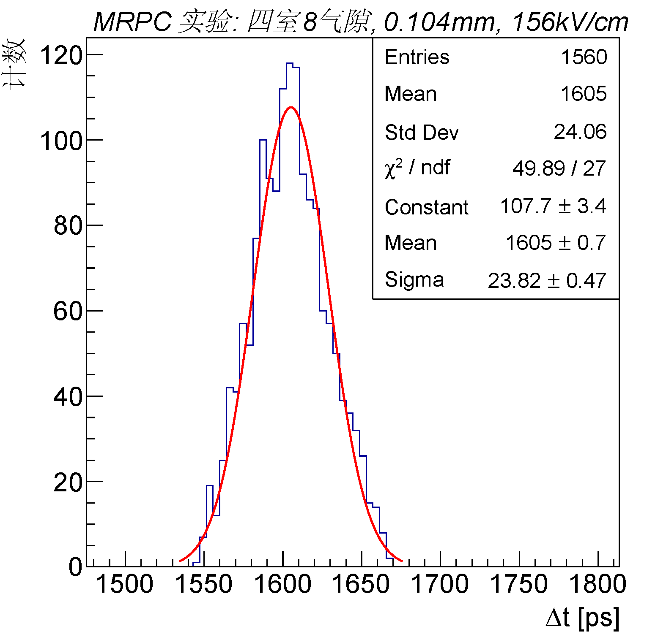
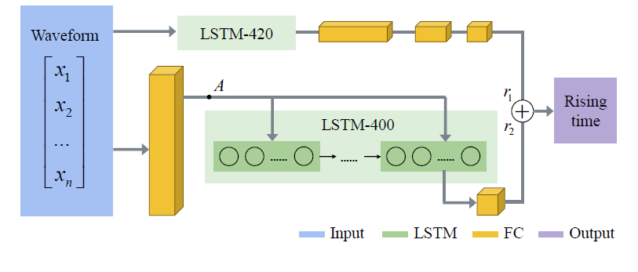
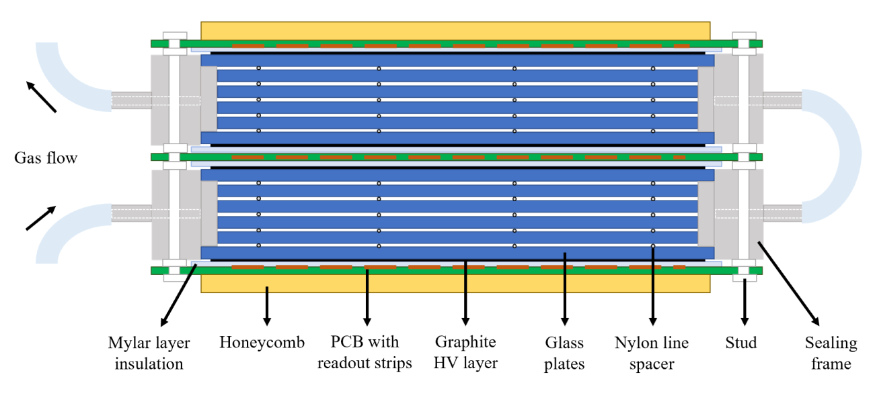
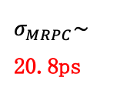
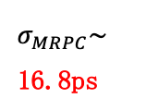
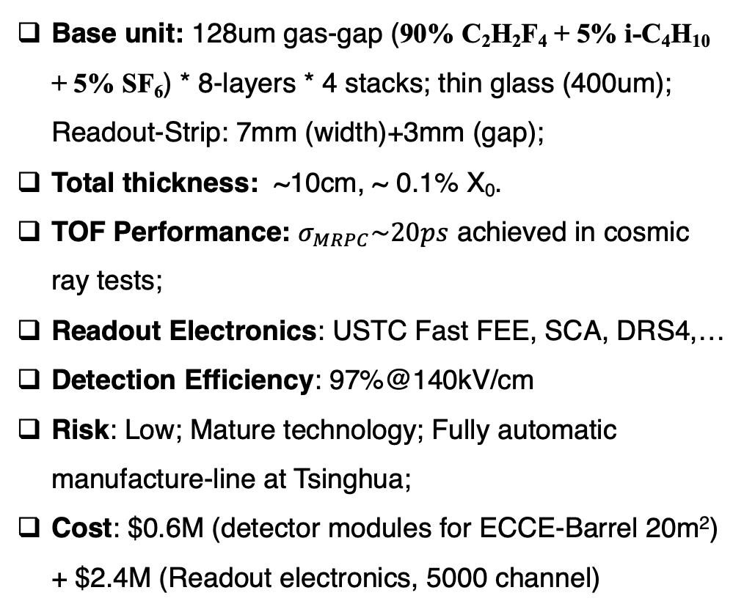
mRPC (Tsinghua U.)
Cosmic Ray Test:
mRPC + USTC FEE + Lecroy Oscilloscope
Base unit: 128um gas-gap (90% C₂H₂F₄ + 5% i-C₄H₁₀ + 5% SF₆) * 8-layers * 4 stacks; thin glass (400um); Readout-Strip: 7mm (width)+3mm (gap);
Total thickness: ~10cm, ~ 0.1% X₀.
TOF Performance: $σ_{MRPC}\sim 20ps$ achieved in cosmic ray tests;
Readout Electronics: USTC Fast FEE, SCA, DRS4,…
Detection Efficiency: 97%@140kV/cm
Risk: Low; Mature technology; Fully automatic manufacture-line at Tsinghua;
Cost: $0.6M (detector modules for ECCE-Barrel 20m²) + $2.4M (Readout electronics, 5000 channel)
E-field：
140 kV/cm
$σ_{MRPC}\sim$ 20.8ps
Cosmic Ray Test
R&D#1: Low-resistive glass (for high rates)
R&D#2: Analysis with Neural network
$σ_{MRPC}\sim$ 16.8ps
R&D#3: Sealed-mRPC (reduce pollution effect)
Ongoing R&D Activities: Improved design & beam-test at Jlab in Spring 2022
R&D#4: Replacement of NONE green-house gas

Slide 8
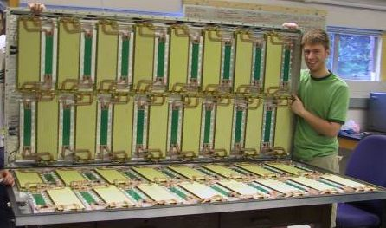
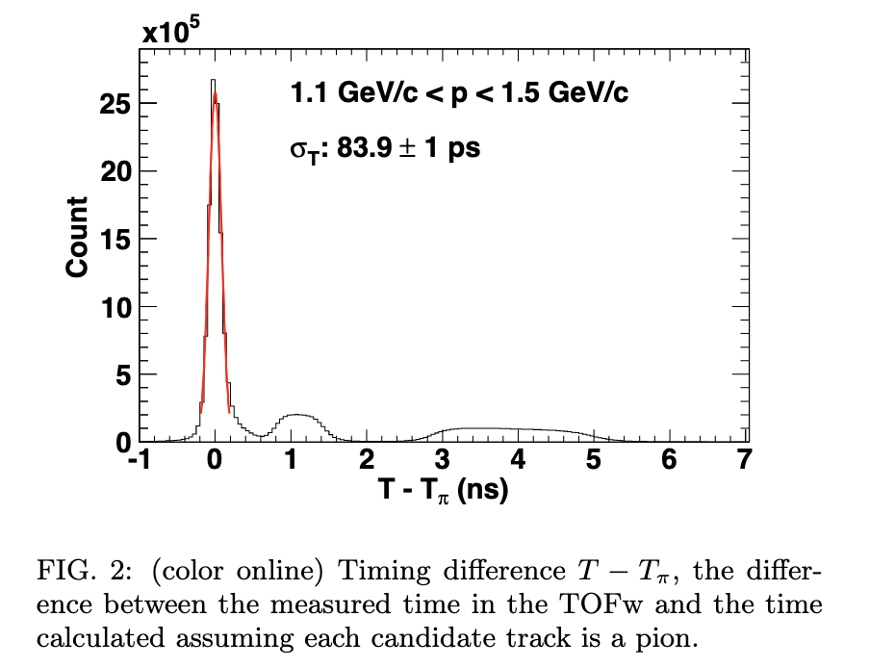
MRPC (the PHENIX TOF.W)
Base unit: 37 cm x 12 cm in x-y, but could be other
Thickness of MRPC in PHENIX: 6-gaps with 0.55mm glass, 0.23 mm gas gaps; honeycomb, signal pick-up boards → 3 cm
Total thickness: 7.6 cm with feedthrough boards, readout electronics, Al gas box;
X0 is 0.05 for detector and 0.13 with support structure and services. Can be optimized further.
TOF Performance: Established ~60 ps resolution (intrinsic), but ~ 84 ps in situ Au+Au collisions with start time and electronics; similar numbers reported by ALICE in PbPb. We were aiming at 100 ps. This can be improved significantly with better electronics and modifications to the glass stack.
Detection efficiency: ~ 95% with 14 kV/cm 95% freon+5% isobutane
Risk: Low. The detector worked for 10 years in PHENIX without an incident. We have facilities and expertise to engage in R&D and production of mRPC TOF for ECCE
Cost: most of the cost is in preamp and FEM electronics, HV supply and cables, machining of gas box, etc. I don’t have a good estimate of today’s cost, but Zhihong Ye’s numbers seem right.
Phys.Rev.C 85 (2012) 064914

Slide 9
To Be Added:
slides on AC-LGAD
Slides on other considerations we should be making

