Slide 1
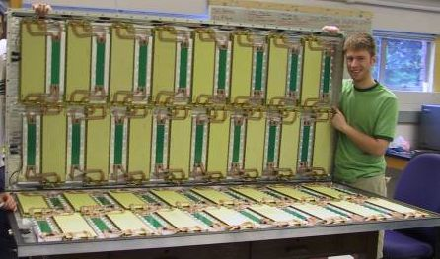
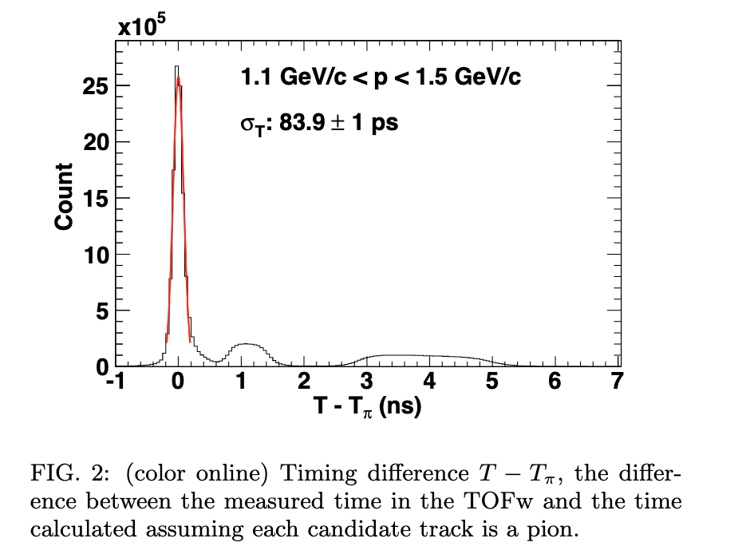
MRPC (the PHENIX TOF.W)
Base unit: 37 cm x 12 cm in x-y, but could be other
Thickness of MRPC in PHENIX: 6-gaps with 0.55mm glass, 0.23 mm gas gaps; honeycomb, signal pick-up boards → 3 cm
Total thickness: 7.6 cm with feedthrough boards, readout electronics, Al gas box;
X0 is 0.05 for detector and 0.13 with support structure and services. Can be optimized further.
TOF Performance: Established ~60 ps resolution (intrinsic), but ~ 84 ps in situ Au+Au collisions with start time and electronics; similar numbers reported by ALICE in PbPb. We were aiming at 100 ps. This can be improved significantly with better electronics and modifications to the glass stack.
Detection efficiency: ~ 95% with 14 kV applied; 95% freon+5% isobutane
Risk: Low. The detector worked for 10 years in PHENIX without an incident. We have facilities and expertise to engage in R&D and production of mRPC TOF for ECCE
Cost: most of the cost is in preamp and FEM electronics, HV supply and cables, machining of gas box, etc. I don’t have a good estimate of today’s cost, but Zhihong Ye’s numbers seem right.
Phys.Rev.C 85 (2012) 064914

