Slide 1
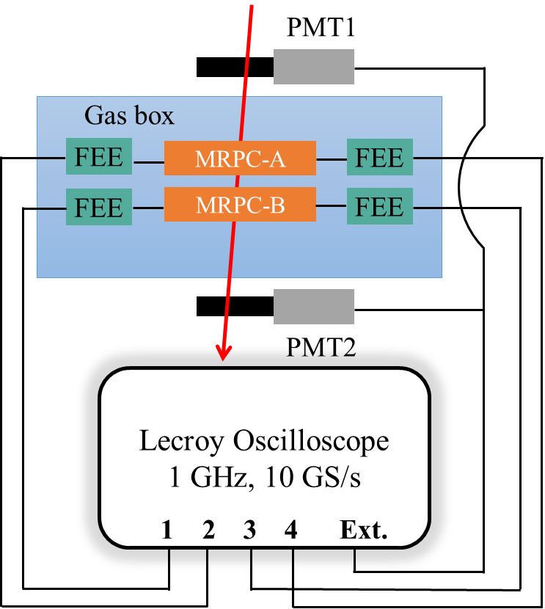
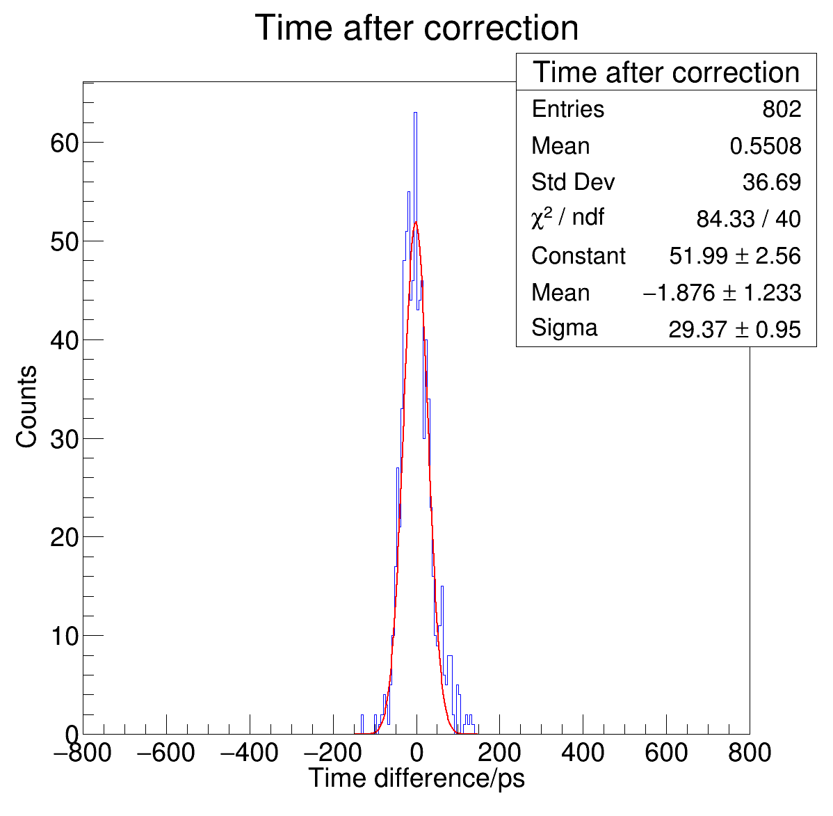
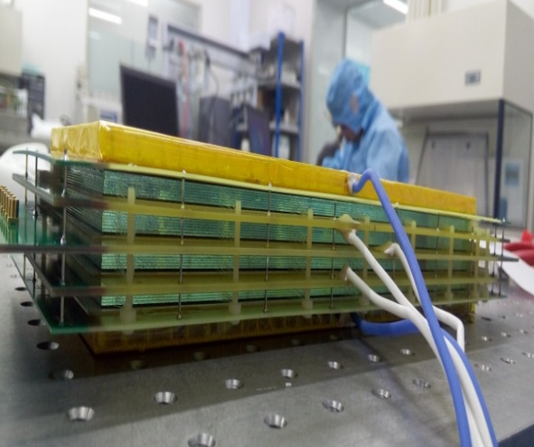
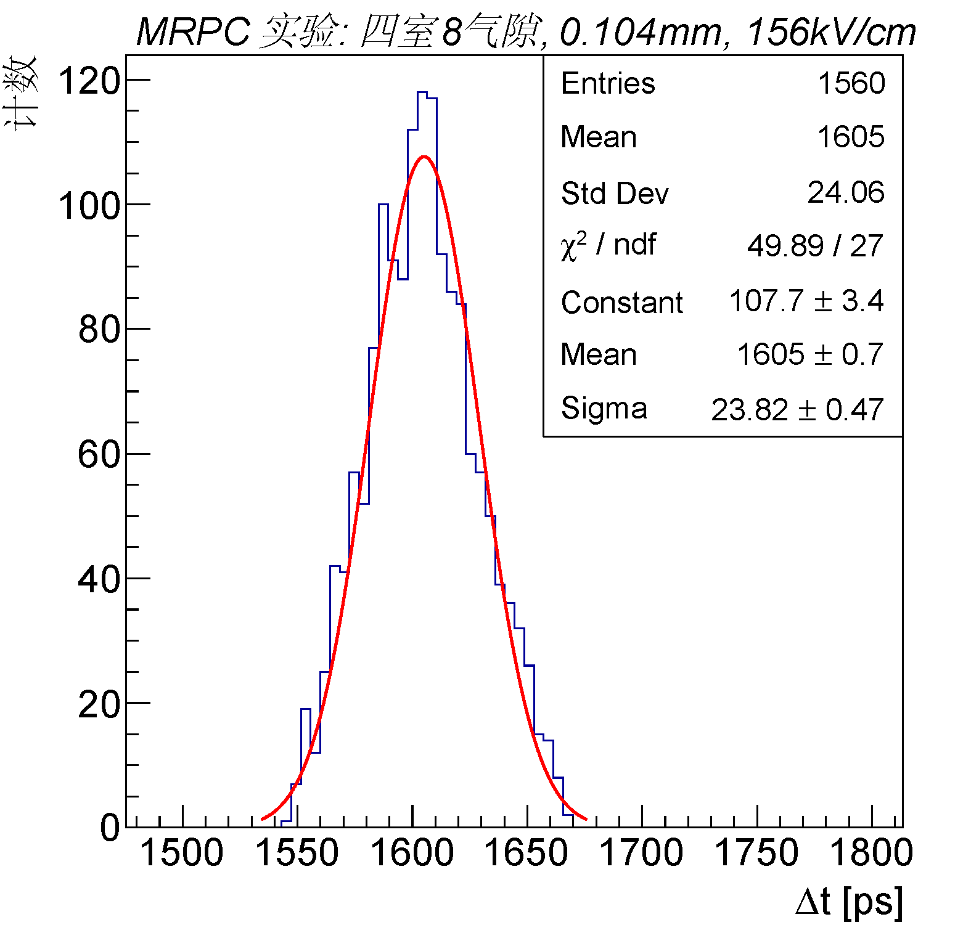
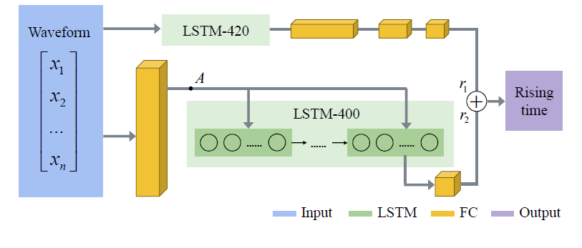
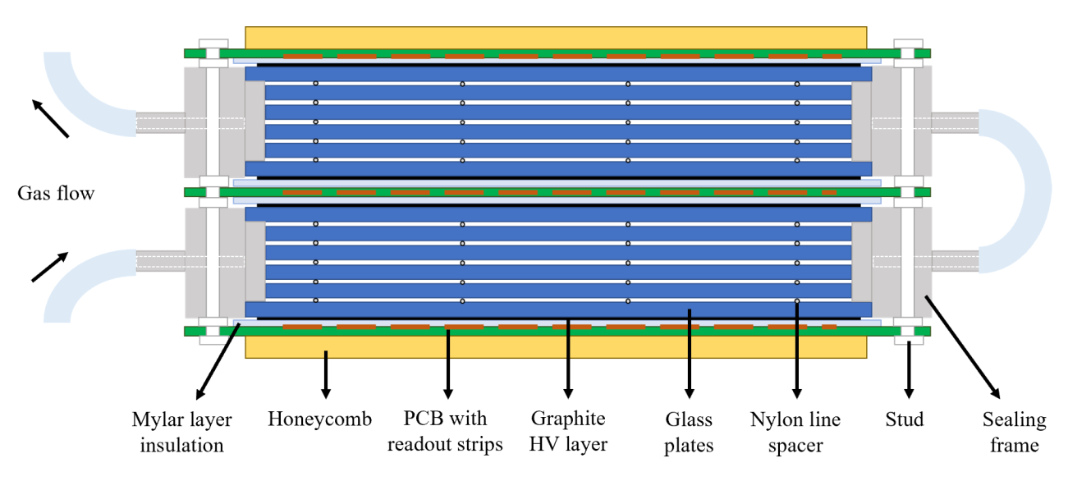
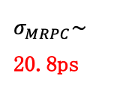
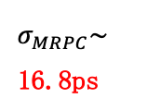
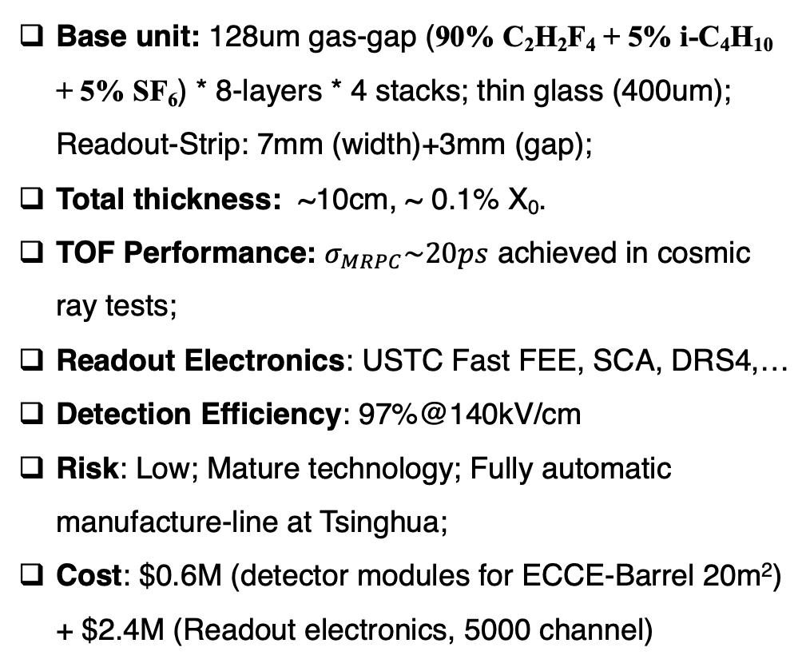
mRPC
Cosmic Ray Test:
mRPC + USTC FEE + Lecroy Oscilloscope
Base unit: 128um gas-gap (90% C₂H₂F₄ + 5% i-C₄H₁₀ + 5% SF₆) * 8-layers * 4 stacks; thin glass (400um); Readout-Strip: 7mm (width)+3mm (gap);
Total thickness: ~10cm, ~ 0.1% X₀.
TOF Performance: $σ_{MRPC}\sim 20ps$ achieved in cosmic ray tests;
Readout Electronics: USTC Fast FEE, SCA, DRS4,…
Detection Efficiency: 97%@140kV/cm
Risk: Low; Mature technology; Fully automatic manufacture-line at Tsinghua;
Cost: $0.6M (detector modules for ECCE-Barrel 20m²) + $2.4M (Readout electronics, 5000 channel)
E-field：
140 kV/cm
$σ_{MRPC}\sim$ 20.8ps
Cosmic Ray Test
R&D#1: Low-resistive glass (for high rates)
R&D#2: Analysis with Neural network
$σ_{MRPC}\sim$ 16.8ps
R&D#3: Sealed-mRPC (reduce pollution effect)
Ongoing R&D Activities: Improved design & beam-test at Jlab in Spring 2022
R&D#4: Replacement of NONE green-house gas

