Slide 1




EICROC
F. Bouyjou, M. Firlej, T. Fiutowski ,J. Gonzalez, M. Idzik, C. de La Taille, D. Marchand, A. Molenda, M. Morenas, , J. Moron, C. Munoz, N. Seguin-Moreau, L. Serin, K. Swientek,
16 sep 2021

Slide 2
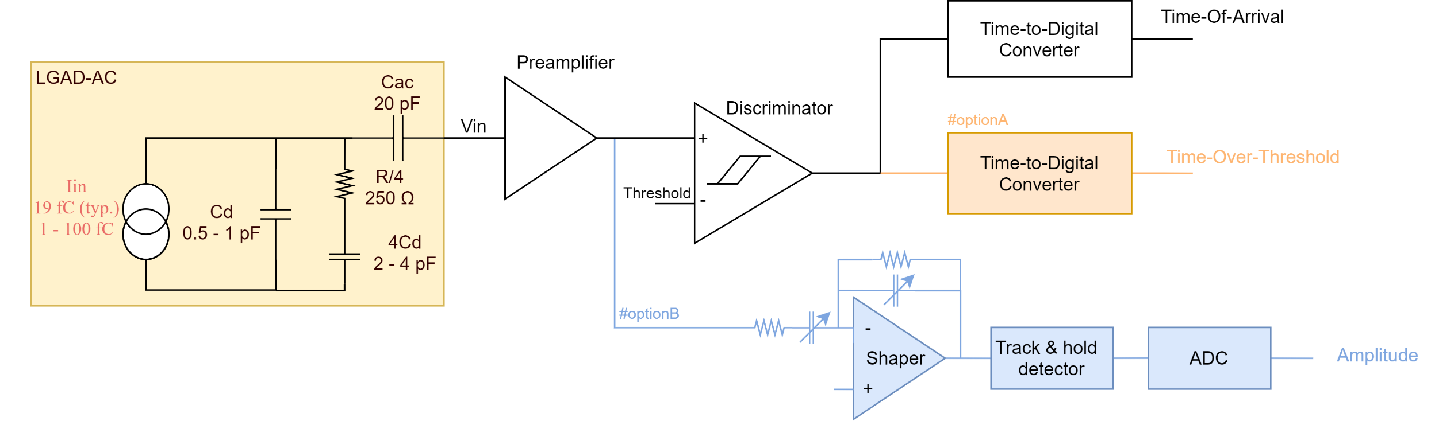
EIC chip proposal
Smaller pixel : 0.5x0.5 mm²
Integrate TZ preamp from Altiroc and TDC [CEA/IRFU]from HGCROC
Aim at lower power : < 2 mW/ch
Simulation Studies of TZ/VPA with resistive LGAD in progress
TOT or ADC for time walk correction

Slide 3
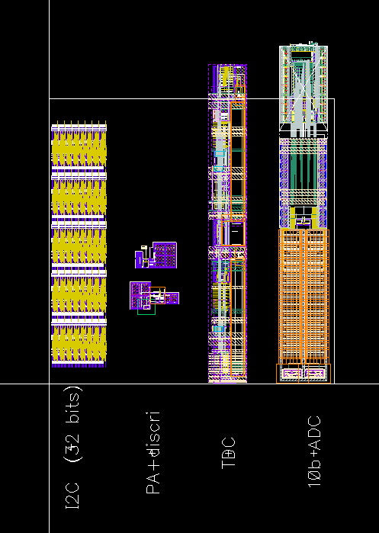
Preliminary layout overview
500x500 um pixel
  4 bytes of slow control (local DAC, TDC calib…)
  High speed TZ preamp and discri
  25 ns shaper for amplitude measurement
  12 or 25 ps TDC [F. Bouyjou et al. IRFU Saclay]
  8bits 40 MHz ADC [M. Idzik et al. AGH Krakow]
Possibility to replace ADC by TOT on half columns
Target 8x4 pixels or 8x8 pixels tbc.

